Slide 1

Machine Learning to Predict Diabetes
Presented by:
Swati Lathwal

Slide 2

Index
Dataset - feature extraction and selection
DATA PREPROCESSING
Models – classification and regression
Conclusion

Slide 3
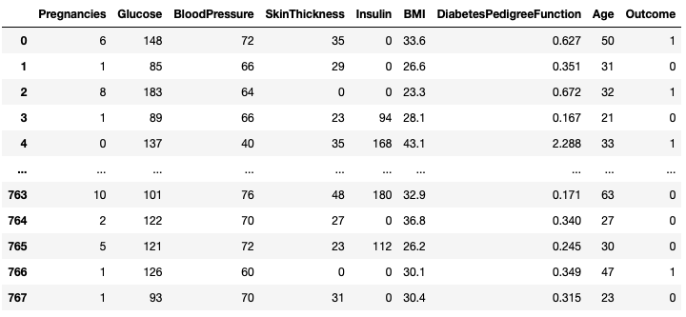
DATASET
dimension of diabetes data(768, 9)

Slide 4

DATA PREPROCESSING
Normalization
To reduce the variance between the scaling of features

Slide 5
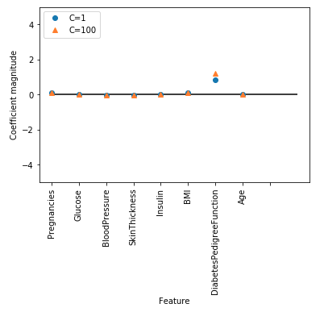
MODEL 1 LOGISTIC REGRESSION
C = 1, Accuracy = 77%
C = 100, Accuracy = 76%
“DiabetesPedigreeFunction” feature is related to a sample being “diabetes”, regardless which model we look at.

Slide 6

Model 2 Decision tree
Accuracy = 71%
While the accuracy on training set is observed to be 100%
Why?

Slide 7
Over Fitting
Limiting the depth to 3 to resolve the issue by setting the parameter max_depth=3
Resulting in lower accuracy in training and higher in test.
Accuracy on test set 74%

Slide 8
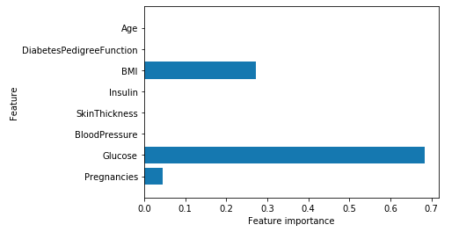
Model 2 Decision tree
Feature Importance

Slide 9
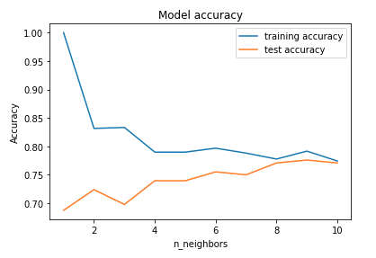
Model 3 K-Nearest neighbors
Accuracy – 77%

Slide 10
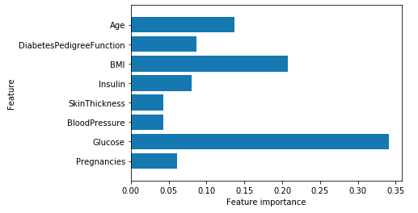
Model 4 Random Forests
Accuracy = 78%
While training set at 100% without any tuning.

Slide 11
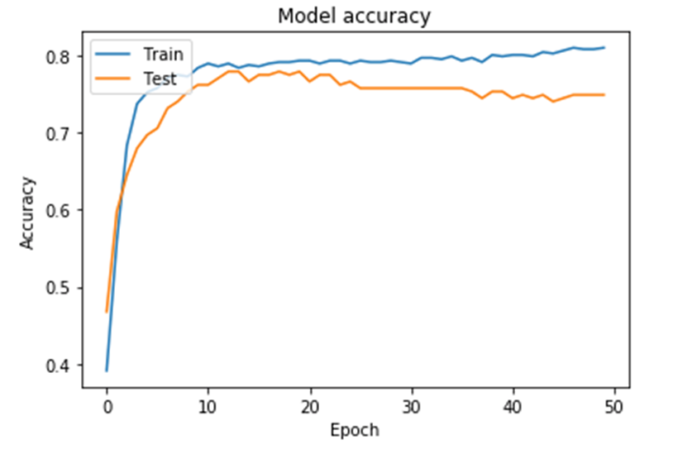
Model 5 Neural Network
ACCURACY: 75%
While training accuracy is 81%

Slide 12
Conclusion Neural Network model gave the accuracy of 75%
Deep Learning
Good Accuracy
Correct Model

Slide 13

Thank You

