Slide 1
Text Summarization using Deep Learning
Presented By :
Priscilla Sugumar
Rashi Jain
Swati Lathwal

Slide 2
Introduction:
Text Summarization - Process of automatically producing a summary of the given document.
Two types of approaches :
Extractive text summarization
Abstractive text summarization
Using Abstractive text summarization for our project.
Abstractive Text Summarization - Generating the summary utilizing words outside the given document.
Dataset: Amazon Fine Food Review.

Slide 3
Problem Statement:
Textual data is multiplying exponentially with an ever-increasing quantity of customer evaluations.
Reading the whole text document is a time consuming task.
Tedious to read the humongous data manually to produce actionable insights.
Abstractive text summarization gives fluent summary of customer reviews.

Slide 4
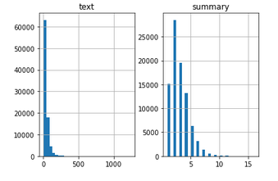
Exploratory Data Analysis
The below graph represents the entire data:

Slide 5
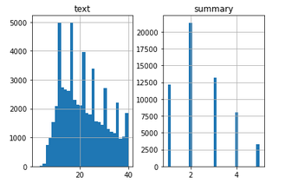
Filtered Data
Review text - 40 word count
Summary - 5 word count

Slide 6
Text Summarization:
TEXT SUMMARIZATION
Abstractive Summarization
Extractive Summarization

Slide 7
Extractive Summarization:
Text
Sentence 1
Sentence 2
Sentence 3
Sentence 4
Summary
Sentence 2
Sentence 4
EXTRACTIVE
SUMMARIZER

Slide 8
Abstractive Summarization:
Text
Sentence 1
Sentence 2
Sentence 3
Sentence 4
Summary
New Sentences
ABSTRACTIVE
SUMMARIZER

Slide 9
Sequence to Sequence Modeling:
Predicts output sequence for a given input sequence.
Uses:
Sentiment classification
Neural Machine Translation
Named Entity Recognition
Input: Long word sequence of customer review
Output: Short word sequence of summary
We model our data as a Many-Many Seq2Seq problem.

Slide 10
Encoder-Decoder Architecture
The input will be a long sequence of words and the output will be a short version of input sequence.
Output
Encoder
InternalState
Decoder
h,c
Input

Slide 11
Cont...
Variants of RNN like Gated Recurrent Neural or LSTM are preferred as the encoder decoder components.
In our model we use LSTM.

Slide 12
Model Architecture
y1
y2
end
LSTM
LSTM
LSTM
LSTM
LSTM
LSTM
LSTM
X1
X2
X3
X4
start
y1
y2
Encoder
Decoder

Slide 13
Encoder-Decoder Phase
Encoder-Decoder has two phase:
Training Phase
Inference Phase

Slide 14
Training Phase
Set up the encoder and decoder.
Train the model to predict the target sequence offset by one timestep.
Encoder:
Encoder LSTM reads the entire input sequence at each timestep.
Processes the information at each timestep.
Captures the contextual information from input.

Slide 15
Encoder
h1
h2
h3
h4
Initial size is zero vector or randomly initialized
h0,c0
h3,c3
h4,c4
h1,c1
h2,c2
LSTM
LSTM
LSTM
LSTM
Final State
x1
x2
x3
x4

Slide 16
Decoder
LSTM network reads the target sequence word-by-word.
Predict the next word in the sequence given the previous word.

Slide 17
Decoder
y1
y2
end
Initial state is the final state of encoder
h4,c4
s1,c1
s2,c2
LSTM
LSTM
LSTM
start
y1
y2

Slide 18
Inference Phase
Encoder
h1
h2
h3
h4
ŷ1
ŷ2
end
Internal state
LSTM
LSTM
LSTM
LSTM
LSTM
LSTM
LSTM
h,c
x1
x2
x3
x4
start
ŷ1
ŷ2
Decoder

Slide 19
Attention Mechanism
Attention Mechanism - We give importance to some parts of the source sequence that results in the target sequence.
Example:
Source sequence: “Which sport do you like the most?
Target sequence: “I love cricket”
The first word ‘I’ in the target sequence is connected to the fourth word ‘you’ in the source sequence.
Similarly, the second-word ‘love’ in the target sequence is associated with the fifth word ‘like’ in the source sequence.

Slide 20
Cont...
Types of Attention Mechanism:
Global Attention
Local Attention
Global Attention is used in the model

Slide 21
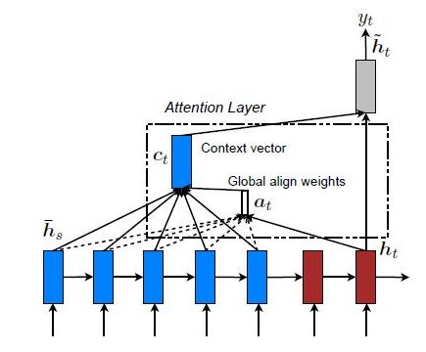

Slide 22
DEMO

Slide 23
CONCLUSION
Performed Abstractive Summarization on Amazon Fine Food Reviews dataset.
Techniques used:
Encoder - Decoder model(Seq2Seq Model)
LSTM(Long Short Term Memory)
Attention Mechanism
Evaluated the performance of a machine-generated summary against a human-generated summary.

Slide 24
Future Work:
Increase training data size
Implement distributed processing
Implement Bi-Directional LSTM
Beam Search Strategy for Decoder

