Slide 1
Location choice for opening
a Chinese restaurant in Toronto
Capstone Project Final Report
July 2019

Slide 2
Introduction
Methodology
Data
Results
Discussions

Slide 3
Introduction
Which neighborhood in Downton Toronto is an better location, to open a Chinese restaurant?
  Demand side
    Which neighborhood has the most demands on Chinese cuisine
  Supply side
    Which neighborhood so far has the mildest competition regarding Chinese food
  Market side
    The infrastructure, supply chain, consumer preferences, transportation, neighborhood security, etc

Slide 4
Introduction
Methodology
Data
Results
Discussions

Slide 5
Methodology
Attractiveness = F(ChnPercent)
Attractiveness
  Measurement of whether it's a good idea to open the restaurant in this neighborhood
ChnPercent
  percentage of Chinese restaurants in this neighborhood
  ChnPercent = (number of Chinese restaurants / total number of restaurants)
F
  A monotone, linear function satisfying

Slide 6
Introduction
Methodology
Data
Results
Discussions

Slide 7
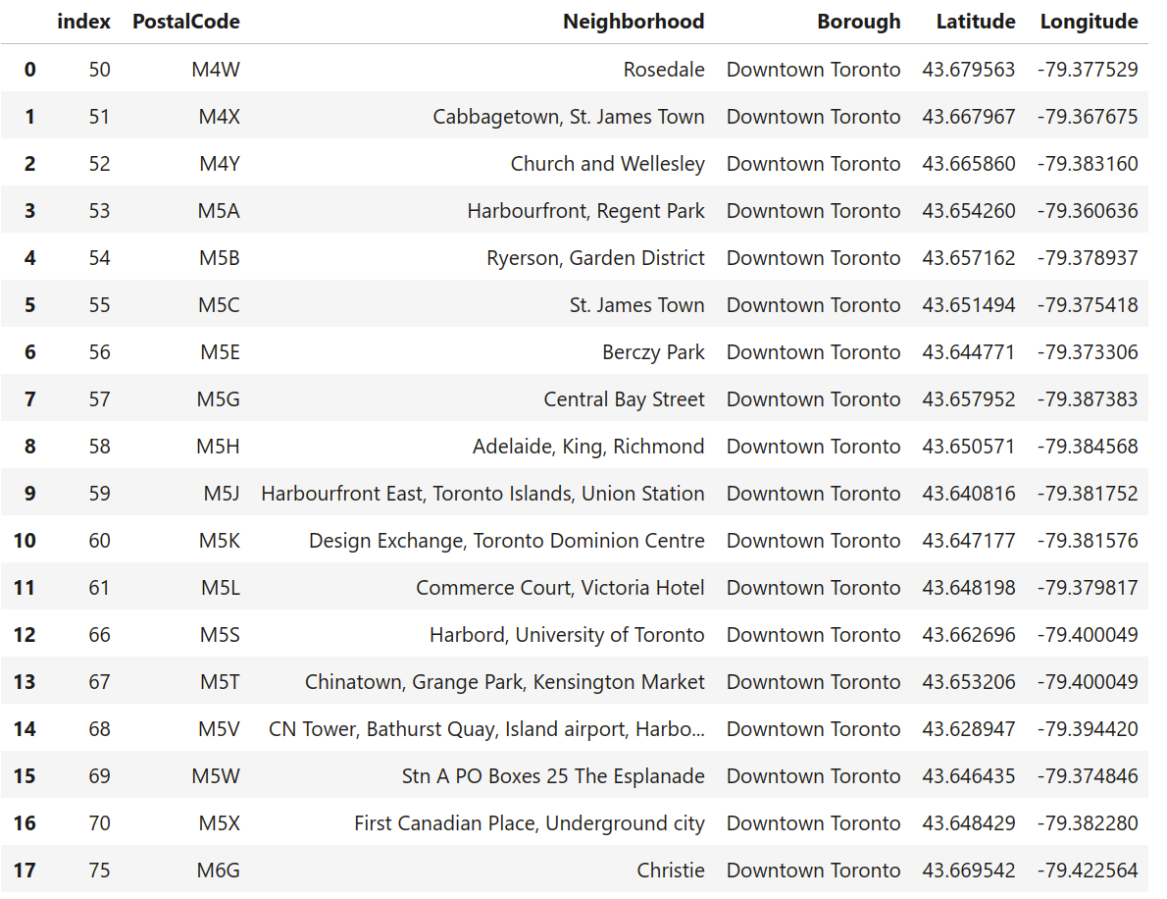
Data - Neighborhood
Administrative data of Neighborhood
  City (Toronto) – Borough (Downtown Toronto) – Neighborhoods (16)
  Coordiates (Latitude, Longitude)

Slide 8
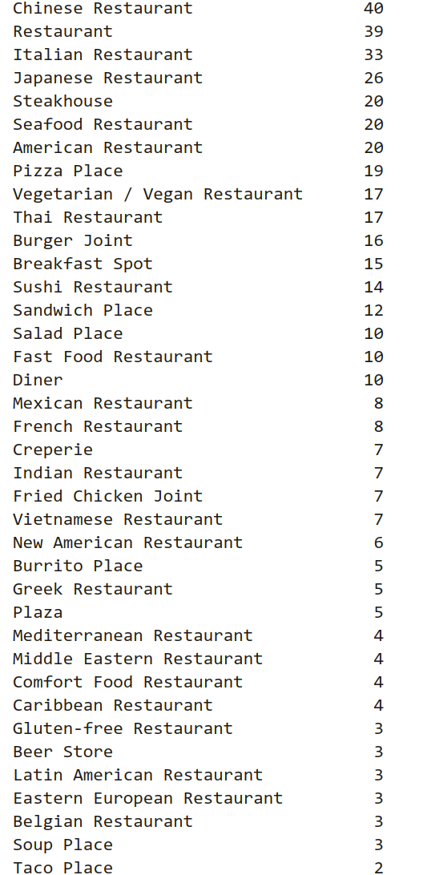
Data – Restaurants(1/2)
In Downtown Toronto
463 restaurants
54 restaurants types
16 Neighborhoods

Slide 9
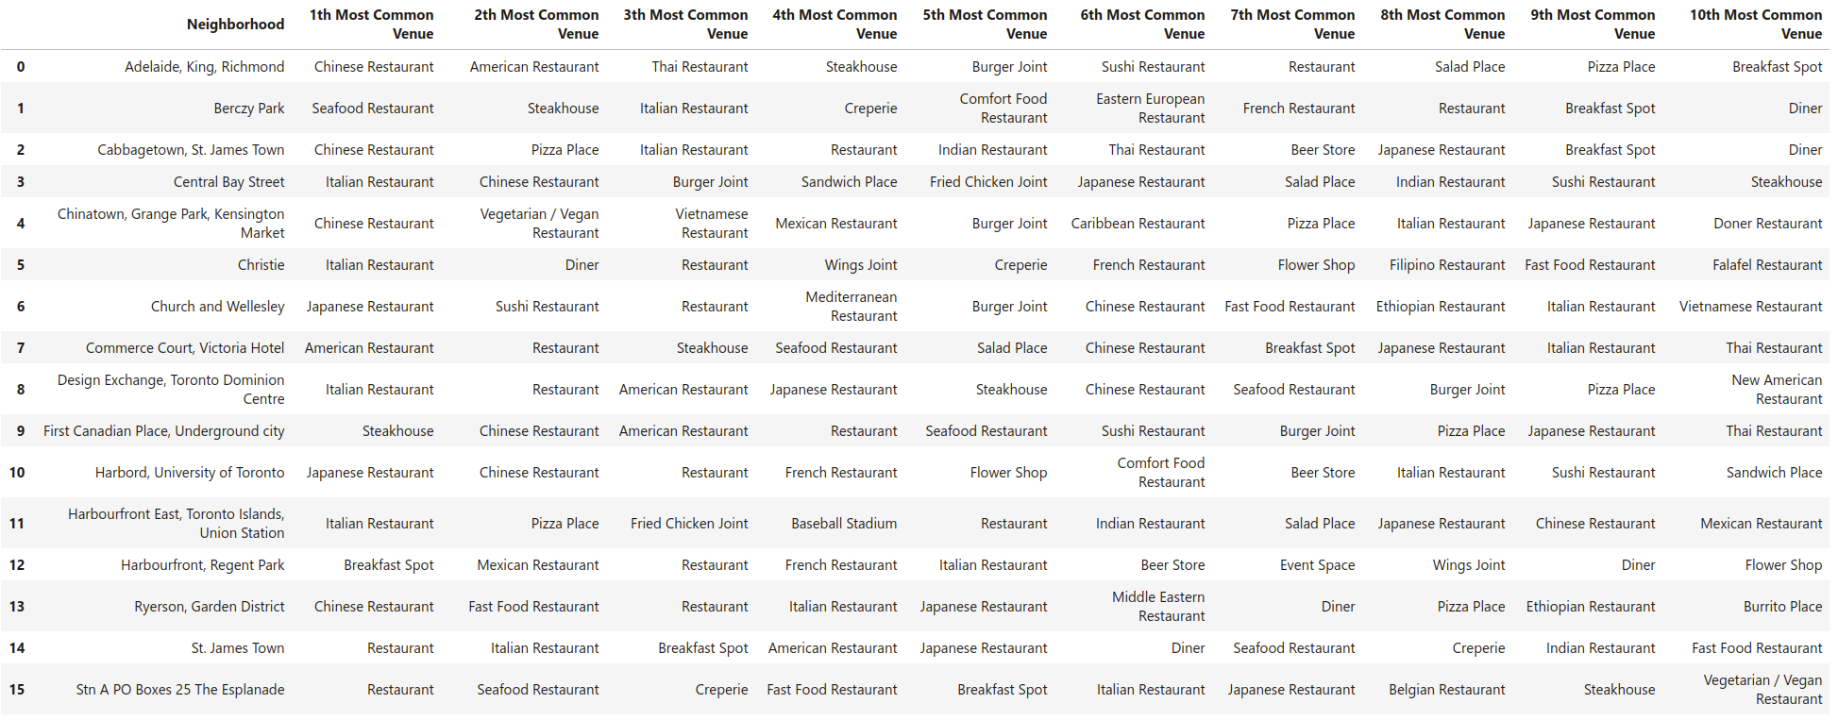
Data – Restaurants(2/2)
Neighborhoods differ by restaurant types and densities

Slide 10
Introduction
Methodology
Data
Results
Discussions

Slide 11
Results
3 Neighborhoods are fit
Mild competition, and satisfying demand scale
  Adelaide, King, Richmond
  Design Exchange, Toronto Dominion Centre
  Church and Wellesley
6 of 16 Neighborhoods show strong competition
  Chinatown, Grange Park, Kensington Market
  Harbord, University of Toronto
  Cabbagetown, St. James Town
  Central Bay Street
  First Canadian Place, Underground city
  Ryerson, Garden District
7 of 17 Neighborhoods show lack of interests in Chinese cuisine
  Commerce Court, Victoria Hotel
  Harbourfront East, Toronto Islands, Union Station
  Stn A PO Boxes 25 The Esplanade
  St. James Town
  Berczy Park
  Christie
  Harbourfront, Regent Park

Slide 12
Introduction
Methodology
Data
Results
Discussions

Slide 13
Discussions(1/2): Conclusion
In The Borough "Downtown Toronto" of Toronto, there are 3 neighborhoods we can choose to open a new Chinese Restaurant, which are
  Adelaide, King, Richmond
  Design Exchange, Toronto Dominion Centre
  Church and Wellesley

Slide 14
Discussions(2/2): Risks and TODOs
Yet a series of other influencing factors need more attentions in the future studies
Demand side
  Inhabitants and Tourists
    Population structure, by age, income level, work, ethnity
  Domestic consumer preferences regarding Chinese cuisine
Supply side
  Competition situation
    Major competitors' business, profitability situation
      Potential responses to new entries]
    Supply chain
      Materials
      Chefs, Waiters/Waitresses
Market side
  Industry trend
  Economy trend
  Others...

