Slide 1
Background
Control technical systems with BCI
Need to use surprise signal (P300) in traffic scenario and control the vehicle
We discussed about the option to modify P300 setup with camera information for surprise detection
Based on the research, there is also an option to use Rapid Serial Visual Presentation (RSVP) setup for surprise detection

Slide 2
What is RSVP and Dual/Triple RSVP
In RSVP, a continuous sequence of images is rapidly presented in a static location
In Dual RSVP, two images are simultaneously presented at the screen left side and right side
In Triple RSVP, three images are simultaneously presented at the screen left, right, and bottom sides.

Slide 3
Feasibility of Driving with P300+Camera+RSVP
Core functions of vehicles
        Steering
        Velocity Control
        Braking
        Path Planning
        Path Following
        Obstacle Avoidance
Goal
        Steer through two parallel white lines on the road

Slide 4
Usages
Low speed ride in apartment complexes for people with disabilities
Low speed ride in zoo

Slide 5
Assumptions
The camera gives us the view of the road with the two parallel lines to drive
We do not have any other sensors like Radar, Lidar, Light Sensor or Distance Sensor at present
We only have the camera and the RSVP setup
Surprise signal (P300) is likely to get generated when vehicle approaches the white line

Slide 6
Assumptions (contd..)
The road gets curvy at couple of places

Slide 7
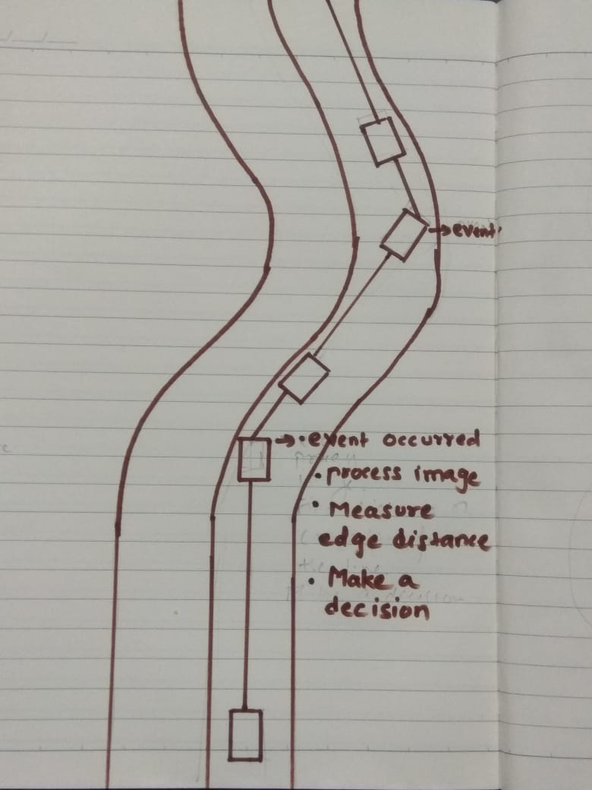
Steering Sequence
The RSVP frames are presented to the driver at a rate of 4-20 frames per sec (fps)
The driver focuses on the target image
The target image is processed, to figure out the placement of left or right edge of the car
Decision to steer left or right is made

Slide 8
Advantages and dis-advantages of P300 driving Vs. Computer Vision (CV)
With P300 driving speed is slow (eye processes around 4-20 fps) whereas with Computer Vision (CV) driving speed is fast (YOLO processes around 155 fps)
With P300 driving, only the target image need to be processed. Whereas with CV based driving, the number of images need to be processed is more.
Computational speed required for P300 based driving might be much less than CV based driving

Slide 9
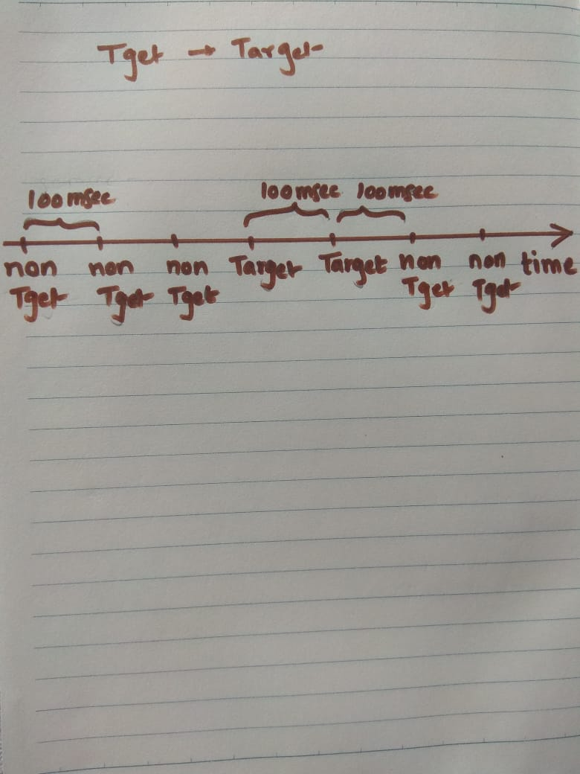
Questions
How to process the P300 potential, if the frames get refreshed at 100ms?

Slide 10
Questions (contd..)
Do we need Dual or Triple RSVP?
What is the maximum capability of eyes to detect a target image?
What is the max speed of vehicle that we can achieve?

Slide 11
Questions (contd..)
Do we need timing information along with EEG data to process P300?
        For Offline analysis, we need timing informa
        tion to process EEG data.
        For Real Time analysis, we might not need
        timing information. I need to read literature
        about it.

Slide 12
Challenges
I did not find any example code snippet to process RSVP images
The subject is mobile and we may need to work on Artifact Removal due to mobility

Slide 13
Important Points
Frame Rate of the Camera and Television
      The current industry standard for clear, smooth video even with moving objects is 30 fps
      30 fps is the standard rate for television
Frame Rate for RSVP for P300 Detection
      4-20 fps
That means we have to drop some frames from the camera and present few to the driver

Slide 14
Losing Control of the Vehicle
In RSVP, the images can be refreshed at every 50-200 msec
If the car drives at 30 km/hr,
        it will cover a distance of 40cm in 50 msec
        It will cover a distance of 1.6m in 200 msec
That means we do not have any control over the car for 40 cm - 1.6 meters.

Slide 15
Future Work
Implement right from the beginning Vs implement specific requirement

