Slide 1
Design Alert Correlation Engine using Mutual Information
CS-410 – Fall 2021
Team Alpha
Abhijit Bhadra abhadra2@illinois.edu
Sanjeev Kumar sanjeev5@illinois.edu
Swati Nanda swatin2@illinois.edu

Slide 2
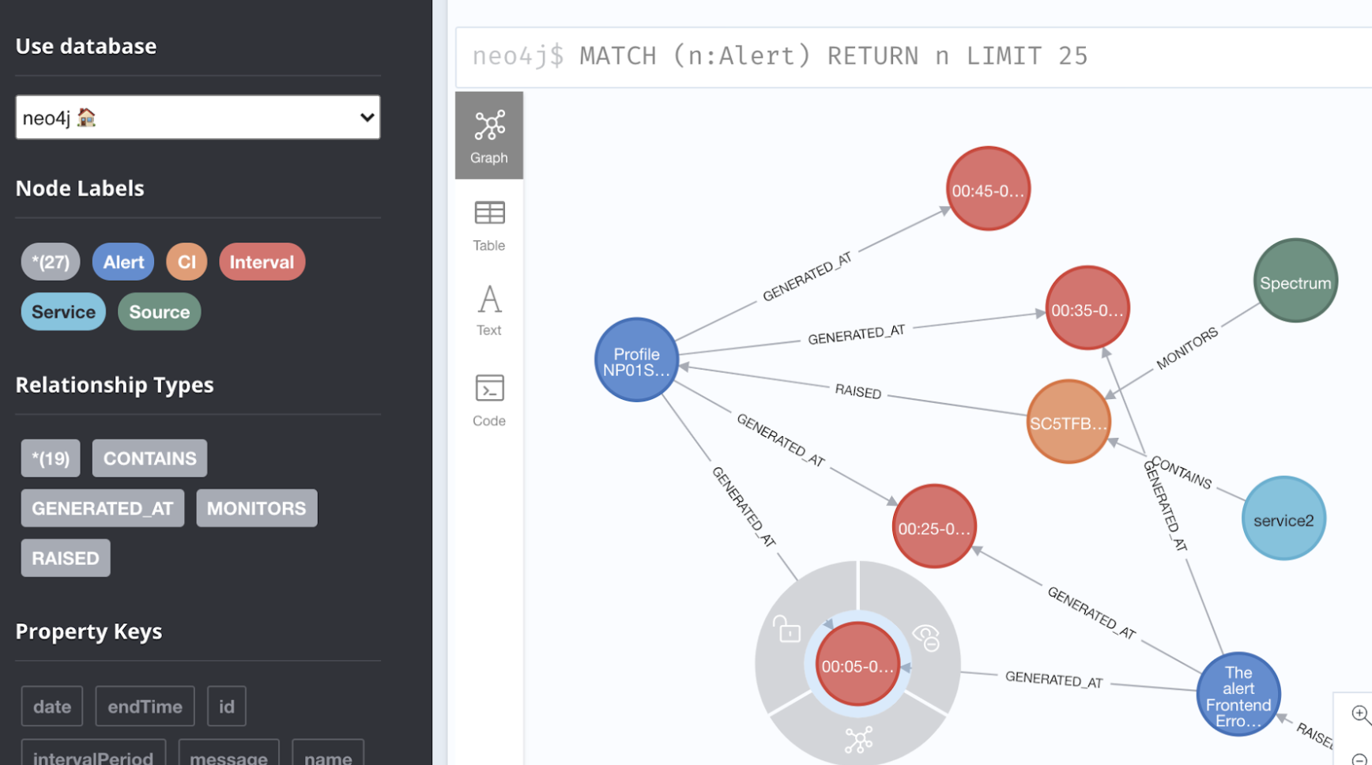
Intent: Alert Correlation based on Ontology & Mutual Information

Slide 3
We would like to answer the following sample questions through Knowledge Graph
Diagnose related alerts of an incident
Annotate root cause with time window based on manual feedback
Get Alert Counts in each duration
Get Impacted Devices due to an Alert in each duration
Unhealthy services in each duration

Slide 4
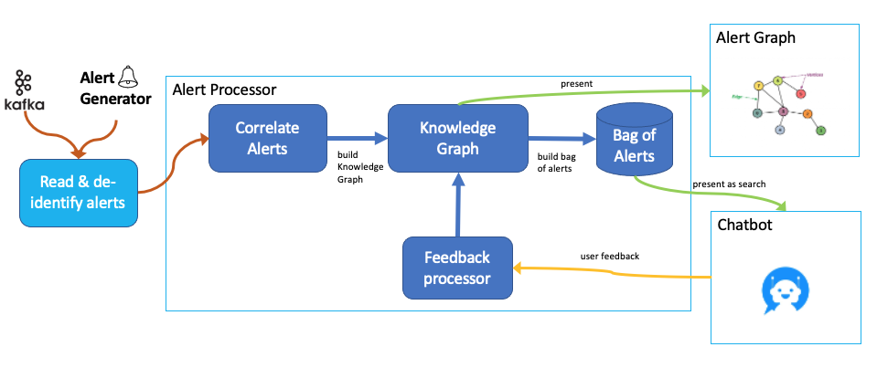
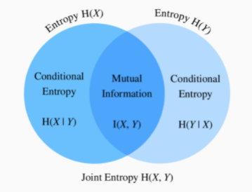

Architecture
Main Concepts
Mutual Information I(X,Y)

Slide 5
How have we achieved this ?
Correlate these alerts using Mutual Information
Build a ontology based Knowledge Graph using Neo4j
Querying layer to extract all relevant information and visualizing the cypher query result in Neo4j browser

Slide 6

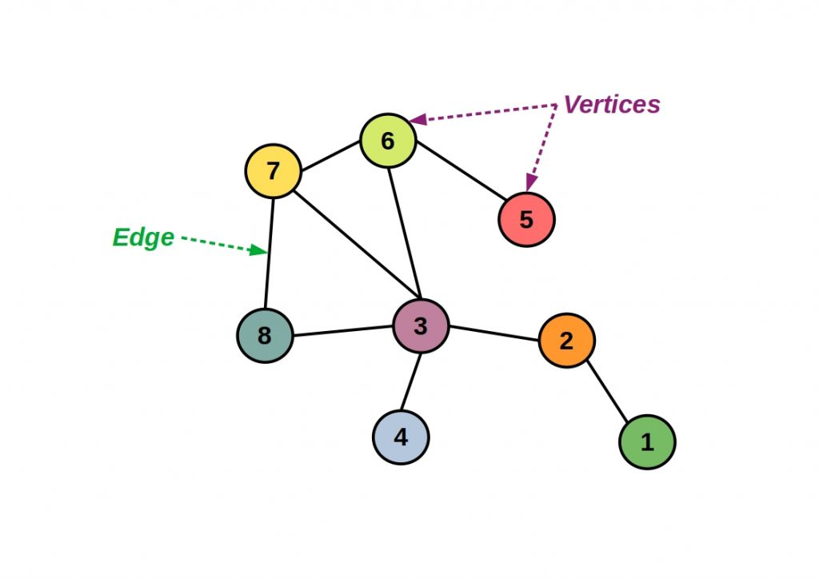


Mutual Information & Knowledge Graph
Alert Graph
Alert Generator
present
Alert Processor
Correlate Alerts
Knowledge Graph
Bag of Alerts
build Knowledge Graph
build bag of alerts
Read & de-identify alerts
present as search
Chatbot
Feedback processor
user feedback

Slide 7
How to calculate Mutual Information
Identify the syntagmatic relationship between the alerts over specified time
Divide the time as 5 mnts window
t_{i} = 1 means Alert gets generated on i^{th} window
t_{i} = 0 means Alert has not generated on i^{th} window
I(A1,A2) = H(A1) – H(A1|A2) = H(A2) – H(A2|A1)
More mutual information == more correlation
Calculate only p(A1|t_{i}=1) , p(A2| t_{i}=1) , p(A1 | t_{i}=1) U p(A2 | t_{i}=1) to get Mutual Information
Apply Smoothing during calculation
Send ontology information to neo4j

Slide 8
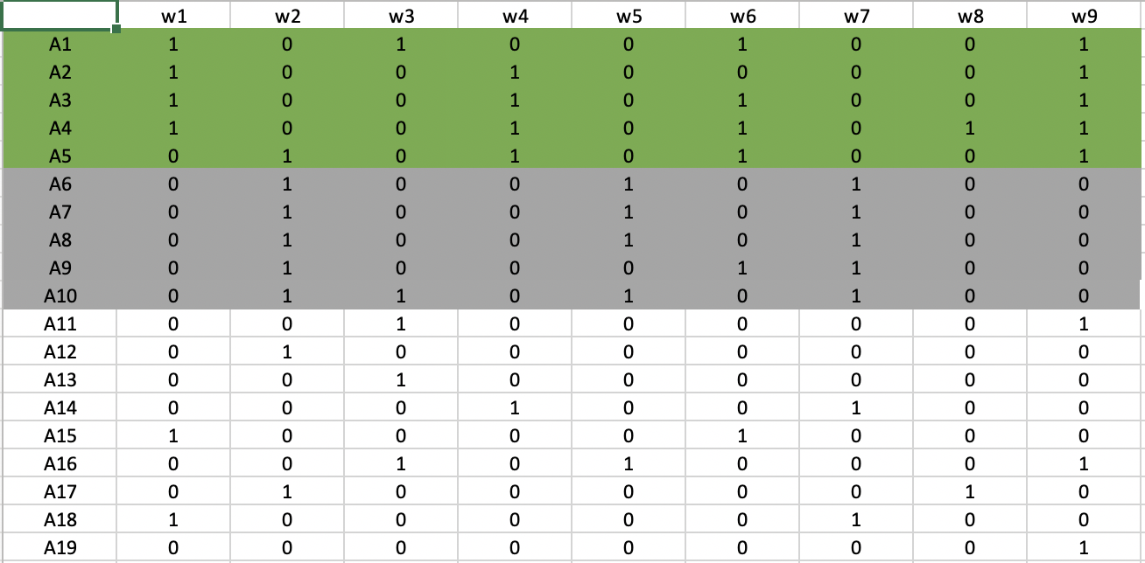
Sample Data for 2 incidents

Slide 9
Demo

Slide 10
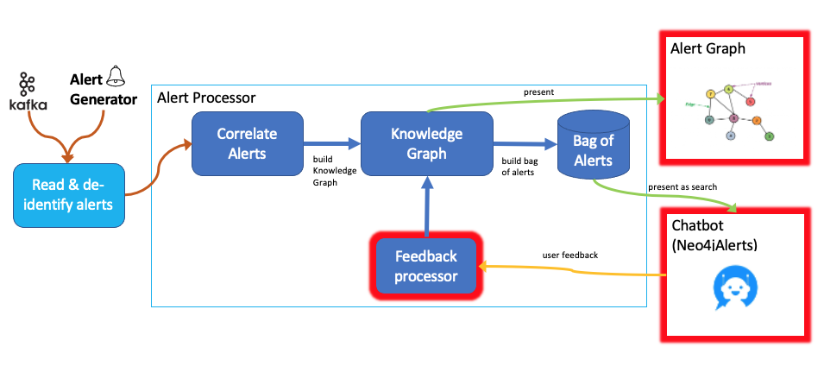
User Interaction, Query Layer, Neo4j Visualization
Neo4jAlert library provides
REST API to query Neo4j knowledge graph
User interactive terminal interface (via REST API )
Cypher queries that can be executed on Neo4j browser

Slide 11
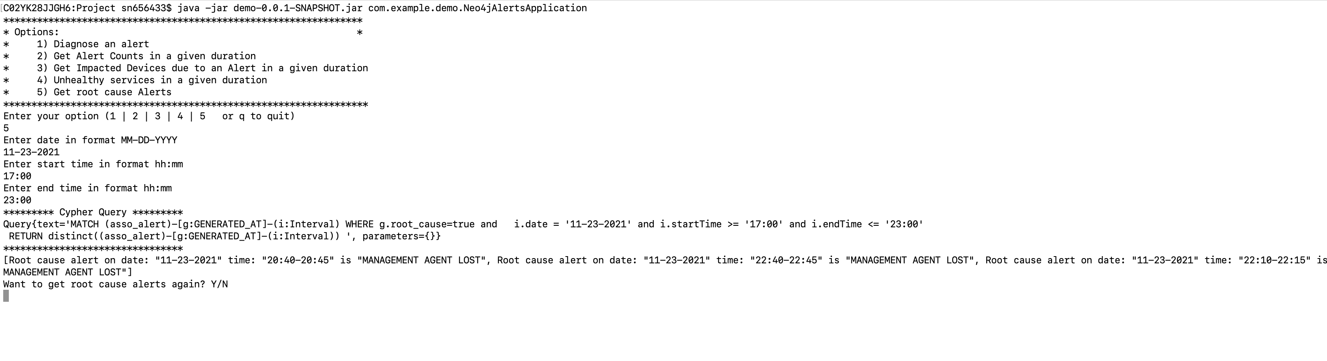
Neo4jAlert service
Chat Client
User Interaction
Cypher Query
REST APIs
The following REST APIs can be accessed at http://localhost:8080 when Neo4jAlert is run
HTTP GET /alertCounts – fetches alert counts
HTTP GET /alerts – fetches top 5 correlated alert to he input alert
HTTP GET /affectedCIs – fetches affected devices from an alert
HTTP GET /affectedServices – fetches affected services from the alert
HTTP POST /setRootCause – takes user feedback and marks the alert as root cause alert
HTTP GET /rootCauseAlerts – fetches root cause alerts

Slide 12
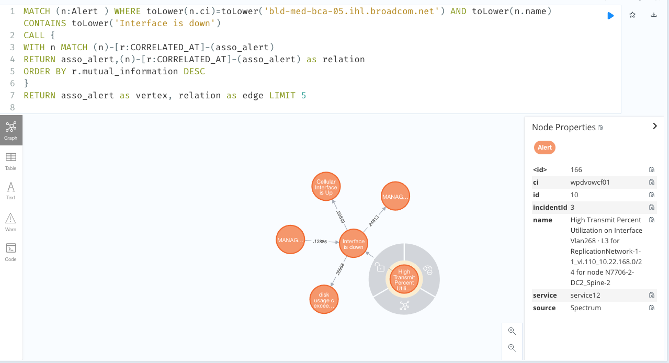
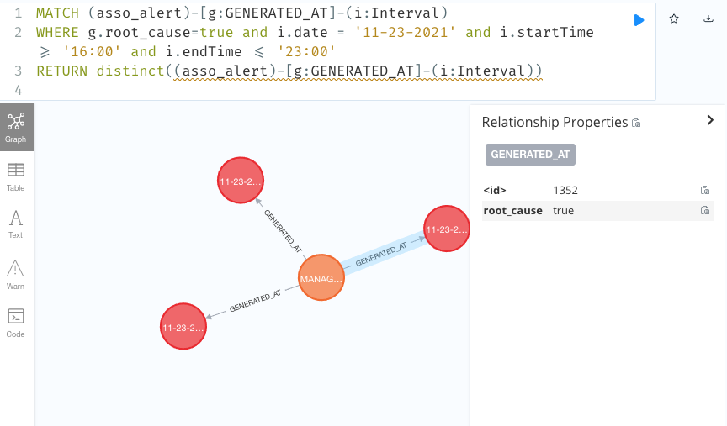
Scenarios
Is my system healthy?
What are the alerts counts in a given time duration?
Cypher Query:
MATCH(i:Interval)-[r]-(a:Alert) WHERE i.date >= '11-23-2021' AND i.startTime >= '17:00' AND i.date <= '11-23-2021' AND i.endTime <= '23:00’ return count(a) as cnt
What could have caused the alert?
Diagnose the alert - get the top 5 correlated alerts
Cypher Query:
MATCH (n:Alert ) WHERE toLower(n.ci)=toLower('bld-med-bca-05.ihl.broadcom.net’)
AND toLower(n.name) CONTAINS toLower('Interface is down')
CALL { WITH n MATCH (n)-[r:CORRELATED_AT]-(asso_alert)
RETURN asso_alert,(n)-[r:CORRELATED_AT]-(asso_alert) as relation
ORDER BY r.mutual_information DESC. }
RETURN asso_alert as vertex, relation as edge LIMIT 5
Provide feedback and mark an alert as “root-cause” alert
Cypher Query:
MATCH (n:Alert ) WHERE toLower(n.name) CONTAINS toLower('Interface is down')
MATCH (n)-[r:CORRELATED_AT]-(asso_alert), (asso_alert)-[:GENERATED_AT]-(i:Interval)
WHERE i.date = '11-23-2021' AND i.startTime <= '20:43' AND i.endTime >= '20:43' AND toLower(asso_alert.name)
CONTAINS toLower('MANAGEMENT AGENT LOST')
MERGE (asso_alert)-[g:GENERATED_AT]-(i)
ON MATCH SET g.root_cause=true
What are the “root-cause” alerts ? Cypher Query:
MATCH (asso_alert)-[g:GENERATED_AT]-(i:Interval) WHERE g.root_cause=true and i.date = '11-23-2021' and i.startTime >= '16:00' and i.endTime <= '23:00'
RETURN distinct((asso_alert)-[g:GENERATED_AT]-(i:Interval))

Slide 13
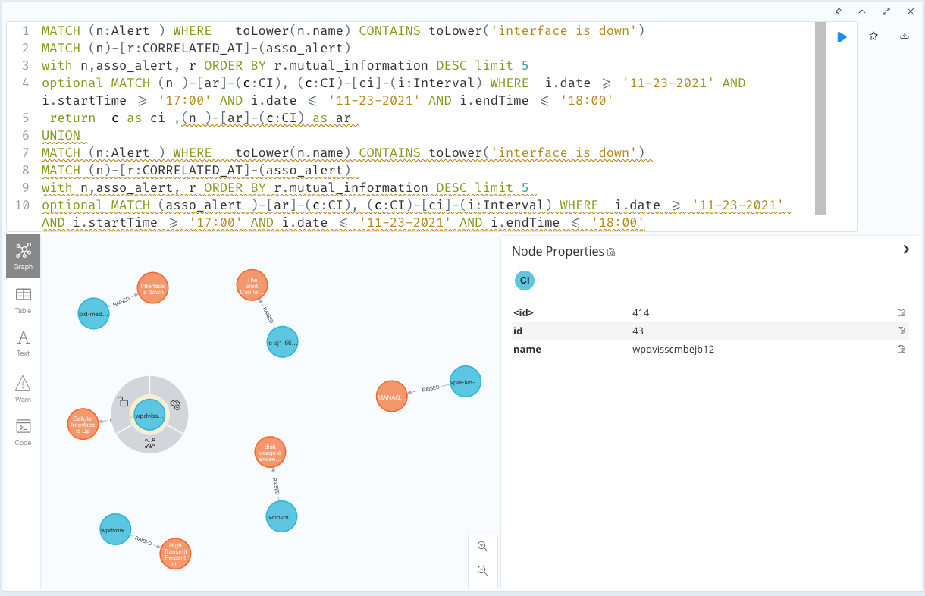
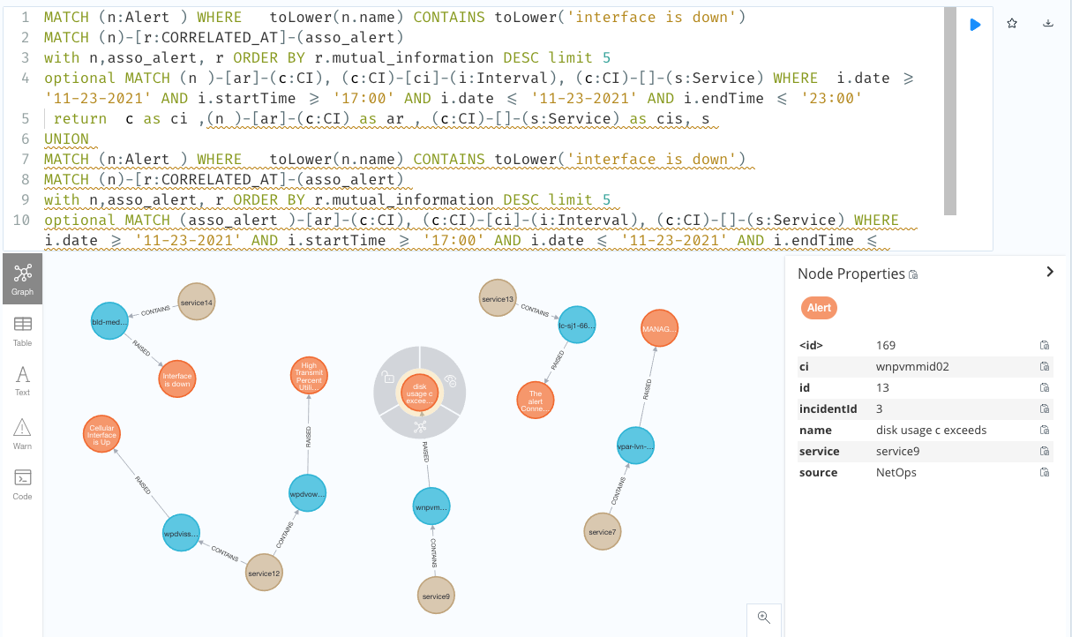
Scenarios (continued…)
What are impacted devices due to an alert? Cypher Query:
MATCH (n:Alert ) WHERE toLower(n.name) CONTAINS toLower('interface is down')
MATCH (n)-[r:CORRELATED_AT]-(asso_alert)
with n,asso_alert, r ORDER BY r.mutual_information DESC limit 5
optional MATCH (n )-[ar]-(c:CI), (c:CI)-[ci]-(i:Interval)
WHERE i.date >= '11-23-2021' AND i.startTime >= '17:00' AND i.date <= '11-23-2021' AND i.endTime <= '18:00'
return c as ci ,(n )-[ar]-(c:CI) as ar
UNION
MATCH (n:Alert ) WHERE toLower(n.name) CONTAINS toLower('interface is down')
MATCH (n)-[r:CORRELATED_AT]-(asso_alert)
with n,asso_alert, r ORDER BY r.mutual_information DESC limit 5
optional MATCH (asso_alert )-[ar]-(c:CI), (c:CI)-[ci]-(i:Interval)
WHERE i.date >= '11-23-2021' AND i.startTime >= '17:00' AND i.date <= '11-23-2021' AND i.endTime <= '18:00'
return c as ci ,(asso_alert )-[ar]-(c:CI) as ar
What are the Unhealthy services? Cypher Query:
MATCH (n:Alert ) WHERE toLower(n.name) CONTAINS toLower('interface is down')
MATCH (n)-[r:CORRELATED_AT]-(asso_alert)
with n,asso_alert, r ORDER BY r.mutual_information DESC limit 5
optional MATCH (n )-[ar]-(c:CI), (c:CI)-[ci]-(i:Interval), (c:CI)-[]-(s:Service)
WHERE i.date >= '11-23-2021' AND i.startTime >= '17:00' AND i.date <= '11-23-2021' AND i.endTime <= '23:00'
return c as ci ,(n )-[ar]-(c:CI) as ar , i, (c:CI)-[]-(s:Service) as cis, s
UNION
MATCH (n:Alert ) WHERE toLower(n.name) CONTAINS toLower('interface is down')
MATCH (n)-[r:CORRELATED_AT]-(asso_alert)
with n,asso_alert, r ORDER BY r.mutual_information DESC limit 5
optional MATCH (asso_alert )-[ar]-(c:CI), (c:CI)-[ci]-(i:Interval), (c:CI)-[]-(s:Service)
WHERE i.date >= '11-23-2021' AND i.startTime >= '17:00' AND i.date <= '11-23-2021' AND i.endTime <= '23:00'
return c as ci ,(asso_alert )-[ar]-(c:CI) as ar , i, (c:CI)-[]-(s:Service) as cis, s

Slide 14
Demo

Slide 15
Validation
Used Cranfield Methodology
Collected a Set of alarms from a real system where a known incidents has happened
Collected Cranfield Ground Truth for Alarm Correlation
Id | 0 | 41 | 82 | 205 | 567 | 789 | 987
0 | N/A | Y | Y | Y | N | N | Y
41 | Y | N/A | Y | Y | N | N | Y
82 | Y | Y | N/A | Y | N | N | Y
205 | Y | Y | Y | N/A | N | N | Y
567 | N | N | N | N | N/A | N | N
789 | N | N | N | N | N | N/A | N
987 | Y | Y | Y | Y | N | N | N/A
Id | 0 | 41 | 82 | 205 | 567 | 789 | 987
0 | 0 | 0.133 | 0.104 | 0.166 | 0.025 | 0.021 | 0.166
41 | 0.133 | 0 | 0.104 | 0.105 | 0.019 | 0.018 | 0.156
82 | 0.104 | 0.104 | 0 | 0.133 | 0.021 | 0.009 | 0.187
205 | 0.166 | 0.105 | 0.133 | 0 | 0.019 | 0.019 | 0.127
567 | 0.025 | 0.019 | 0.021 | 0.019 | 0 | 0.011 | 0.016
789 | 0.021 | 0.018 | 0.009 | 0.019 | 0.011 | 0 | 0.014
987 | 0.166 | 0.156 | 0.187 | 0.127 | 0.016 | 0.014 | 0

