Slide 1
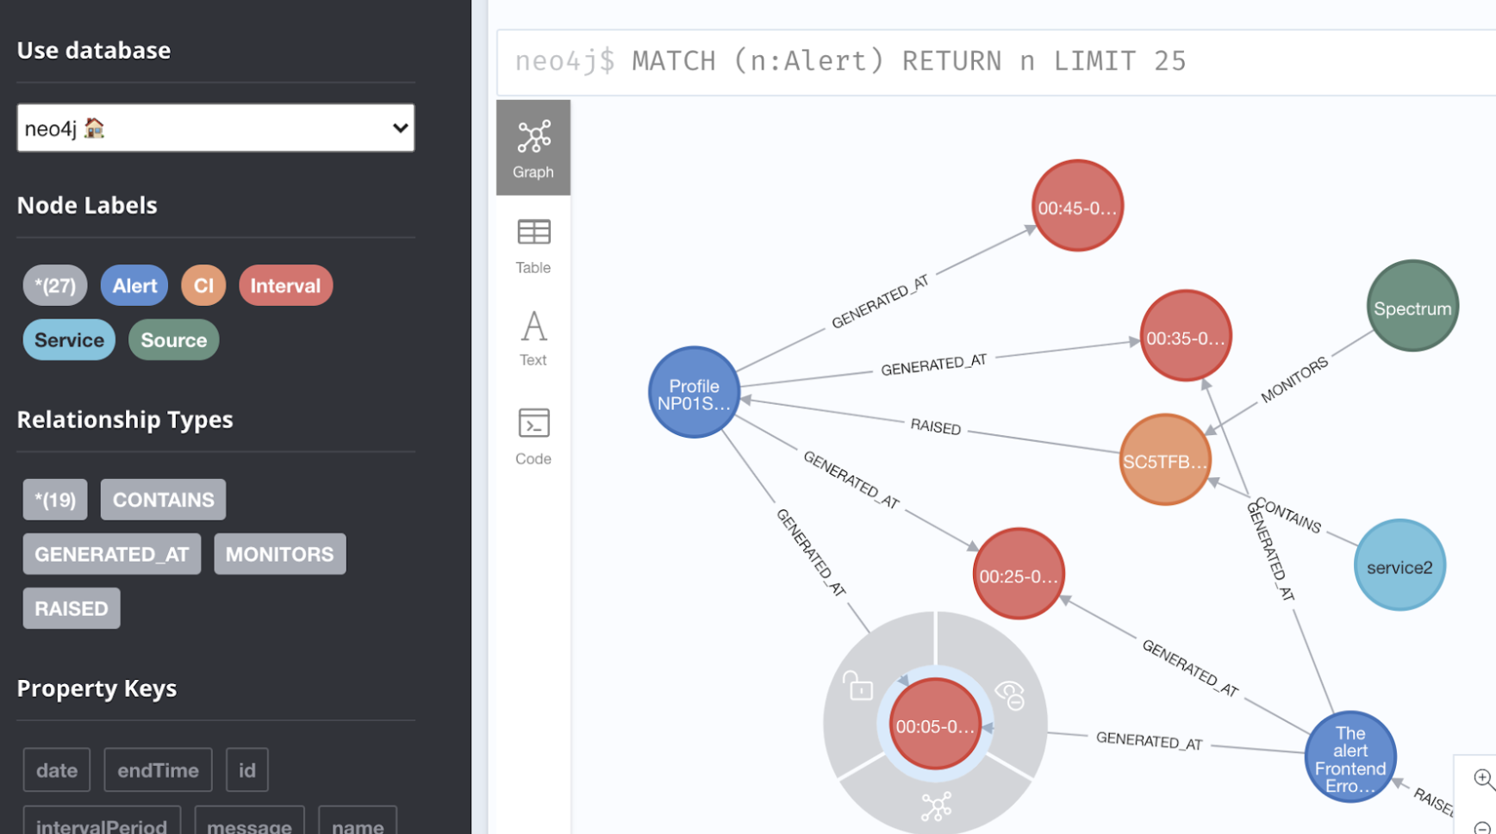

Slide 2
We would like to answer the following sample questions through Knowledge Graph
Diagnose related alerts of an incident
Annotate root cause with time window based on manual feedback
Get Alert Counts in each duration
Get Impacted Devices due to an Alert in each duration
Unhealthy services in each duration

Slide 3
How have we achieved this ?
Correlate these alerts using Mutual Information
Build a ontology based Knowledge Graph using Neo4j
Querying layer to extract all relevant information and visualizing the cypher query result in Neo4j browser

Slide 4
How to calculate Mutual Information
Identify the syntagmatic relationship between the alerts over specified time
Divide the time as 5 mnts window
t_{i} = 1 means Alert gets generated on i^{th} window
t_{i} = 0 means Alert has not generated on i^{th} window
I(A1,A2) = H(A1) – H(A1|A2) = H(A2) – H(A2|A1)
More mutual information == more correlation
Calculate only p(A1|t_{i}=1) , p(A2| t_{i}=1) , p(A1 | t_{i}=1) U p(A2 | t_{i}=1) to get Mutual Information
Apply Smoothing during calculation
Send ontology information to neo4j

Slide 5
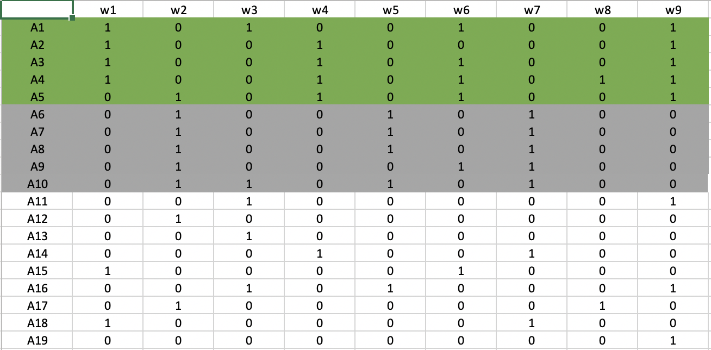
Sample Data for 2 incidents

Slide 6
Validation Against Real scenario
Swati – Please fill up the scenario details

Slide 7
Validation
Used Cranfield Methodology
Collected a Set of alarms from a real system where a known incidents has happened
Collected Cranfield Ground Truth for Alarm Correlation
Id | 0 | 41 | 82 | 205 | 567 | 789 | 987
0 | N/A | Y | Y | Y | N | N | Y
41 | Y | N/A | Y | Y | N | N | Y
82 | Y | Y | N/A | Y | N | N | Y
205 | Y | Y | Y | N/A | N | N | Y
567 | N | N | N | N | N/A | N | N
789 | N | N | N | N | N | N/A | N
987 | Y | Y | Y | Y | N | N | N/A
Id | 0 | 41 | 82 | 205 | 567 | 789 | 987
0 | 0 | 0.133 | 0.104 | 0.166 | 0.025 | 0.021 | 0.166
41 | 0.133 | 0 | 0.104 | 0.105 | 0.019 | 0.018 | 0.156
82 | 0.104 | 0.104 | 0 | 0.133 | 0.021 | 0.009 | 0.187
205 | 0.166 | 0.105 | 0.133 | 0 | 0.019 | 0.019 | 0.127
567 | 0.025 | 0.019 | 0.021 | 0.019 | 0 | 0.011 | 0.016
789 | 0.021 | 0.018 | 0.009 | 0.019 | 0.011 | 0 | 0.014
987 | 0.166 | 0.156 | 0.187 | 0.127 | 0.016 | 0.014 | 0

