Slide 1
Human Resource Analytics: Why Are Employees Leaving Prematurely and Who’s Next?
Carlo Aseron
Swati Botuwar
Swathi Prakasha
Ashwini Ravindra

Slide 2
Agenda
Goal
Dataset
Data Discovery
Models
Conclusion

Slide 3
Goal
The goal of this project was to analyze a dataset of human resource information to determine why employees are leaving prematurely in order to predict and identify which valuable employees may be next.

Slide 4
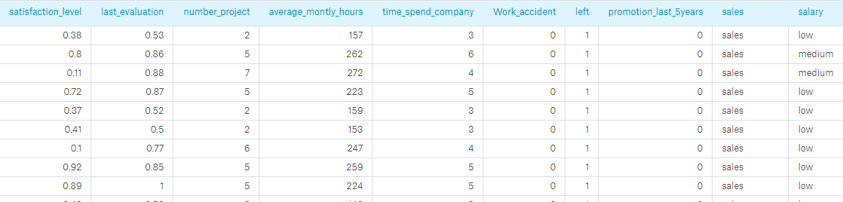
Dataset
This dataset includes employee information that we will use to analyze why the employee left. The attributes include:
satisfaction_level
Data Type: numeric
Description: the level of satisfaction measured as a value between 0 and 1.
last_evaluation
Data Type: numeric
Description: the last evaluation score of the employee
number_projects
Data Type: numeric
Description: the number of projects completed while at work
average_montly_hours
Data Type: numeric
Description: the average monthly hours at the workplace
time_spend_company
Data Type: numeric
Description: the number of years spent in the company
Work_accident
Data Type: numeric
Description: whether an employee had a workplace accident
Promotion_last_5years
Data Type: numeric
Description: whether an employee was promoted in the last 5 years
sales
Data Type: string
Description: the department in which the employee works (sales, accounting, hr, technical, support, management, IT, product-mng)
salary
Data Type: string
Description: relative level of salary (low, medium, or high)
left
Data Type: numeric
Description: whether the employee has left (1=yes, 0=no)

Slide 5
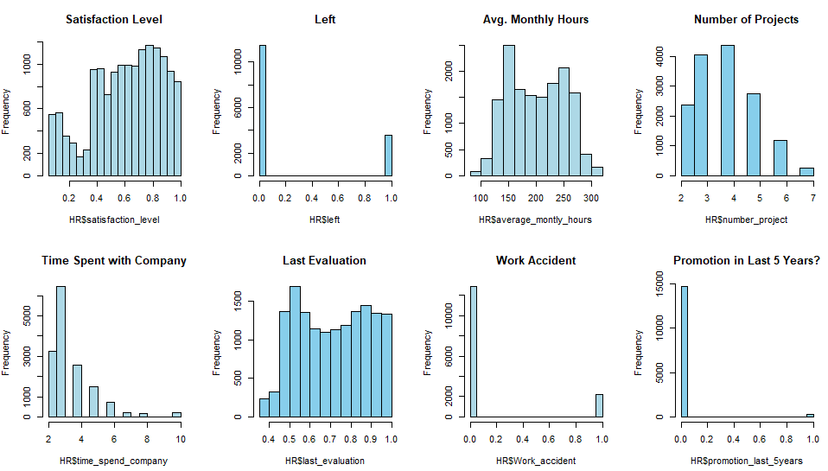
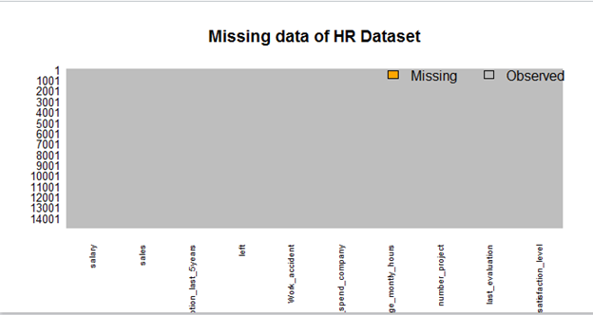
Data Discovery
No Missing Values
Examined the Distributions of Numeric Attributes

Slide 6
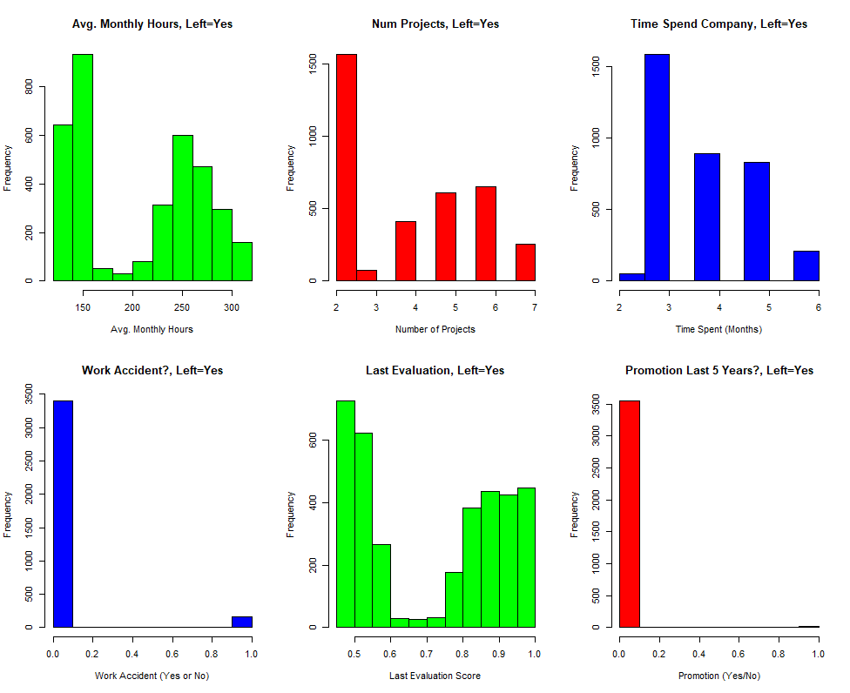
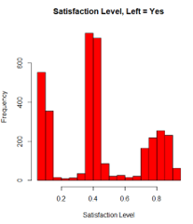
Data Discovery (continued)
Examined the Distributions of Data for only employees who left.
Bimodal distributions for some variables: Avg. Monthly Hours, Num. Of Projects, Last Evaluation
Satisfaction Level has 3 distinct groups
Work Accident seems to have little effect since most who left didn't have accidents

Slide 7
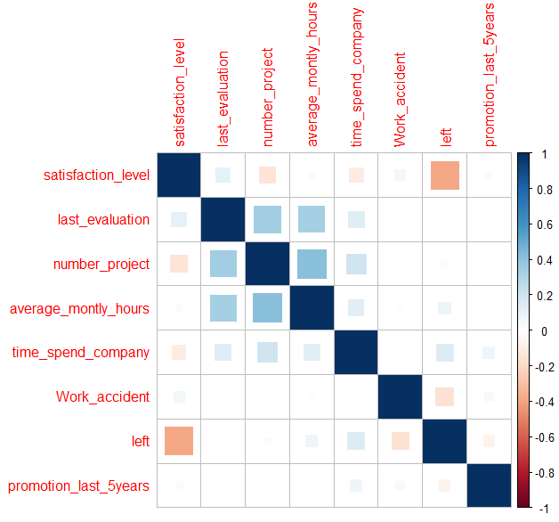
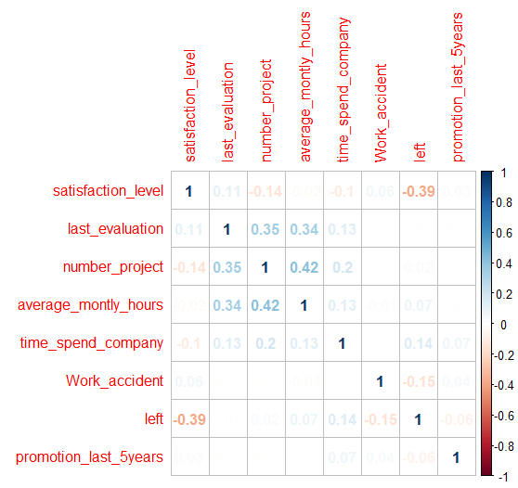
Data Discovery (continued)
Variable correlations

Slide 8
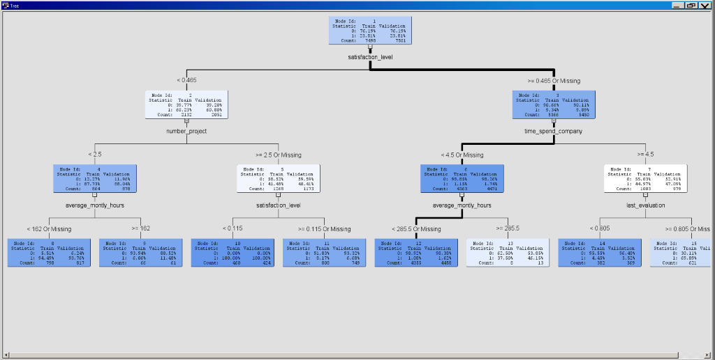
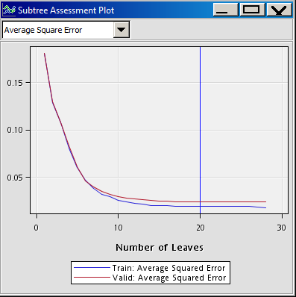
Decision Tree Analysis
Developed a decision tree under SAS EM used to show under what conditions employees are more likely to leave.
Used all the variables to determine "left", the binary dependent variable.

Slide 9
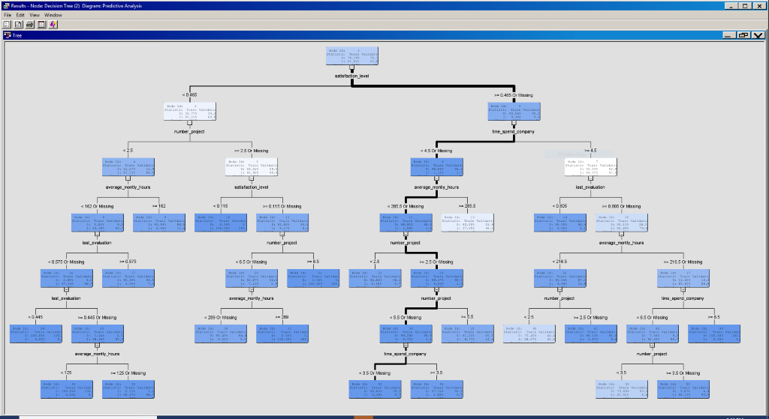
Decision Tree Analysis
Based on Subtree Assessment Plot, optimal number of leaves is around 5-6
Cut tree at depth of 3 as some variables began splitting further across same variable.
Tried removing "irrelevant" variables (low correlations), but results the same

Slide 10
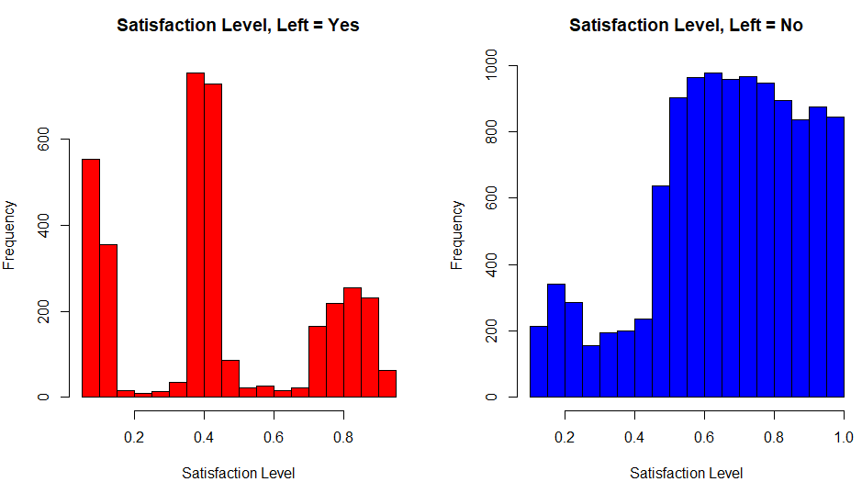
Decision Tree Analysis Results
Satisfaction level best determinant of employee turnover
Employees who worked less hours and less projects more likely to leave.

Slide 11
Predicting the next employee to leave
1. Create the Model
2. Predict using the above model
3. Compare the Prediction and Reference
Logistics model chosen here as the Left is categorical binary variable

Slide 12
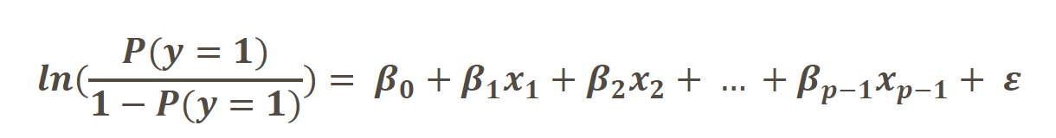
1. Creating Logistics Model
glm() function is used to Logistics Regression , it takes
Left – dependent variable
All the other variables – Independent variable.
output:
set of coefficients that indicate relative impact of each driver
Which indicate the log odd ratio of Left w.r.t each drivers.

Slide 13
Reading the co-efficients of Logistics Model
Left Vs. Satisfaction Level
Satisfaction Level : -0.4108,
Odd ration = exp( -0.4108) = 0.66
The odd ratio to Leave the company reduces by 0.66 times for every unit increase in Satisfaction level
Higher the Satisfaction level lowers the probability of to leave the company.
To Remember:
The Odds ratio greater than 1 - Positive association
The Odd ratio less than 1 - Negative association

Slide 14
Left Vs. Monthly Hours
Average Monthly hours = 0.02632
Odd ratio = 1.02
The odd ratio to leave the company increases 1.02 times by every unit increase in Average monthly hours
Odd ratio's
w.r.t Number of Projects = 2.73
w.r.t Time Spend in company = 1.62
w.r.t Promotion in last 5 years = 0.97

Slide 15
2.Predicting using the previous model
pred = predict(mylogit, type="response")
mylogit is the logistic Model result
The prediction variables are discrete value 0-1
so we made them categorical variable using below function
Mydata$predicted <- ifelse(pred > 0.5, 1, 0)

Slide 16
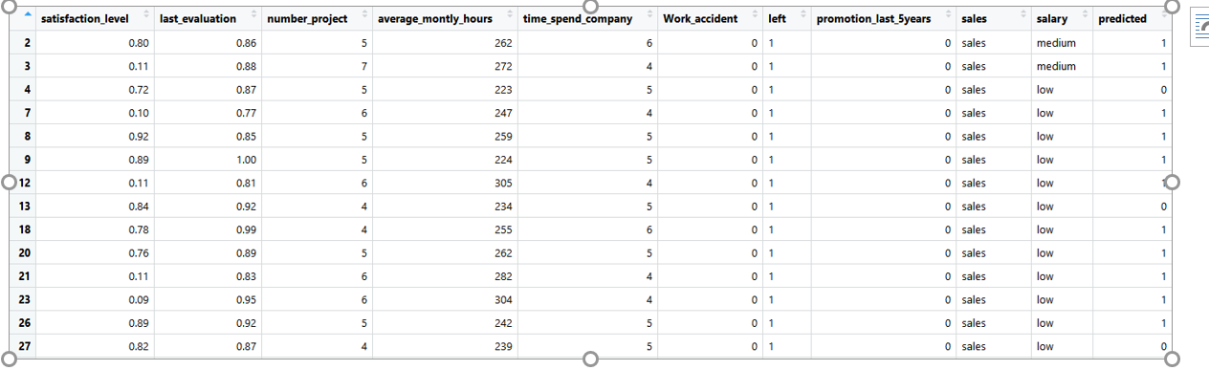
The Predicted values are added to data set,
With this table we can analyze who might leave next.

Slide 17
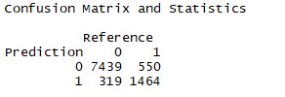
3. Compare the Prediction and Reference
Confusion Matrix and ROC curve
Lower the FP and FN better the model

Slide 18
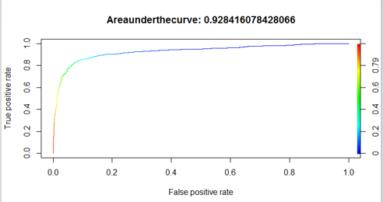
ROC curve is 92% - which suggest Model works well.

Slide 19
Conclusion
Analyzed:
Variable Distributions and Correlations
Developed:
Decision Tree to analyze under what conditions employees likely to leave.
Regression Model to predict which employees will leave next.
Results:
Satisfaction level found to be the best indicator of employee turnover (higher satisfaction = less likely to leave)
Employees with lower number of projects and lower work hours (I.e. underworked employees) more likely to leave
Number of Projects, Avg Monthly Hours, and Last Evaluation have bimodal distributions for employees who left. Satisfaction level has three main ranges of concern; may need to analyze why
Recommendation:
Use regression model to predict which employees will leave
Develop ways to address issues of low work hours to help retain employees
​
For future analysis:​
Categorical Variables (department, salary level)​

