Slide 1
The Gas Station Problem
Samir Khuller
Azarakhsh Malekian
Julian Mestre
UNIVERSITY OF MARYLAND

Slide 2
General Description
Suppose you want to go on a road trip across the US. You start from New York City and would like to drive to San Francisco.
You have :
  roadmap
  gas station locations and their gas prices
Want to:
  minimize travel cost

Slide 3


Information and Constraints
Information:
  map of the road: G=(V, E)
  length of the roads: d: E→ R⁺
  gas prices: c: V→ R⁺
Constraint:
  tank capacity: U
Goal:
  find a min. cost solution to go from s to t
v₁
v₂
v₃
Capacity U
d(v₁,v₂)
d(v₂,v₃)
d(s,v₁)
c(v₂)
c(v₃)
d(v₃,t)
c(v₁)
v₄
s
v₅
t
c(v₄)
v₆
(NYC)
(SF)
c(v₅)
c(v₆)

Slide 4
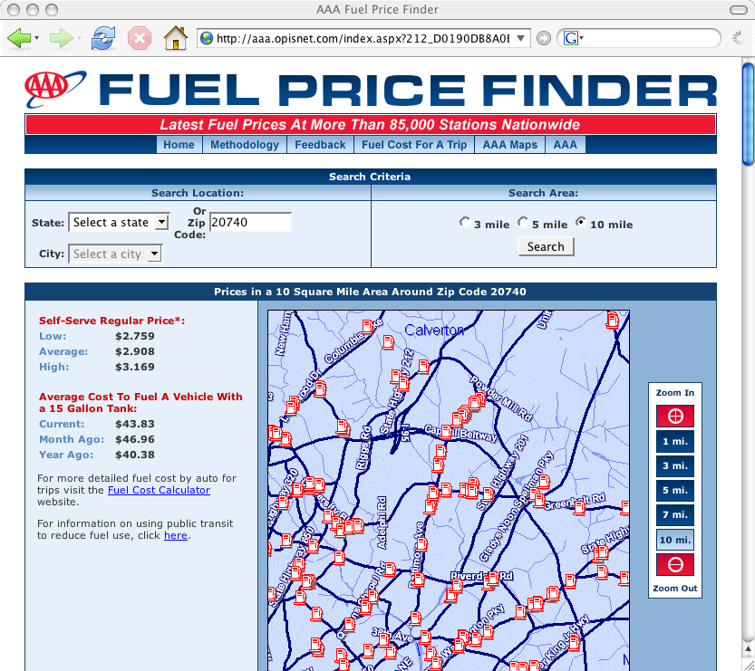
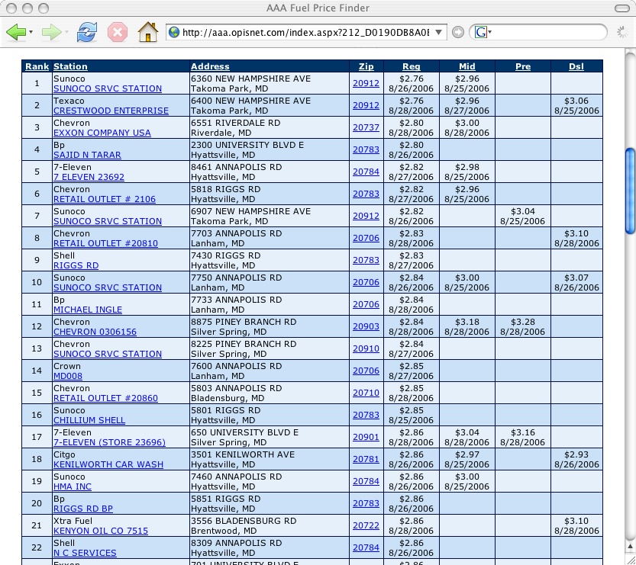
Finding gas prices online

Slide 5
Structure of the Optimal Solution
Two vertices s & t
A fixed path
Optimal solution involves stops at every station!
Thus we permit at most Δ stops.
v₁
v₂
v₃
v_{n}
t
s
2.99$
2.98$
2.97$
1.00$

Slide 6

The Problem we want to solve
Input:
  Road map G=(V,E), source s, destination t
  U: tank capacity
  d: E→R⁺
  c: V→R⁺
  Δ: No. of stops allowed
  μ: The initial amount of gas at s
Goal:
  Minimize the cost to go from s to t.
Output:
  The chosen path
  The stops
  The amount of gas filled at each stop
Gas cost is “per mile” and U is the range of the car in miles.
We can assume we start with 0 gas at s.
c(s’)= 0
s’
s
t
U - μ

Slide 7
Dynamic Programming
Minimum cost to go from x to t in q stops, starting with g units of gas.
OPT[x,q,g] =
Assuming all values are integral, we can find an optimal solution in O(n² ∆ U²) time.
Not strongly polynomial time.
The problem could be weakly NP-hard!

Slide 8
Why not Shortest Path?
Shortest path is of length 15. Cost = 37 = 4×7 + 3×3
Cheapest path is of length 16. Cost = 28 = 4×2 + 2×7 + 2×3
7
2
2
6
Start with 7
Tank capacity= 7
3
4
7
3
7
2
2
7
3
s
t

Slide 9
One more try at Shortest Path
Let the length of (u,v) be d(u,v)×c(u), if d(u,v) ≤ U
  Shortest path has length 20. Cost = 20 = 2×10.
  Cheapest path has length 30. Cost = 5 = 5×1 .
0
1
30
5
6
s
5
t
Start with 10
Tank capacity=10
10
10
0
2
20
10

Slide 10
Key Property
Suppose the optimal sequence of stops is u₁,u₂,…,u_{Δ.}
If c(u_{i}) < c(u_{i+1}) ⇨ Fill up the whole tank
If c(u_{i}) > c(u_{i+1}) ⇨ Just fill enough to reach u_{i+1}.
u_{i}
u_{i+1}
c(u_{i})
c(u_{i+1})

Slide 11
Solution
Minimum cost to go from x to t in q stops, starting with g units of gas.
OPT[x,q,g] =
Suppose the stop before x was y.
The amount of gas we reach x with is
For each x we need to keep track of at most n different values of g.
0 if c(x) < c(y)
U - d(y,x) if c(x) ≥ c(y)
reach x with g units of gas
At most q stops
y
x
t
d( y, x)
0
U - d(y,x)

Slide 12
Dynamic Program
Minimum cost to go from x to t in q stops, starting with g units of gas.
OPT[x,q,g] =
OPT[v,q-1,0] + (d(x,v)-g) c(x) if c(v) ≤ c(x) & d(x,v) > g
OPT[v,q-1,U-d(x,v)] + (U-g) c(x) if c(v)>c(x)
min_{v}
q -1 more stops
reach x with g units of gas
t
x
v
d(x,v)

Slide 13
Problem Wrap Up
The given DP table can be filled in:
  O(Δ n³) time by the direct and naïve solution
  O(Δ n² log n) time by a more intricate solution
Faster algorithm using a different approach for the “all-pairs” version
Faster algorithm for the fixed path with Δ=n with running time O(n log n)

Slide 14
Fixed Path
Input
  s, t: source & destination
  p: a given fixed path
  U: tank capacity
Goal:
  finding a Min. cost solution
No restriction on the number of stops
Can solve this in O(n logn) time

Slide 15
Key Property
Definition:
  next(x): cheapest GS in distance U after x
  prev(x): cheapest GS in distance U before x
Lemma: If i= prev(i), there is an optimal solution which reaches i with empty tank

Slide 16
Algorithm
Drive-to-Next(i,k)
  Let x be i
  If d(x,k) ≤ U then just fill enough gas to go k
  Otherwise Fill up and drive to next(x)
  Set x= next(x) go to 2
Use priority queue to find prev(x) & next(x)
The running time is O(n log n)

Slide 17
Tour Gas Station problem
Would like to visit a set of cities T.
We have access to set of gas stations S.
Assume gas prices are uniform.
  The problem is NP-hard even with this restriction.
  Guess the range of prices the optimal solution uses, pay extra factor in approximation ratio.
  Deals with gas companies.

Slide 18
Uniform Cost Tour Gas Station
There is a set S of gas stations and a set T of cities.
Want to visit the cities with min cost.
Gas prices are the same.

Slide 19
Uniform Cost Tour Gas Station
Input
  G = (V,E)
  d : E→R⁺
  T, S ⊆ V : set of cities & gas stations.
  U : Tank Capacity
Goal:
  Find cheapest tour visiting all vertices in T & possibly some vertices in S.

Slide 20
Uniform Cost Tour Gas Station
Problem is APX-hard since it generalizes TSP.
If each city has a gas station (T⊆S) the two problems are equivalent:
  Let c(x,y) be shortest feasible path from x to y.
  Triangle inequality holds in c
3
3
U=5
4
6
3
7
7
3
10
4
3
4
10
8

Slide 21
Uniform Cost Tour Gas Station
The method works only when T⊆ S
  c(x, y) depends on the last stop before x.
Assumption:
  Each city has a gas station within distance at most αU/2.
U=5
x
4
y
2
1
3
3

Slide 22
A simple case
For all edges (u,v) in the tour
d(u,v) ≤ (1- α)U
Find the TSP on the cities.
Start from g(x₁), go to x₁
Continue along the tour until x₂,
farthest city at distance at most (1-α)U
Go to g(x₂), repeat the procedure from g(x₂)
Continue until you reach x₁.
Let g(v) be nearest
gas station to v
g(x₂)
x₂
x_{k}
≤ (1-α)U
x₁
g(x₁)
g(x_{k})

Slide 23
Uniform Cost Tour Gas Station
In this solution
  |T(x_{i},x_{i+1})| ≤ (1- α)U
  |T(x_{i},x_{i+2})| > (1- α)U
Charge cost of trips to Gas Stations to the tour:
≤ (1-α)U
X_{i+1}
x_{i}
X_{i+2}
> (1- α)U
|T|+ αU k ≤ (1 + 2α/(1-α)) |T|
Round trips to g(x_{i})

Slide 24
Uniform Cost Tour Gas Station
Obtain a bound of (1 +2α/(1- α)) 1.5 c(OPT).
Note that when α=0, then we get 1.5 c(OPT).
Let c(x,y) be cheapest traversal to go from x to y, such that we start at g(x) and end at g(y).
g(x)
g(y)
x
c(x,y)
y

Slide 25
Main problem
Lack of triangle inequality
Use Christofides method. Combine with previous approach to get a feasible solution.
y
x
z

Slide 26
Single Gas Station Problem
Suppose the salesman lives near a gas station.
He wants to go to a set of cities.
In each trip we can travel a distance of U.

Slide 27
Single Gas Station
We are given G=(V,E)
We want to cover the vertices in V
We have only one gas station
Dist. of the farthest city to the gas station is αU/2.
Each cycle has length ≤ U
Cycle length less than U
αu/2

Slide 28
Naïve Solution
Find the TSP on cities & gas station
Chop the tour into parts of length (1-α)U
Connect each segment to the root
This is a 1.5/(1-α) approximation
Given by Li et al. [1991]
αU/2

Slide 29
Improved Method
Group cities based on their distance to the gas station
Solve the problem for each group separately
ρ₃U/2
ρ₂U/2
ρ₁U/2
γ =(1-ρ_{i})/(1-ρ_{i+1})

Slide 30
Finding Segments in Layer i
Guess the Min. No. of cycles: k
Run Kruskal until you have k connected components. (R)
Double subtrees to find cycles
Chop the cycles as needed
Connect the k’ CCs to GS
  Cost(C)< 2cost(R)+k’ ρ_{i+1}U
We can show that
  k’ ≤ (2γ+ 1) k
# of groups ≤ log(1- ρ₁)/(1-α)
k’=4
Putting everything together we get a O(log 1/(1-α))

Slide 31
Summary of The Results
Problem | Complexity | Approx. Ratio
2 Cities Graph Case | Single sink: O(Δn² log n) All pairs: O(n³ Δ²)
Fixed Path (Δ=n) | O(n log n)
Single gas station | APX-hard | O(log 1/(1-α))
Uniform Tour | APX-hard | O(1/(1-α))

Slide 32
Conclusion
Incorporate the algorithms as part of a “tool” for path planning.
Solve the tour gas station problem with arbitrary gas prices.
Remove the assumption that every city has a gas station at distance αU/2.

Slide 33
Thanks for your attention

