Slide 1

Major Project On
“Facial emotion, Age And Gender Recognition System”
e-DBDA,Sep-20
Under the guidance of: By:
Mr. Mohit Ved Aditya Kumar Agrawal
(Joint Director, Amit Kumar
Big Data Analytics Group, Anjali Dubey
C-DAC, Bengaluru) Swati Singh
Vinita Yadav

Slide 2
CONTENTS
Motivation
Introduction
Project Overview
Dataset
Convolutional Neural Networks
Network Architecture
Applications
Conclusion

Slide 3
MOTIVATION
Automatic age, gender and emotion classification has become relevant to an increasing amount of applications, particularly since the rise of social platforms and social media.
By learning representations through the use of deep-convolutional neural networks (CNN), a significant increase in performance can be obtained on these tasks. we used a simple convolutional network architecture that can be used to do the same.

Slide 4
INTRODUCTION
Age and gender play fundamental roles in social interactions. Languages reserve different salutations and grammar rules for men or women, and very often different vocabularies are used when addressing elders compared to young people.
Therefore automated translation services and other forms of speech generation can factor in gender and age classification of subjects to improve their performance. Having an idea about the age and gender of a person makes the task of interaction with them easier.
It can be further improved by sensing the emotion of the subject and proceeding accordingly.

Slide 5
PROJECT OVERVIEW
We have used UTKFACE dataset for age and gender classification.
Trained CNN (Convolutional Neural Networks) using the same dataset for age and gender prediction.
For emotion detection, we have used CKPLUS dataset.
Trained CNN (Convolutional Neural Networks) using the same dataset for emotion prediction.
Created a python application using OpenCV deep learning module to combine both model and perform real time age, gender and emotion detection.

Slide 6
UTKFACE DATASET
UTKFACE dataset is a large-scale face dataset with long age span (range from 0 to 116 years old). The dataset consists of 23,708 face images with annotations of age, gender, and ethnicity. The images cover large variation in pose, facial expression, illumination, occlusion, resolution, etc.
consists of 20k+ face images in the wild (only single face in one image)
provides the correspondingly aligned and cropped faces
provides the corresponding landmarks (68 points)
images are labelled by age, gender, and ethnicity
File name is formatted like:-
[age]_[gender]_[race]_[date&time].jpg

Slide 7
CKPLUS DATASET
CKPLUS dataset consists of 981 file in 7 folder, each having similar emotion namely:
Anger – 135 files
Contempt – 54 files
Disgust – 177 files
Fear – 75 files
Happy – 207 files
Surprise – 249 files
Sadness – 84 files
Each folder has different number of images.

Slide 8
CONVOLUTIONAL NEURAL NETWORKS
Convolutional neural networks are a special type of feed-forward networks. These models are designed to emulate the behavior of a visual cortex. CNNs perform very well on visual recognition tasks.
These networks have 3 types of layers: Input layer, hidden layer and output layer. In these networks, data moves from the input layer through the hidden nodes and to the output nodes.
The convolutional, pooling and ReLU layers act as learnable features extractors, while the fully connected layers acts as a machine learning classifier.

Slide 9
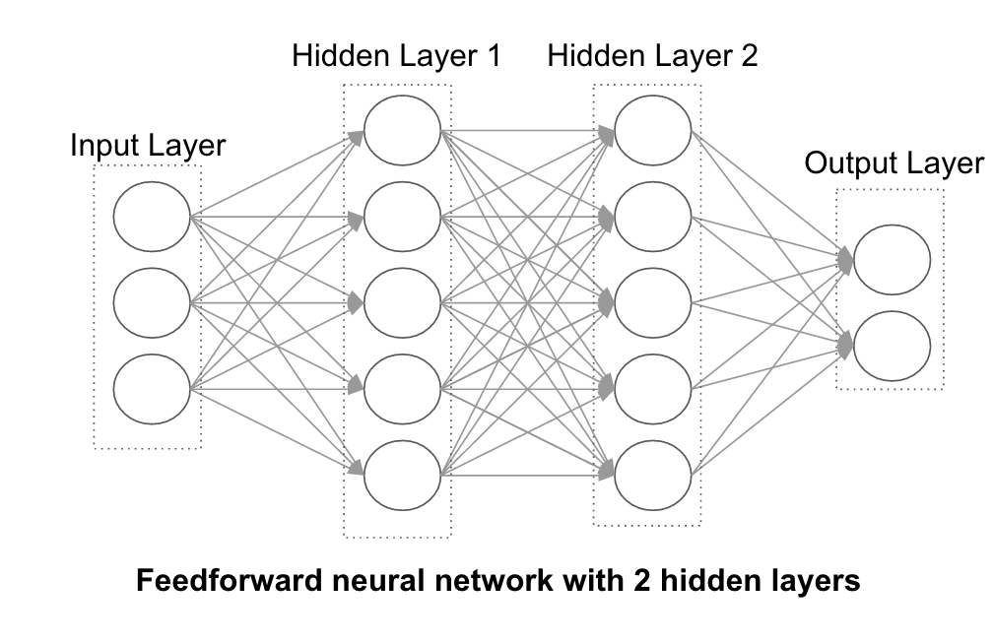

Slide 10
CNN for Age, Gender and Emotion Estimation
Data-sets for age, gender and emotion estimation from real-world social images are therefore relatively limited in size and presently no match in size with the much larger image classification data-sets.
Over fitting is common problem when machine learning based methods are used on such small image collections. This problem is exacerbated when considering deep convolutional neural networks due to their huge numbers of model parameters. Care must therefore be taken in order to avoid over fitting under such circumstances.

Slide 11
NETWORK ARCHITECTURE
Age and Gender model:-
The network comprises of only three convolutional layers and four fully-connected layer in age-model, six fully connected layer in gender-model with a small number of neurons.
Images are first rescaled to 64 X 64 and is fed to the network.
Each convolutional layer, followed by a rectified linear operator (ReLu), 2 X 2 a max pooling layer.
Last fully connected layer maps to the final classes for age or gender.

Slide 12
NETWORK ARCHITECTURE
Emotion model:-
The network comprises of a VGG-16 architecture and one fully-connected layer.
Images are first rescaled to 224 X 224 and is fed to the network.
Last fully connected layer maps to the final classes for emotion.

Slide 13
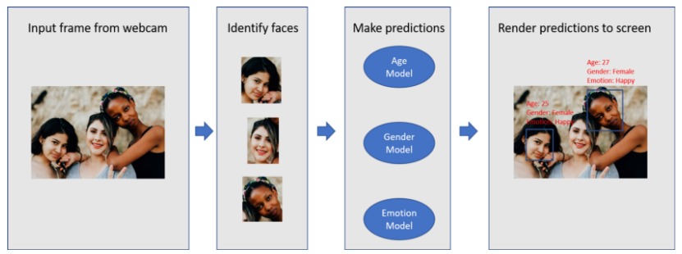
NETWORK ARCHITECTURE

Slide 14
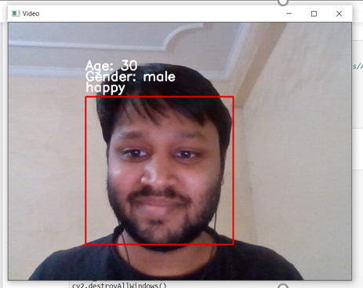
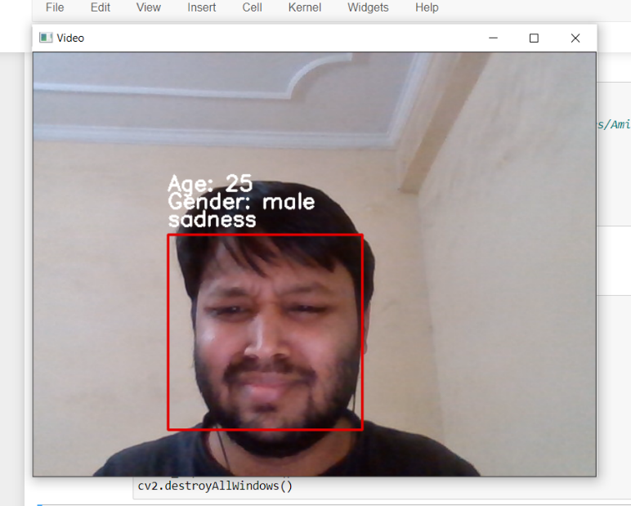
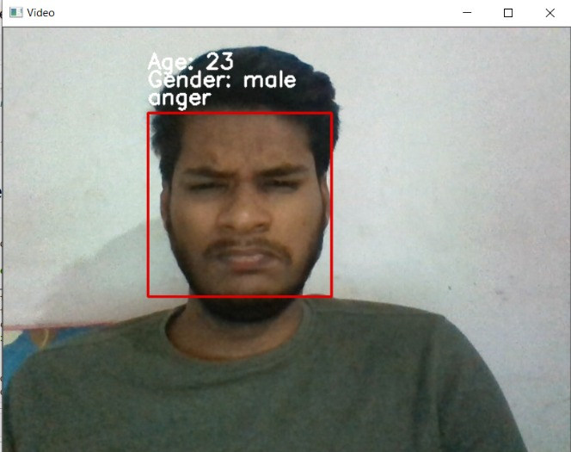
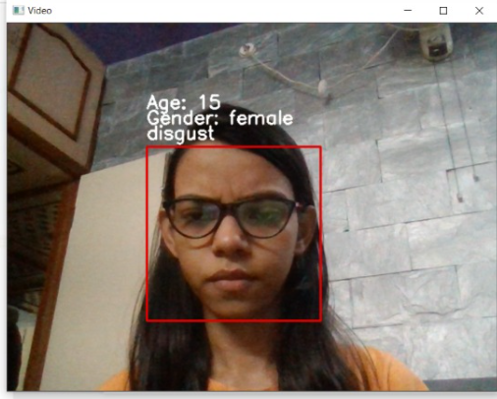
Sample Output

Slide 15
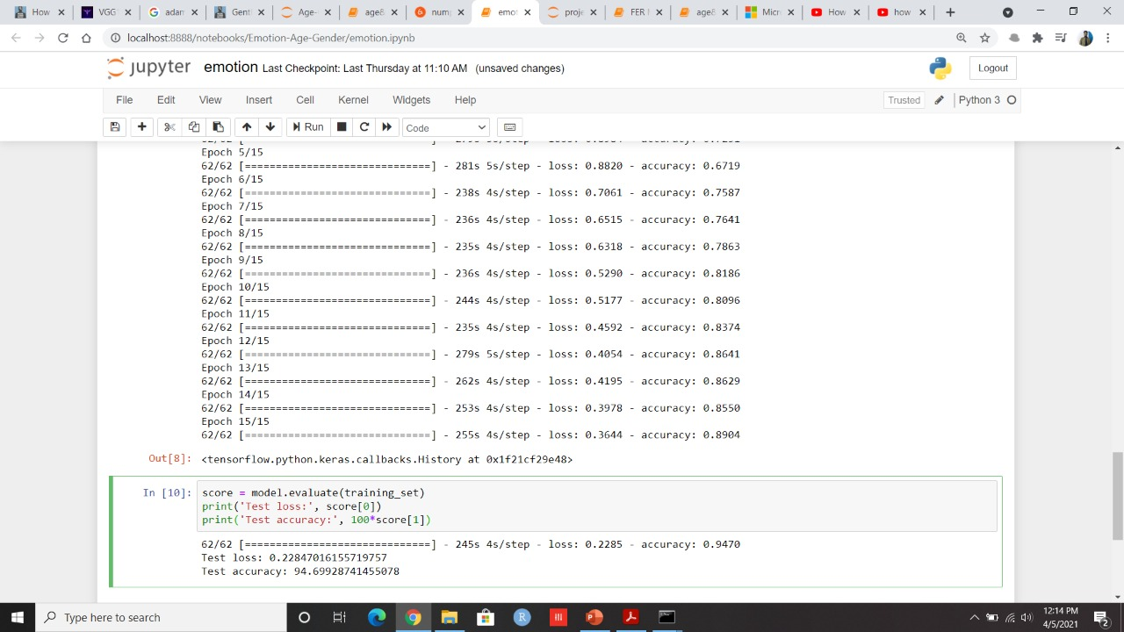
Accuracy
Test accuracy for emotion model is 94.69%.

Slide 16
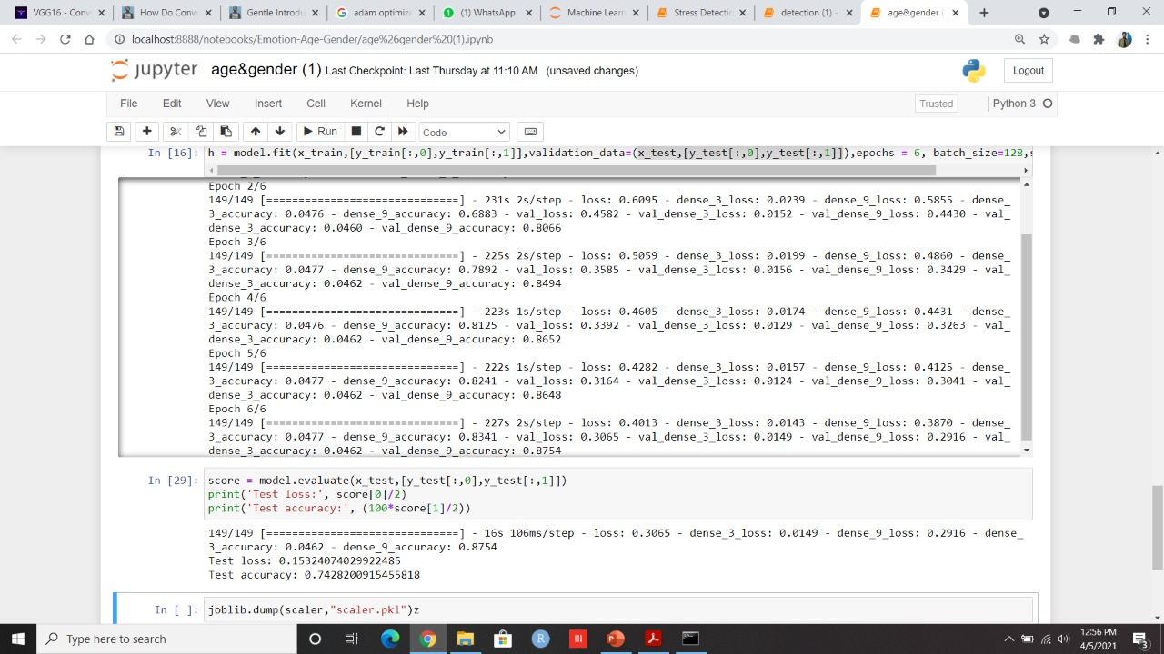
Accuracy
Test accuracy for age and gender model is 74.28%

Slide 17
APPLICATIONS
Applications for this technology have a broad scope and the potential to make a large impact. This could be used to aid assisted vision devices for those with deteriorating, or lost, eyesight.
Social media websites like Facebook could use the information about the age and gender of the people to better infer the context of the image.
In human machine interaction.

Slide 18
CONCLUSION
CNN can be used to provide improved age and gender classification results, even considering the much smaller size of contemporary unconstrained image sets labeled for age and gender and emotion.
The simplicity of the model implies that more elaborate systems using more training data may well be capable of substantially improving results beyond these results.
One can also try to use a regression model instead of classification for Age Prediction if enough data is available.

Slide 19
REFERENCES
Nagesh Singh Chauhan (2018), Predict Age and Gender using Convolutional Neural Network and openCV. Retrieved from https://towardsdatascience.com/predict-age-and-gender-using-convolutional-neural-network-and-opencv-fd90390e3ce6
VGG 16 - https://towardsdatascience.com/step-by-step-vgg16-implementation-in-keras-forbeginnersa833c686ae6c#:~:text=VGG16%20is%20a%20convolution%20neural,vision%20model%20architecture%20till%20date.&text=It%20follows%20this%20arrangement%20of,consistently%20throughout%20the%20whole%20architecture.

Slide 20
THANK YOU

