Slide 1



B. M. S. College of Engineering
20/09/2025
CHANTING
OM
KARA
WELLNESS ASSITANCE
Swati
Navya

Slide 2

Problem Statement
Many people perform Om chanting incorrectly (poor posture, distractions).
Lack of real-time feedback leads to ineffective practice.
No digital solution to monitor, guide, and correct practitioners during meditation.

Slide 3
Objectives
Provide real-time posture correction during Om chanting.
Detect and correct head/neck misalignment.
Monitor eye closure and give instant audio alerts if eyes open.
Track and guide chant length (time in seconds) for proper rhythm.

Slide 4
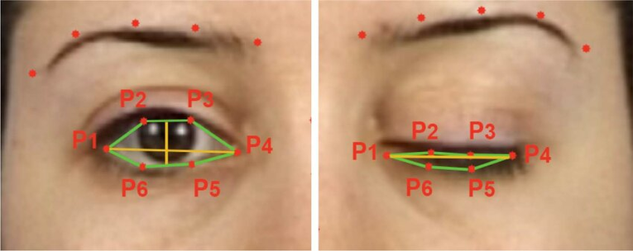
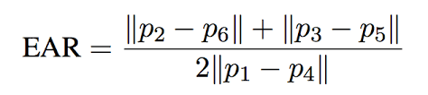
Key Features
Spinal Alignment Correction – ensure practitioner sits straight.
Head/Neck Positioning Feedback – maintain balance.
Eye Monitoring with Alerts – sustain meditative focus.
Chant Duration Guide – measure and guide length of Om chanting.

Slide 5
Tech Stack
Computer Vision & Pose Detection
opencv-python – Video capture & frame processing
mediapipe – Detect spine, head/neck, facial landmarks
numpy – Compute metrics like Eye Aspect Ratio (EAR)
Audio Processing & Feedback
speech-recognition – Detect Om chanting
pyaudio – Microphone input for real-time audio
pyttsx3 – Audio alerts for inhalation & exhalation

Slide 6
Tech Stack
Integration Modules
posture_detector.py – Monitors spinal & head/neck alignment
eye_detector.py – Monitors eye closure and calculates EAR
breathing_thread.py – Manages Om chanting sessions
speech_engine.py – Handles audio feedback
Threads & Classes – Run real-time monitoring in parallel

Slide 7
Flowcharts
Initialize WellnessApp
Test Components
Calibrate System
Start Breathing Thread
Inhale
Exhale
Chant
Capture Frame from Camera
Posture Detection
Eye Detection
Session Summary

Slide 8
DEMO

Slide 9
Thank you

