Slide 1


MEP Design
Drycool Intelligence – A Division of Drycool Systems

Slide 2
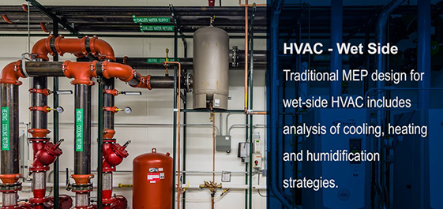
HVAC
Photo 1
Photo 2

Slide 3

ELECTRICAL
Photo 1
Photo 2
Drycool

Slide 4
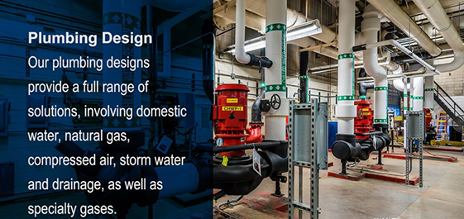
PLUMBING
Photo 1
Photo 2

Slide 5
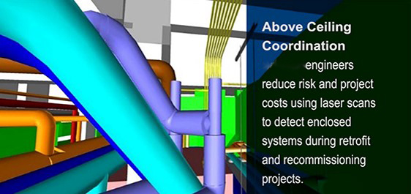
ABOVE CEILING COORDINATION
Photo 1
Photo 2
Drycool
Photo 3
Photo 4

Slide 6
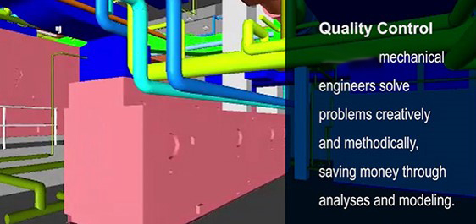
QUALITY
Drycool

Slide 7

FINANCIAL ANALYSIS
Photo 1
Photo 2
Photo 3
Photo 4

Slide 8
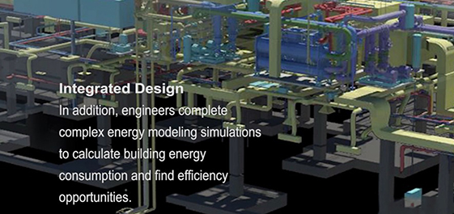
INTEGRATED DESIGN
Photo 1
Photo 2
Photo 3
Photo 4

Slide 9

MISSION CRITICAL PROJECTS
Photo 1
Photo 2
Photo 3
Photo 4

Slide 10
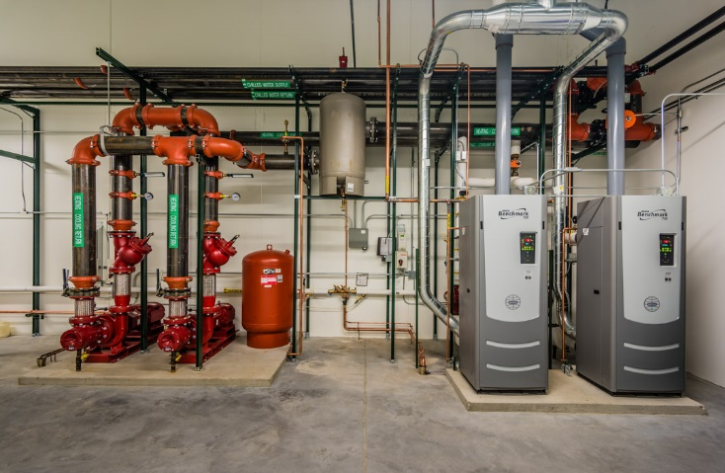
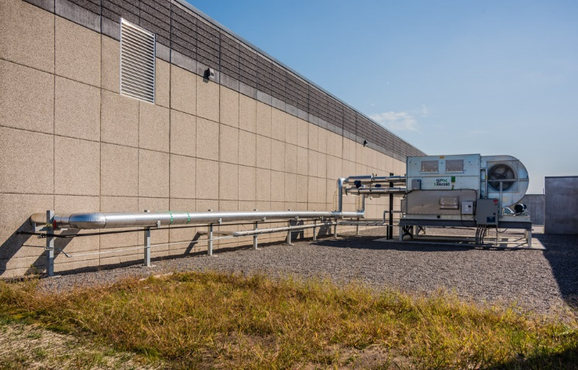
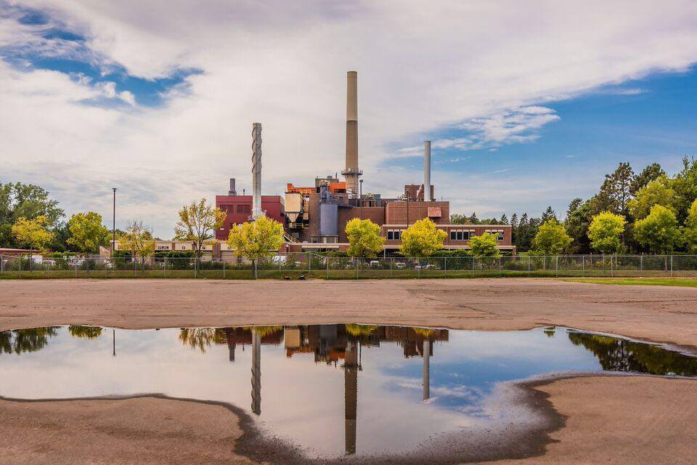
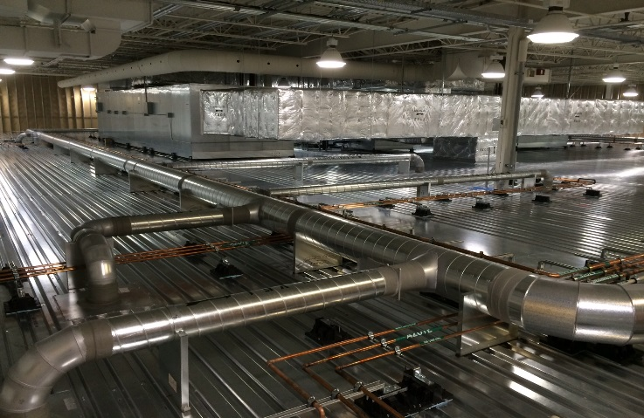
PROJECT TYPES
Photo 1
Photo 2
Heating Systems
Cooling Systems
Photo 3
Photo 4
Central Utility Plants
Critical Environments

Slide 11
KEY CONTACTS
Yash Verma: yash@drycoolchillers.com
Vatsal Verma: vatsal.verma@drycoolchillers.com

