Slide 1

Work-let Name: Plant and Disease Classification
Worklet Details
Worklet ID: 25ST17
College Name: VITC
KPIs achieved till now
Model | Accuracy(%) | Size(MB)
Mobilenetv2 | 88 | 23.65
Efficientnetb0 | 91 | 39
Mobilenetv3large | 79 | 30
After converting the Efficientnetb0 model to Tflite size reduced to 4.6 MB. The accuracy is 89%.
Date: 19.12.2025

Slide 2
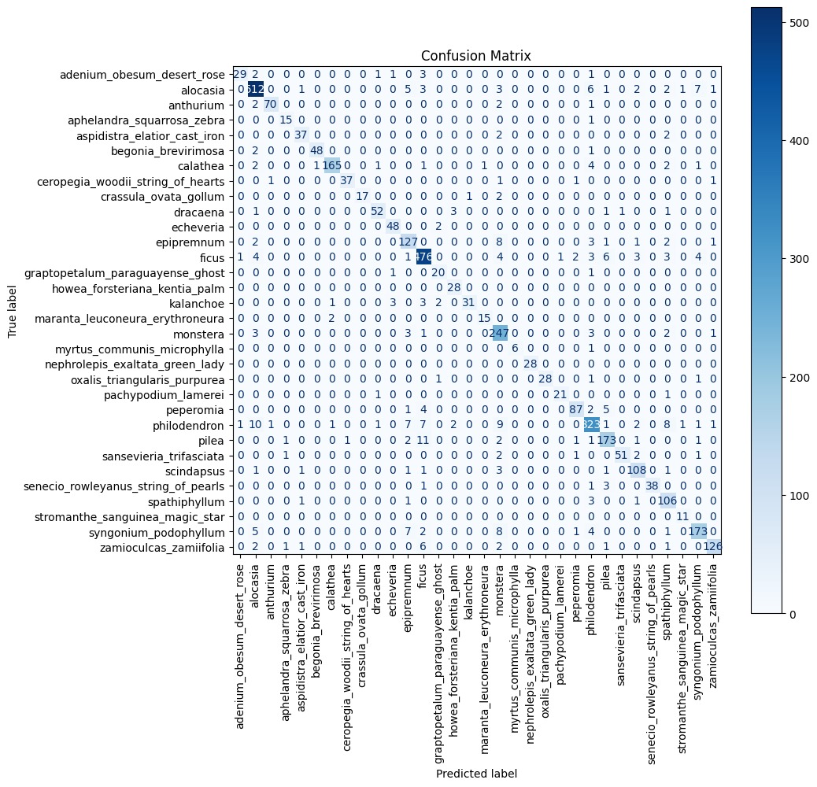
Work-let Name: Plant and Disease Classification
Worklet Details
Worklet ID: 25ST17
College Name: VITC
KPIs achieved till now
Fig: Confusion Matrix
Date: 19.12.2025

Slide 3
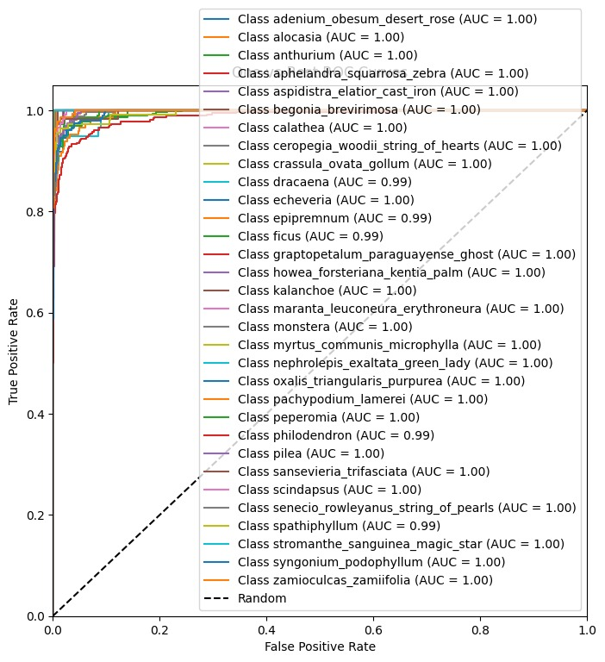
Work-let Name: Plant and Disease Classification
Worklet Details
Worklet ID: 25ST17
College Name: VITC
KPIs achieved till now
Fig: ROC Curve
Date: 19.12.2025

Slide 4
Work-let Name: Plant and Disease Classification
Worklet Details
Worklet ID: 25ST17
College Name: VITC
[Disease Datatset yet not available. The roboflow dataset provided had 157 classes, many classes of similar plants caused overfitting. To overcome that we reduced it to 32 classes with no image loss and increased accuracy by 9%.]
Any Challenges/ Issues faced
Date: 19.12.2025

Slide 5
Work-let Name: Plant and Disease Classification
Worklet Details
Worklet ID: 25ST17
College Name: VITC
Next Steps
[After getting the disease dataset we can train the same model on the datatset]
Date: 19.12.2025

Slide 6
Work-let Name: Plant and Disease Classification
Worklet Details
Worklet ID: 25ST17
College Name: VITC
[Made a model on the plant identification. Best Model is Mobilenetv2 with 88% accuracy and 23.65 MB size and EfficientnetB0 with Tflite with size 4.6MB and 89% accuracy.]
Key Achievements/ Outcome till now
Date: 19.12.2025

Slide 7
Work-let Name: Plant and Disease Classification
Worklet Details
Worklet ID: 25ST17
College Name: VITC
[Disease Dataset]
[Github: https://github.ecodesamsung.com/SRIB-PRISM/25ST17_Plant_and_Disease_Classification.git]
Resource Requirement Identified with Status
Github Repository Link and PRISM Portal Registration Status
Any Anticipated Break (Due to exams etc)
[Exams: 24.01.26 to 31.01.26]
dataset link:
https://www.kaggle.com/datasets/vishwaraj1523/mergerplantdataset
Data Collection Information
Date: 19.12.2025

Slide 8
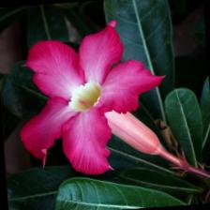
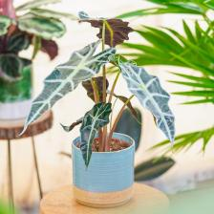
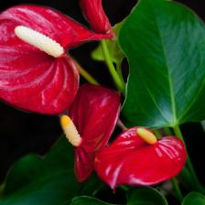
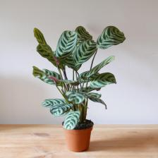
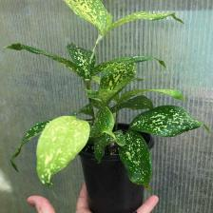
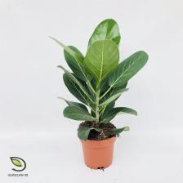
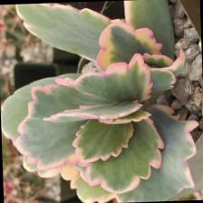
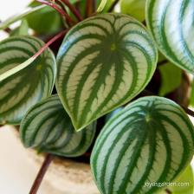
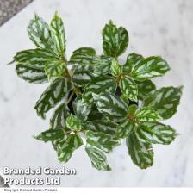

Work-let Name: Plant and Disease Classification
Worklet Details
Worklet ID: 25ST17
College Name: VITC
dataset link: https://www.kaggle.com/datasets/vishwaraj1523/mergerplantdataset
3 Directories i.e. Test, Train and Valid. 32 Classes for different plants.
10 sample classes:
adenium_obesum alocasia anthurium calathea dracaena ficus
kalanchoe peperomia pilea scindapsus
Data Collection Information
Date: 19.12.2025

Slide 9
Work-let Name: Plant and Disease Classification
Worklet Details
Worklet ID: 25ST17
College Name: VITC
Status and future plan
Latest Literature Review
Expert Insights
Any other comment
Professor Comments (To be filled in and presented by professor (Either)
COMPUTATION RESOURCE Details:
[Google Collab and Kaggle]
Date: 19.12.2025

