Slide 1

Work-let Name: Plant and disease Classification
Worklet Details
Worklet ID: 25ST1
College Name: Vellore Institute of Technology, Chennai
KPIs achieved till now
Experimentation of different model architectures: We implemented and tested 2 CNN models to achieve lighterweigh models giving 90% + accuracies on custom plant diseases dataset.
Date: 17/10/2025

Slide 2
Work-let Name: Plant and disease Classification
Worklet Details
Worklet ID: 25ST1
College Name: Vellore Institute of Technology, Chennai
Architecture 1 – MobileNetV2 with Simple Classification Head
Architecture:
Pre-trained MobileNetV2 on ImageNet (frozen base)
GlobalAveragePooling2D layer
Dropout (0.2)
Dense output layer with sigmoid activation
Training Strategy:
Phase 1: 6 initial epochs with frozen base
Phase 2: Fine-tuning from layer 100 onwards for 10 additional epochs (16 total)
Loss: SparseCategoricalCrossentropy
Optimizer: Adam
Date: 17/10/2025

Slide 3
Work-let Name: Plant and disease Classification
Worklet Details
Worklet ID: 25ST1
College Name: Vellore Institute of Technology, Chennai
Architecture 2 – MobileNetV2 with Deep Classification Head
Architecture:
Pre-trained MobileNetV2 on ImageNet (frozen base)
GlobalAveragePooling2D layer
Dense layer (configurable units) with ReLU activation
Dropout layer (configurable rate)
Dense output layer with softmax activation
Training Strategy:
Phase 1: Custom head training with frozen base + callbacks (EarlyStopping, ReduceLROnPlateau, ModelCheckpoint)
Phase 2: Fine-tuning top 30% of base layers with reduced learning rate
Loss: Categorical Crossentropy
Optimizer: Adam (different learning rates per phase)
Date: 17/10/2025

Slide 4
Work-let Name: Plant and disease Classification
Worklet Details
Worklet ID: 25ST1
College Name: Vellore Institute of Technology, Chennai
Any Challenges/ Issues faced
The required dataset was not available yet.
Currently using a placeholder public dataset (e.g., PlantVillage) for pipeline testing and model benchmarking.
Date: 17/10/2025

Slide 5
Work-let Name: Plant and disease Classification
Worklet Details
Worklet ID: 25ST1
College Name: Vellore Institute of Technology, Chennai
Next Steps
Mobile Application Prototype Development
Develop an Android/iOS mobile application for real-time plant disease classification using the trained MobileNetV2 model
Develop a Conditional GAN (cGAN) or StyleGAN2-ADA architecture to generate synthetic home plant disease images​
Implementation Steps:
Collect seed dataset (minimum 100-500 images per disease class)
Implement DCGAN/StyleGAN2 architecture with disease class conditioning for targeted generation
Train GAN for 50-200 epochs with progressive quality monitoring using FID and IS metrics​
Date: 16/10/2025

Slide 6
Work-let Name: Plant and disease Classification
Worklet Details
Worklet ID: 25ST1
College Name: Vellore Institute of Technology, Chennai
Key Achievements/ Outcome till now
Architecture Development & Implementation
Successfully designed and implemented two distinct MobileNetV2-based transfer learning architectures with different classification head complexities
Implemented two-phase fine-tuning strategies (frozen base + custom head training, followed by selective layer unfreezing)
Date: 16/10/2025

Slide 7
Work-let Name: Plant and disease Classification
Worklet Details
Worklet ID: 25ST1
College Name: Vellore Institute of Technology, Chennai
Key Achievements/ Outcome till now
Architecture 1: MobileNetV2 with Simple Classification Head
Test Accuracy: 95.54%
Model Size: 25 MB
Architecture 2: MobileNetV2 with Deep Classification Head
Test Accuracy: 97.00%
Model Size: 10.75 MB (57% smaller than Architecture 1)
Date: 16/10/2025

Slide 8
Work-let Name: Plant and disease Classification
Worklet Details
Worklet ID: 25ST1
College Name: Vellore Institute of Technology, Chennai
Key Achievements/ Outcome till now
Architecture 1: MobileNetV2 with Simple Classification Head
Test Accuracy: 95.54%
Model Size: 25 MB
Architecture 2: MobileNetV2 with Deep Classification Head
Test Accuracy: 97.00%
Model Size: 10.75 MB (57% smaller than Architecture 1)
Date: 16/10/2025

Slide 9
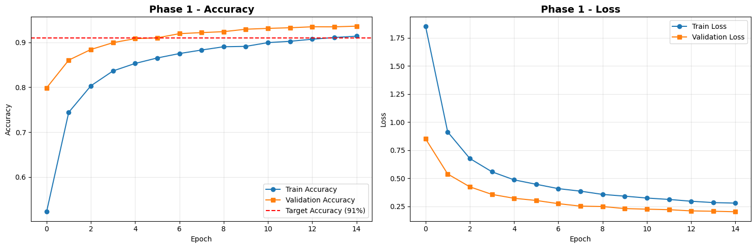
Work-let Name: Plant and disease Classification
Worklet Details
Worklet ID: 25ST1
College Name: Vellore Institute of Technology, Chennai
Key Achievements/ Outcome till now
Date: 16/10/2025

Slide 10
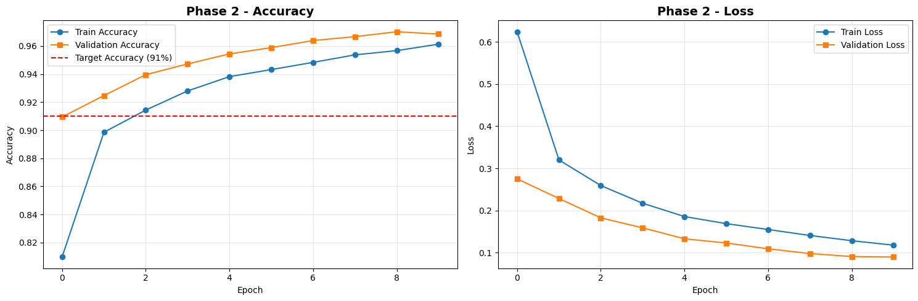
Work-let Name: Plant and disease Classification
Worklet Details
Worklet ID: 25ST1
College Name: Vellore Institute of Technology, Chennai
Key Achievements/ Outcome till now
Date: 16/10/2025

Slide 11
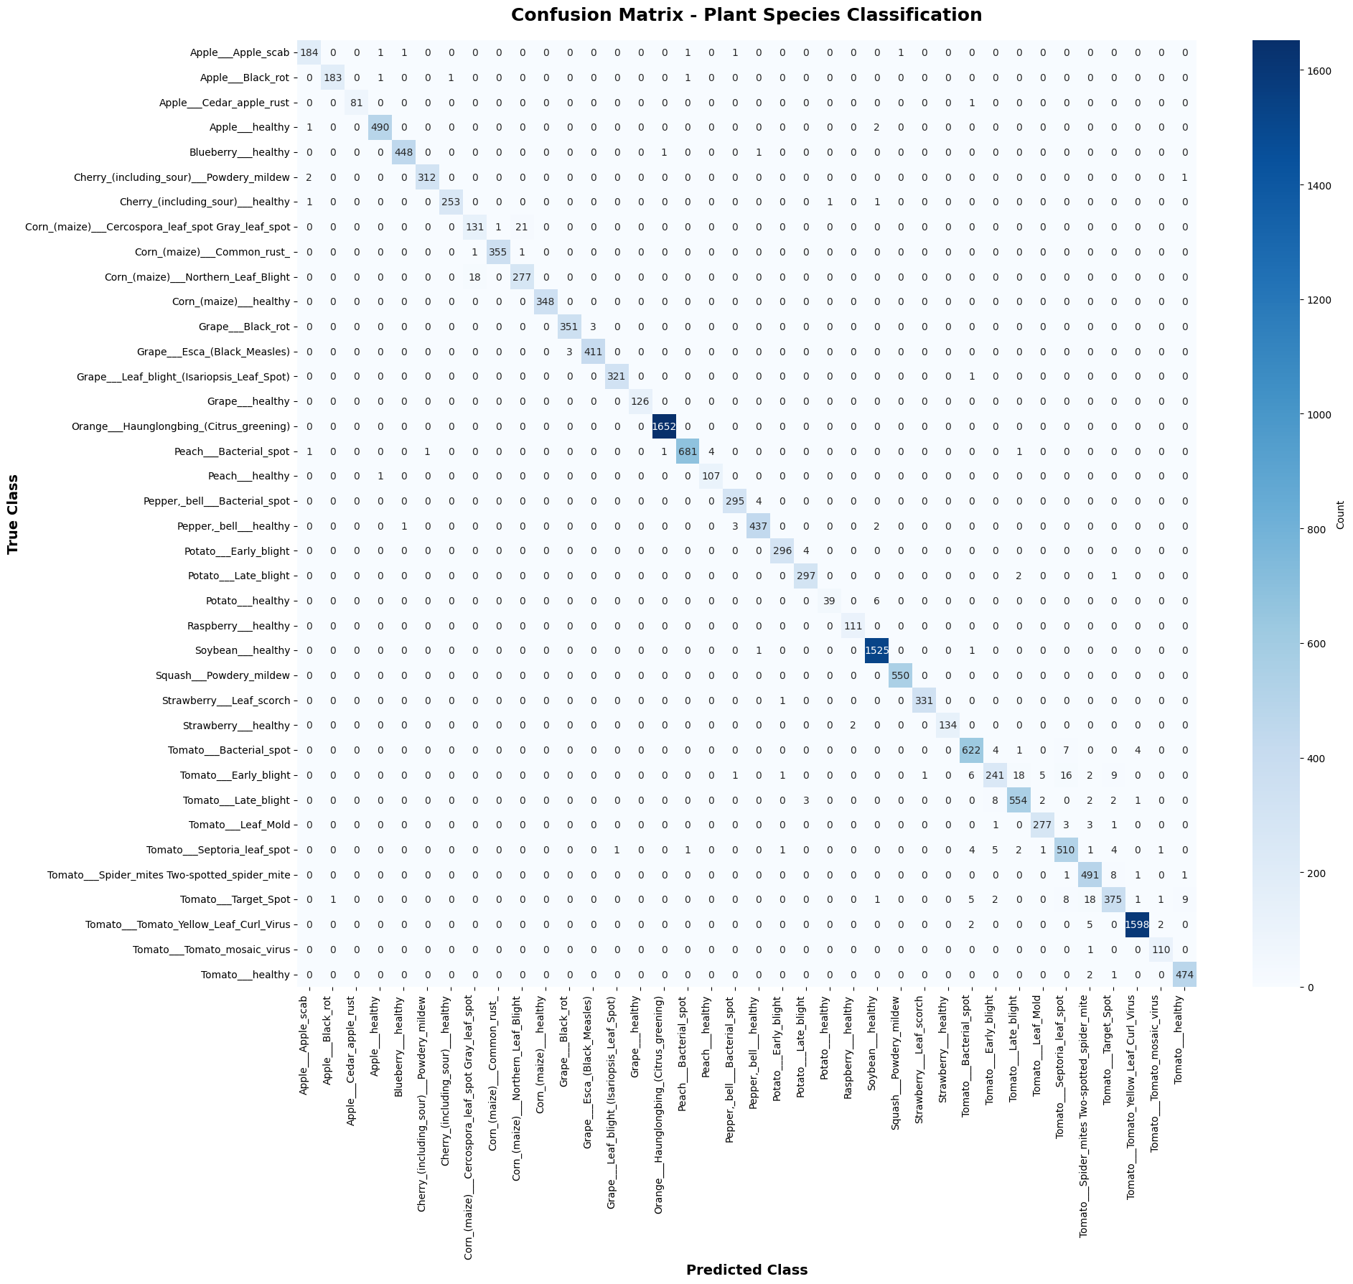
Work-let Name: Plant and disease Classification
Worklet Details
Worklet ID: 25ST1
College Name: Vellore Institute of Technology, Chennai
Key Achievements/ Outcome till now
Date: 16/10/2025

Slide 12
Work-let Name: Plant and Disease classification
Worklet Details
Worklet ID: 25-ST1
College Name: Vellore Institute of Technology, Chennai
Github Repository Link and PRISM Portal Registration Status
eCODE registration complete
Date: 17/10/2025

Slide 13
Work-let Name: Plant and Disease classification
Worklet Details
Worklet ID: 25-ST1
College Name: Vellore Institute of Technology, Chennai
Any Anticipated Break (Due to exams etc)
FAT Exams: 17 November - 2 December 2025
Date: 17/10/2025

Slide 14
Work-let Name: Plant and Disease classification
Worklet Details
Worklet ID: 25-ST1
College Name: Vellore Institute of Technology, Chennai
Data Collection Information
Plant Village Dataset:
https://www.kaggle.com/datasets/abdallahalidev/plantvillage-dataset
The PlantVillage dataset consists of 54303 healthy and unhealthy leaf images divided into 38 categories by species and disease.
Date: 17/10/2025

Slide 15
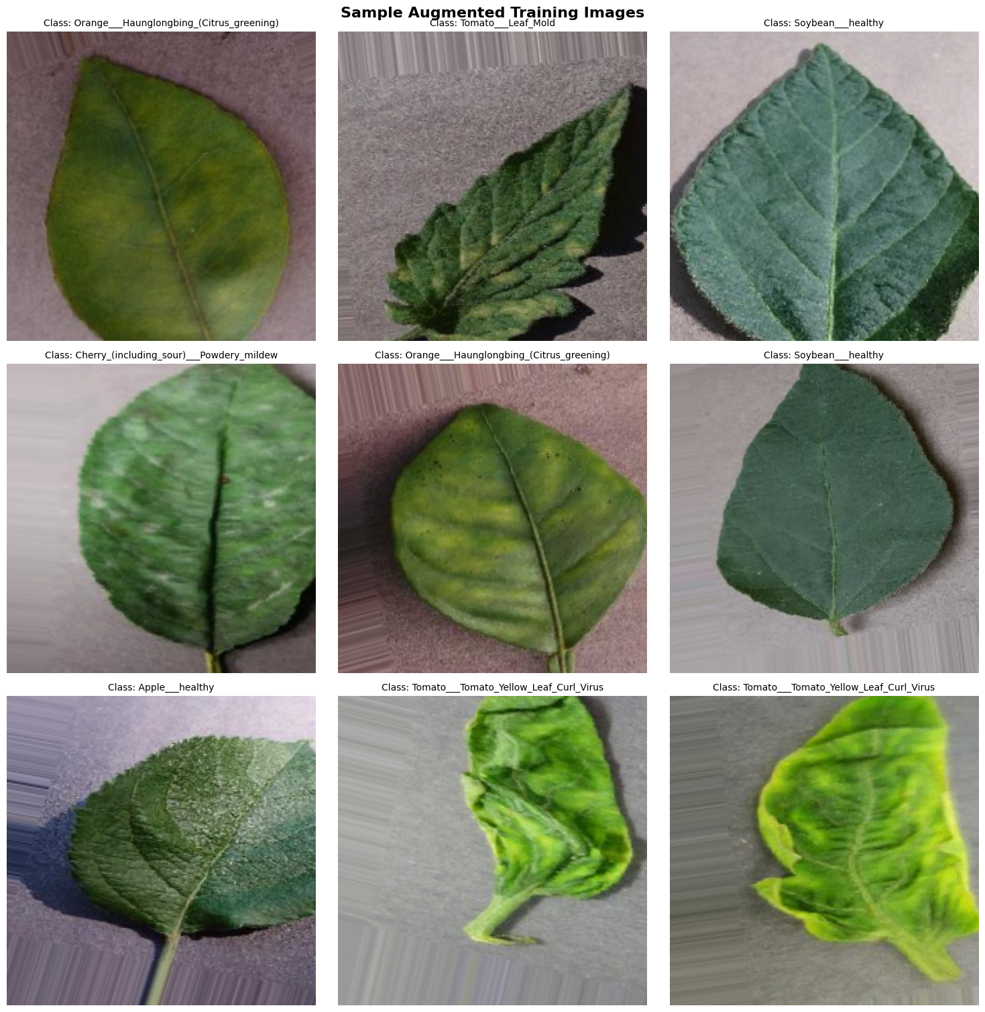
Work-let Name: Plant and Disease classification
Worklet Details
Worklet ID: 25-ST1
College Name: Vellore Institute of Technology, Chennai
Data Collection Information
Date: 17/10/2025

Slide 16
Work-let Name: Plant and Disease Classification
Worklet Details
Worklet ID: 25ST1
College Name: Vellore Institute of Technology, Chennai
Professor Comments
Current Status
Developed and tested two MobileNetV2-based transfer learning architectures on placeholder plant dataset achieving 95.54% (Architecture 1, 25 MB) and 97.00% (Architecture 2, 10.75 MB) test accuracy with production-ready training pipelines​
Next Steps (Future Work)
Develop mobile app prototype with TensorFlow Lite integration, implement GAN pipeline for synthetic home plant disease dataset generation, and validate models on GAN-generated data until actual curated dataset becomes available from partner team
Date: 17/10/2025

Slide 17
Work-let Name: Plant and Disease Classification
Worklet Details
Worklet ID: 25ST1
College Name: Vellore Institute of Technology, Chennai
COMPUTATION RESOURCE Details:
T4 GPU (Google Colab and Kaggle)
Date: 17/10/2025

