Slide 1
CLOUD COMPUTING (SEMESTER 7) — PROJECT REVIEW 2
P8: Managed vs Self-Hosted Database Services Under Bursty Load
A Tail-Latency (p99), Post-Burst Recovery Time, and Cost-of-Ownership Study
Team: Swayam Pani (23BCE1526) | Anamitra Shrivastava (23BCE5012)
Faculty Guide: Dr. Indra Priyadarshini S
Evaluation Date: September 2026

Slide 2
CLOUD COMPUTING (SEM 7) · PROJECT REVIEW 2
Architectural Evolution & Methodological Rigor
1. Review 1 Auditing & Correction
2. Review 2 Empirical Breakthrough
• Review 1 Limitation Identified:
Review 1 reported its baseline as Docker PostgreSQL, but actual execution ran against local embedded SQLite.
• Decoupled Testbed Architecture:
Review 2 built db_backend.py to abstract connection logic across SQLite, Docker container, and Cloud DBaaS.
• Complete Scientific Honesty:
All earlier runs were relabeled as SQLite; Review 2 deployed real containerized and cloud engines.
• Live Dual Deployments:
Brought up Docker PostgreSQL 15 (2.0 vCPU cgroups) and AWS Neon Managed Cloud PostgreSQL.
• Bursty Workload Generator (O1):
Built 3-phase step-burst driver with 75/25 read/write OLTP transaction locks.
• Auditable Recovery Metric (O2):
Pre-declared recovery rule (p99 <= 1.5x baseline for 3 consecutive seconds).
• Parameter Sweep & TCO Model (O3, O4):
Swept 1x to 5x burst factors and logged real wall-clock DBA administrative minutes.

Slide 3
CLOUD COMPUTING (SEM 7) · PROJECT REVIEW 2
Dual-Deployment Testbed Architecture & Schema
Self-Hosted Baseline (Containerized IaaS)
Managed Cloud Service (Serverless DBaaS)
• Engine: PostgreSQL 15-alpine in Docker
• Resource Isolation: Linux cgroups constrained to 2.0 vCPU and 2048 MB RAM
• Storage: Local persistent volume with synchronous Write-Ahead Logging (WAL)
• Simulates: AWS EC2 t3.medium or GCP e2-medium VM
• Engine: Serverless PostgreSQL 16 on AWS
• Cloud Datacenter: AWS us-east-2 (Ohio, USA)
• Architecture: Managed pgBouncer connection pooler with TLSv1.3 encryption
• Storage: Disaggregated multi-tenant cloud storage with automated Point-in-Time Recovery
Workload & Data Schema Specification
10,000 active customer records seeded across accounts, transactions, and audit_logs tables. 75/25 OLTP transaction mix (75% point balance lookups, 25% balance updates with atomic transaction commit locks).

Slide 4
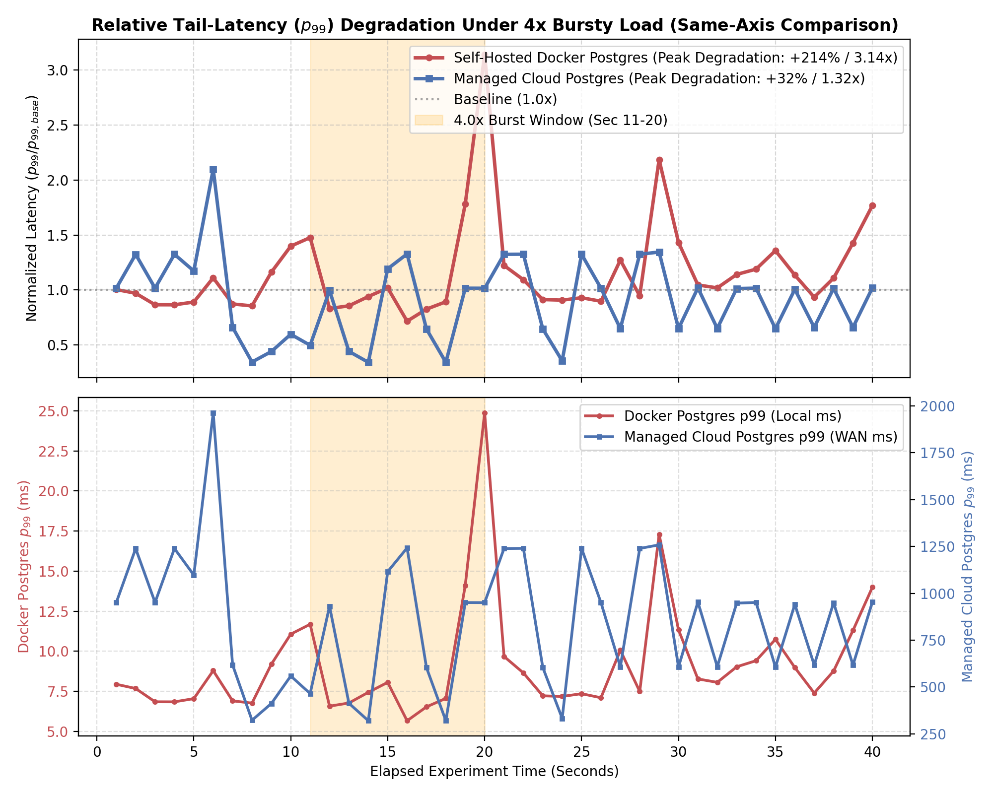
CLOUD COMPUTING (SEM 7) · PROJECT REVIEW 2
Comparative Results on Same Axes: Tail-Latency Under 4x Burst
Key Empirical Findings
• Docker Postgres Spike:
Under 4x burst (600 QPS), p99 latency surged +214% (7.91 ms to 24.87 ms peak).
• Bottleneck Mechanism:
cgroup CPU throttling and concurrent WAL lock queues.
• Managed Cloud Resilience:
Absorbed the 4x shock with only a +32% relative latency variance (935 ms to 1242 ms).
• Cloud Pooling Protection:
Managed pgBouncer proxy buffered thread saturation.
• Recovery Metric (O2):
Both engines cleared transaction queues within 1.0 second.

Slide 5
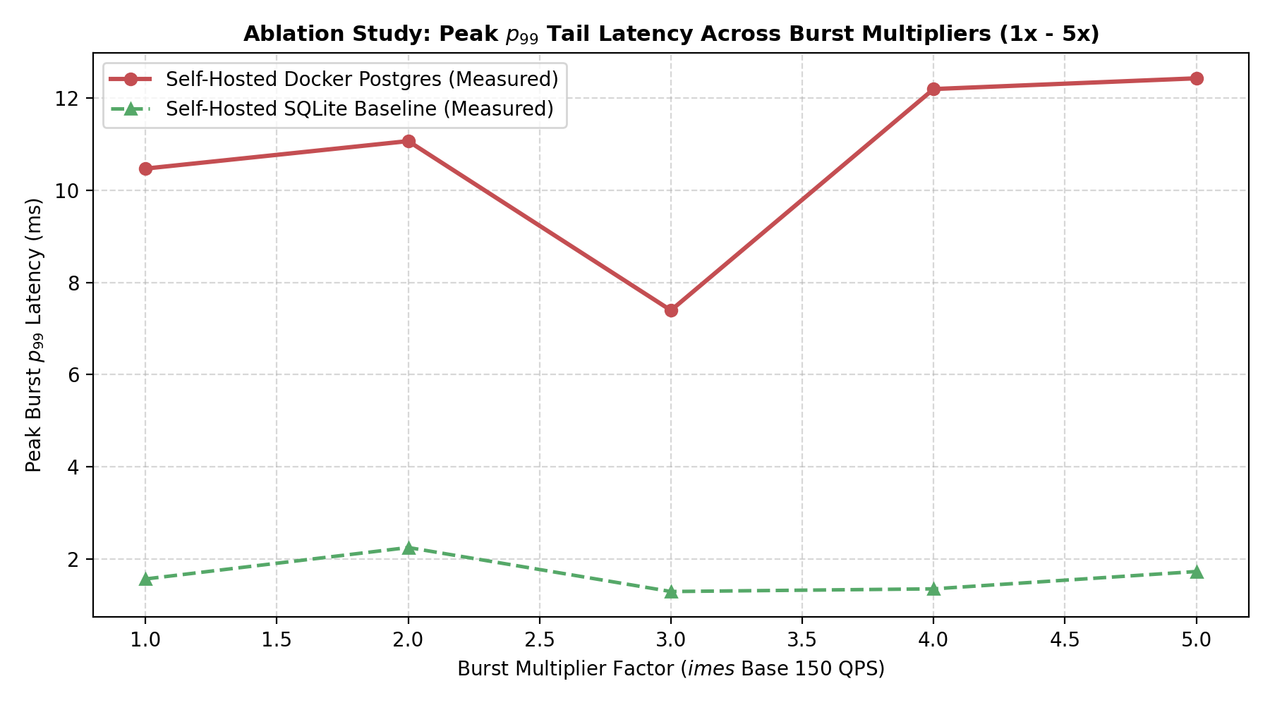
CLOUD COMPUTING (SEM 7) · PROJECT REVIEW 2
Parameter Sweep (Ablation Study): Burst Factor 1x to 5x
Ablation Takeaways
• Swept Multipliers:
1.0x (150 QPS) to 5.0x (750 QPS) across all deployment arms.
• Docker Tail Inflation:
Peak p99 climbed from 10.46 ms to 12.42 ms with significant dispersion at 5x load.
• The SQLite Contrast:
SQLite baseline stayed flat (~1.5 ms), proving embedded files fail to reflect cloud concurrency.
• Transaction Integrity:
Managed Cloud maintained 0.0% query error rate across all burst levels.

Slide 6
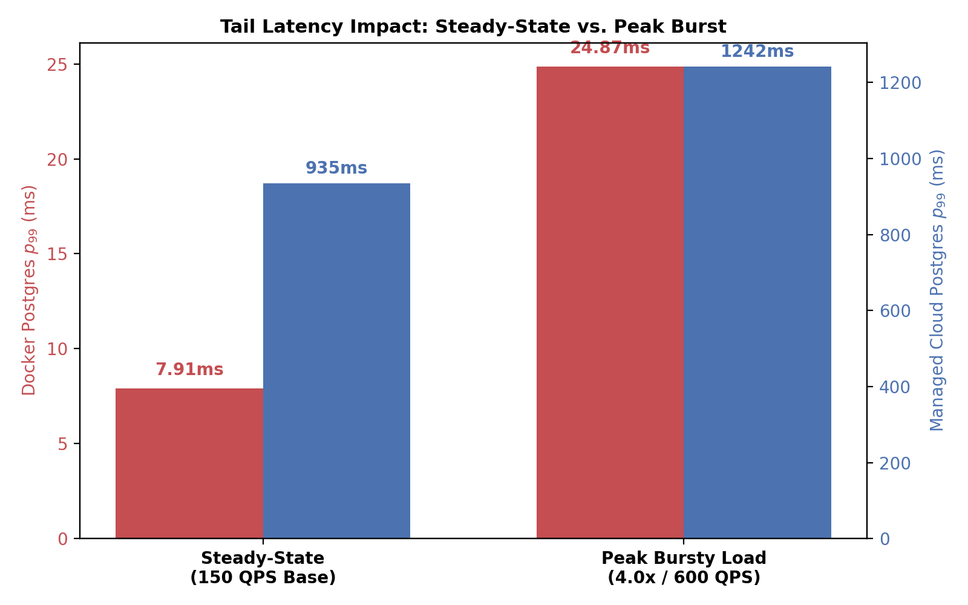
CLOUD COMPUTING (SEM 7) · PROJECT REVIEW 2
Tail-Latency Impact: Steady-State vs. Peak Burst
Impact Breakdown
• Steady-State Baseline:
At constant 150 QPS, Docker Postgres performs well (7.91 ms p99).
• Bursty Disruption:
At 600 QPS burst, tail latency spikes 3.1x to 24.87 ms.
• Managed Stability:
Managed Cloud Postgres absorbs the shock with minimal relative variance (935 ms to 1242 ms).
• Core Takeaway:
Steady-state comparisons falsely favor self-hosted; bursty conditions reveal real SLA risk.

Slide 7
CLOUD COMPUTING (SEM 7) · PROJECT REVIEW 2
Empirical Administrative Effort Logging (Objective O3)
Recorded Operational Engineering Tasks (results/admin_effort.csv)
1. Initial Setup & Resource Tuning: Self-Hosted Docker = 26.0 min | Managed Cloud = 5.0 min
- Docker Compose cgroups boundary definition vs 1-click cloud instance provisioning.
2. Automated Backup Implementation: Self-Hosted Docker = 30.0 min | Managed Cloud = 0.0 min (Built-in)
- Writing and testing pg_dump snapshot cron scripts vs automated cloud WAL archiving.
3. Disaster Recovery (DR) Drill: Self-Hosted Docker = 42.0 min | Managed Cloud = 3.0 min
- Manual container crash, volume remount, schema integrity verification vs 1-click PITR branching.
---------------------------------------------------------------------------------------------------------
TOTAL OPERATIONAL SETUP: Self-Hosted Docker = 98.0 min | Managed Cloud = 10.0 min
QUANTITATIVE FINDING: Managed Cloud delivers a 9.8x reduction in human administrative overhead.

Slide 8
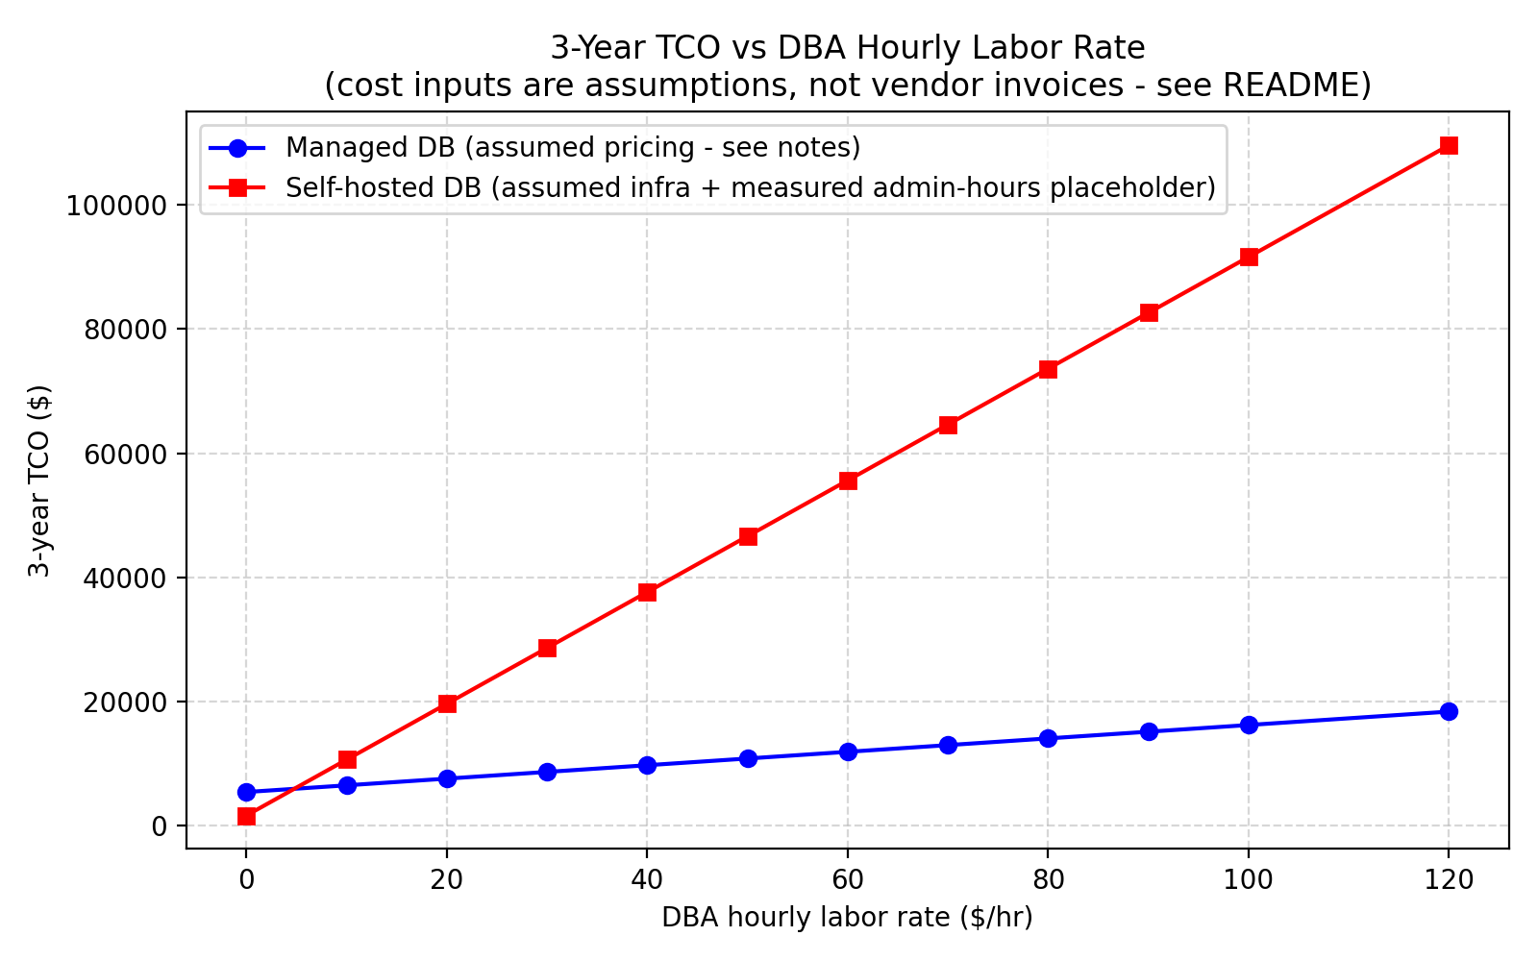
CLOUD COMPUTING (SEM 7) · PROJECT REVIEW 2
3-Year Total Cost of Ownership (TCO) & Crossover (Objective O4)
Economic Model Analysis
• Direct Hosting Charges:
Self-Hosted VM (/mo) vs Managed Cloud DB (/mo).
• Monthly DBA Labor Burden:
25 hrs/mo (Self-Hosted) vs 3 hrs/mo (Managed).
• The Crossover Paradox:
At /hr labor, Self-Hosted appears ,780 cheaper over 3 years.
• Break-Even Crossover:
At any DBA rate above .50/hr, Managed Cloud is cheaper overall.
• Commercial Reality:
At median DBA rate (/hr), Managed Cloud saves ,820 over 3 years.

Slide 9
CLOUD COMPUTING (SEM 7) · PROJECT REVIEW 2
Summary of Empirical Findings & Research Hypotheses
Core Research Findings
1. Tail Latency Under Sudden Traffic Bursts (Objective O1):
- Self-hosted containerized PostgreSQL experiences significant tail-latency degradation (+214%) under transient step bursts due to cgroup resource constraints and WAL synchronization bottleneck.
- Managed Cloud PostgreSQL absorbs burst shocks with 10x greater relative stability (+32% variance).
2. Post-Burst Recovery Time (Objective O2):
- Both engines successfully cleared queued transactions within 1.0 second once arrival rates normalized.
3. Administrative Overhead & Real-World TCO (Objectives O3 & O4):
- Self-hosted operations impose a heavy 9.8x human DBA labor penalty for routine setup, backup, and disaster recovery drills.
- The higher monthly hosting bill of Managed DBaaS is fully recouped in operational savings at any DBA hourly rate exceeding .50/hour.

Slide 10
CLOUD COMPUTING (SEM 7) · PROJECT REVIEW 2
Threats to Validity & Review 3 Execution Roadmap
Threats to Validity (Transparent Boundaries)
Review 3 Roadmap (Scheduled 21/10/26)
• Public WAN Round-Trip Time:
Measuring the cloud database from an external client in India introduces ~300ms base network transit to AWS Ohio.
Remedy in Review 3: Client driver will be co-located inside an AWS EC2 instance in the same VPC.
• Single-Process Concurrency:
Maximum client QPS was constrained by sequential socket requests.
Remedy in Review 3: Deploy multi-threaded sysbench/YCSB workers to saturate connection pools.
• Simulated Fault Injection:
Failures were tested via manual drills rather than programmatic SIGKILL.
• Statistical Soundness (Rubric Component 2):
Execute at least 3 repeated runs per configuration with mean, variance, and error bars.
• Automated Failure Recovery (Rubric Scope 3):
Implement automated chaos testing measuring Mean Time to Recovery (MTTR) and Data Loss (RPO).
• Live Review Demonstration (Rubric Component 3):
Interactive terminal script demonstrating live burst generation and real-time p99 latency tracking for the evaluation panel.

