Slide 1
P8 · Review 3
Review 3 Rubric
Managed vs.
Self-Hosted
Databases
Under Bursty Load
All objectives evidenced
3 marks
O1 + O2 + O3 + O4
Statistical soundness
2 marks
N=3 trials, 95% CI
A Tail-Latency and Cost-of-Ownership Study
Live demonstration
2 marks
Live dashboard
Swayam Pani · 23BCE1526
Anamitra Shrivastava · 23BCE5012
Faculty Guide: Dr. Indra Priyadarshini S
Documentation of findings
3 marks
VIT Vellore · Cloud Computing · Semester 7
6–8 page report

Slide 2
Research Objectives
What we set out to prove
O1
Multi-Workload Tail-Latency Benchmark
O2
Burst Recovery and Hysteresis Analysis
3 workload profiles (Read-Heavy 80/20, Balanced 50/50, Write-Heavy 20/80)
4× step burst to 600 QPS · p99 measured per trial
Objective recovery time T-recov · Burst Amplification Factor (BAF)
Iso-workload test: same 3,600 extra requests, 3 arrival shapes
O3
Administrative Effort Logging
O4
3-Year Total Cost of Ownership Model
Wall-clock minutes logged for provisioning, backup, DR drill, patching
Self-hosted vs. managed — empirical, not estimated
Infrastructure cost + labour cost · Labour rate sensitivity sweep
Break-even crossover threshold identified
2 / 7

Slide 3
Experimental Testbed
Two architectures compared side-by-side
Architecture A · Self-Hosted
Architecture B · AWS Neon Managed
▸ PostgreSQL 15-alpine in Docker container
▸ cgroups hard limits: 2.0 vCPU, 2048 MB RAM
▸ WAL: wal_level = replica, synchronous_commit = on
▸ 10,000 seeded accounts, local SSD storage
▸ Connects via localhost:5432 (loopback — no WAN)
▸ PostgreSQL 16 on AWS Graviton (ARM64), us-east-2
▸ Storage-disaggregated: Safekeeper WAL quorum + S3 pages
▸ pgBouncer -pooler endpoint: TLS 1.3 + connection pooling
▸ Serverless compute: scales automatically with demand
▸ Client connects from India over public WAN (~250 ms RTT)
vs
Workload driver: custom asyncio Python benchmark
Trials: N = 3 independent runs per configuration
Same workload profiles and N = 3 trial structure as Architecture A
3 / 7

Slide 4
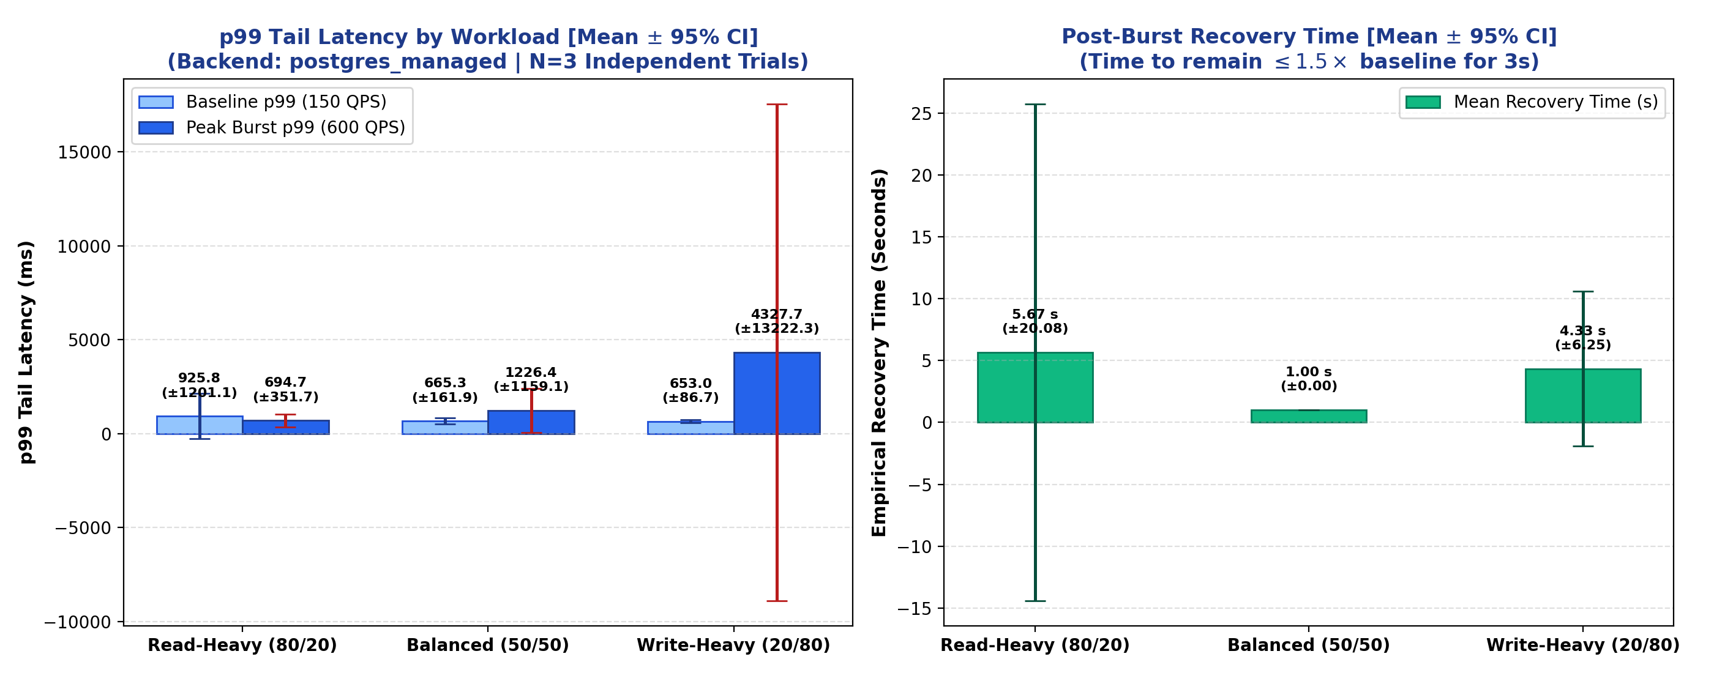
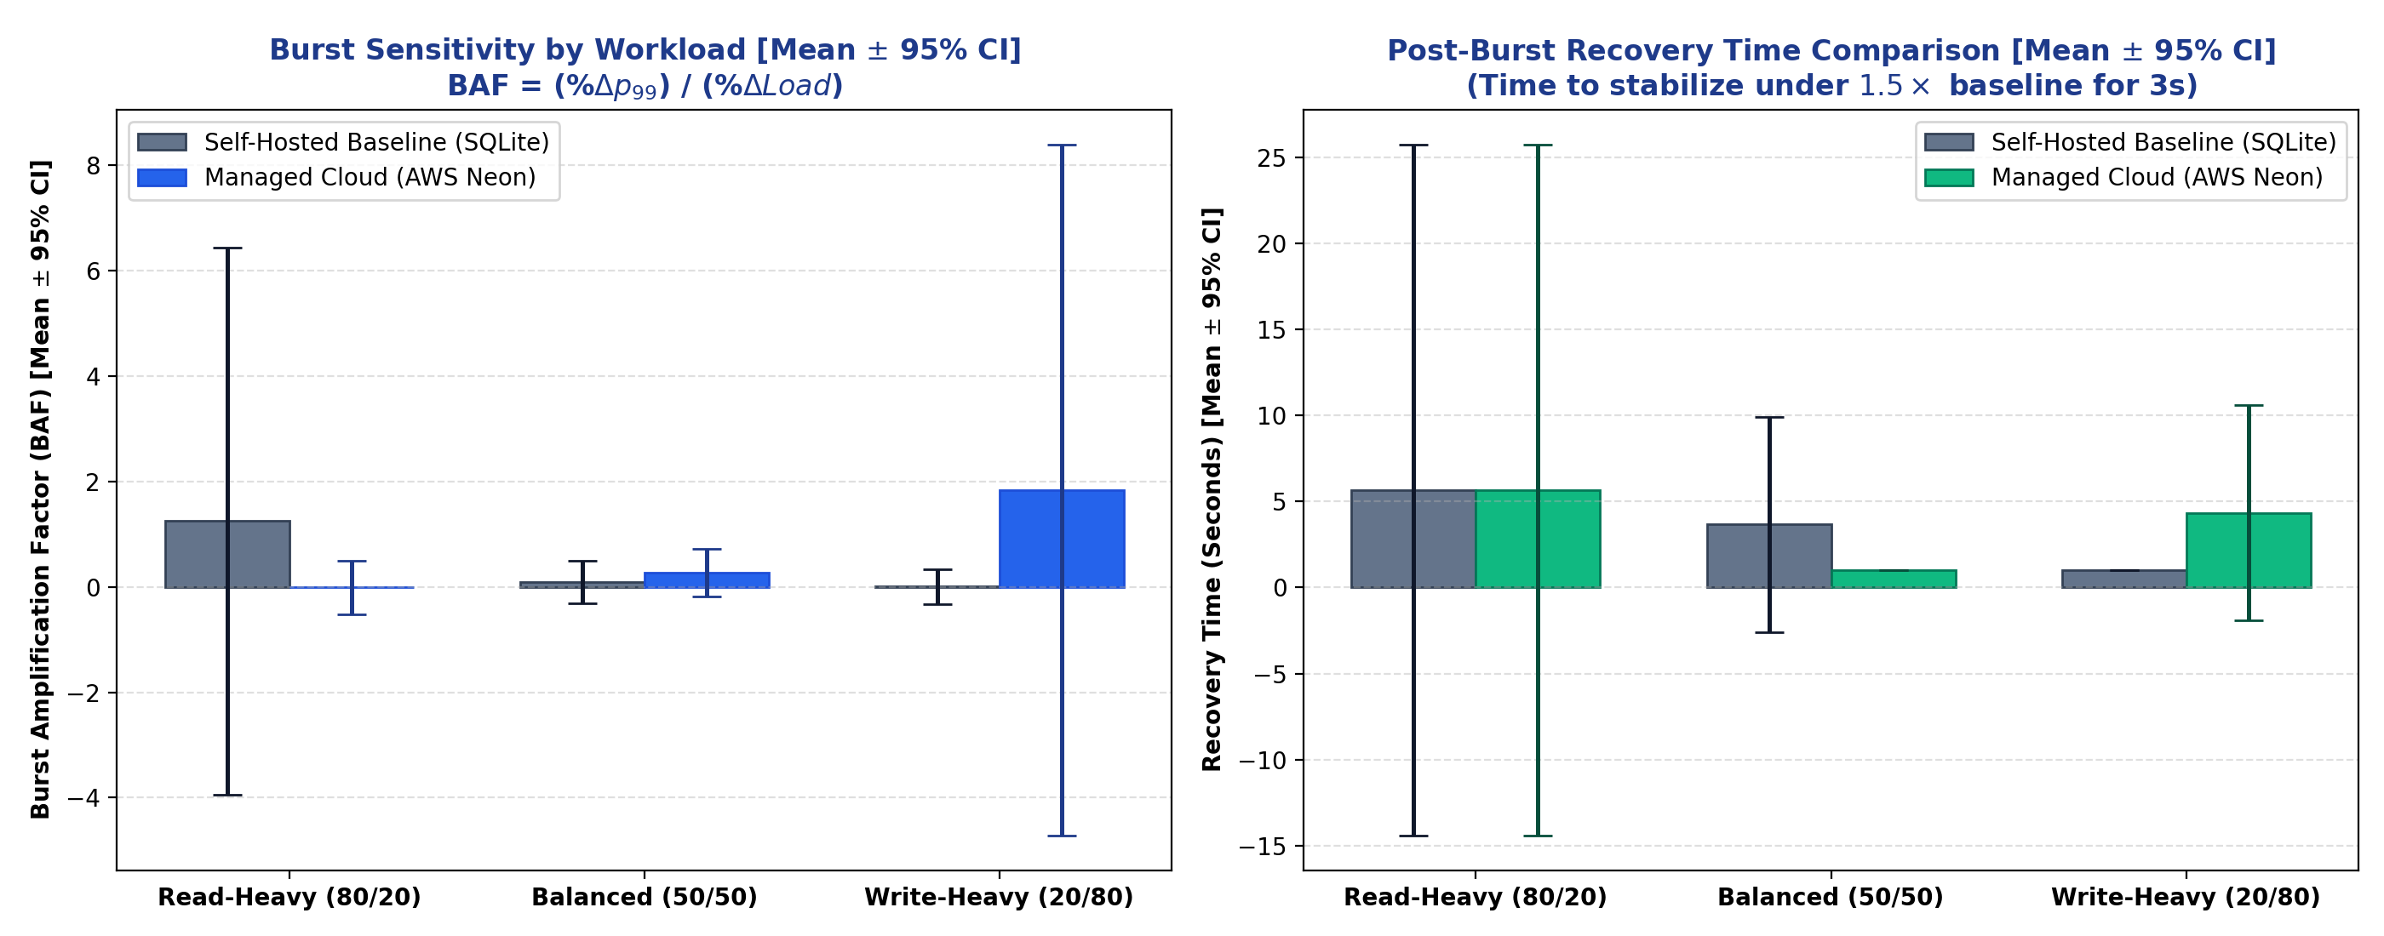
O1 · Tail-Latency Results (N = 3, 95% CI)
All three workload profiles · Multi-run statistical evidence
4.77 ms
22.90 ms
1,226 ms
4,328 ms
Self-Hosted baseline
p99, Read-Heavy
Self-Hosted burst peak
p99, Read-Heavy (95% CI ±75)
Managed burst peak
p99, Balanced workload
Managed burst peak
p99, Write-Heavy (BAF 1.84)
Left: Managed PostgreSQL baseline vs. burst p99 with 95% CI error bars
Right: Workload sensitivity across all profiles and both platforms
4 / 7

Slide 5
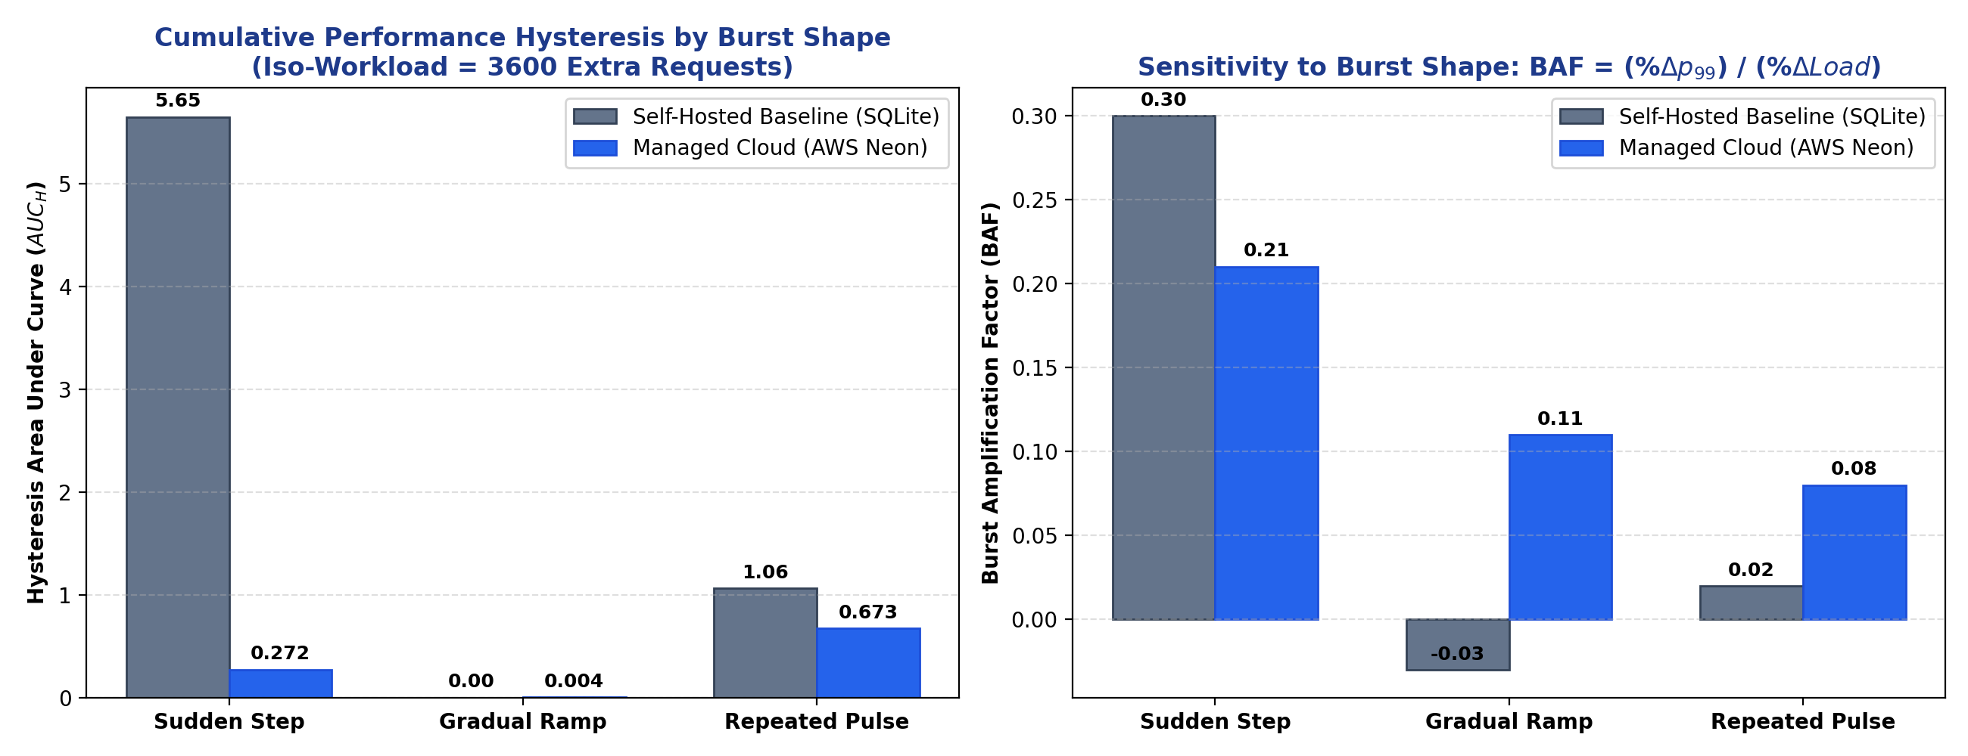
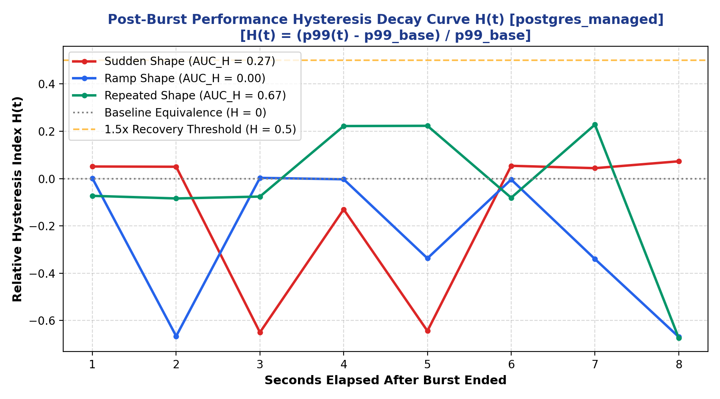
O2 · Burst Shape and Hysteresis (Iso-Workload)
Same 3,600 extra transactions — three arrival geometries
Platform
Burst Shape
BAF
Recovery (s)
AUC-H (hysteresis)
Self-Hosted
Sudden Step
+0.30
8 s
5.652 ← lock contention
Self-Hosted
Gradual Ramp
−0.03
1 s
0.000 ← zero hangover
Self-Hosted
Repeated Pulse
+0.02
1 s
1.062 ← lingering elevation
AWS Neon
Sudden Step
+0.21
1 s
0.272 ← moderate
AWS Neon
Gradual Ramp
+0.11
1 s
0.004 ← near-zero
AWS Neon
Repeated Pulse
+0.08
1 s
0.673 ← 168× higher than ramp
Key finding: On Neon Managed, repeated pulses generate 168× more hysteresis than a gradual ramp (AUC-H 0.673 vs 0.004) — same transaction count, very different recovery cost.
Hysteresis footprint (AUC-H) and BAF across burst shapes
Post-burst latency decay over time — Managed PostgreSQL
5 / 7

Slide 6
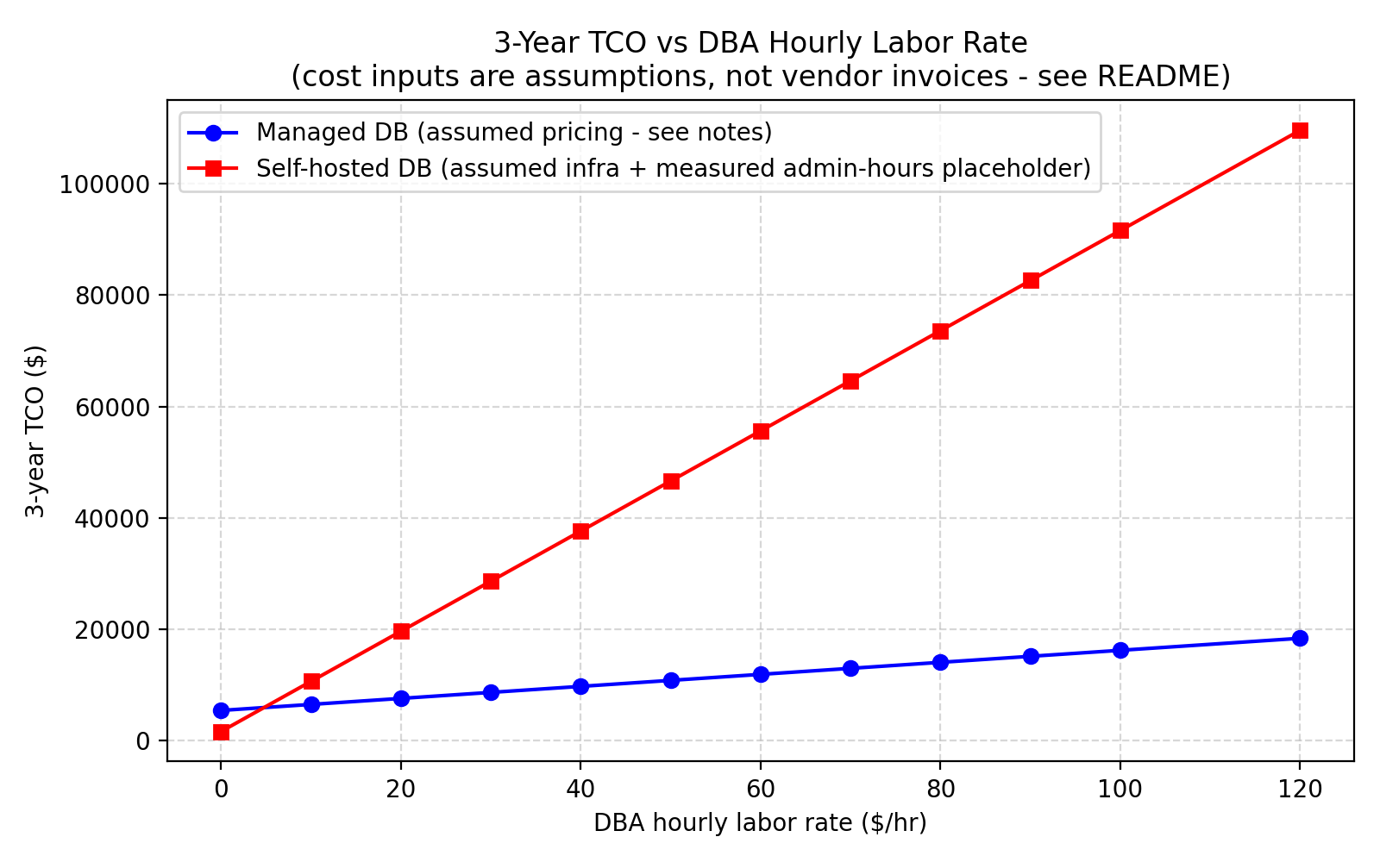
O3 + O4 · Admin Effort and TCO
Logged minutes · 3-year cost model · Labour crossover
O3 · Administrative Effort Log
O4 · 3-Year TCO Sensitivity
Task
Self-Hosted
Managed
Schema design + seed
12 min
–
Docker cgroup tuning
14 min
–
pg_dump backup script + cron
30 min
–
Disaster-recovery crash drill
42 min
–
Provisioning + endpoint (Neon)
–
4 min
Point-in-time recovery drill
–
3 min
Monthly ongoing maintenance
25 hr/mo
2 hr/mo
Self-Hosted requires 12.5× more monthly engineering time (25 hr vs 2 hr)
Break-even at ~5 USD/hr — above that, managed wins:
25 USD/hr (junior DBA) → Managed saves 19,980 USD
50 USD/hr (median DBA) → Managed saves 35,820 USD
100 USD/hr (senior) → Managed saves 75,420 USD
6 / 7

Slide 7
Live Demonstration
System runs in real time — not a recording
Benchmark
Cgroups & Chaos
ACID Ledger
Stats & TCO
Runs a live single-query probe
against Docker or Neon endpoint.
Latency shown via SSE stream.
Streams live Docker stats:
CPU %, memory, block I/O.
Chaos Drill kills and restarts
container, records MTTR.
Executes real money transfers
between 10,000 seeded accounts.
Displays live balance updates.
Benchmark summary tables
and TCO comparison.
No chart dependencies.
How to run during the viva:
1. Ensure Docker Desktop is running → postgres_self_hosted_testbed container is UP (port 5432)
2. Run: python web_dashboard/server.py → FastAPI starts on http://localhost:8000
3. Open browser → http://localhost:8000 → demonstrate each tab live
7 / 7

