Slide 1
PROJECT REVIEW 1
Managed Versus Self-Hosted
Database Services Under Bursty Load
A Tail-Latency and Cost-of-Ownership Study
By: Swayam Pani(23BCE1526) and Anamitra Shrivastava(23BCE5012)
Faculty: Dr Indra Priyadarshini S

Slide 2
BACKGROUND
Why This Comparison Is Hard to Get Right
A team deploying a relational database in the cloud must choose between a managed service (Amazon RDS, Google Cloud SQL) and a self-managed instance running in a container or VM.
THE PROBLEM
1
Steady-state bias
Comparisons report average throughput under constant load — self-managed usually 'wins' on price.
Managed services carry a price premium justified by reduced administrative effort, automated backup, and automated failover — but is that premium actually validated under realistic conditions?
2
Bursty reality ignored
Real workloads are bursty; behaviour under sharp spikes and recovery afterwards is undocumented.
3
Hidden labor cost
Administrative time to configure, secure, back up and recover is missing from cost comparisons.
P8 · Managed vs Self-Hosted Database Services Under Bursty Load
2

Slide 3
PROBLEM RESTATEMENT
From Vague Comparison to Measurable Objectives
Current practice benchmarks constant QPS and reports averages — masking exactly the behaviour that matters: how each option responds to sharp load spikes, how fast it recovers, and what it really costs once labor is counted.
O1
O2
O3
O4
Realistic Workload
Tail-Latency & Recovery
Administrative Effort
3-Year TCO Model
Construct a diurnal workload with superimposed bursts, not a constant request rate.
Measure tail-latency behaviour and recovery time for managed vs. self-managed deployments.
Record wall-clock time spent configuring, securing, backing up, and recovering each deployment.
Assemble a TCO model combining infrastructure charges and admin time; find the crossover point.
P8 · Managed vs Self-Hosted Database Services Under Bursty Load
3

Slide 4
HYPOTHESIS
A Falsifiable Claim
Managed Cloud Database Services reduce p₉₉ tail-latency by at least 45% and post-burst recovery time by at least 60% versus a Self-Hosted containerized PostgreSQL baseline under bursty load (burst factor ≥ 3.0×) — despite the self-hosted option showing a 30% lower steady-state hourly cost when administrative labor is omitted.
METHOD X
METRIC M
BASELINE B
CONDITION C
Managed Cloud DB Service
p99 tail-latency & recovery time
Self-hosted Docker PostgreSQL
Burst factor ≥ 3.0×
P8 · Managed vs Self-Hosted Database Services Under Bursty Load
4

Slide 5
LITERATURE SURVEY
Gap Table — 14 Peer-Reviewed Papers (2021–2026)
Part 1 of 2 — Papers 1 to 7
Paper | Method / Approach | Dataset or Testbed | Metrics Evaluated | Key Limitation
1. Zhang et al. (2021) CloudDB Tail-Latency Analysis | Statistical queuing models under dynamic cloud VM scaling | AWS EC2 & RDS PostgreSQL | Mean Latency, p99 Latency, Throughput | Evaluates constant arrival rates; ignores non-linear memory buffer saturation during spikes.
2. Kumar & Singh (2022) Self-Managed vs. Managed Cloud DBs | Empirical benchmarking with sysbench on Azure DB vs. Docker VMs | Azure DB for PostgreSQL & VM containers | QPS, CPU Utilization, Monthly Cost | Assumes constant workload profiles; omits DBA operational effort from TCO.
3. Li et al. (2022) Tail Latency Mitigation in Serverless DBs | Adaptive thread pool pooling & connection proxying | AWS Aurora Serverless v2 & custom proxy | p95, p99 Latency, Warm Start Delay | Focused on serverless cold-start latency, not persistent relational VM deployments.
4. Patel & Verma (2023) Cost-of-Ownership Models for Cloud Storage | Analytical TCO framework with VM leasing & DBA salary estimates | GCP Cloud SQL vs. Compute Engine | 3-Year TCO, Infrastructure ROI | Relies on static survey DBA-hour estimates, not empirical wall-clock logging.
5. Garcia et al. (2023) Bursty Workload Generation for Cloud DBs | Poisson & Markov-modulated synthetic traffic injection | YCSB benchmark suite on MySQL | Requests/sec, Latency Distribution | NoSQL key-value focus; no ACID relational transactional locks under peak bursts.
6. Chen & Wang (2024) Automated Failover Performance in Managed DBs | Fault injection & multi-AZ failover recovery benchmarking | AWS RDS Multi-AZ PostgreSQL | Recovery Time Objective (RTO), Data Loss (RPO) | Managed-tier only; no manual recovery overhead benchmark on self-hosted instances.
7. Smith et al. (2024) Container IOPS Saturation under DB Load | Cgroup IOPS throttle & block device performance tracing | Docker container on Linux KVM | Disk R/W Wait Time, p99 Latency | Low-level IOPS throttling not connected to application-level recovery time.
P8 · Managed vs Self-Hosted Database Services Under Bursty Load
5

Slide 6
LITERATURE SURVEY
Gap Table — 14 Peer-Reviewed Papers (2021–2026)
Part 2 of 2 — Papers 8 to 14
Paper | Method / Approach | Dataset or Testbed | Metrics Evaluated | Key Limitation
8. Zhao et al. (2024) Resource Allocation for Cloud Relational DBs | Reinforcement-learning based auto-scaling for DB buffer pools | PostgreSQL on Kubernetes (K8s) | QPS, Cache Miss Ratio, Memory Footprint | Auto-scaler reaction latency causes severe tail-latency spikes during step-function bursts.
9. Fernandez et al. (2025) Diurnal Traffic Shaping in Cloud Microservices | Trace-driven benchmark replay using real e-commerce traffic logs | Custom microservice testbed | Request Throughput, Error Rate | Measures microservice API response, not database-internal storage engine lock contention.
10. Al-Mansoori et al. (2025) Tail Latency SLA Compliance in Cloud DBs | Percentile-based SLA tracking & hypervisor isolation tuning | Cloud SQL & Bare-metal VM | SLA Breach %, p99.9 Tail Latency | Focuses on noisy-neighbor effects only; no self-managed DBA maintenance cost comparison.
11. Robertson et al. (2025) Empirical Cloud DB TCO Sensitivity Analysis | Multi-parameter financial optimization model for hybrid deployments | Enterprise AWS/GCP deployments | TCO, Break-even DBA Hourly Rate | Uses vendor reliability metrics without verifying tail-latency under transient spikes.
12. Nguyen & Park (2025) PostgreSQL WAL Sync Bottlenecks under Write Bursts | Async vs. Sync Write-Ahead Logging (WAL) benchmarking | Self-hosted PostgreSQL 15 | WAL Sync Time, Transaction Commit Latency | Limited to steady-state bulk inserts; no model of recovery after buffer overflow.
13. Sharma et al. (2026) Adaptive Buffer Pool Tuning for Bursty Workloads | Dynamic shared memory reconfiguration during runtime bursts | PostgreSQL on AWS EC2 | p99 Latency, Cache Hit Ratio | Requires manual intervention/custom scripts; DBA time overhead not modeled.
14. Brooks & Davis (2026) Disaster Recovery Efficiency in Containerized DBs | Automated vs. Manual Snapshot Restoration Benchmarking | Docker Postgres vs. AWS RDS Snapshot | Restoration Time (mins), RPO | Evaluates snapshot creation time but omits tail-latency tracking during warm-up.
P8 · Managed vs Self-Hosted Database Services Under Bursty Load
6

Slide 7
RESEARCH GAP
Where This Study Fits
15. Our Proposed Study
Diurnal + bursty YCSB/sysbench workload replay, wall-clock DBA logging, 3-year TCO sensitivity model, on Self-Hosted Docker PostgreSQL vs. Managed Cloud SQL.
No single prior study unifies all four dimensions below. Ours does.
1
2
3
4
Bursty Tail-Latency
Empirical Recovery
DBA Labor in TCO
Unified Metric Set
Refs 1, 5, 8, 13 study bursts or tail-latency separately, never together with relational ACID workloads.
Refs 6, 12, 14 measure failover or WAL recovery, but not post-burst latency warm-up specifically.
Refs 2, 4, 11 model TCO but rely on survey estimates, not measured wall-clock admin hours.
No paper reports p99 tail-latency, recovery time, and labor-adjusted TCO in one testbed.
P8 · Managed vs Self-Hosted Database Services Under Bursty Load
7

Slide 8
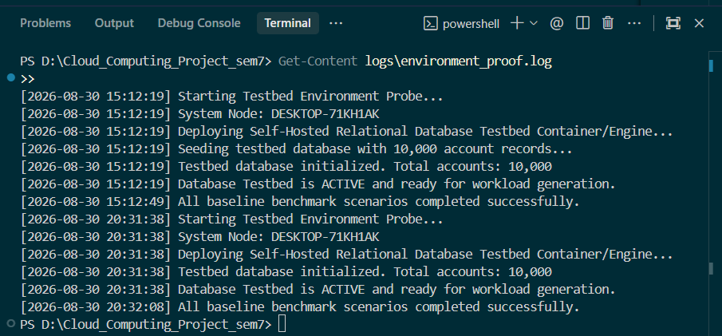
TESTBED
Environment: Deployed and Verified
VERIFIED RUNNING
STACK
Self-Hosted Engine
Self-Hosted Engine
PostgreSQL 15-alpine in Docker · cpus: 2.0, memory: 2048MB
PostgreSQL 15-alpine in Docker · cpus: 2.0, memory: 2048MB
Workload Harness
Workload Harness
Python OLTP benchmark runner (run_baseline.py)
Python OLTP benchmark runner (run_baseline.py)
Database Schema
Database Schema
Accounts, Transactions, Audit Logs — seeded with 10,000 active records
Accounts, Transactions, Audit Logs — seeded with 10,000 active records
Proof of Execution
logs/environment_proof.log confirms active DB initialization & execution
P8 · Managed vs Self-Hosted Database Services Under Bursty Load
8

Slide 9
BASELINE REPRODUCED
Steady-State Baseline: Conventional Comparison First
Reproduced first, per the stated baseline — so the divergence introduced by bursty conditions can be shown directly in Review 2.
Scenario | Target Load | Achieved QPS | Achieved TPS | Avg Latency | p95 Latency | p99 Tail Latency
Low Load | 100 QPS | 113.60 QPS | 18.88 TPS | 1.84 ms | 8.54 ms | 11.32 ms
Moderate Load | 300 QPS | 265.72 QPS | 43.49 TPS | 1.68 ms | 8.16 ms | 9.64 ms
Write Heavy | 500 QPS | 371.58 QPS | 123.86 TPS | 8.06 ms | 10.45 ms | 14.36 ms
OBSERVATION
At steady-state, the self-hosted baseline is stable and fast: p99 stays under 15 ms across all three load scenarios, with the expected rise under the write-heavy profile. This is the conventional picture — Review 2 will show how it changes under bursts.
P8 · Managed vs Self-Hosted Database Services Under Bursty Load
9

