Slide 1

SMART INDIA HACKATHON 2026
IDEA SUBMISSION
Problem Statement ID – 26189
Problem Statement Title – AI-Powered Criminal Network Analysis System
Theme – Blockchain & Cybersecurity
PS Category – Software
Team ID – <Team ID>
Team Name – Team Innovexa
DRISTI
Evidence-Centric Criminal Network Intelligence System
दृष्टि · “sight, perception”
One case graph. Many analytical lenses. Every finding evidenced.

Slide 2
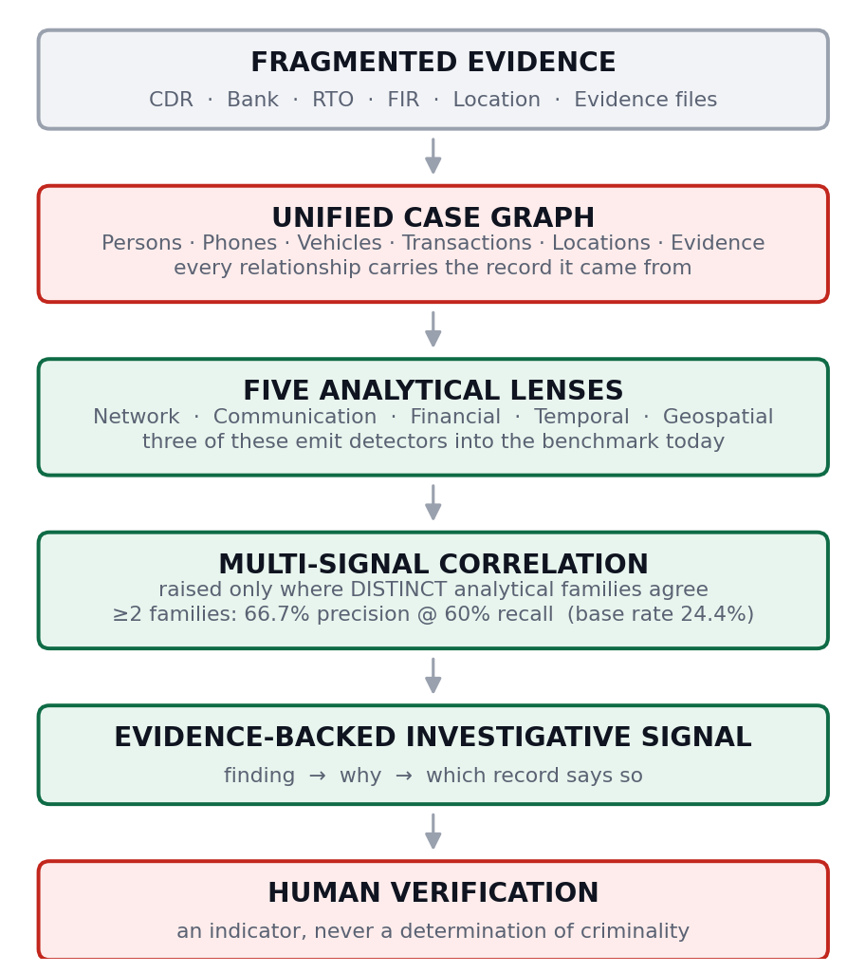
IDEA AND PROPOSED SOLUTION
Team Innovexa
THE PROBLEM
PROPOSED SOLUTION
CORE INNOVATION
▸ Investigation data is fragmented across CDR, banking, RTO, FIRs, locations and evidence files.
▸ Relationships between people, phones, vehicles, transactions and places are hard to establish across systems that do not talk to each other.
▸ Officers spend days cross-referencing records and reconstructing timelines by hand.
▸ A detected relationship is only useful if it can be traced back to the record that evidences it.
▸ Any single analytical signal, on its own, produces more noise than leads.
DRISTI builds one case-level investigation graph that unifies heterogeneous evidence and lets multiple analytical lenses examine the same network.
01 PROVENANCE-AWARE EVIDENCE GRAPH
Evidence is part of the data model, not a reporting feature. Every relationship and every finding can be walked back to the source record that produced it.
02 MULTI-SIGNAL CORRELATION ACROSS ANALYTICAL FAMILIES
Signals from distinct analytical families are correlated to strengthen investigative leads; single-detector outputs remain leads rather than corroborated findings. Model output is never counted as a corroborating family.
THE GAP IS NOT DISCOVERY
An investigator often already suspects the connection. What takes weeks is assembling it from disconnected systems — and then showing, for each link, which record it came from. A tool that surfaces names without that trail adds work instead of removing it.
03 GROUND-TRUTH EVALUATION FRAMEWORK
A labelled synthetic investigation with known relationships and planted patterns, so the system can be measured rather than demonstrated — including where it fails.
Recorded fact ≠ derived inference ≠ model prediction
DRISTI stores which kind of claim it is making.

Slide 3
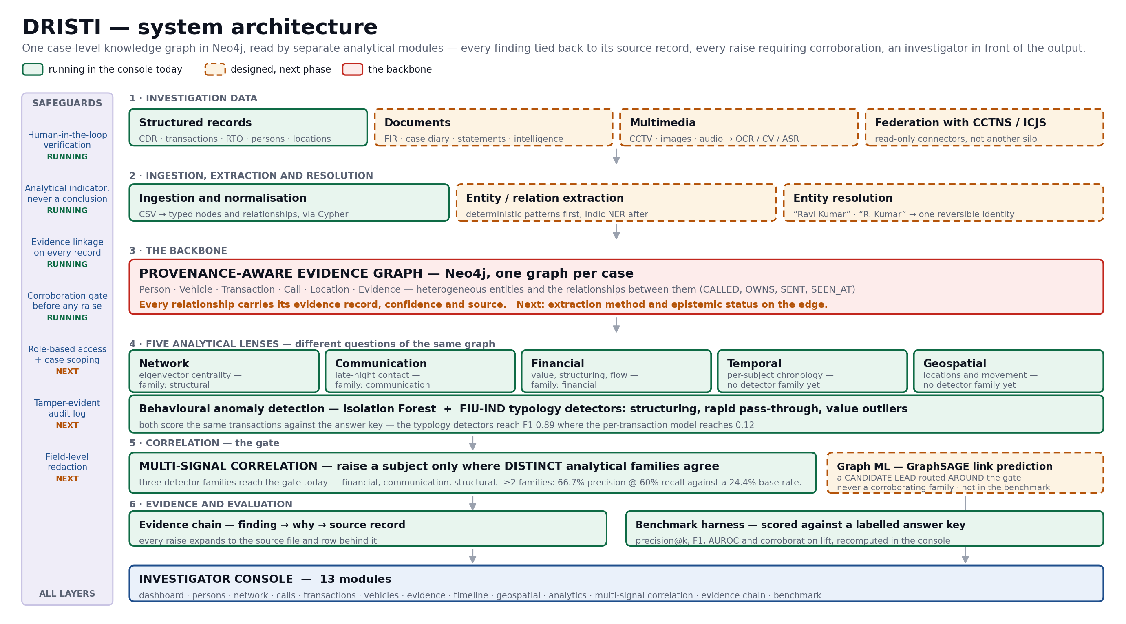
TECHNICAL APPROACH
Team Innovexa
TECHNOLOGY STACK
● Data and backend
Python · pandas · Neo4j · Cypher · Streamlit
● Graph analytics
NetworkX · Neo4j GDS · Plotly
● Machine learning
scikit-learn · Isolation Forest
● Financial intelligence
FIU-IND typology detectors — structuring, rapid pass-through, value outliers
● Evaluation
labelled synthetic corpus · benchmark harness in the console
○ NLP and entity resolution
IndicNER · MuRIL · phonetic blocking
○ Graph ML
GraphSAGE link prediction — candidate leads only
○ Security
RBAC · case scoping · tamper-evident audit log
● running today ○ next phase
No GPU and no outbound network call — deployable inside an existing police network.
Green blocks run in the console today and can be opened on request; amber dashed blocks are designed and scheduled. Five analytical lenses exist in the console; three of them — financial, communication, structural — emit the detector families that feed the correlation gate measured here. Graph ML sits on its own branch by design: a link prediction is a candidate lead, never a corroborating family, and it does not enter the benchmark.

Slide 4
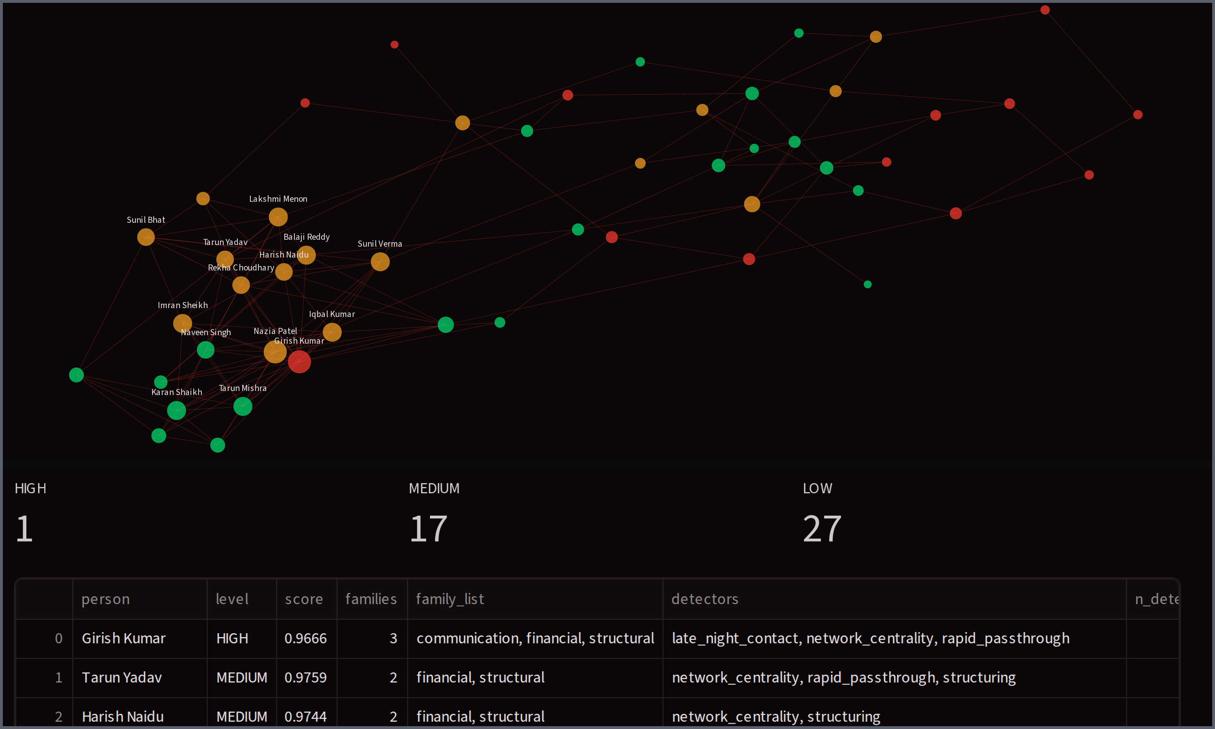
FEASIBILITY AND VIABILITY
Team Innovexa
A WORKING PROTOTYPE, NOT A CONCEPT
Live Neo4j case graph · 13 modules · 82 subjects · 2,522 calls · 254 transactions · 2,811 evidence records
CHALLENGES AND MITIGATION
Challenge | How DRISTI addresses it
Fragmented identities | Conservative entity resolution — merge only on a shared identifier or a corroborating attribute, and every merge reversible by the officer.
False positives from any one analytic | Correlation across distinct analytical families. On our labelled corpus, ≥2 families gives 66.7% precision at 60% recall against a 24.4% base rate.
A score mistaken for a finding of guilt | Indicators labelled as indicators on every screen, a human-verification step in front of every output, predictions stored apart from recorded facts.
Sensitive CDR, FIR and financial data | Role-based access with case-level scoping, field-level redaction and a tamper-evident audit log — access bound to assignment, every read accountable.
Messy, unstructured source documents | Staged extraction: deterministic patterns for numbers and registration marks, a locality gazetteer for places, an Indic NER model for names last.
Standardized benchmarks are limited across the literature reviewed | We built a labelled corpus and harness of our own. It gives controlled prototype evidence, not a prediction of field performance; next step is the same harness on real annotated records with NCRB.
Graph growth across a large case | Indexed Cypher queries and modular analytics — each lens reads the graph independently, so the console scales by module, not by rewrite.
Network Graph and Multi-Signal Correlation, live. HIGH 1 · MEDIUM 17 · LOW 27. HIGH requires all three currently implemented detector families to agree; the thresholds are fixed, not tuned to the answer key.
CURRENTLY DEMONSTRATED
Neo4j case graph · network visualisation · entity traversal · call, transaction, timeline and geospatial analytics · Evidence Desk · anomaly detection · typology detectors · multi-signal correlation · evidence chain · benchmark evaluation.
Feasible on open-source components, ordinary hardware and a modular architecture — no GPU, no cloud dependency, no outbound traffic from a police network.

Slide 5
IMPACT AND BENEFITS
Team Innovexa
FOR THE INVESTIGATING OFFICER
ANOMALY ≠ CRIMINALITY
AI assists the investigator. It does not replace investigative judgement.
▸ One unified case picture instead of manually cross-referencing disconnected sources — the assembly work that currently takes days collapses into a single load.
▸ Relationship discovery, timeline reconstruction and communication, financial and spatial pattern analysis against the same graph.
▸ Immediate evidence traceability: every subject screen answers “what else is this person connected to?” and “which record says so?” side by side.
MEASURED, NOT ASSERTED
Work in this field is validated almost entirely by case study. We built a labelled synthetic investigation — 82 subjects, 2,522 calls, 254 transactions, 20 syndicate members, planted patterns — and scored our own analytics against the answer key.
Key individuals by network connectivity P@5 1.00 · P@10 1.00 · P@20 1.00
Evidence linkage 100% of records resolve to a source evidence record
Transaction anomaly generic outlier model F1 0.12 / AUROC 0.51 · structuring typology detector F1 0.89
That gap is the finding, not a defect: structuring is built to look ordinary one transaction at a time, so no per-row model can see it. Measuring it is how we knew to add typology detectors rather than a bigger model.
FOR NCRB AND THE INSTITUTION
▸ An evidence-backed analytical workflow — the chain from an insight to the originating record is part of the data model, so every finding is auditable and traceable rather than asserted.
▸ A standardised case-level investigation graph, with auditable access.
▸ Designed to federate with CCTNS and ICJS through read-only connectors rather than becoming another parallel silo.
FOR THE CITIZEN — WHY THE SAFEGUARDS ARE THE FEATURE
A system that names people from inferred patterns can do real harm to someone innocent. DRISTI makes no autonomous criminal conclusions: an indicator is never presented as a determination, a person surfaced by the system can always be traced back to the specific records that surfaced them, and access to a citizen's call and financial records is bound to a case assignment and logged. Proportionality and purpose limitation are design constraints here, not a compliance annexe.
No autonomous criminal conclusions · human verification in front of every output · evidence traceability on every record · case-bound access · auditable use of sensitive data.
MULTI-SIGNAL CORRELATION — LABELLED SYNTHETIC CORPUS
Gate: a subject is raised only on ≥2 distinct analytical families (financial · communication · structural). Thresholds fixed, not tuned to the answer key.
66.7% precision
at 60% recall · base rate 24.4%
Evaluated population 82 persons
Ground-truth positives 20
Flagged at ≥2 families 18
TP 12 · FP 6 · FN 8 · TN 56
Measured on our labelled synthetic investigation corpus. Controlled prototype evidence that the pipeline recovers a known structure and that design choices can be compared under identical conditions — not a prediction of field performance.

Slide 6
RESEARCH AND REFERENCES
Team Innovexa
RESEARCH FOUNDATIONS
Criminal network analysis
Sparrow, M. — “The application of network analysis to criminal intelligence: an assessment of the prospects”, Social Networks 13(3), 1991.
Morselli, C. — “Inside Criminal Networks”, Springer, 2009. Brokerage, and why covert networks are deliberately sparse.
Network analytics
Bonacich, P. — “Power and Centrality: A Family of Measures”, American Journal of Sociology 92(5), 1987.
Blondel, V. et al. — “Fast unfolding of communities in large networks”, J. Stat. Mech., 2008. arxiv.org/abs/0803.0476
Anomaly detection
Liu, F.T., Ting, K.M., Zhou, Z-H. — “Isolation Forest”, IEEE ICDM, 2008.
Graph ML and entity resolution
Hamilton, W., Ying, R., Leskovec, J. — “Inductive Representation Learning on Large Graphs” (GraphSAGE), NeurIPS 2017. arxiv.org/abs/1706.02216
Christen, P. — “Data Matching”, Springer, 2012. Blocking, pairwise scoring and transitive closure.
TECHNOLOGY, DOMAIN AND LEGAL GROUNDING
Systems this federates with
National Crime Records Bureau — CCTNS and the Inter-operable Criminal Justice System (ICJS). ncrb.gov.in
Neo4j Graph Data Science — centrality, community detection and pathfinding at scale. neo4j.com/docs/graph-data-science
Financial intelligence
Financial Intelligence Unit – India — cash transaction reporting thresholds and layering typologies; the basis for the financial indicators. fiuindia.gov.in
Language resources
AI4Bharat — IndicNER and MuRIL, for names in Indic scripts and transliterated forms in FIR text. ai4bharat.org
Legal and privacy framework
Bharatiya Nagarik Suraksha Sanhita, 2023 — production of documents and search; the evidence chain is built to survive this scrutiny.
Digital Personal Data Protection Act, 2023 — purpose limitation and accountability; why access is bound to case assignment and logged.
K.S. Puttaswamy v. Union of India, (2017) 10 SCC 1 — necessity and proportionality; why the system refuses to escalate on a single unverified signal.
OUR CONTRIBUTION
A provenance-aware case graph, a correlation layer across distinct analytical families, and a labelled ground-truth evaluation framework for evidence-centric criminal-network investigation. Across the literature we reviewed, existing evaluations are often case-study based, with limited standardization across datasets and metrics, which makes systems hard to compare directly. We intend to release our corpus and harness, including the negative results they produce — the per-transaction outlier model at F1 0.12 among them.

