Slide 1
Research Agent AI
IBM HACKATHON PROJECT
Presented By:-
Student name : Swayam Sharma
College Name & Department : Parul University, Department of Computer Science

Slide 2
OUTLINE
Problem Statement
Technology used
Wow factor
End users
Result
Conclusion
Git-hub Link
Future scope
IBM Certifications

Slide 3
Problem Statement
Research Agent
Researchers, students, and professionals often struggle to stay updated with the rapidly growing volume of academic publications, technical articles, and datasets. Manually reviewing and synthesizing this data is time-consuming and inefficient.
Proposed Solution: An AI-powered Research Agent that leverages Natural Language Processing (NLP) and Retrieval-Augmented Generation (RAG) to:
- Summarize research papers
- Identify research gaps
- Generate hypotheses
- Recommend datasets, collaborators, and more

Slide 4
Technology used
• IBM Watsonx.ai Studio – for building the agent
• IBM Granite Foundation Model – core reasoning and generation model
• Retrieval-Augmented Generation (RAG) – for grounded document-based responses
• Natural Language Processing (NLP) – to understand academic queries
• IBM Cloud Object Storage (Lite) – for storing research papers
• Watsonx Agent Builder – no-code interface for agent creation

Slide 5
IBM cloud services used
- IBM Watsonx.ai Studio
- IBM Watsonx Runtime
- IBM Cloud Object Storage (Lite)
- IBM Granite Model (13B)
- Watsonx Agent Builder (No-code)

Slide 6
Wow factors
Automates literature reviews and research drafting
Semantic search across uploaded papers and documents
Auto-summarization of technical content
Identifies research gaps and trends
Collaboration mapping for co-author suggestions
Citation influence tracking

Slide 7
End users
Academic Researchers
Research Institutions and Universities
Industry R&D Labs
Educators and Ph.D. Guides

Slide 8
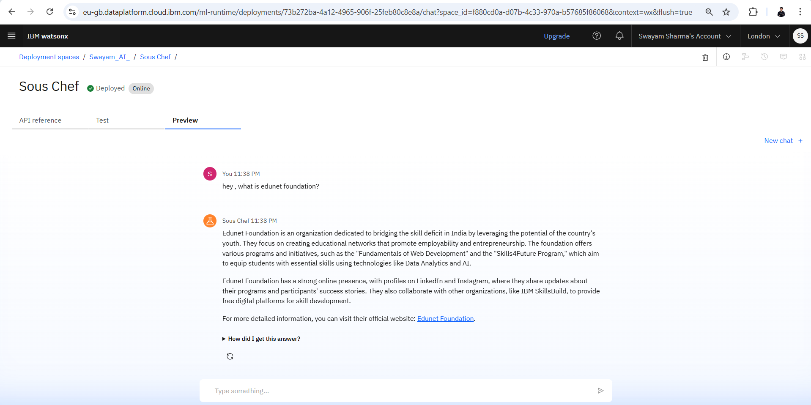
Results

Slide 9
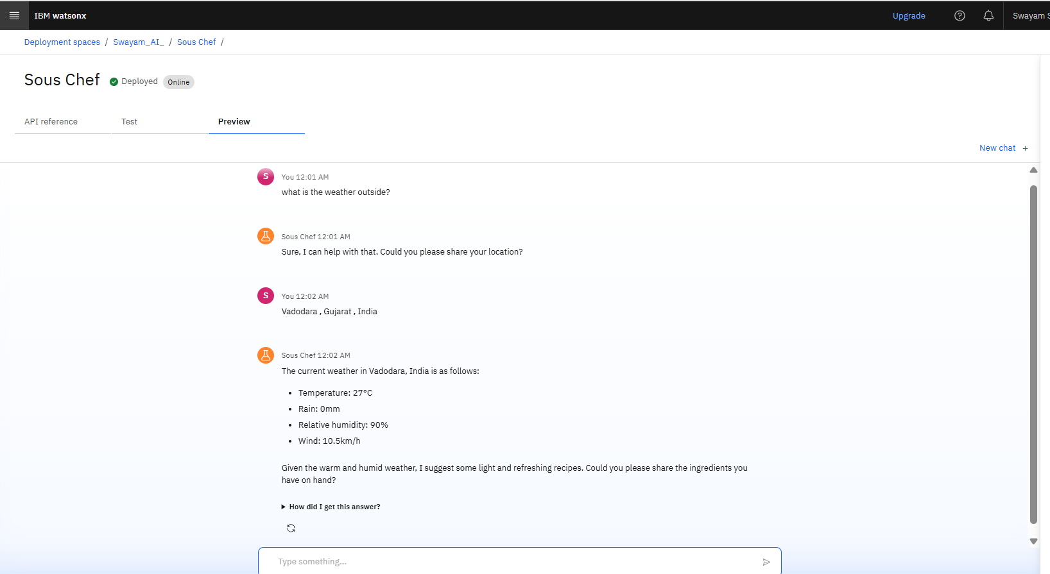
Results

Slide 10
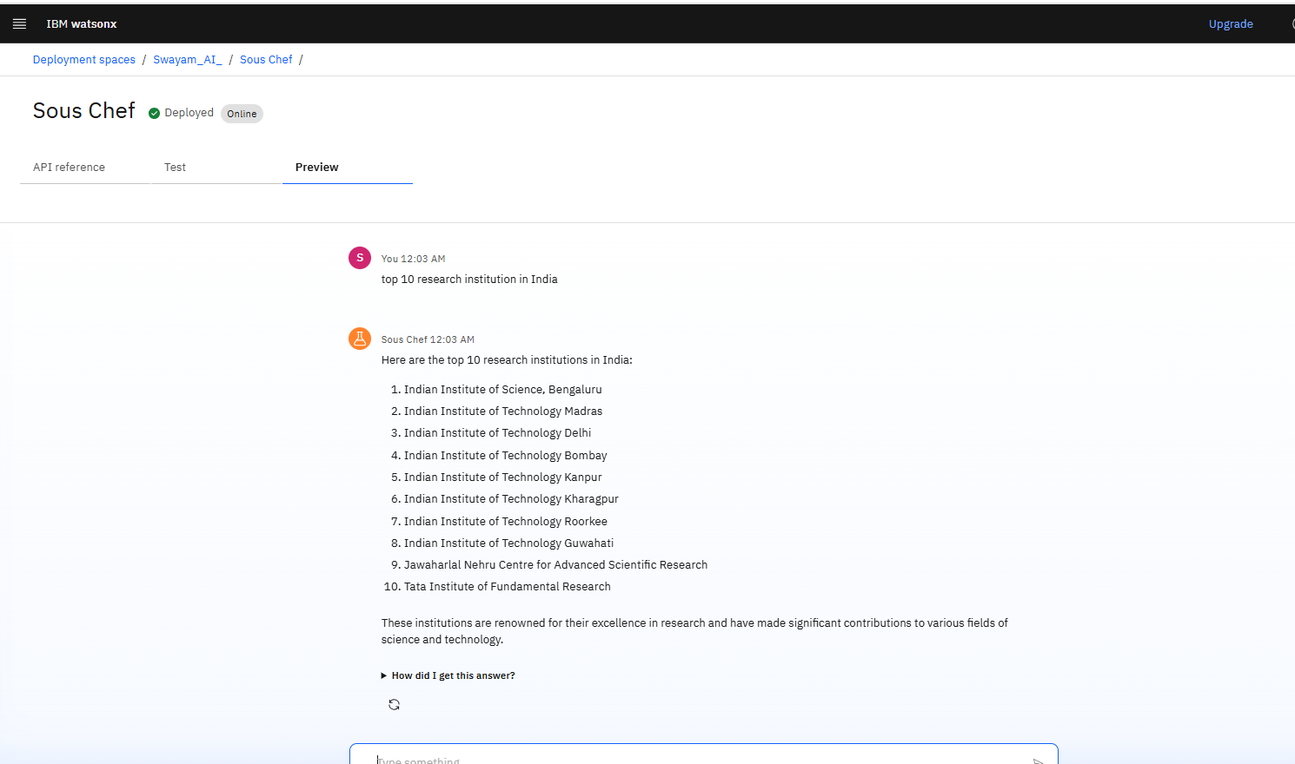
Results

Slide 11
Conclusion
The Research Agent AI assists with literature review, drafting, citation management, and hypothesis generation. It improves research quality, saves time, and fosters interdisciplinary work. The agent enhances both academic and industrial research workflows using AI.

Slide 12
GitHub Link
GitHub Link: https://github.com/swayam1604/research-agent-ai_ibm

Slide 13
Future scope
Multilingual support for regional researchers
Voice-activated research interaction
Real-time collaboration dashboard
Automatic BibTeX citation exports
Research topic suggestion & gap detection
AI-assisted full paper drafting

Slide 14
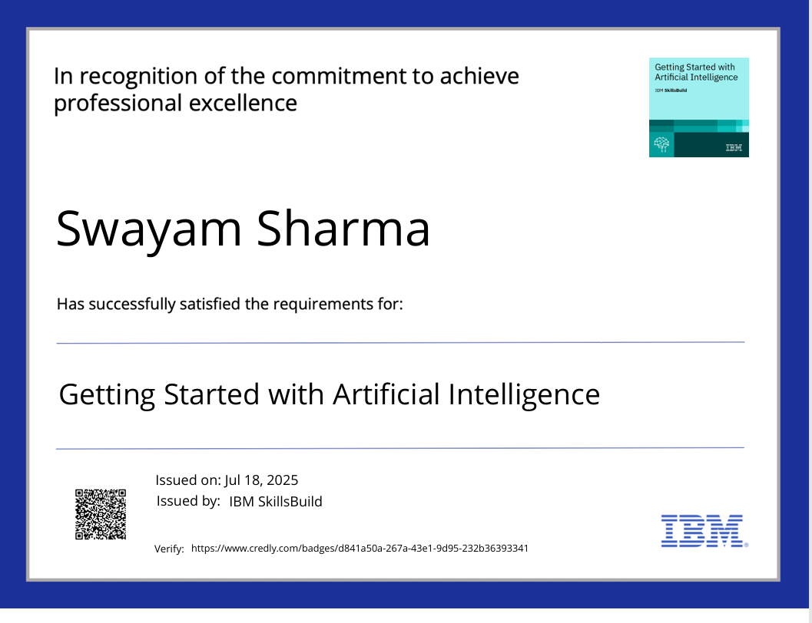
IBM Certifications

Slide 15
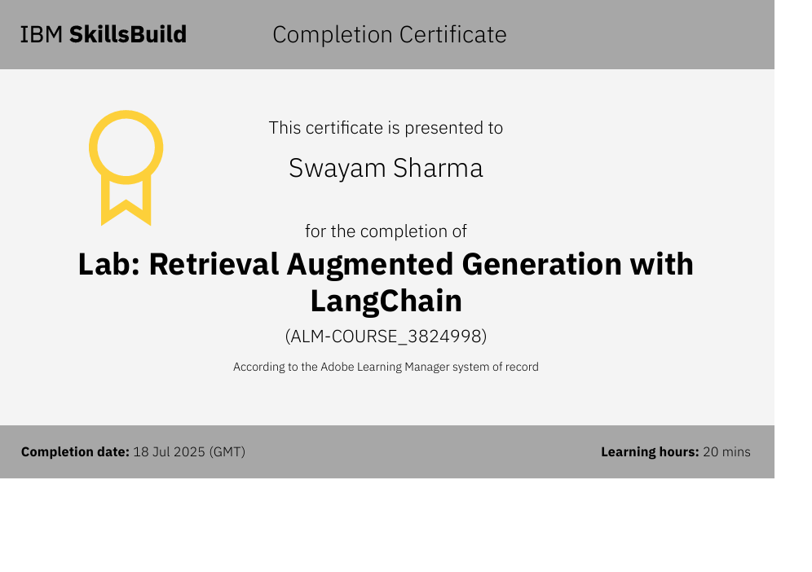

Slide 16
THANK YOU

