Slide 1
COMMON BROAD PHASE
One common broad-phase contract
Can we share candidate generation
while preserving each method’s contact requirements?
Research proposal · conservative candidate generation
Plan: compare the shared interface with each method’s native pipeline.
Swayam Singal · Kyoto research discussion · 2 November 2026
01
Notes:
Grounded in Dr. Kikuchi’s October 13 and October 23 correspondence. Her stated scope is shared surrounding collision infrastructure, not unifying solvers. Email: https://mail.google.com/mail/u/?authuser=swayam.singal%40gmail.com#all/1a13485674974687

Slide 2
COMMON BROAD PHASE
The boundary we want to share
CALLER / METHOD
COMMON BROAD PHASE
Prepare conservative bounds
Choose the interval and margin
Define valid primitive-pair types
Read one bounds format
Find overlapping bounds
Return stable primitive-ID pairs
Narrow phase, contact model and solver stay with the method.
Swayam Singal · Kyoto research discussion · 2 November 2026
02
Notes:
Source: Kikuchi email October 13, 2026. This is the proposed abstraction boundary; no real IPC/OGC/PBD adapter is implemented.

Slide 3
COMMON BROAD PHASE
One primitive-bound record
INPUT
OUTPUT
PrimitiveBounds
id stable primitive identity
kind vertex, edge or face
min three lower coordinates
max three upper coordinates
CandidatePair
(idA, idB)
One ordered,
deduplicated pair list
Bounds carry the caller’s query semantics; the search does not infer them.
Swayam Singal · Kyoto research discussion · 2 November 2026
03
Notes:
Proposed format implemented in apps/common_bounds_demo.cpp. The demonstration uses a point and triangle. The format can represent bounds for edges, but no edge-edge distance routine or external solver adapter is claimed. Time interval and margin are request metadata; bounds already incorporate them.

Slide 4

COMMON BROAD PHASE
Correctness: retain every required pair
Required pairs: interactions that the caller must test precisely.
Broad-phase pairs: overlaps of the supplied conservative bounds.
Extra candidates are allowed. Missing a required pair is a failure.
Swayam Singal · Kyoto research discussion · 2 November 2026
04
Notes:
Set inclusion is a contract, conditional on conservative enclosure, matching eligibility filters and correct margin semantics. It is not a universal validation claim based on this small experiment.

Slide 5

COMMON BROAD PHASE
Conservative bounds for a mesh snapshot
Each triangle supplies its padded 3D minimum and maximum.
The sphere bound includes its radius and the same half-margin.
This experiment checks evaluated mesh snapshots.
A continuous query would require a validated swept-motion enclosure.
Swayam Singal · Kyoto research discussion · 2 November 2026
05
Notes:
Per-frame conservative AABB records from actual Blender cloth vertices. C++ query uses the same PrimitiveBounds{id,kind,min,max} format. Each triangle AABB is expanded by half the proximity margin; the sphere bound includes geometric radius plus half the margin. This is discrete snapshot analysis, not continuous collision handling or replacement of Blender’s internal broad phase.

Slide 6
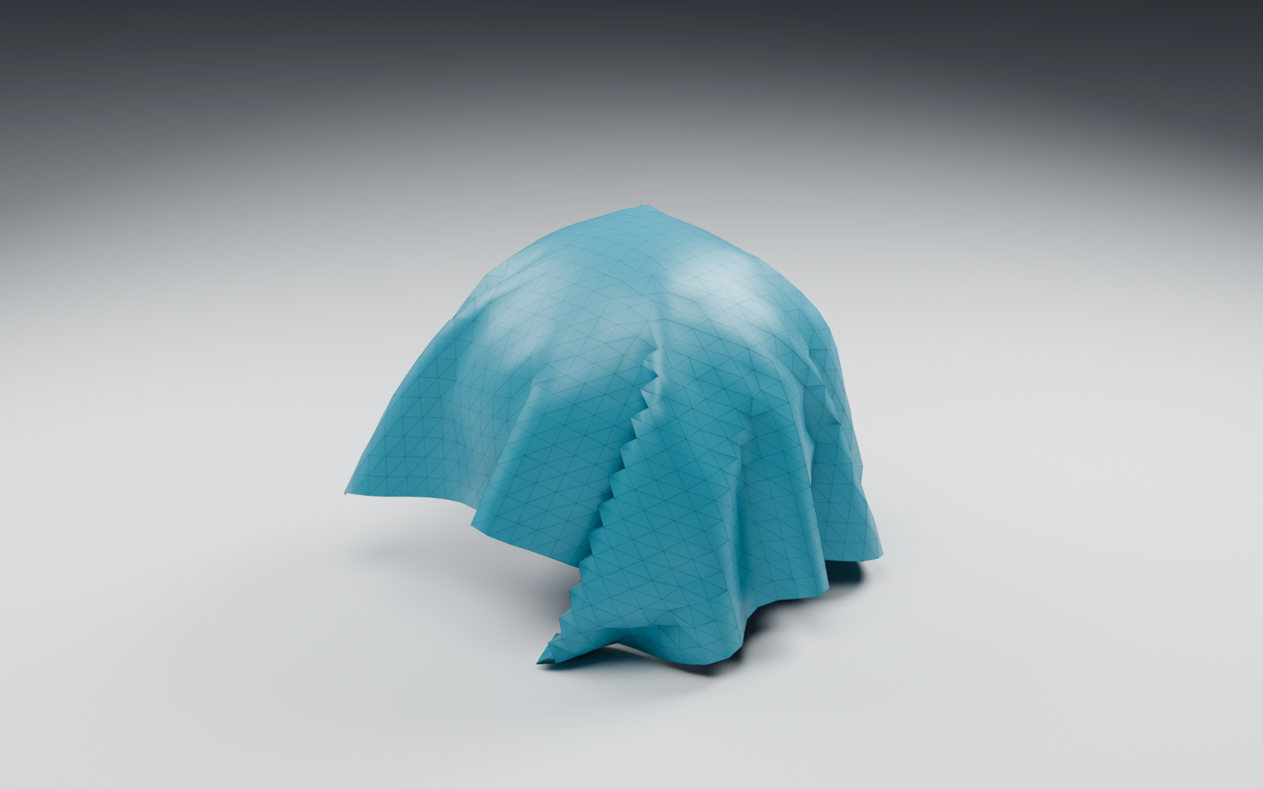
COMMON BROAD PHASE
3D physics evidence: cloth draping over a sphere
Simulated cloth mesh
Fixed spherical obstacle
Gravity and collision response
Native 3D replay
Perspective camera
Lit triangle topology
Swayam Singal · Kyoto research discussion · 2 November 2026
06
Notes:
Rendered from an actual Blender 5.2 cloth simulation, recorded into native shape keys for self-contained playback. Rendering uses Blender Cycles. Stable triangle IDs and vertex positions are exported to C++ mesh_bounds_query. This is not an IPC, OGC, XPBD or CCFR integration. The renderer is genuine 3D; the cloth geometry is physics-generated, not a hand-drawn image or generated illustration.

Slide 7
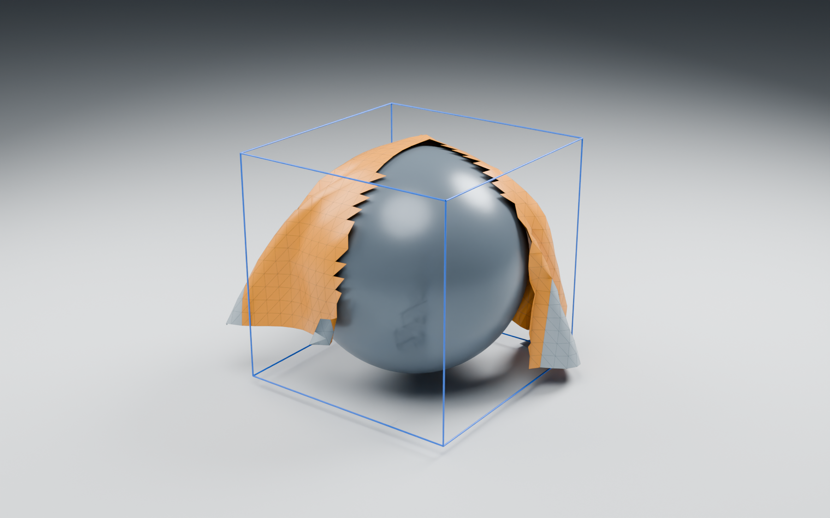
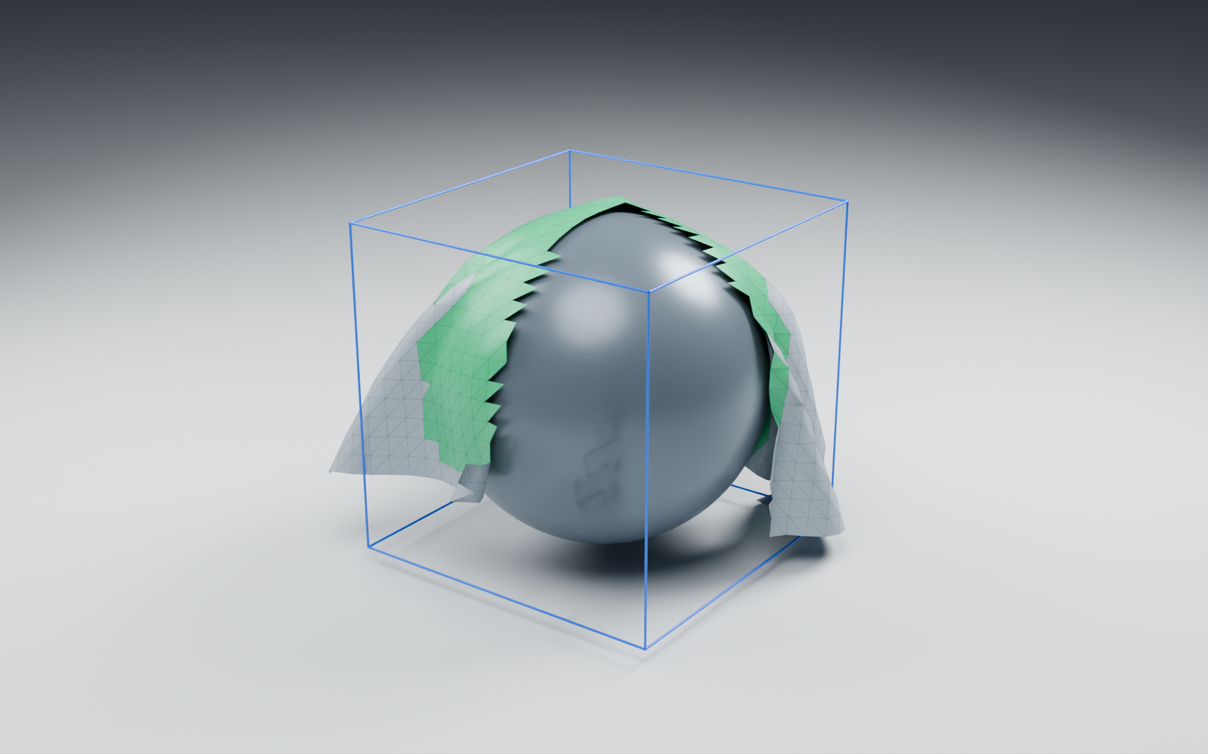
COMMON BROAD PHASE
Shared query results on the simulated mesh
Visualization cutaway · C++ queries use the full simulated mesh
Broad phase: candidate triangles
Narrow phase: within the chosen margin
Amber: AABB overlaps retained by SAP.
Blue: padded sphere query bound.
Green: precise sphere–triangle distance
is within the proximity margin.
Swayam Singal · Kyoto research discussion · 2 November 2026
07
Notes:
Both images use the same actual simulated mesh and perspective camera. A front quadrant is omitted as an explicit visualization cutaway to reveal the sphere; the C++ query is run on the full mesh before visualization clipping. Triangle colors come from candidateTriangleIds and proximityTriangleIds returned by the native C++ executable. The same records and filtering are checked against exhaustive AABB overlap; all within-margin triangles are retained on captured frames. Proximity is center-to-triangle distance minus sphere radius <= margin. No timing speedup or integration claim is made.

Slide 8
COMMON BROAD PHASE
Evaluation measures from the contact literature
PROPOSED EVALUATION · measurements to collect after integration
Runtime
Average / maximum step time;
collision-stage time breakdown
CCFR Table 1, Fig. 10
OGC Table 1
Collision workload
Candidate / contact workload;
number of collision detections
IPC Fig. 23
OGC Fig. 18
Convergence
Iterations and residual vs time,
when solver measures are comparable
IPC Fig. 23
OGC Fig. 17
Collision safety
Remaining violations or intersections
after collision handling
CCFR Fig. 11
OGC §5
Swayam Singal · Kyoto research discussion · 2 November 2026
08
Notes:
These are evaluation quantities used by the cited work, not measurements of this prototype. CCFR: Kikuchi & Kanai, Convex Collision-Free Regions, §4.3 Table1, Figs10–11, https://arxiv.org/html/2607.26901v1 . OGC: Chen et al., Offset Geometric Contact, Table1, §5, §5.3 Fig17, §5.4 Fig18, https://graphics.cs.utah.edu/research/projects/ogc/Offset_Geometric_Contact-SIGGRAPH2025.pdf . IPC: Li et al., Incremental Potential Contact, Fig23 and Table1, https://ipc-sim.github.io/file/IPC-paper-fullRes.pdf . CCFR reports aggregate broad-phase time; splitting build and traversal is a proposed instrumentation extension. OGC checks intersections after every frame. Convergence quantities are method-dependent; do not equate residuals across unlike solvers.

Slide 9
COMMON BROAD PHASE
How existing methods would use the contract
IPC
Adapter supplies bounds covering its required contact / CCD queries.
OGC
Adapter supplies bounds consistent with its offset geometry.
PBD / XPBD
Adapter supplies bounds for its collision and constraint queries.
Proposed adapter roles; these integrations have not been implemented.
Swayam Singal · Kyoto research discussion · 2 November 2026
09
Notes:
Conceptual boundaries from Kikuchi correspondence, not a completed source-code integration audit. IPC: https://ipc-sim.github.io/ ; OGC: https://ankachan.github.io/Projects/OGC/ ; PBD: https://github.com/InteractiveComputerGraphics/PositionBasedDynamics . CCFR is a collision-handling technique defining convex feasible regions and compatible with XPBD, not a fourth independent solver: https://arxiv.org/abs/2607.26901

Slide 10
COMMON BROAD PHASE
Controlled comparison: native vs shared candidates
CHANGE ONE COMPONENT
HOLD THE SIMULATION FIXED
Native candidate generator
versus
shared bounds-based generator
Same geometry and trajectory
Same timestep and contact settings
Same narrow phase and solver
Same hardware and stopping rules
Compare identical simulated duration; report workload size and settings.
A faster broad phase is useful only if collision safety is preserved.
Swayam Singal · Kyoto research discussion · 2 November 2026
10
Notes:
Proposed paired experiment, not completed. Inspired by IPC Table1/Fig23 timestep and workload reporting, OGC Table1 workload/time comparisons, and CCFR Table1 stage breakdown. Integrate and validate one codebase first, then repeat the same comparison independently for another method. Never attribute an end-to-end difference to the broad phase if solver settings differ.

Slide 11
COMMON BROAD PHASE
Measures specific to the shared broad phase
Correctness
Required-pair omissions against an exhaustive oracle
Eligibility, margins and time interval must match.
Cost
Construction / update time, query time, peak candidates
Track total collision-handling time as well.
Sensitivity
Vary primitive count, contact density and motion range
Repeat at the method’s supported timestep and margin.
Swayam Singal · Kyoto research discussion · 2 November 2026
11
Notes:
These are proposed infrastructure diagnostics adapted for this research question. Candidate coverage vs an exhaustive oracle is not presented as a metric reported in IPC/OGC/CCFR. Candidate and stage-cost analysis is motivated by CCFR §4.3 Figs10–11 and OGC §5.4 Fig18. No timing campaign, speedup, solver equivalence or cross-method numerical result has been measured by this prototype.

Slide 12
COMMON BROAD PHASE
The next experiment to agree on
Choose one existing codebase and one example.
Replace only candidate generation with this contract.
Keep its narrow phase, tolerances and solver unchanged.
Compare required-pair coverage, simulation outcomes,
and measured runtime against the original implementation.
Swayam Singal · Kyoto research discussion · 2 November 2026
12
Notes:
Discussion proposal: select the first adapter with Dr. Kikuchi. The current controlled experiment demonstrates the interface and checks a narrow contract; it does not establish cross-solver equivalence or speedups.

