Slide 1
COMMON CONTACT PIPELINE
A reusable broad phase
inside a live C++ physics demo
0.999 ms
mean CPU step
guarded reuse
The first result is narrow but measurable: guarded candidate reuse reduced CPU step time in one deterministic XPBD cloth experiment.
vs 2.351 ms
rebuild each iteration
Exploratory result · Apple M2 Pro · fixed scene and settings · no IPC / OGC adapter
Kyoto research discussion · Swayam Singal · 2 November 2026
Notes:
This is a working research prototype and a bounded measurement, not a universal speedup claim. The comparison uses the same C++ XPBD cloth solver, SAP margin 0.05, displacement budget 0.04, fixed dt 1/120, and paired runs on an Apple M2 Pro. See benchmark slide and output/native/benchmark-summary.txt.

Slide 2
COMMON CONTACT PIPELINE
Can candidate generation be shared safely?
Many simulators repeatedly search for geometrically nearby primitives.
A common service could own conservative bounds, spatial search and stable pair output.
SHARED SERVICE
METHOD OWNER
Bounds · eligibility · candidate pairs · reuse policy
Narrow phase · contact meaning · solver · tolerances
The proposal shares search infrastructure, not contact mathematics.
Kyoto research discussion · 2 Nov 2026
02
Notes:
Research question: can a reusable geometric candidate-generation interface support different simulators without weakening method-specific correctness requirements? IPC, OGC, XPBD and CCFR retain distinct contact semantics and solver assumptions. CCFR is a collision-handling method compatible with XPBD, not an independent XPBD solver. Sources are provided in speaker notes on the method boundary slide.

Slide 3
COMMON CONTACT PIPELINE
The demo keeps the stages visible
1
2
3
4
XPBD cloth state
Shared broad phase
Precise query
Contact response
›
›
›
C++ positions
and velocities
Bounds + guarded
SAP candidates
Sphere–triangle
proximity
XPBD cloth
solver update
Observed in one process: the C++ solver consumes the service’s candidate output.
Discrete sphere–triangle query · no self-collision · no CCD
Kyoto research discussion · 2 Nov 2026
03
Notes:
This is a full same-process demonstration: an XPBD cloth solver calls the generic BroadPhaseService and uses returned candidate pairs for precise sphere-triangle proximity. The service provides stable candidates. This prototype has no continuous collision detection, cloth self-collision, IPC integration or OGC integration. The GUI reports frame, candidate, proximity, CPU step and broad-phase timing.

Slide 4
COMMON CONTACT PIPELINE
A small contract carries the caller’s query meaning
BOUNDS
REQUEST
Primitive identity
3D minimum and maximum
Category and collision mask
Movable / fixed status
Query margin
Displacement budget
Update policy
Selected backend
OUTPUT
A stable, deduplicated list of candidate ID pairs
Precise tests decide contact; the broad phase does not.
Kyoto research discussion · 2 Nov 2026
04
Notes:
Implemented record: Bounds{id,min,max,category,mask,movable}; QueryRequest{margin,displacementBudget,updatePolicy}. The service expands each bound by half the requested margin. Candidate output is an actual pair list, not only a count. Downstream narrow phase decides precise contact. Caller controls geometry and semantics; current demo supports sphere-triangle proximity.

Slide 5
COMMON CONTACT PIPELINE
Reuse is bounded by a displacement envelope
1 BUILD
2 MOVE
3 CHECK
Create padded bounds
and cache SAP pairs.
›
Advance the same
solver and geometry.
›
Reuse only while each
current bound fits its guard.
Otherwise rebuild. Reuse also requires unchanged IDs, masks, request and backend.
Bᵢ(t): padded current bound · Eᵢ: stored envelope · unchanged IDs, masks, request and backend
Kyoto research discussion · 2 Nov 2026
05
Notes:
Certificate: if each current padded bound B_i(t) is contained by its stored envelope E_i, then any pair of current padded bounds that overlap is also a pair of overlapping envelopes. The cached pair list is built from envelope overlaps. Reuse requires unchanged primitive IDs, eligibility masks, query request (including margin/budget/policy) and broad-phase backend. The certificate concerns discrete query bounds at evaluation time; it does not certify the continuous path between steps. In the measured run, margin was 0.05 and displacement budget 0.04.

Slide 6
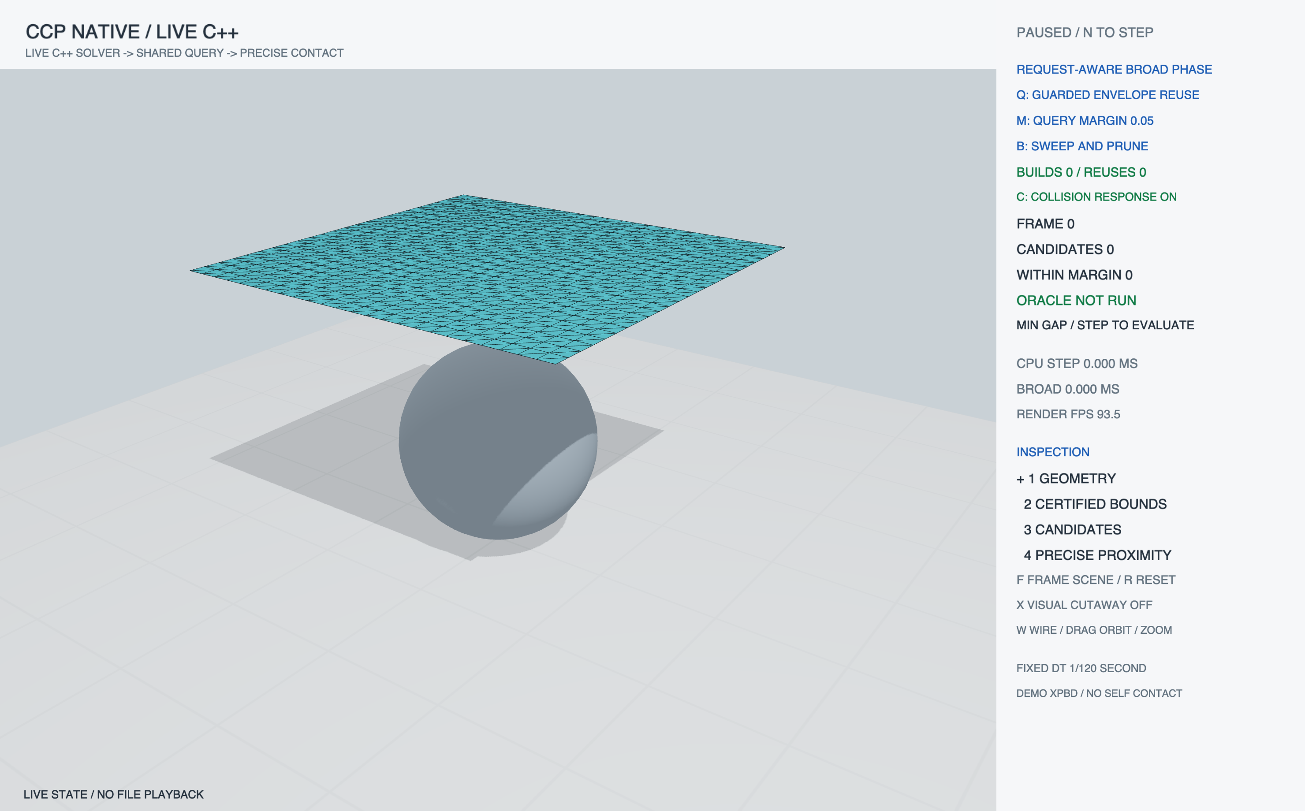
COMMON CONTACT PIPELINE
Native demo: live C++ cloth–sphere scene
Same-process C++ XPBD solver
Live candidate and proximity counts
Pause, step, reset and inspect controls
Initial state · no file playback
Kyoto research discussion · 2 Nov 2026
06
Notes:
Native OpenGL framebuffer capture from output/native/native-initial.png on Apple M2 Pro, OpenGL 4.1 Metal. Frame zero shows the actual cloth mesh and sphere before stepping. This is not a Blender rendering, offline playback, or a scripted animation. Controls shown in the running application: Q guarded reuse, M margin, B broad phase, F frame scene, R reset, X visual cutaway (disabled by default), W wire mode / drag orbit / zoom.

Slide 7
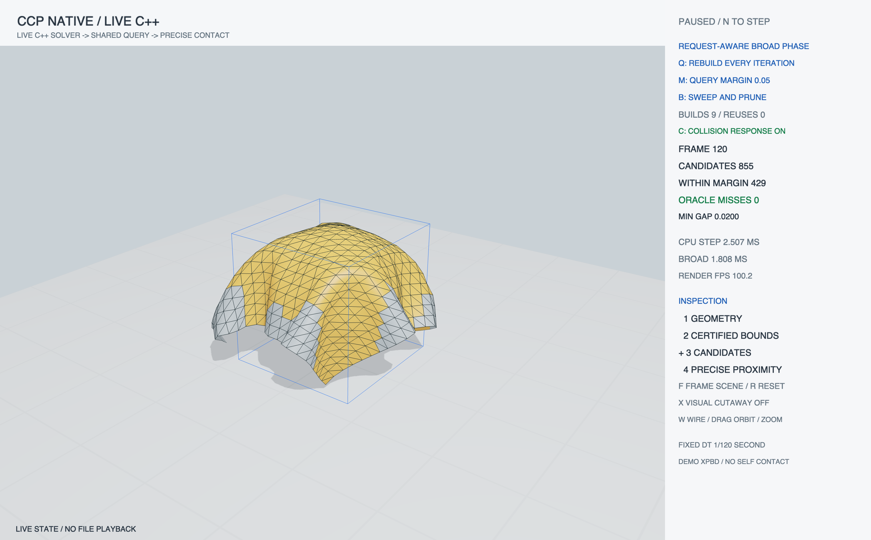
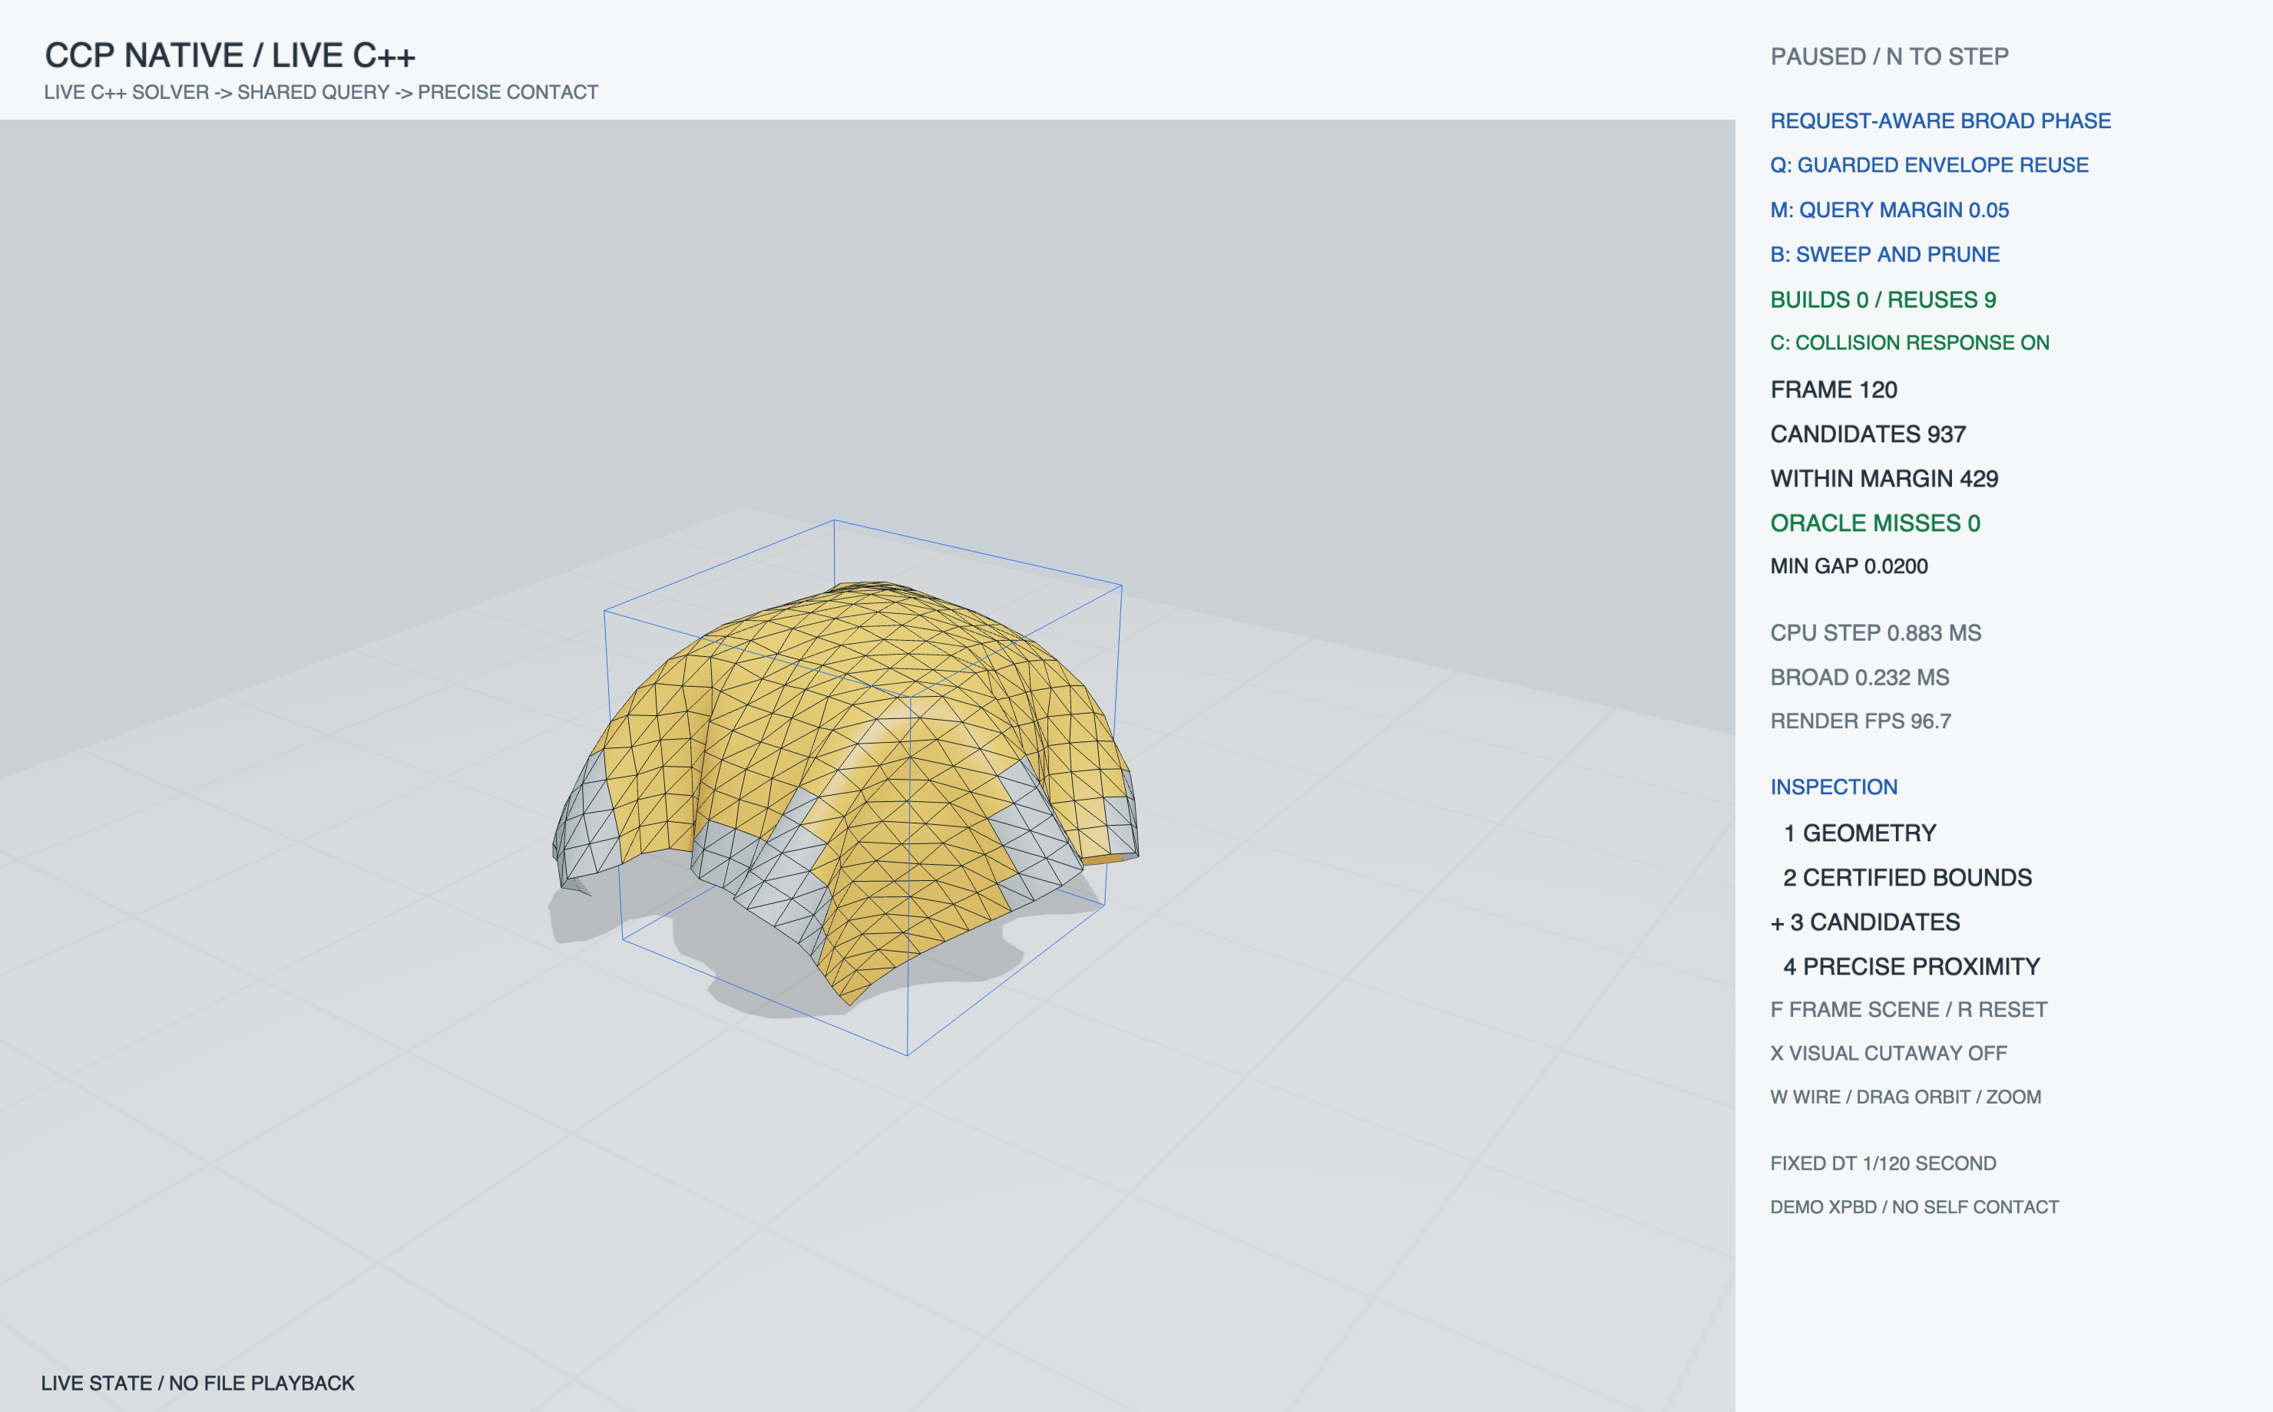
COMMON CONTACT PIPELINE
Two broad-phase policies reach the same captured state
Rebuild every iteration
Guarded envelope reuse
Frame 120 · same solver state hash · candidate set differs, trajectory does not
Kyoto research discussion · 2 Nov 2026
07
Notes:
Both are native OpenGL framebuffer captures at frame 120, with cutaway off. The trace state hashes match exactly for this frame. Baseline log: output/native/baseline-capture.log. Adaptive log: output/native/adaptive-capture.log. The adaptive scene reports 937 candidates and 429 within-margin triangles; baseline reports 855 candidates and the same min gap. These visual candidate counts are at a single capture frame and are not the average timing workload. No oracle omissions were observed in the recorded capture checks.

Slide 8
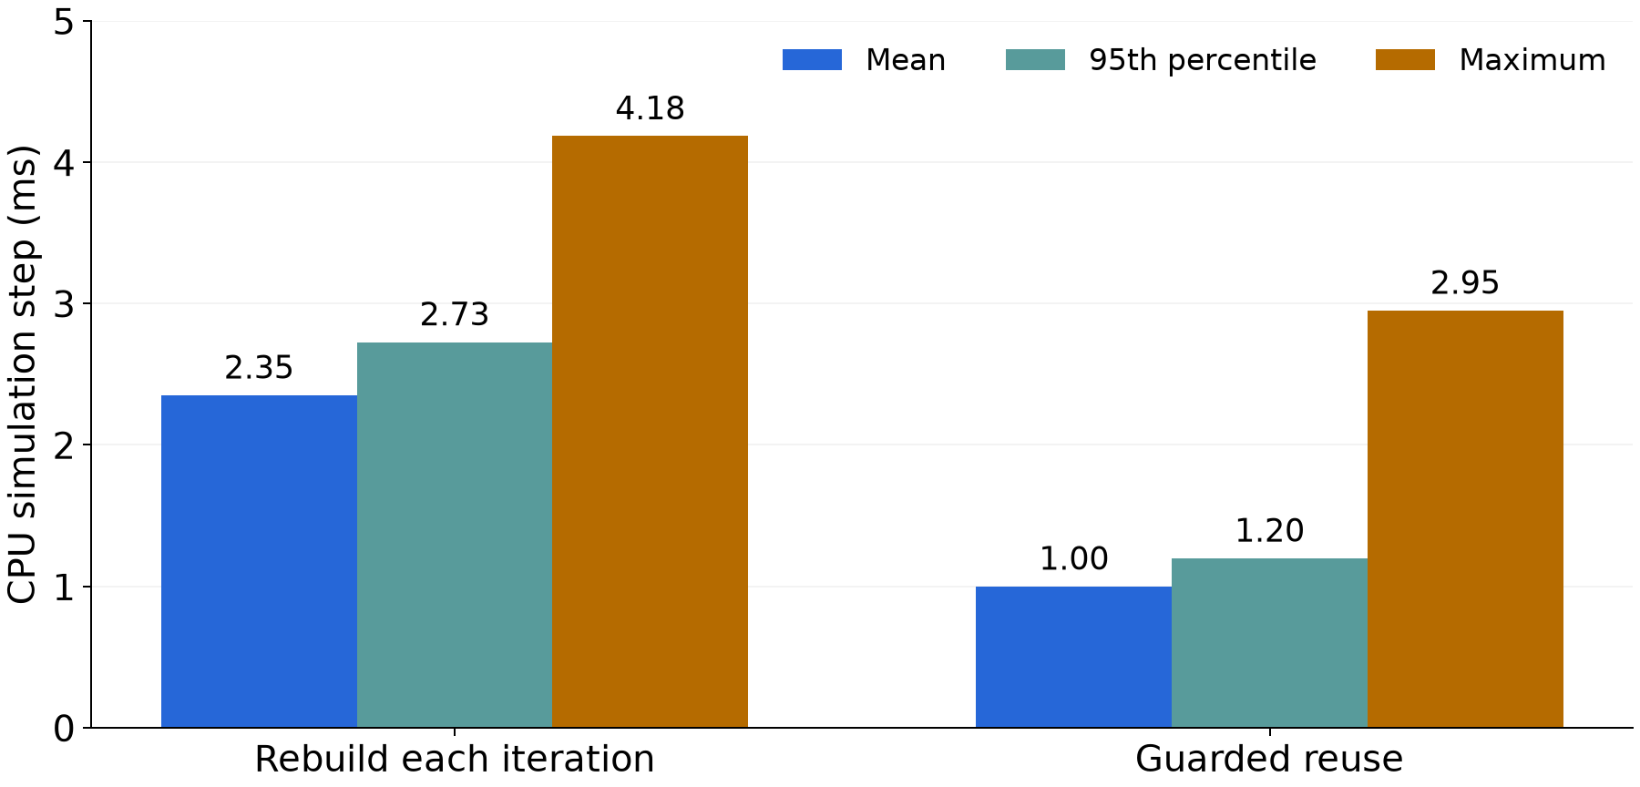
COMMON CONTACT PIPELINE
Measured CPU step time fell in this paired run
2.351 ms
mean · rebuild
0.999 ms
mean · guarded reuse
Max: 4.184 ms → 2.951 ms
5 paired trials · 1,350 measured steps / policy · Apple M2 Pro · Release
CPU timing includes the oracle and excludes rendering · exploratory single-scene result
Kyoto research discussion · 2 Nov 2026
08
Notes:
Source: output/native/benchmark-summary.txt and output/native/benchmark.png, generated from output/native/live_benchmark.csv. Mean/max/p95 (ms): rebuild 2.35117 / 4.18375 / 2.72708; guarded reuse 0.999491 / 2.9505 / 1.19762. The experiment ran Release C++ on Apple M2 Pro, same-process XPBD cloth, sweep-and-prune, margin 0.05, displacement budget 0.04, dt 1/120. Five paired trials of 300 steps per policy; first 30 steps of each trial warmed up, leaving 1,350 measured steps per policy. CPU step time is wall-clock CPU-side timing and excludes rendering. Results are exploratory for this implementation and machine; do not generalize to other geometries or simulators.

Slide 9
COMMON CONTACT PIPELINE
The time reduction tracks fewer broad-phase rebuilds
12,150
600
11,550
generator calls
rebuild each iteration
generator calls
guarded reuse
cached pair-list reuses
Oracle coverage
0 required-pair omissions in recorded comparisons
Solver agreement
Maximum position error: 0 across measured trajectories
2,700 measured CSV rows · 1,350 steps per policy · 5 trials per policy
Kyoto research discussion · 2 Nov 2026
09
Notes:
Benchmark summary reports generatorCalls 12150 versus 600 and 11550 reuses, with maxPositionError 0 and measuredFramesPerPolicy 1350. The 2700-row CSV contains measured rows for both policies and excludes warmup. The native capture trace checks at frame 120 also have matching state hashes and zero oracle misses. These checks apply to this tested scene/configuration only and do not establish general equivalence for other methods.

Slide 10
COMMON CONTACT PIPELINE
What to measure in a real method adapter
Runtime
IPC Table 1 · OGC Table 1 · CCFR Table 1
Broad-phase build and query time; full collision-stage time
Workload
IPC Fig. 23 · OGC Fig. 18 · CCFR Table 1
Candidate count, verified contacts and collision detections
Convergence
IPC Fig. 23 · OGC Fig. 17
Solver iterations and residuals where methods permit comparison
Safety
OGC §5 · CCFR Figs. 10–11
Post-step intersections or violations under each method’s criteria
Planned adapter measurements. This demo measures CPU step time and pair-cache work.
Kyoto research discussion · 2 Nov 2026
10
Notes:
Literature measurement anchors retained from the proposal: IPC, Fig. 23 and Table 1 (https://ipc-sim.github.io/file/IPC-paper-fullRes.pdf); OGC, Figs. 17–18, Table 1 and §5 (https://graphics.cs.utah.edu/research/projects/ogc/Offset_Geometric_Contact-SIGGRAPH2025.pdf); CCFR, Table 1 and Figs. 10–11 (https://arxiv.org/html/2607.26901v1). These inform future evaluation design only. They are not measurements of this demo. CCFR is compatible with XPBD but has its own collision-free-region formulation.

Slide 11
COMMON CONTACT PIPELINE
The prototype boundary is explicit
IMPLEMENTED
NOT IMPLEMENTED
C++23 core and live viewer
XPBD cloth contact response
Sphere–triangle discrete query
Brute-force oracle and sweep-and-prune
Guarded reuse with cached pairs
Continuous collision detection
Cloth self-collision
Official IPC / OGC integration
CCFR implementation
Cross-method performance study
This experiment tests an infrastructure seam, not solver interchangeability.
Kyoto research discussion · 2 Nov 2026
11
Notes:
CCFR: Kikuchi and Kanai, “Convex Collision-Free Regions,” arXiv:2607.26901 (2026). It constructs local convex feasible regions for non-penetration and is compatible with XPBD, while remaining a distinct collision handling method. The prototype does not reproduce CCFR, IPC, or OGC and does not claim their guarantees. Official research project links: IPC https://ipc-sim.github.io/ ; OGC https://ankachan.github.io/Projects/OGC/ ; XPBD source https://github.com/InteractiveComputerGraphics/PositionBasedDynamics .

Slide 12
COMMON CONTACT PIPELINE
The next test should change one method boundary
1
Select one existing solver and one representative scene.
2
Replace only candidate generation with the shared service.
3
Compare pair coverage, collision outcomes and measured cost.
Which method and correctness requirement should anchor that adapter?
Kyoto research discussion · 2 Nov 2026
12
Notes:
Discussion objective: agree on the first external adapter and its correctness oracle. Preserve the method’s own narrow phase, tolerances, solver and acceptance tests. The prototype demonstrates one seam in an XPBD cloth implementation; it does not yet prove reuse across heterogeneous simulators.

