Slide 1
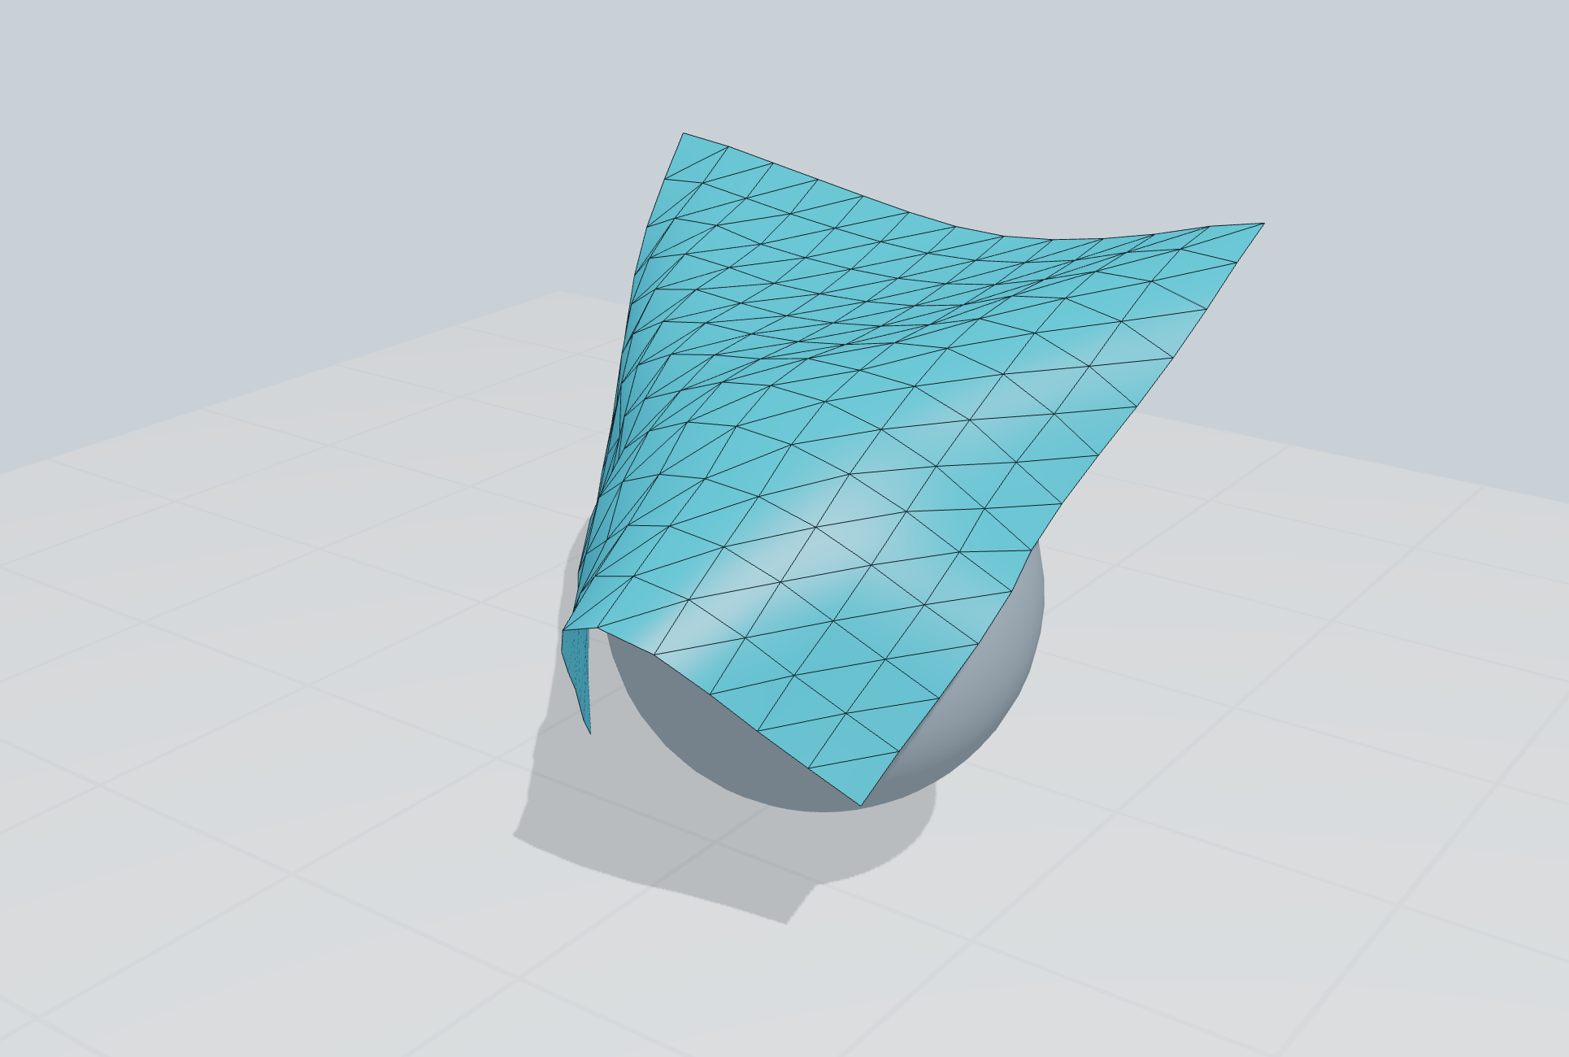
CONTACT SIMULATION · IMPLEMENTATION AND PROPOSAL
Online adaptation for a common broad phase
Adjust collision-search work as cloth deforms,
while retaining the caller’s required pairs.
One geometric bounds format
Local candidate certificates
Measured contact-work feedback
Working C++ prototype
Evidence from one local cloth family
Swayam Singal · Kyoto research discussion · 2 November 2026
01
Notes:
Scope: three-dimensional native GLFW/OpenGL application, XPBD-style cloth test solver, shared broad-phase services and online controller. No official IPC/OGC/CCFR implementation is integrated. Cover scene is cropped from cases/one-sap.png; the full framebuffer and per-step CSV are retained. Current source and executable hashes: after/metadata.json.

Slide 2
RESEARCH PROTOTYPE
The question is total collision cost
Pressure point
Deformation changes spatial overlap, invalidation frequency and precise-contact work.
Tradeoff
Larger guards save rebuilds but admit extra pairs. Smaller regions add bookkeeping.
Research question
Can observed local work select useful partitions and update strategies during simulation?
Swayam Singal · Kyoto research discussion · 2 November 2026
02
Notes:
We optimize candidate infrastructure, with the narrow phase and solver held fixed. The objective must include maintenance, candidate filtering, precise contact work and controller cost. Candidate count alone is insufficient. CCFR §4.3 and Fig10 motivate collision-stage measurement; https://arxiv.org/html/2607.26901v1

Slide 3
LITERATURE
Contact methods keep different responsibilities
Work | Core idea | What a common broad phase must preserve
IPC · 2020 | Barrier contact with CCD-limited optimization | Required contact and motion queries
OGC · 2025 | Offset geometry with conservative motion bounds | Offset-dependent neighborhood semantics
XPBD · 2016 | Compliant position constraints | Caller’s collision and solver requirements
CCFR · 2026 | Local convex regions for feasible displacement | Primitive neighborhoods for region construction
Shared candidate infrastructure does not make the contact models interchangeable.
Swayam Singal · Kyoto research discussion · 2 November 2026
03
Notes:
Primary sources: IPC https://ipc-sim.github.io/file/IPC-paper-fullRes.pdf ; OGC https://ankachan.github.io/Projects/OGC/ ; XPBD https://matthias-research.github.io/pages/publications/XPBD.pdf ; CCFR https://arxiv.org/html/2607.26901v1. IPC Algorithm1/§4.4, OGC abstract and method, XPBD abstract/constraint formulation, CCFR §3 and Appendix B. These are literature roles, not implemented external adapters.

Slide 4
PRIOR ART AND GAP
Established ideas leave a narrower research question
Already established
Spatial hierarchies, fat bounds, temporal reuse and automatic box pruning have prior art.
This prototype asks
Can confirmed contact work guide topology-aligned patch changes under a shared certificate?
Still unproven
Novelty, strong-baseline superiority and transfer across solvers require further evidence.
Relevant comparators: Bullet DBVT · PhysX ABP/PABP · conservative CCD broad phases
Swayam Singal · Kyoto research discussion · 2 November 2026
04
Notes:
PhysX officially documents SAP/MBP/ABP/PABP; https://nvidia-omniverse.github.io/PhysX/physx/5.1.0/docs/RigidBodyCollision.html. Scalable CCD supplies conservative broad/narrow algorithms and benchmark data; https://continuous-collision-detection.github.io/scalable_ccd/. Bullet is actually exercised in our isolated benchmark. This establishes relevant prior art, not an exhaustive novelty search. The open question is evaluation of this particular online policy, not whether adaptive broad phase exists.

Slide 5
IMPLEMENTATION
One pipeline; the solver keeps ownership
Predict / constrain
Prepare bounds
Find candidates
Precise response
→
→
→
XPBD-style cloth
IDs, masks, margin
Certified region cache
VF / EE / sphere
Repeat within each timestep. Feed measured work to the online controller once per step.
C++ state → service candidates → contact corrections → same-process native rendering
Swayam Singal · Kyoto research discussion · 2 November 2026
05
Notes:
MultiCloth::step in src/research_multicloth.cpp invokes five collision queries and calls OnlinePartitioner::observe at full-frame boundaries. Actual candidate IDs feed projectContacts. Native renderer consumes the same positions vector. Python validates and plots measurements after C++ runs; it does not drive this solver. VF=vertex-face, EE=edge-edge.

Slide 6

CORRECTNESS CONTRACT
A reuse certificate constrains every query
Enclose
Raw min/max AABBs, stable IDs, category/mask and movable flags; explicit margin.
Invalidate
An escaped bound, changed mask, request or partition requires rebuilding before use.
Regional blocks are rechecked against current bounds. This certifies discrete queries, not CCD.
Swayam Singal · Kyoto research discussion · 2 November 2026
06
Notes:
B_i is a current half-margin-padded primitive AABB; E_i is its stored guard. Inclusion plus unchanged eligibility makes current overlaps a subset of cached envelope overlaps. RegionalCandidates rechecks cached IDs against tight current boxes, sorts canonical pairs, and returns the current candidate set. Full partition changes reset certificates. Generic bounds are not a swept-motion enclosure. Proof and tests: docs/ONLINE_ALGORITHM.md, CODE_AUDIT_CORE.md.

Slide 7
IMPLEMENTED POLICY
Online feedback changes patches and traversal
Observe
AABB tests, cached-pair rechecks, invalidations and executed contact corrections.
Smooth and decide
EWMA signals; six-frame decisions with cooldowns and bounded structural edits.
Apply safely
Split hot patches; merge quiet siblings; select flat or hierarchical search; invalidate caches.
Patch spans: 12 → 6 → 3 mesh cells. Particles and physical constraints stay fixed.
Swayam Singal · Kyoto research discussion · 2 November 2026
07
Notes:
src/online_partitioner.cpp: W = AABB tests + 0.65 cached checks + 2 rejected candidates + 3 invalidations. EWMA beta=0.22. Heuristic thresholds; two hot windows allow split, three quiet windows for siblings allow merge, 12-frame structural cooldown, 18-frame traversal cooldown. This is runtime control, not an offline calibration table. Contact signal counts successful corrections, not unique physical contact points.

Slide 8
ALGORITHM INVOCATION AUDIT
Every comparison has an exercised code path
Path | Actually exercised by | Evidence
SAP / global guarded | Coupled solver + native policy selector | Three repeats; paired states
Regional flat / two-tier | Same solver; fixed and adaptive budgets | All seven policy rows
Online split / merge / switch | Per-step controller + regional query | Live trace; merge regression
Bullet DBVT / dynamic DBVT | Isolated AABB benchmark, not cloth solver | Six workloads × nine methods
Self-contact / grabbing | Shared precise response / barycentric attachment | Headless fold and grab regressions
Baselines are deliberate ablations; benchmark results do not integrate Bullet into cloth physics.
Swayam Singal · Kyoto research discussion · 2 November 2026
08
Notes:
Invocation matrices: docs/CODE_AUDIT_CORE.md and docs/EVIDENCE_METHODS_AUDIT.md. All 54 isolated output rows executed; all 21 coupled policy/sheet combinations run per repetition. Online merge is exercised in changing-workload regression, not observed in the 160-frame physics trace. Legacy rigid-sphere islands/analytic TOI are separate testbed paths, not cloth CCD.

Slide 9
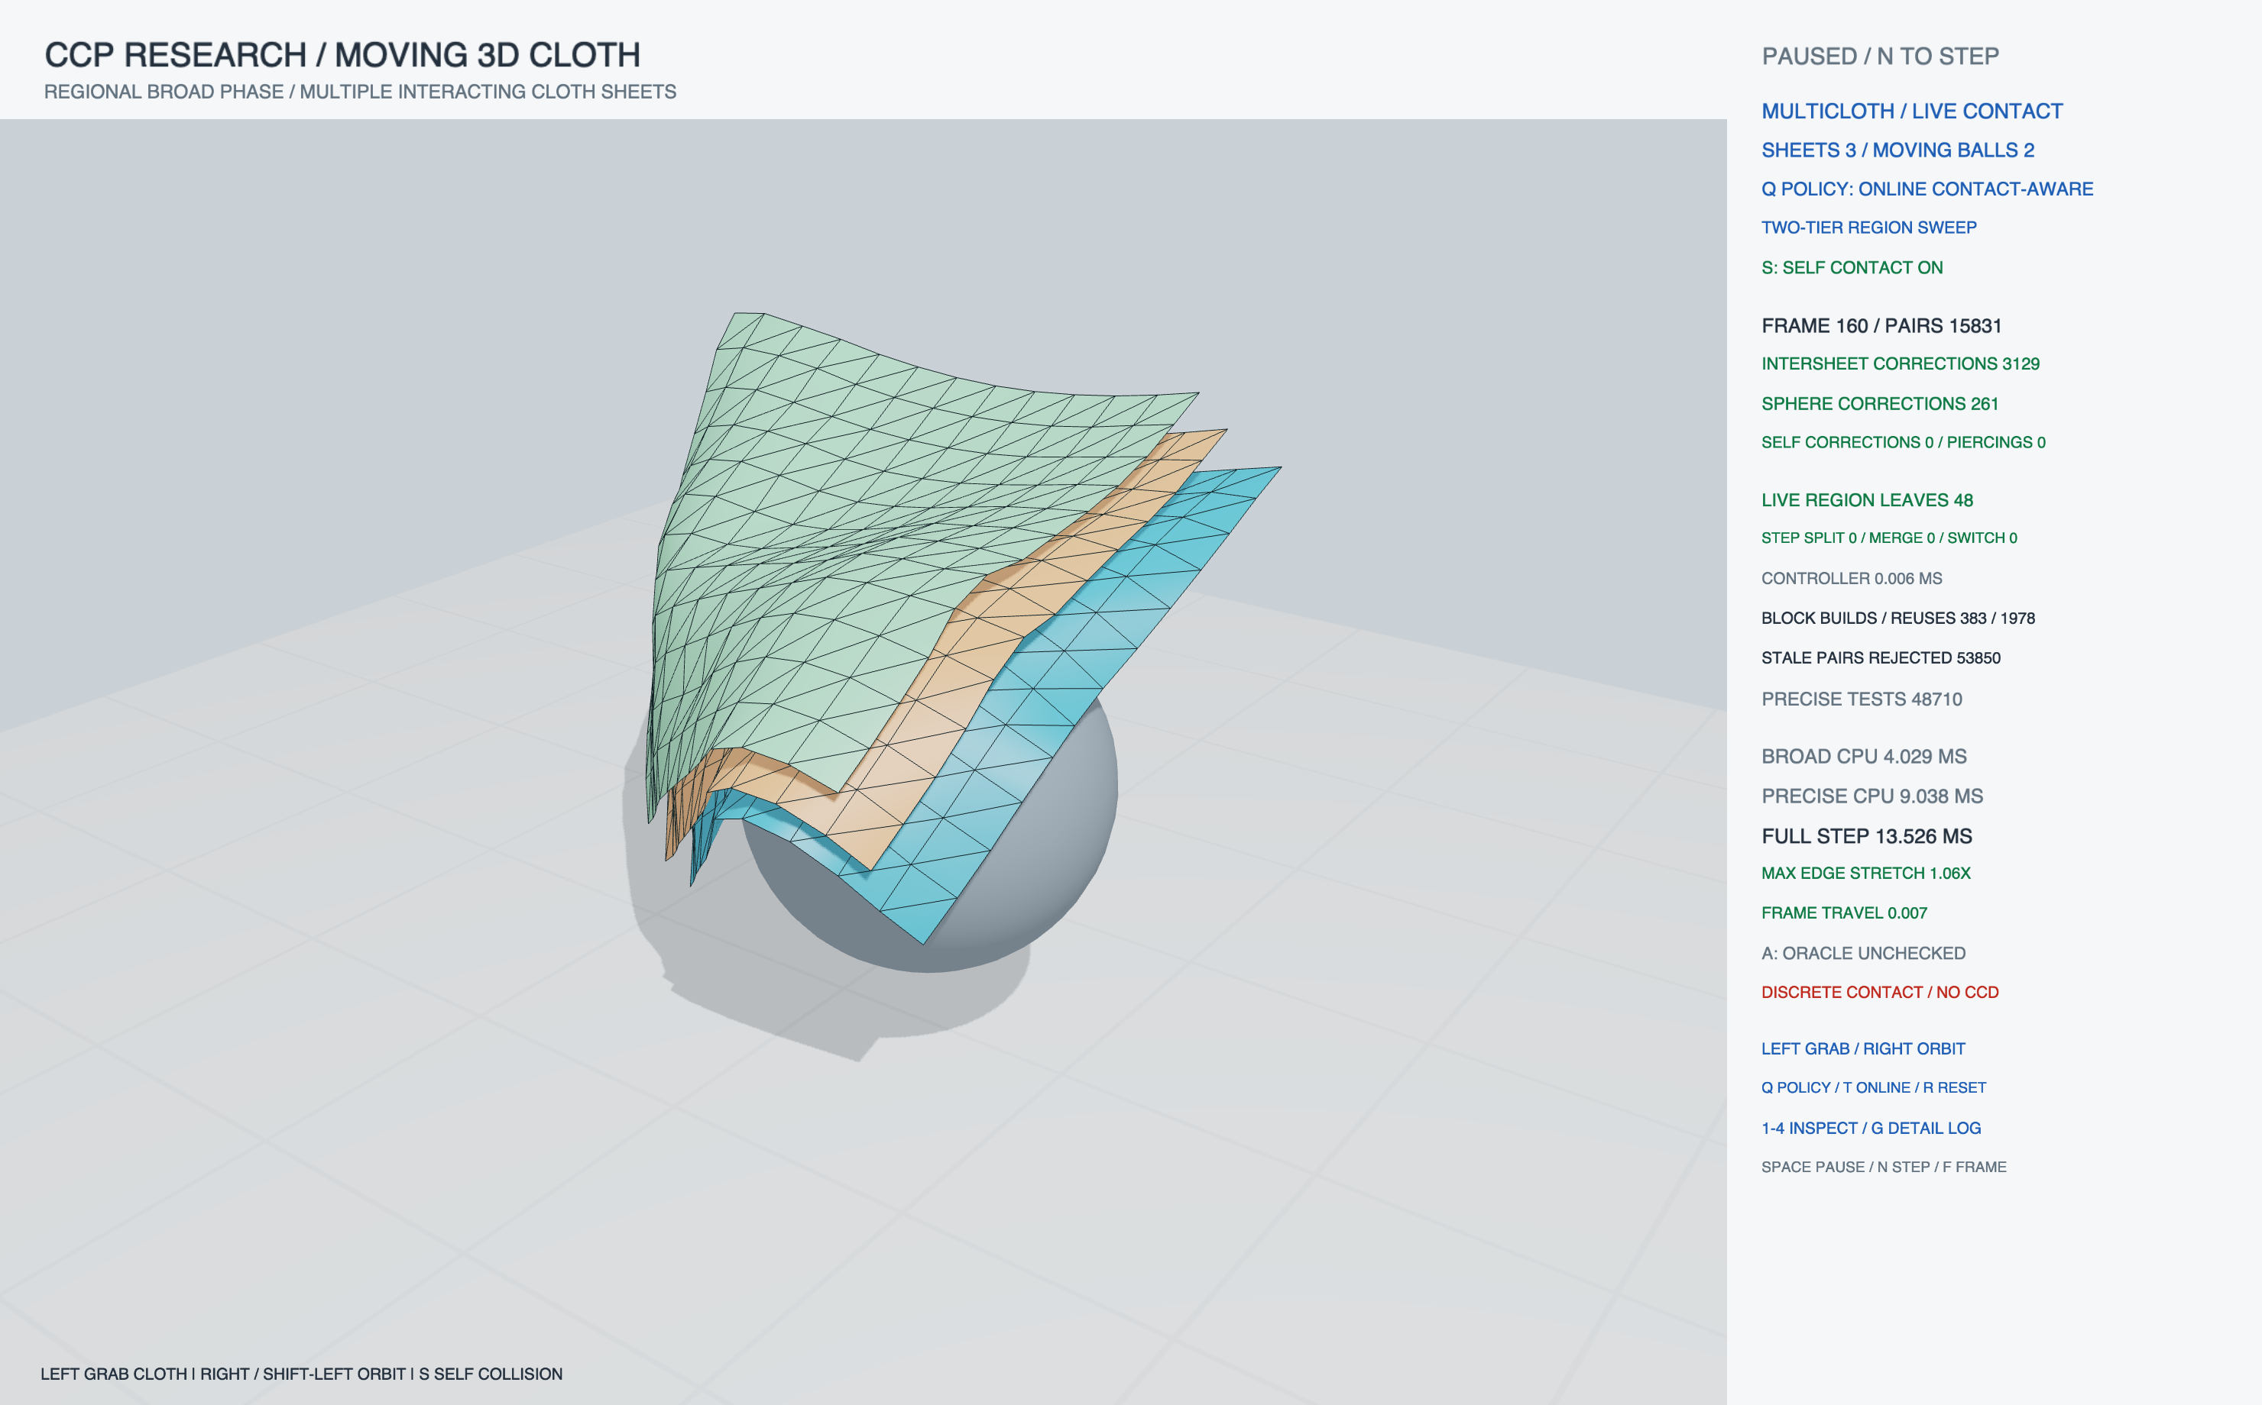
ACTUAL OPENGL FRAMEBUFFER · STEP 160
Native case: three interacting sheets
Online region control
Same C++ solver
Self-contact enabled
Two moving spheres
Full frame, CSV and
configuration retained
Swayam Singal · Kyoto research discussion · 2 November 2026
09
Notes:
Source: cases/three-online.png, .csv and .log. CLI advances exactly 160 actual fixed steps then pauses. No replay mesh or Blender simulation is loaded. Intersheet/sphere corrections are observed; zero self corrections at this frame does not demonstrate a fold. Timings in a screenshot are one frame, not the repeated benchmark result.

Slide 10
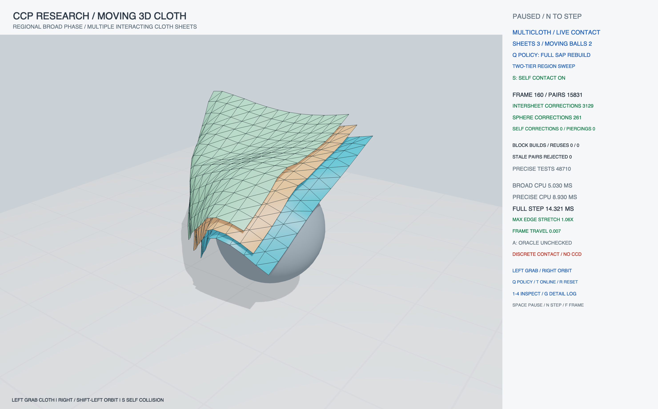
SAP REBUILD · SAME STEP 160
A matched native case checks the comparison
Same state, different
candidate maintenance
All 160 recorded state
checksums match the
online case.
Full coordinate comparison
is also run headlessly.
Swayam Singal · Kyoto research discussion · 2 November 2026
10
Notes:
Source cases/three-sap.png/.csv/.log and cases/three-online.csv. All160 paired native trace state hashes match; the benchmark separately checks every particle coordinate. Native mouse automation returned noWindowsAvailable or no positive grab rows, so a live drag is NOT presented as verified evidence. Picking/attachment/self-contact routines pass targeted headless regressions. See VERIFICATION.md for this practical limit.

Slide 11
EXPERIMENT DESIGN
Measure coverage, physics and cost separately
Controlled comparison
1/2/3 sheets × seven policies; identical forces, constraints and timestep. Three local repeats.
Independent checks
Compare every particle against SAP; periodically audit candidates with exhaustive AABB search.
Timing boundary
Complete CPU step includes periodic oracle checks; rendering is excluded. Isolated AABB timing is separate.
Δt = 1/90 s · 5 solver iterations · 60 steps/policy (warm-up: 8)
Online trace: 160 steps (warm-up: 12). Same settings across policies.
Swayam Singal · Kyoto research discussion · 2 November 2026
11
Notes:
Raw records after/multicloth-{1,2,3}.csv (63 aggregate rows) and after/online-{1,2,3}.csv (480 per-frame rows). Apple M2 Pro, AppleClang Release; metadata records source/executable hashes. Repeats are on one deterministic scene family, not independent scene samples. Method execution order is fixed in the seven-way comparison; timing-guided controller decisions can vary. Confidence intervals are not claimed.

Slide 12
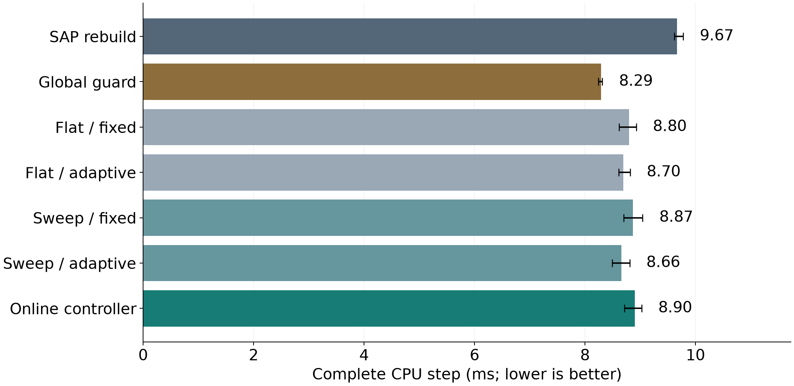
LOCAL RESULTS · THREE CLOTHS
Online improves on SAP here; global guard wins
9.67 ms
SAP rebuild
8.90 ms
Online controller
8.29 ms
Global guard
Bars: mean of three trial means. Whiskers: min–max trial means, not confidence intervals.
Swayam Singal · Kyoto research discussion · 2 November 2026
12
Notes:
Computed directly from fresh after/multicloth-{1,2,3}.csv, sheets=3, 52 timed steps per variant/trial. Full CPU timings include periodic audit costs. All 63 rows have maxPositionError=0. Online is not the fastest tested policy; small-fixture overhead can outweigh local pruning. Do not attribute this chart to an IPC/OGC adapter, GPU kernel or general speedup.

Slide 13
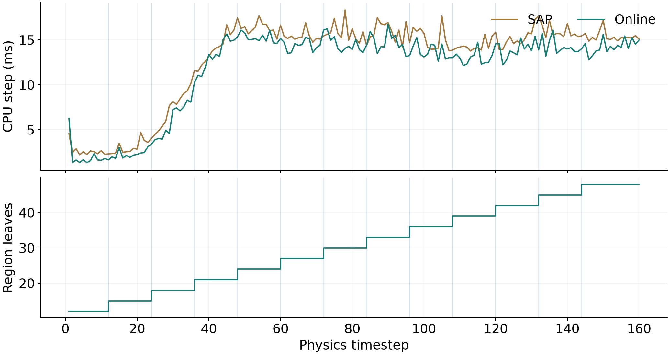
ONLINE TRACE · FIRST OF THREE REPEATS
The controller changes real runtime structure
12 splits
4 strategy switches
0 observed merges
Merging is tested in a
separate quiet-workload
regression.
Swayam Singal · Kyoto research discussion · 2 November 2026
13
Notes:
after/online-1.csv. Blue vertical markers indicate actual split frames; region count grows 12 to 48. This repeat performs 12 splits, zero merges, four strategy switches. All three repeats compare every frame with SAP with maximum error0 and audit11 frames each. The time spikes include periodic oracle work. Selection windows do not provide same-frame A/B causal proof.

Slide 14
CODE SAFETY AND REDUNDANCY
Audit fixes make the evidence harder to misread
Found | Changed | Verification
Finite inputs could overflow padding | Validate padded bounds and guards before cache use | Overflow + recovery regression
Redundant pair pass / dead helpers | Remove proven redundant unique pass and unused code | Multi-region uniqueness + equivalence
tee could hide failed benchmark | Bash pipefail; reject incomplete/invalid CSVs | Malformed-data and shell fixtures
Native trace / HUD ambiguity | Per-step scene, policy, grab and audit flags; fit HUD | Window captures and CLI checks
Seven Release test suites pass. The 480-step stability probe remains bounded.
Swayam Singal · Kyoto research discussion · 2 November 2026
14
Notes:
Exact changes and commands: CODE_AUDIT_CORE.md, EVIDENCE_METHODS_AUDIT.md, NATIVE_CASES.md and output/review-2026-11-02/VERIFICATION.md. Removal of one redundant pass is an optimization; no statistically established code-audit speedup is claimed. Sanitizer results are recorded separately. Native finite-state checks pause runaway motion.

Slide 15
LIMITATIONS
Coverage is necessary; it is not physical validation
Contact model
Approximate discrete response; fast folds can tunnel. Self-contact is not a nonpenetration proof.
Stabilization
480-step max edge stretch 1.15×; damping and 12,105 velocity clamps affect the trajectory.
Generalization
Small fixed-resolution cloth family, CPU implementation, heuristic controller, no external solver adapter.
Equal trajectories show broad-phase agreement in these runs; they do not certify material accuracy.
Swayam Singal · Kyoto research discussion · 2 November 2026
15
Notes:
after/stability.log: max absolute coordinate2.45379, max frame displacement.08324, structural edge stretch1.14950, floor minZ.04000, velocityClamps12105 over480frames. These are implementation safeguards and engineering bounds, not physical calibration. No general historical originality or solver-independent performance claim.

Slide 16
FUTURE WORK
Next experiments should challenge the policy
1 · Stronger evaluation
Larger independent scenes; randomized order; stage costs, tail latency and controller ablations.
2 · One real adapter
Keep an existing method’s narrow phase and solver; validate its exact margin and motion contract.
3 · Stronger safety
Explicit swept-bound requests and robust CCD; test pathological folds and floating-point edge cases.
Swayam Singal · Kyoto research discussion · 2 November 2026
16
Notes:
Prioritize comparison to persistent dynamic BVHs and automatic pruning on compatible workloads, not only rebuild baselines. A true external adapter must preserve method-specific motion/offset requirements. Scalable CCD provides relevant conservative algorithms and benchmark data: https://continuous-collision-detection.github.io/scalable_ccd/

Slide 17
REFERENCES
Sources and reproducible evidence
IPC — Li et al., 2020 · Algorithm 1, Table 1, Fig. 23
OGC — Chen et al., 2025 · Table 1, Figs. 17–18
XPBD — Macklin et al., 2016 · compliant constraint formulation
CCFR — Kikuchi & Kanai, 2026 · §4.3, Table 1, Figs. 10–11
Metric choices: full runtime and collision-stage cost; contact workload;
method-specific convergence and remaining violations.
Local bundle: output/review-2026-11-02/
Raw CSVs · full native captures · logs · source/build hashes · verification report
Swayam Singal · Kyoto research discussion · 2 November 2026
17
Notes:
ipc: https://ipc-sim.github.io/file/IPC-paper-fullRes.pdf
ogc: https://ankachan.github.io/Projects/OGC/
xpbd: https://matthias-research.github.io/pages/publications/XPBD.pdf
ccfr: https://arxiv.org/html/2607.26901v1
physx: https://nvidia-omniverse.github.io/PhysX/physx/5.1.0/docs/RigidBodyCollision.html
ccd: https://continuous-collision-detection.github.io/scalable_ccd/
Evaluation anchors refer to quantities used in the papers, not numerical comparisons against them. OGC publication/project page checked; source paper location retained from earlier audit. All demo figures come from actual local C++ measurements or native framebuffers. No paper result image is substituted for implemented output.

