Slide 1
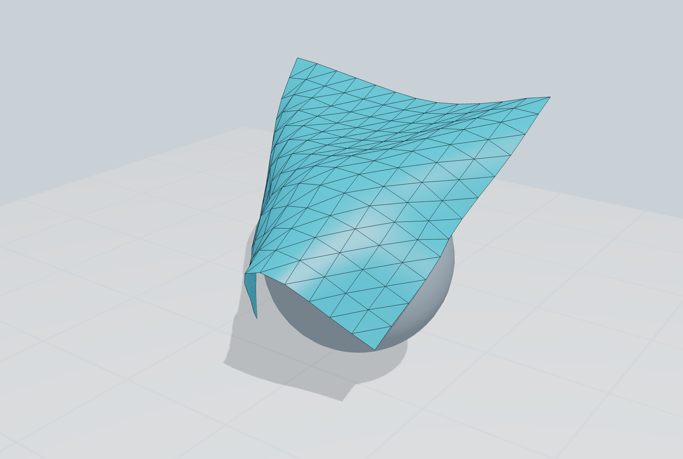
RESEARCH PROPOSAL · VERIFIED C++ PROTOTYPE
One broad phase, adapting to contact work
Shared candidate search.
Method-specific contact.
The prototype changes collision-search regions
using measured work and confirmed corrections.
One geometric format
Certified candidate reuse
Online partition decisions
Actual native C++ scene · one cloth case
Swayam Singal · Kyoto research discussion · 2 November 2026
01
Notes:
Scope: three-dimensional native GLFW/OpenGL application, XPBD-style cloth test solver, shared broad-phase services and online controller. No official IPC/OGC/CCFR implementation is integrated. Cover scene is cropped from cases/one-sap.png; the full framebuffer and per-step CSV are retained. Current source and executable hashes: after/metadata.json.

Slide 2
PROBLEM AND OBJECTIVE
Less search does not always mean a faster step
REUSE LARGER GUARDS
USE SMALLER REGIONS
Fewer candidate-list rebuilds.
More stale pairs may reach filtering
and precise contact checks.
More local pruning.
More region bookkeeping, guard
checks and cache maintenance.
Optimize complete collision cost
Measure search + candidate filtering + precise response + controller overhead.
A smaller candidate set alone is not the objective.
Swayam Singal · Kyoto research discussion · 2 November 2026
02
Notes:
We optimize candidate infrastructure, with the narrow phase and solver held fixed. The objective must include maintenance, candidate filtering, precise contact work and controller cost. Candidate count alone is insufficient. CCFR §4.3 and Fig10 motivate collision-stage measurement; https://arxiv.org/html/2607.26901v1

Slide 3
LITERATURE
Contact methods keep different responsibilities
Work | Core idea | What a common broad phase must preserve
IPC · 2020 | Barrier contact with CCD-limited optimization | Required contact and motion queries
OGC · 2025 | Offset geometry with conservative motion bounds | Offset-dependent neighborhood semantics
XPBD · 2016 | Compliant position constraints | Caller’s collision and solver requirements
CCFR · 2026 | Local convex regions for feasible displacement | Primitive neighborhoods for region construction
Shared candidate infrastructure does not make the contact models interchangeable.
Swayam Singal · Kyoto research discussion · 2 November 2026
03
Notes:
Primary sources: IPC https://ipc-sim.github.io/file/IPC-paper-fullRes.pdf ; OGC https://ankachan.github.io/Projects/OGC/ ; XPBD https://matthias-research.github.io/pages/publications/XPBD.pdf ; CCFR https://arxiv.org/html/2607.26901v1. IPC Algorithm1/§4.4, OGC abstract and method, XPBD abstract/constraint formulation, CCFR §3 and Appendix B. These are literature roles, not implemented external adapters.

Slide 4
ESTABLISHED METHODS → PROPOSED EVALUATION
The research question is the control policy
ESTABLISHED MACHINERY
OUR IMPLEMENTED POLICY
Spatial hierarchies and sweeps
Fat bounds and temporal reuse
Automatic box pruning
Observe local work and corrections
Adjust mesh-patch membership
Rebuild certificates before reuse
Does contact-work feedback reduce total cost
against strong baselines as the scene changes?
Policy novelty and transfer across solvers remain unproven. Comparators include Bullet DBVT and PhysX ABP/PABP.
Swayam Singal · Kyoto research discussion · 2 November 2026
04
Notes:
PhysX officially documents SAP/MBP/ABP/PABP; https://nvidia-omniverse.github.io/PhysX/physx/5.1.0/docs/RigidBodyCollision.html. Scalable CCD supplies conservative broad/narrow algorithms and benchmark data; https://continuous-collision-detection.github.io/scalable_ccd/. Bullet is actually exercised in our isolated benchmark. This establishes relevant prior art, not an exhaustive novelty search. The open question is evaluation of this particular online policy, not whether adaptive broad phase exists.

Slide 5
PIPELINE AND OWNERSHIP
The shared stage sits inside the solver loop
CALLER
CALLER
SHARED SERVICE
CALLER
Predict / constrain
Prepare bounds
Find candidates
Precise response
→
→
→
Cloth positions and
internal constraints
Raw min/max boxes
and eligibility
Certified regional
search and reuse
Vertex–face, edge–edge
and sphere checks
Five collision queries per timestep; one controller update at the end.
Candidate IDs enter the same precise contact solver. The renderer reads the resulting C++ positions.
Swayam Singal · Kyoto research discussion · 2 November 2026
05
Notes:
MultiCloth::step in src/research_multicloth.cpp invokes five collision queries and calls OnlinePartitioner::observe at full-frame boundaries. Actual candidate IDs feed projectContacts. Native renderer consumes the same positions vector. Python validates and plots measurements after C++ runs; it does not drive this solver. VF=vertex-face, EE=edge-edge.

Slide 6
SHARED GEOMETRIC FORMAT
What crosses the common interface?
GEOMETRY
QUERY REQUIREMENTS
CANDIDATE OUTPUT
Stable primitive ID
XYZ min/max bounds
Category / mask
Movable / fixed
Proximity margin
Reuse / rebuild mode
Guard budget
Discrete query scope
Canonical ID pairs
Possible interactions
Precise tests required
AABB = an axis-aligned min/max box around a primitive.
The caller supplies conservative geometry and contact semantics;
the shared service does not select forces or replace the solver.
Swayam Singal · Kyoto research discussion · 2 November 2026
06
Notes:
Existing common record Bounds{id,min,max,category,mask,movable}. The global service uses QueryRequest{margin,displacementBudget,updatePolicy}; the regional path uses the same geometric record plus region/sheet metadata, margin and policy controls. This normalizes the conceptual boundary, not a claim that official IPC/OGC adapters already implement one universal API. Half the margin pads each primitive box. Current queries are discrete, not swept trajectories.

Slide 7

CERTIFICATE AND INVALIDATION
Reuse is justified by enclosure, not prediction
B: current padded box · E: cached guard · C: overlap-pair set
STAYS INSIDE THE GUARD
ESCAPES OR MEANING CHANGES
Reuse the cached pair superset.
Recheck each pair against today’s
tight padded boxes.
Rebuild before answering.
A changed mask, request or patch
assignment also invalidates reuse.
Why it works: an overlap inside smaller boxes must also exist in their enclosing guards.
This is a current-configuration coverage argument; it does not certify continuous motion.
Swayam Singal · Kyoto research discussion · 2 November 2026
07
Notes:
B_i is a current half-margin-padded primitive AABB; E_i is its stored guard. Inclusion plus unchanged eligibility makes current overlaps a subset of cached envelope overlaps. RegionalCandidates rechecks cached IDs against tight current boxes, sorts canonical pairs, and returns the current candidate set. Full partition changes reset certificates. Generic bounds are not a swept-motion enclosure. Proof and tests: docs/ONLINE_ALGORITHM.md, CODE_AUDIT_CORE.md.

Slide 8
RUNTIME CONTROL LOOP
Measured work drives bounded online decisions
Observe
→
Smooth
→
Decide
→
Apply
Box tests, rechecks,
invalidations and corrections
Reduce reaction to
single-step noise
Six-frame windows
plus cooldowns
Patch edits or traversal
change; reset certificates
Split hot patches
Merge quiet siblings
Localize expensive searches and rechecks.
New certificates cost work immediately.
Reduce region bookkeeping when little
contact work is being observed.
The 12 → 6 → 3-cell hierarchy changes region IDs, not particles or physical constraints. Thresholds are heuristic.
Swayam Singal · Kyoto research discussion · 2 November 2026
08
Notes:
src/online_partitioner.cpp: W = AABB tests + 0.65 cached checks + 2 rejected candidates + 3 invalidations. EWMA beta=0.22. Heuristic thresholds; two hot windows allow split, three quiet windows for siblings allow merge, 12-frame structural cooldown, 18-frame traversal cooldown. This is runtime control, not an offline calibration table. Contact signal counts successful corrections, not unique physical contact points.

Slide 9
ALGORITHM INVOCATION AUDIT
Every comparison has an exercised code path
Path | Actually exercised by | Evidence
SAP / global guarded | Coupled solver + native policy selector | Three repeats; paired states
Regional flat / two-tier | Same solver; fixed and adaptive budgets | All seven policy rows
Online split / merge / switch | Per-step controller + regional query | Live trace; merge regression
Bullet DBVT / dynamic DBVT | Isolated AABB benchmark, not cloth solver | Six workloads × nine methods
Self-contact / grabbing | Shared precise response / barycentric attachment | Headless fold and grab regressions
Baselines are deliberate ablations; benchmark results do not integrate Bullet into cloth physics.
Swayam Singal · Kyoto research discussion · 2 November 2026
09
Notes:
Invocation matrices: docs/CODE_AUDIT_CORE.md and docs/EVIDENCE_METHODS_AUDIT.md. All 54 isolated output rows executed; all 21 coupled policy/sheet combinations run per repetition. Online merge is exercised in changing-workload regression, not observed in the 160-frame physics trace. Legacy rigid-sphere islands/analytic TOI are separate testbed paths, not cloth CCD.

Slide 10
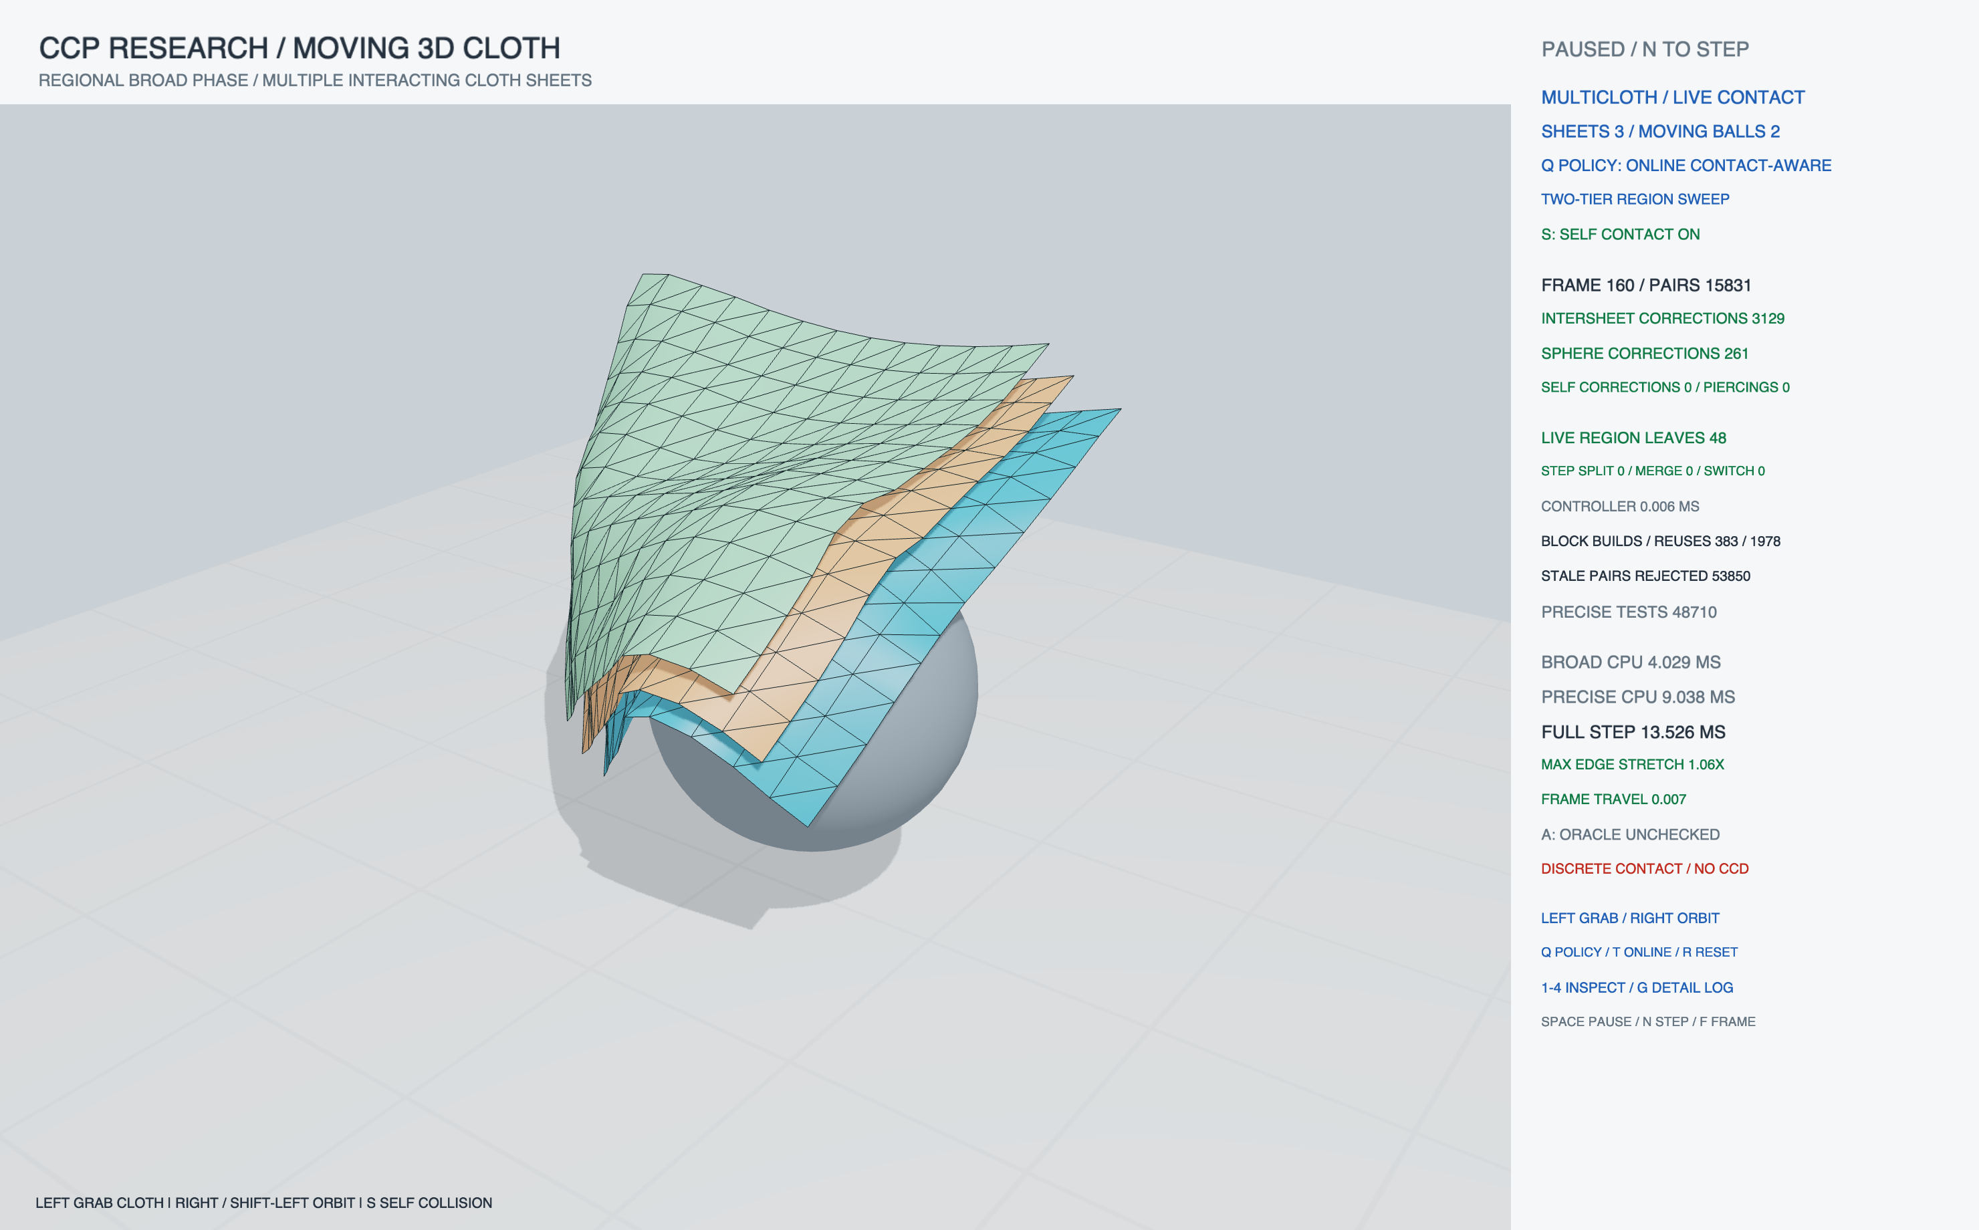
THREE CLOTHS · TWO MOVING SPHERES · STEP 160
Native evidence: the online policy is in the loop
What it shows
Live C++ geometry.
Candidates feed
precise response.
Self-contact is ON.
No self-correction
is shown this step.
Full framebuffer, selected policy, configuration and per-step CSV are retained.
Swayam Singal · Kyoto research discussion · 2 November 2026
10
Notes:
Source: cases/three-online.png, .csv and .log. CLI advances exactly 160 actual fixed steps then pauses. No replay mesh or Blender simulation is loaded. Intersheet/sphere corrections are observed; zero self corrections at this frame does not demonstrate a fold. Timings in a screenshot are one frame, not the repeated benchmark result.

Slide 11
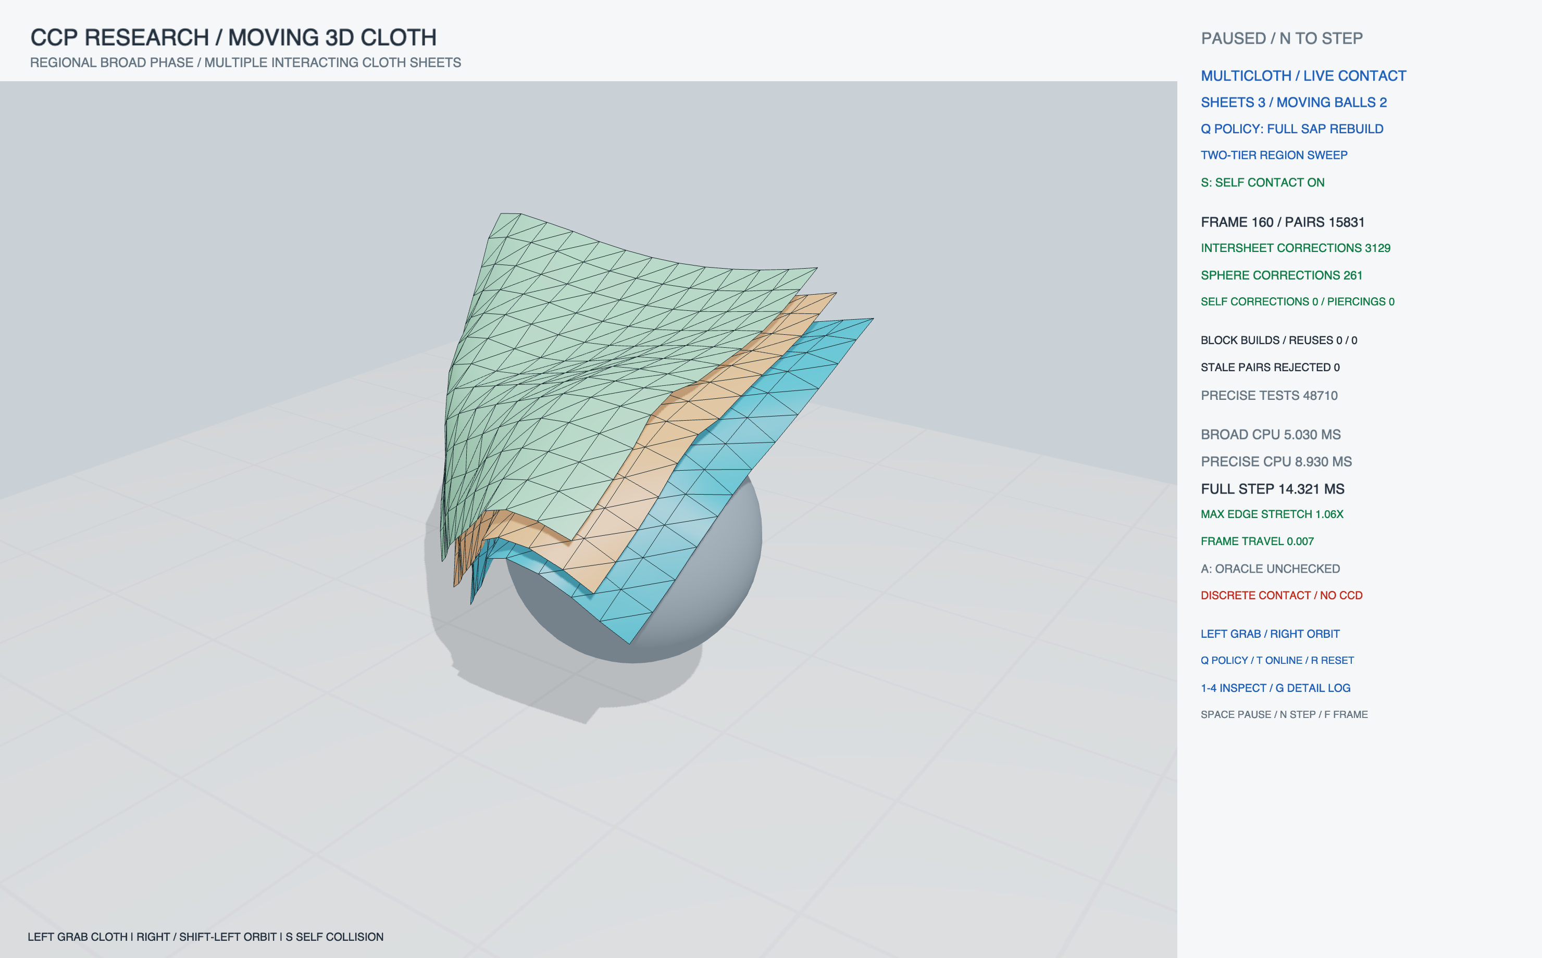
SAP REBUILD REFERENCE · SAME STEP 160
Matched state; different candidate maintenance
What is held fixed?
Same forces.
Same timestep.
Same contact solver.
160 matching
state checksums
The headless comparison also checks every particle coordinate; a screenshot alone cannot prove equivalence.
Swayam Singal · Kyoto research discussion · 2 November 2026
11
Notes:
Source cases/three-sap.png/.csv/.log and cases/three-online.csv. All160 paired native trace state hashes match; the benchmark separately checks every particle coordinate. Native mouse automation returned noWindowsAvailable or no positive grab rows, so a live drag is NOT presented as verified evidence. Picking/attachment/self-contact routines pass targeted headless regressions. See VERIFICATION.md for this practical limit.

Slide 12
METRIC INTERPRETATION
Read the HUD counters at their actual scope
LATEST QUERY
WHOLE TIMESTEP
PERIODIC AUDIT
Candidates
Contact corrections
Coverage status
Possible pairs returned by the last query. Extra pairs are allowed; they are not confirmed collisions.
Executed positional corrections across solver iterations. One pair can contribute more than once.
An independent exhaustive check ran only when marked checked. Unchecked zero is not evidence.
A HUD value is one step. A benchmark chart summarizes a specified time window.
Swayam Singal · Kyoto research discussion · 2 November 2026
12
Notes:
Metrics::pairs/candidatePairs describe the latest broad-phase query. contacts/interSheetContacts/sphereContacts/selfContacts accumulate successful correction applications over a complete timestep. They are neither unique pair counts nor contact probabilities. Do not divide counters with different scopes. oracleChecked must be true before an oracleMisses=0 value is interpreted as coverage evidence. Native screenshots are individual frames; chart means use declared warm-up and measurement windows.

Slide 13
EXPERIMENT DESIGN
Measure coverage, physics and cost separately
Controlled comparison
1/2/3 sheets × seven policies; identical forces, constraints and timestep. Three local repeats.
Independent checks
Compare every particle against SAP; periodically audit candidates with exhaustive AABB search.
Timing boundary
Complete CPU step includes periodic oracle checks; rendering is excluded. Isolated AABB timing is separate.
Δt = 1/90 s · 5 solver iterations · 60 steps/policy (warm-up: 8)
Online trace: 160 steps (warm-up: 12). Same settings across policies.
Swayam Singal · Kyoto research discussion · 2 November 2026
13
Notes:
Raw records after/multicloth-{1,2,3}.csv (63 aggregate rows) and after/online-{1,2,3}.csv (480 per-frame rows). Apple M2 Pro, AppleClang Release; metadata records source/executable hashes. Repeats are on one deterministic scene family, not independent scene samples. Method execution order is fixed in the seven-way comparison; timing-guided controller decisions can vary. Confidence intervals are not claimed.

Slide 14
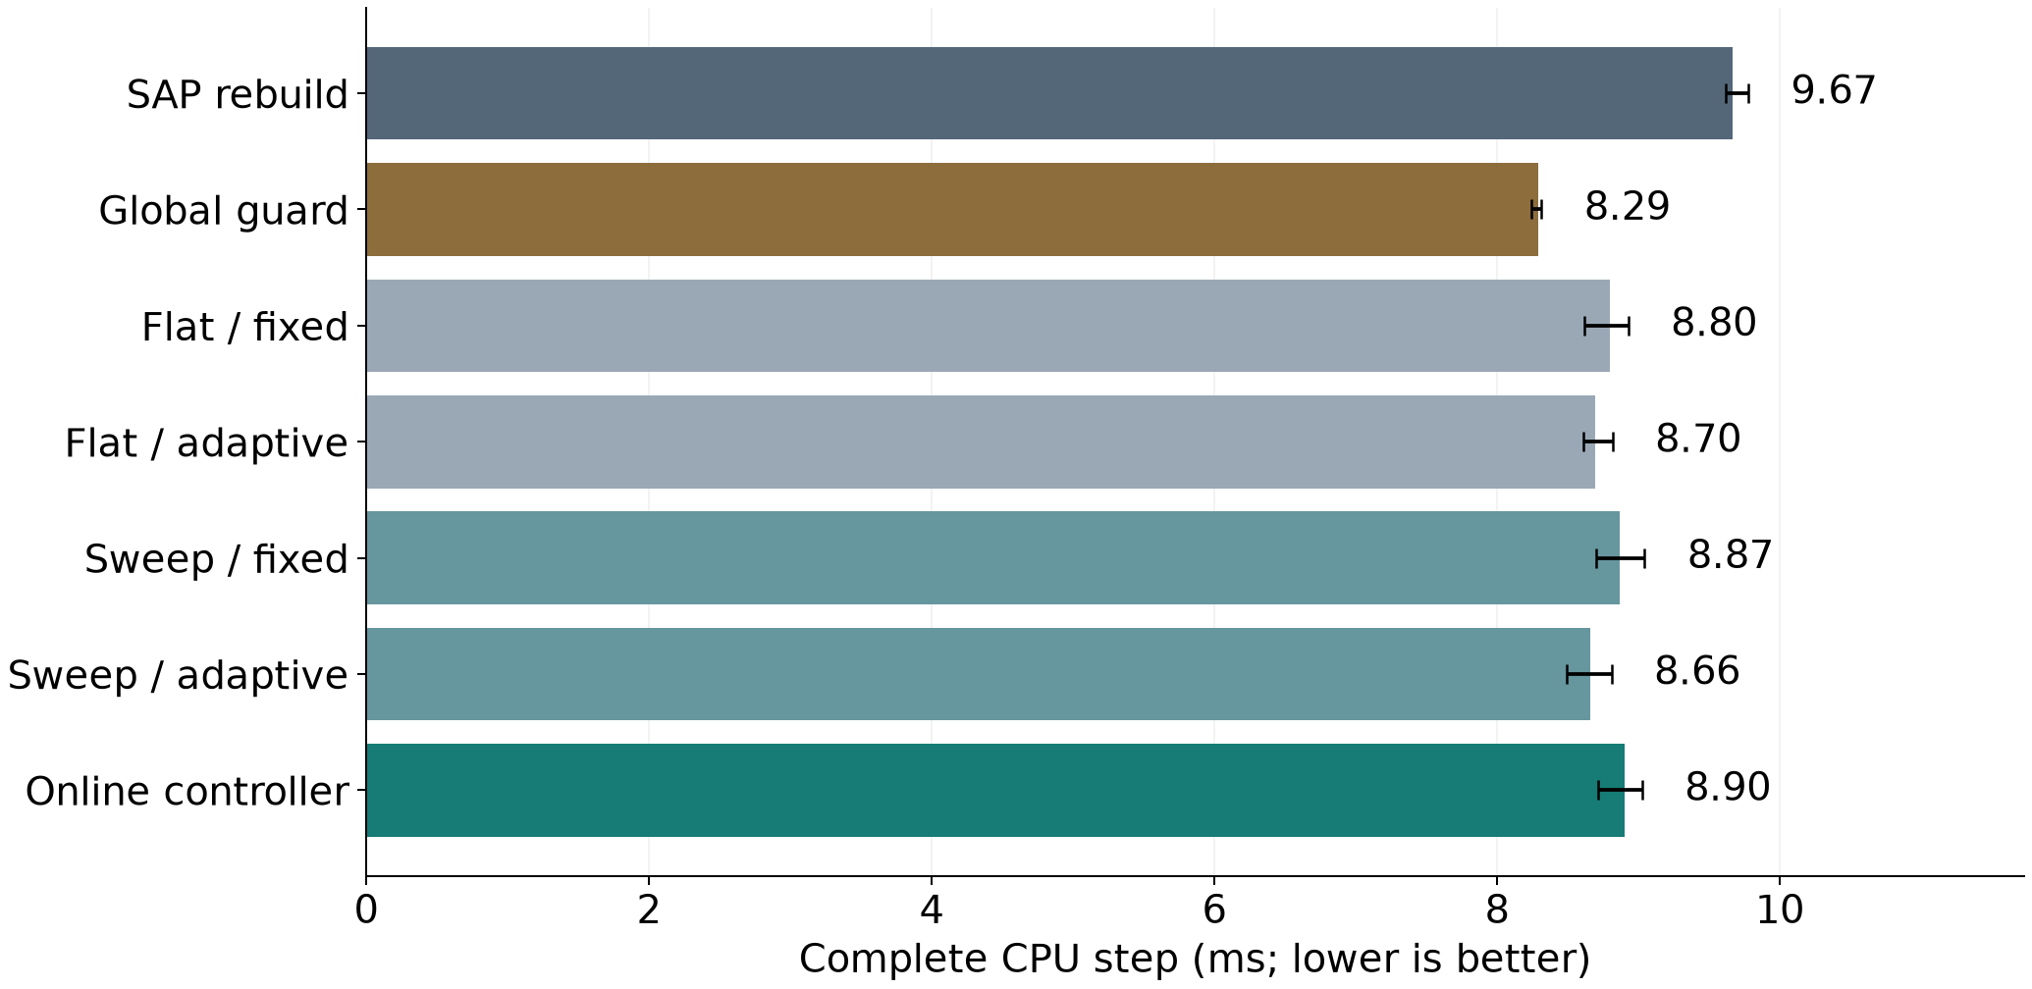
LOCAL RESULTS · THREE CLOTHS
Online improves on SAP here; global guard wins
7.9% below SAP
Online reduces full step
time in this fixture.
Global guard is faster
Adaptation overhead can
outweigh local pruning on
a small scene.
Bars: mean of three trial means. Whiskers: min–max trial means, not confidence intervals.
Swayam Singal · Kyoto research discussion · 2 November 2026
14
Notes:
Computed directly from fresh after/multicloth-{1,2,3}.csv, sheets=3, 52 timed steps per variant/trial. Full CPU timings include periodic audit costs. All 63 rows have maxPositionError=0. Online is not the fastest tested policy; small-fixture overhead can outweigh local pruning. Do not attribute this chart to an IPC/OGC adapter, GPU kernel or general speedup.

Slide 15
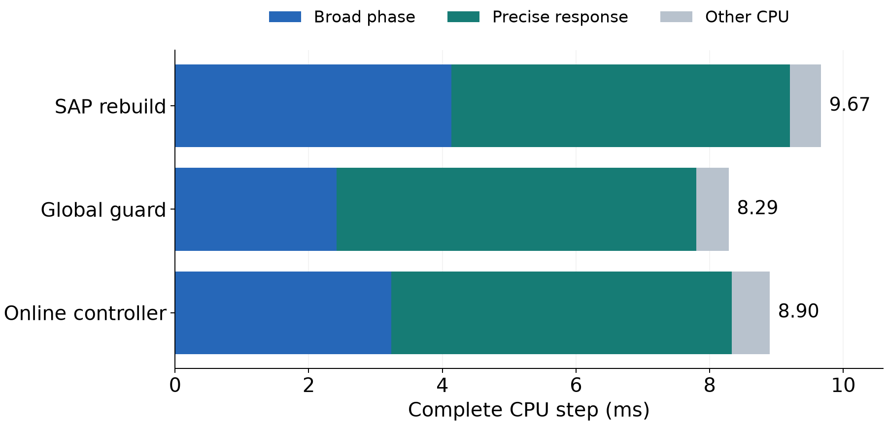
MEASURED STAGE BREAKDOWN · SAME THREE-CLOTH RUNS
The winning policy balances search and response
Global guard vs SAP
Broad phase
2.42 vs 4.13 ms
Precise response
5.38 vs 5.07 ms
Search savings exceed
the extra precise work.
Other CPU = total − broad − precise; includes constraints, periodic audit and controller work. Rendering excluded.
Swayam Singal · Kyoto research discussion · 2 November 2026
15
Notes:
Derived from the same three paired repetitions as the total-cost chart, not a separate benchmark. Each component is the mean of its per-trial means. Other CPU is an arithmetic residual from measured total/broad/narrow columns; it is not a separately instrumented kernel. The observed global-guard saving in broad time exceeds its increase in precise-response time. This explains the measured decomposition in this fixture, without claiming a universal winner or causal ablation of every component.

Slide 16
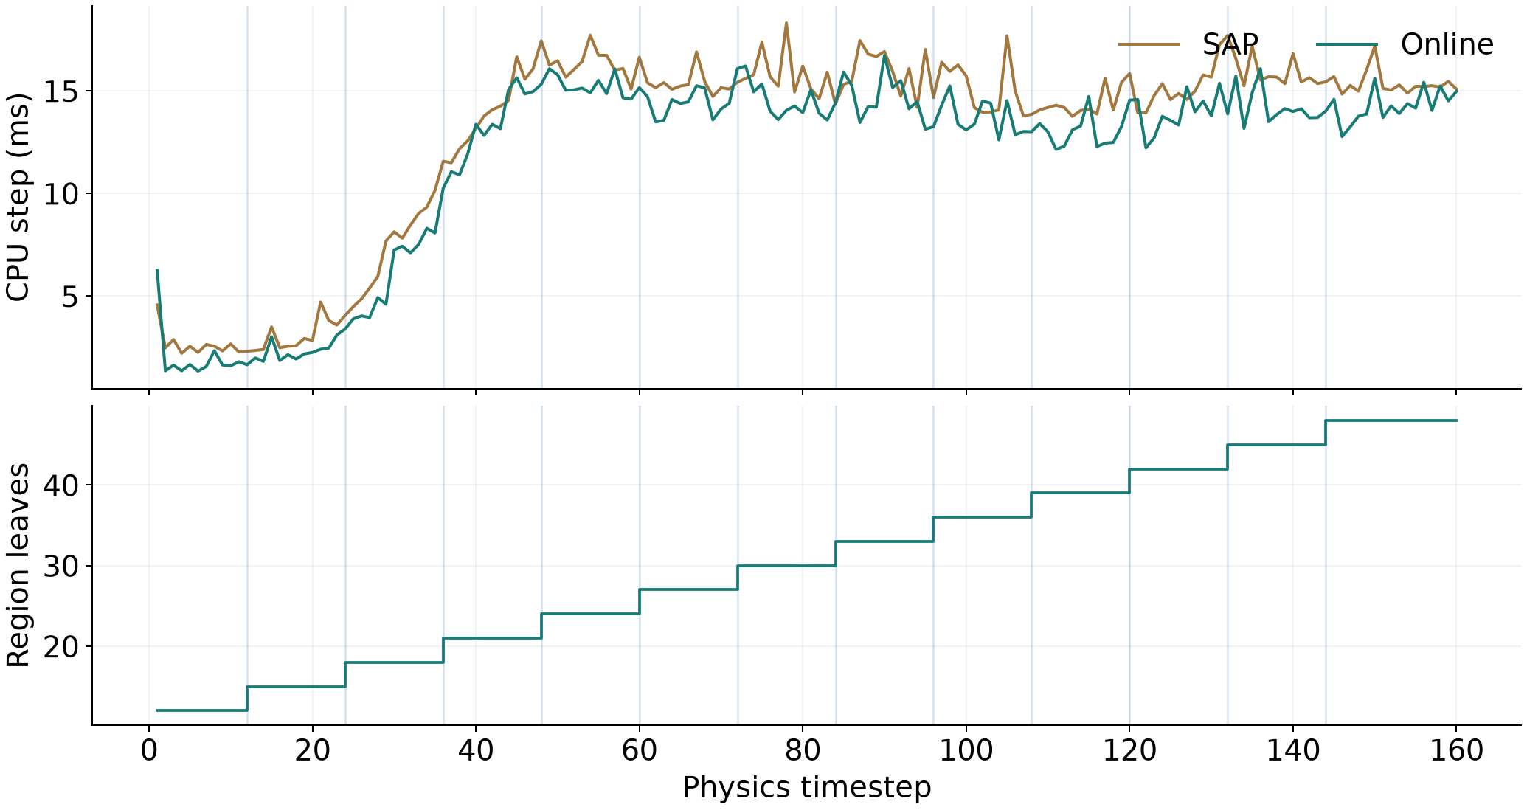
ONLINE CONTROL · FIRST OF THREE REPEATS
The trace shows real structural changes
12 splits · 4 switches
Rising leaf count means
more collision regions,
not a finer cloth mesh.
0 observed merges
Merge tested separately.
Spikes include audits.
Swayam Singal · Kyoto research discussion · 2 November 2026
16
Notes:
after/online-1.csv. Blue vertical markers indicate actual split frames; region count grows 12 to 48. This repeat performs 12 splits, zero merges, four strategy switches. All three repeats compare every frame with SAP with maximum error0 and audit11 frames each. The time spikes include periodic oracle work. Selection windows do not provide same-frame A/B causal proof.

Slide 17
CODE SAFETY AND REDUNDANCY
Audit fixes make the evidence harder to misread
Found | Changed | Verification
Finite inputs could overflow padding | Validate padded bounds and guards before cache use | Overflow + recovery regression
Redundant pair pass / dead helpers | Remove proven redundant unique pass and unused code | Multi-region uniqueness + equivalence
tee could hide failed benchmark | Bash pipefail; reject incomplete/invalid CSVs | Malformed-data and shell fixtures
Native trace / HUD ambiguity | Per-step scene, policy, grab and audit flags; fit HUD | Window captures and CLI checks
Seven Release test suites pass. The 480-step stability probe remains bounded.
Swayam Singal · Kyoto research discussion · 2 November 2026
17
Notes:
Exact changes and commands: CODE_AUDIT_CORE.md, EVIDENCE_METHODS_AUDIT.md, NATIVE_CASES.md and output/review-2026-11-02/VERIFICATION.md. Removal of one redundant pass is an optimization; no statistically established code-audit speedup is claimed. Sanitizer results are recorded separately. Native finite-state checks pause runaway motion.

Slide 18
LIMITATIONS AND CONSEQUENCES
What the present evidence does not establish
Contact safety
Physical model
Generalization
Discrete checks can miss fast crossings. AABB coverage does not prove continuous nonpenetration.
480-step motion stays bounded, but damping and 12,105 velocity clamps affect the trajectory. Material accuracy remains uncalibrated.
One small cloth family, fixed resolution, CPU code and heuristic control. No official IPC / OGC / CCFR adapter.
Matching trajectories protect this comparison; they do not certify physical accuracy.
Swayam Singal · Kyoto research discussion · 2 November 2026
18
Notes:
after/stability.log: max absolute coordinate2.45379, max frame displacement.08324, structural edge stretch1.14950, floor minZ.04000, velocityClamps12105 over480frames. These are implementation safeguards and engineering bounds, not physical calibration. No general historical originality or solver-independent performance claim.

Slide 19
NEXT RESEARCH STEPS
Three tests to strengthen the proposal
01
02
03
Challenge the policy
Integrate one method
Extend motion safety
Larger independent scenes, randomized execution order, and controller / stage-cost ablations.
Preserve the method’s solver, narrow phase and query requirements; replace candidate generation only.
Explicit swept bounds, robust CCD, and adversarial tests for folding and floating-point errors.
Does the benefit generalize?
Does the adapter preserve its contract?
Can the safety scope be expanded?
Swayam Singal · Kyoto research discussion · 2 November 2026
19
Notes:
Prioritize comparison to persistent dynamic BVHs and automatic pruning on compatible workloads, not only rebuild baselines. A true external adapter must preserve method-specific motion/offset requirements. Scalable CCD provides relevant conservative algorithms and benchmark data: https://continuous-collision-detection.github.io/scalable_ccd/

Slide 20
REFERENCES
Sources and reproducible evidence
IPC — Li et al., 2020 · Algorithm 1, Table 1, Fig. 23
OGC — Chen et al., 2025 · Table 1, Figs. 17–18
XPBD — Macklin et al., 2016 · compliant constraint formulation
CCFR — Kikuchi & Kanai, 2026 · §4.3, Table 1, Figs. 10–11
Metric choices: full runtime and collision-stage cost; contact workload;
method-specific convergence and remaining violations.
Local bundle: output/review-2026-11-02/
Raw CSVs · full native captures · logs · source/build hashes · verification report
Swayam Singal · Kyoto research discussion · 2 November 2026
20
Notes:
ipc: https://ipc-sim.github.io/file/IPC-paper-fullRes.pdf
ogc: https://ankachan.github.io/Projects/OGC/
xpbd: https://matthias-research.github.io/pages/publications/XPBD.pdf
ccfr: https://arxiv.org/html/2607.26901v1
physx: https://nvidia-omniverse.github.io/PhysX/physx/5.1.0/docs/RigidBodyCollision.html
ccd: https://continuous-collision-detection.github.io/scalable_ccd/
Evaluation anchors refer to quantities used in the papers, not numerical comparisons against them. OGC publication/project page checked; source paper location retained from earlier audit. All demo figures come from actual local C++ measurements or native framebuffers. No paper result image is substituted for implemented output.

