Slide 1
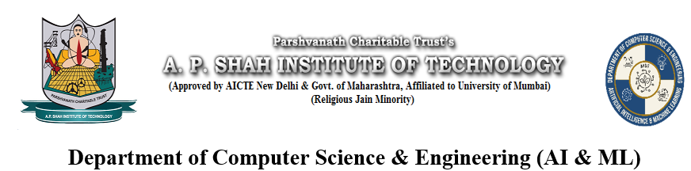
Music Streaming Web App with
Multilingual Features
NISHANT DAKUA (23106014)
ARIF CHOUDHARY (23106054)
RUSHI CHORAGHE (23106033)
SWAYAM BHOIR (23106025)
Project Guide
Ms. Sayali Badhan
Academic year 2024-25
Notes:
1

Slide 2
Introduction
This project aims to develop a user-friendly and innovative music streaming platform. In today's age music streaming has revolutionized how we listen to music. There are more than 615 millions monthly active music users in the world.
With this music streaming app, we are trying to fill the gap of different needs for all kinds of music listeners.
Motivation:
Unavailability of translated lyrics to songs in Hindi language.
Improper suggestions of songs of different genres.
Notes:
2

Slide 3
Literature Review
Title | Description | Challenges / Consideration
Machine Translation (MT) | Describes machine translation (MT), the use of computers to translate from one language to another. | Poetic language, idioms, slang, and cultural references are difficult for MT systems. Maintaining rhyme, rhythm, and meter is extremely challenging. MT systems are trained on general text, not specifically on lyrics.
Natural Language Processing (NLP) for Poetry/Literary Text | NLP techniques tailored to the specific characteristics of poetry and literary text. | Computational analysis of poetry is still an active research area. Transferring these techniques to song lyrics requires adaptation.

Slide 4
Title | Description | Challenges / Consideration
Lyrics to Audio Techniques | This paper presents a system that automatically synchronizes lyrics with music audio, using alignment techniques and text processing for accurate lyric display. | Automatically syncing lyrics is difficult, particularly with songs that have fast lyrics or varying tempos. It is hard to accurately determine the correct timing of each word or phrase in relation to the audio.
Cross-Lingual Word Embeddings/Represe ntations | Learning representations of words that capture semantic meaning across languages. These are crucial for improving MT and other cross-lingual tasks. | Capturing the nuances of musical and emotional context is difficult. Limited resources for some language pairs (English-Hindi-Marathi is relatively well-resourced, but still presents challenges).

Slide 5
Title | Description | Challenges / Consideration
Evaluation Metrics for Translation | Assessing the quality of translations. Human evaluation remains crucial, especially for creative text like lyrics. | Traditional metrics like BLEU may not be suitable for evaluating the artistic quality of lyric translations. Subjective nature of evaluating artistic merit.
Computational Musicology | Combining music analysis with NLP. Could be used to analyze the relationship between lyrics and music. | Integrating linguistic analysis with musical structure is complex.

Slide 6
Problem statement
Over the past few years, 32% of music listeners have faced difficulty to adjusting to changing UI designs of different music platforms like Spotify and iTunes. This project introduces a user convenient UI to browse music, create playlist and many more miscellaneous activities.
Leading music platforms don’t have translated lyrics to songs in alternate languages.

Slide 7
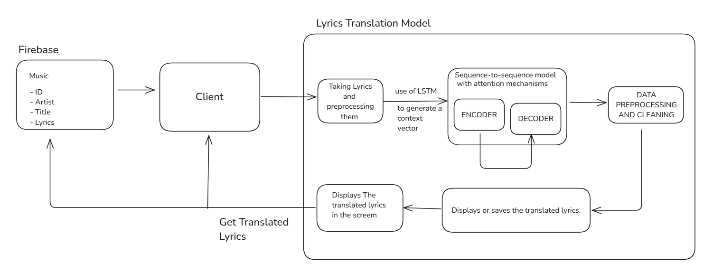
System Design
Notes:
7

Slide 8
Technologies and Methodologies
Frontend: React.js – Provides a dynamic and responsive user interface.
Backend: Node.js & Express.js – Handles API requests and server-side logic.
Database: Firebase Firestore – Stores translated lyrics and user preferences.
Language Translation Model:
Sequence-to-sequence: In this method the input sequence is transformed into an output sequence.
LSTM: These are kind of neural networks designed to handle long term dependencies in sequential order.
Encoder: The encoder processes the input lyrics and transforms it in a fixed length word vector.
Decoder: The decoder performs the reverse operation of encoder. And uses it to generate the lyrics into hindi language.
Output: The model can either display the translated lyrics directly on the screen or save them to the cloud database, like in this case Firestore.

Slide 9

Implementations (Screenshots of Implementations)
Initial Login Page

Slide 10
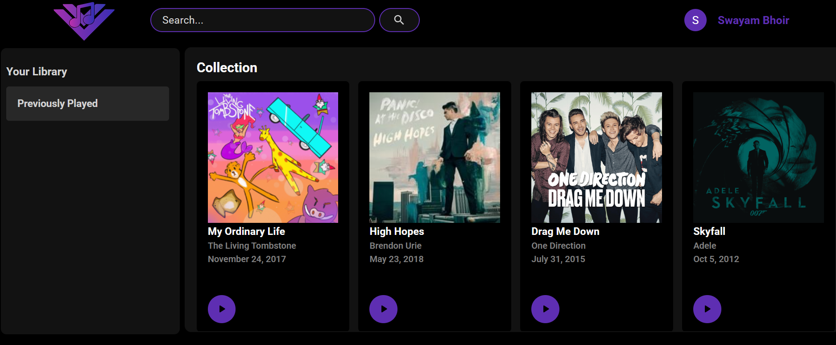
Implementations (Screenshots of Implementations)
Songs Collection Page

Slide 11
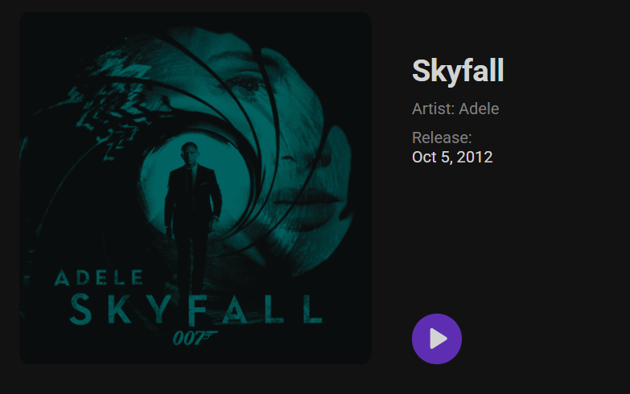
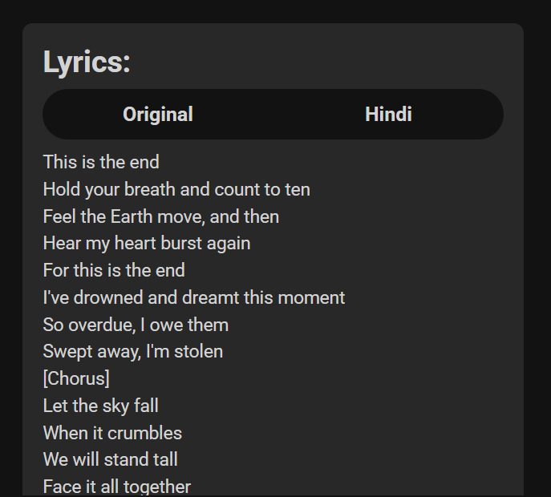
Implementations (Screenshots of Implementations)
Card for each song
Original Lyrics for each song

Slide 12
Conclusion
In conclusion, our Music Streaming Web App with Multilingual Features aims to bridge the gap between music and language barriers by providing real-time Hindi subtitles for English songs. By integrating AI-driven lyric translation, a user-friendly interface, our platform enhances the listening experience for a diverse audience.
This project not only improves music accessibility but also opens new opportunities for language learners, cultural exploration, and personalized content discovery.

Slide 13
References
Jurafsky D., Martin J. H., Speech and Language Processing, Standford University, NLP techniquest used for text translations, sentiment analysis, and language modeling (2021)
Vaswani A., Shazeer N. Parmaar N., Attention Is All You Need. Advances in Neural Information Processing Systems, A guide to speech-to-text and machine learning in Music, (2017)
Fujihara H., Goto M., Ogata J. & Okuno, H. G. (2011). Lyric Synchronization Using Music Audio Alignment and Text Processing. IEEE Transactions on Audio, Speech, and Language Processing (2011)
Peeters, G. A Large Set of Audio Features for Sound Description: Audio Representation for Music Information Retrieval (2004)
Marmik Pandya, NLP Based Poetry Analysis and Generation, Norteastern University (2016)
Anders Søgaard, Ivan Vuli´c, Sebastian Ruder, Manaal Faruqui, Cross-Lingual Word Embeddings, University of the Basque Country, 2019

Slide 14
Thank You...!!
Notes:
14

