Slide 1
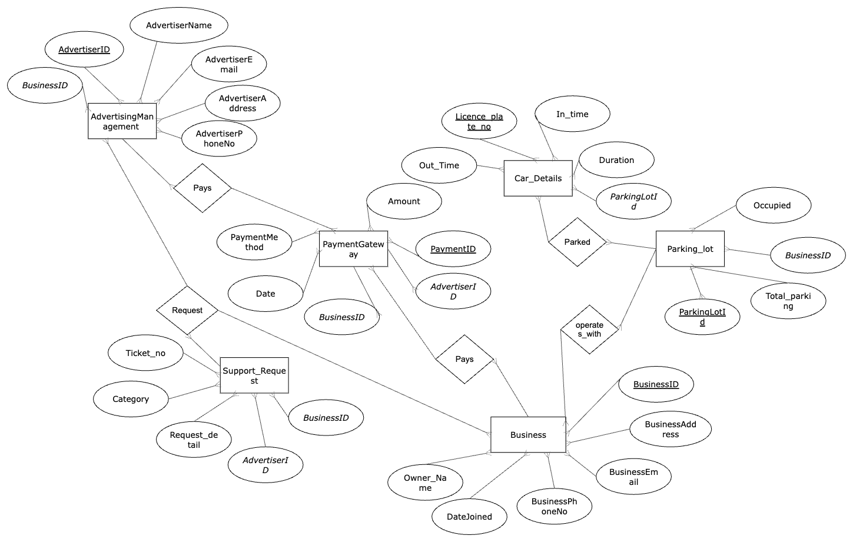
ER Diagram

Slide 2

Logical Diagram
Advertising_Management
Parking_lot
PaymentGateway
ParkingLotId (varchar)
TotalParkingNo (int)
BusinessID (varchar)
Occupied (int)
AdvertiserID (varchar)
BusinessID (varchar)
AdvertisementName (varchar)
AvertisementEmail (varchar)
AdvertisementPhoneNo (varchar)
AvertisementAddress (varchar)
PaymentID (varchar)
BusinessID (varchar)
Date (date)
PaymentMethod (varchar)
Amount (double)
AdvertiserID (varchar)
FK
FK
FK
One-to-many
One-to-many
Car_Details
FK
One-to-one
One-to-many
One-to-many
LicensePlateNo (varchar)
InTime (timestamp)
OutTime (timestamp)
Duration (double)
FK ParkingLotId (varchar)
One-to-many
Business
Support_Request
BusinessID (varchar)
BusinessAddress (varchar)
BusinessEmail (varchar)
BusinessPhoneNo (varchar)
OwnerName (varchar)
DateJoined (varchar)
TicketNo (varchar)
Category (varchar)
RequestDetails (varchar)
AdvertiserID (varchar)
BusinessID (varchar)
One-to-many
FK
FK

