Slide 1
Priyadarshini Bhagwati College of Engineering, Nagpur
Department of Information Technology
Session: 2026-2027
🧘
LTJSS
CEP Task Seminar on
YogaLife — 3D Interactive Yoga &
Wellness Android Application
Guided by
<Guide Name>
Presented by
Swayam Gulhane
<Group Member Names>

Slide 2
Contents
Introduction
Aim and Objectives
Problem / Issue Identified
Proposed Solution
Application Architecture & Features
Application Screenshots & Demo
Resources Required
Outcome & Future Scope
Priyadarshini Bhagwati College of Engineering, Nagpur | Department of IT

Slide 3
Introduction
YogaLife is an interactive 3D mobile wellness platform combining yogic traditions with modern real-time graphics and speech.
Built with React Native, Expo SDK 53, and Three.js to deliver native 60 FPS skeletal animations on Android devices.
Features a 19-bone articulated humanoid mannequin that demonstrates precise posture geometry from 360° angles.
Integrates synchronized bilingual Hindi (हिंदी) and English voice guidance powered by Android Text-To-Speech.
Priyadarshini Bhagwati College of Engineering, Nagpur | Department of IT

Slide 4
Aim and Objective
Aim: To design and develop an interactive 3D Android yoga application offering real-time pose visualization and synchronized bilingual audio instruction.
Objectives:
Construct 3D skeletal humanoid models demonstrating correct biomechanical alignment.
Develop a synchronization engine pairing spoken cues with 3D pose transitions.
Provide bilingual accessibility across both Hindi and English with live subtitles.
Integrate wellness features including Pranayama breathwork and scheduled alarms.
Priyadarshini Bhagwati College of Engineering, Nagpur | Department of IT

Slide 5
Problem/Issue Identified
2D Visual Limitations: Static images and pre-recorded videos cannot be rotated or viewed from custom angles, obscuring subtle joint placements.
Language Accessibility Barriers: Existing yoga apps primarily provide English narration, excluding millions of native Hindi speakers.
Lack of Real-Time Breath Coordination: Users struggle to pace inhalation and exhalation with physical body movements.
High Risk of Postural Injury: Practicing without alignment feedback or beginner modifications frequently causes muscular strains.
Priyadarshini Bhagwati College of Engineering, Nagpur | Department of IT

Slide 6
Proposed Solution
Interactive 3D Skeletal Mannequin: 19-bone articulated rig offering 360° touch rotation, pinch-zoom, and 4 perspective presets (Front, Side, Back, Reset).
Synchronized Bilingual Speech Engine: Dual Hindi & English TTS coordination tying step progression directly to narration timestamps.
Comprehensive 15+ Pose Library: Sanskrit, English, and Hindi names, breathing cues, alignment guidance, benefits, and safety precautions.
Integrated Wellness Ecosystem: Smart practice alarms with loud ringtones, animated Pranayama breath pacing, and persistent streak tracking.
Priyadarshini Bhagwati College of Engineering, Nagpur | Department of IT

Slide 7
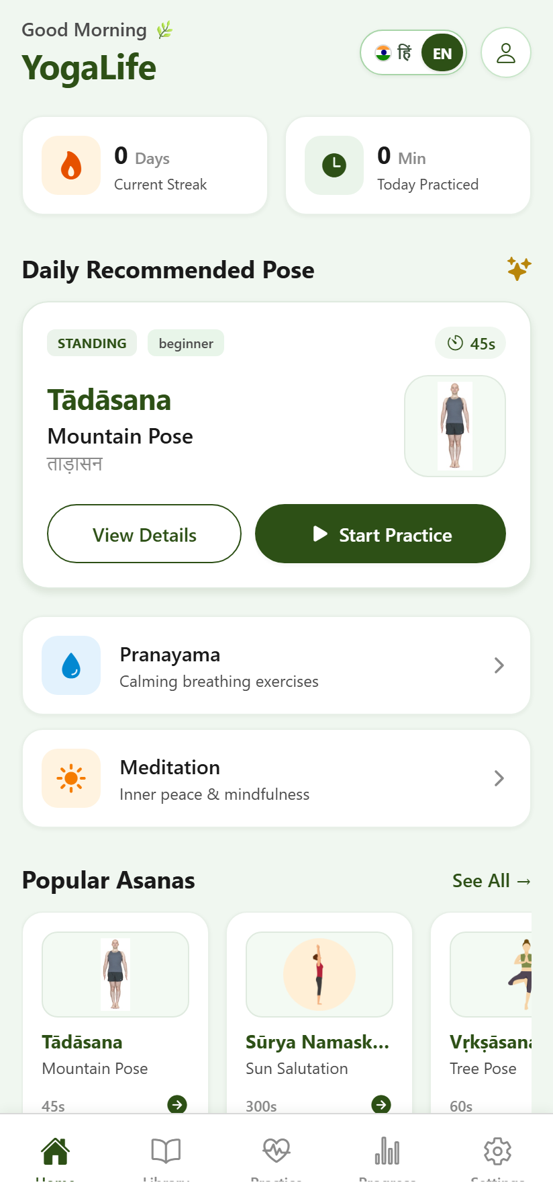
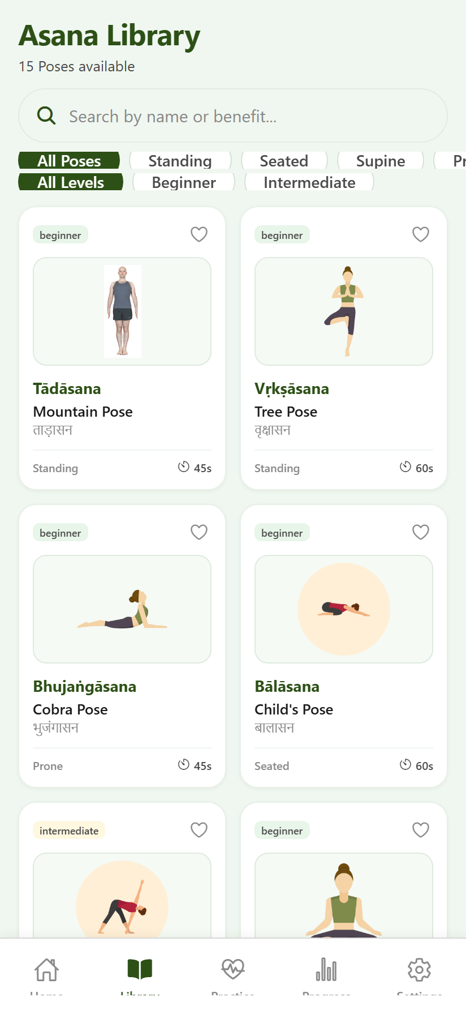
Application Screenshots — Home & Library
Key UI Capabilities:
Dynamic bilingual greeting and flame streak counter.
One-tap Hindi (हिंदी) and English language toggle switch.
Live search bar across Sanskrit and Hindi keywords.
Filter chips for Standing, Seated, Prone & Inversion poses.
Direct access to Pranayama breathwork & meditation.
Home Screen
Streak, Daily Pose & Quick Start
Pose Library
Filter by Category & Difficulty
Priyadarshini Bhagwati College of Engineering, Nagpur | Department of IT

Slide 8
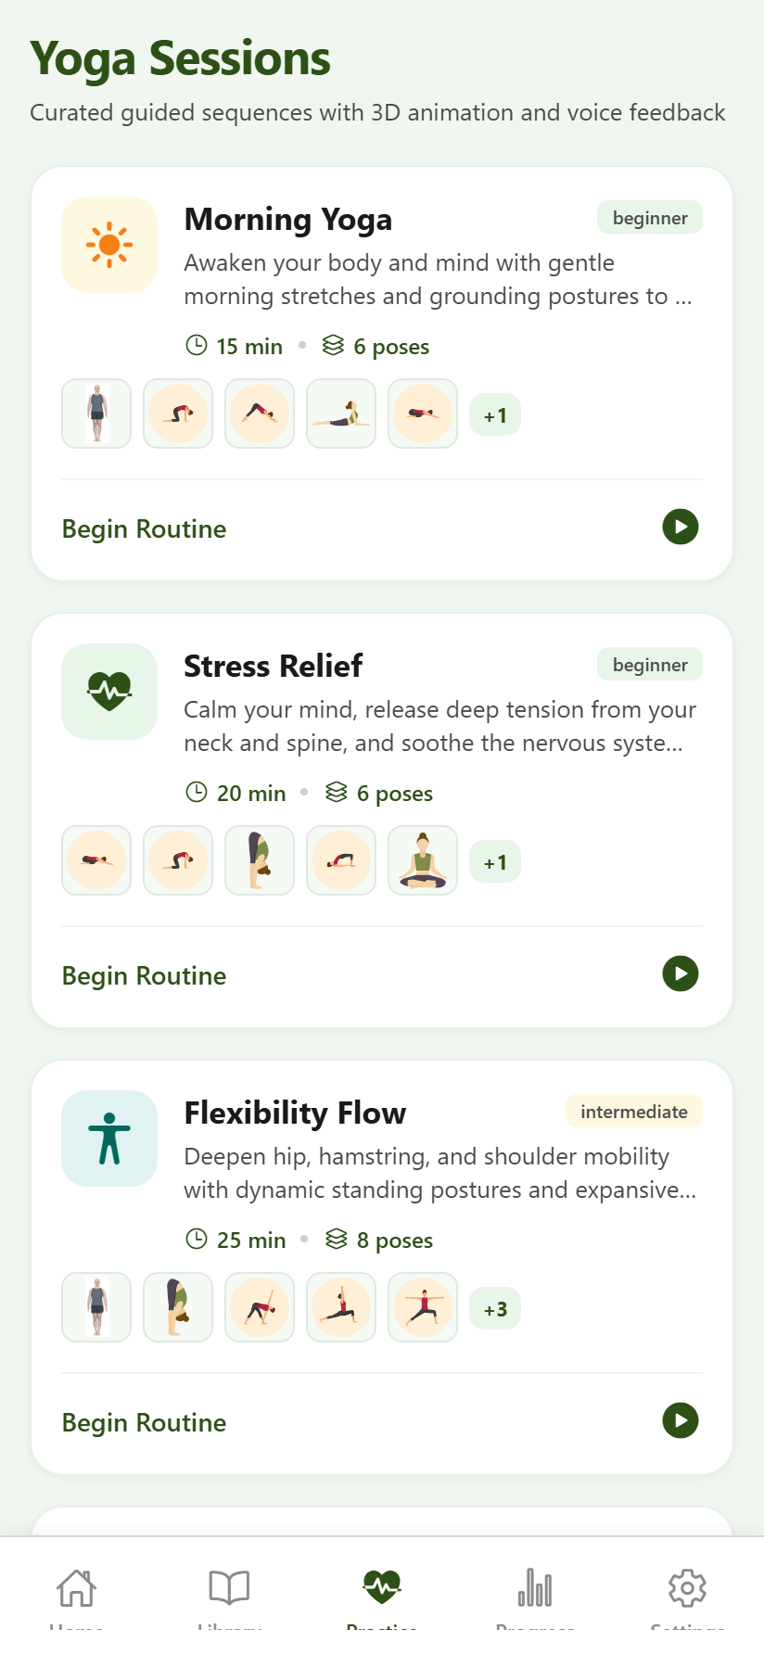
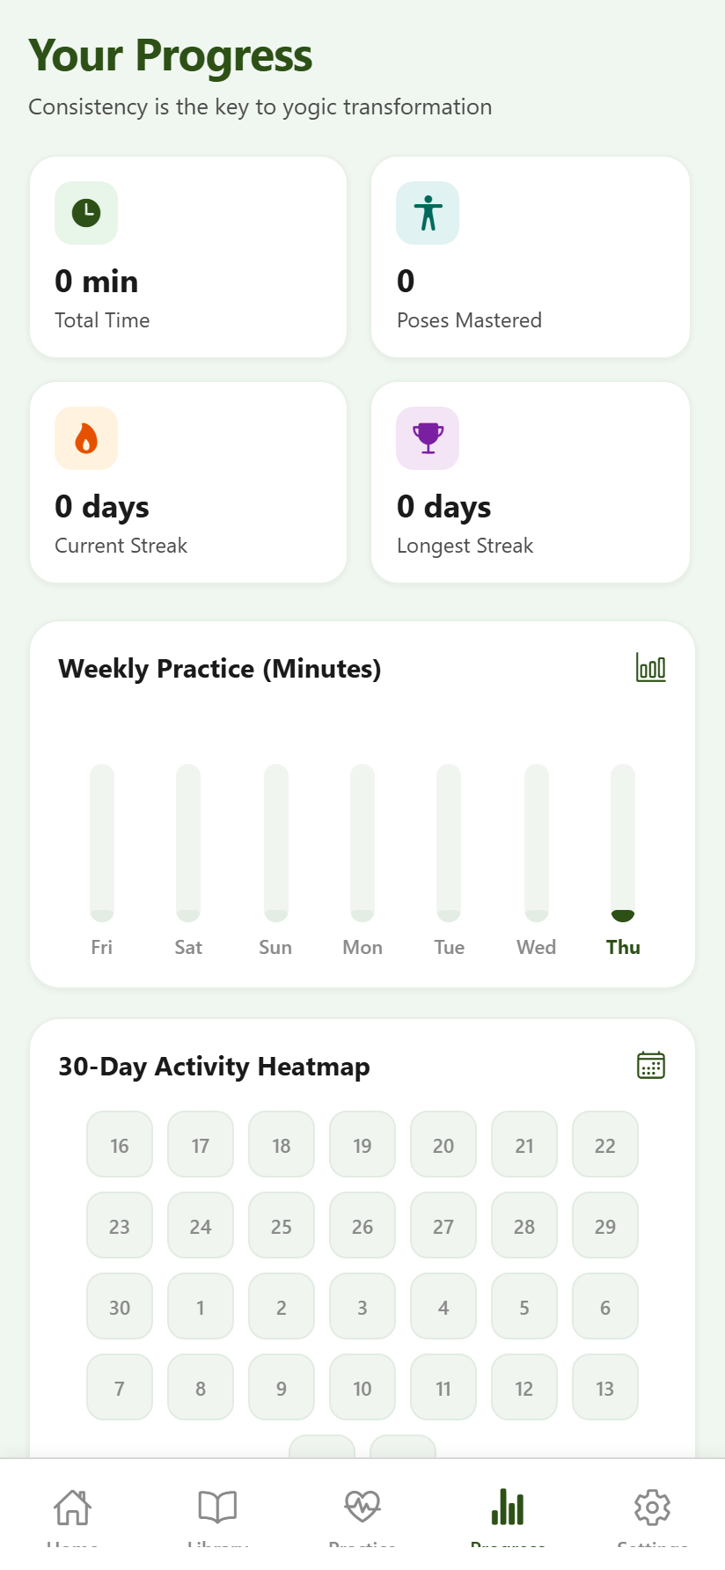
Application Screenshots — Practice & Progress
Practice & Tracking Flow:
6 Curated flows: Morning Yoga, Stress Relief & Surya Namaskar.
Duration & difficulty tags for structured yogic routines.
30-Day calendar heatmap tracking daily consistency.
Dynamic weekly practice chart with total minutes practiced.
Persistent storage retention with AsyncStorage.
Practice Sessions
Curated Multi-Pose Flows
Progress Tracker
Heatmap & 7-Day Analytics
Priyadarshini Bhagwati College of Engineering, Nagpur | Department of IT

Slide 9
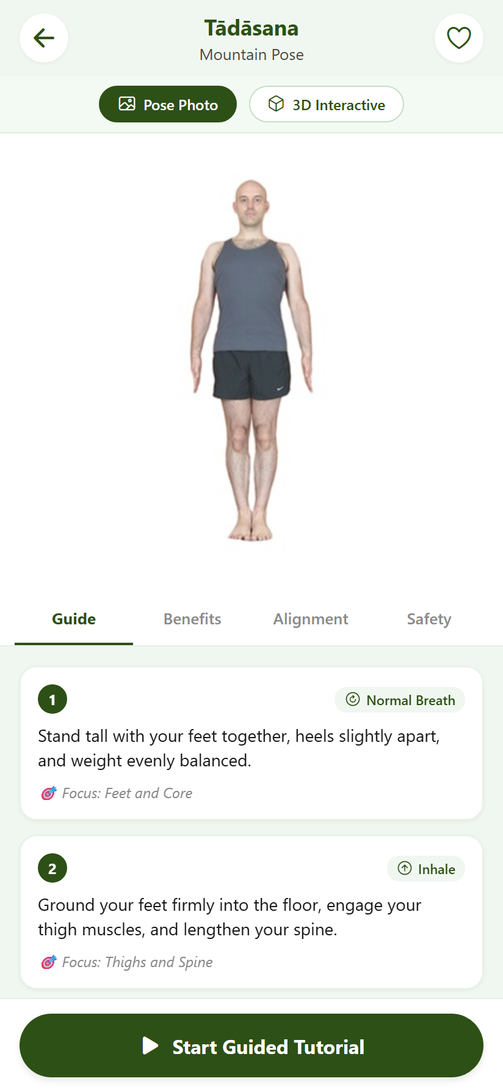
Application Screenshots — 3D Pose Viewer
3D Engine & Guidance Features:
Real-time 3D Canvas rendering at 60 FPS using Expo-GL & Three.js.
Touch Orbit Controls: Drag for 360° rotation and pinch to zoom in/out.
Camera Presets: Front, Side, and Rear angle buttons for quick alignment check.
Four segmented tabs: Instructions, Yogic Benefits, Alignment, Precautions.
One-click "Start Guided Tutorial" for voice-synchronized guided practice.
Pose Detail & 3D Viewer
Tadasana (Mountain Pose)
Priyadarshini Bhagwati College of Engineering, Nagpur | Department of IT

Slide 10
Resources Required
Software Requirements:
Operating System: Windows 11 / Linux / macOS for cross-platform development.
Frontend & Runtime: React Native, Expo SDK 53, and Node.js v24.
3D Graphics Engine: Three.js with Expo-GL WebGL context bindings.
Audio & Speech: Android native Text-To-Speech API (expo-speech) and Expo-AV.
Hardware Requirements:
Target Device: Mid-range Android smartphone (Android 9.0+, 3GB+ RAM, WebGL 2.0).
Development Machine: Quad-core 64-bit processor, 8GB+ RAM, 20GB free storage.
Priyadarshini Bhagwati College of Engineering, Nagpur | Department of IT

Slide 11
Outcome
Delivered an interactive, production-ready 3D Android yoga learning platform with 15+ verified asana models.
Successfully unified skeletal 3D character animation with synchronized bilingual Hindi & English speech narration.
Eliminated dependencies on paid AI voice APIs by utilizing Android native speech synthesis engines.
Deployed live production web build (https://dist-navy-nu-38.vercel.app) with full multi-device accessibility.
Priyadarshini Bhagwati College of Engineering, Nagpur | Department of IT

Slide 12
Thank You
Questions & Discussion
Priyadarshini Bhagwati College of Engineering, Nagpur
Department of Information Technology
Session: 2026-2027
Project: YogaLife — 3D Interactive Yoga & Wellness Android App
Live Demo: https://dist-navy-nu-38.vercel.app

