Slide 1

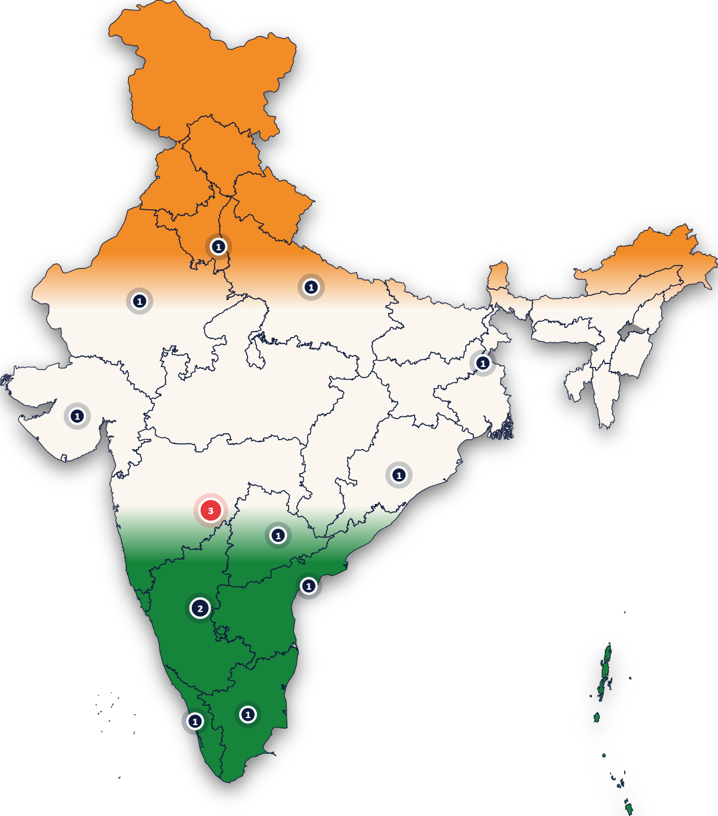
D3COY 1.0 · DJS ISACA WITH C-DAC · PS-01
Odyssey
National cyber threat early warning, running entirely on one laptop.
It reads the public threat record and its own sensors, finds what threatens India’s critical operators across six sectors and twelve states, and warns each in its own language, hours to weeks before the incident.
0 cloud calls 13 intelligence sources 22 Indian languages
Team Odyssey · 1 November 2026
Legend PS-01: Problem Statement 01 · SIM: simulated data, labelled as such · ISACA: Information Systems Audit and Control Association · C-DAC: Centre for Development of Advanced Computing · DJS: Dwarkadas J. Sanghvi College of Engineering
On the map: the 15 operators we protect (simulated, labelled SIM), by state; the red one is the suspected compromise open right now.
Notes:
Open with one sentence: Odyssey is a national cyber threat early warning system that runs entirely on this laptop, with zero cloud calls. Everything shown today is live on the machine in front of you.

Slide 2

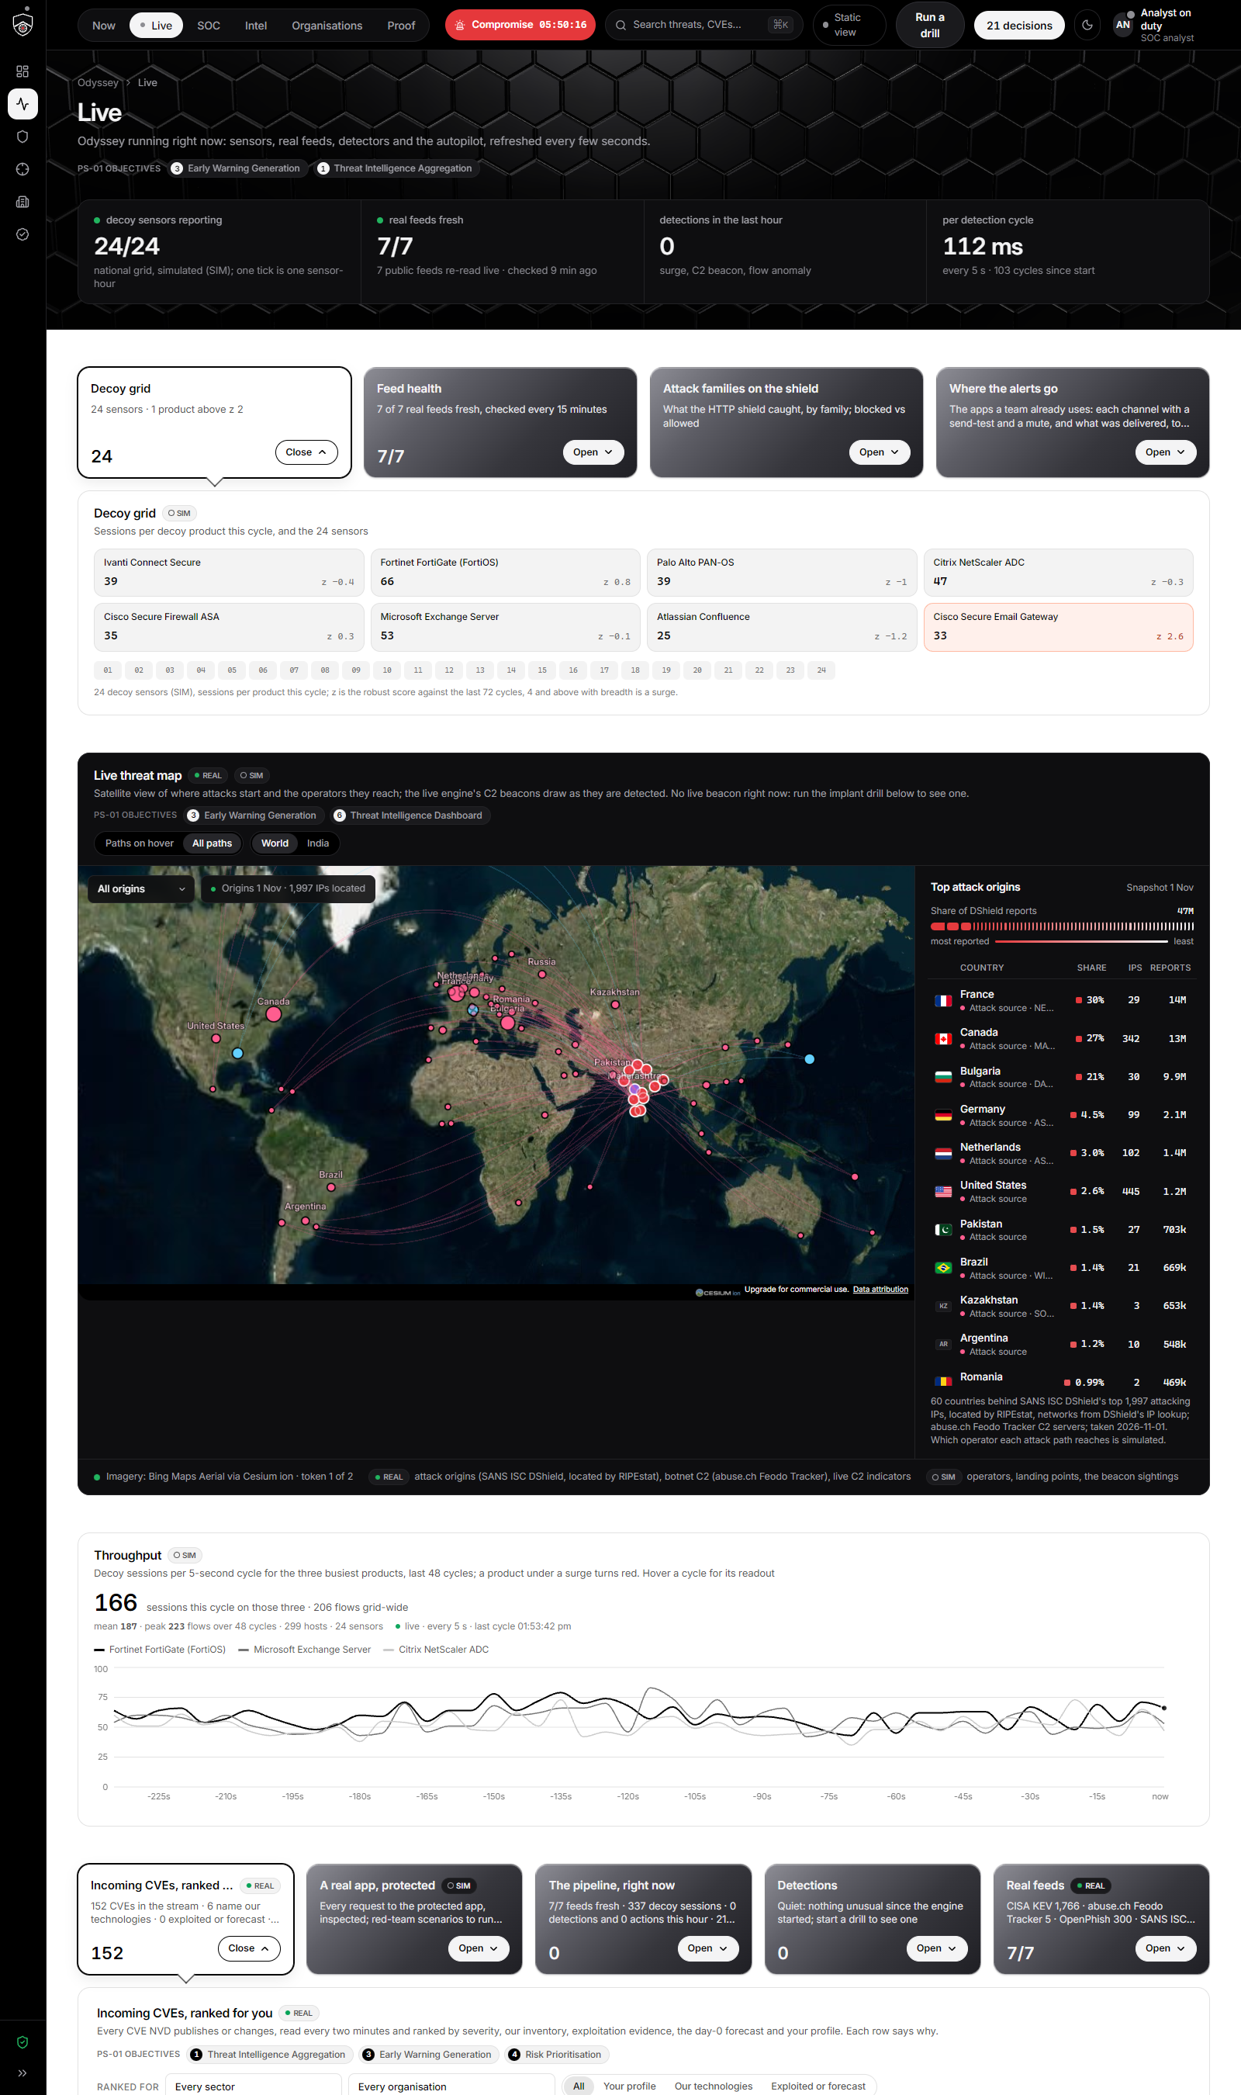
PROBLEM STATEMENT · PS-01
Security teams see the attack after it has happened.
Threats evolve faster than teams
Newly discovered vulnerabilities, phishing campaigns, malware and attacks on digital infrastructure, every day.
Many sources, no single picture
Intelligence arrives from many feeds, so it is hard to spot what is emerging, correlate incidents and decide which systems come first.
Reaction, not anticipation
Traditional approaches react once suspicious activity has occurred. The brief asks for a proactive system that warns before threats become incidents.
Real attack origins this week: SANS ISC DShield’s top 1,997 attacking IPs located by RIPEstat, reaching India’s operators.
“A need for an intelligent, proactive system that can analyse available cyber threat intelligence, identify emerging attack patterns, and generate early warnings before threats develop into major security incidents.” — the brief
Legend PS-01: Problem Statement 01 · DShield: SANS Internet Storm Center’s distributed sensor network · SANS ISC: SANS Internet Storm Center
Odyssey · D3COY 1.0 · PS-01 · AI-Based National Cyber Threat Early Warning System
2
Notes:
The problem is not a shortage of threat information but the opposite: teams drown in feeds and still react late.

Slide 3
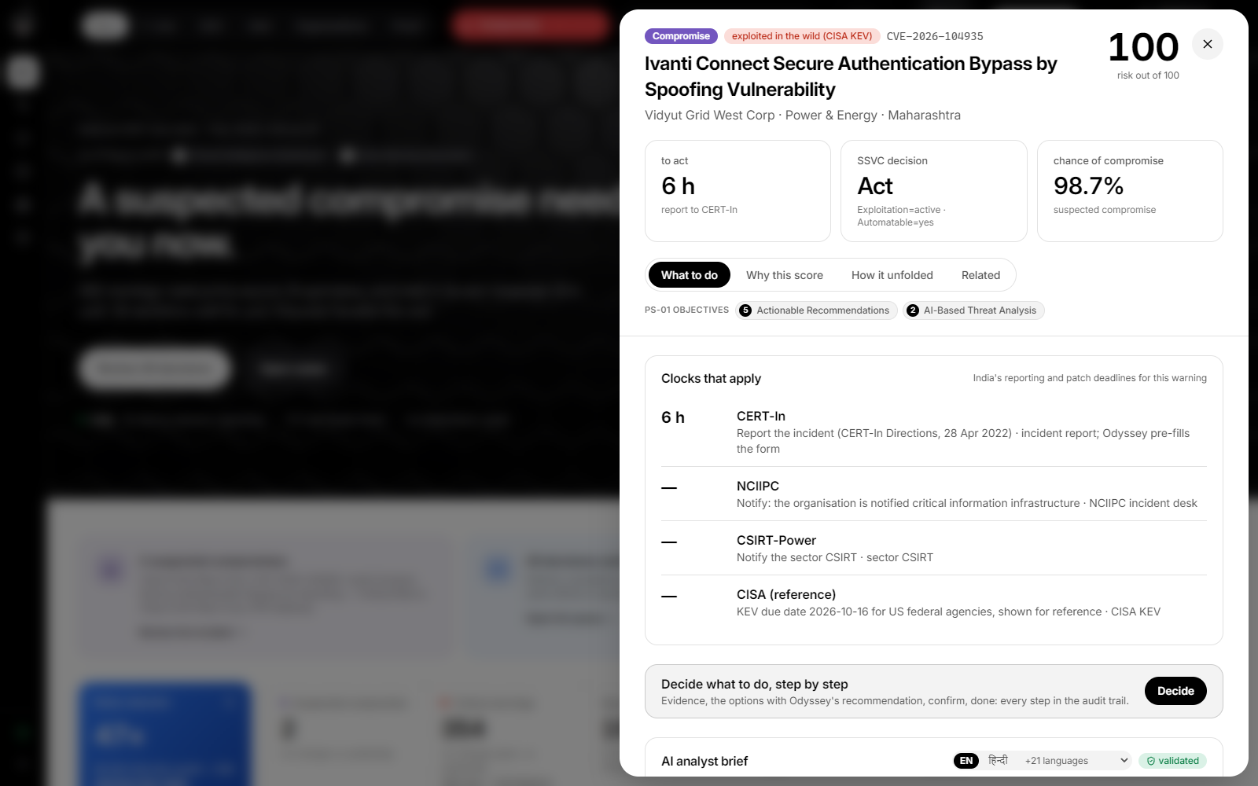
THE CHALLENGE
Turn raw threat information into three answers an analyst can act on.
1
What is happening?
Suspicious patterns, emerging campaigns and the systems they touch, correlated across every source.
2
Which assets are at risk?
A new advisory, matched against the inventory: who runs the affected software, in which version, reachable from where.
3
What to do first?
A prioritised risk score, an early warning that explains itself, and the preventive measure to take now.
One warning answers all three: what it is and how urgent, which assets and versions, and what to do, with the clocks that apply.
Expected solution: a dashboard of incoming intelligence, an AI-generated threat summary, a prioritised risk score and an early warning that explains why. Odyssey ships all four, measured.
Legend PS-01: Problem Statement 01
Odyssey · D3COY 1.0 · PS-01 · AI-Based National Cyber Threat Early Warning System
3
Notes:
We read the challenge as three questions an analyst must answer in under a minute. Every screen in Odyssey is built around one of them.

Slide 4
WHAT WE BUILT
One early-warning loop for the nation’s critical operators.
15
6
13
12
operators, SIM
NCIIPC sectors
intelligence sources
states
Power, banking, telecom, transport, government and strategic enterprises, each operator warned in its own language.
Legend NCIIPC: National Critical Information Infrastructure Protection Centre · SIM: simulated data, labelled as such
Notes:
Section divider. The map shows the simulated constituency: fifteen operators across twelve states; the red marker is the suspected compromise.

Slide 5
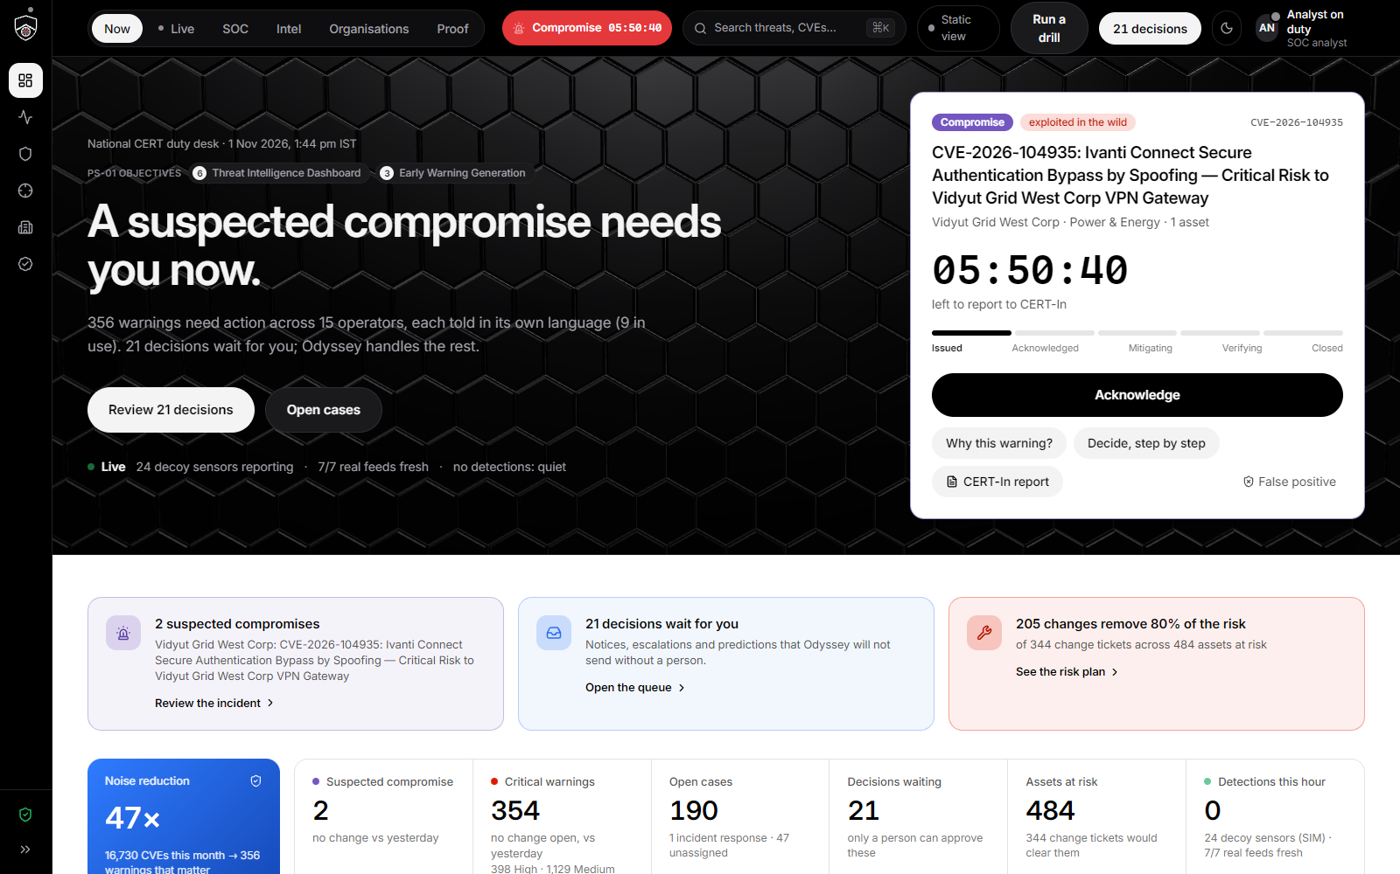
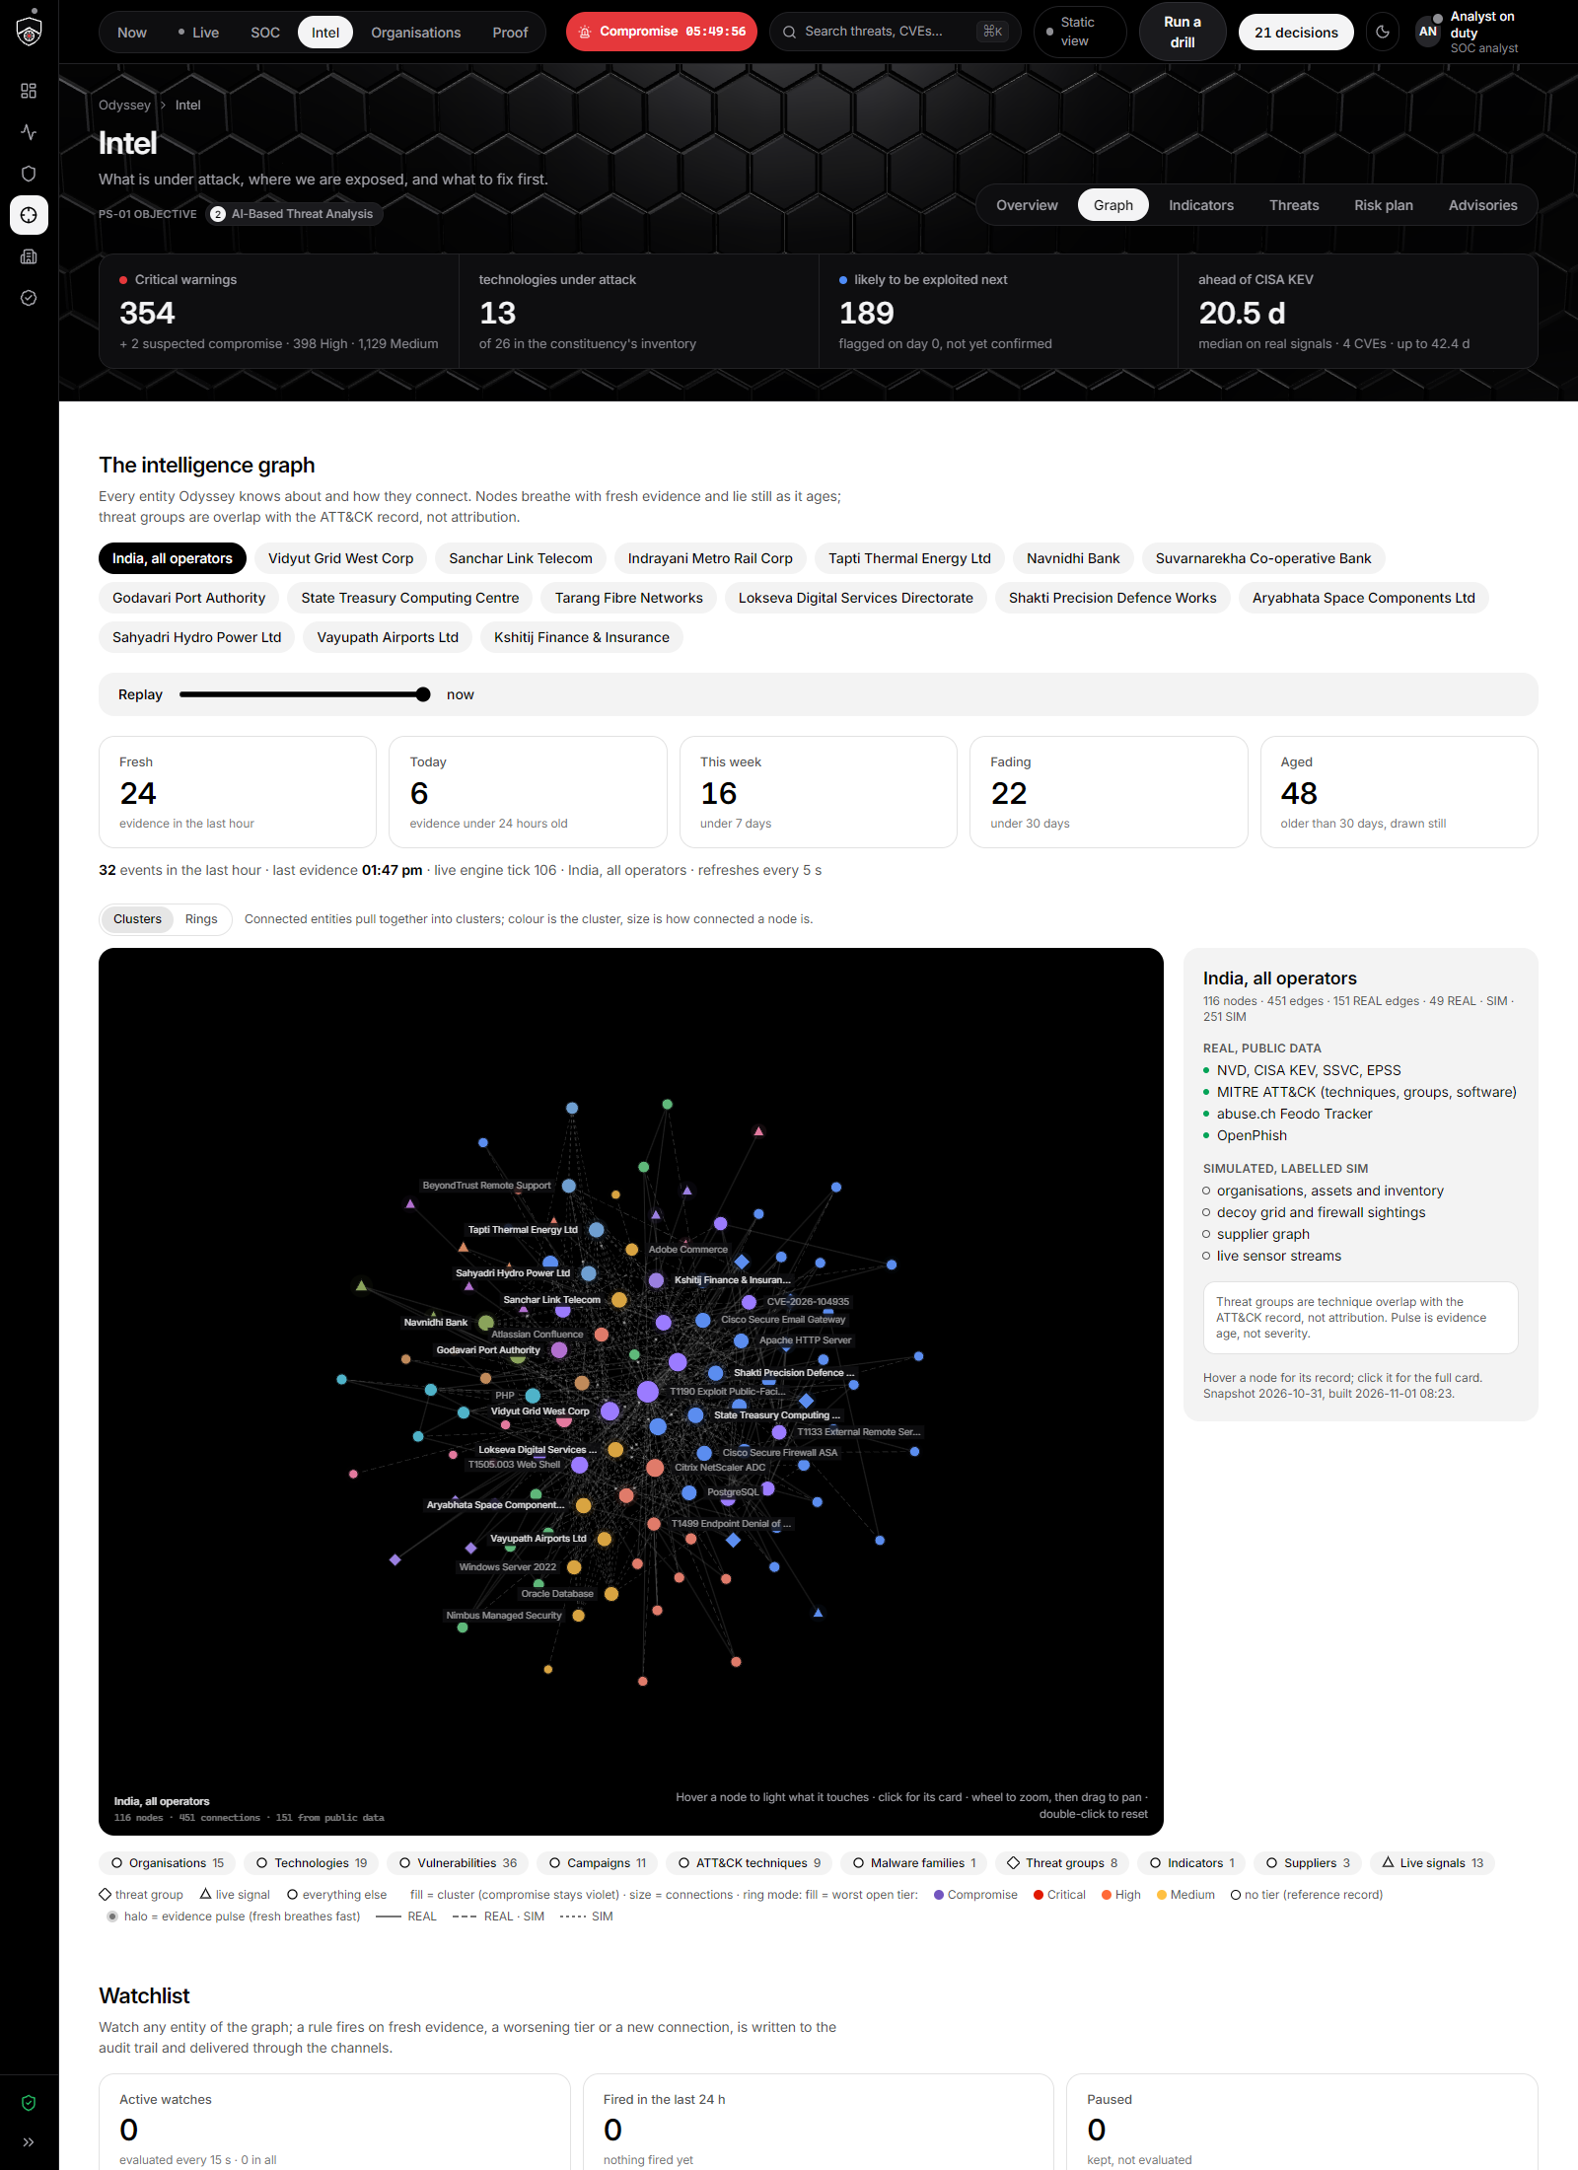
OUR SOLUTION
Odyssey closes the loop: six objectives, one pipeline, one audit trail.
1
Aggregate
2
Analyse
3
Warn
4
Prioritise
5
Act
6
See
13 sources, snapshot-backed and re-read live
Security LLMs, SecureBERT, forecast, Bayes, detectors
NVD every 2 min, surges, day-0 flags, 22 languages
Risk = 100·R·K·(0.55L + 0.30S + 0.15V), SSVC, clocks
Fixed release, block, hunt, risk plan, decide step by step
Duty desk, satellite map, SOC, graph, organisations, proof
Now: the duty desk
Live: the satellite threat map
Intel: the intelligence graph
Legend PS-01: Problem Statement 01 · NVD: National Vulnerability Database (NIST) · SSVC: Stakeholder-Specific Vulnerability Categorization · SOC: Security Operations Centre
Odyssey · D3COY 1.0 · PS-01 · AI-Based National Cyber Threat Early Warning System
5
Notes:
Six steps, in the order the brief lists its key objectives, and the three screens where the loop is visible.

Slide 6
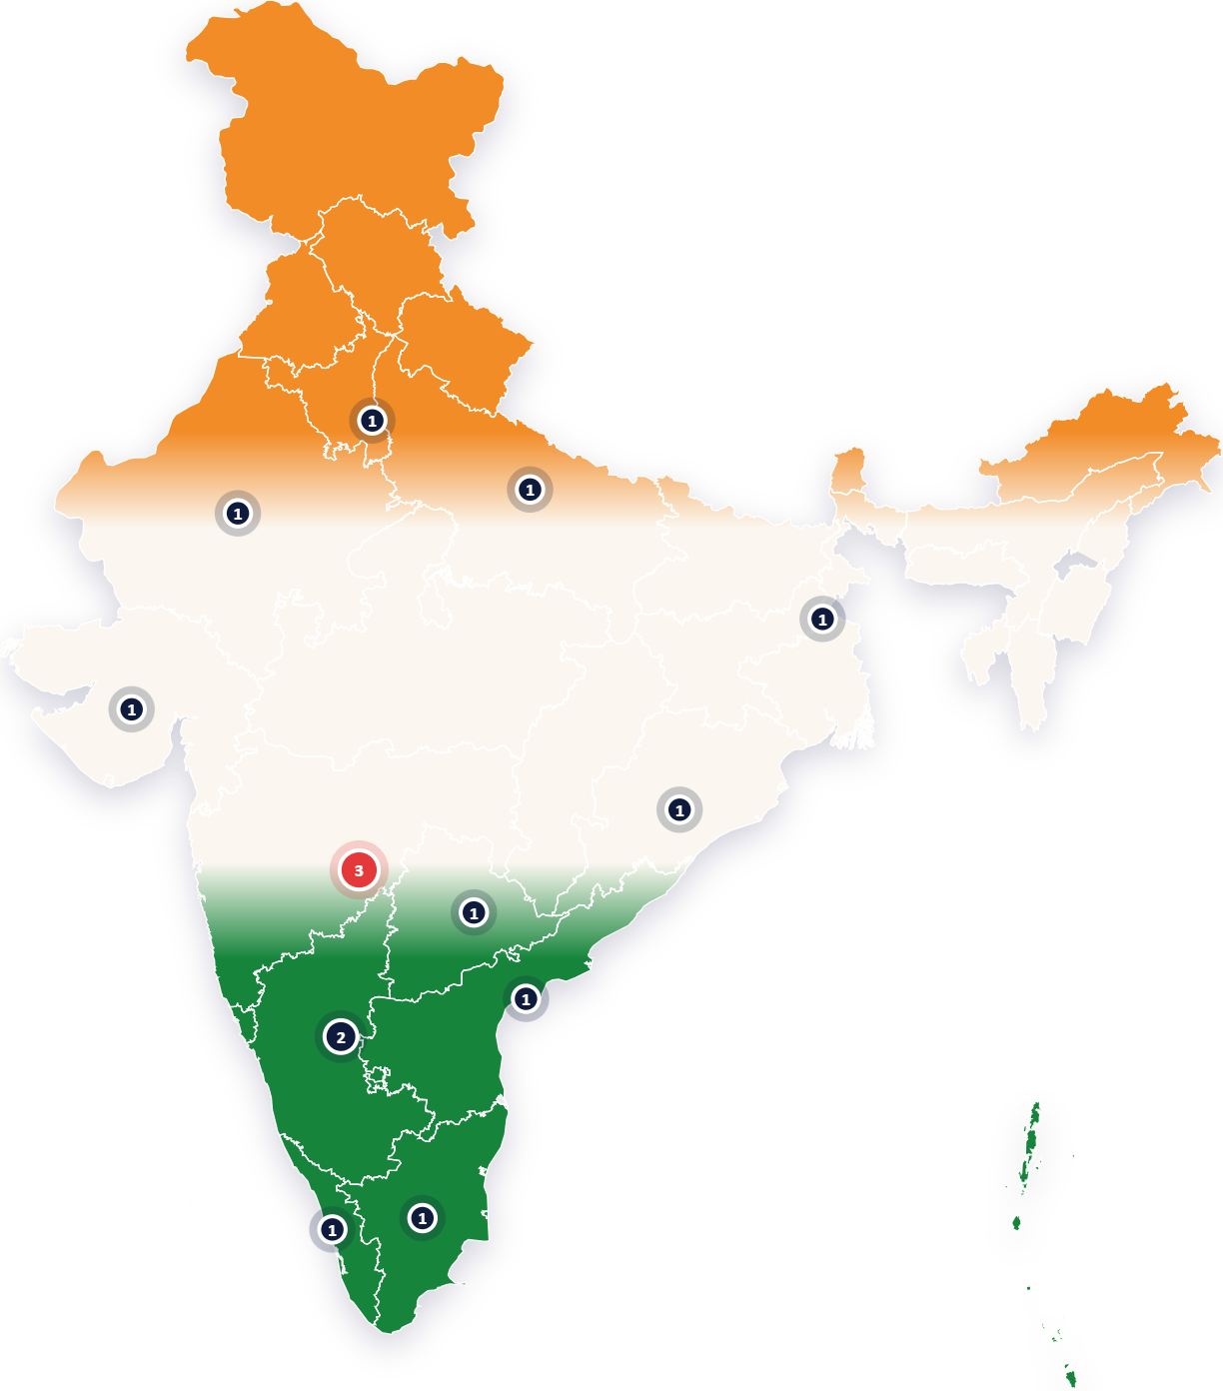
THE SIX KEY OBJECTIVES
Each objective has a home in the product, and the screen says so.
1
Threat Intelligence Aggregation
In Odyssey: Intel › Overview, Live › Real feeds, Indicators in and out (STIX, TAXII)
2
AI-Based Threat Analysis
In Odyssey: The AI brief on every warning, advisory analysis, the intelligence graph, the day-0 forecast
3
Early Warning Generation
In Odyssey: The duty desk, the Live page (NVD intake, detectors, drills), SOC › Warnings
4
Risk Prioritisation
In Odyssey: Why this score on every warning, the ranked warning list, Intel › Risk plan, Organisations
5
Actionable Recommendations
In Odyssey: What to do on every warning, SOC cases with playbooks, change tickets, step-by-step decision support
6
Threat Intelligence Dashboard
In Odyssey: Now, SOC › Overview, Intel › Overview, Organisations, the satellite threat map
Every page, tab and warning sheet carries the pill of the objective it answers.
Operators by state (SIM); red: the suspected compromise
Legend PS-01: Problem Statement 01 · NVD: National Vulnerability Database (NIST) · STIX: Structured Threat Information Expression · TAXII: Trusted Automated Exchange of Intelligence Information · SOC: Security Operations Centre · SIM: simulated data, labelled as such
Odyssey · D3COY 1.0 · PS-01 · AI-Based National Cyber Threat Early Warning System
6
Notes:
This is the traceability table from our plan, made visible in the product itself.

Slide 7
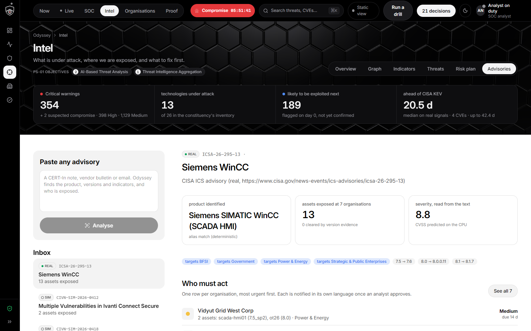
THE BRIEF’S EXAMPLE USE CASE, LIVE
A new advisory arrives. Within seconds, every exposed operator has a warning.
1
Arrive
A real CISA ICS advisory for Siemens WinCC, or a CVE from NVD read every two minutes.
2
Correlate
Version ranges parsed and checked against installed versions: 13 WinCC assets at 7 operators.
3
Score
Risk out of 100, an SSVC tier, the CERT-In deadline and a day-0 exploitation forecast.
4
Warn
A validated AI brief, the named fixed release, indicators to block, the hunt steps.
5
Decide
Intel › Advisories: the real CISA advisories matched to the inventory; the WinCC one touches 13 assets at 7 operators and proposes notices in their languages.
Notices go out in each operator’s language once an analyst approves; every step is in the audit trail.
Evidence-based warnings go out on their own; predictions and escalations wait for a person. The time from publication to warning is a ledger event, shown on the Live page.
Legend PS-01: Problem Statement 01 · CVE: Common Vulnerabilities and Exposures · NVD: National Vulnerability Database (NIST) · CISA: Cybersecurity and Infrastructure Security Agency (US) · SSVC: Stakeholder-Specific Vulnerability Categorization · CERT-In: Indian Computer Emergency Response Team · ICS: Industrial Control Systems
Odyssey · D3COY 1.0 · PS-01 · AI-Based National Cyber Threat Early Warning System
7
Notes:
This is the brief’s own example, run live on real data.

Slide 8
OBJECTIVE 6 · THREAT INTELLIGENCE DASHBOARD
The duty desk: what needs a person right now, with its clock and its evidence.
47×
less noise: 16,730 CVEs this month → 356 warnings
6 h
CERT-In clock on the suspected compromise
26
decisions waiting for a person
205
changes remove 80% of the risk
Now page: the suspected compromise with CERT-In’s 6-hour clock, the decisions waiting, the risk plan and the noise reduction, every figure live from the engine.
Legend PS-01: Problem Statement 01 · CERT-In: Indian Computer Emergency Response Team
Odyssey · D3COY 1.0 · PS-01 · AI-Based National Cyber Threat Early Warning System
8
Notes:
The hero card is one warning, one countdown, one action: acknowledge, why this warning, decide step by step.

Slide 9
OBJECTIVES 3 AND 6 · EARLY WARNING ON A SATELLITE MAP
Where attacks start, whom they reach, and the live beacons as they are detected.
60
attacking countries, REAL (DShield, RIPEstat)
1,997
of the top 2,000 attacking IPs located
5
botnet C2 servers, Feodo Tracker
2 min
between NVD reads: every new CVE, ranked
Live page: a flat satellite world (CesiumJS; Sentinel-2 or Bing via Cesium ion, bundled tiles offline) with DShield’s top attacking countries, Feodo C2s, the operators’ states and attack paths as comet trails.
Legend PS-01: Problem Statement 01 · CVE: Common Vulnerabilities and Exposures · NVD: National Vulnerability Database (NIST) · C2: Command and Control (attacker infrastructure) · DShield: SANS Internet Storm Center’s distributed sensor network · REAL: real public data
Odyssey · D3COY 1.0 · PS-01 · AI-Based National Cyber Threat Early Warning System
9
Notes:
Origins are real; the operators and the landing points are simulated and say so.

Slide 10
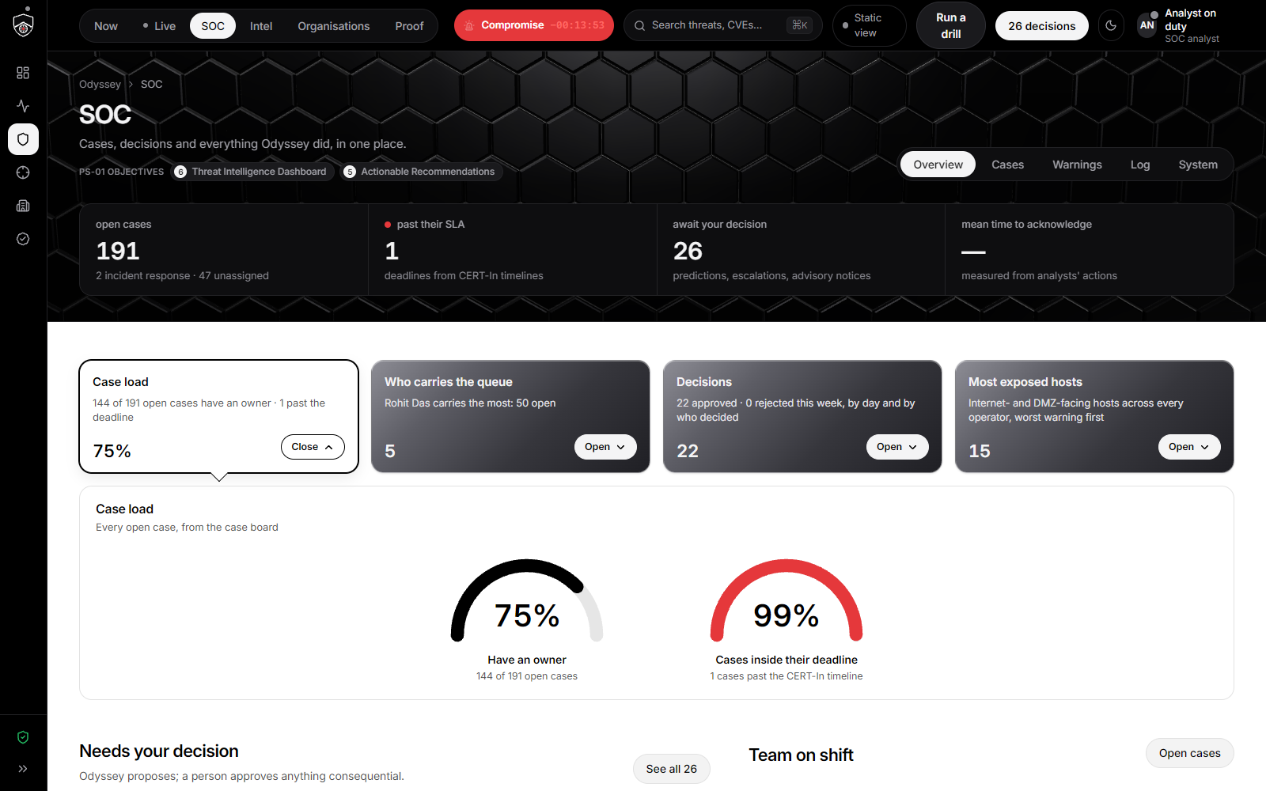
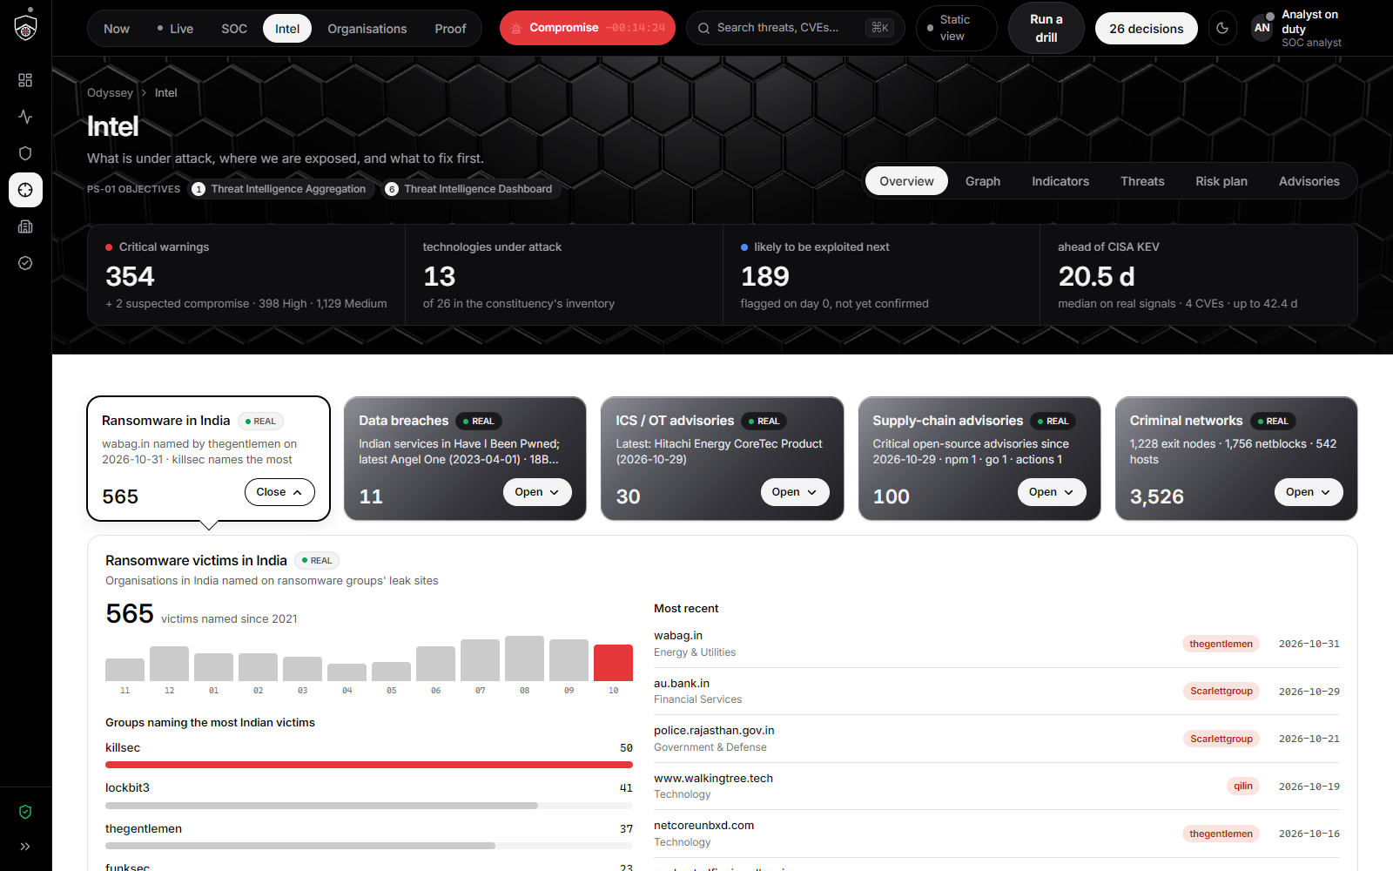
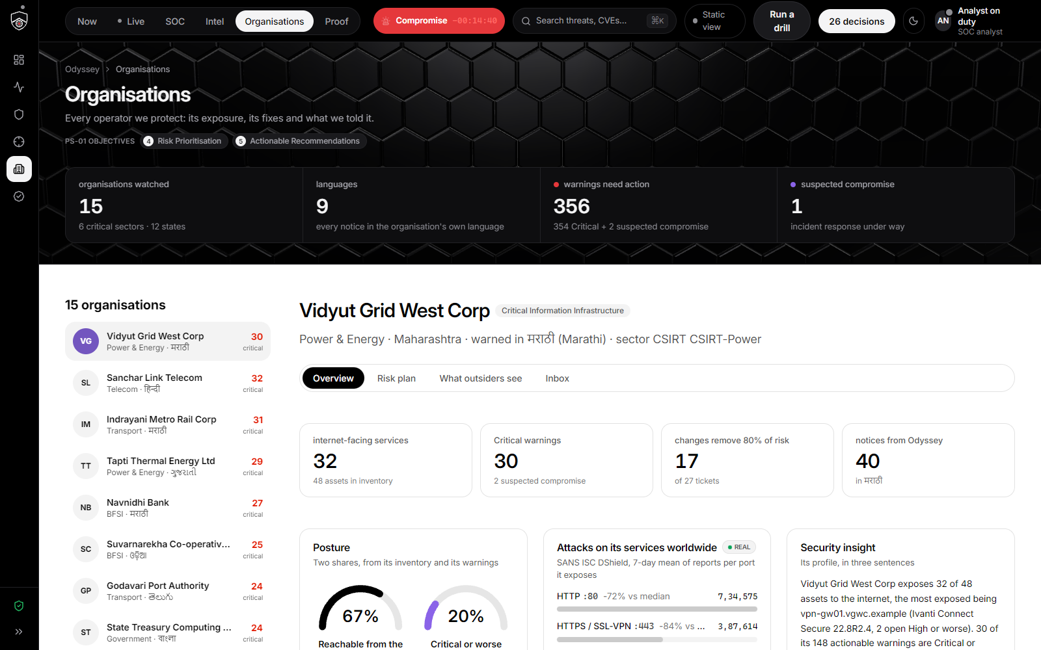
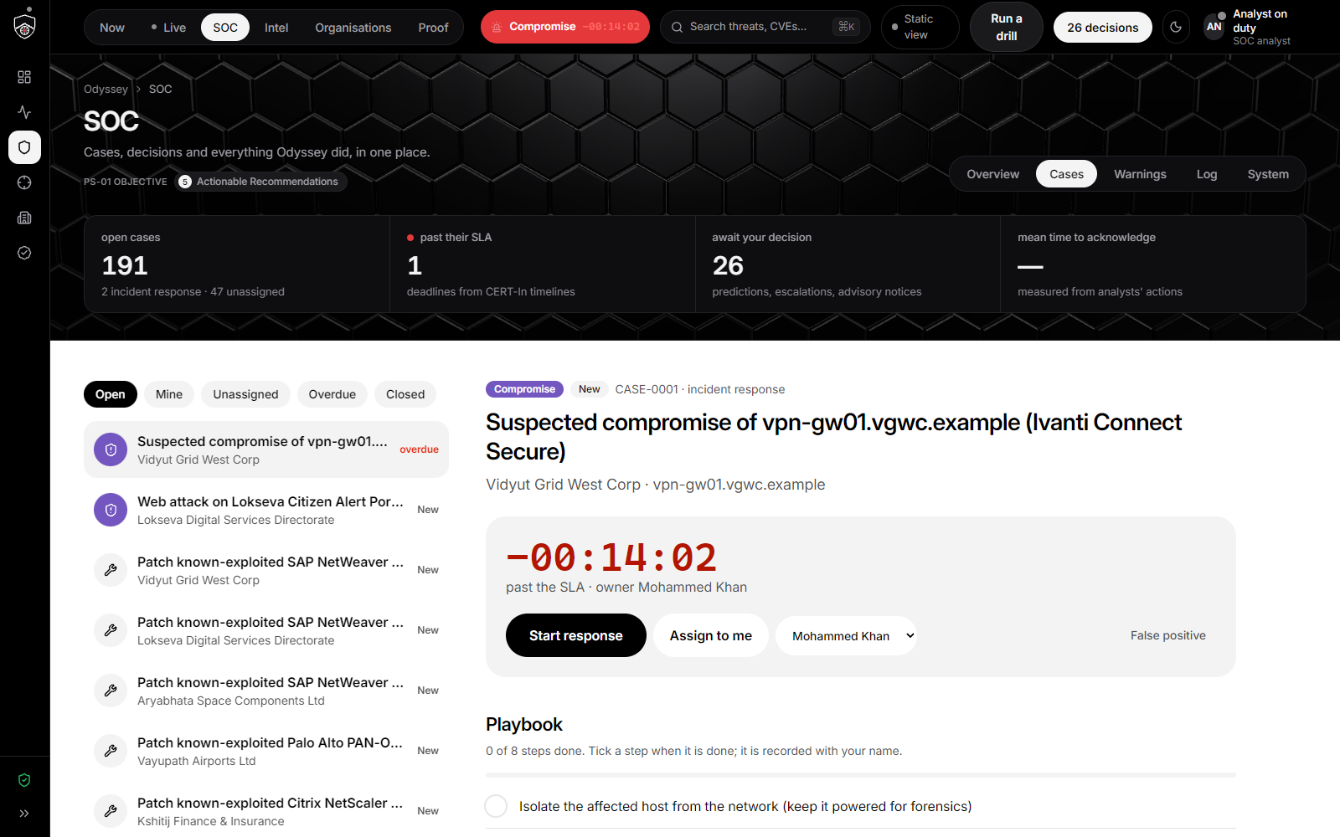
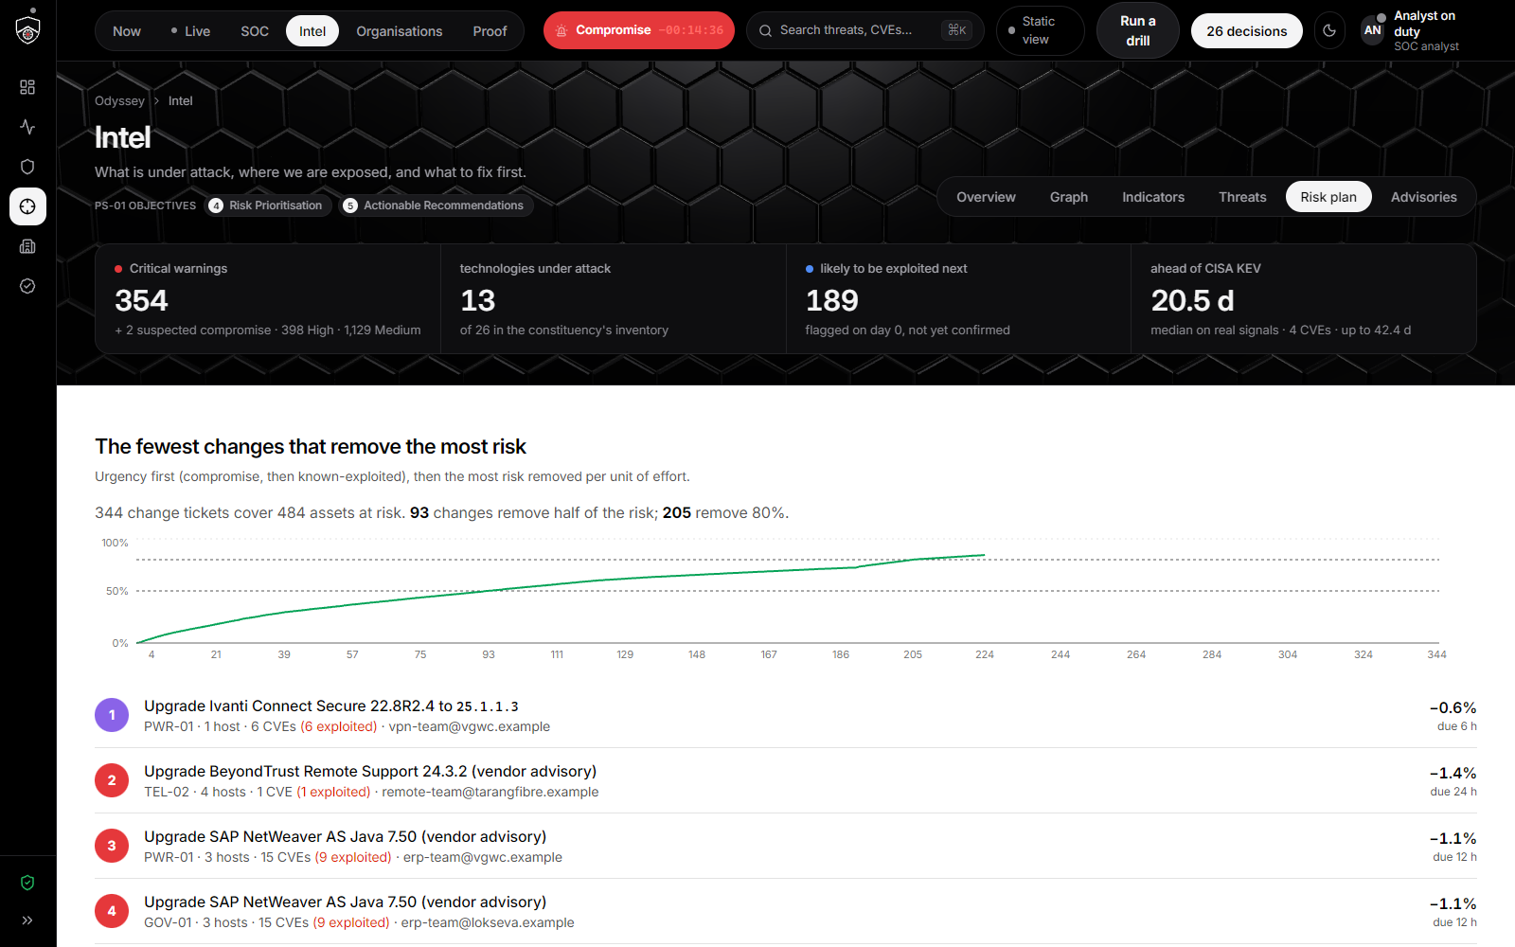
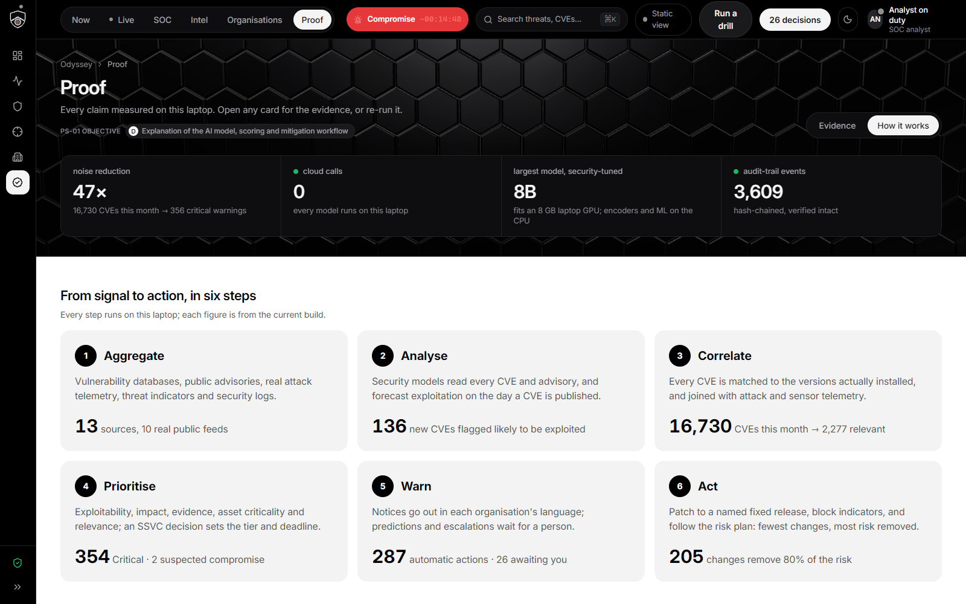
THE CONSOLE, END TO END
Six destinations, one question each; details slide in as sheets.
SOC › Overview: cases, SLAs, decisions
Intel › Overview: sources and real feeds
Organisations: one operator’s picture
SOC › Cases: playbooks, MTTA, MTTR
Intel › Risk plan: fewest changes, most risk
Proof › How it works: models and scoring
Legend PS-01: Problem Statement 01 · SOC: Security Operations Centre · MTTA: Mean Time To Acknowledge · MTTR: Mean Time To Resolve
Odyssey · D3COY 1.0 · PS-01 · AI-Based National Cyber Threat Early Warning System
10
Notes:
Each page keeps one question: Now, Live, SOC, Intel, Organisations, Proof.

Slide 11

HOW IT WORKS
Four innovations, every one measured on this laptop.
Risk prioritisation you can recompute
Early warning before the incident
Human in the loop, by construction
Sovereign and offline
Notes:
Section divider.

Slide 12
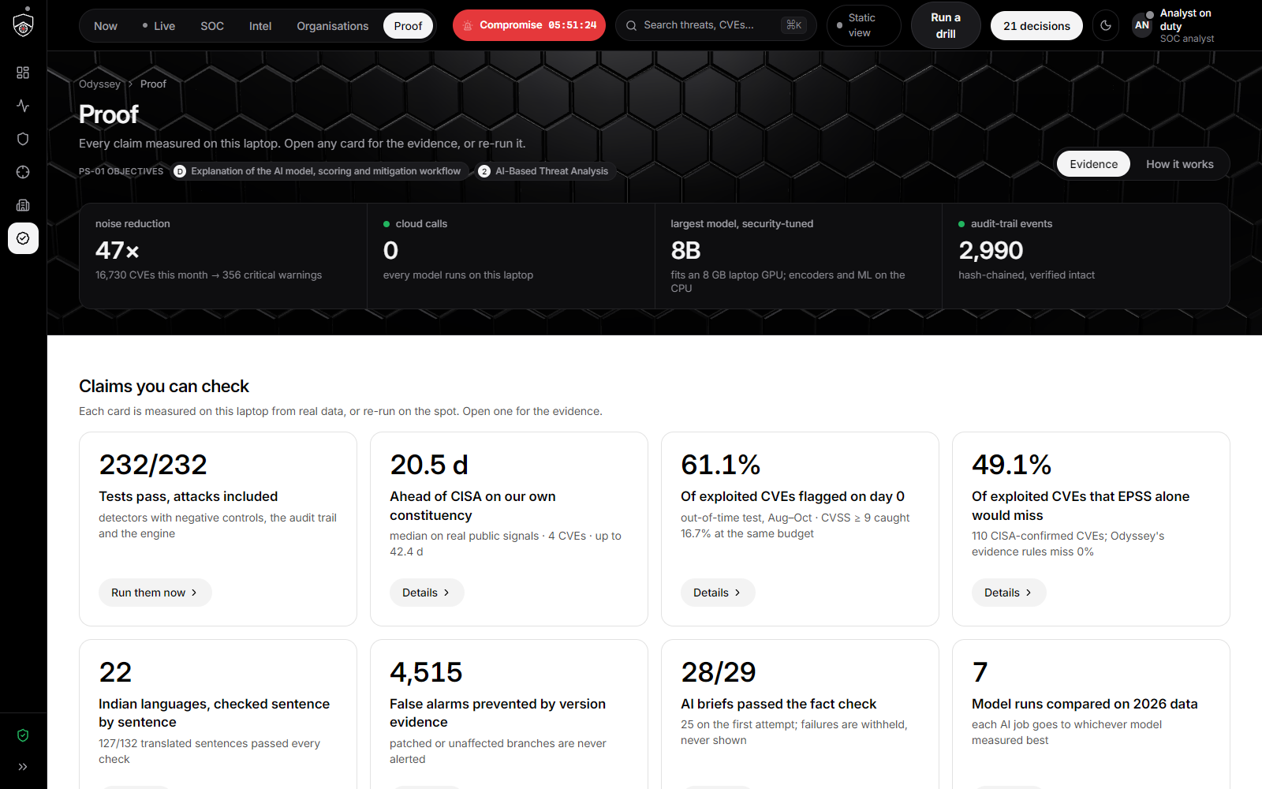
INNOVATION 1 · RISK PRIORITISATION
One transparent score, recomputable from the evidence, with India’s clocks attached.
47× less noise
Risk = 100 · R · K · (0.55 L + 0.30 S + 0.15 V)
measured this morning
Term | Meaning | Where it comes from
L | Exploitability | Likelihood rules with floors: CISA KEV, SSVC active, decoy exploit hits, vendor “exploited” text, EPSS, the forecast
S | Potential impact | SSVC technical impact, OT safety minimum, CVSS
V | Evidence | Admiralty-graded sources, independent origins, decay with age
K | Asset context | Criticality tier, internet exposure, blast radius to crown jewels
R | Relevance | Installed version against NVD, the CNA record and advisory text; disputes go to an analyst
16,730 CVEs published this month became 356 warnings that matter, 2 of them suspected compromises.
An SSVC decision sets the tier; a Bayesian P(compromise) orders a hunt at 20% and declares a suspected compromise at 50%, starting CERT-In’s 6-hour clock. Every warning stores the hash of the scoring config, so any score can be recomputed.
Proof › Evidence: every claim as a card, with its measurement.
Legend PS-01: Problem Statement 01 · NVD: National Vulnerability Database (NIST) · CISA: Cybersecurity and Infrastructure Security Agency (US) · KEV: Known Exploited Vulnerabilities catalogue · SSVC: Stakeholder-Specific Vulnerability Categorization · EPSS: Exploit Prediction Scoring System · CVSS: Common Vulnerability Scoring System · CNA: CVE Numbering Authority · CERT-In: Indian Computer Emergency Response Team · OT: Operational Technology
Odyssey · D3COY 1.0 · PS-01 · AI-Based National Cyber Threat Early Warning System
12
Notes:
The formula is deliberately simple and fully visible on every warning’s Why this score tab.

Slide 13
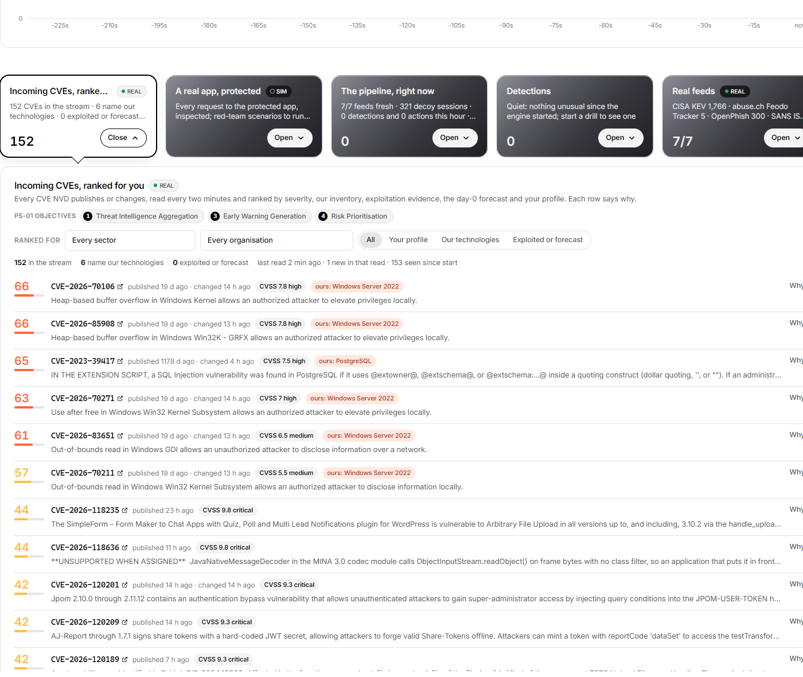
INNOVATION 2 · EARLY WARNING, BEFORE THE INCIDENT
Four ways Odyssey gets ahead of the attacker, each one measured.
Live intake, every two minutes
Every CVE NVD publishes or changes is read, matched to installed versions, scored and ranked for the analyst with its reasons; an exposed match gets a notice within seconds.
Day-0 exploitation forecast
Logistic regression, trained 2021 to 2025 and frozen 31 July 2026. Out of sample it flags 2.0% of new CVEs and catches 61.1% of those later exploited; CVSS ≥ 9 catches 16.7%. ROC AUC 0.926.
Pre-disclosure scanning surges
A national decoy grid (24 sensors, SIM, calibrated to published honeypot patterns) raises a robust-z surge per product; the Ivanti surge came 12 days before disclosure.
Three live detectors, re-tuned by analysts
Surge, C2 beacon periodicity and an IsolationForest flow anomaly every five seconds; a beacon re-scores every warning on that host at once. Thresholds re-derive from the analysts’ own decisions.
Live page: the incoming CVE stream, ranked for the analyst with the reasons for each rank, NVD read every two minutes.
Forecast precision is about 5% (exploitation is rare, base rate 0.16%), so forecasts are proposals for a person.
Legend PS-01: Problem Statement 01 · CVE: Common Vulnerabilities and Exposures · NVD: National Vulnerability Database (NIST) · CVSS: Common Vulnerability Scoring System · C2: Command and Control (attacker infrastructure) · ROC AUC: Receiver Operating Characteristic, Area Under the Curve · SIM: simulated data, labelled as such
Odyssey · D3COY 1.0 · PS-01 · AI-Based National Cyber Threat Early Warning System
13
Notes:
The forecast numbers come from docs/eval_exploit_forecast.json; the Proof page recomputes them live.

Slide 14
INNOVATION 3 · HUMAN IN THE LOOP, BY CONSTRUCTION
Odyssey acts on evidence, proposes on prediction, and never acts alone on anything consequential.
Runs on its own
Waits for a person
• Notices on confirmed exploitation of an affected version
• Daily digests and threat hunts
• CERT-In report drafts, pre-filled
• Day-0 predictions and sensor-only warnings
• Escalations to CERT-In, NCIIPC, sector CSIRTs
• Every rejection is recorded for calibration
A SOC on top: cases with owners and SLAs, playbooks, shift handover, MTTA and MTTR measured from what analysts actually did. A profile (sector, organisation) re-ranks the incoming stream and the recommendations for this analyst. Alerts reach Slack, Teams, Discord, e-mail or any webhook, one card per event, audited.
SOC › Cases: the incident case opened by the detector, its playbook, owner and SLA; every step and note is a hash-chained ledger event.
Legend PS-01: Problem Statement 01 · CERT-In: Indian Computer Emergency Response Team · NCIIPC: National Critical Information Infrastructure Protection Centre · SOC: Security Operations Centre · SLA: Service Level Agreement · MTTA: Mean Time To Acknowledge · MTTR: Mean Time To Resolve
Odyssey · D3COY 1.0 · PS-01 · AI-Based National Cyber Threat Early Warning System
14
Notes:
Graduated autonomy was the mentors’ round-one ask.

Slide 15
OBJECTIVE 5 · ACTIONABLE RECOMMENDATIONS, STEP BY STEP
From evidence to an audited decision in four steps, on every warning.
1
Evidence
Tier, risk, the rules that fired with their sources, exposure votes, the clocks that apply, live detections on the host.
2
Options
Patch, mitigate, hunt, escalate, verify, accept: each with its steps and effects, and Odyssey’s recommendation with the reason.
3
Confirm
Who to escalate to (CERT-In, the sector CSIRT, NCIIPC), a notice to the operator in its own language, a note for the audit trail.
4
Done
The warning sheet: tier, risk, clocks, the validated AI brief, the named fixed release, indicators to block, hunt steps, and “Decide, step by step”.
Workflow moved, case opened or advanced with its playbook, escalation card to the channels, every step returned with its ledger reference.
Nothing runs until the analyst presses the last button, and then only through mechanisms that already existed and were tested: workflow, cases, channels, ledger.
Legend PS-01: Problem Statement 01 · CERT-In: Indian Computer Emergency Response Team · NCIIPC: National Critical Information Infrastructure Protection Centre · CSIRT: Computer Security Incident Response Team
Odyssey · D3COY 1.0 · PS-01 · AI-Based National Cyber Threat Early Warning System
15
Notes:
Show the Decide button on the hero card.

Slide 16
OBJECTIVE 2 · AI-BASED THREAT ANALYSIS
The intelligence graph relates everything Odyssey knows, breathing with fresh evidence.
116
entities in the record, every edge with provenance
9
earlier instants the record can be replayed at
Top 5
threat groups by ATT&CK overlap, recommended with reasons
15 s
between watchlist evaluations
Intel › Graph: organisations, assets, technologies, CVEs, campaigns, ATT&CK techniques, malware, threat groups (overlap, never attribution), indicators and live signals; replay and watchlists.
Legend PS-01: Problem Statement 01 · ATT&CK: MITRE Adversarial Tactics, Techniques and Common Knowledge
Odyssey · D3COY 1.0 · PS-01 · AI-Based National Cyber Threat Early Warning System
16
Notes:
Threat groups are stated as overlap with the ATT&CK record, never attribution.

Slide 17
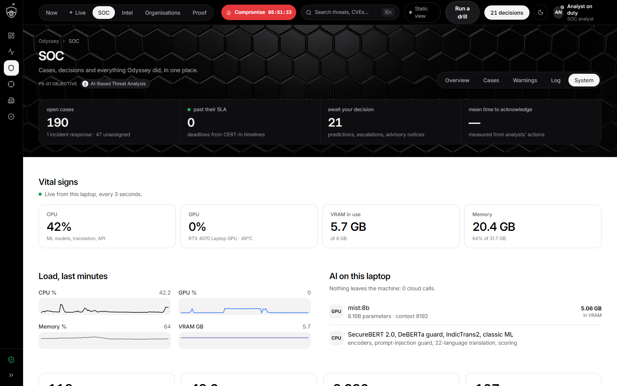
INNOVATION 4 · SOVEREIGN AND OFFLINE
Everything runs on one laptop. Nothing leaves it unless an analyst routes it.
0
8 GB
cloud calls
of laptop GPU
Every model, score and brief is computed here.
One 8B security LLM resident; encoders and ML on the CPU.
13
22
sources, snapshot-backed
scheduled languages
Re-read live when online, written through to the snapshot.
IndicTrans2 locally; 127 of 132 sentences validated.
SOC › System: the laptop’s live vital signs, the models resident on the GPU, every AI job timed, the audit trail growing.
LIVE re-reads NVD every two minutes, KEV, Feodo, OpenPhish and SACHET every fifteen, DShield and CISA advisories hourly; DEMO serves the same screens from the snapshot. Every feed read, model output and click is a hash-chained ledger event.
Legend PS-01: Problem Statement 01 · NVD: National Vulnerability Database (NIST) · CISA: Cybersecurity and Infrastructure Security Agency (US) · KEV: Known Exploited Vulnerabilities catalogue · SACHET: NDMA’s national alert dissemination platform · SOC: Security Operations Centre · LLM: Large Language Model · ML: Machine Learning · DShield: SANS Internet Storm Center’s distributed sensor network
Odyssey · D3COY 1.0 · PS-01 · AI-Based National Cyber Threat Early Warning System
17
Notes:
For a national system, data residency is the precondition.

Slide 18

THE MODEL STACK · ALL LOCAL, ALL MEASURED
Security-tuned models explain; a deterministic engine decides.
Job | Model | Measured on 2026 data
Extract, classify, narrate | MiST 8B, security-tuned, Apache-2.0 (GPU) | 79.9% vendor accuracy on every 2026 KEV CVE; best LLM on CWE
Deep reasoning on Critical alerts | Foundation-Sec 8B Reasoning, Cisco (GPU) | Security reasoning traces, in batches
Entities and related threats | SecureBERT 2.0 NER and bi-encoder (CPU) | Advisory entities; related-threat retrieval
Prompt-injection guard | DeBERTa-v3 prompt-injection v2 plus rules (CPU) | A hostile advisory is blocked on stage
22 Indian languages | IndicTrans2 en-indic 200M, AI4Bharat (CPU) | 127 of 132 sentences validated
CWE and CVSS prediction | TF-IDF, LinearSVC and logistic heads (CPU) | CWE 77.5% (top-3 87.5%); CVSS metrics 80 to 98%
Day-0 exploitation forecast | Logistic regression, leak-free KEV history (CPU) | Flags 2.0%, catches 61.1%; ROC AUC 0.926
Live detection and decision | Robust-z, RITA-style beacon, IsolationForest, Bayes (CPU) | 0 alerts in 240 quiet sensor-hours; drills caught
8B
the largest model, security-tuned, fits an 8 GB GPU
1 per role
chosen by local benchmarks, swappable by config
0
Every brief is checked against the record before it is shown: a number the source never stated is caught, not published.
general LLMs in the running system: baselines only
Legend PS-01: Problem Statement 01 · CVE: Common Vulnerabilities and Exposures · KEV: Known Exploited Vulnerabilities catalogue · CVSS: Common Vulnerability Scoring System · CWE: Common Weakness Enumeration · LLM: Large Language Model · NER: Named Entity Recognition · ROC AUC: Receiver Operating Characteristic, Area Under the Curve · RITA: Real Intelligence Threat Analytics (beacon analysis)
Odyssey · D3COY 1.0 · PS-01 · AI-Based National Cyber Threat Early Warning System
18
Notes:
Figures are from docs/MODEL_CARD.md; the Proof page shows the same tables live.

Slide 19
ARCHITECTURE AND TECH STACK
From thirteen sources to one audited decision, on one machine.
SOURCES
NVD
CISA KEV · SSVC
FIRST EPSS
CISA advisories
SANS ISC DShield
Feodo Tracker
OpenPhish
MITRE ATT&CK
NDMA SACHET
Decoy grid · SIM
Firewall logs · SIM
HTTP shield agents
ENGINE
Connectors
Exposure
Scoring
Live engine
Autopilot
Ledger
snapshot, live refresh, write-through
CPE, CNA and text vs installed versions
risk, SSVC tier, Bayes, India’s clocks
detectors every 5 s, NVD every 2 min
acts on evidence, proposes on prediction
hash-chained SQLite audit trail
LOCAL AI
Ollama, 8 GB GPU
CPU models
MiST 8B · Foundation-Sec 8B Reasoning, through one llm_client adapter
SecureBERT 2.0 · DeBERTa guard · IndicTrans2 · forecast · classifiers · IsolationForest
OUT
Console
Channels
Exchange
India
React 19 · Vite · Tailwind · CesiumJS satellite map · three.js site view · live SSE
Slack · Teams · Discord · e-mail · webhook
STIX 2.1 · TAXII 2.1 · CSV risk lists
CERT-In report draft · SACHET-compatible CAP 1.2 · 22 languages
FastAPI 0.162 · Python 3.15 · SQLite · scikit-learn · PyTorch CPU · Ollama · pinned versions · one command starts the whole stack
Legend PS-01: Problem Statement 01 · NVD: National Vulnerability Database (NIST) · CISA: Cybersecurity and Infrastructure Security Agency (US) · KEV: Known Exploited Vulnerabilities catalogue · SSVC: Stakeholder-Specific Vulnerability Categorization · EPSS: Exploit Prediction Scoring System · FIRST: Forum of Incident Response and Security Teams · CPE: Common Platform Enumeration · CNA: CVE Numbering Authority · ATT&CK: MITRE Adversarial Tactics, Techniques and Common Knowledge · STIX: Structured Threat Information Expression · TAXII: Trusted Automated Exchange of Intelligence Information · CAP: Common Alerting Protocol · SACHET: NDMA’s national alert dissemination platform · NDMA: National Disaster Management Authority · CERT-In: Indian Computer Emergency Response Team · DShield: SANS Internet Storm Center’s distributed sensor network · SANS ISC: SANS Internet Storm Center · SIM: simulated data, labelled as such
Odyssey · D3COY 1.0 · PS-01 · AI-Based National Cyber Threat Early Warning System
19
Notes:
Top to bottom: the sources, the deterministic engine, the local AI beside it, and the ways out.

Slide 20
EXPECTED DELIVERABLES
All four deliverables, each with its proof a click away.
A functional prototype
Offline on an 8 GB laptop GPU. About 140 engine tests, 26 product flows through the API, a 25-step browser audit, a test bench of 135 checks the judges can re-run.
A dashboard of threats, risk levels and alerts
Six destinations; every warning with its tier, risk, clocks and evidence; every page names the objective it serves.
A demonstration on public intelligence and a controlled dataset
REAL: CVEs, KEV, SSVC, EPSS, advisories, DShield, Feodo, phishing, SACHET. SIM: 15 operators, the decoy grid, firewall logs. Every item labelled.
Proof › How it works: from signal to act in six steps, the models with measured results, the scoring on a live example.
An explanation of the AI, the scoring and the mitigation workflow
Proof › How it works walks the pipeline, the model roster, the formula on a live example and the workflow; model card and coverage documents in the repository.
Red-teamed: 45 real web attacks at the lab app, 45 detected and blocked, 0 false positives; 10 hostile CAP messages, 10 refused, no leak.
Legend PS-01: Problem Statement 01 · KEV: Known Exploited Vulnerabilities catalogue · SSVC: Stakeholder-Specific Vulnerability Categorization · EPSS: Exploit Prediction Scoring System · CAP: Common Alerting Protocol · SACHET: NDMA’s national alert dissemination platform · DShield: SANS Internet Storm Center’s distributed sensor network · SIM: simulated data, labelled as such · REAL: real public data
Odyssey · D3COY 1.0 · PS-01 · AI-Based National Cyber Threat Early Warning System
20
Notes:
Each deliverable maps to something the judges can click.

Slide 21
WHAT WE SAY BEFORE YOU ASK
Honest limits, stated on the screens themselves.
Sensors are simulated
Forecast precision is low
The decoy grid and firewall flows are SIM, labelled, accelerated; the feeds beside them are real and live.
About 5%, because exploitation is rare (base rate 0.16%); forecasts are proposals for a person.
Lead time has two origins
Groups are overlap, not attribution
Real signals and the simulated decoy grid; the Proof page attributes each lead to one of them.
A threat group appears only as overlap with its public ATT&CK record. Odyssey never attributes activity.
Translation is checked, not assumed
CERT-In has no machine-readable feed
127 of 132 sentences validated across 22 languages; Santali is weakest; withheld lines fall back to English.
Its advisories are style-matched samples, labelled SIM; the real national feed we read is NDMA’s SACHET.
Every fact on screen is labelled REAL or SIM; every claim on the Proof page is measured on this laptop and can be re-run.
Legend PS-01: Problem Statement 01 · ATT&CK: MITRE Adversarial Tactics, Techniques and Common Knowledge · SACHET: NDMA’s national alert dissemination platform · NDMA: National Disaster Management Authority · CERT-In: Indian Computer Emergency Response Team · SIM: simulated data, labelled as such · REAL: real public data
Odyssey · D3COY 1.0 · PS-01 · AI-Based National Cyber Threat Early Warning System
21
Notes:
Judges reward candour. These are the limits a careful reviewer would find; we show them first.

Slide 22
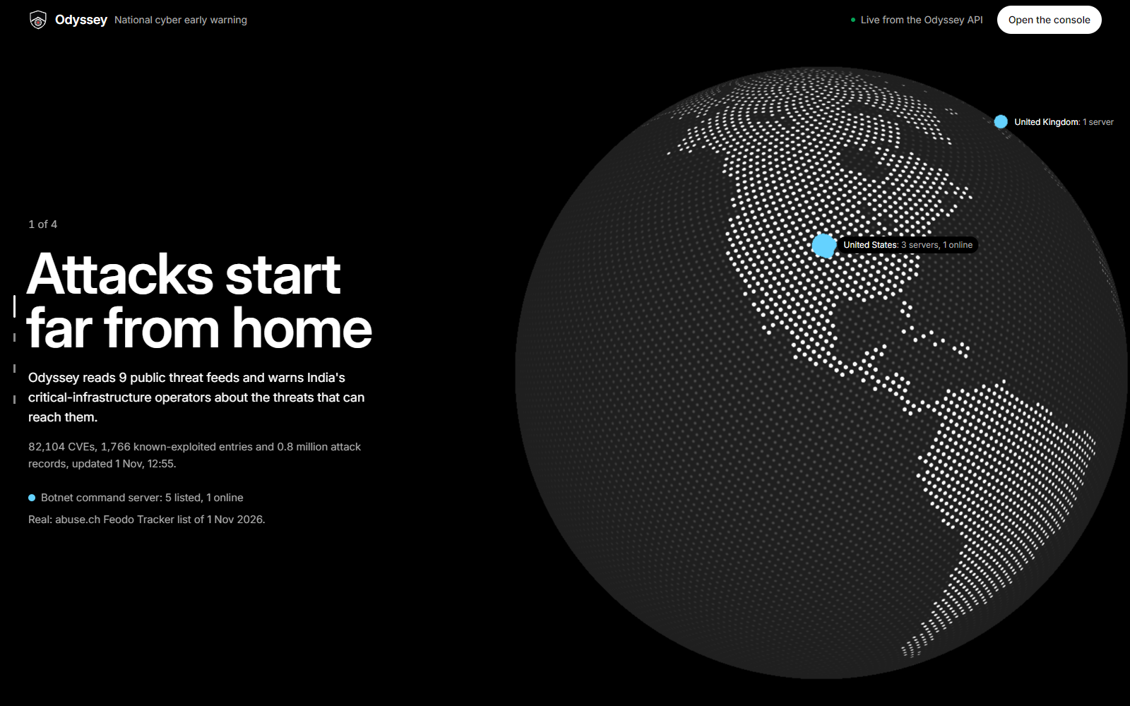
JOIN THE HUNT
Early warning for the nation, from one laptop.
Live demo on this machine: the duty desk, the satellite threat map, a real CVE taken in from NVD, a red-team against the shield, and one decision taken step by step.
Aggregate · Analyse · Warn · Prioritise · Act · See
Team Odyssey · D3COY 1.0 · PS-01 · Thank you
Legend PS-01: Problem Statement 01 · CVE: Common Vulnerabilities and Exposures · NVD: National Vulnerability Database (NIST)
Notes:
Close on the six verbs, then open the console for the live demo.

