Slide 1
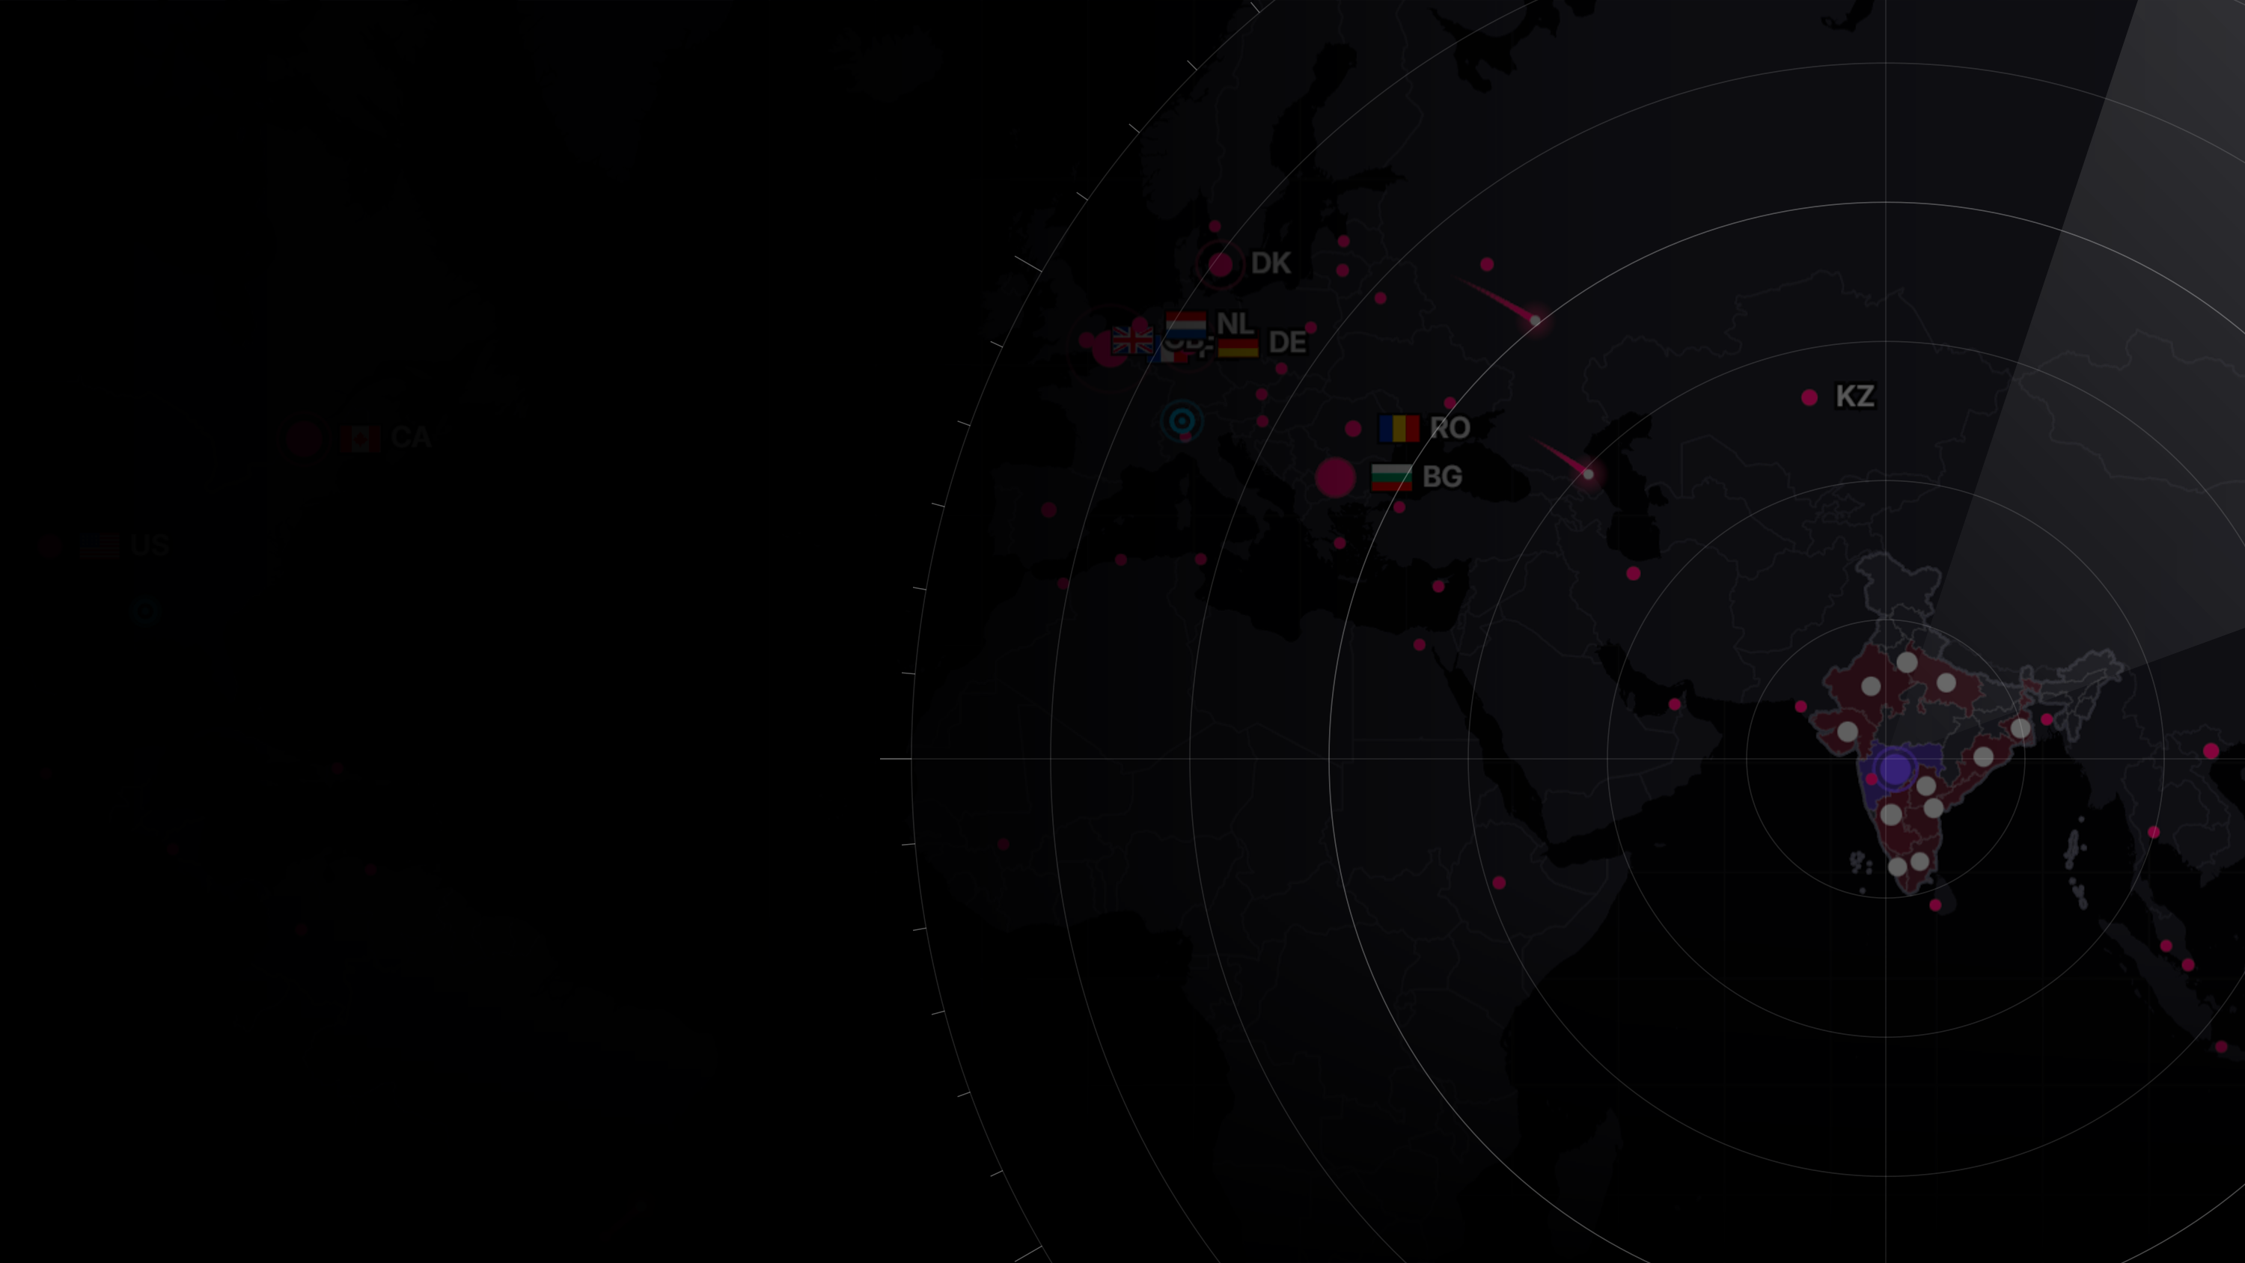

ODYSSEY
National cyber threat early warning
See the attack coming.
Public threat intelligence in. For every Indian organisation: which systems are at risk, how sure we are, what to do, and by when. On one laptop, with no cloud.
FIG 1 · THE LIVE THREAT MAP, AS THE CONSOLE DRAWS IT · 1 NOV 2026
attack source (SANS ISC DShield, REAL)
botnet C2 (Feodo Tracker, REAL)
operator state (SIM)
suspected compromise
FINAL ROUND · D3COY 1.0 · DJS ISACA · PROBLEM STATEMENT 01 · 1 NOV 2026
Notes:
Open on the line. Behind it is the live map from the console: real attack origins from the last snapshot, each origin labelled real, each operator labelled simulated. Then two sentences: in July 2024 one supplier's unpatched server took about 300 Indian banks offline. The flaw had been public for six months. Odyssey exists so that the decision is never late again.

Slide 2
The warning was public. The decision was late.
FIG 2.1 · ONE MARK PER CVE PUBLISHED IN OCTOBER 2026 · CVE PROGRAM, NVD
says which product and version (21%)
does not (79%)
16,730
72% → 21%
29%
new CVEs in October 2026 alone, from dozens of feeds, each needing a decision
of new CVEs say which product and version they affect, January against now
of the CVEs exploited in 2026 were attacked on or before the day they were announced
C-Edge, 2024
the Indian case the brief is written against
31 Jul 2024 ransomware through the supplier; about 300 banks lose UPI and ATM
Jan 2024 Jenkins flaw disclosed; exploit public within days
19 Aug 2024 CISA lists the flaw, 19 days after the banks went down
the warning was public and nothing connected it to who was exposed (six months)
event
the breach
Notes:
The problem is not a shortage of intelligence. It is volume, missing labels, and attackers who move on day zero. The field at the top is October alone, one mark per CVE; only a fifth say what they affect. The C-Edge case is the Indian example: six months of public warning, then 300 banks offline, then the national list catching up 19 days later. Sources: CVE Program, NVD, CISA KEV, NPCI statement of 31 July 2024.

Slide 3
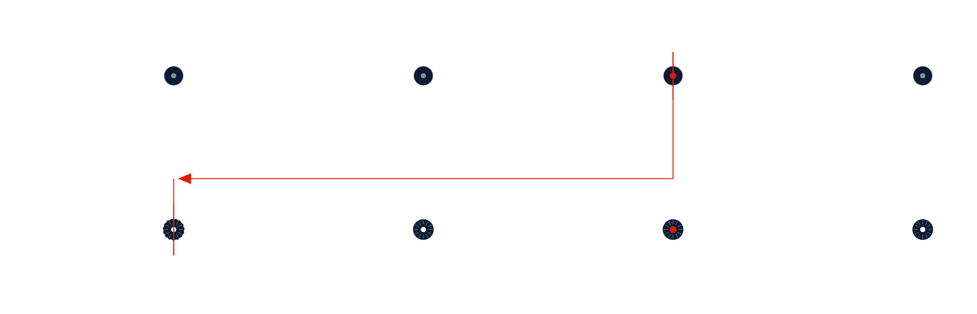
Move the line left
THEN · REACT AFTER THE BREACH
Flaw disclosed
Nothing connects it
Breach
Listed
public record, exploit code soon after
to who runs the product
the warning signs were public for months
the national list catches up weeks later
NOW · ACT ON THE SIGNAL
12 days before
Day 0
Warning
+20.5 days
a scanning surge on the decoy grid (SIM) raises a pre-disclosure warning
the CVE is matched to installed versions within seconds; a day-0 forecast flags the likely-exploited
tier, confidence, a countdown, a notice in the operator's language; a person approves
median before CISA lists it, on real signals; up to 42
Every number is recomputed live on the Proof page. Leads from simulated sensors are reported apart from leads on real signals.
where action starts
reactive step
Odyssey step
simulated signal (SIM)
a person decides
Notes:
Top lane is how it usually goes. Bottom lane is Odyssey: the decoy grid sees scanning before disclosure (simulated, labelled); on day zero a new CVE is matched to the inventory in seconds and the forecast flags the ones likely to be exploited; the warning goes out with its tier, confidence and clock; and CISA's list follows, a median 20.5 days later on real signals. Reactive systems start at the breach. We start at the signal. The red arrow is the whole pitch: the same line, moved left.

Slide 4
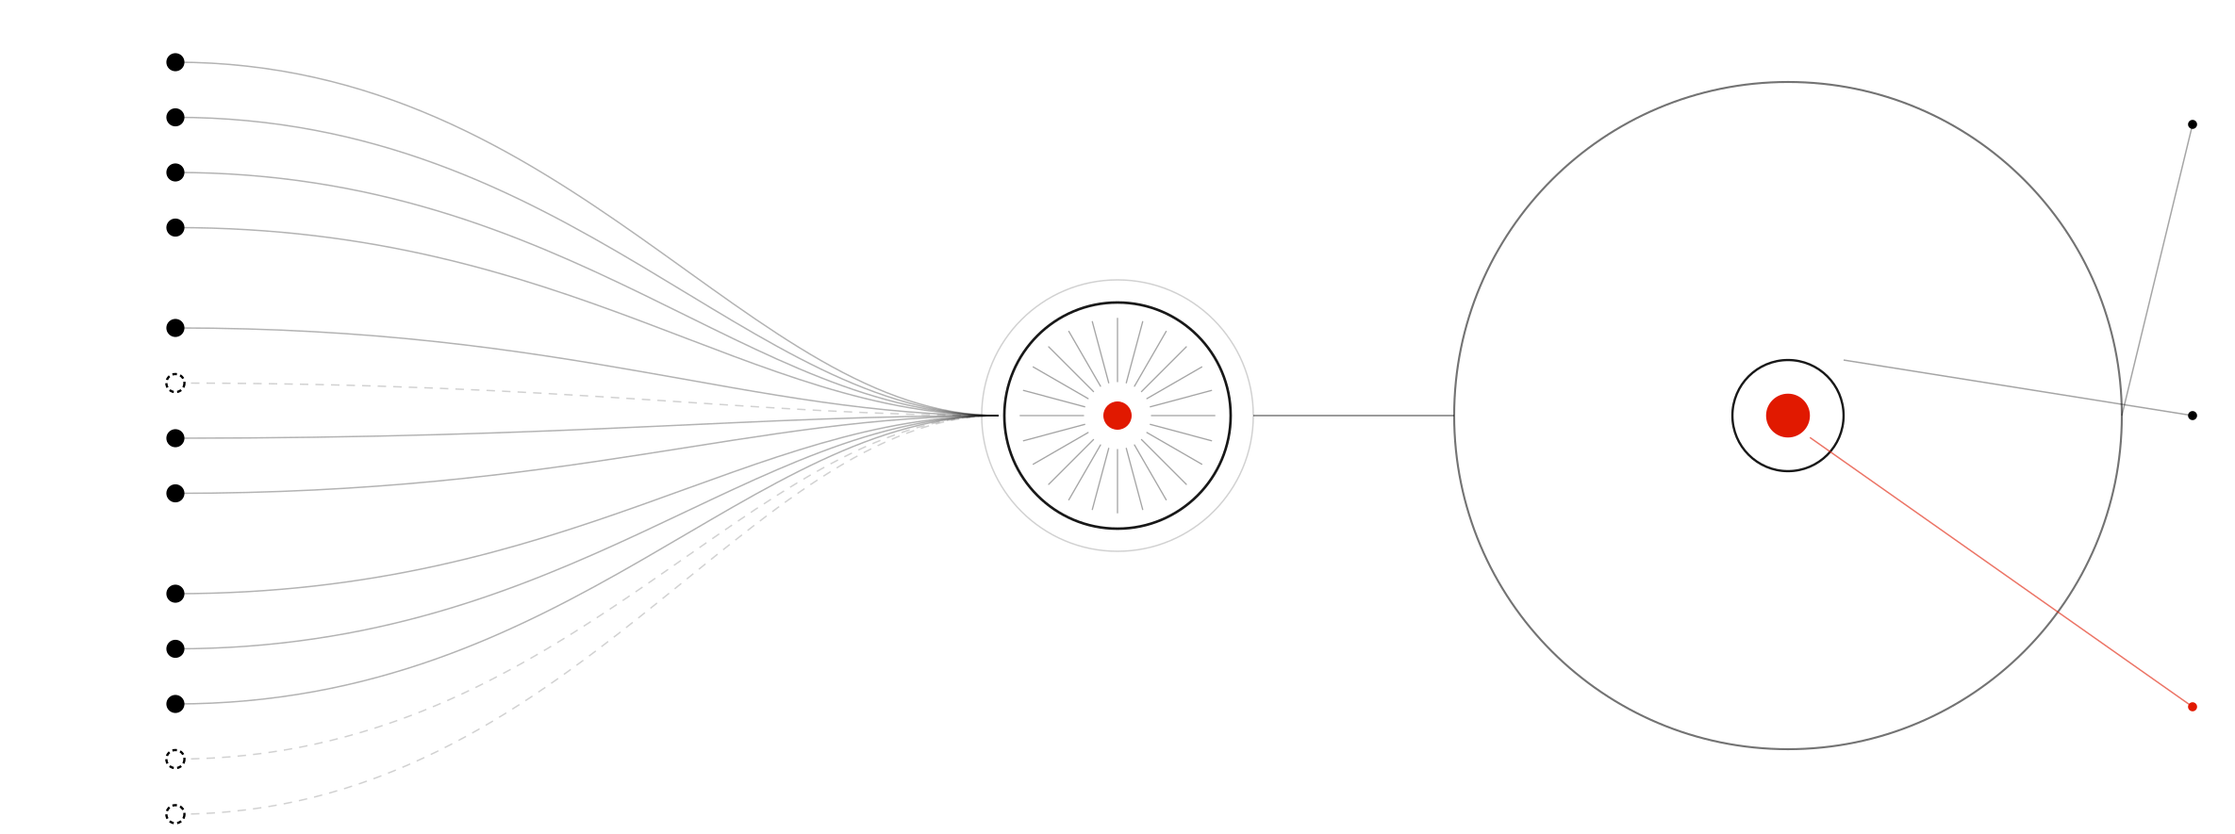
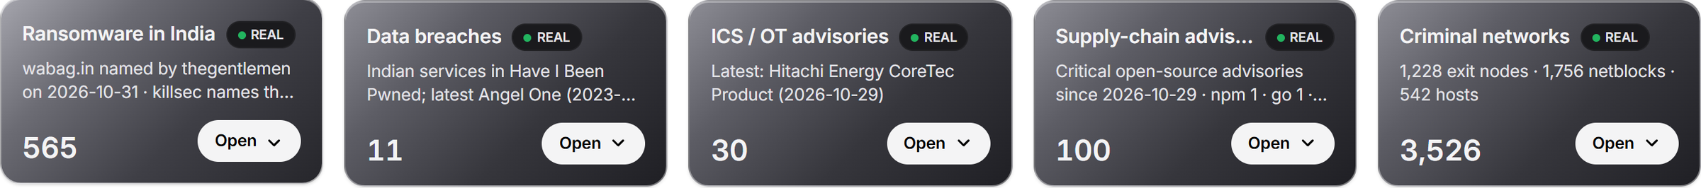
Every source, one record
VULNERABILITY DATABASES
NVD 2021 to 2026
CISA KEV
82,104
CISA SSVC
CVEs published in 2026
FIRST EPSS
ADVISORIES AND CONTEXT
ONE RECORD
CISA ICS and alerts
CERT-In style advisories (SIM)
2,277
MITRE ATT&CK
NDMA SACHET
name a product an operator runs
TELEMETRY, INDICATORS, LOGS
hash-chained, provenance on every line
SANS ISC DShield honeypots
Feodo Tracker C2
OpenPhish
354
National decoy grid (SIM)
Critical warnings, each to a named operator
Firewall flows (SIM)
FIG 4 · 13 SOURCES, 10 REAL, 3 SIMULATED · AREA OF EACH CIRCLE BY SQUARE ROOT OF THE COUNT
real public source
simulated, labelled SIM
the record
count, area by square root
warnings
In and out in the formats a SOC already runs: STIX 2.1, TAXII 2.1, CSV. A partner's indicators are matched against the record in seconds. Also bundled, real: Exploit-DB, ransomware.live, Have I Been Pwned, GitHub advisories, Tor, Spamhaus DROP, Emerging Threats.
Notes:
Thirteen sources, grouped as the brief lists them: vulnerability databases, public advisories, attack telemetry and indicators, and simulated logs, each labelled. The circles are the point: 82,000 CVEs this year become 2,277 that name something an operator runs, and 354 Critical warnings addressed to a named operator. The record goes in and out as STIX, TAXII and CSV; the strip at the bottom is the console's own real-feed row.

Slide 5
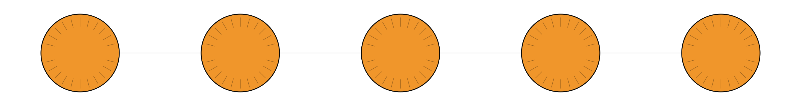
One advisory, start to finish
1
2
3
4
5
A real advisory arrives
Versions parsed
Exposure found
Risk assigned
People decide
CISA's ICS advisory for Siemens WinCC, read by the security LLM. It works even when the advisory carries no CVE id.
Machine-readable ranges lifted from the text: vers:intdot/<8.0.0.11 and vers:all/*.
13 WinCC assets at 7 operators, checked against the inventory version by version. Patched hosts are marked safe.
A score with its working, an SSVC tier, a CERT-In deadline. Patch where a fix exists, mitigation where none does.
A notice proposed to each operator in its own language. An analyst approves. Every step lands in the audit trail.
The same path runs for every input
a KEV entry
a new CVE from NVD
a scanning surge on the decoys
a partner's indicator list
a disaster alert from SACHET
each is matched to who is exposed, scored, and turned into something a person can approve.
FIG 5 · THE EXAMPLE USE CASE, RUN ON THE REAL CISA ADVISORY FOR SIEMENS WINCC
automated step, written to the audit trail
a person decides
the rings carry the chakra of the emblem: 24 spokes, one record
Notes:
This is the walk-through in the demo. A real CISA advisory for Siemens WinCC comes in. The model reads it, the version ranges are parsed, thirteen assets at seven operators are found exposed, each gets a risk with its working and a deadline, and the notices are proposed in Marathi, Gujarati and Hindi for a person to approve. Then: the same path for every input.

Slide 6
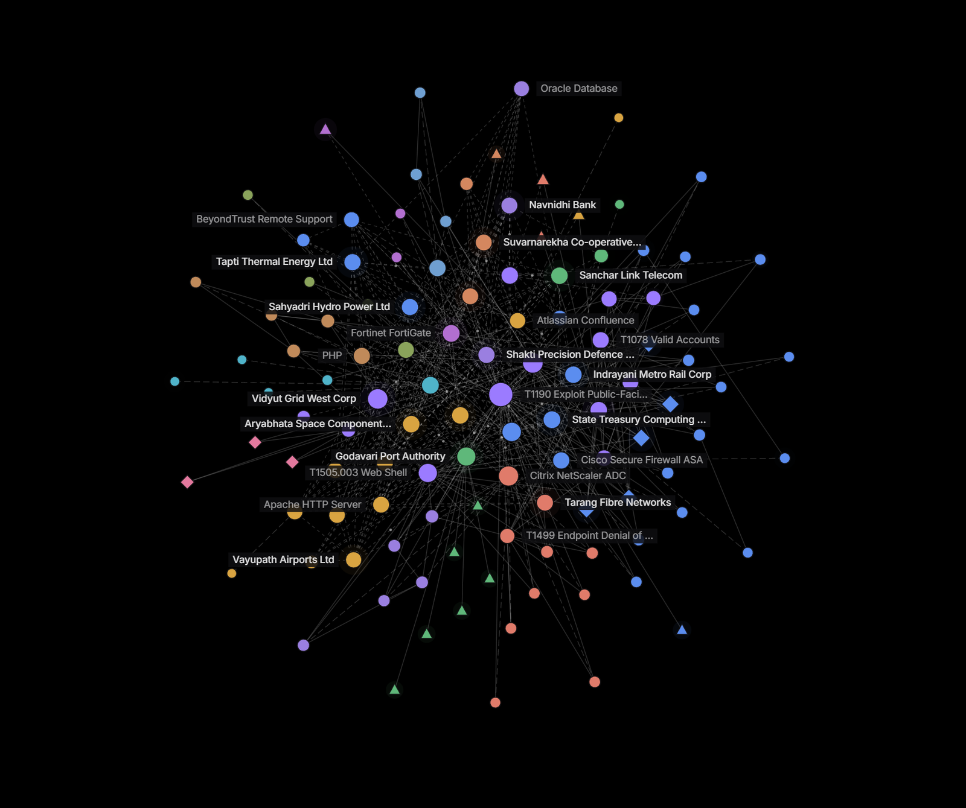
Patterns, not noise
1
Reads
A security LLM (MiST-8B) reads advisories and writes every brief. 22 of 23 briefs passed the fact validator; a sentence that fails is withheld, never shown.
2
Relates
SecureBERT 2.0 links entities and related threats; a clustering model groups campaigns (12 active). Threat groups come from the ATT&CK record as overlap, never attribution.
3
Detects
Scanning surges, C2 beacons and flow anomalies, every 5 seconds. A hostile advisory with hidden instructions is caught by the injection guard, 5 of 5, and still scored by the rules.
AI explains. Rules decide.
No model sets a score, a tier or a deadline. All of it runs on one RTX 4070 laptop, 0 cloud calls; each job's model is set in a config file and was chosen by measurement on 2026 CVEs.
FIG 6 · INTEL › GRAPH · 115 NODES · 447 LINKS · 146 PUBLIC
colour: community
size: links
threat group (overlap, not attribution)
live signal
Notes:
Three jobs for the models: read, relate, detect. Read: the security LLM reads advisories and writes the brief, and the brief is fact-checked line by line. Relate: entities, related threats, campaigns, and the graph on the left, every entity in the record and how they connect, coloured by community. Detect: surges, beacons and anomalies every five seconds, plus the guard that catches a poisoned advisory. The rule we never break: AI explains, rules decide. And it all runs here, offline.

Slide 7
What goes first
Risk = 100 × Relevance × Importance × (0.55 Likelihood + 0.30 Severity + 0.15 Evidence)
FIG 7 · ONE REAL WARNING FROM THIS BUILD, FACTOR BY FACTOR
LIKELIHOOD, FROM EVIDENCE, IN RANK ORDER
WARNING RECEIPT
build 1 Nov 2026 · REAL CVE
On CISA KEV · SSVC says active · exploit seen on 2+ decoys
Tapti Thermal Energy · Ivanti Connect Secure 22.8R2.4
1.0
CVE-2026-111357 · VPN gateway · internet-facing · tier 1
The vendor says exploited in the wild
0.8
Likelihood
0.55 × 1.0
45.8
A public proof of concept
KEV 30 Oct · SSVC active · vendor: in the wild
0.5
Severity
0.30 × 1.0
25.0
SSVC technical impact: total
A scanning surge on the decoy grid, decays with age
Evidence
0.15 × 1.0
12.5
0.4
CISA (A), NVD (A), vendor (B) agree
EPSS ≥ 0.5 · CVSS ≥ 9 · automatable
Relevance
× 1.0
corroborate
NVD and the vendor both list 22.8R2.4 as affected
The day-0 forecast
Importance
× 0.83
prediction, not evidence
tier 1 · internet-facing ×1.2 · blast radius
Importance: criticality tier 5 to 2, internet-facing ×1.2, blast radius up to ×1.3. Relevance: the installed version checked against NVD, the vendor and the advisory. Confidence is scored apart, from A to F source grades.
RISK
83.3
Critical · SSVC: Act · 12 h to patch or mitigate · P(compromise) 18%, no beacon seen
floor set by the rule
certain
corroborates
prediction
Notes:
The score is a formula anyone can check. Likelihood comes from evidence in rank order, and the ladder shows what counts and how much: a KEV listing or an active SSVC verdict is 1.0, a vendor claim 0.8, proof of concept 0.5, a decoy surge 0.4 and decaying, while EPSS and CVSS only corroborate and the forecast is a prediction, not evidence. The receipt on the right is one real warning from this build: 83.3, Critical, Act, twelve hours. The tier follows CISA's SSVC decision method; confidence is scored separately from risk.

Slide 8
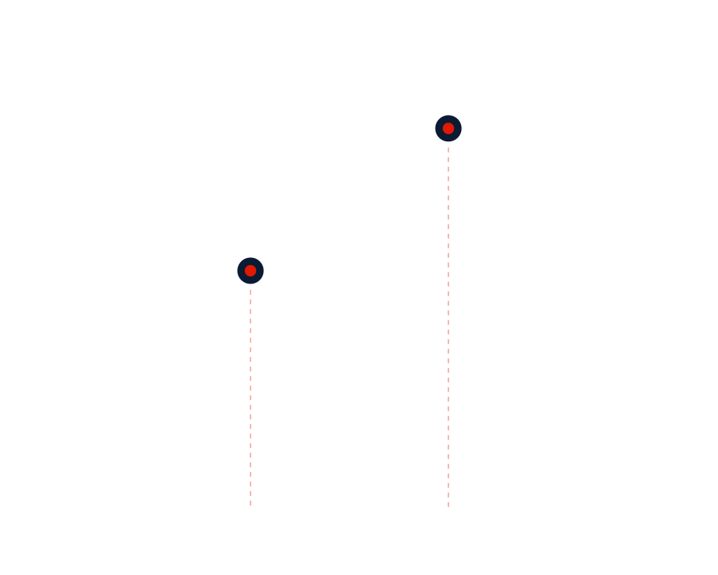

What to do, and by when
ON EVERY WARNING
RISK PLAN · FEWEST CHANGES, MOST RISK REMOVED
BY WHEN · CERT-IN BLUEPRINT
1
Patch to a named fixed release, never a downgrade (22.8R2.5, 25.1.3.0 for the Ivanti case)
100%
6 h
suspected compromise
2
Block the indicators: STIX 2.1 export, risk lists for the firewall, C2 addresses refanged
12 h
known-exploited, internet-facing
24 h
3
Investigate a hunt playbook, ATT&CK mitigations, forensic triage where CISA asks for it
93
changes remove half the national risk
Critical
72 h
4
Report the CERT-In 6-hour report pre-drafted; RBI, SEBI, DPDP and NCIIPC clocks shown
205
remove 80%, of 344 change tickets
High
120 h
0
Medium
Notify a notice in the operator's own language; a person approves before it goes
share of national risk removed
change tickets, in plan order →
ONE WORKFLOW PER WARNING
Odyssey proposes; a person approves anything consequential. Evidence-based notices, digests and hunts run on their own. Every action is in a hash-chained audit trail.
Issued
Acknowledged
Mitigating
Verifying
Closed
a person decides
curve = risk removed in plan order
milestone
dial = deadline on a 120-hour face
the 6-hour incident clock
Notes:
Every warning ends in something a team can do: patch to a named release, block the indicators, hunt, report, notify. Nationally, the risk plan orders the fewest changes that remove the most risk: the curve. Each warning moves through one workflow, with a real countdown from the CERT-In timelines, the dials, and a person approves anything consequential.

Slide 9
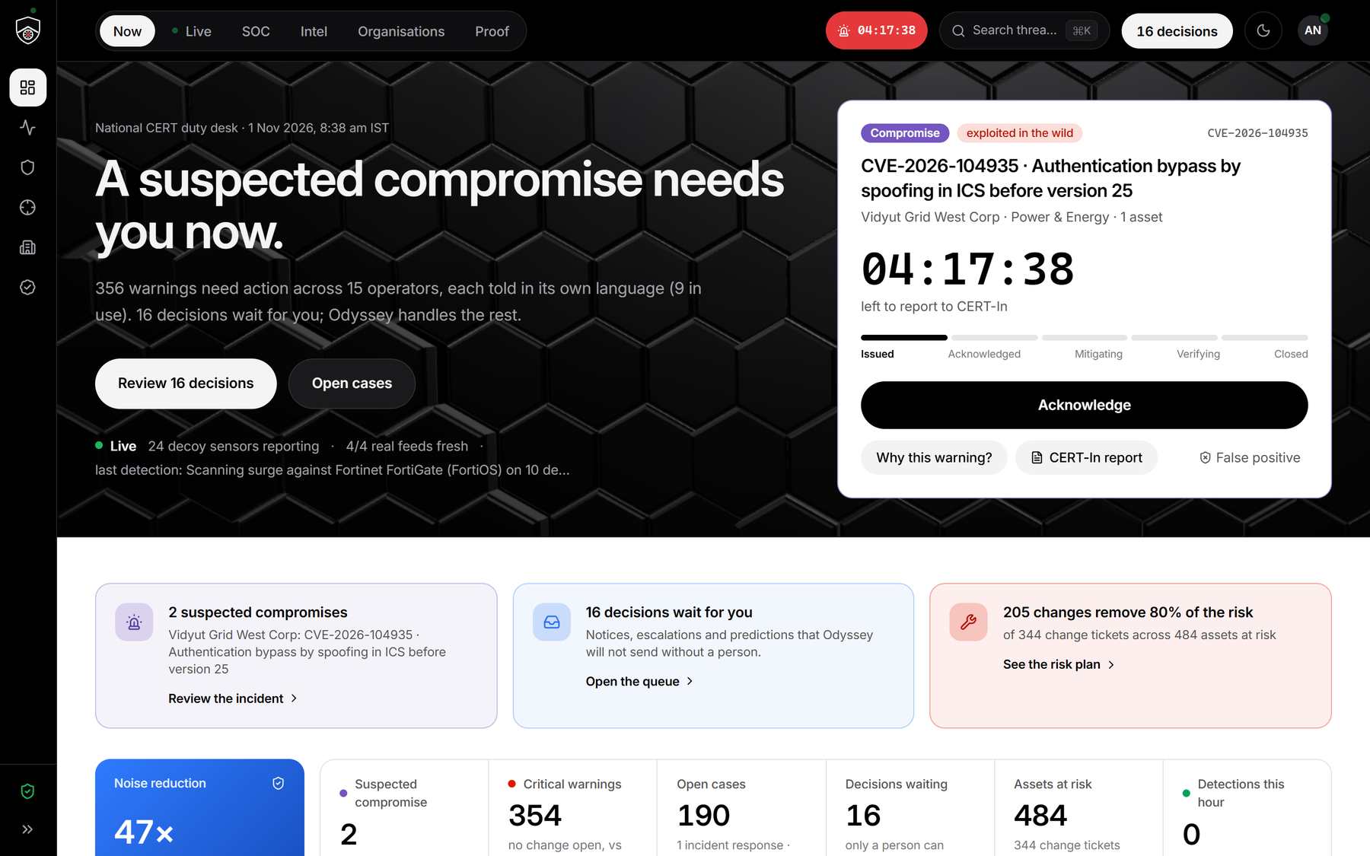
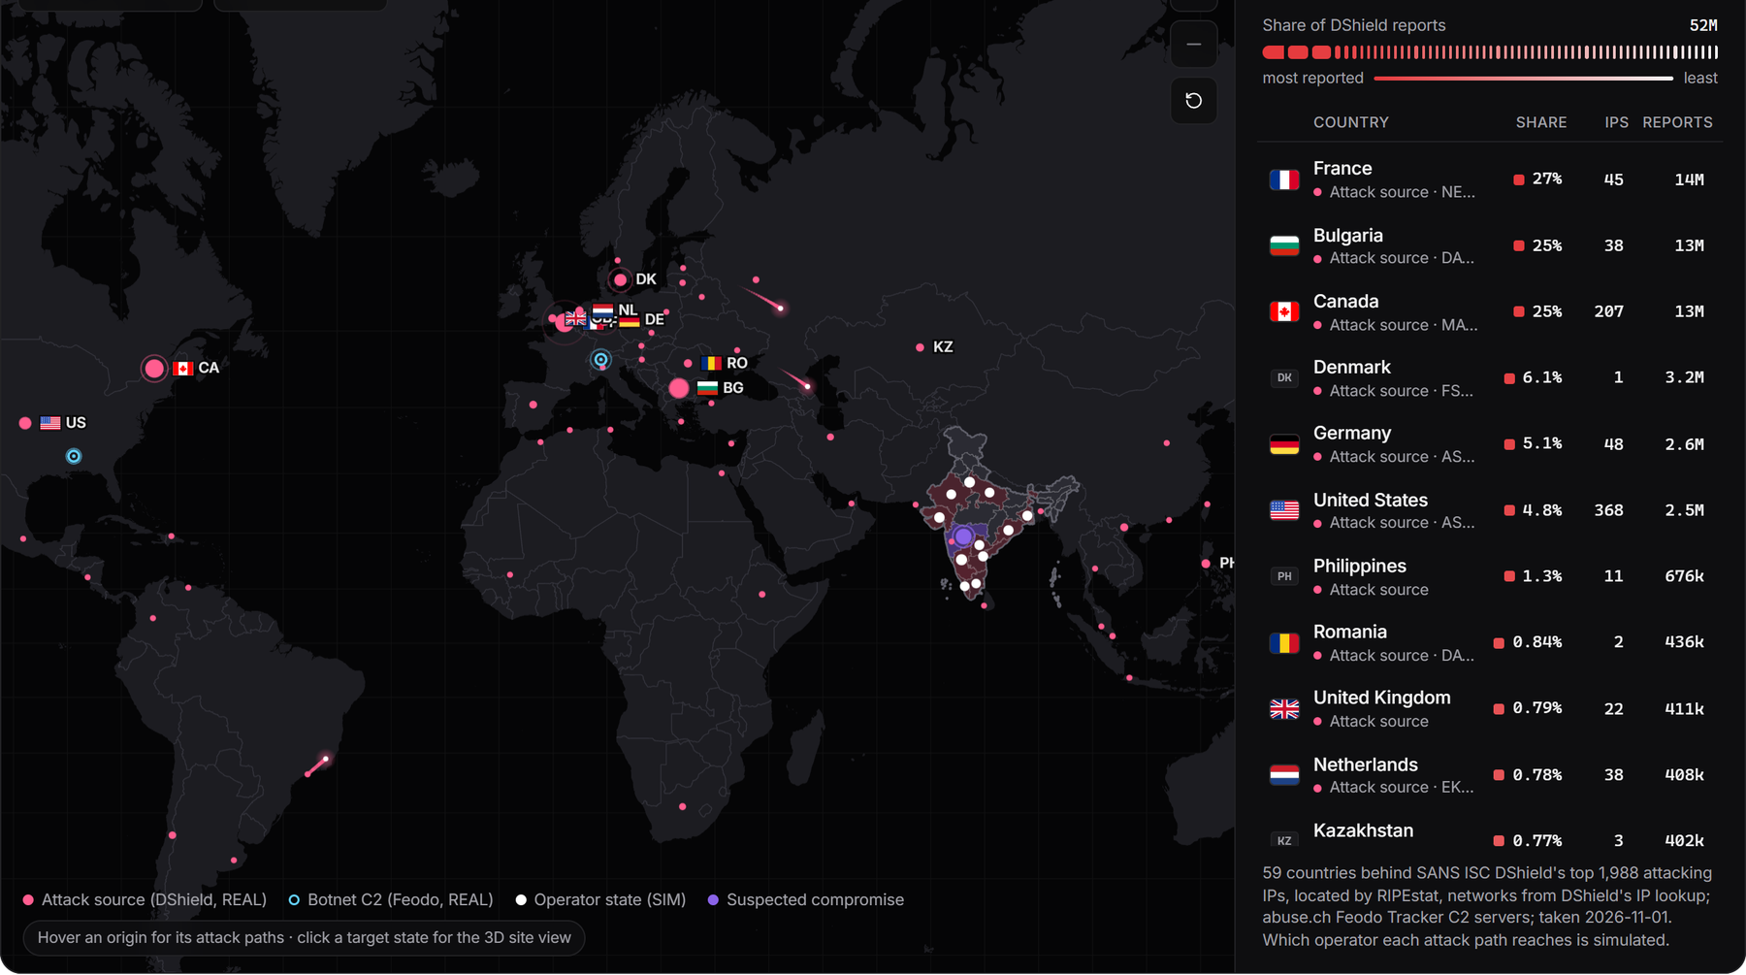
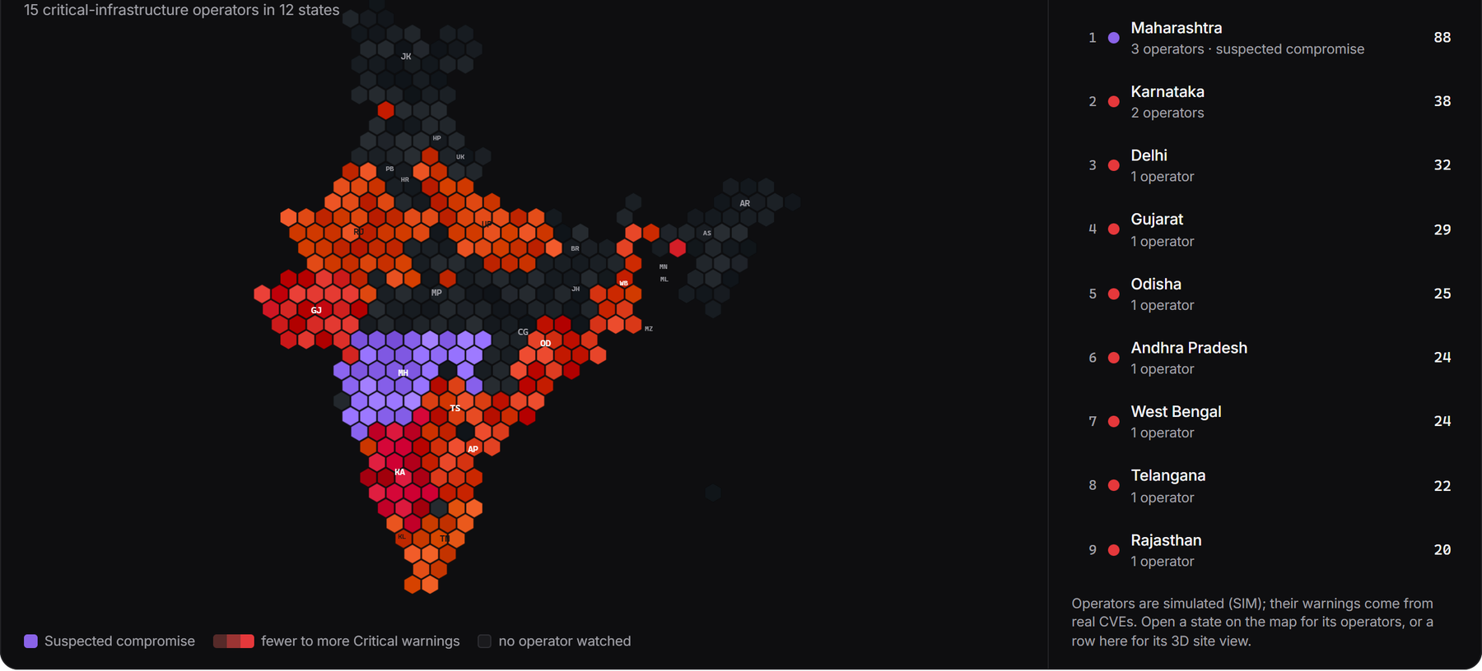
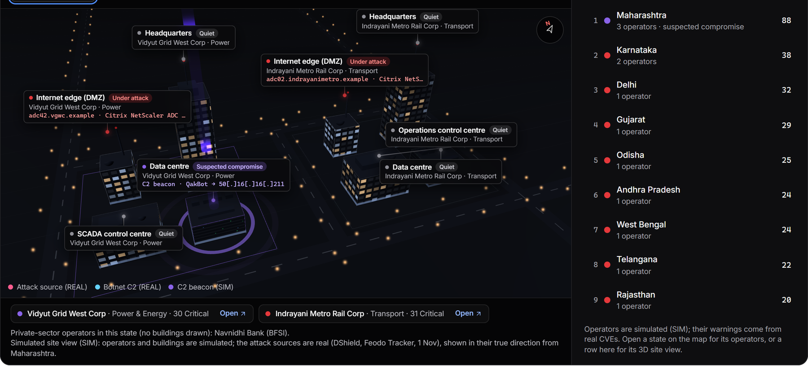
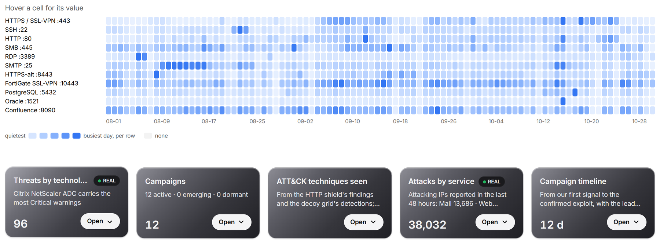
One screen per question
Now: what needs me; the brief and the score a click away
Where attacks start, and the operators they reach
India by Critical warnings; compromise in violet
SIM operators · REAL CVEs
origins REAL · landing points SIM
operators SIM · warnings from REAL CVEs
Now what needs me
Live what is happening, shield included
SOC the cases
Intel what is under attack, the graph, indicators
Organisations one operator at a time
Proof the numbers, recomputed on stage
Intel: real attacks by port and day; threats by technology
A state in 3D: its agencies and the attack origins
Every panel says REAL or SIM. Feeds are bundled, so nothing waits on the network. A night-shift mode for the room.
DShield, REAL
buildings SIM · origins REAL
six screens · one question each
Notes:
Six screens, one question each. Now: what needs me. Live: what is happening, including real attacks on a real app behind the shield. SOC: the cases. Intel: what is under attack, which technologies, the graph, indicators. Organisations: one operator at a time. Proof: the numbers, recomputed on stage. The threat map and the India view are drawn from real feeds bundled into the console; each screenshot carries its own key.

Slide 10
It runs here. Offline.
0
1
85 s
221
internet or cloud AI calls, ever; the feeds are snapshot-backed
laptop: an RTX 4070 with 8 GB, every model under 8B parameters
to re-score the nation: 15 operators, 612 systems, 2,277 flaws
engine tests green; 26 of 26 product flows; 25 of 26 browser steps
SHARE OF 110 EXPLOITED CVES (KEV, AUG–OCT 2026) EACH RULE FLAGS
Real, public
CVEs, KEV, SSVC, EPSS, CISA advisories, DShield, Feodo, OpenPhish, SACHET, Exploit-DB, ransomware.live, breach and network lists.
Simulated, labelled
the 15 operators and their inventory, the decoy grid, the firewall logs.
Proven on the wire
45 of 45 real web attacks detected and blocked inline, 0 false positives, about 15 ms each. Models, scoring and workflow are explained on the Proof page; the test bench is a click away.
a single public score, on its own
Odyssey's evidence rules
KEV is one of our inputs, so 110 of 110 is by design. The honest test is out of time: the day-0 forecast, frozen in July, caught 61.1% of the CVEs later exploited in August to October while flagging 2%. CVSS ≥ 9 at the same budget caught 16.7%.
Real data. Measured claims. A human in the loop. Zero cloud calls.
Notes:
Close on what is in the room: a working prototype on this laptop, no cloud, every model under 8B. Eighty-five seconds to re-score the nation. The chart is the backtest on 110 real exploited CVEs; say that 110 of 110 is by design because KEV is one of our inputs, and that the honest test is the forecast. Then the line: real data, measured claims, a human in the loop, zero cloud calls.

