Slide 1

Odyssey
National cyber threat early warning
See the attack coming.
Odyssey tells each Indian organisation which of its systems are at risk, how sure we are, what to do and by when.
Mentor round 2
D3COY 1.0 · DJS ISACA · Problem Statement 01: AI-Based National Cyber Threat Early Warning System · 1 Nov 2026
Notes:
Open with the one line. Then the C-Edge story in two sentences: in July 2024 one supplier's unpatched Jenkins server took about 300 Indian banks offline. The CVE was public for six months; nobody connected it to who was exposed in time. Odyssey closes that gap.

Slide 2
Flaws arrive faster than anyone can read
16,730
72% → 21%
of new CVEs say which product and version they affect, January against now
new CVEs in October 2026 alone
29%
Sources: CVE Program · NVD · CISA KEV · NPCI, 31 Jul 2024
of the CVEs exploited in 2026 were attacked on or before the day they were announced
July 2024. One unpatched Jenkins server at a supplier took about 300 Indian banks offline. The flaw had been public for six months. CISA listed it 19 days after the banks went down.
Notes:
Volume, missing labels, and attackers who move on day zero. The C-Edge case is the Indian example, and the reason the system is built around who is exposed, not around the feed.

Slide 3
What PS-01 asks for, and where Odyssey stands
1
Aggregate
2
Analyse
3
Warn
4
Prioritise
5
Recommend
13
0
20.5 d
44×
205
sources of threat intelligence, 10 real
cloud calls: local AI explains, rules decide
median lead over CISA KEV, up to 42
less noise: 16,730 flaws to 384 warnings
changes remove 80% of national risk
Delivered as one dashboard (Now, Live, SOC, Intel, Organisations, Proof), fully offline on one laptop, every number recomputed live on the Proof page.
Notes:
The agenda is the PS itself. Five objectives, one number each, and the next five slides take them in order. Everything is delivered as the dashboard and runs on this laptop.

Slide 4
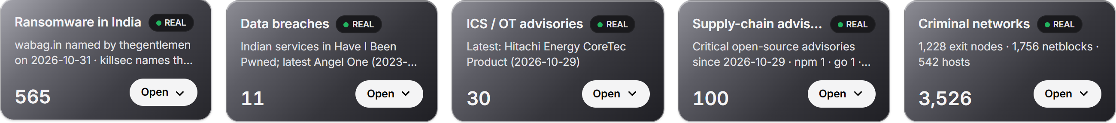
1 Aggregate: 13 sources, 10 real
Vulnerability databases
82,104
CVEs published in 2026
NVD 2021 to 2026
CISA KEV
CISA SSVC
FIRST EPSS
Advisories and context
2,277
name a product an operator runs
CISA ICS and alerts
CERT-In style (SIM)
MITRE ATT&CK
NDMA SACHET
354
Critical warnings, each to a named operator
Attack telemetry, indicators, logs
DShield honeypots
Feodo C2
OpenPhish
Decoy grid (SIM)
Firewall flows (SIM)
In and out in the formats a SOC already runs: STIX 2.1, TAXII 2.1, CSV. A partner's indicators are matched against our record in seconds.
Every item on screen says REAL or SIM. Also bundled in the console, real: Exploit-DB, ransomware.live, Have I Been Pwned, GitHub advisories, Tor, Spamhaus DROP, Emerging Threats.
Notes:
Thirteen sources, grouped the way the PS lists them. The funnel on the right is the point: 82,000 CVEs this year, 2,277 name something an operator actually runs, 354 are Critical warnings addressed to a named operator. The record goes in and out as STIX, TAXII and CSV, so a partner's indicators or a SIEM plug straight in.

Slide 5
2 Analyse: AI explains, rules decide
22 / 23
AI briefs passed the fact validator; a sentence that fails is withheld
MiST-8B, a security LLM
77.5%
root cause (CWE) top-1 by classic ML; the best LLM scored 62.5%
TF-IDF and a linear classifier
5 / 5
hostile advisories caught by the injection guard, 0 of 5 benign blocked
DeBERTa classifier and rules
22
Indian languages for every brief; 127 of 132 sentences validated
IndicTrans2, on the laptop
Also on the laptop: SecureBERT 2.0 relates threats and entities, a Bayesian model estimates compromise, and detectors for scanning surges, C2 beacons and flow anomalies run every 5 seconds. One RTX 4070, 0 cloud calls. Models are chosen by measurement on 2026 CVEs and set in a config file.
Notes:
The AI never sets a score. It reads advisories, writes the brief, and every number, version and deadline in the brief is checked; a sentence that fails is withheld. Where a small classic model beats the LLM, as on root cause, we use the classic model. All measured on 2026 CVEs, newer than any model's training data.

Slide 6
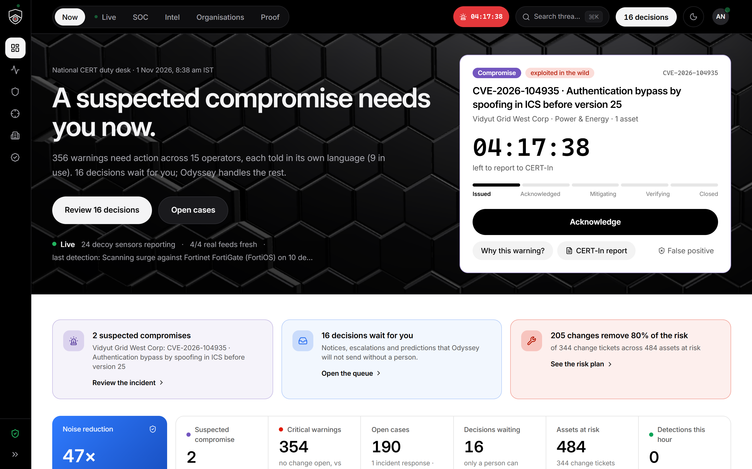
3 Warn: ahead of the threat
20.5 days
median lead over CISA KEV on real signals, up to 42.4 days
61.1%
of later-exploited CVEs caught by the day-0 forecast while flagging 2%; CVSS ≥ 9 catches 16.7%
12 days
One warning, one countdown, one action: the Now screen
Every warning carries severity, confidence and relevance
before disclosure, from a scanning surge on the decoy grid (SIM)
New CVEs matched within seconds; detectors every 5 s, feeds every 15 min
Weather or attack? NDMA SACHET read beside the cyber record
Notes:
The warning in the operator's hand: the single most urgent threat, its clock, its next step. Behind it: a lead over CISA's list measured on real signals only, an out-of-time forecast, and the decoy grid. Since this morning, SACHET's disaster alerts sit beside the cyber record, read-only and labelled.

Slide 7
4 Prioritise: a score you can check by hand
Risk = 100 × Relevance × Importance × (55% Likelihood + 30% Severity + 15% Evidence)
44×
less noise: 16,730 flaws in October cut to 384 Critical warnings
Tier by CISA's SSVC path: Act, Attend, Track
Confidence scored apart: A to F source grades, agreement raises it
Exploitability, asset criticality, impact, evidence: each shown with its working
EPSS alone misses 49%, CVSS alone 53%. KEV is one of our rules, so 110 of 110 is by design.
Deadline from the CERT-In Blueprint; a Bayesian P(compromise) starts the 6-hour clock
Notes:
The formula is on the slide because anyone can check it. Likelihood, severity and evidence weighted; relevance and importance multiply. The tier follows CISA's SSVC decision method. The chart is the backtest on 110 real exploited CVEs: a single score misses about half; say out loud that 110 of 110 is by design because KEV is one of our inputs.

Slide 8
5 Recommend: what to do, and by when
On every warning
Nationally: the risk plan
1
Patch to a named fixed release, never a downgrade
93
205
2
Block the indicators: STIX 2.1 export, risk lists for the firewall
changes remove half the national risk
changes remove 80%, of 344 tickets
3
Hunt playbook and ATT&CK mitigations
4
CERT-In 6-hour report, pre-drafted
The clocks on every warning
5
A notice in the operator's own language; a person approves it
CERT-In 6 h
RBI DAKSH
SEBI CSCRF
DPDP 72 h
NCIIPC
Sector CSIRT
Odyssey proposes; a person approves anything consequential. Evidence-based notices, digests and hunts run on their own; every action is in a hash-chained audit trail.
Notes:
Every warning ends in something a team can do: a named fix, a block list, a hunt, the regulator report already drafted, and a notice in the operator's language that a person approves. Nationally the risk plan orders the fewest changes that remove the most risk. India's clocks are the real ones.

Slide 9
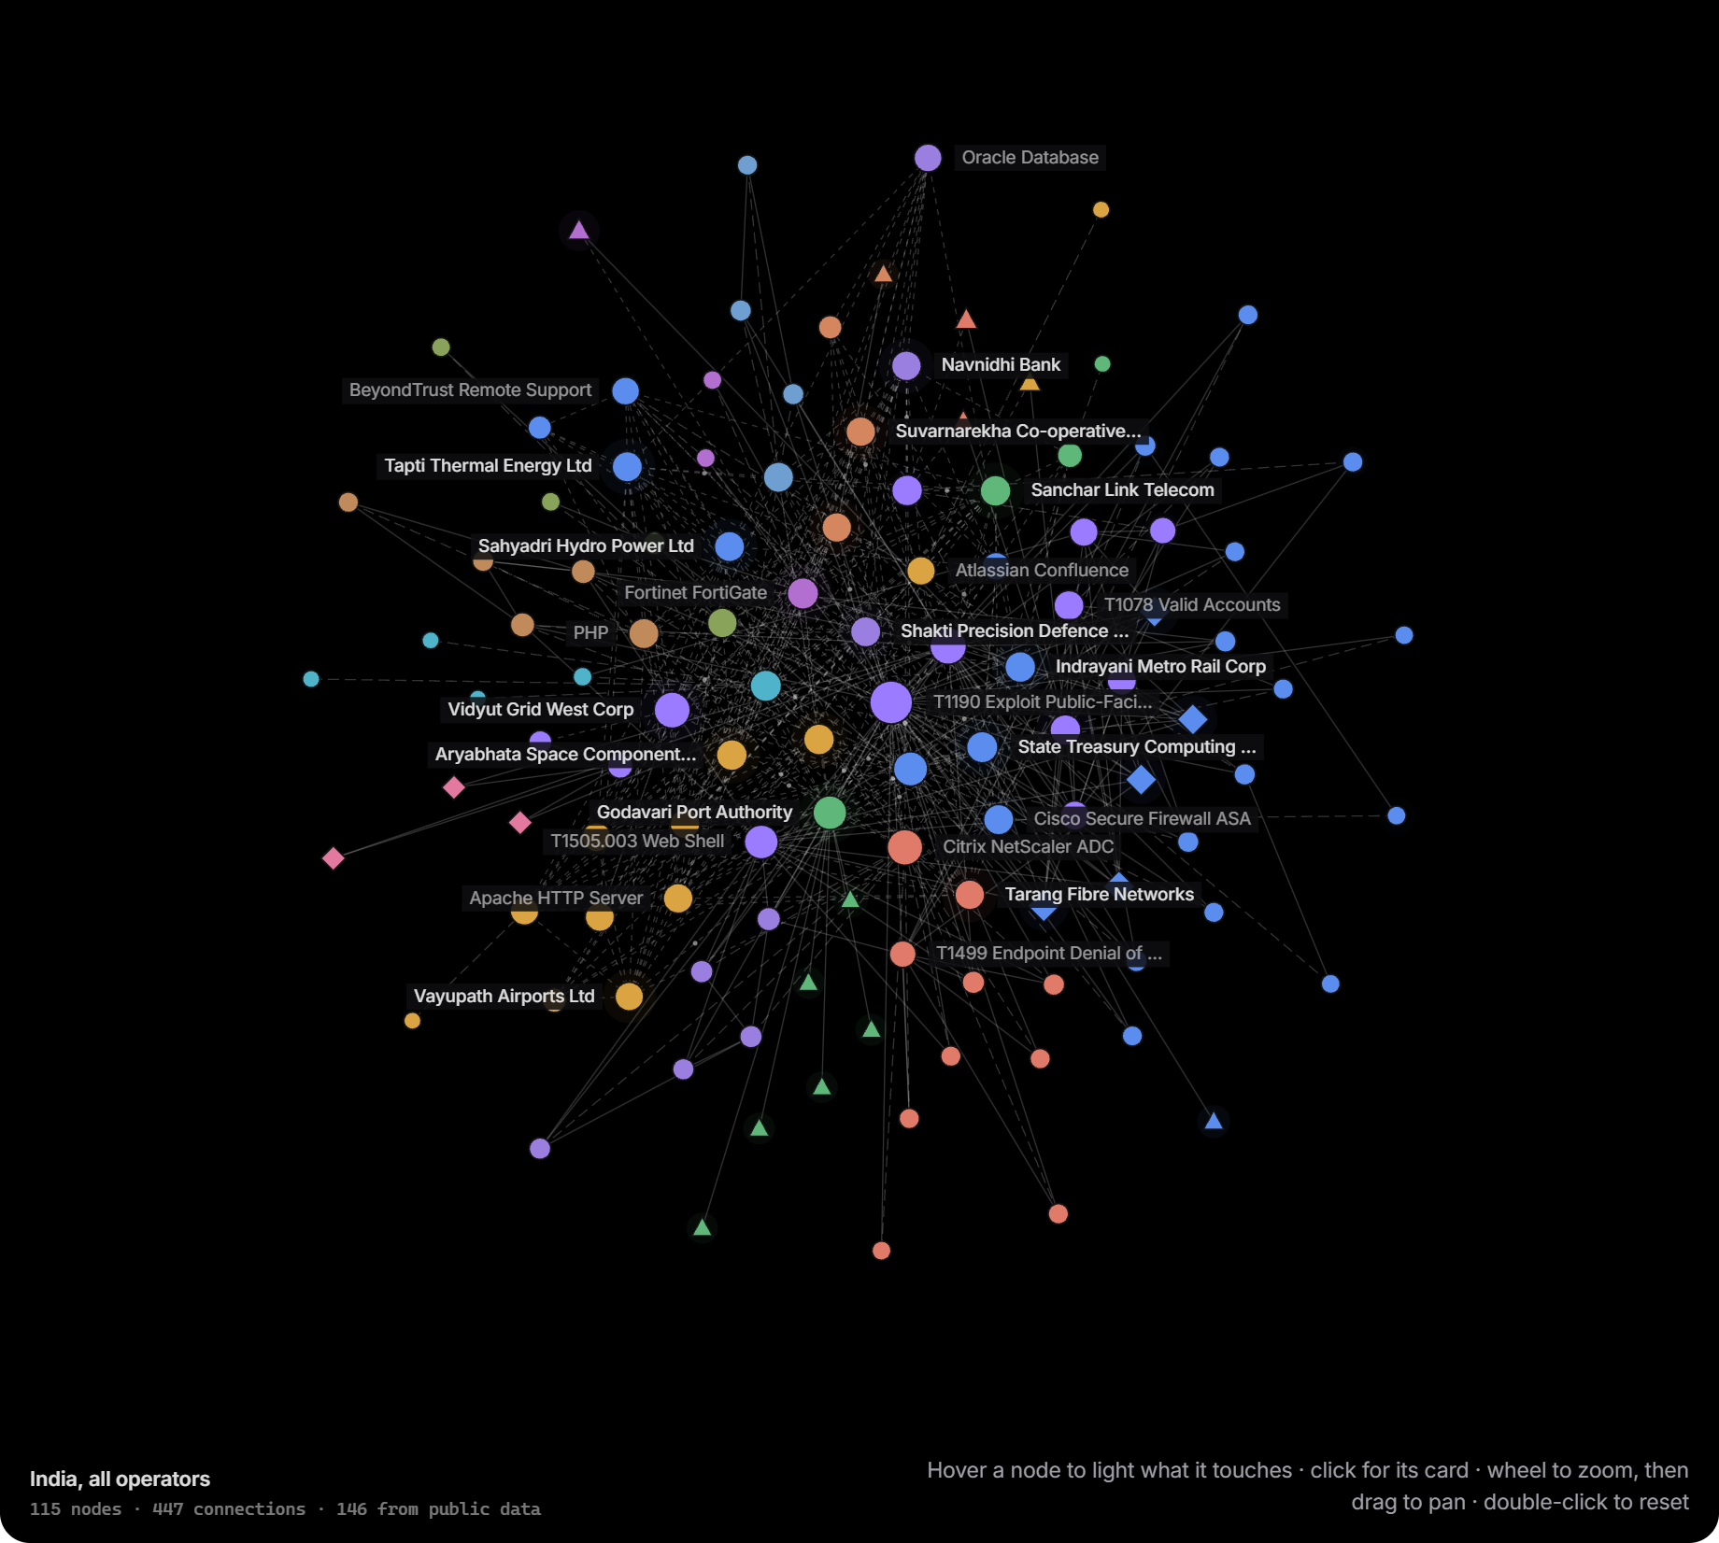
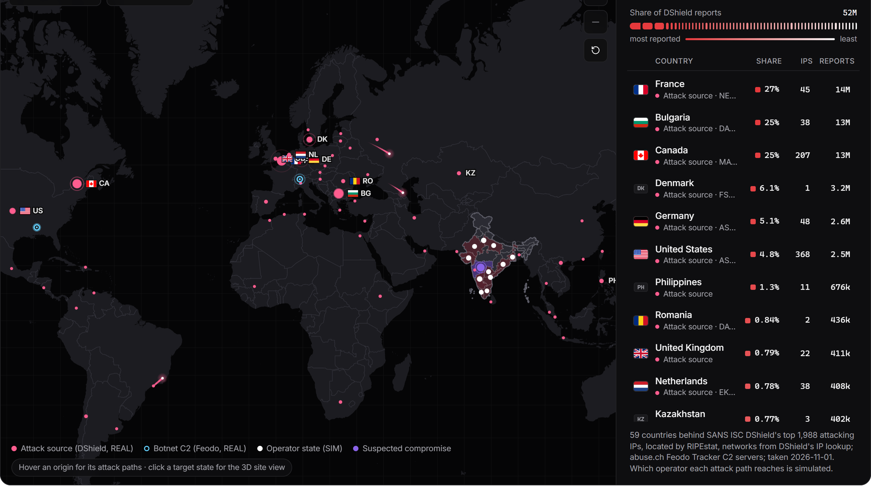
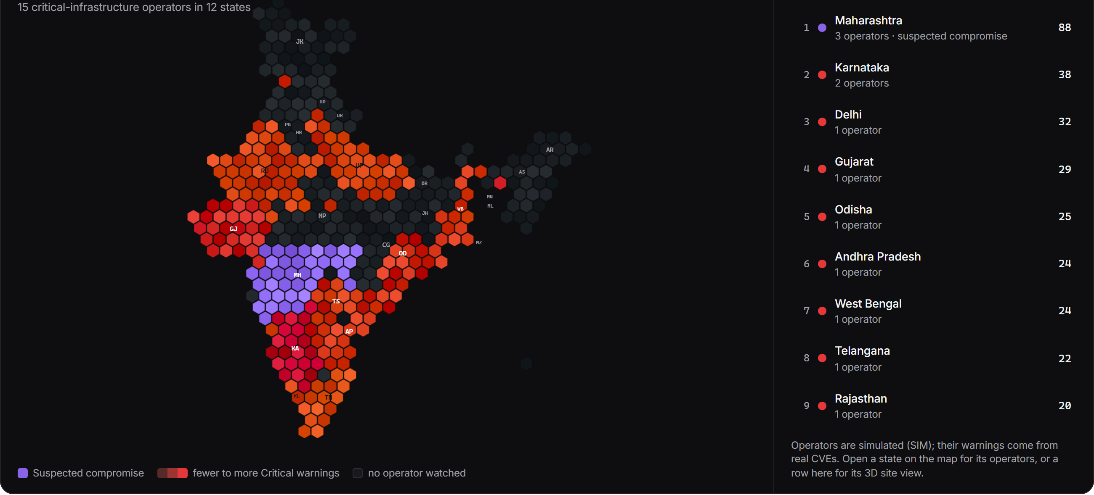
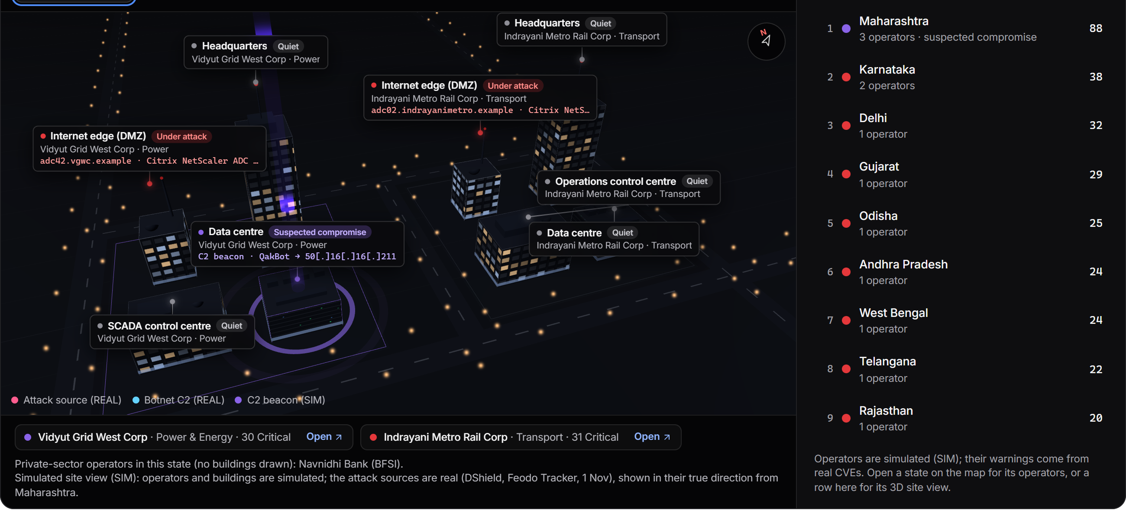
The dashboard: one question per screen
Now: real attack origins (DShield, Feodo) and the operators they reach
Intel: the intelligence graph, 115 entities, breathing with evidence age
India by Critical warnings
A state in 3D, with the origins aimed at it
Now · Live · SOC · Intel · Organisations · Proof. Every panel says REAL or SIM; feeds are bundled, so the demo never waits on the network.
Notes:
Six screens, one question each. Now: what needs me. Live: what is happening. SOC: the cases. Intel: what is under attack, the graph, indicators. Organisations: one operator at a time. Proof: the numbers, recomputed. Everything on screen says whether it is real or simulated.

Slide 10
Proven on real traffic, and what comes next
45 / 45
459
221
0
real web attacks detected and blocked inline by the HTTP shield; 0 false positives, about 15 ms each
attacks in the lab loop on a fictional portal we own: 242 blocked, a Compromise case opened, alerts delivered
engine tests green; 26 of 26 product flows; 25 of 26 browser steps
internet or cloud AI calls; one RTX 4070 laptop; 85 s to re-score 15 operators
Next
Inventory connectors for real operators
Supplier graph from procurement data
OT telemetry: power, water, transport
Live CERT-In and NCIIPC feeds
The decoy grid as a national honeynet
A routed SACHET channel, if authorised
Real data, measured claims, a human in the loop, zero cloud calls, and it runs on this laptop.
Notes:
Close on proof: the shield against real attacks over the wire, the lab loop on a target we own, the test counts, zero cloud calls. Then what comes next. End on the one line. Honest limits if asked: forecast precision is 5% because exploitation is rare, so forecasts are proposals for a person; operators and sensors are simulated and labelled.

