Slide 1
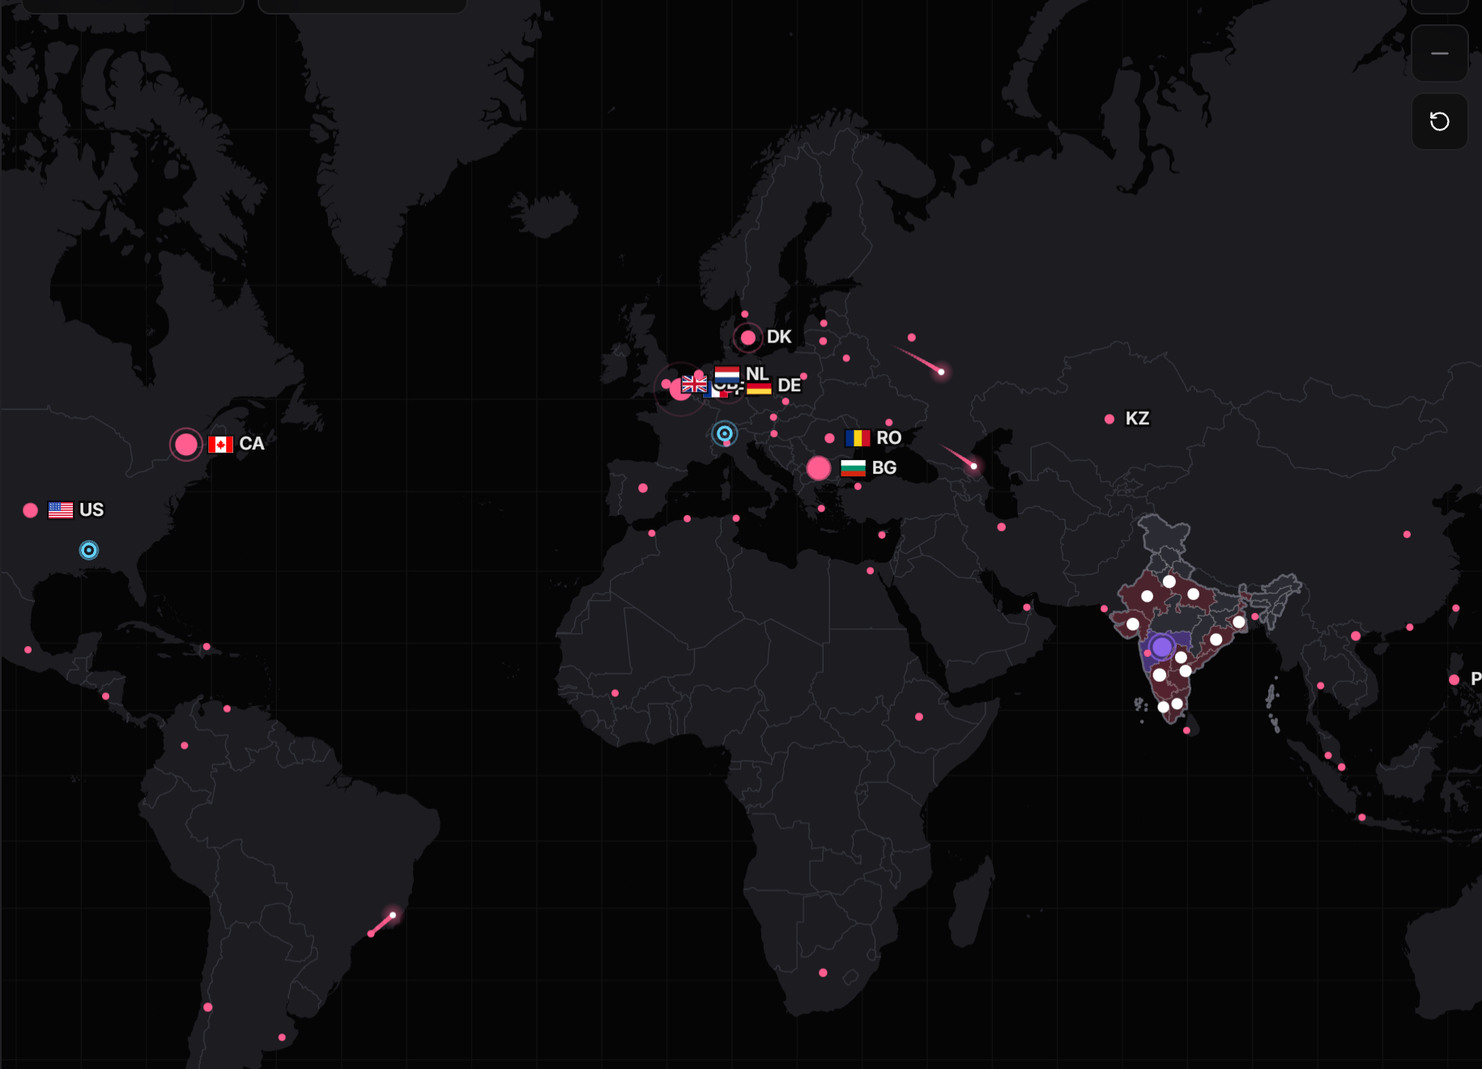
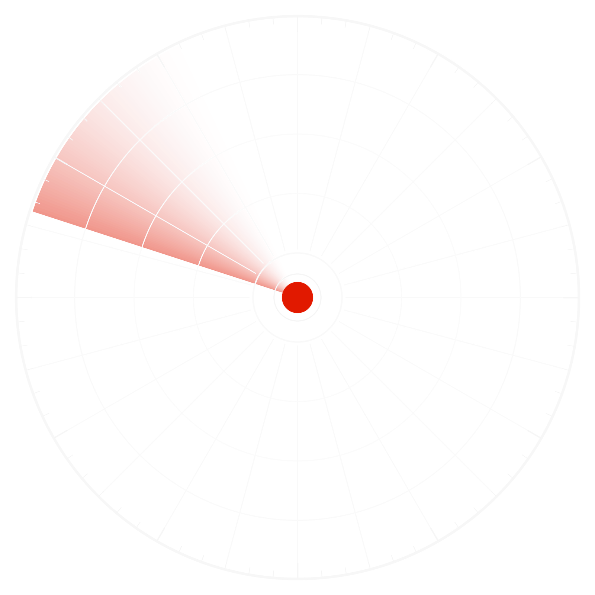

Odyssey
NATIONAL CYBER THREAT EARLY WARNING
FINAL ROUND · D3COY 1.0 · DJS ISACA · PROBLEM STATEMENT 01
See the attack coming.
Public threat intelligence in. For every Indian organisation: which systems are at risk, how sure we are, what to do, and by when. On one laptop, with no cloud.
SEVEN ASKS · ONE SYSTEM
1
Collect
2
Analyse
3
Warn
4
Prioritise
5
Recommend
6
Show
D
Explain
BEHIND: THE LIVE THREAT MAP, AS THE CONSOLE DRAWS IT · RED = ATTACK SOURCE (DSHIELD, REAL) · VIOLET = COMPROMISE
01 / 10
Notes:
Open on the line. Behind it is the live map from the console, real attack origins from the last snapshot; the ring is the chakra from our emblem drawn as a radar. Then two sentences: in July 2024 one supplier's unpatched server took about 300 Indian banks offline. The flaw had been public for six months. Odyssey exists so that the decision is never late again. The strip at the bottom is the talk: seven asks, one system.

Slide 2



The warning was public.
The decision was late.
02 · THE PROBLEM
16,730
72% → 21%
of new CVEs say which product and version they affect, January against now
29%
new CVEs published in October 2026 alone, from dozens of feeds. Every one needs a decision: does it touch us, how badly, how soon.
of the CVEs exploited in 2026 were attacked on or before the day they were announced
one of 100 CVEs
labelled with product and version
attacked by day 0
REAL · CVE PROGRAM · NVD · CISA KEV
31 Jul 2024 ransomware via the supplier; about 300 banks lose UPI and ATM
C-EDGE · 2024 · THE INDIAN CASE
Jan 2024 Jenkins flaw disclosed; exploit public within days
19 Aug 2024 CISA lists the flaw, 19 days later
six months of public warning, nothing connecting it to who was exposed
event
the breach
ODYSSEY · D3COY 1.0 · SOURCES: CVE PROGRAM, NVD, CISA KEV, NPCI 31 JUL 2024
02 / 10
Notes:
The problem is not a shortage of intelligence. It is volume, missing labels, and attackers who move on day zero. Each dot plate is a hundred CVEs: the lit ones say what they break, and that share fell from 72 to 21 in a year; the red ones were attacked by the day they were announced. C-Edge is the Indian case: six months of public warning, then 300 banks offline, then the national list catching up 19 days later.

Slide 3
One advisory, start to finish
SIEMENS WINCC · CISA ICS ADVISORY · REAL
03 · THE LOOP · THE BRIEF'S OWN EXAMPLE, RUN FOR REAL
1
2
3
4
5
Advisory arrives
Versions parsed
Exposure found
Risk assigned
People decide
CISA's ICS advisory for Siemens WinCC, read by the security LLM. No CVE id needed.
Machine-readable ranges lifted from the text: below 8.0.0.11, and all versions.
13 WinCC assets at 7 operators, checked against the inventory version by version.
A score with its working, an SSVC tier, a CERT-In clock. Patch, or mitigate where no fix exists.
A notice to each operator in its own language. An analyst approves. Every step audited.
THE SAME PATH FOR EVERY INPUT
a KEV entry
a new CVE from NVD
a decoy-grid surge
a partner's indicators
a SACHET alert
Each is matched to who is exposed, scored, and turned into something a person can approve.
automated, written to the audit trail
the score
a person decides
ODYSSEY · D3COY 1.0 · DJS ISACA · PS-01
03 / 10
Notes:
This is the walk-through in the demo and the brief's own example. A real CISA advisory for Siemens WinCC comes in. The model reads it, the version ranges are parsed, thirteen assets at seven operators are found exposed, each gets a risk with its working and a deadline, and the notices are proposed in Marathi, Gujarati and Hindi for a person to approve. The saffron station is the score; the bone one is the person. Then: the same path for every input.

Slide 4
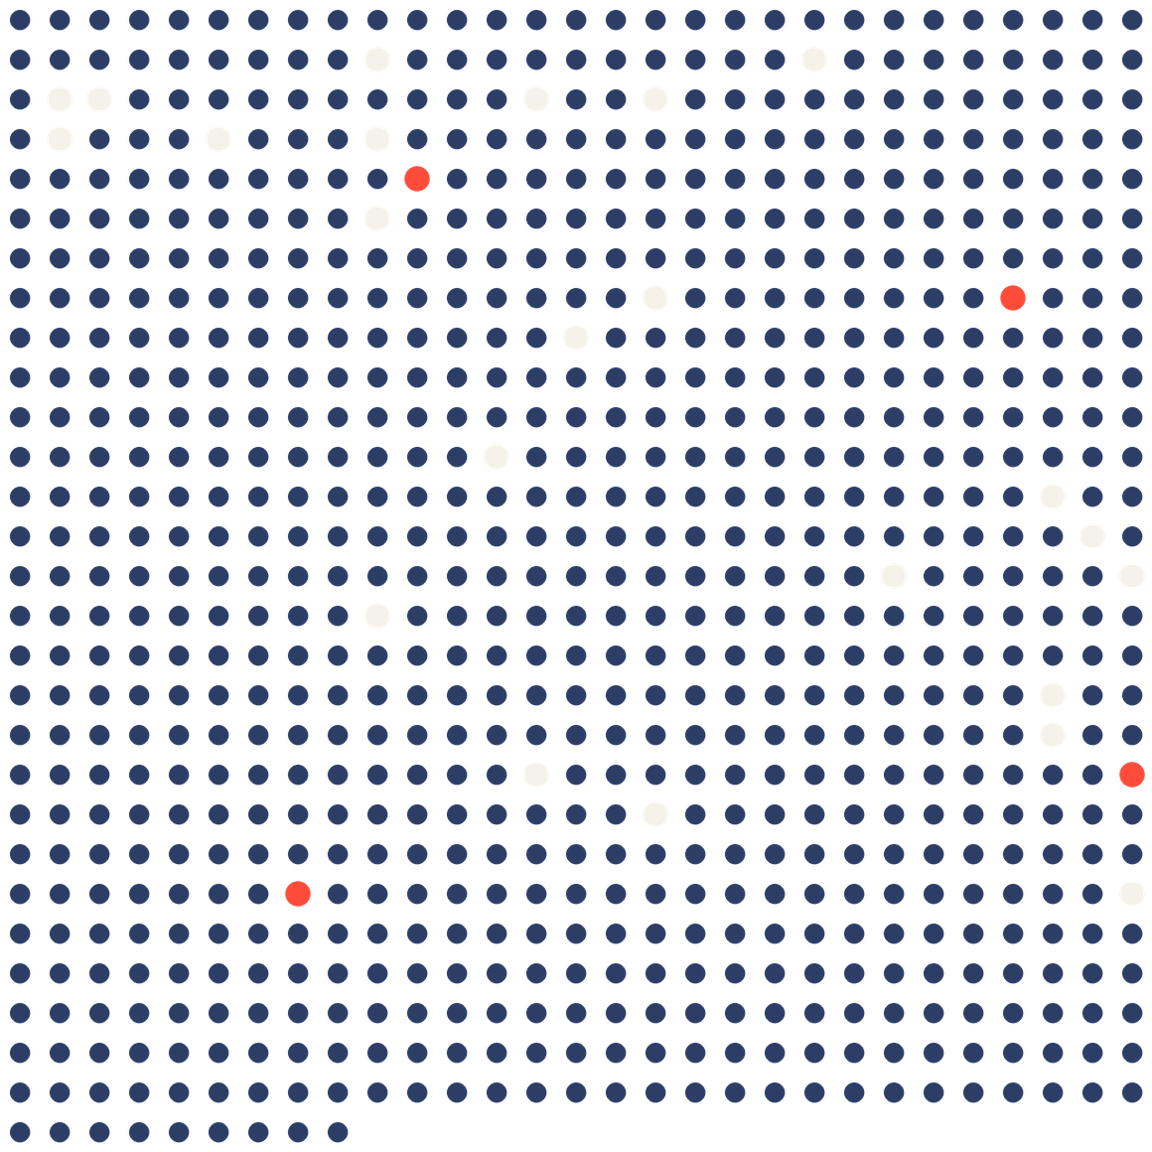
Every source, one record
04 · 1 COLLECT
13 SOURCES · 10 REAL · 3 SIM
MANIFEST
SOURCE
82,104
NVD 2021 to 2026
REAL
CISA KEV
REAL
CISA SSVC
REAL
CVES PUBLISHED · 2026
FIRST EPSS
REAL
2,277
CISA ICS and alerts
REAL
MITRE ATT&CK
REAL
NDMA SACHET
REAL
NAME A PRODUCT WE RUN
DShield honeypots
REAL
354
Feodo C2
REAL
OpenPhish
REAL
CERT-In style advisories
SIM
one dot = 100 CVEs published in 2026
Decoy grid, 24 sensors
SIM
CRITICAL, EACH TO A NAMED OPERATOR
names a product an operator runs
Firewall flows
SIM
a Critical warning to a named operator
In and out as STIX 2.1, TAXII 2.1 and CSV. A partner's indicators are matched against the record in seconds.
ALSO BUNDLED, REAL: EXPLOIT-DB · RANSOMWARE.LIVE · HIBP · GITHUB ADVISORIES · TOR · SPAMHAUS DROP · ET
04 / 10
Notes:
Thirteen sources, in a manifest with the provenance of each: vulnerability databases, public advisories, attack telemetry and indicators, and the simulated layer, labelled. The plate in the middle is the whole year: every dot is a hundred CVEs, the lit ones name something an operator actually runs, the red ones are Critical warnings addressed to a named operator. The record goes in and out as STIX, TAXII and CSV.

Slide 5
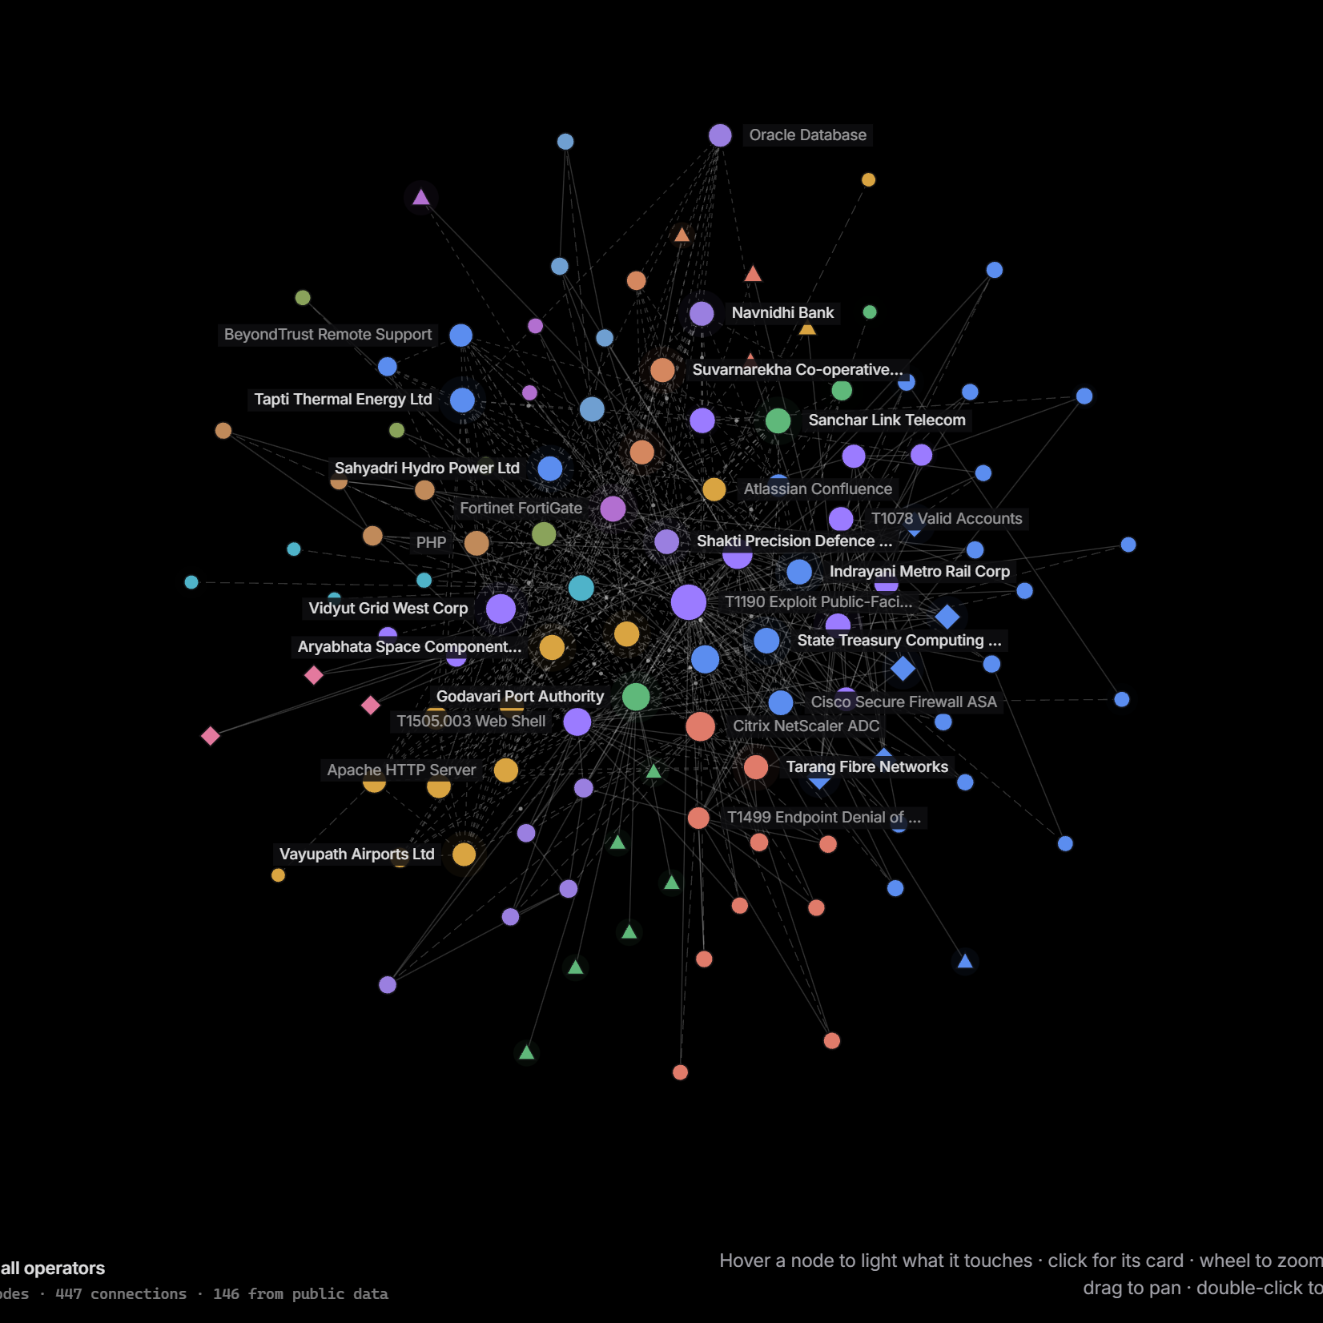
AI explains. Rules decide.
9 MODELS · ONE RTX 4070 · 0 CLOUD CALLS
05 · 2 ANALYSE
22/23
Reads
MiST 8B, a security LLM, reads every advisory and writes every brief. 22 of 23 briefs pass the fact validator; a failing sentence is withheld, never shown.
12
Relates
SecureBERT 2.0 links entities and threats; a clustering model groups 12 active campaigns. Threat groups are ATT&CK overlap, never attribution.
5/5
Detects
Surges, C2 beacons and flow anomalies, every 5 seconds. A poisoned advisory with hidden instructions: caught by the DeBERTa guard, 5 of 5.
MIST 8B · FOUNDATION-SEC 8B · SECUREBERT 2.0 · TF-IDF CLASSIFIERS · DAY-0 FORECAST · BAYES · LIVE DETECTORS · DEBERTA GUARD · INDICTRANS2, 22 LANGUAGES
INTEL › GRAPH · 115 NODES · 447 LINKS
colour = technology family
compromise
No model sets a score, a tier or a deadline. One model per job, fixed in config, chosen by measurement on 2026 CVEs, newer than any model's training data.
threat group, overlap not attribution
live signal
ODYSSEY · D3COY 1.0 · DOCS/MODEL_CARD.MD · MEASURED 31 OCT 2026 ON THE DEMO LAPTOP
05 / 10
Notes:
Three jobs for the models: read, relate, detect. Read: the security LLM reads advisories and writes the brief, and the brief is fact-checked line by line. Relate: entities, related threats, campaigns, and the graph on the left, where colour is the technology family, violet a suspected compromise, a diamond a threat group stated as overlap and never attribution, a triangle a live signal. Detect: surges, beacons and anomalies every five seconds, plus the guard that catches a poisoned advisory. Nine models, each chosen by measurement, none of them deciding.

Slide 6
Move the line left
+20.5 days
06 · 3 WARN
THEN · REACT AFTER THE BREACH
MEDIAN LEAD OVER CISA KEV · REAL SIGNALS · UP TO 42.4
Flaw disclosed
Nothing connects it
Breach
Listed
public record; exploit code soon after
to who actually runs the product
the warning signs were public for months
the national list catches up weeks later
NOW · ACT ON THE SIGNAL
12 days before
Day 0
Warning
+20.5 days
a decoy-grid surge (SIM) raises a warning
matched to installed versions in seconds
tier, confidence, clock; a person approves
median before CISA lists it, on real signals
61%
1 tick
15 min
of later-exploited CVEs flagged on day 0 at a 2% alert budget; CVSS ≥ 9 catches 17% at the same budget
one 5-second tick to catch a scanning surge or an implant beacon in the drills; 0 alerts on clean traffic
between feed reads; a new NVD CVE naming our products is matched, scored and forecast within seconds
reactive step
Odyssey step
the breach
the decision, moved before it
SIM = simulated sensor, labelled · numbers recomputed live on the Proof page
ODYSSEY · D3COY 1.0 · DJS ISACA · PS-01
06 / 10
Notes:
Top lane is how it usually goes. Bottom lane is Odyssey: the decoy grid sees scanning before disclosure (simulated, labelled); on day zero a new CVE is matched to the inventory in seconds and the forecast flags the ones likely to be exploited; the warning goes out with its tier, confidence and clock; and CISA's list follows, a median 20.5 days later on real signals. The saffron arrow is the whole pitch: reactive systems start at the breach, we start at the signal.

Slide 7
A score you can check by hand
07 · 4 PRIORITISE
SCORING.JSON · HASHED INTO EVERY ALERT
Risk
RELEVANCE ×
IMPORTANCE ×
LIKELIHOOD
SEVERITY
EVIDENCE
0 → 1
0.4 → 1.3
55%
30%
15%
= 100 ×
this exact version affected?
criticality · exposure · blast radius
from evidence, in rank order
SSVC technical impact
Admiralty-graded sources
LIKELIHOOD · FROM EVIDENCE · IN RANK ORDER
ONE REAL WARNING · TAPTI THERMAL · IVANTI CS 22.8R2.4
On CISA KEV · SSVC says active · exploit seen on 2+ decoys
1.0
Likelihood 0.55 × 1.0
45.8
The vendor says exploited in the wild
0.8
KEV 30 Oct · SSVC active · vendor: in the wild
A public proof of concept
0.5
Severity 0.30 × 1.0
25.0
A scanning surge on the decoy grid, decaying with age
0.4
SSVC technical impact: total
Evidence 0.15 × 1.0
12.5
EPSS ≥ 0.5 · CVSS ≥ 9 · automatable
corroborate
CISA (A), NVD (A), vendor (B) agree
The day-0 forecast
prediction
Relevance × 1.0 · Importance × 0.83
affected version · VPN gateway, internet-facing, tier 1
Tier by CISA's SSVC decision path: Act, Attend, Track. Confidence scored apart: A to F source grades; agreement between independent sources raises it. Relevance checked against NVD, the vendor and the advisory: 0 false "affected" on the Ivanti case.
RISK
83.3
Critical · Act · 12 h to patch · P(compromise) 18%
ODYSSEY · D3COY 1.0 · DJS ISACA · PS-01 · ONE REAL WARNING FROM THIS BUILD, FACTOR BY FACTOR
07 / 10
Notes:
The score is a formula anyone can check: the five tiles are its five factors. Likelihood comes from evidence in rank order, and the ladder shows what counts and how much: a KEV listing or an active SSVC verdict is 1.0, a vendor claim 0.8, proof of concept 0.5, a decoy surge 0.4 and decaying, while EPSS and CVSS only corroborate and the forecast is a prediction, not evidence. The receipt on the right is one real warning from this build: 83.3, Critical, Act, twelve hours. The tier follows CISA's SSVC decision method; confidence is scored separately from risk.

Slide 8
What to do, and by when
08 · 5 RECOMMEND
A PERSON APPROVES ANYTHING CONSEQUENTIAL
ON EVERY WARNING
THE RISK PLAN
BY WHEN · CERT-IN
344 TICKETS IN ALL
01
Patch to a named fixed release, never a downgrade
100%
6 h
suspected compromise
02
Block the indicators: STIX 2.1 export, risk lists for the firewall, C2 refanged
205 changes
80% of it
12 h
known-exploited, internet
03
Investigate a hunt playbook, ATT&CK mitigations, forensic triage where CISA asks
93 changes
half the risk
24 h
Critical
04
Report the CERT-In 6-hour report pre-drafted; RBI, SEBI, DPDP and NCIIPC clocks shown
72 h
0
High
05
Notify a notice in the operator's own language; a person approves before it goes
CHANGES, IN PRIORITY ORDER →
120 h
national risk removed, cumulative
Medium
the two cuts the plan proposes, of 344 change tickets
Odyssey proposes; a person approves anything consequential. Every action is in a hash-chained audit trail.
DIAL = DEADLINE ON A 120-HOUR FACE
runs on its own, audited
a person decides
one workflow per warning: issued → acknowledged → mitigating → verifying → closed
ODYSSEY · D3COY 1.0 · DJS ISACA · PS-01
08 / 10
Notes:
Every warning ends in something a team can do: patch to a named release, block the indicators, hunt, report, notify. The hollow rings run on their own and are audited; the filled ring is the person. Nationally, the risk plan is the curve: 93 changes remove half the risk, 205 remove 80 percent, of 344 tickets in all. The dials are India's clocks from the CERT-In Blueprint, and the countdown runs on the warning itself.

Slide 9
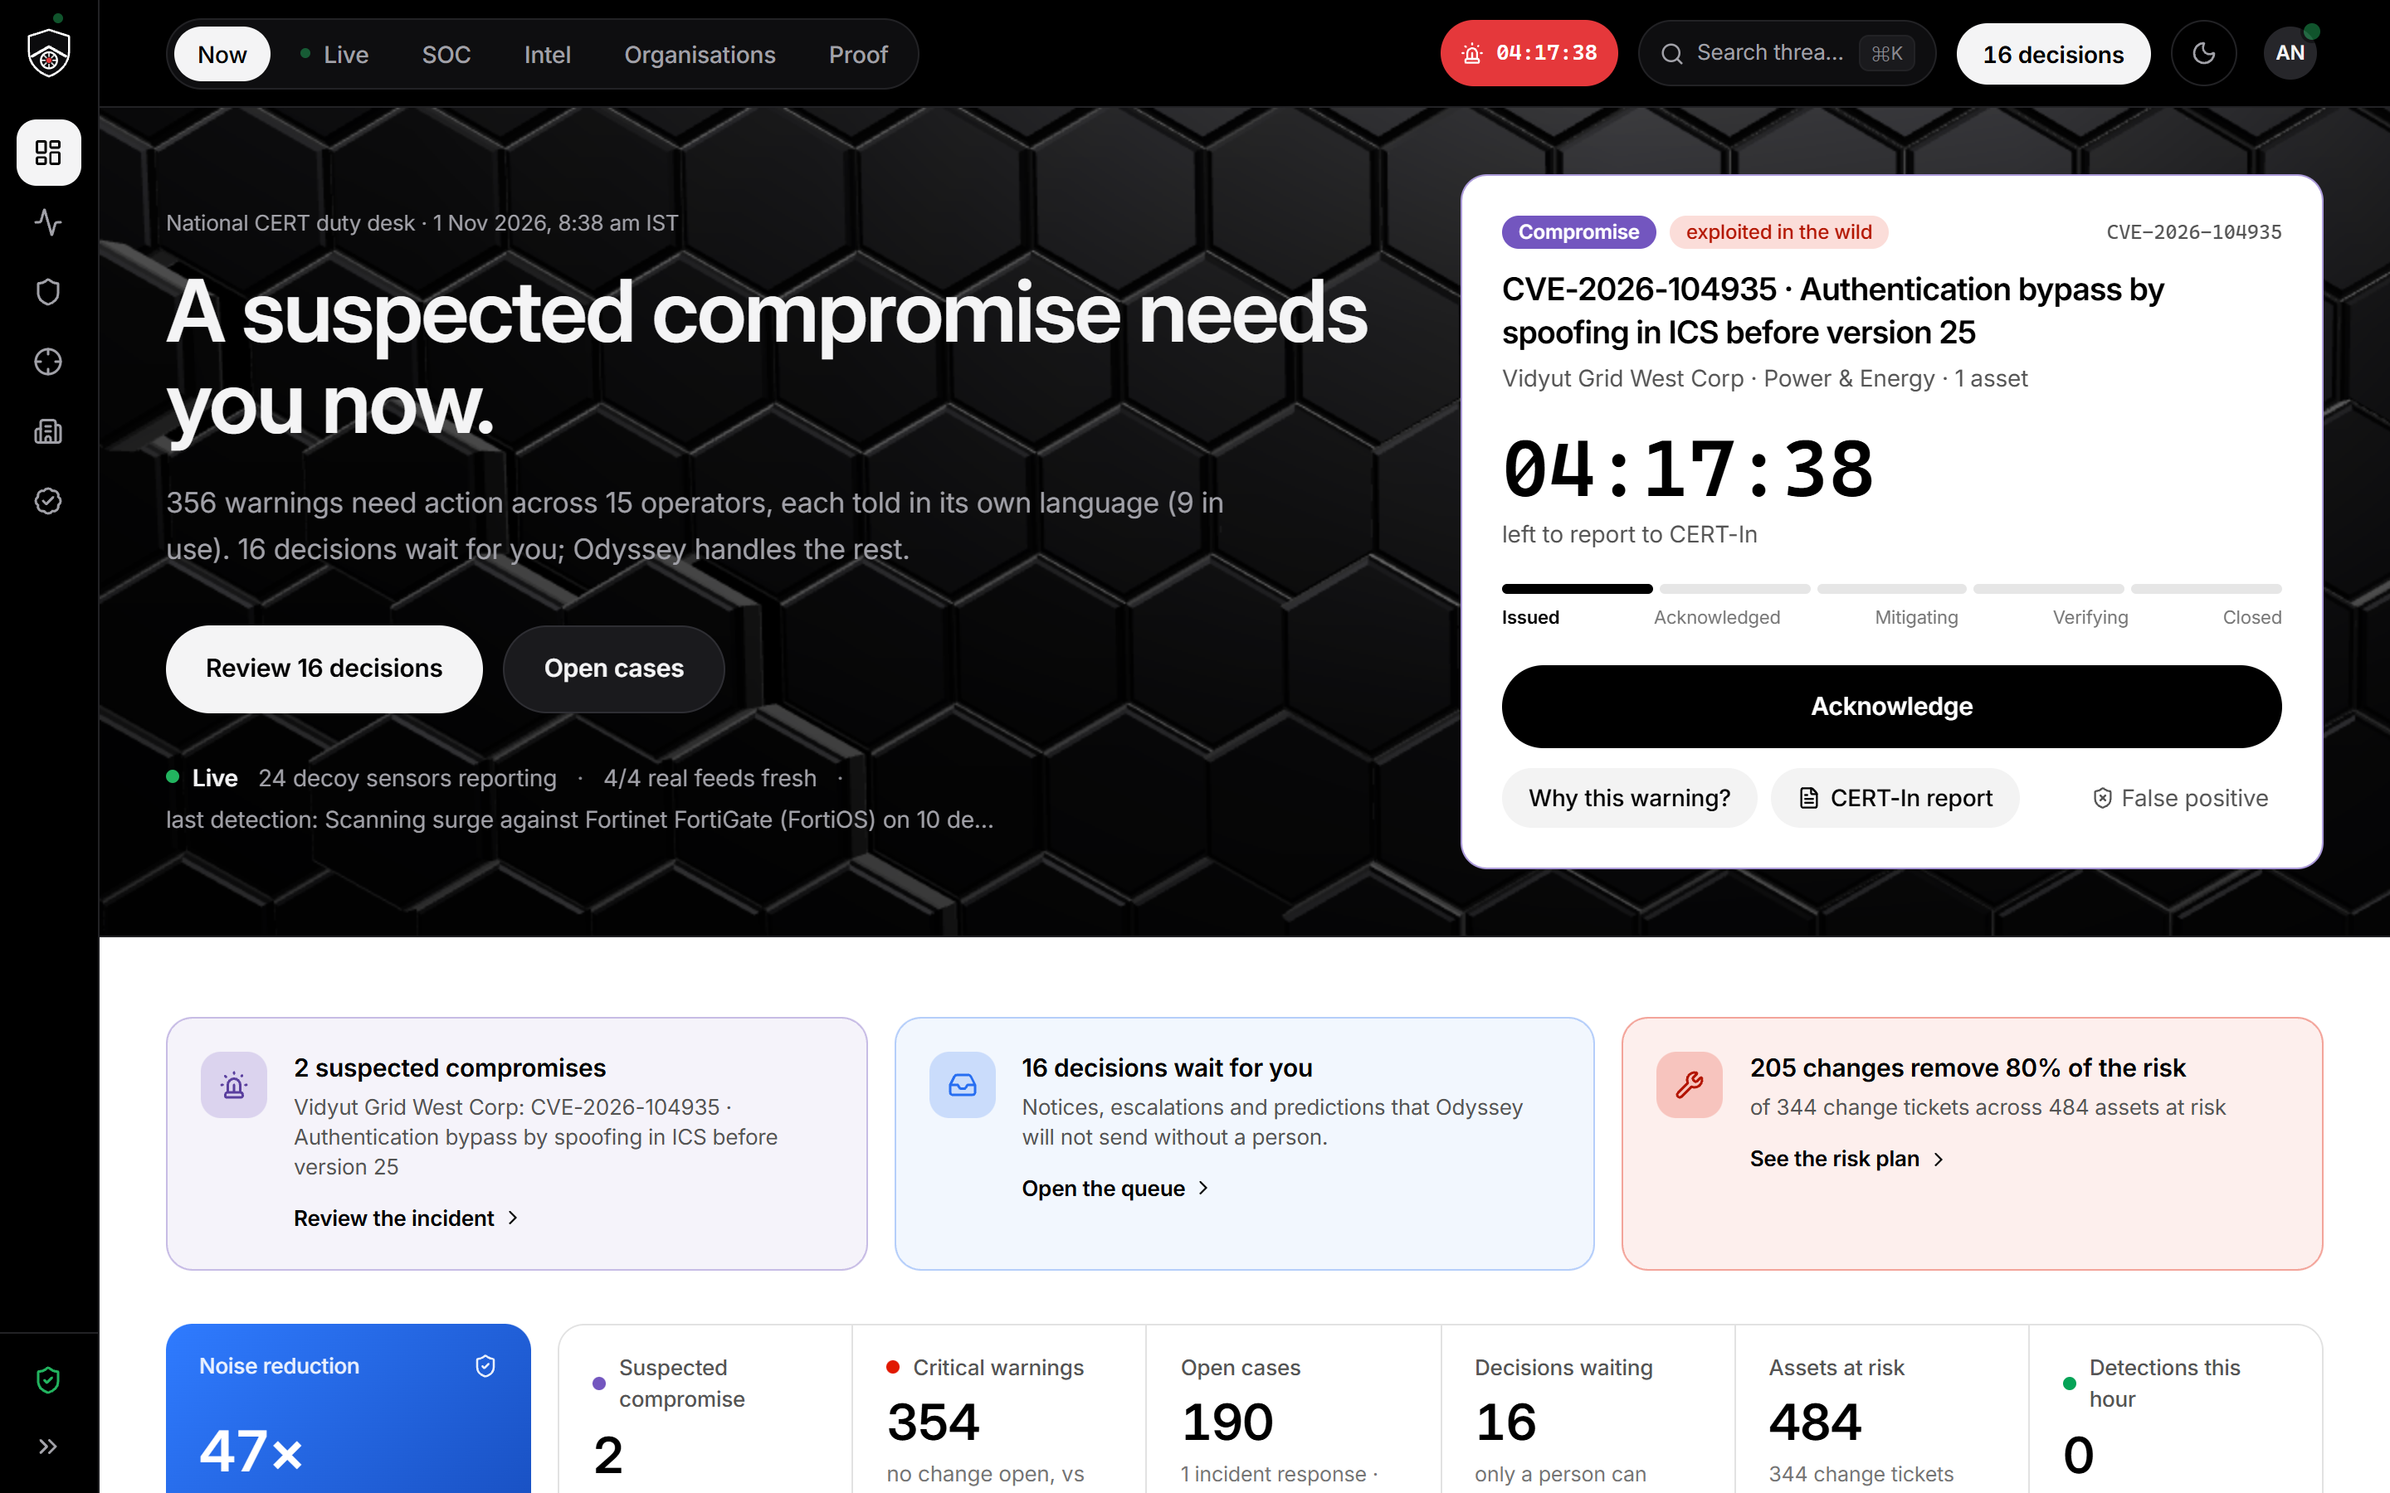
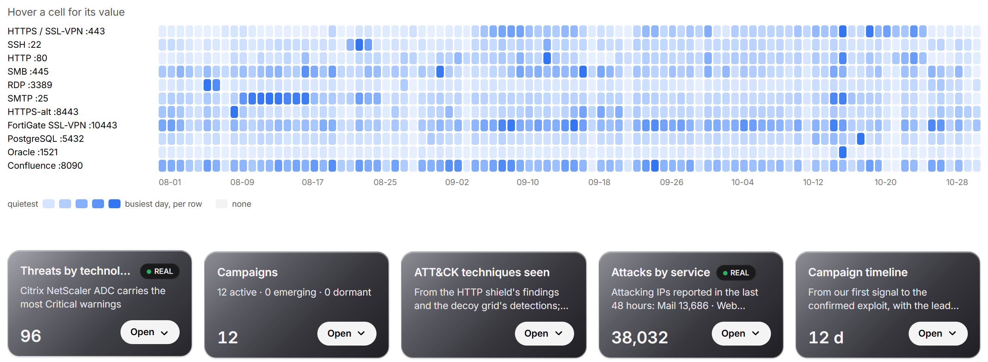
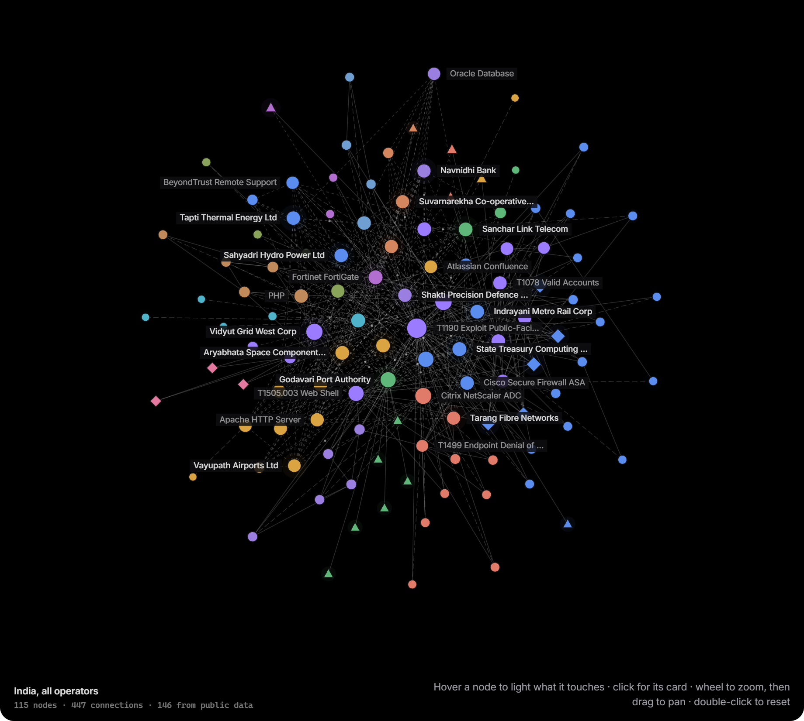
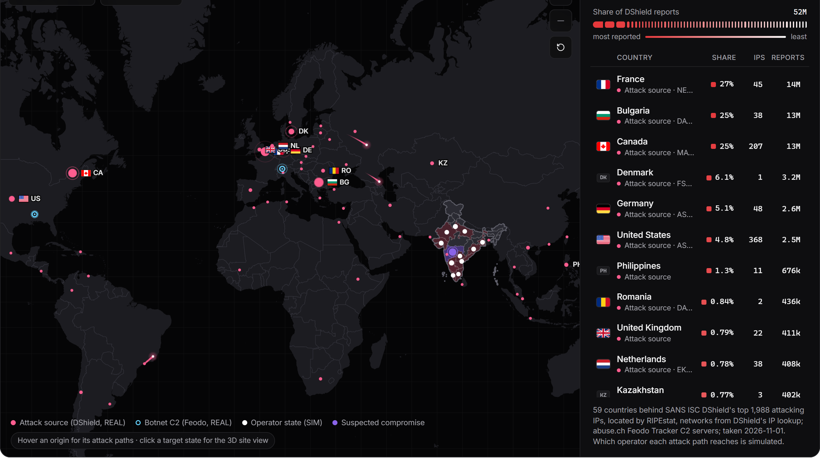
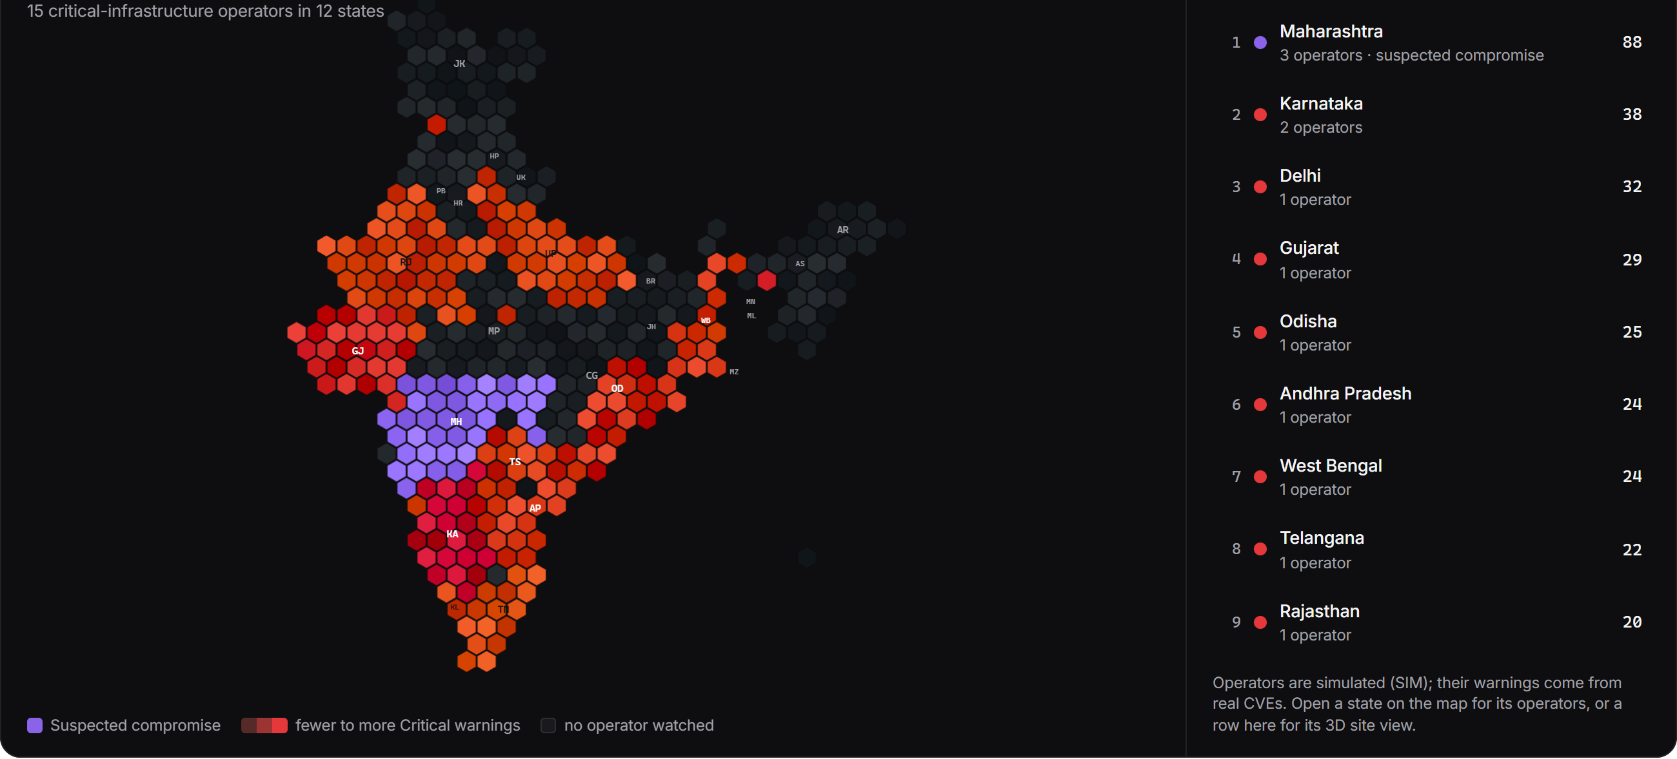
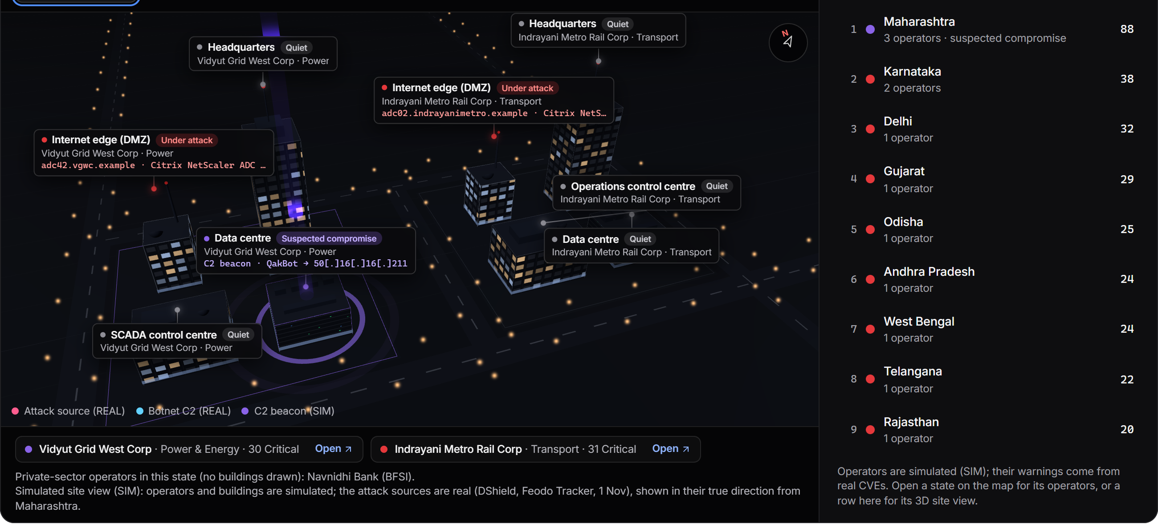
One screen per question
NOW · LIVE · SOC · INTEL · ORGANISATIONS · PROOF
09 · 6 SHOW
FIG 9A · NOW · WHAT NEEDS ME
FIG 9B · INTEL · WHAT IS UNDER ATTACK
FIG 9C · INTEL · THE GRAPH
chip = compromise
clock = CERT-In deadline
cell = attacks on a port that day, quiet → busy
colour = technology family
compromise
black button = the one action · operators SIM
DShield, REAL · rows = the services operators expose
threat group (overlap)
live signal
FIG 9D · NOW · WHERE ATTACKS START
FIG 9E · INDIA BY WARNINGS
FIG 9F · A STATE, IN 3D
attack source, REAL
botnet C2, REAL
Critical warnings per state, few → many
agency site, SIM
attack from a real origin
operator state, SIM
compromise
compromise
operators SIM, warnings from REAL CVEs
origins REAL · buildings SIM
ODYSSEY · D3COY 1.0 · REAL OR SIM ON EVERY PANEL · FEEDS BUNDLED, NOTHING WAITS ON THE NETWORK
09 / 10
Notes:
Six screens, one question each. Now: what needs me. Live: what is happening, including real attacks on a real app behind the shield. SOC: the cases. Intel: what is under attack, which technologies, the graph, indicators. Organisations: one operator at a time. Proof: the numbers, recomputed on stage. Each figure carries its legend; the threat map and the India view are drawn from real feeds bundled into the console, and every panel says REAL or SIM.

Slide 10
It runs here. Offline.
EVERY NUMBER RECOMPUTED LIVE ON THE PROOF PAGE
10 · D EXPLAIN · THE MODEL, THE SCORING, THE WORKFLOW
0
1
85 s
221
cloud or internet AI calls, ever
laptop, an RTX 4070 with 8 GB; every model under 8B
to re-score the nation: 15 operators, 612 systems, 2,277 flaws
engine tests green; 26 of 26 product flows; 25 of 26 browser steps
Real, public
CVEs, KEV, SSVC, EPSS, CISA advisories, DShield, Feodo, OpenPhish, SACHET, Exploit-DB, ransomware.live, breach and network lists.
Simulated, labelled
the 15 operators and their inventory, the decoy grid, the firewall logs.
Proven on the wire
45 of 45 real web attacks detected and blocked inline, 0 false positives, about 15 ms each.
KEV is one of our inputs, so 110 of 110 is by design. The honest test is out of time: the day-0 forecast, frozen in July, caught 61.1% of the CVEs exploited from August to October while flagging 2%; CVSS ≥ 9 at the same budget caught 16.7%.
Real data. Measured claims. A human in the loop. Zero cloud calls.
ODYSSEY · D3COY 1.0 · DJS ISACA · PS-01
10 / 10
Notes:
Close on what is in the room: a working prototype on this laptop, no cloud, every model under 8B. Eighty-five seconds to re-score the nation. The chart is the backtest on 110 real exploited CVEs; say that 110 of 110 is by design because KEV is one of our inputs, and that the honest test is the forecast. Then the line: real data, measured claims, a human in the loop, zero cloud calls.

