Slide 1
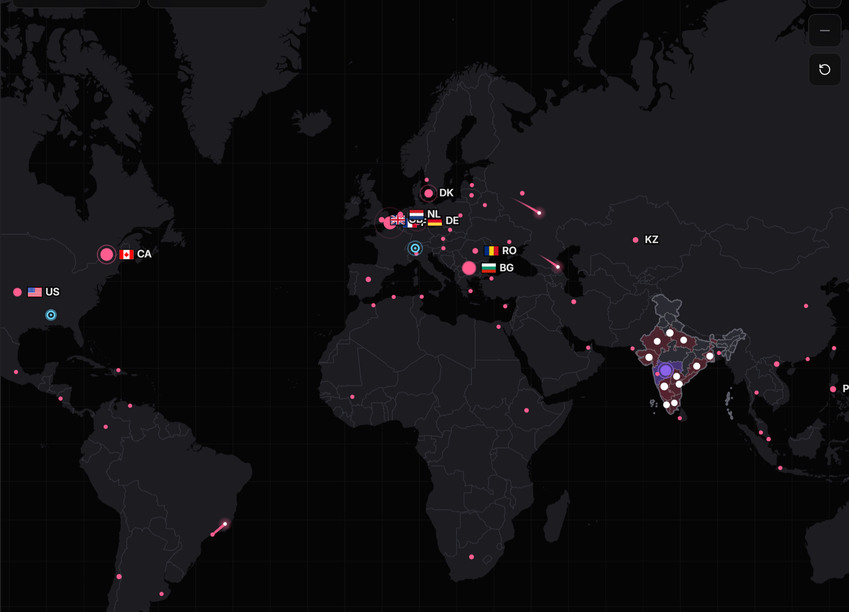

Odyssey
National cyber threat early warning
See the attack coming.
Public threat intelligence in. For every Indian organisation: which systems are at risk, how sure we are, what to do, and by when. On one laptop, with no cloud.
Final round
D3COY 1.0 · DJS ISACA · Problem Statement 01 · 1 Nov 2026
Notes:
Open on the line. Behind it is the live map from the console: real attack origins from the last snapshot. Then two sentences: in July 2024 one supplier's unpatched server took about 300 Indian banks offline. The flaw had been public for six months. Odyssey exists so that the decision is never late again.

Slide 2
The warning was public. The decision was late.
16,730
72% → 21%
of new CVEs say which product and version they affect, January against now
new CVEs in October 2026 alone, from dozens of feeds, each needing a decision
29%
of the CVEs exploited in 2026 were attacked on or before the day they were announced
C-Edge, 2024
Jan 2024 Jenkins flaw disclosed; exploit public within days
31 Jul 2024 Ransomware through the supplier; about 300 banks lose UPI and ATM
19 Aug 2024 CISA lists the flaw, 19 days after the banks went down
Notes:
The problem is not a shortage of intelligence. It is volume, missing labels, and attackers who move on day zero. The C-Edge case is the Indian example: six months of public warning, then 300 banks offline, then the national list catching up 19 days later. Sources: CVE Program, NVD, CISA KEV, NPCI statement of 31 July 2024.

Slide 3
Move the line left
Then: react after the breach
Flaw disclosed
public record, exploit code soon after
Nothing connects it
to who runs the product
Breach
the warning signs were public for months
Listed
the national list catches up weeks later
Now: act on the signal
12 days before
a scanning surge on the decoy grid (SIM) raises a pre-disclosure warning
Day 0
the CVE is matched to installed versions within seconds; a day-0 forecast flags the likely-exploited
Warning
tier, confidence, a countdown, a notice in the operator's language; a person approves
+20.5 days
median before CISA lists it, on real signals; up to 42
Every number recomputed live on the Proof page; leads from simulated sensors are reported apart from leads on real signals.
Notes:
Top lane is how it usually goes. Bottom lane is Odyssey: the decoy grid sees scanning before disclosure (simulated, labelled); on day zero a new CVE is matched to the inventory in seconds and the forecast flags the ones likely to be exploited; the warning goes out with its tier, confidence and clock; and CISA's list follows, a median 20.5 days later on real signals. Reactive systems start at the breach. We start at the signal.

Slide 4
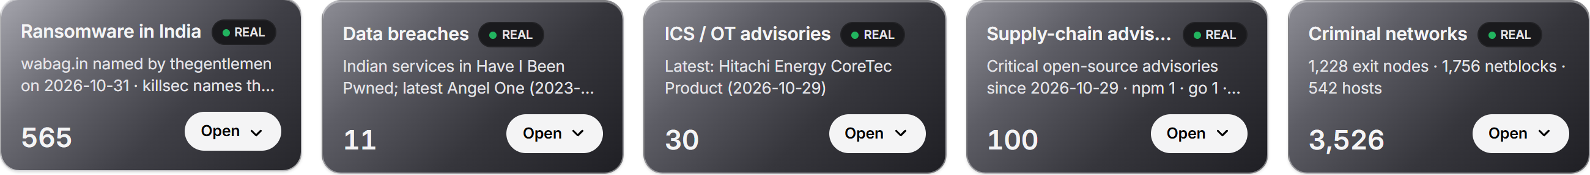
Every source, one record
Vulnerability databases
82,104
CVEs published in 2026
NVD 2021 to 2026
CISA KEV
CISA SSVC
FIRST EPSS
Advisories and context
2,277
name a product an operator runs
CISA ICS and alerts
CERT-In style (SIM)
MITRE ATT&CK
NDMA SACHET
354
Critical warnings, each to a named operator
Telemetry, indicators, logs
DShield honeypots
Feodo C2
OpenPhish
Decoy grid (SIM)
Firewall flows (SIM)
In and out in the formats a SOC already runs: STIX 2.1, TAXII 2.1, CSV. A partner's indicators are matched against the record in seconds.
13 sources, 10 real, 3 simulated. Every item on screen says REAL or SIM. Also bundled, real: Exploit-DB, ransomware.live, Have I Been Pwned, GitHub advisories, Tor, Spamhaus DROP, Emerging Threats.
Notes:
Thirteen sources, grouped as the brief lists them: vulnerability databases, public advisories, attack telemetry and indicators, and simulated logs, each labelled. The white card is the point: 82,000 CVEs this year become 2,277 that name something an operator runs, and 354 Critical warnings addressed to a named operator. The record goes in and out as STIX, TAXII and CSV.

Slide 5
One advisory, start to finish
1
2
3
4
5
A real advisory arrives
Versions parsed
Exposure found
Risk assigned
People decide
CISA's ICS advisory for Siemens WinCC, read by the security LLM. It works even when the advisory carries no CVE id.
Machine-readable ranges lifted from the text: vers:intdot/<8.0.0.11 and vers:all/*.
13 WinCC assets at 7 operators, checked against the inventory version by version. Patched hosts are marked safe.
A score with its working, an SSVC tier, a CERT-In deadline. Patch where a fix exists, mitigation where none does.
A notice proposed to each operator in its own language. An analyst approves. Every step lands in the audit trail.
The same path runs for every input. A KEV entry, a new CVE from NVD, a scanning surge on the decoys, a partner's indicator list, a disaster alert from SACHET: each is matched to who is exposed, scored, and turned into something a person can approve.
Notes:
This is the walk-through in the demo. A real CISA advisory for Siemens WinCC comes in. The model reads it, the version ranges are parsed, thirteen assets at seven operators are found exposed, each gets a risk with its working and a deadline, and the notices are proposed in Marathi, Gujarati and Hindi for a person to approve. Then: the same path for every input.

Slide 6
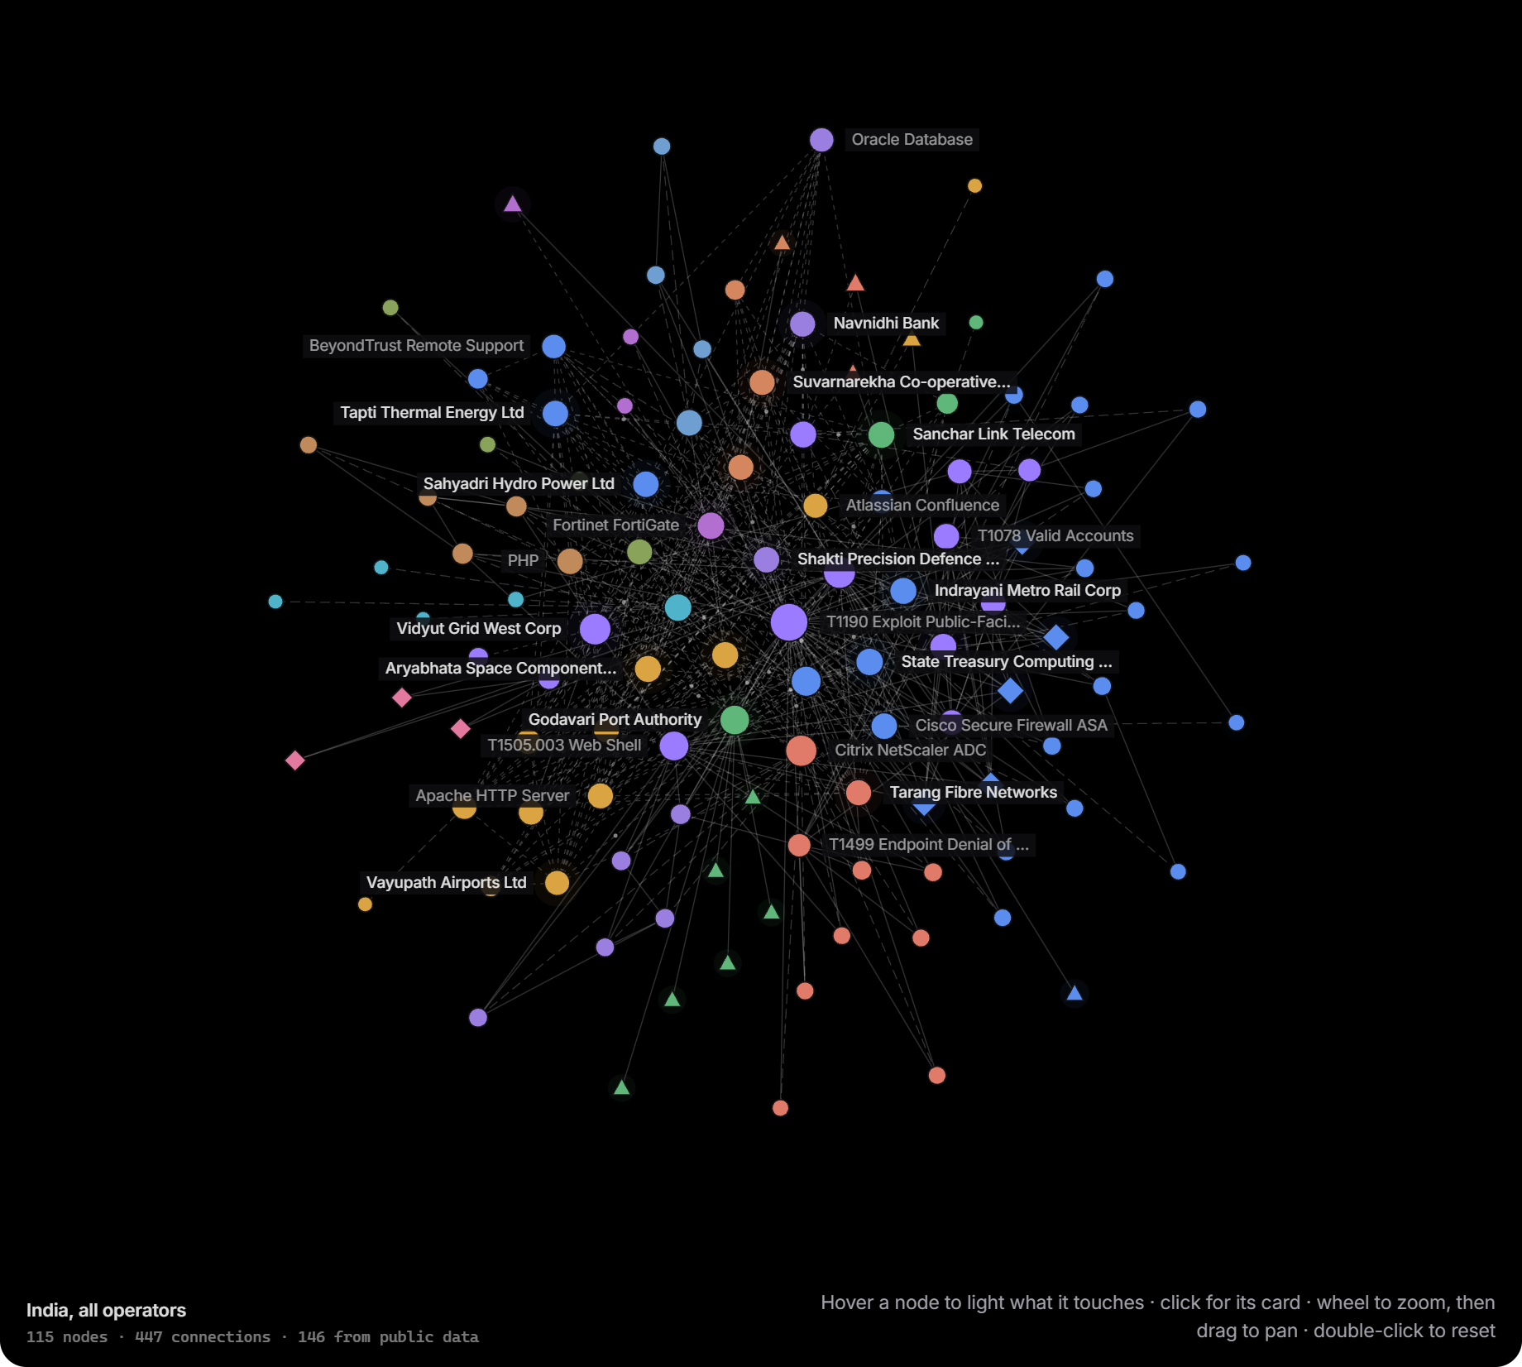
Patterns, not noise
Reads
A security LLM (MiST-8B) reads advisories and writes every brief. 22 of 23 briefs passed the fact validator; a sentence that fails is withheld, never shown.
Relates
SecureBERT 2.0 links entities and related threats; a clustering model groups campaigns (12 active). Threat groups come from the ATT&CK record as overlap, never attribution.
Detects
Scanning surges, C2 beacons and flow anomalies, every 5 seconds. A hostile advisory with hidden instructions is caught by the injection guard, 5 of 5, and still scored by the rules.
AI explains. Rules decide. No model sets a score, a tier or a deadline. All of it runs on one RTX 4070 laptop, 0 cloud calls; each job's model is set in a config file and was chosen by measurement on 2026 CVEs.
Intel: every entity in the record and how they connect, 115 nodes, 447 links; fresh evidence pulses, old lies still
Notes:
Three jobs for the models: read, relate, detect. Read: the security LLM reads advisories and writes the brief, and the brief is fact-checked line by line. Relate: entities, related threats, campaigns, and the graph on the left. Detect: surges, beacons and anomalies every five seconds, plus the guard that catches a poisoned advisory. The rule we never break: AI explains, rules decide. And it all runs here, offline.

Slide 7
What goes first
Risk = 100 × Relevance × Importance × (55% Likelihood + 30% Severity + 15% Evidence)
Likelihood, from evidence, in rank order
One warning, shown with its working
On CISA KEV · SSVC says active · exploit seen on 2+ decoys
1.0
Tapti Thermal Energy · Ivanti Connect Secure 22.8R2.4 · CVE-2026-111357
The vendor says exploited in the wild
0.8
Likelihood 0.55 × 1.0
45.8
A public proof of concept
0.5
KEV 30 Oct · SSVC active · vendor: in the wild
Severity 0.30 × 1.0
25.0
A scanning surge on the decoy grid (decays with age)
0.4
SSVC technical impact: total
Evidence 0.15 × 1.0
12.5
EPSS ≥ 0.5 · CVSS ≥ 9 · automatable
corroborate
CISA (A), NVD (A), vendor (B) agree
The day-0 forecast
prediction
Relevance × 1.0
NVD and the vendor both list 22.8R2.4 as affected
Importance criticality tier 5 to 2; internet-facing ×1.2; blast radius up to ×1.3. Relevance the installed version checked against NVD, the vendor and the advisory; 0 false "affected" on the Ivanti case. Confidence, scored apart A to F source grades; agreement between independent sources raises it.
Importance × 0.83
VPN gateway, internet-facing, tier 1
Risk
83.3
Critical · SSVC: Act · 12 h to patch or mitigate (known-exploited, internet-facing) · chance of compromise 18%, no beacon seen
Notes:
The score is a formula anyone can check. Likelihood comes from evidence in rank order, and the ladder shows what counts and how much: a KEV listing or an active SSVC verdict is 1.0, a vendor claim 0.8, proof of concept 0.5, a decoy surge 0.4 and decaying, while EPSS and CVSS only corroborate and the forecast is a prediction, not evidence. The receipt on the right is one real warning from this build: 83.3, Critical, Act, twelve hours. The tier follows CISA's SSVC decision method; confidence is scored separately from risk.

Slide 8
What to do, and by when
On every warning
Nationally: the fewest changes that remove the most risk
1
Patch to a named fixed release, never a downgrade (22.8R2.5, 25.1.3.0 for the Ivanti case)
93
205
2
Block the indicators: STIX 2.1 export, risk lists for the firewall, C2 addresses refanged
changes remove half the national risk
remove 80%, of 344 change tickets
3
Investigate a hunt playbook, ATT&CK mitigations, forensic triage where CISA asks for it
4
Report the CERT-In 6-hour report pre-drafted; RBI, SEBI, DPDP and NCIIPC clocks shown
One workflow per warning
5
Notify a notice in the operator's own language; a person approves before it goes
Issued
Acknowledged
Mitigating
Verifying
Closed
Odyssey proposes; a person approves anything consequential. Evidence-based notices, digests and hunts run on their own. Every action is in a hash-chained audit trail.
Deadlines from the CERT-In Blueprint: 6 h for a suspected compromise, 12 h for a known-exploited flaw on the internet, then 24, 72, 120 h by tier. The countdown runs in real time on the warning.
Notes:
Every warning ends in something a team can do: patch to a named release, block the indicators, hunt, report, notify. Nationally, the risk plan orders the fewest changes that remove the most risk. Each warning moves through one workflow, with a real countdown from the CERT-In timelines, and a person approves anything consequential.

Slide 9
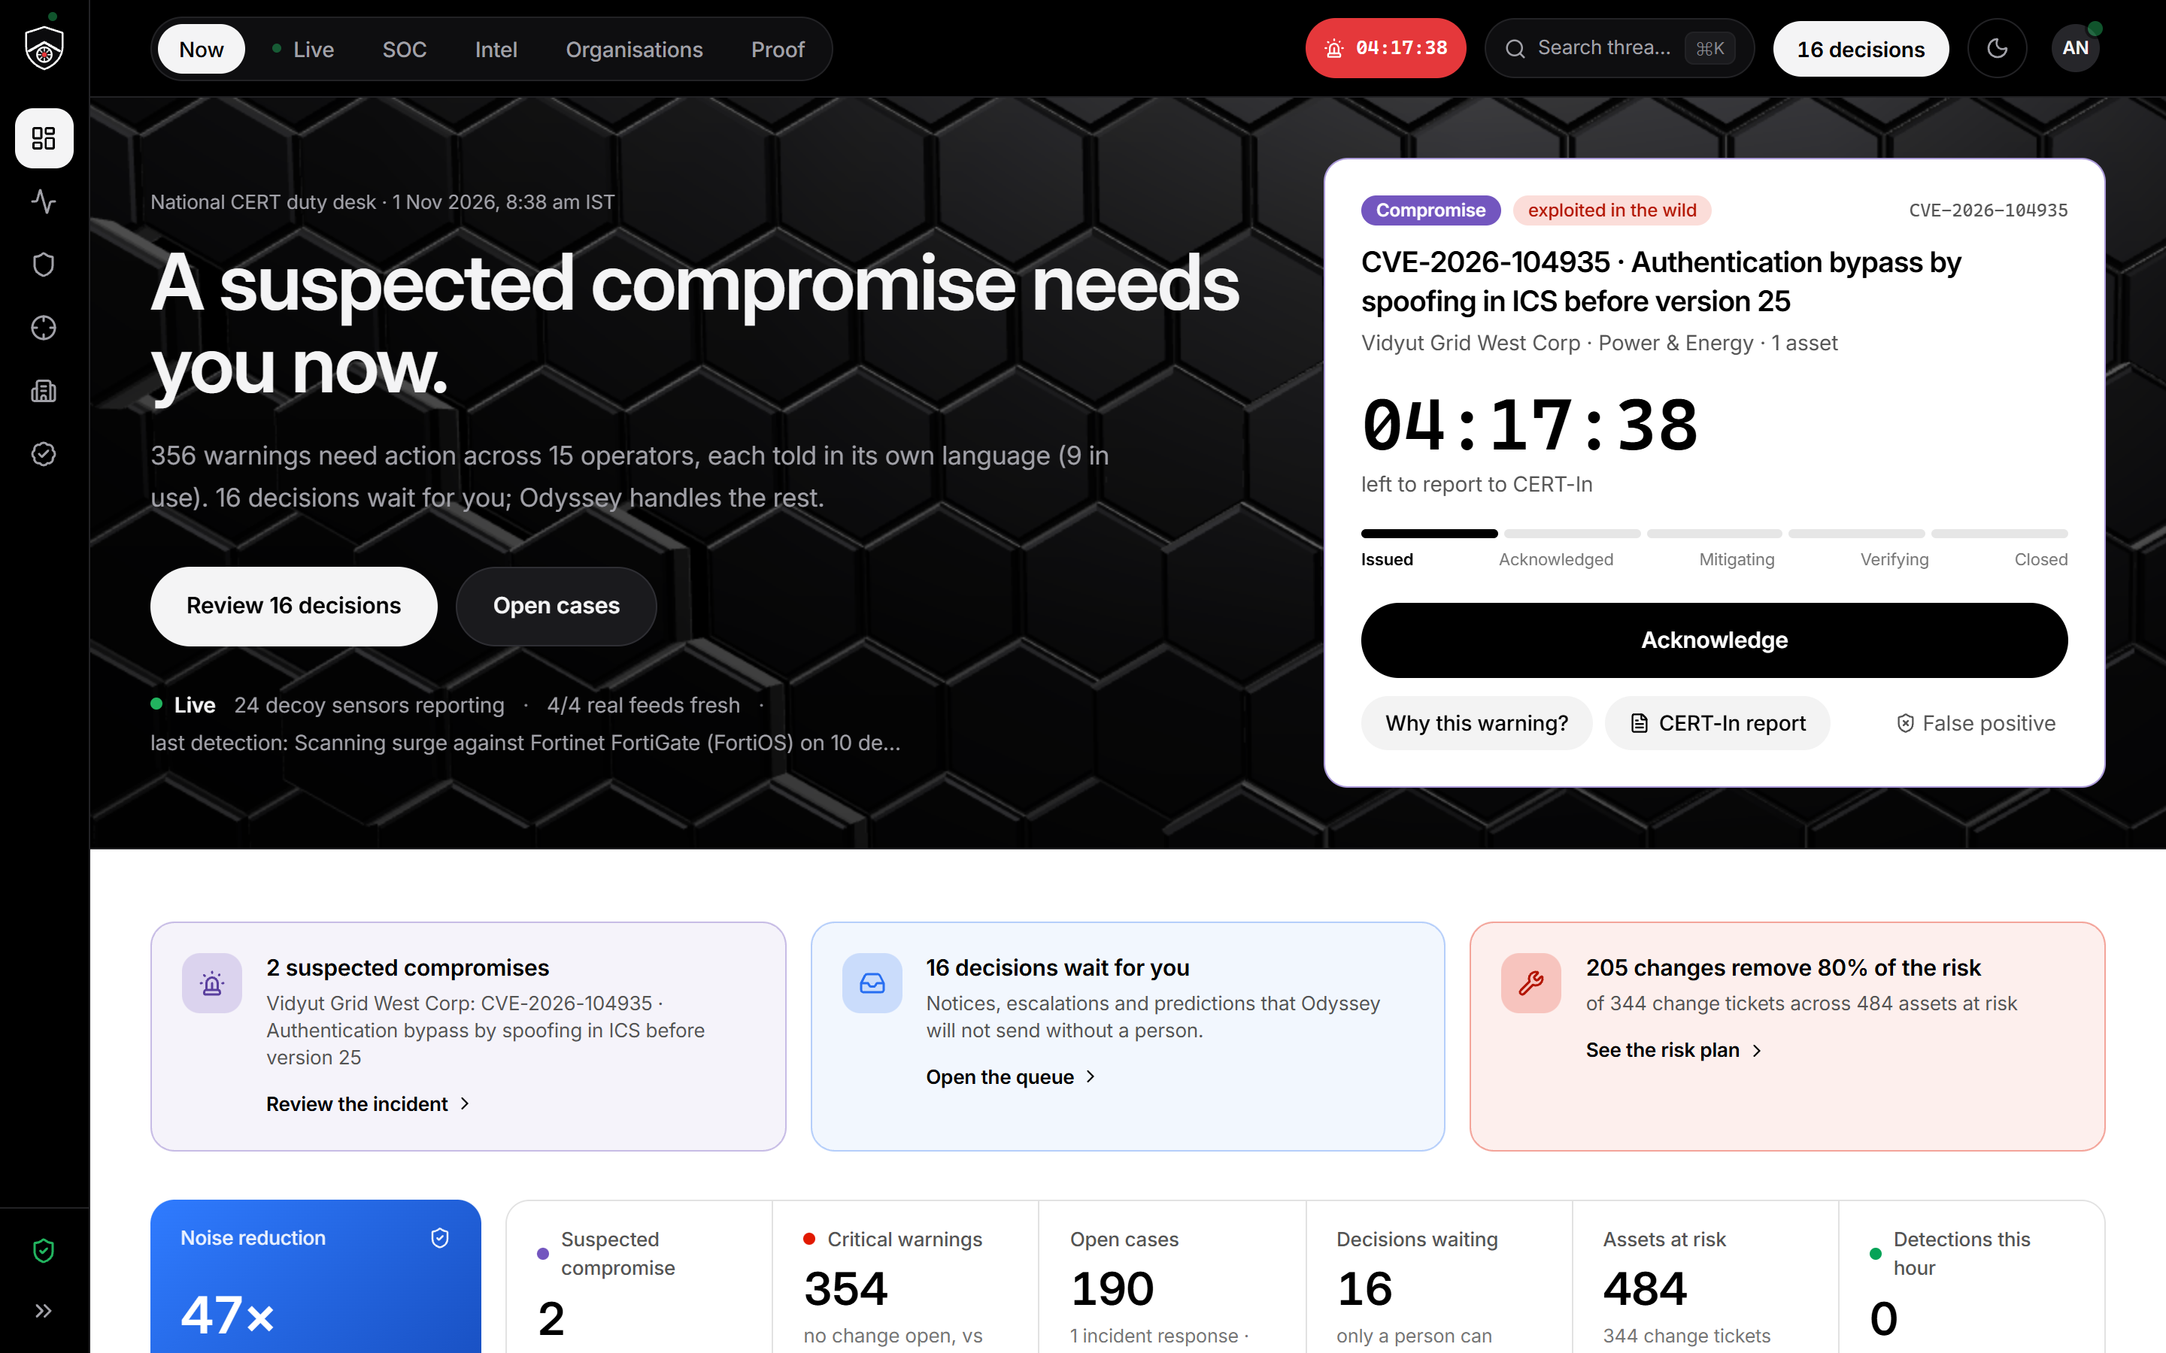
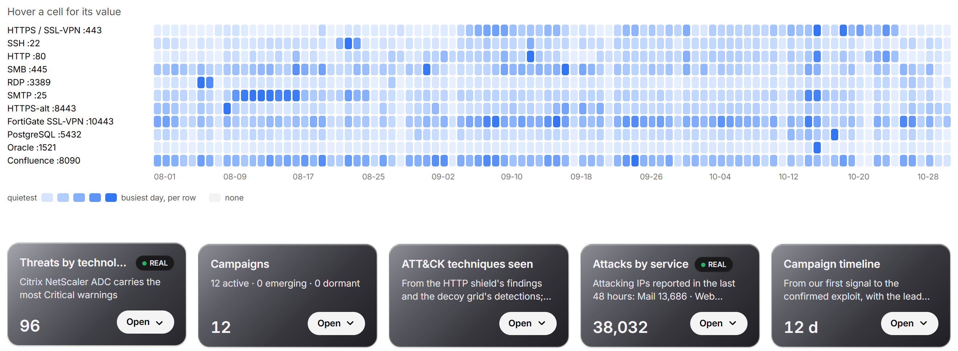
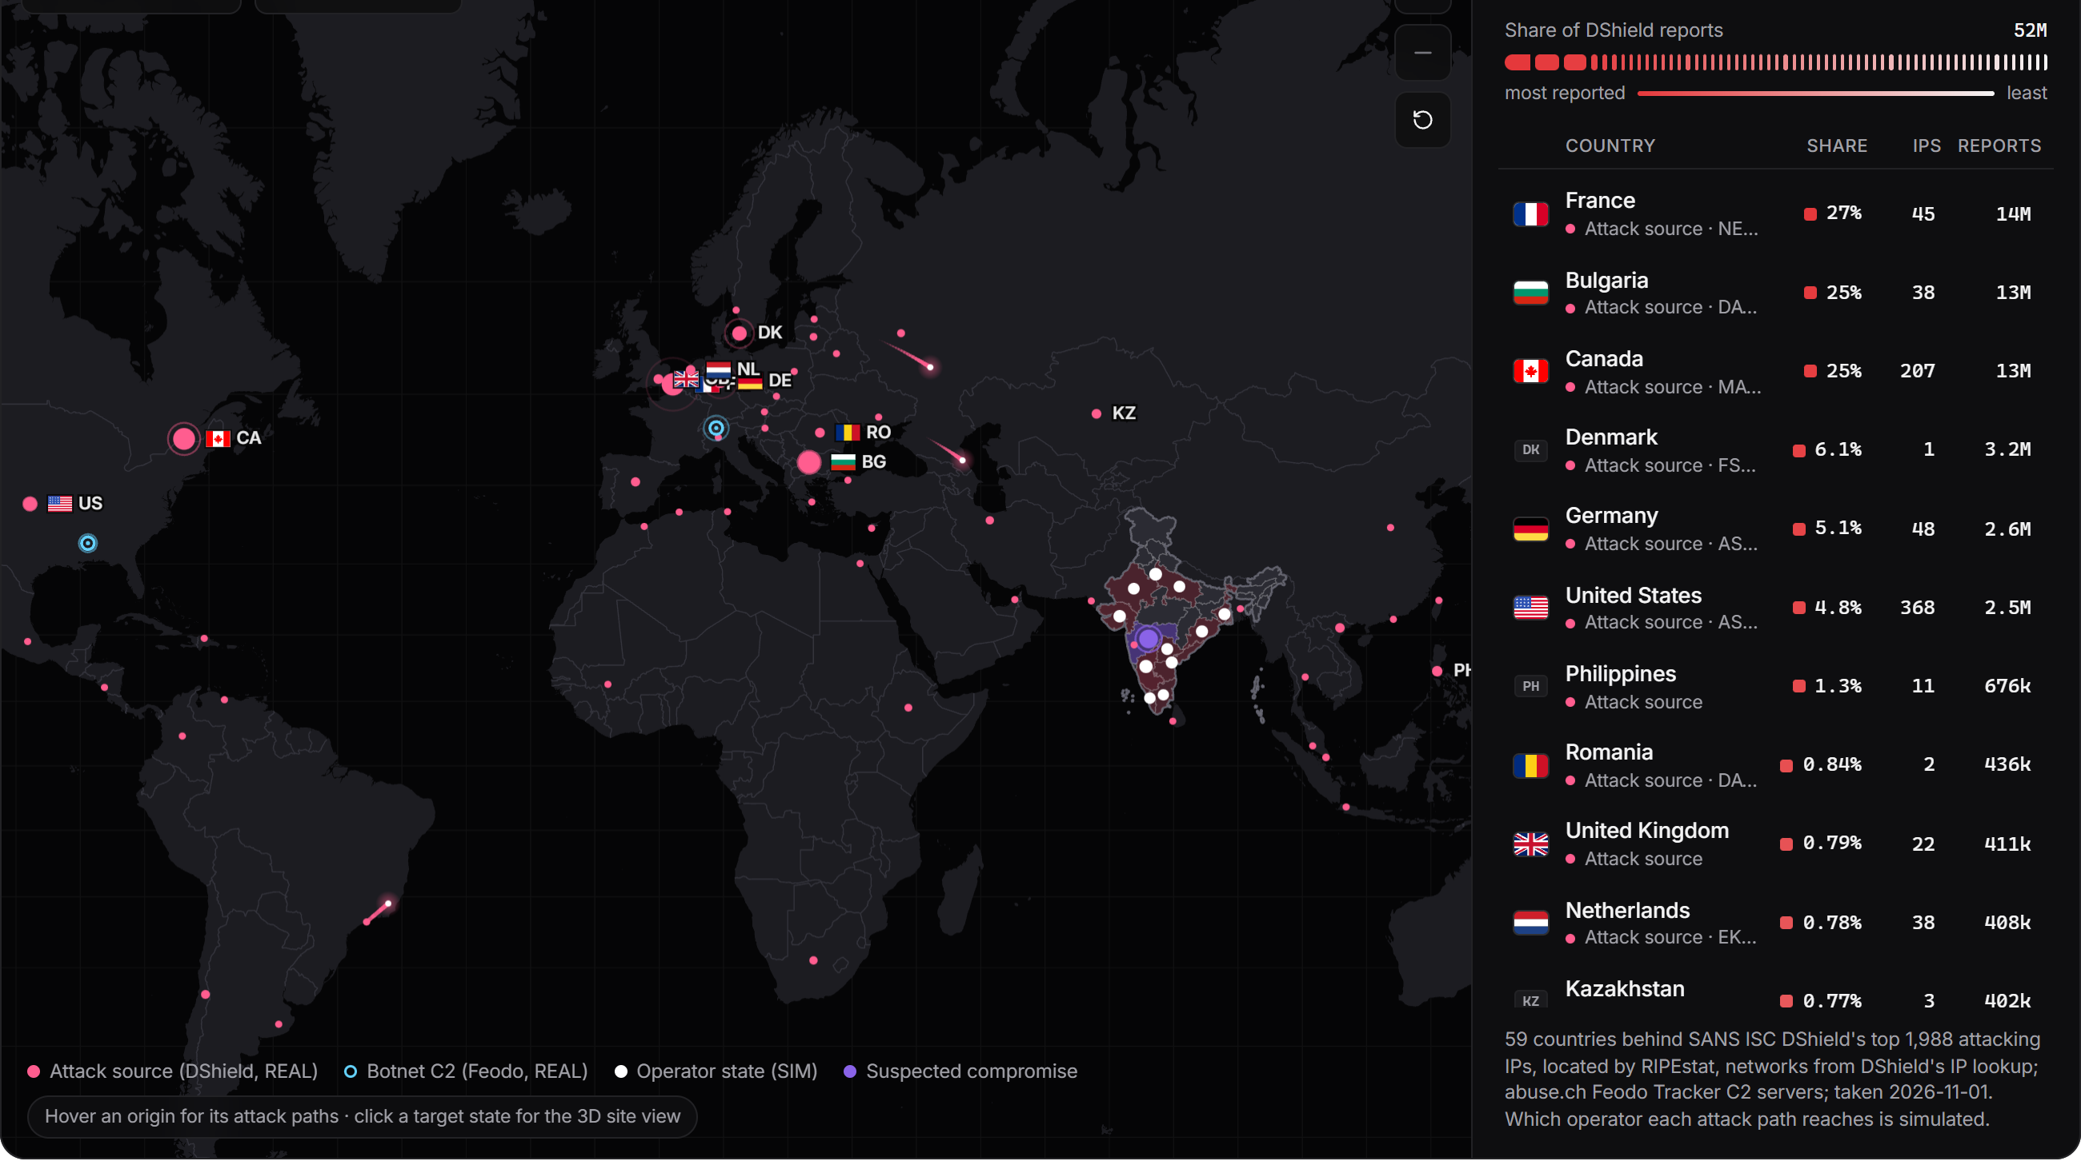
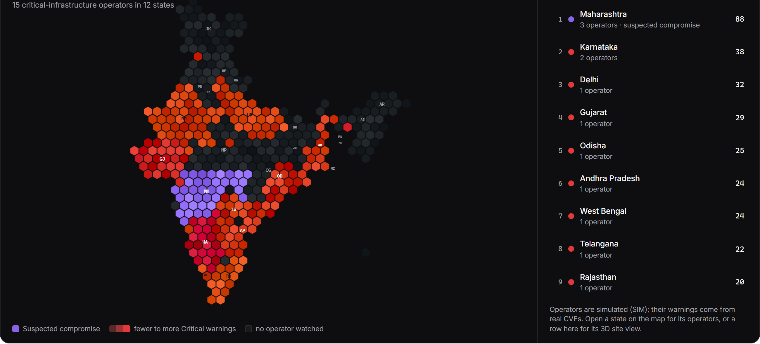
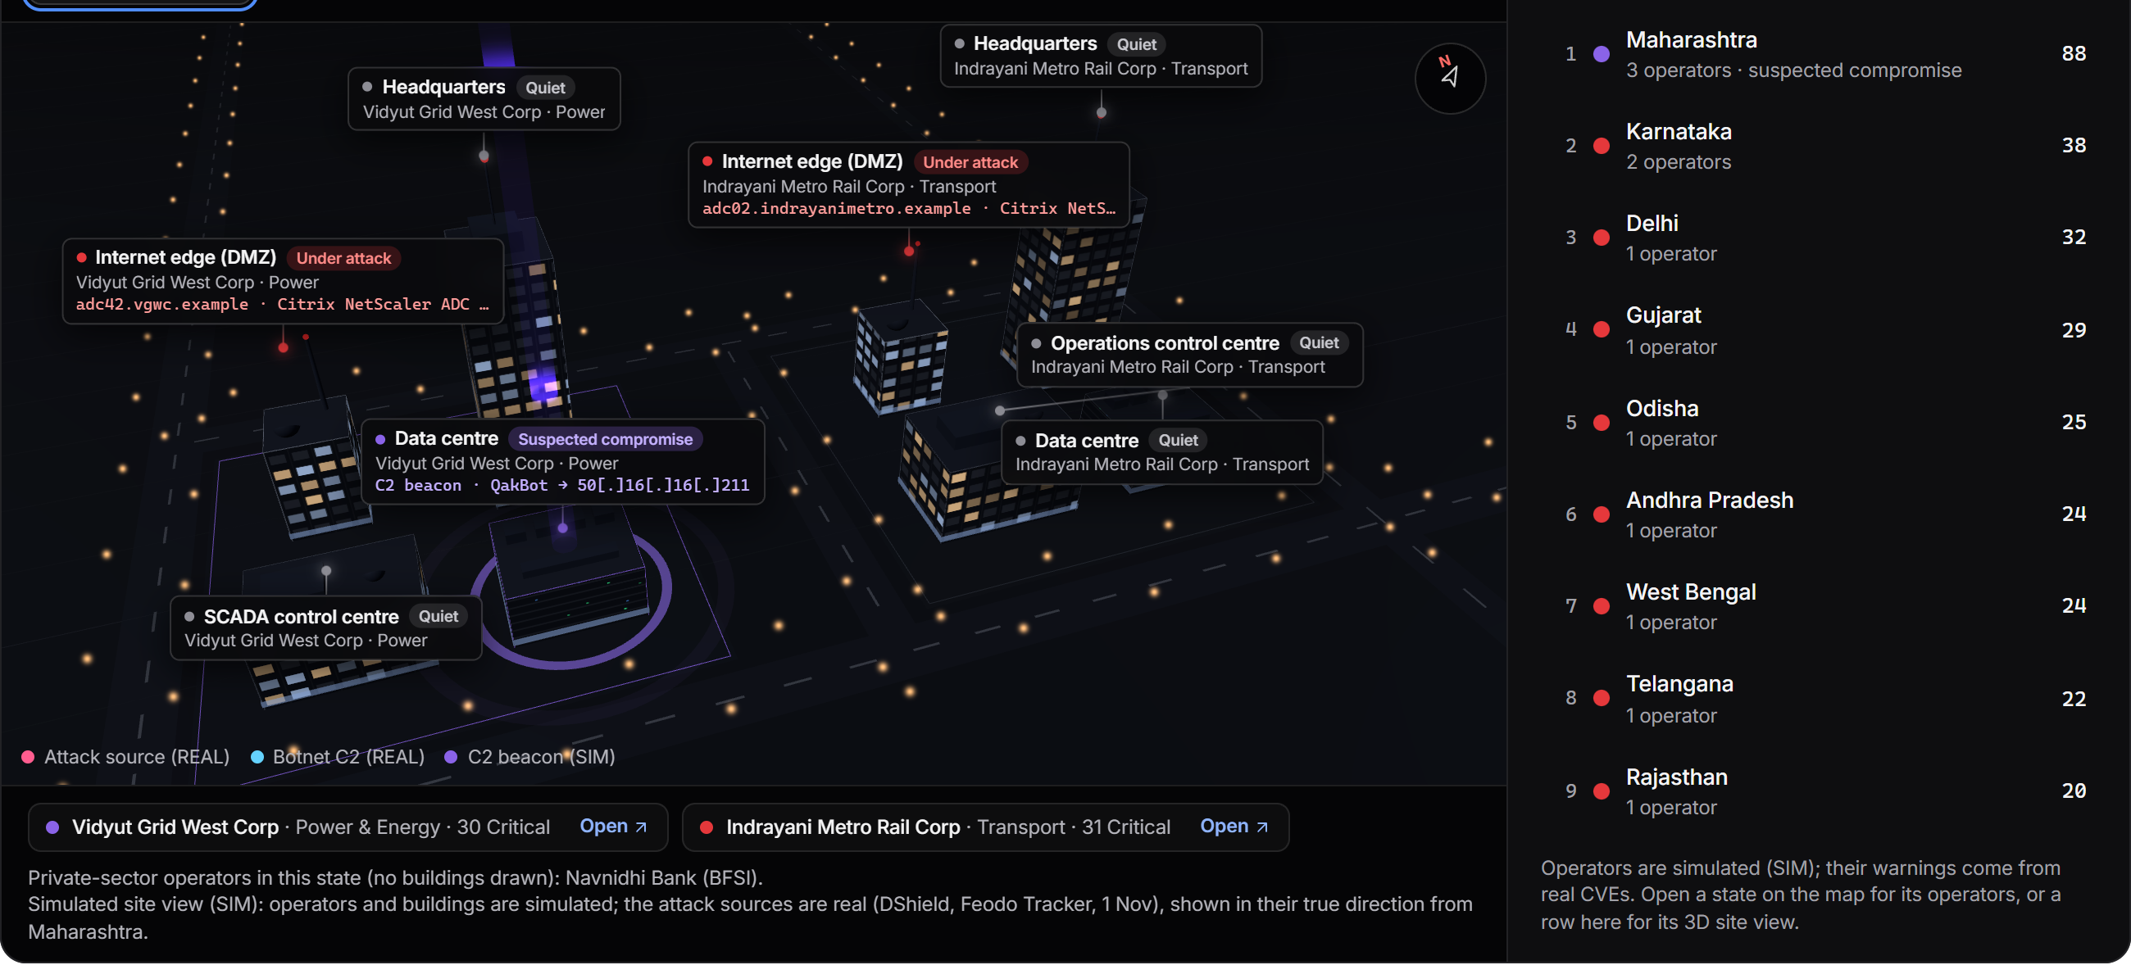
One screen per question
Intel: active threats, the technologies under attack, exposure by sector
Now · Live · SOC · Intel · Organisations · Proof
REAL or SIM on every panel. Feeds bundled, so nothing waits on the network. A night-shift mode. Every figure in a header recomputed live.
Now: what needs me, with the AI brief and the score a click away
Where attacks start, and the operators they reach
India by Critical warnings; compromise in violet
A state in 3D: its agencies and the attack origins
Notes:
Six screens, one question each. Now: what needs me. Live: what is happening, including real attacks on a real app behind the shield. SOC: the cases. Intel: what is under attack, which technologies, the graph, indicators. Organisations: one operator at a time. Proof: the numbers, recomputed on stage. The threat map and the India view are drawn from real feeds bundled into the console.

Slide 10
It runs here. Offline.
0
1
85 s
221
internet or cloud AI calls, ever; the feeds are snapshot-backed
laptop: an RTX 4070 with 8 GB, every model under 8B parameters
to re-score the nation: 15 operators, 612 systems, 2,277 flaws
engine tests green; 26 of 26 product flows; 25 of 26 browser steps
Real, public: CVEs, KEV, SSVC, EPSS, CISA advisories, DShield, Feodo, OpenPhish, SACHET, Exploit-DB, ransomware.live, breach and network lists.
Simulated, labelled: the 15 operators and their inventory, the decoy grid, the firewall logs.
Proven on the wire: 45 of 45 real web attacks detected and blocked inline, 0 false positives, about 15 ms each. Models, scoring and workflow are explained on the Proof page; the test bench is a click away.
A single score misses about half. KEV is one of our inputs, so 110 of 110 is by design; the honest test is the out-of-time forecast: 61.1% of later-exploited CVEs caught while flagging 2%.
Real data. Measured claims. A human in the loop. Zero cloud calls.
Notes:
Close on what is in the room: a working prototype on this laptop, no cloud, every model under 8B. Eighty-five seconds to re-score the nation. The chart is the backtest on 110 real exploited CVEs; say that 110 of 110 is by design because KEV is one of our inputs, and that the honest test is the forecast. Then the line: real data, measured claims, a human in the loop, zero cloud calls.

