Slide 1


A Presentation
On
Rank & Normal Form of a Matrix
By
Mr. MoienAhmad Borotikar
Faculty of Engineering Mathematics
F. Y. B. Tech. Department
G. H. Raisoni College of Engineering & Management, Pune

Slide 2
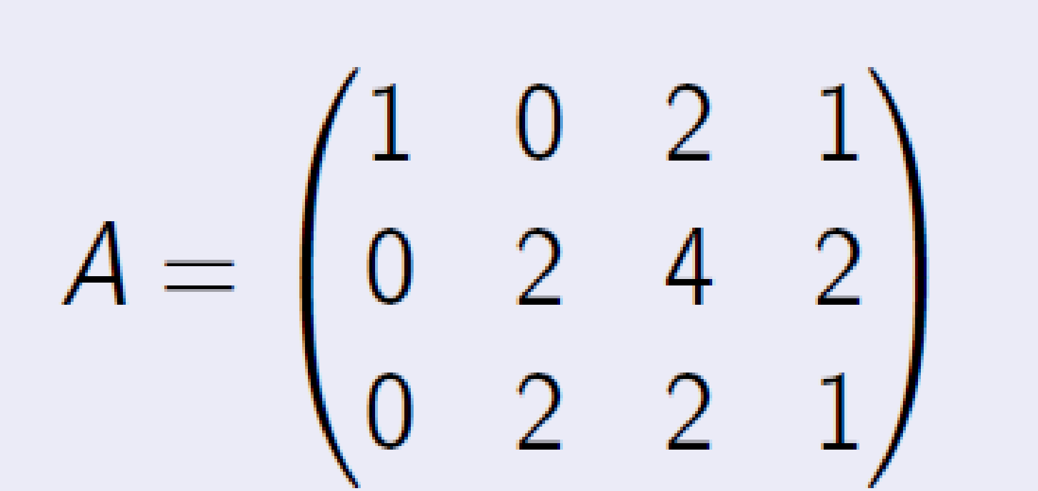
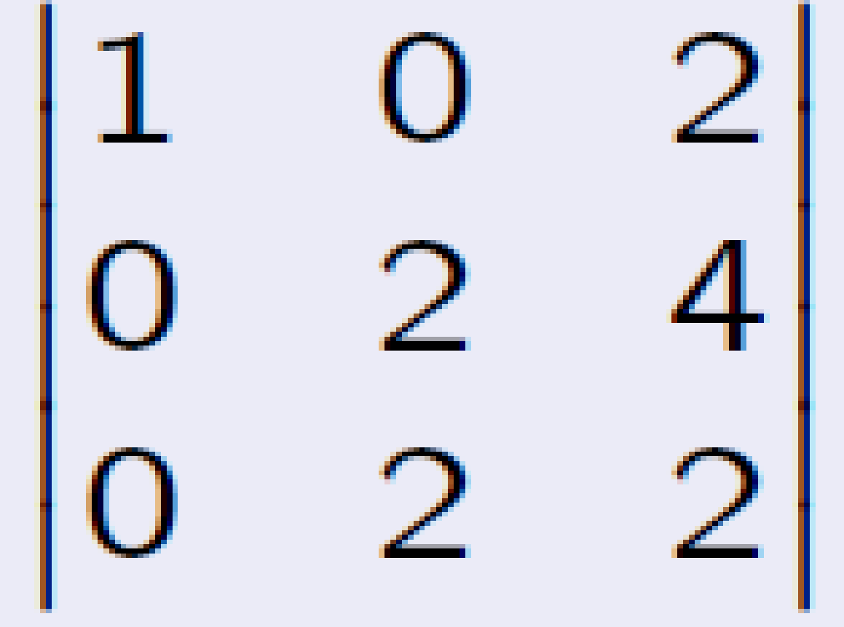
Minor of matrix
Let A be an m × n matrix. A minor of A of order k is a determinant of a k × k sub-matrix of A.
We obtain the minors of order k from A by first deleting m − k rows and n − k columns, and then computing the determinant. There are usually many minors of A of a given order.
Example :Find the minors of order 3 of the matrix
Solution We obtain the determinants of order 3 by keeping all the rows and deleting one column from A. So there are four different minors of order 3. one of them is:
= 1 · (−4) + 2 · 0 = −4
The minors of order 3 are called the maximal minors of A, since there are no 4 × 4 sub-matrices of A. There are 3 · 6 = 18 minors of order 2 and 3 · 4 = 12 minors of order 1

Slide 3
Rank of Matrix
The rank of a matrix A is defined as the order of a highest order non-vanishing minor of the matrix A. It is denoted by the symbol ρ (A).
The rank of a matrix A is equal to the number of non-zero rows or columns in it’s reduced standard form. i.e. Normal or echelon form.
(i) If a matrix contains at-least one non-zero element, then ρ (A) ≥ 1
(ii) If A is an m × n matrix, then ρ (A) ≤ min {m, n} = minimum of m, n.
(iii) A square matrix A of order n has inverse if and only if ρ (A) = n.
(iv) If the rank of a matrix A is r, then there exists at-least one minor of A of order r which does not vanish and every minor of A of order r + 1 and higher order (if any) vanishes
(v) The rank of the identity matrix In is n

Slide 4
Standard forms of matrix to compute It’s Rank
Normal Form
Row Echelon Form
PAQ Form

Slide 5
Elementary Matrix Operations There are three kinds of elementary matrix operations.
Interchange two rows (or columns).
Multiply each element in a row (or column) by a non-zero number.
Multiply a row (or column) by a non-zero number and add the result to another row (or column)
Operation description | Notation
Row operations
1. Interchange rows i and j | R_{i} <--> R_{j}
2. Multiply row i by s, where s ≠ 0 | sR_{i} --> R_{i}
3. Add s times row i to row j | sR_{i} + R_{j} --> R_{j}
Column operations
1. Interchange columns i and j | C_{i} <--> C_{j}
2. Multiply column i by s, where s ≠ 0 | sC_{i} --> C_{i}
3. Add s times column i to column j | sC_{i} + C_{j} --> C

Slide 6
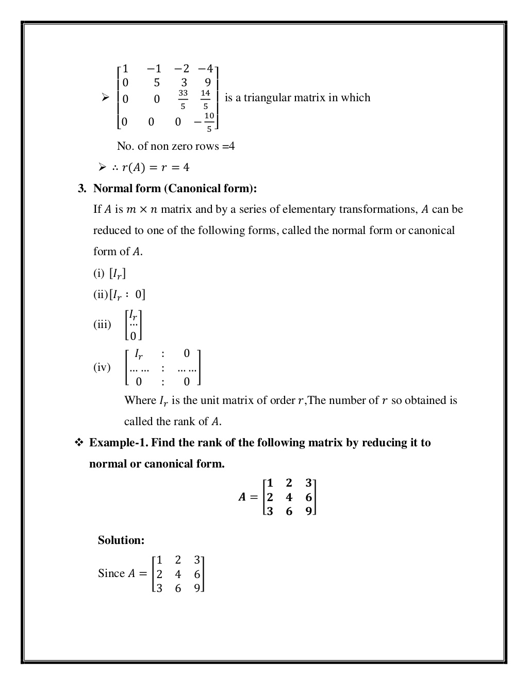
Normal Form

Slide 7
Algorithm to reduce a matrix to Normal Form
Make the first element of first column unity by scaling. If the first element is zero the first make use of interchange.
Make all elements of first column below the first element zero by using replacement.
Now make the second element of second column unity and all other elements zero.
Continue the process column by column to get an identity matrix

Slide 8
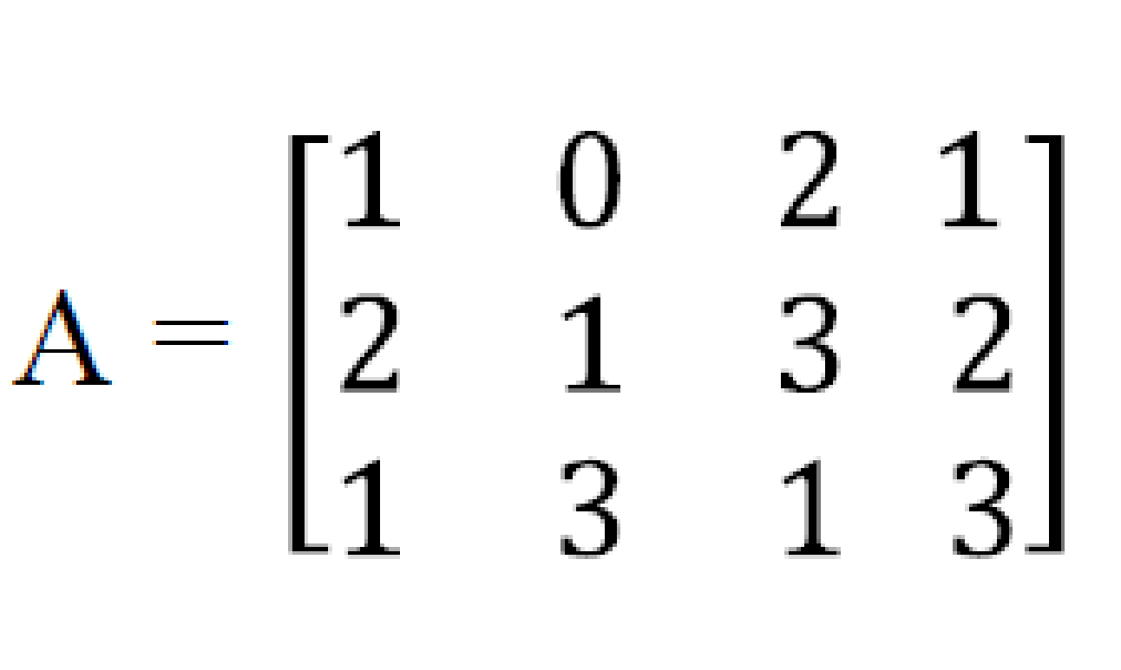
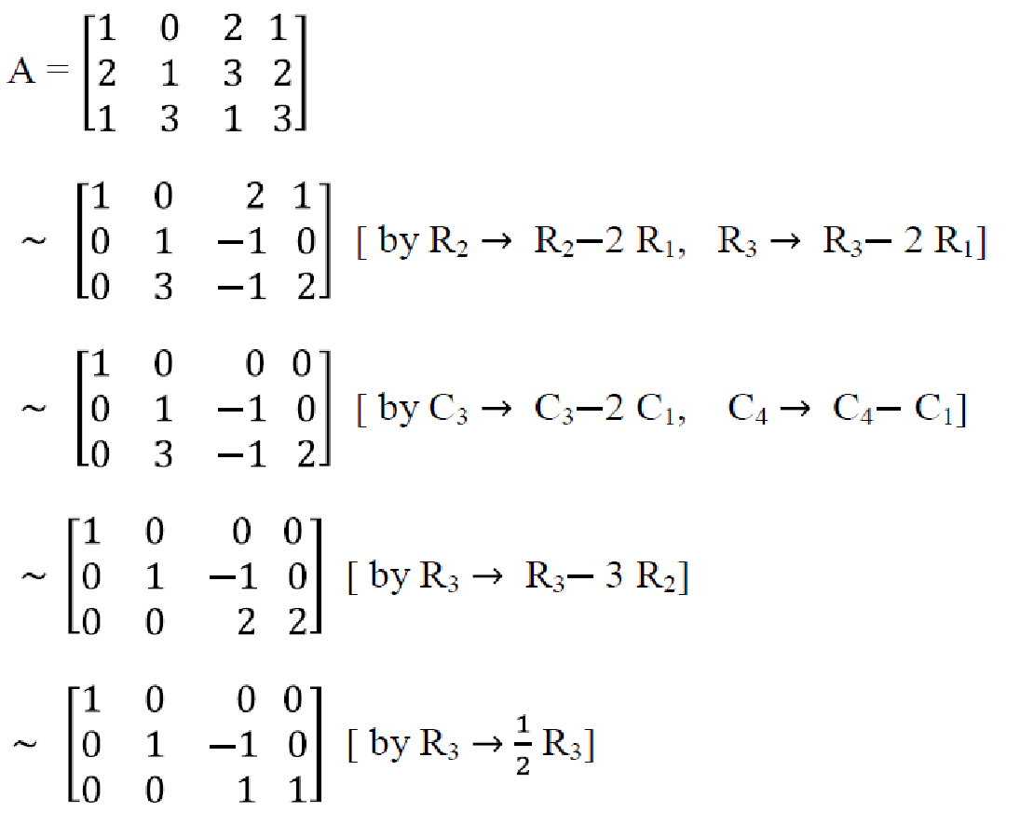
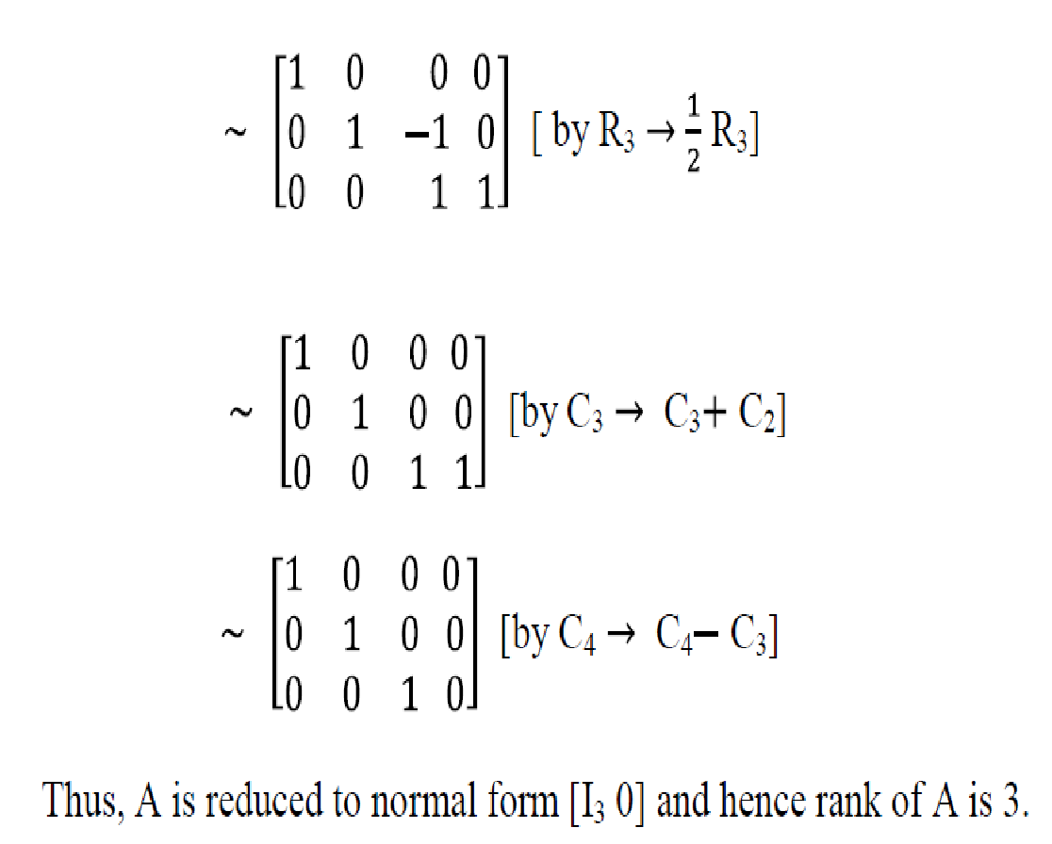
Example : Reduce the matrix to its normal form and hence determine its rank.
Solution

Slide 9
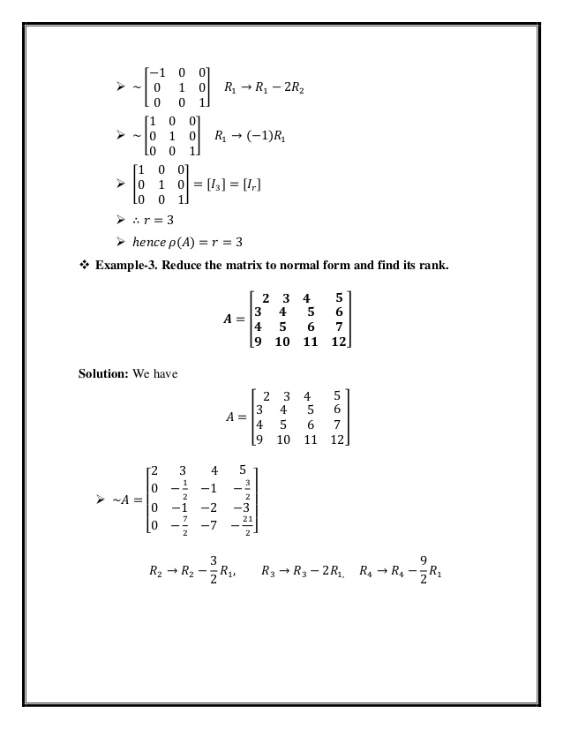
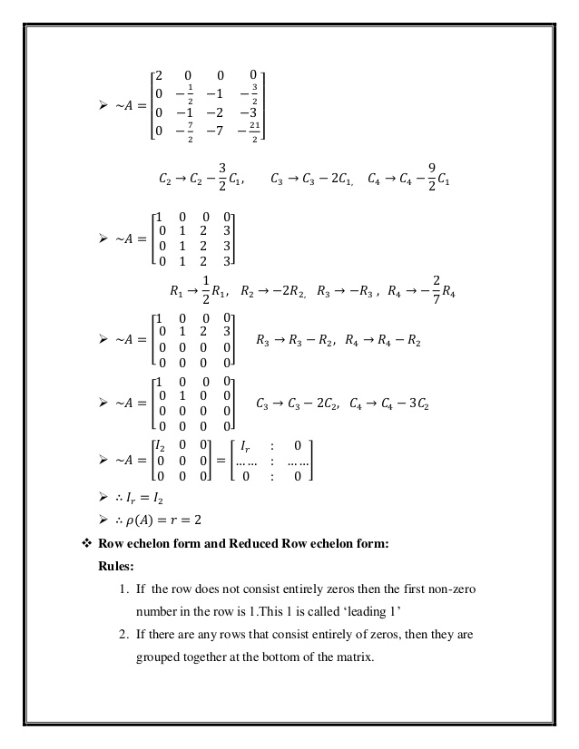
Example : Reduce the matrix to its normal form and hence determine its rank.

Slide 10
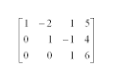
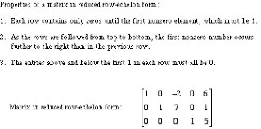
Row Echelon Form
A matrix is in row echelon form when it satisfies the following conditions.
The first non-zero element in each row, called the leading entry, is 1.
Each leading entry is in a column to the right of the leading entry in the previous row.
Rows with all zero elements, if any, are below rows having a non-zero element.
Example

Slide 11
THE ROW REDUCTION ALGORITHM
Given a matrix, obtaining an echelon form or the reduced echelon form by performing the following steps i s called the row reduction algorithm:
Step 1. Begin with the leftmost nonzero column. This is a pivot column. the pivot position is at the top
Step 2. Select a nonzero entry in the pivot column as pivot. If necessary, interchange rows to move this entry into the pivot position.
Step 3. Use row replacements operations to create zeros in all positions below the pivot.
Step 4. Cover (or ignore) the r ow containing t h e pivot position and cover all rows, if any, above it. ApplyStep 1-3 to the sub-matri x that remains. Repeat the process until there are no more nonzero rows to modify

Slide 12
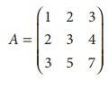
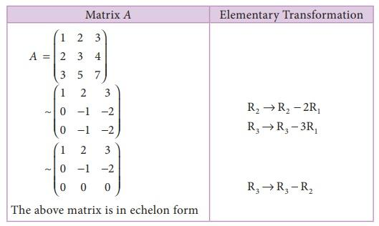
Example:
Find the rank of the matrix
Solution: The order of A is 3 × 3∴ ρ(A) ≤ 3.
.
The number of non zero rows is 2,
ρ(A) = 2.

Slide 13

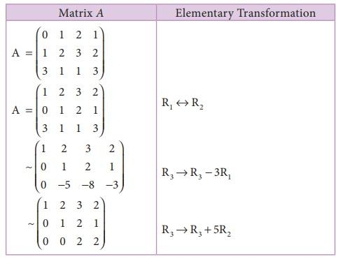
Example:
Find rank of the matrix A= by reducing it to row echelon form
Solution: The order of A is 3 × 4. ∴ ρ (A)≤3.
Let us transform the matrix A to an echelon form
The number of non zero rows is 3. ∴ ρ(A) =3.

Slide 14
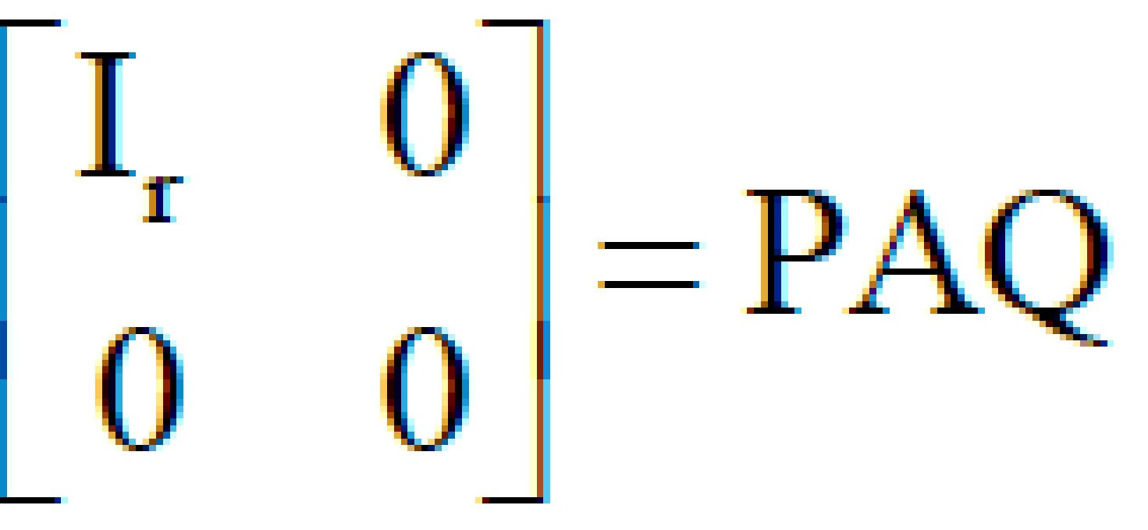
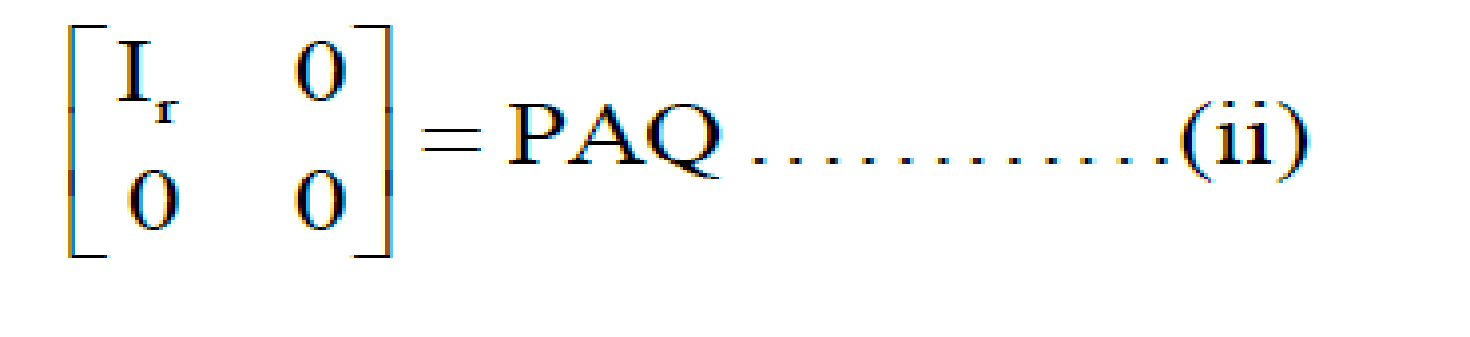
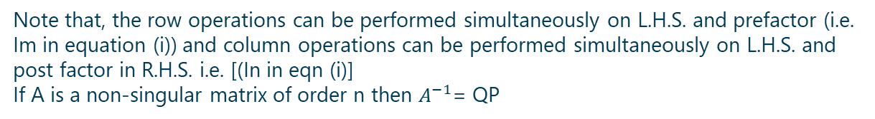
PAQ FORM
If A is any mxn matrix of rank r then there exist non singular matrices P and Q such that,       
We observe that, the matrix A can be expressed as
A = Im In …………(i)
Where Im & In are the identity matrices of order m and n respectively. Applying the elementary transformations on this equation. A in L.H.S can be reduced to normal form
The equation can be transformed into the equations

Slide 15
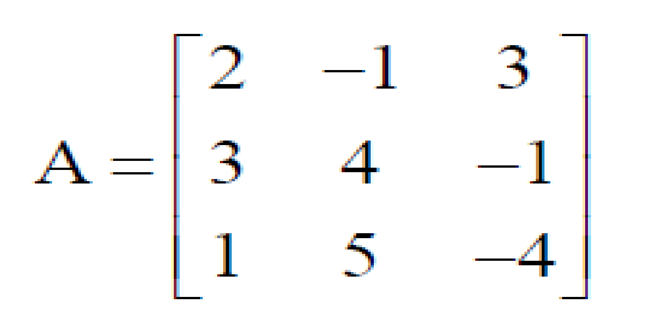
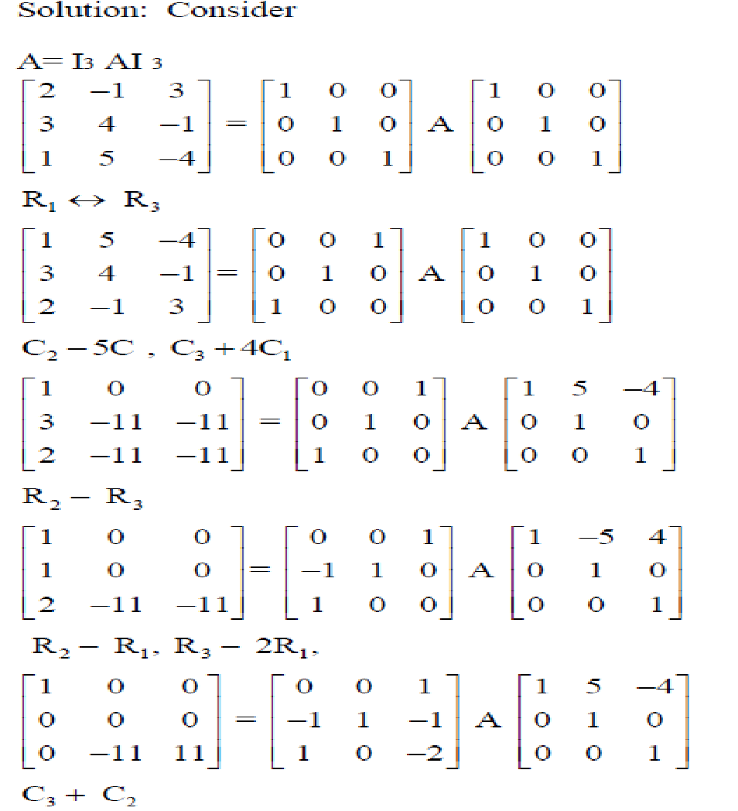
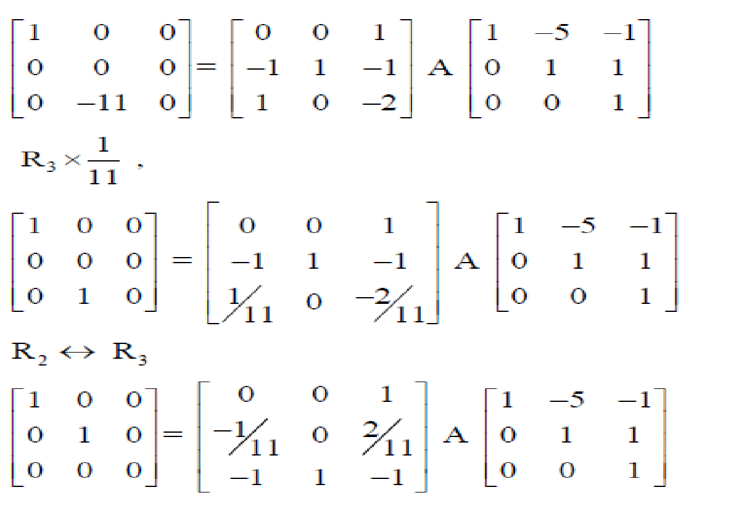
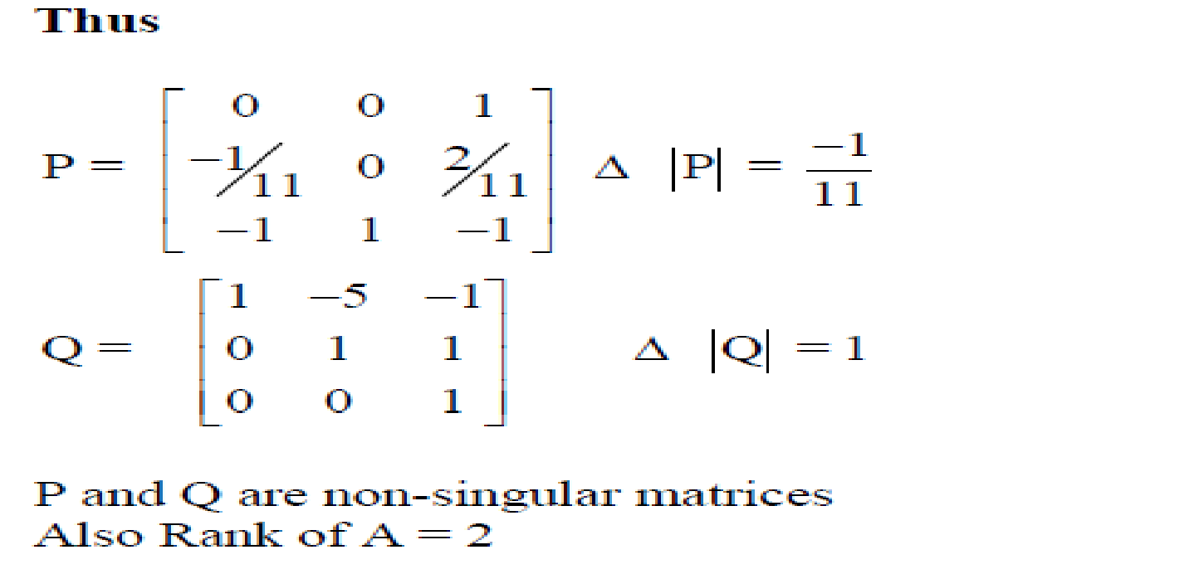
Example: Find the non-singular matrices P and Q such that PAQ is in normal and hence find the rank of
Solution: Consider

Slide 16
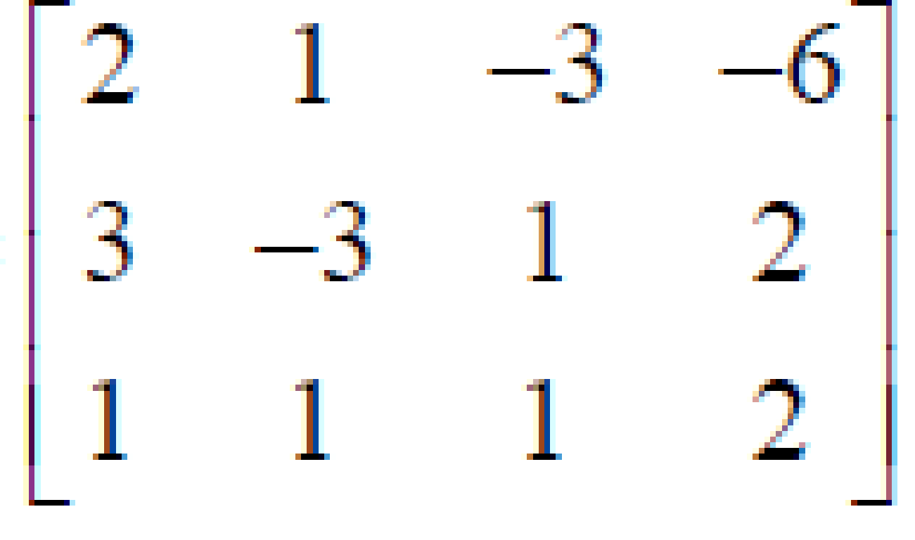
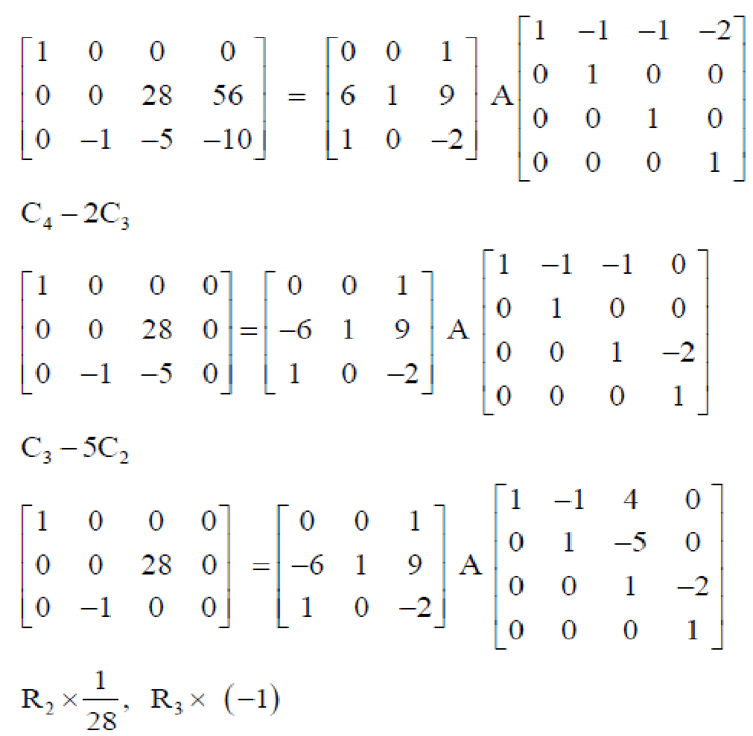
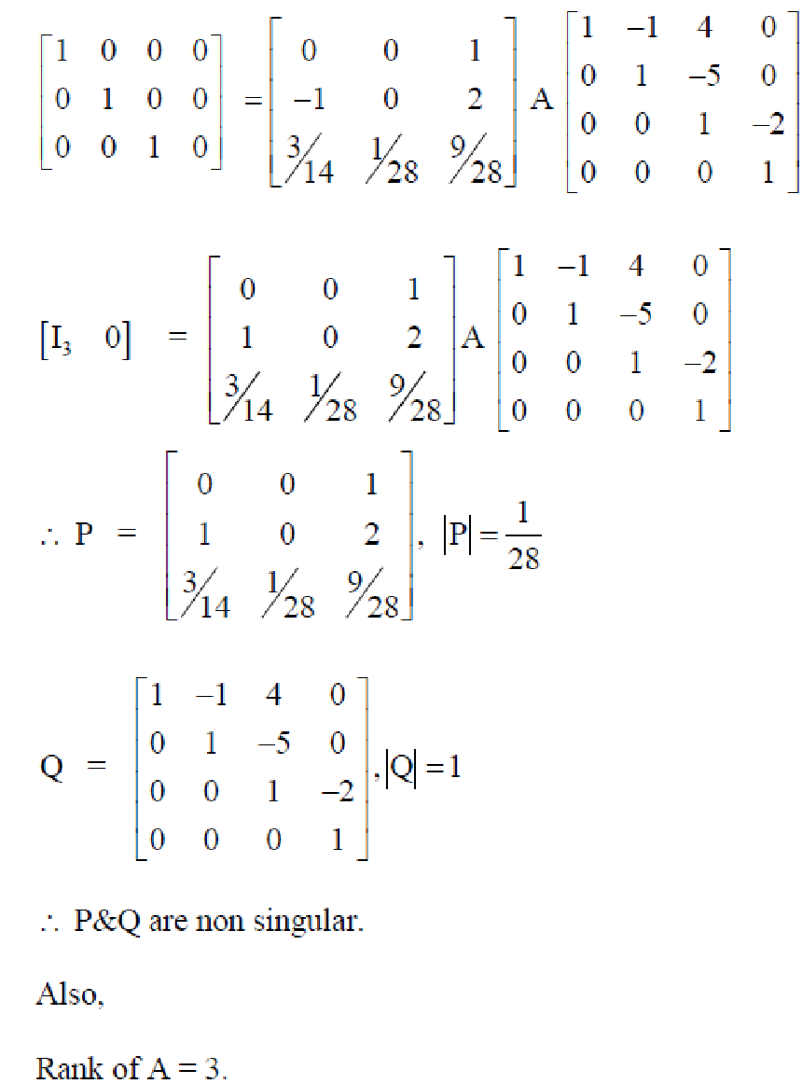
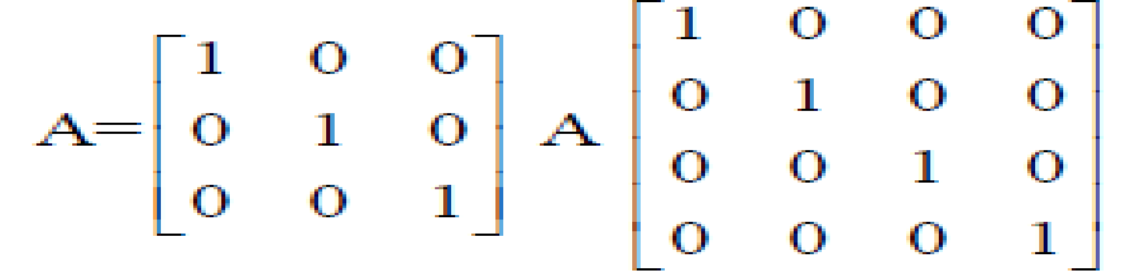
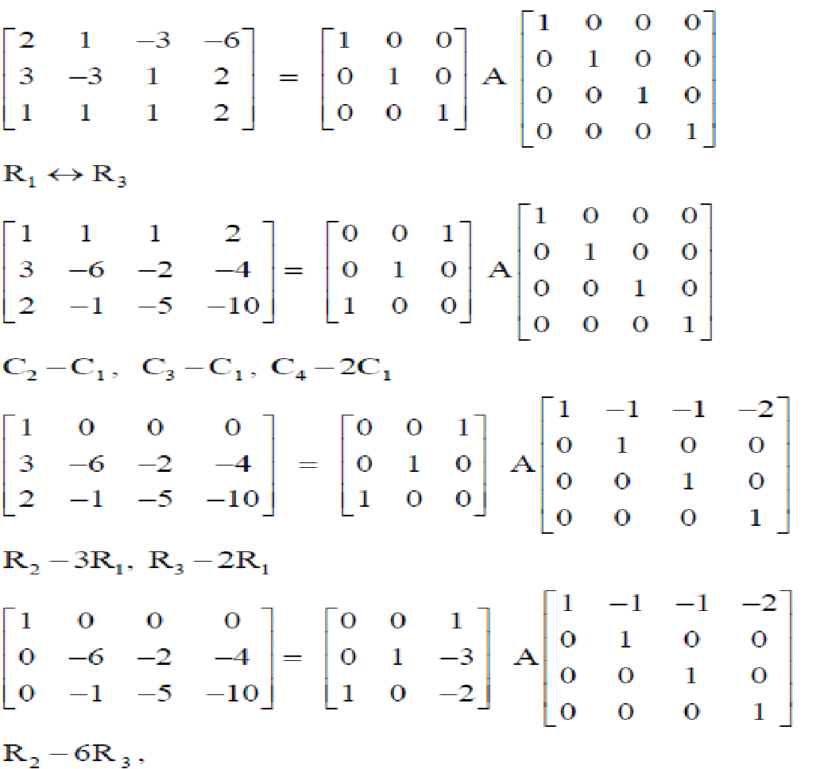
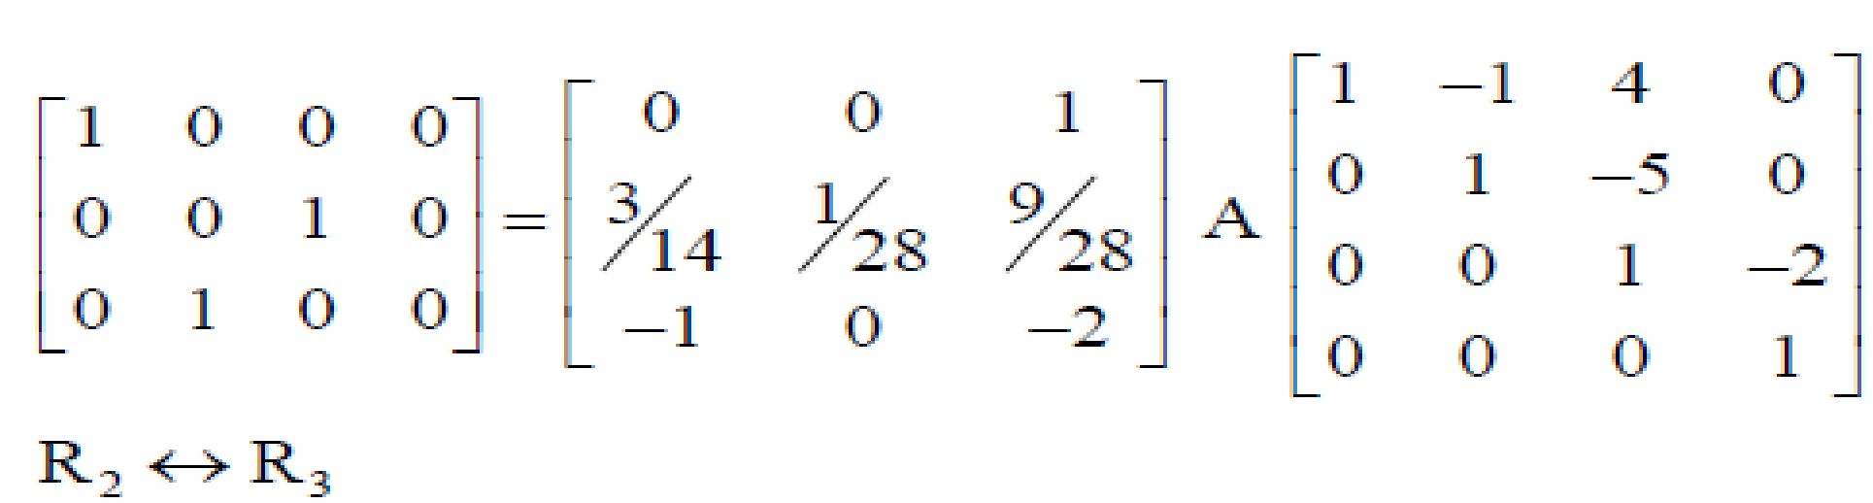
Example: Find the non-singular matrices P and Q such that PAQ is in normal and hence find the rank of
A =
Solution: Consider

Slide 17
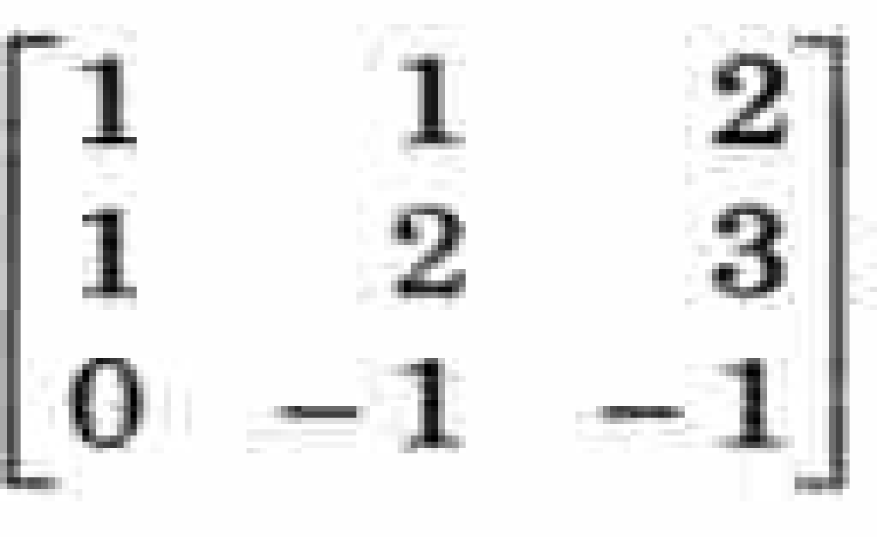
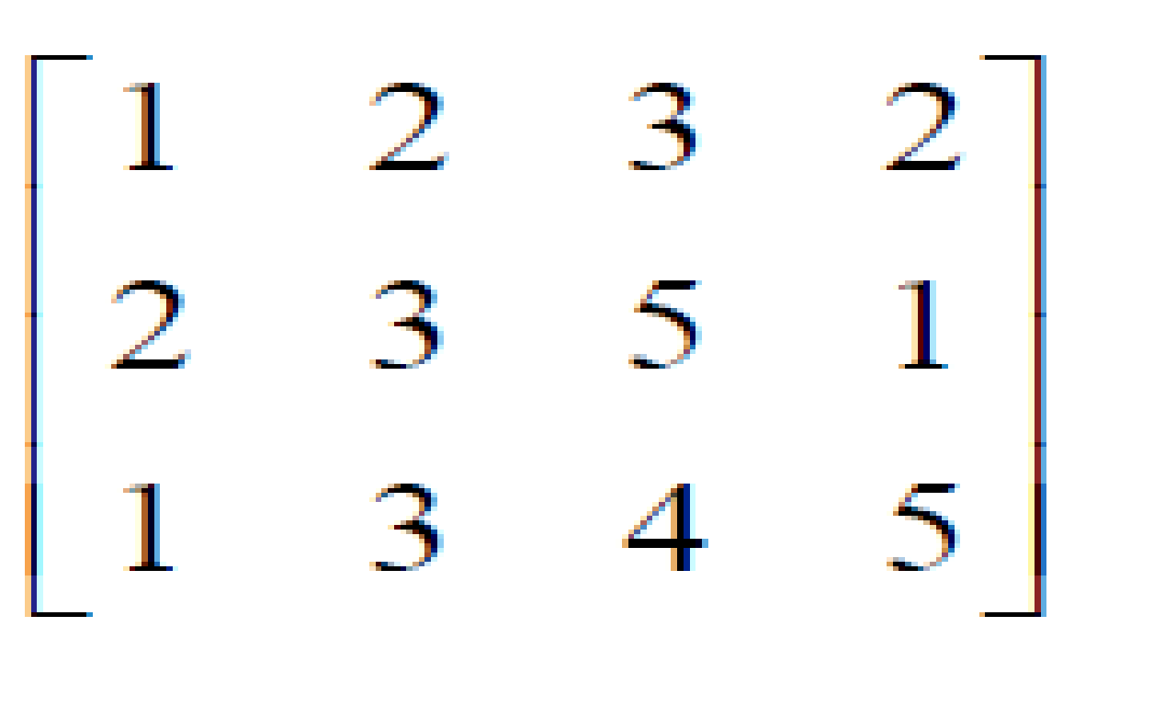
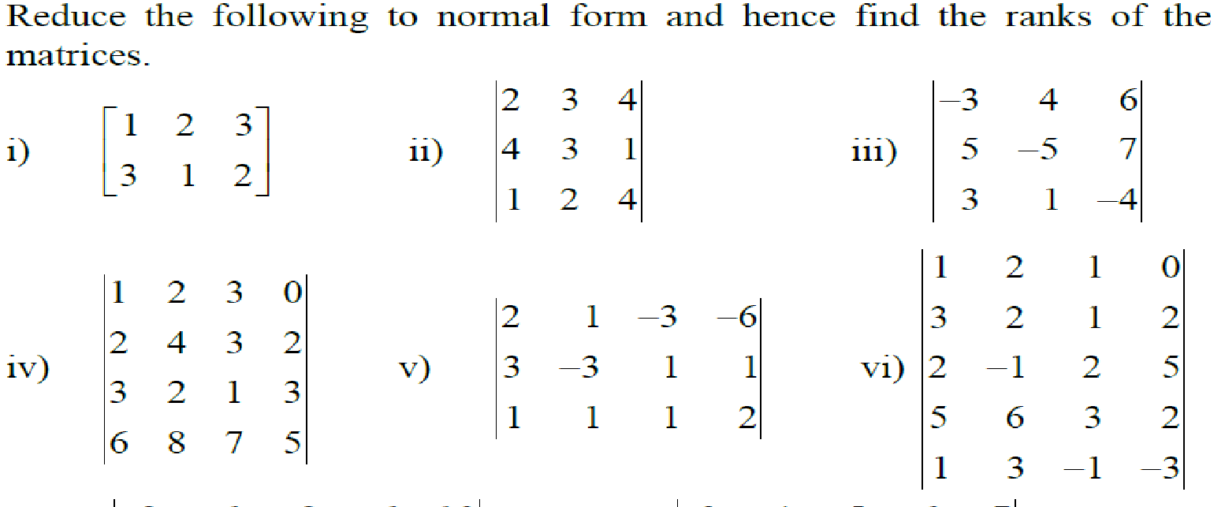
Assignment
Q.1 Find the non-singular matrices P and Q such that PAQ is in normal form and hence find rank of matrix A.
i) A= ii) A=
Q,2 Reduce the following to normal form and hence find the ranks of the matrices

Slide 18
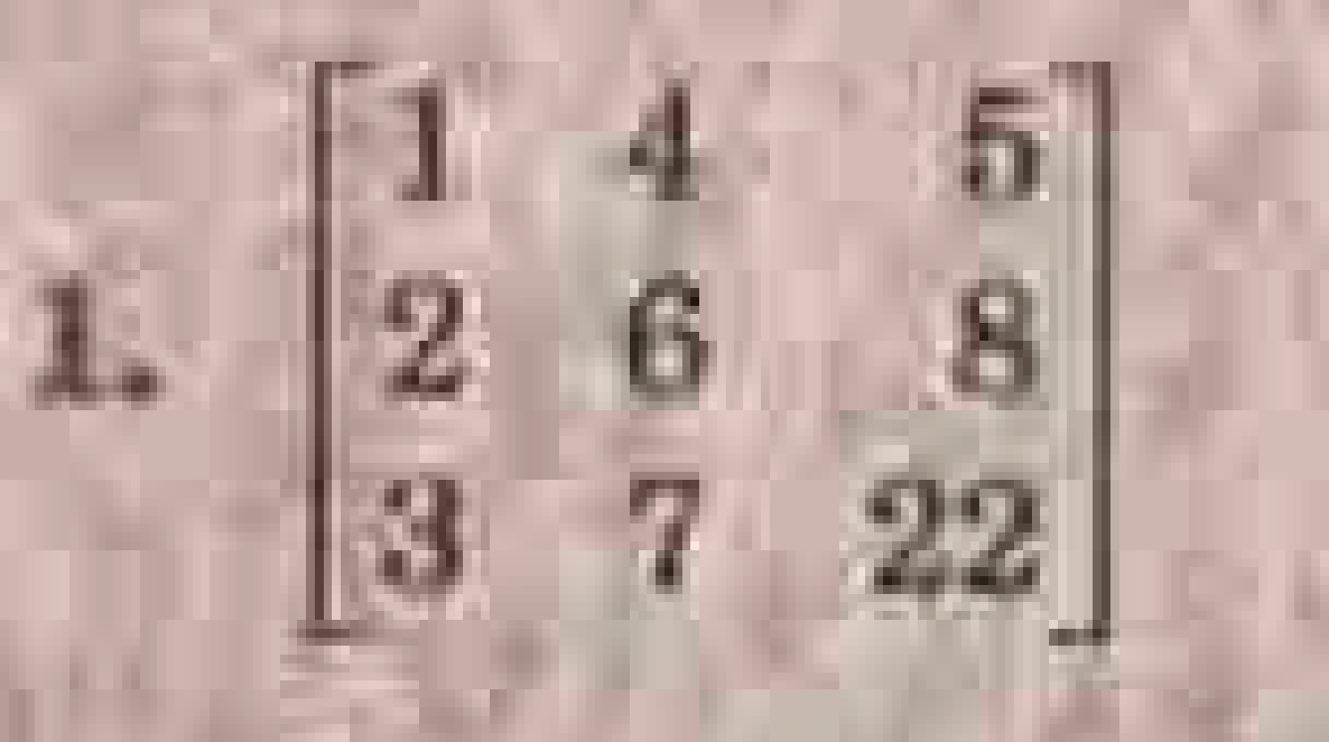
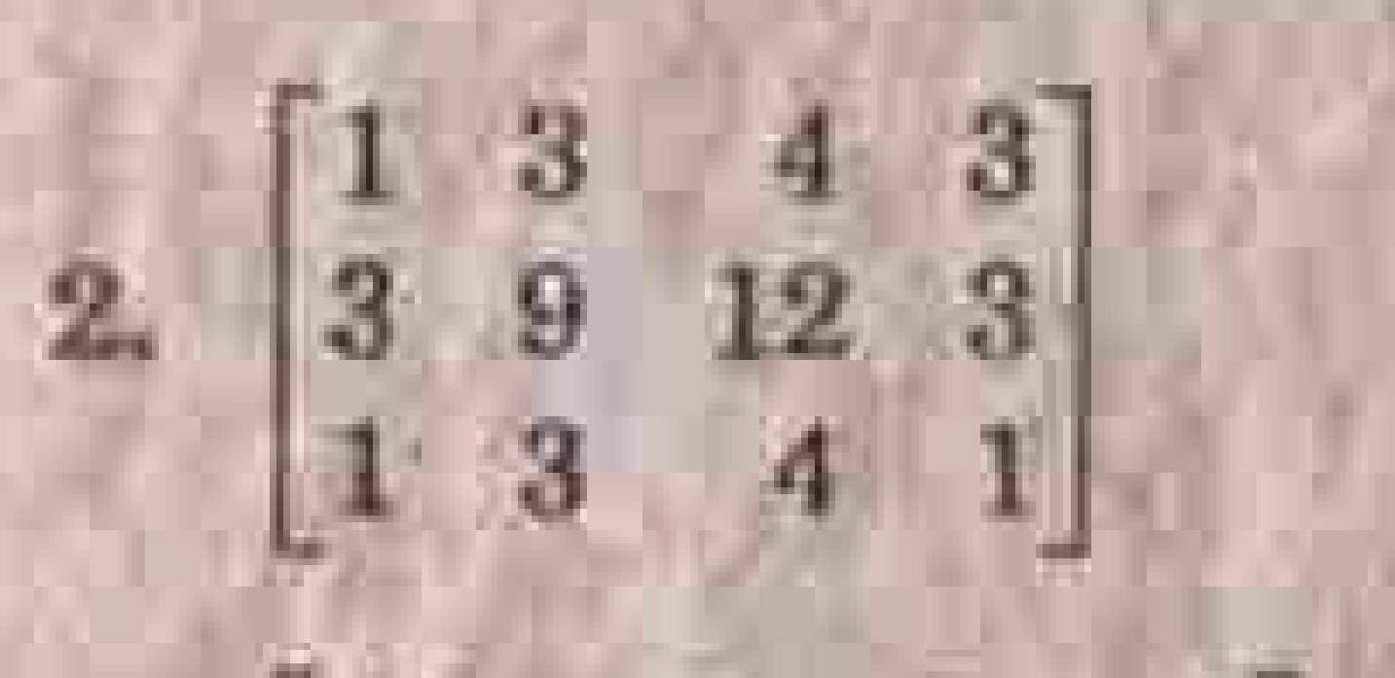
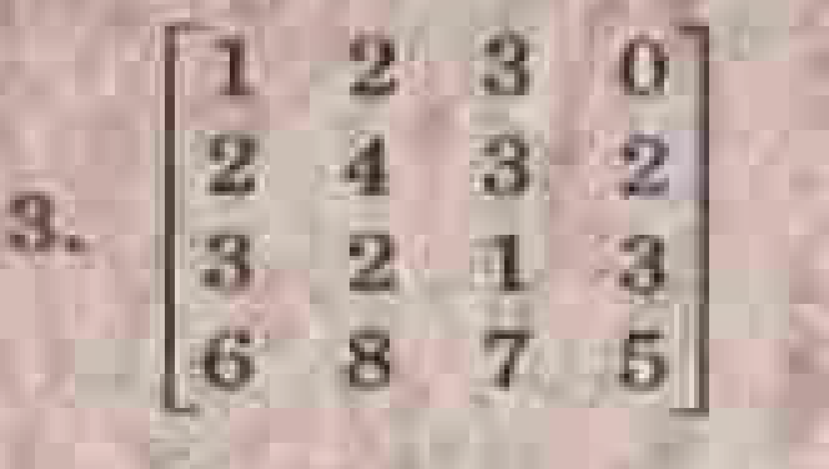
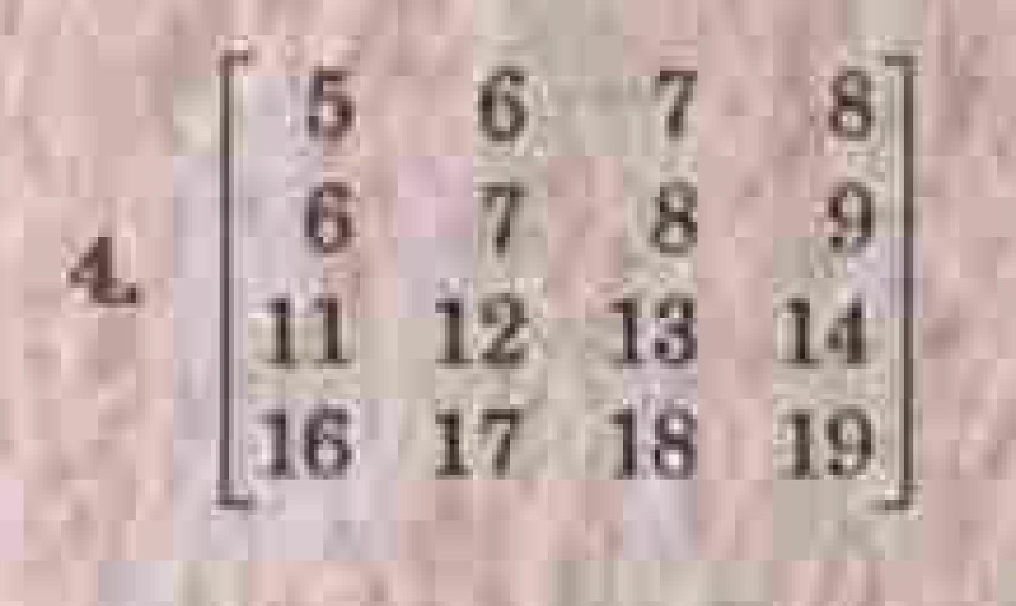
Assignment
Q,2 Reduce the following to row echelon form and hence find the ranks of the matrices

Slide 19


