Slide 1


A Presentation
On
Linear System of equations
By
Mr. Urmila Navaghan
Faculty of Engineering Mathematics
F. Y. B. Tech. Dept.
G. H. Raisoni College of Engineering & Management

Slide 2
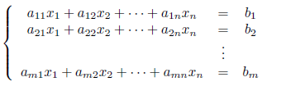
Systems of Linear Equations
Linear systems: A linear equation in variables x1, x2, . . . , xn is an equation of the form
a1x1 + a2x2 + · · · + anxn = b
where a1, a2, . . . , an and b are constant real or complex numbers. The constant ai is called the coefficient of xi ; and b is called the constant term of the equation
System of linear equations :A system of linear equations (or linear system) is a finite collection of linear equations in same variables. For instance, a linear system of m equations in n variables x1, x2, . . . , xn can be written as
(1.1)
A solution of a linear system (1.1) is a tuple of numbers that makes each equation a true statement when the values s1, s2, . . . , sn are substituted for x1, x2, . . . , xn, respectively. The set of all solutions of a linear system is called the solution set of the system.

Slide 3
Consistency of Systems of Linear Equations
Any system of linear equations has one of the following exclusive conclusions.
No solution.
Unique solution.
Infinitely many solutions. .
A linear system is said to be consistent if it has at least one solution;
and is said to be inconsistent if it has no solution
A system of n linear equations in n variables can be expressed as a matrix equation Ax = B
If B= 0, then system is homogeneous; otherwise it is nonhomogeneous.

Slide 4

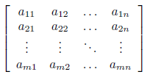
The augmented matrix of the general linear system (1.1) is the table
[A B] =
and the coefficient matrix of (1.1) is
A =
calculate the rank of the coefficient matrix and the rank of the augmented matrix, if the 2 ranks are the same then it is consistent. If the rank of the coefficient matrix is less than the rank of the augmented matrix then it is inconsistent.
If ρ(A) = ρ(A|B) = n then linear system is consistent & have unique solution
If ρ(A) = ρ(A|B) < n then linear system is consistent & have infinite solution
If ρ(A) ≠ ρ(A|B) then linear system is inconsistent

Slide 5
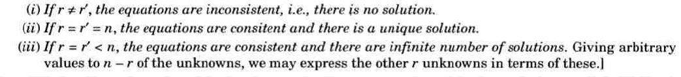
Non-Homogeneous linear equations
Consider nonhomogeneous linear equations
(i)
Where at least one bi≠ 0.
The system of n linear equations in n variables can be expressed as a matrix equation Ax = B (ii)
A is coefficient matrix & [A | B] is augmented matrix
To check Consistency and to find solution of the system ,
1)Reduce the matrix A to Row Echelon form using elementary row operations .
2)Then calculate the rank of the coefficient matrix and the rank of the augmented matrix
Let ρ(A) =r And ρ(A|B) =r’

Slide 6

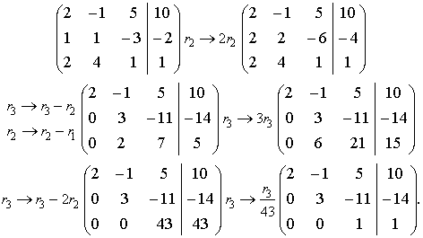


Example: Check the consistency of the system and solve if consistent
Solution: Reduce the augmented matrix of the system to a row echelon form:
As ρ(A) = ρ(A|B) = 3 the linear system is consistent & have unique solution .This matrix corresponds to the system
[A І B]=
which is equivalent to the initial system. Now the solution can be easily found:

Slide 7

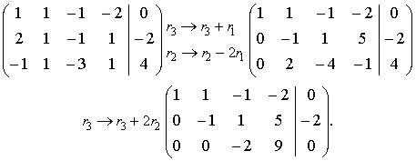

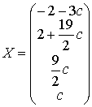



Example: Check the consistency of the system and solve if consistent
Solution: Reduce the augmented matrix of the system to a row echelon form:
[A І B]=
ρ(A) = ρ(A|B) < 4 then linear system is consistent & have infinite solution .This matrix has the rank 3 and corresponds to the system
The variable x₄ can be considered as an arbitrary parameter c , Thus the system has the following general solution
,

Slide 8
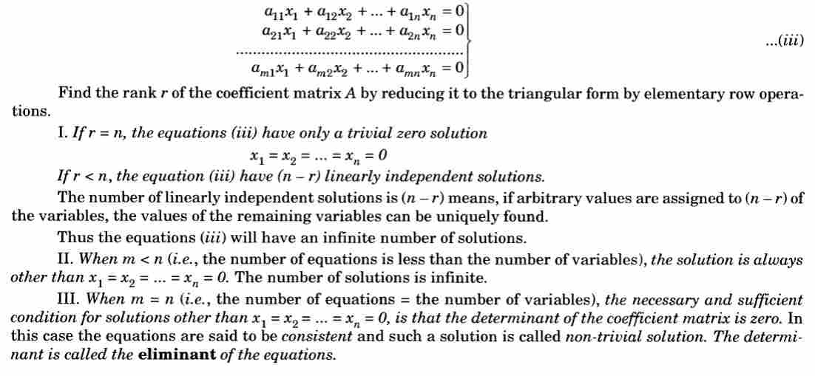
Homogeneous linear equations
Consider the homogeneous linear equations

Slide 9
Example: Solve the equations
Solution: Reduce the Coefficient matrix A of the system to a row echelon form
A=
ρ(A) = 3 = no. of variables so system has trivial solution.
i.e. x = y = z = 0

Slide 10
Example: Solve the equations

Slide 11


