Slide 1


G. H. RAISONI COLLEGE OF ENGG. & MANAGEMENT Gat No. 1200, Wagholi, Pune – 412 207 (An Autonomous Institute Affiliated to Savitribai Phule Pune University)
Session 2020-21
Presentation on
“APPLICATIONS OF LASER IN ENGINEERING Physics ”
By
C69 - SUSHMA DIPAK YEMMEWAR
C70 - SWAYAM PRAMOD TERODE
C71 - TANMAY RADHAKRISHNA ASWALE
C72 - VALLABH RAJARAM SHRIMANGALE
Faculty Name: Prof. PRAVEN JANGADE
FY B.Tech : Div C

Slide 2
APPLICATIONS OF LASER IN ENGINEERING

Slide 3
WHAT IS LASER?
Laser, a device that stimulates atoms or molecules to emit light at particular wavelengths and amplifies that light, typically producing a very narrow beam of radiation. The emission generally covers an extremely limited range of visible, infrared, or ultraviolet wavelengths. Many different types of lasers have been developed, with highly varied characteristics. Laser is an acronym for “light amplification by the stimulated emission of radiation.”

Slide 4
Application of laser:
MANUFACTURING (INDUSTRY)
MADICAL
METROLOGY
DATA-STORAGE
COMMUNICATIONS
DISPLAYS
SPECTROSCOPY
MICROSCOPY
ENERGY TECHNOLOGY
MILITARY
SCIENCE AND TECHNOLOGY

Slide 5
Scientific & Engineering applications
Since the laser beam can stay on at a single frequency, it can be modulated to transmit large number of messages at a time in radio, television and telephone.
The semiconductor laser is the best light source for optical fiber communication.
Narrow angular spread of the laser beam makes it a very useful tool for microwave communication. Communication with earth satellites and in rocketry. Laser is also used in accurate range finders for detecting the targets.

Slide 6
Scientific & Engineering applications
The earth-moon distance has been measured with the help of lasers. It is used in laser Raman Spectroscopy. Laser is also used in holography (three dimensional lensless photography). Laser beam can determine precisely the distance, velocity and direction as well as the size and form of the objects by means of the reflected signal as in radar.

Slide 7
Scientific & Engineering applications
Barcode Scanner : Supermarket scanners typically use helium-neon lasers to scan the universal barcodes to identify products. The laser beam bounces off a rotating mirror and scans the code, sending a modulated beam to a light detector and then to a computer which has the product information stored.
Laser cooling : The use of lasers to achieve extremely low temperatures has advanced to the point that temperatures of 10⁻⁹ K have been reached.
CD’s and Optical Discs : The detection of the binary data stored in the form of pits on the compact disc is done with the use of a semiconductor laser.
7

Slide 8
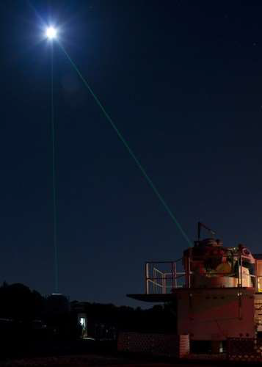
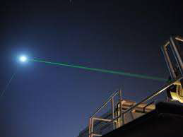
PICTURES OF LEASER

Slide 9
Thank YOU!

Slide 10
WEBLIOGRAPHY
The Photos were taken from wikipedia.com
The more information about the application of laser taken from Encyclopedia.

