Slide 1

Basic Electronics
Lecture-2
Diode Applications

Slide 2
Lecture Outline
Half wave Rectifier
Full wave Rectifier
Bridge Rectifier

Slide 3
introduction
A rectifier is an electrical device that converts alternating current (AC), which periodically reverses direction, to direct current (DC), which is in only one direction, a process known as rectification.

Slide 4
Types of Rectifiers
Half wave Rectifier
Full wave Rectifier
Bridge Rectifier

Slide 5
Half wave rectifier
In half wave rectification, either the positive or negative half of the AC wave is passed, while the other half is blocked.
Because only one half of the input waveform reaches the output, it is very inefficient if used for power transfer.

Slide 6
Half wave rectifier working animation

Slide 7
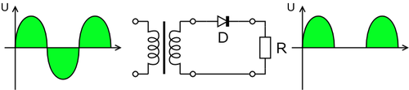
Half wave rectification

Slide 8


Output dc voltage calculation
The output DC voltage of a half wave rectifier can be calculated with the following two ideal equations
Ripple factor: 1.21
Efficiency: 40.6%=0.406

Slide 9
Full wave rectification
For single-phase AC, if the transformer is center-tapped, then two diodes back-to-back (i.e. anodes-to-anode or cathode-to-cathode) can form a full-wave rectifier.

Slide 10
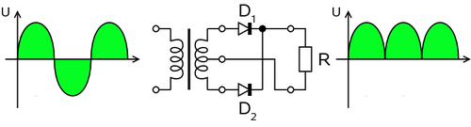
Full wave rectifier using transformer and 2 diodes

Slide 11
Full wave rectification
In a circuit with a non - center tapped transformer, four diodes are required instead of the one needed for half-wave rectification.

Slide 12
Full wave rectifier working animation

Slide 13


formula
The average and root-mean-square output voltages of an ideal single phase full wave rectifier can be calculated as:

Slide 14
Output voltage of the full wave rectifier Animation

Slide 15
Bridge rectifier
A bridge rectifier makes use of four diodes in a bridge arrangement to achieve full-wave rectification.

Slide 16
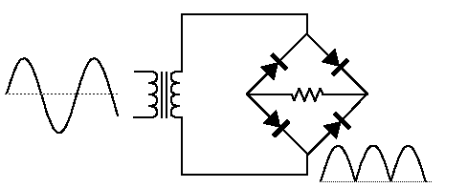
Bridge rectifier circuit

Slide 17
Bridge rectifier working animation

Slide 18
End of Lecture-2

