Slide 1

Diodes and Diode Applications
Chapter
01
27-1: Semiconductor Materials
27-2: The PN Junction Diode
27-3: Volt-Ampere Characteristic Curve
27-4: Diode Approximations
27-5: Diode Ratings
27-6: Rectifier Diodes
27-7: Special Diodes

Slide 2
27-1: Semiconductor Materials
Semiconductors conduct less than metal conductors but more than insulators.
Some common semiconductor materials are silicon (Si), germanium (Ge), and carbon (C).
Silicon is the most widely used semiconductor material in the electronics industry.
Almost all diodes, transistors, and ICs manufactured today are made from silicon.

Slide 3
27-1: Semiconductor Materials
Intrinsic semiconductors are semiconductors in their purest form.
Extrinsic semiconductors are semiconductors with other atoms mixed in.
These other atoms are called impurity atoms.
The process of adding impurity atoms is called doping.

Slide 4
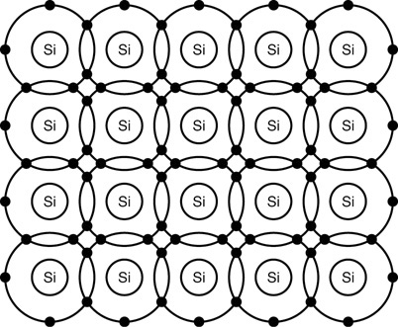
27-1: Semiconductor Materials
Fig. 27-2 illustrates a bonding diagram of a silicon crystal.
Fig. 27-2
Copyright © The McGraw-Hill Companies, Inc. Permission required for reproduction or display.

Slide 5
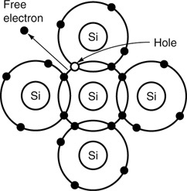
27-1: Semiconductor Materials
Thermal energy is the main cause for the creation of an electron-hole pair, as shown in Fig. 27-3.
As temperature increases, more thermally generated electron-hole pairs are created.
In Fig. 27-3, the hole acts like a positive charge because it attracts a free electron passing through the crystal.
Intrinsic semiconductor materials are doped with impurity atoms to increase their conductivity
Fig. 27-3
Copyright © The McGraw-Hill Companies, Inc. Permission required for reproduction or display.

Slide 6
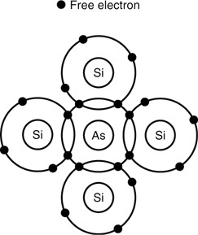
27-1: Semiconductor Materials
Fig. 27-4 shows the doping of a silicon crystal with a pentavalent impurity.
Arsenic (As) is shown in this figure, but other pentavalent impurities such as antimony (Sb) or phosphorous (P) could also be used.
Electrons are basic particles of negative charge, so we call this an n-type semiconductor
Electrons are called majority current carriers
n-type semiconductors have many positive ions
Fig. 27-4
Copyright © The McGraw-Hill Companies, Inc. Permission required for reproduction or display.

Slide 7
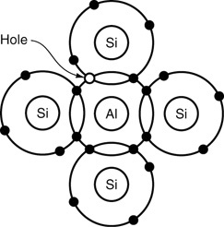
27-1: Semiconductor Materials
Fig. 27-5 shows the doping of a silicon crystal with a trivalent impurity.
Aluminum (Al) is shown in this figure, but other trivalent impurities such as boron (B) or gallium (Ga) could also be used.
A Hole exhibits a positive charge, so we call this a p-type semiconductor
Holes are called majority current carriers
p-type semiconductors have many negative ions
Fig. 27-5
Copyright © The McGraw-Hill Companies, Inc. Permission required for reproduction or display.

Slide 8
27-1: Semiconductor Materials
One of the valence electrons in the pentavalent impurity atom in Fig. 27-4 is not needed in the covalent bond structure and can float through the material as a free electron.
One more valence electron is needed at the location of each trivalent atom in the crystal to obtain the maximum electrical stability as shown in Fig. 27-5.
Fig. 27-4
Fig. 27-5
Copyright © The McGraw-Hill Companies, Inc. Permission required for reproduction or display.

Slide 9
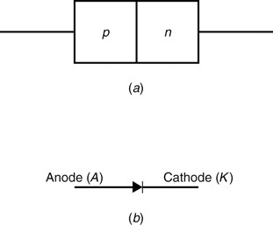
27-2: The PN Junction Diode
A popular semiconductor device called a diode is made by joining p- and n-type semiconductor materials, as shown in Fig. 27-6 (a).
The doped regions meet to form a p-n junction.
Diodes are unidirectional devices that allow current to flow in one direction.
The schematic symbol for a diode is shown in Fig. 27-6 (b).
Fig. 27-6

Slide 10
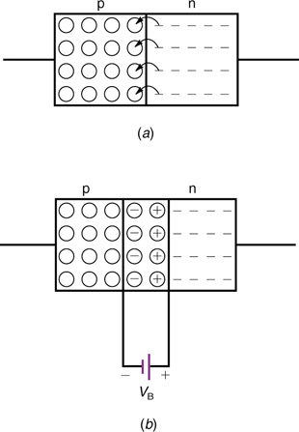
27-2: The PN Junction Diode
Fig. 27-7 (a) shows a p-n junction with free electrons on the n side and holes on the p side.
The free electrons are represented as dash (-) marks and the holes are represented as small circles (○).
The important effect here is that when a free electron leaves the n side and falls into a hole on the p side, two ions are created; a positive ion on the n side and a negative ion on the p side (see Fig. 27-7 b).
Diffusion creates a barrier potential
The area with positive and negative ions is called depletion region
electrons on n side diffuse across the junction to the p side
Fig. 27-7
Copyright © The McGraw-Hill Companies, Inc. Permission required for reproduction or display.

Slide 11
27-2: The PN Junction Diode
The term bias voltage is defined as the DC voltage applied across the terminals of a PN junction
A PN junction is forward biased when a positive voltage is applied to the P-region with respect to the N-region
A PN junction is reversed-biased when the voltage polarity is reversed
Copyright © The McGraw-Hill Companies, Inc. Permission required for reproduction or display.

Slide 12
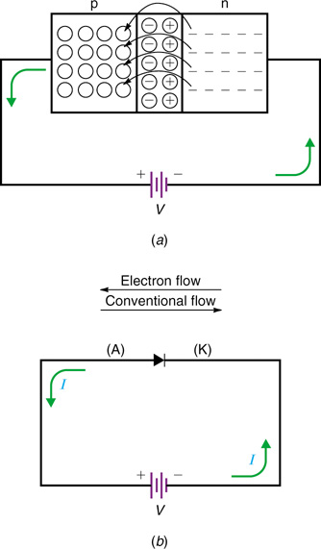
27-2: The PN Junction Diode
Forward-biasing a diode allows current to flow easily through the diode.
Fig. 27-8 (a) illustrates a PN junction that is forward-biased.
Fig. 27-8 (b) shows the schematic symbol of a diode with the voltage source, V, connected to provide forward bias.
Fig. 27-8
Copyright © The McGraw-Hill Companies, Inc. Permission required for reproduction or display.

Slide 13
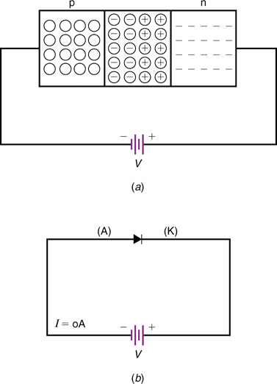
27-2: The PN Junction Diode
Fig. 27-9 illustrates a reverse-biased pn-junction.
Fig. 27-9 (a) shows how an external voltage pulls majority current carriers away from the pn junction.
This widens the depletion zone.
Fig. 27-9 (b) shows a schematic symbol showing how a diode is reverse-biased with the external voltage, V.
Fig. 27-9
Copyright © The McGraw-Hill Companies, Inc. Permission required for reproduction or display.

Slide 14
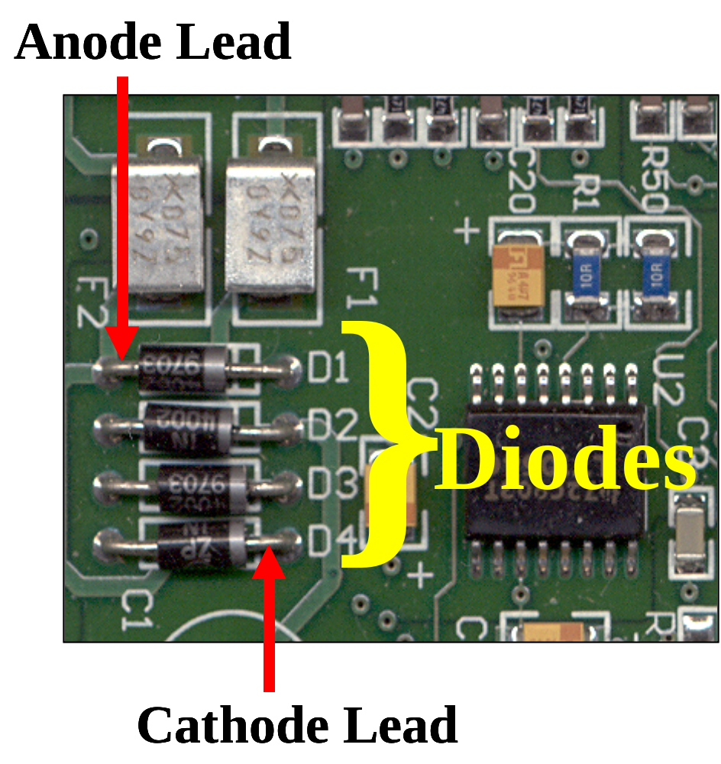
27-2: The PN Junction Diode
Diodes Have Polarity
(They must be
installed correctly.)

Slide 15
27-3: Volt-Ampere
Characteristic Curve
Figure 27-10 (next slide) is a graph of diode current versus diode voltage for a silicon diode.
The graph includes the diode current for both forward- and reverse-bias voltages.
The upper right quadrant of the graph represents the forward-bias condition.
Beyond 0.6 V of forward bias the diode current increases sharply.
The lower left quadrant of the graph represents the reverse-bias condition.
Only a small current flows until breakdown is reached.

Slide 16
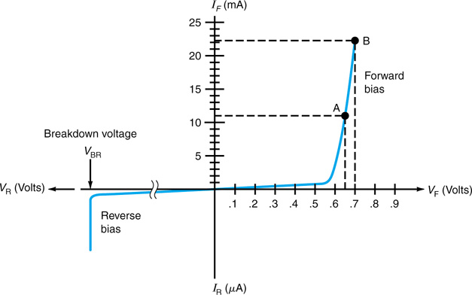
27-3: Volt-Ampere
Characteristic Curve
Fig. 27-10 illustrates a volt-ampere characteristic curve of a silicon diode.
DC Resistance
R_{F} = V_{F} / I_{F}
Fig. 27-10
Copyright © The McGraw-Hill Companies, Inc. Permission required for reproduction or display.

Slide 17
27-4: Diode Approximations
Three different approximations can be used when analyzing diode circuits.
The one used depends on the desired accuracy of your circuit calculations.
These approximations are referred to as
  The first approximation
  The second approximation
  The third approximation

Slide 18
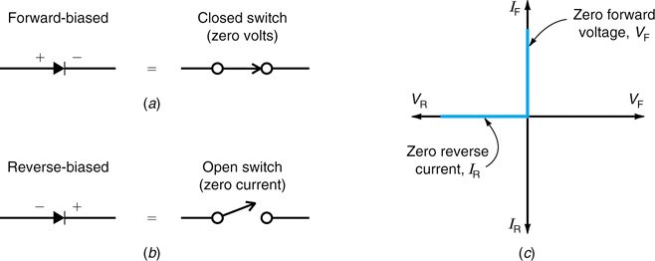
27-4: Diode Approximations
The first approximation treats a forward-biased diode like a closed switch with a voltage drop of zero volts, as shown in Fig. 27-11.
Fig. 27-11
Copyright © The McGraw-Hill Companies, Inc. Permission required for reproduction or display.

Slide 19
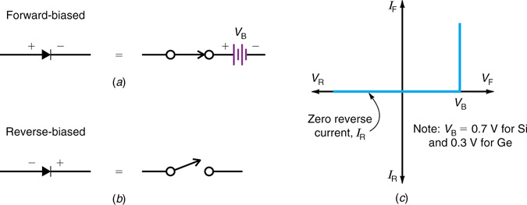
27-4: Diode Approximations
The second approximation treats a forward-biased diode like an ideal diode in series with a battery, as shown in Fig. 27-12 (a).
Fig. 27-12
Copyright © The McGraw-Hill Companies, Inc. Permission required for reproduction or display.

Slide 20
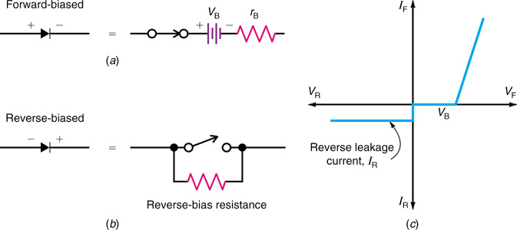
27-4: Diode Approximations
The third approximation of a diode includes the bulk resistance, r_{B}.
The bulk resistance, r_{B} is the resistance of the p and n materials.
The third approximation of a forward-biased diode is shown in Fig. 27-13 (a).
r_{B} = ∆V / ∆I
Fig. 27-13
Copyright © The McGraw-Hill Companies, Inc. Permission required for reproduction or display.

Slide 21
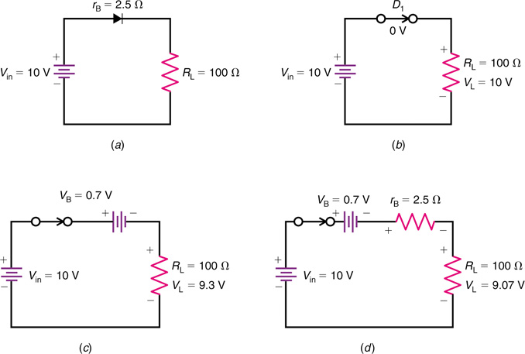
27-4: Diode Approximations
Fig. 27-14
Copyright © The McGraw-Hill Companies, Inc. Permission required for reproduction or display.

Slide 22
27-5: Diode Ratings
Diode ratings include maximum ratings and electrical characteristics.
Typical ratings are
  Breakdown Voltage Rating, V_{BR}
  Average Forward-Current rating, I_{O}
  Maximum Forward-Surge Current Rating, I_{FSM}
  Maximum Reverse Current, I_{R}

Slide 23
27-5: Diode Ratings
Rating | Abbreviation | Designated As | Significance
Breakdown Voltage | V_{BR} | PIV, PRV, V_{BR}, or V_{RRM} | Voltage at which avalanche occurs; diode is destroyed if this rating is exceeded.
Average Forward-Current | I_{O} | I_{O} | Maximum allowable average current.
Maximum Forward-Surge Current | I_{FSM} | I_{FSM} | Maximum instantaneous current.
Maximum Reverse Current | I_{R} | I_{R} | Maximum reverse current.

Slide 24
27-6: Rectifier Diodes
A circuit that converts the ac power-line voltage to the required dc value is called a power supply.
The most important components in power supplies are rectifier diodes, which convert ac line voltage to dc voltage.
Diodes are able to produce a dc output voltage because they are unidirectional devices allowing current to flow through them in only one direction.

Slide 25
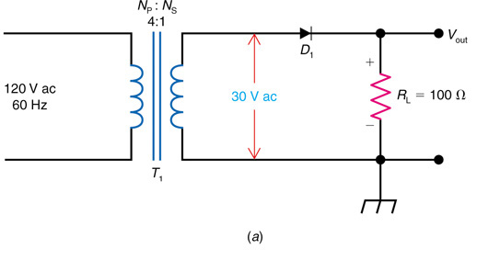
27-6: Rectifier Diodes
The circuit shown in Fig. 27-15 (a) is called a half-wave rectifier.
When the top of the transformer secondary voltage is positive, D₁ is forward-biased, producing current flow in the load.
When the top of the secondary is negative, D₁ is reverse-biased and acts like an open switch. This results in zero current in the load, R_{L}.
The output voltage is a series of positive pulses, as shown in the next slide, Fig. 27-15 (c).
Fig. 27-15(a)
Copyright © The McGraw-Hill Companies, Inc. Permission required for reproduction or display.

Slide 26
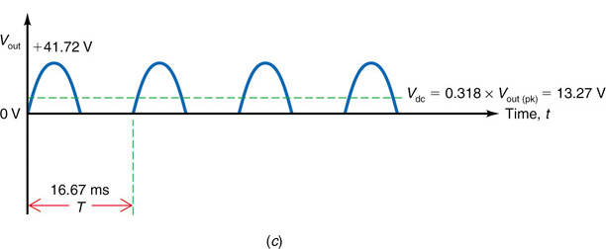
27-6: Rectifier Diodes
I_{diode} = I_{L(DC)}
PIV = 42.42
f_{out} = 60 Hz
Fig. 27-15 (c)
Copyright © The McGraw-Hill Companies, Inc. Permission required for reproduction or display.

Slide 27
Example
Assume the turns ratio of the previous half-wave rectifier is N_{P}:N_{S} = 3:1. Calculate the following:
  V_{Sec (pk)}
  V_{out (pk)}
  V_{dc}
  I_{L}
  I_{diode}
  PIV for D₁
  f_{out}

Slide 28
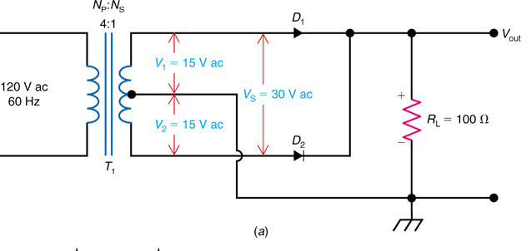
27-6: Rectifier Diodes
The circuit shown in Fig. 27-17 (a) is called a full-wave rectifier.
When the top of the secondary is positive, D₁ is forward-biased, causing current to flow in the load, R_{L}.
When the top of the secondary is negative, D₂ is forward-biased, causing current to flow in the load, R_{L}.
The combined output voltage produced by D₁ and D₂ are shown in Fig. 27-17 (f) in the next slide.
Fig. 27-17(a)
Copyright © The McGraw-Hill Companies, Inc. Permission required for reproduction or display.

Slide 29
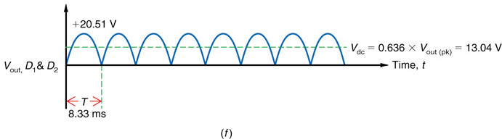
27-6: Rectifier Diodes
Fig. 27-17 (f)
Copyright © The McGraw-Hill Companies, Inc. Permission required for reproduction or display.

Slide 30
Example
Assume the turns ratio of the previous full-wave rectifier is N_{P}:N_{S} = 3:1. Calculate the following using the second approximation:
  V_{Sec (pk)}
  V_{out (pk)}
  V_{dc}
  I_{L}
  I_{diode}
  PIV for D₁
  f_{out}

Slide 31
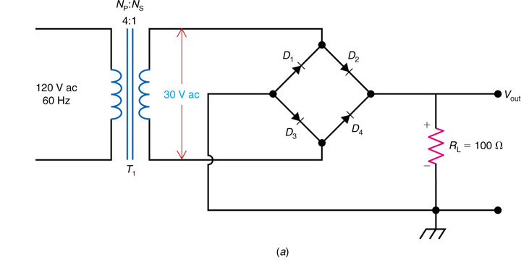
27-6: Rectifier Diodes
The circuit shown in Fig. 27-19 (a) is called a full-wave bridge rectifier.
When the top of the secondary is positive, diodes D₂ and D₃ are forward-biased. producing current flow in the load, R_{L}.
When the top of the secondary is negative, D₁and D₄ are forward-biased, producing current flow in the load, R_{L}.
Fig. 27-19 (a)
Copyright © The McGraw-Hill Companies, Inc. Permission required for reproduction or display.

Slide 32
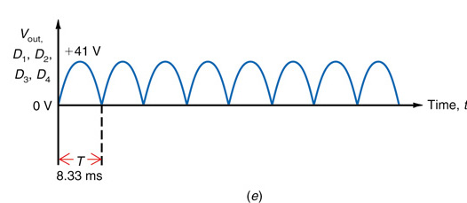
27-6: Rectifier Diodes
Fig. 27-19 (e) illustrates the combined output voltage of the full-wave bridge rectifier circuit of Fig. 27-19 (a) in the previous slide.
Fig. 27-19 (e)
Copyright © The McGraw-Hill Companies, Inc. Permission required for reproduction or display.

Slide 33
Example
Assume the turns ratio of the previous full-wave bridge rectifier is N_{P}:N_{S} = 3:1. Calculate the following:
  V_{S}
  V_{dc}
  I_{L}
  I_{diode}
  PIV for each diode
  f_{out}

Slide 34
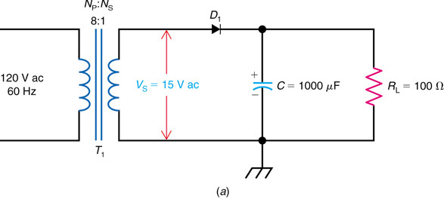
27-6: Rectifier Diodes
Figure 27-21 (a) shows a half-wave rectifier with its output filtered by the capacitor, C.
Usually the filter capacitors used in this application are large electrolytic capacitors with values larger than 100 μF.
Fig. 27-21(a)
Copyright © The McGraw-Hill Companies, Inc. Permission required for reproduction or display.

Slide 35
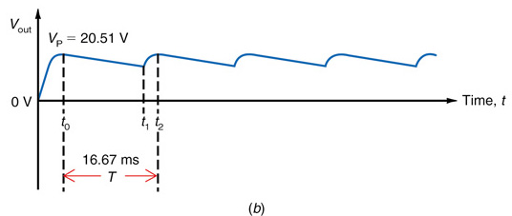
27-6: Rectifier Diodes
Notice the time before t_{o} in Fig. 27-21 (b).
During this time, the capacitor voltage follows the positive-going secondary voltage.
At time t₀, the voltage across C reaches its peak positive value.
Output ripple voltage of the half-wave rectifier is illustrated.
Fig. 27-21 (b)
Copyright © The McGraw-Hill Companies, Inc. Permission required for reproduction or display.

Slide 36
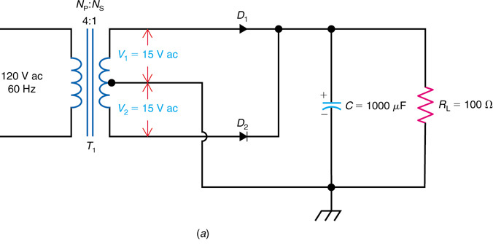
27-6: Rectifier Diodes
Fig. 27-22 (a) shows a full-wave rectifier with its output filtered by the capacitor, C.
When the top of the secondary is positive, D₁ conducts and charges C.
When the bottom of the secondary is positive, D₂ conducts and recharges C.
Fig. 27-22(a)
Copyright © The McGraw-Hill Companies, Inc. Permission required for reproduction or display.

Slide 37
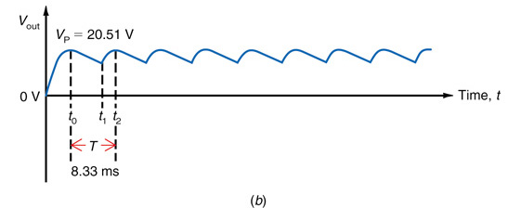
27-6: Rectifier Diodes
Fig. 27-22 (b) illustrates the output ripple voltage of a full-wave rectifier.
Fig. 27-22(b)
Copyright © The McGraw-Hill Companies, Inc. Permission required for reproduction or display.

Slide 38
27-7: Special Diodes
Besides rectification, a semiconductor diode has many other useful applications.
Semiconductor diodes can be manufactured to regulate voltage or emit different colors of light.
Examples of two special purpose diodes are
  Light-emitting diode
  Zener diode

Slide 39
27-7: Special Diodes
A light-emitting diode (LED) is a diode that emits a certain color light when forward-biased.
The color of light emitted by an LED is determined by the type of material used in doping.
A schematic symbol of an LED is shown in Fig. 27-23.
Fig. 27-23

Slide 40
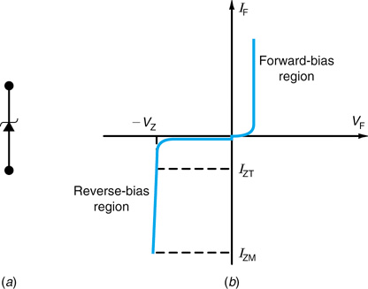
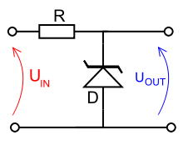
27-7: Special Diodes
A zener diode is a special diode that has been optimized for operation in the breakdown region.
Voltage regulation is the most common application of a zener diode.
Fig. 27-25 shows the schematic symbol for a zener diode.
Fig. 27-25
Copyright © The McGraw-Hill Companies, Inc. Permission required for reproduction or display.

Slide 41
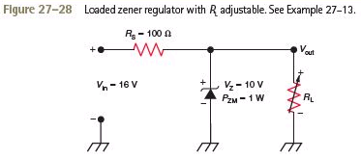
Example 27-13

Slide 42
Designing a Circuit with the Zener Diode
Problem:
You have an unstable 12 Volt supply voltage and need a stable output of 8 Volts to power a 100mA device.
Notes:
Source: http://www.reuk.co.uk/Zener-Diode-Voltage-Regulator.htm

Slide 43
Designing a Circuit with the Zener Diode
1. Choose a Zener Diode
Target voltage is 8 V, so choose a zener diode between 7.5V and 8.2V. An diode with 8.2 Volt zener voltage is perfect

Slide 44
Designing a Circuit with the Zener Diode
2. Calculate the Maximum Current in the Circuit
Our load device needs 100mA of current, plus we also need at least 5mA for the zener diode, therefore lets set I_{max} as 110mA to be safe (add 10-20% to the load current,)

Slide 45
Designing a Circuit with the Zener Diode
3. Select the Power Rating of the Zener Diode
If a large current flows through a small zener diode it will be destroyed, therefore we calculate the power to be lost in the diode and select a diode rated above that value.
zener power rating = 8.2 * 0.110 = 0.9 Watts.
Because, no current is flowing through the load when the device is switched off . Therefore a 1.3 Watt power rated zener diode should be perfect.

Slide 46
Designing a Circuit with the Zener Diode
4. Select the Resistor
The voltage dropped across the resistor is equal to the difference between the source voltage and the zener voltage = 12-8 = 4 Volts, and therefore the resistance according to Ohm's Law is the voltage drop divided by Imax = 4/0.110 = 36 Ohms so choose a 39 Ohm resistor.
If the source voltage is likely to be much over the 12 Volts stated then the voltage dropped across the resistor will be larger and so a resistor with a larger resistance may be required.

Slide 47
Designing a Circuit with the Zener Diode
5. Select the Power Rating of the Resistor
The power dissipated in the resistor is equal to the voltage drop across the resistor multiplied by Imax. Therefore in this example power = 4 * 0.110 = 0.440 Watts. Using a 0.5 Watt resistor would be cutting it a bit fine - particularly if the source voltage is going to fluctuate higher regularly, therefore a 1 or 2 Watt rated resistor should be used here despite it costing a few pennies extra.

