Slide 1

G. H. RAISONI COLLEGE OF ENGG. & MANAGEMENT Gat No. 1200, Wagholi, Pune – 412 207
(An Autonomous Institute Affiliated to Savitribai Phule Pune University)
Session 2020-21
Presentation on
“Humidity & Light sensors”
By
C69 - SUSHMA DIPAK YEMMEWAR
C70 - SWAYAM PRAMOD TERODE
C71 - TANMAY RADHAKRISHNA ASWALE
C72 - VALLABH RAJARAM SHRIMANGALE
Faculty Name: Ms Prajakta Kanase
FY B.Tech: Divison C

Slide 2
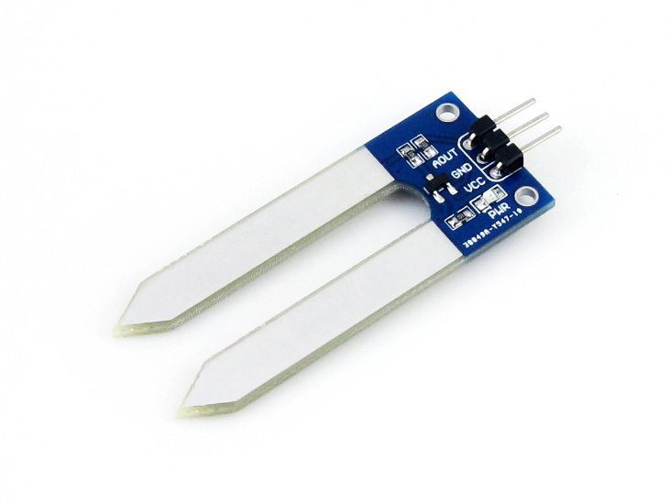
Humidity Sensor:
A humidity sensor (or hygrometer) senses, measures and reports both moisture and air temperature. The ratio of moisture in the air to the highest amount of moisture at a particular air temperature is called relative humidity. Relative humidity becomes an important factor when looking for comfort.
Humidity sensors work by detecting changes that alter electrical currents or temperature in the air.
There are three basic types of humidity sensors:
Capacitive
Resistive
Thermal
All three types of sensors monitor minute changes in the atmosphere in order to calculate the humidity in the air

Slide 3
Let us discuss these types in detail:
Capacitive
A capacitive humidity sensor measures relative humidity by placing a thin strip of metal oxide between two electrodes. The metal oxide’s electrical capacity changes with the atmosphere’s relative humidity. Weather, commercial and industries are the major application areas.
The capacitive type sensors are linear and can measure relative humidity from 0% to 100%. The catch here is a complex circuit and regular calibration. However, for designers this a lesser hassle over precise measurement and hence these dominate atmospheric and process measurements. These are the only types of full-range relative humidity measuring devices down to 0% relative humidity. This low-temperature effect often leads to them being used over wide temperature ranges without active temperature compensation.

Slide 4
Resistive
Resistive humidity sensors utilize ions in salts to measure the electrical impedance of atoms. As humidity changes, so do the resistance of the electrodes on either side of the salt medium.
Thermal
Two thermal sensors conduct electricity based upon the humidity of the surrounding air. One sensor is encased in dry nitrogen while the other measures ambient air. The difference between the two measures the humidity.
Tips on Humidity Sensor working
Coulometric: An electrolyte is formed by absorption of water resulting in a current level which is proportional to the moisture content in the air.
Gravimetric: A drying agent is exposed to moist air, resulting in weight gain by the drying agent. The increased weight corresponds to the amount of moisture.
Microwave/Infrared: A transmitted signal varies as the humidity increases. The attenuation is an indication of the moisture content in the medium.

Slide 5
Some parameters for judgement
Accuracy
Every sensor has its own calibration curve, based on a 9 point system. It basically pitches the pros against the cons of the particular sensor.
Linearity
It indicates the voltage deviation from the BFSL value and the measured output voltage value, converted to relative humidity.
Reliability
The measurements often cause the sensor to fall out of sync. However for a sensor to be useful, it has to provide reliable measurements.
Repeatability
The measurements from a sensor, have to be so that they don’t drift apart. Repeatability is the measurement of drift among measurements of a single quantity.

Slide 6
Response time
Typically, the time is taken by a sensor to rise to 66% (rise time) or fall to 33% (fall time) of maximum output voltage, is known as the response time.
Applications of humidity sensors are far and wide
The applications of humidity sensor range far and wide. People with illnesses affected by humidity, monitoring and preventive measure in homes employ humidity sensors. A humidity sensor is also found as part of home heating, ventilating and air conditioning systems (HVAC systems). These are also used in offices, cars, humidors, museums, industrial spaces and greenhouses and are also used in meteorology stations to report and predict the weather.

Slide 7
Humidity Indicator
Presented here is a simple humidity indicator and controller. In industries such as textile, the change in moisture content has a direct impact on the properties of fabric, such as tensile strength, elasticity, fibre diameter and friction. Cotton and linen require high relative humidity (RH) levels of around 70-80 per cent since they are very brittle. Wool requires RH levels of around 65 per cent. While silk requires between 65 and 70 per cent. With this circuit, you can not only monitor humidity levels between 30 and 90 per cent RH but also control it.
Fridge Temperature and Humidity Indicator
The small sniffer device, described in this project, picks up temperature and humidity from inside the fridge and transmits on an RF link to a nearby receiver unit. The receiver unit checks the received code, identifies the right sniffer device and displays live temperature and humidity. Why do we need it you say? We can measure temperature and humidity inside the fridge using a normal temperature-humidity indicator but relative humidity could be inaccurate in that case.

Slide 8
Humidity And Temperature monitoring Using Arduino With The IoT
In this article, humidity and temperature information from the DHT-11 sensor is analyzed graphically on Thing Speak platform using Adriano MCU and ESP8266 Wi-Fi module.
Humidity Indicator and Controller
Presented here is a simple humidity indicator and controller. In industries such as textile, the change in moisture content has a direct impact on the properties of fabric, such as tensile strength, elasticity, fiber diameter and friction. Therefore the process is executed within a permissible humidity environment only. Depending on the type of fabric and the process being undertaken, the requirement of particular humidity level varies. Cotton and linen have to be processed at very high relative humidity (RH) levels of around 70-80 per cent since they are very brittle. Wool requires RH levels of around 65 per cent. Silk needs to be processed between 65 and 70 per cent. With this circuit, you can not only monitor humidity levels between 30 and 90 per cent RH but also control it.

Slide 9
IoT-Enabled Air Pollution Meter With Digital Dashboard On Smartphone
Presented here is an IoT enabled air pollution meter to monitor air quality on your smartphone using Blynk application and Arduino board. Blynk is an Internet of Things (IoT) platform to control Arduino, Raspberry Pi and the like over the Internet. In this project Blynk provides a digital dashboard on your smartphone that displays real-time air quality readings for the immediate surroundings.

Slide 10
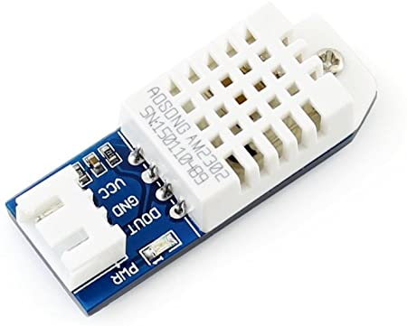
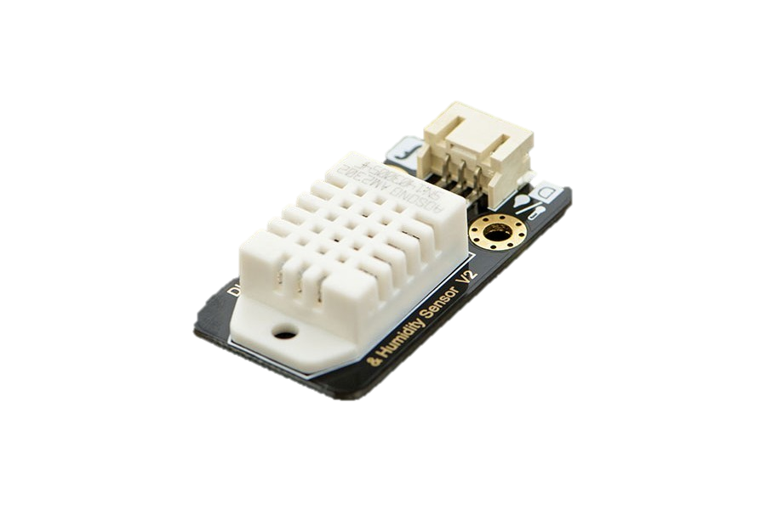
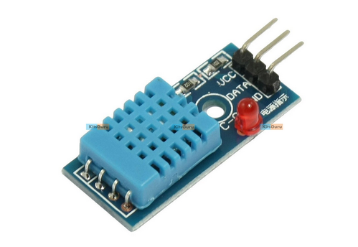
Images of Humidity Sensors

Slide 11
What is a light sensor?
A light sensor is a photoelectric device that converts light energy (photons) detected to electrical energy (electrons). Seems simple? There is more to a light sensor then just its definition. It comes in different types, used in various applications and more!
Glossary of terms
Candela
Originated from the term candles, candela refers to luminous intensity; how strong is the light to a naked eye
The higher the luminous intensity, the higher the sensitivity it is to our eyes
Lumen
Measures the total amount of visible light from a light source through the relationship between luminous intensity and the angle that a light beam fills

Slide 12
Commonly used to rate the brightness of a light bulb
To simply put it Lumen = Total amount of light emitted in all directions
Lux
Used to measure IL luminance, the area where the luminous flux is spread
It’s similar to Lumen but it takes into account the surface area
To simply put it, Lux = total amount of light that falls on a particular surface.
What are the types of light sensor
There are different types of light sensors available; mainly Photo resistor, Photodiodes, and Phototransistors.

Slide 13
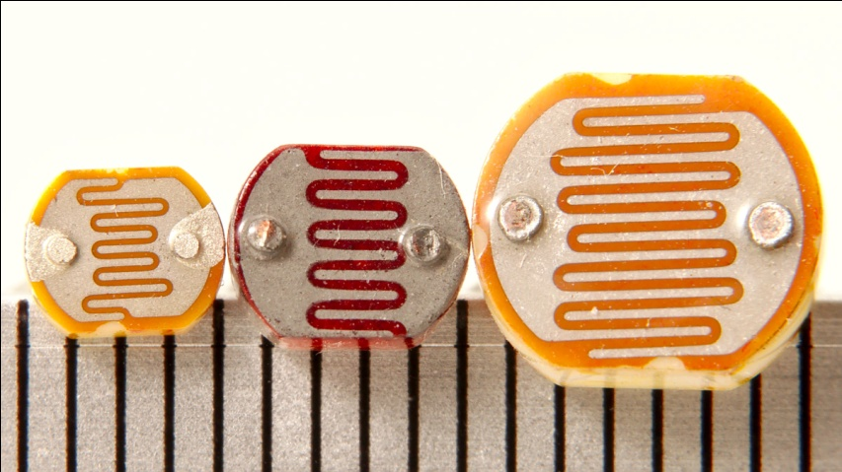
1. Photo resistors (LDR)
The most common light sensor type that’s used in a light sensor circuit are photo resistors, also known as a light-dependent resistor (LDR). Photo resistors are used to simply detect whether a light is on or off and compare relative light levels throughout a day.

Slide 14
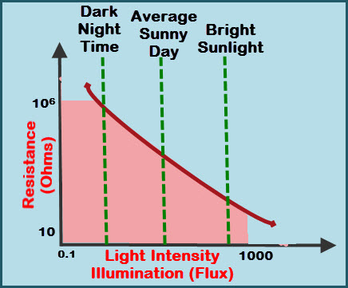
What are photo resistors made of?
A high resistance Semiconductor material called cadmium sulfide cells, highly sensitive to visible and near-infrared light.
How photo resistors work?
As its name suggests, photoresistors work similarly to your regular resistors, but instead resistance change is dependent on the amount of light it’s exposed to.

Slide 15
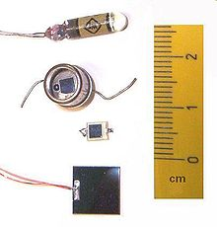
High intensity of light causes a lower resistance between the cadmium sulfide cell
The low intensity of light results in a higher resistance between the cadmium sulfide cells
This working principle can be seen in applications such as street lamps, wherein the day, the higher light intensity results in lower resistance and no light produced.
2. Photodiodes
Photodiodes are another type of light sensor. But instead of using the change in resistance like LDR, it’s more complex to light, easily changing light into a flow of electric currents.
Also known as a photodetector, photo sensor

Slide 16
What are photodiodes made of?
Photodiodes are mainly made from silicon and germanium materials and comprise of optical filters, built-in lenses and surface areas.
How photodiodes work?
Photodiodes work on the working principle called the inner photoelectric effect. To simply put it, when a beam of light hits, electrons are loosened, causing electron-holes which results in electrical current to flow through.
The brighter the light present, the stronger the electrical current will be.

Slide 17
Photodiode light sensor applications
Since current generated by photodiodes are directly proportional to the intensity of light, it makes it favorable for light sensing that requires fast light response changes.
Since photodiodes are responsive to infrared light, it’s applicable for more usages as well.
Here are some of the applications of photodiode:
Consumer electronics ranging from compact disc players to smoke detectors and even remote control devices
Medical applications such as equipment/instruments used for measuring and analysis purposes
Solar energy systems such as solar panels

Slide 18
3. Phototransistors
The last light sensor type we’ll be exploring today is the phototransistor. The phototransistor light sensor can be described as a photodiode + amplifier. With the added amplification, light sensitivity is far better on the phototransistors.
However, it doesn’t fair better in low light level detection as compared to photodiodes.
Since both light sensor types share a similar working principle, do refer to the previous explanation!

Slide 19

What is a light sensor used for? Applications
Despite the different types of light sensors, it can still be used in a variety of applications as seen below:
Consumer electronics
Ever wonder what’s behind your Smartphone
and tablets that allow for auto screen brightness
adjustments? Yes, it’s an ambient light sensor!
It measures the ambient light level of your
surroundings and determines the suitable brightness of your screen!

Slide 20
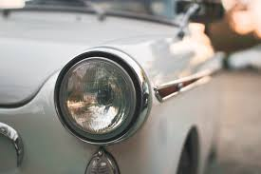
Automobiles
Similarly to how light sensor works on your Smartphone’s, it is used in automobiles to support the drivers’ field of vision. The present light sensor detects surrounding ambient light, and if it’s getting too dark, it’ll automatically turn on light systems!

Slide 21
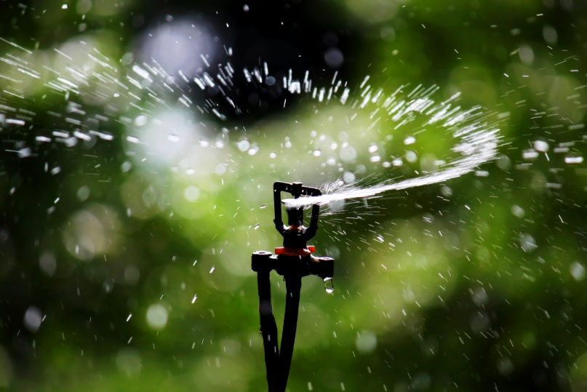
Agricultural Usages
We all know crops need mainly two things for growth; Sunlight and water. This is where a light sensor comes to play; helping farmers keep their crops hydrated yet not over-hydrating it. Here’s how:
A light sensor is connected to a sprinkler system, detecting levels of sunlight and only activating it when the sun isn’t at its brightest
It is used alongside other temperature sensors to help gather informative data as well

Slide 22

Security applications
Commonly used in circuits for shipment cargos, light sensors are connected to circuits and placed inside as it can detect whenever a container is open due to the change in light exposure. This helps in better processing of lost goods and tracking of personnel.
As such, photo resistors are commonly used due to its suitability

Slide 23
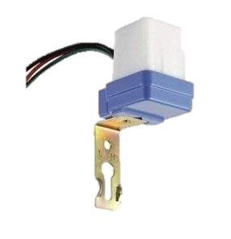
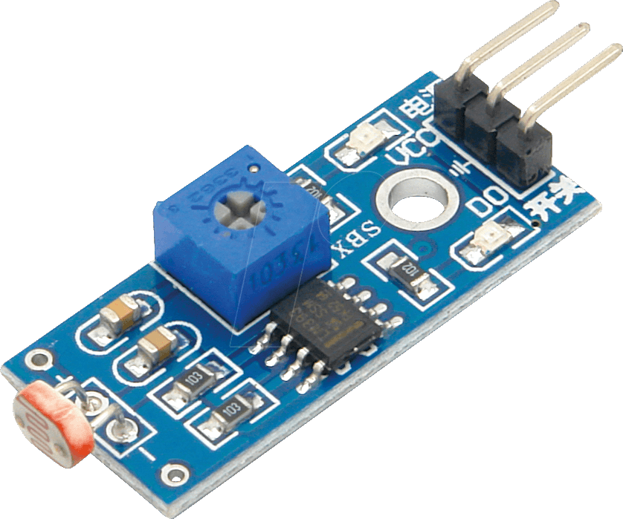
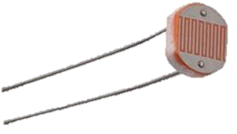
Images of light sensors

Slide 24

THANK YOU

