Slide 1
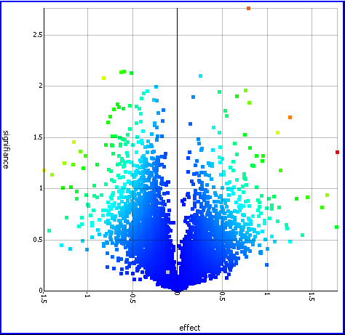
Microarray Data Analysis
March 2004

Slide 2
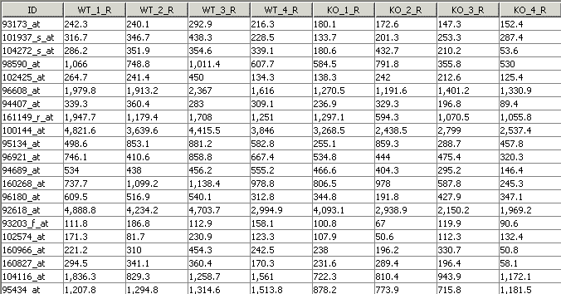
Differential Gene Expression Analysis
The Experiment
  Micro-array experiment measures gene expression in Rats (>5000 genes).
  The Rats split into two groups: (WT: Wild-Type Rat, KO: Knock Out Treatment Rat)
  Each group measured under similar conditions
  Question: Which genes are affected by the treatment? How significant is the effect? How big is the effect?

Slide 3
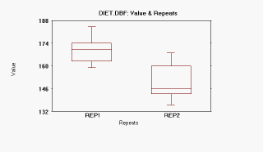
Analysis Workflow
For each gene compare the value of the effect between population WT vs. KO
(fold change)
For each gene calculate the significance of the change
(t-test, p-value)
Identify Genes with high effect and high significance
Volcano Plot
High
Significance
Low
Significance
-ve effect
+ve effect
Fold change:
1 fold change: effect is double
2 fold change: effect is 4 times
n fold change: 2
The lower the p-value the higher significance (confidence)
p=0.001, p=0.01, p=0.001
The more decimal places the more confident I am
n

Slide 4
Hypothesis Testing
Uses hypothesis testing methodology.
For each Gene (>5,000)
  Pose Null Hypothesis (Ho) that gene is not affected
  Pose Alternative Hypothesis (Ha) that gene is affected
  Use statistical techniques to calculate the probability of rejecting the hypothesis (p-value)
  If p-value < some critical value reject Ho and Accept Ha
The issues:
  Estimation of Variance : Limited sample size (= few replicates)
  Normal Distribution assumptions: Law of large number does not apply
  Multiple Testing: ~10 000 genes per experiments
  Need to use a t-test

Slide 5
Statistics 101
Comparing Two Independent Samples
  z Test for the Difference in Two Means (variance known)
  t Test for Difference in Two Means (variance unknown)
F Test for Difference in two Variances
Comparing Two Related Samples:
  t Tests for the Mean Difference
Wilcoxon Rank-Sum Test:
  Difference in Two Medians

Slide 6
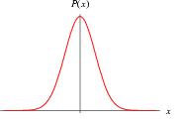

The Normal Distribution
Many continuous variables follow a normal distribution, and it plays a special role in the statistical tests we are interested in;
The x-axis represents the values of a particular variable
The y-axis represents the proportion of members of the population that have each value of the variable
The area under the curve represents probability – e.g. area under the curve between two values on the x-axis represents the probability of an individual having a value in that range
68% of dist.
1 s.d.
1 s.d.
x
Mean and standard deviation tell you the basic features of a distribution
mean = average value of all members of the group
standard deviation = a measure of how much the values of individual members vary in relation to the mean
The normal distribution is symmetrical about the mean
68% of the normal distribution lies within 1 s.d. of the mean

Slide 7
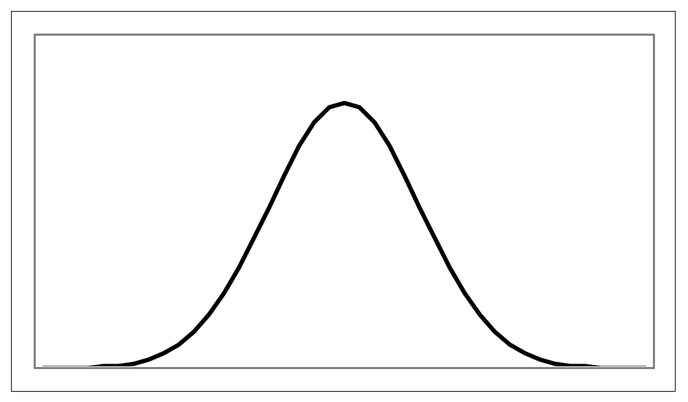
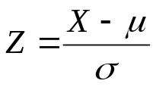
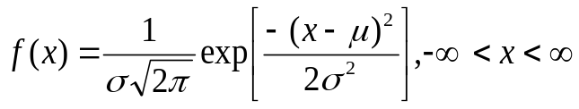
Normal Distribution and Confidence Intervals
Pdf is:
Any normal distribution can be transformed to a standard distribution
(mean 0, s.d. = 1)
using a simple transform
α/2 = 0.025
α/2 = 0.025
1-α = 0.95
-1.96
1.96
0.025 = p-value: probability of a measurement value not belonging to this distribution

Slide 8
Hypothesis Testing: Two Sample Tests
TEST FOR EQUAL MEANS
TEST FOR EQUAL VARIANCES
H_{o}
H_{o}
Population 1
Population 1
Population 2
Population 2
H_{a}
H_{a}
Population 1
Population 1
Population 2
Population 2
If standard deviation known use z test, else use t-test
Use f-test

Slide 9
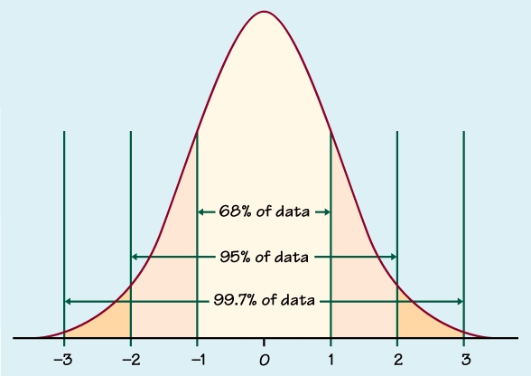
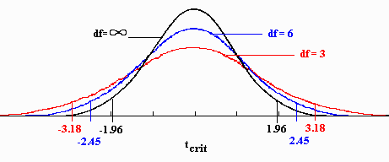
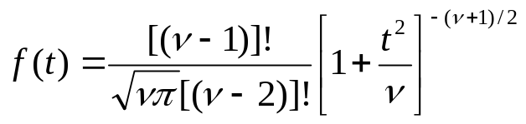
Normal Distribution vs T-distribution
t-test is based on t distribution (z-test was based on normal distribution)
Difference between normal distribution and t-distribution
Normal distribution
t-distribution

Slide 10
T-test
t-test: Single Sample vs. Multi-Sample
Multi Sample: Independent Groups vs. Paired
  Are measurements in the two groups related?
What am I testing for:
  Right Tail: (group1 > group2)
  Left Tail: (group1 < group2)
  Two Tail: Both groups are different but I don’t care how
How do I calculate p value for a t-test
  Use Computer Software
  Statistics Tables:
    calculate t-statistic (easy formula)
    then lookup p-value in table (don’t use formula to calculate !)

Slide 11
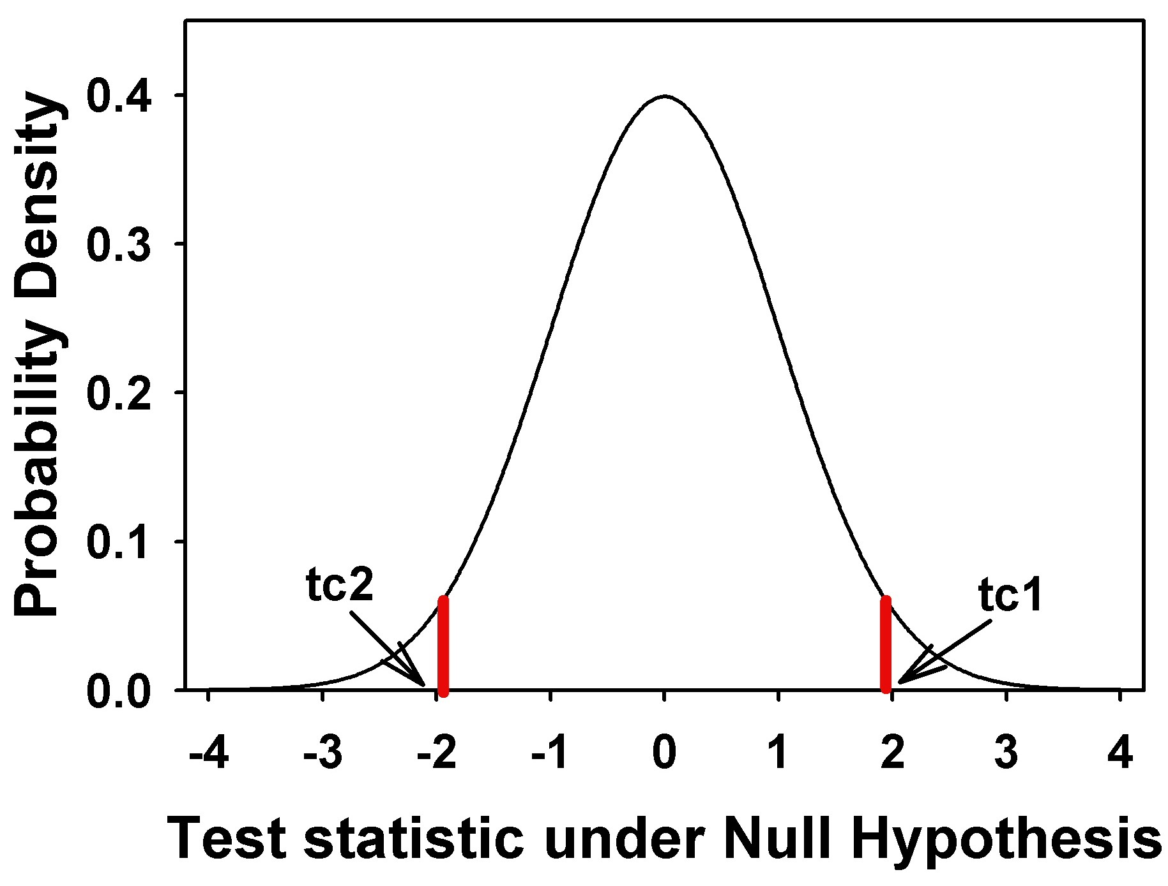
Single Sample t-test
t-test: Used to compare the mean of a sample to a known number (often 0).
Assumptions: Subjects are randomly drawn from a population and the distribution of the mean being tested is normal.
Test: The hypotheses for a single sample t-test are:
  H_{o}: u = u₀
  H_{a}: u < > u₀
p-value: probability of error in rejecting the hypothesis of no difference between the two groups.
(where u₀ denotes the hypothesized value to which you are comparing a population mean)

Slide 12
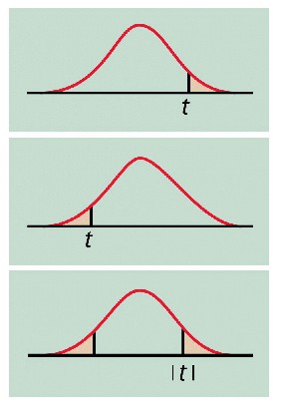
Multi-Sample: Setting Up the Hypothesis
H₀: μ ₁ ≤ μ ₂
H₁: μ ₁ > μ ₂
H₀: μ ₁ - μ ₂ ≤ 0
H₁: μ ₁ - μ ₂ > 0
OR
Right Tail
H₀: μ ₁ ≥ μ ₂
H₀: μ ₁ - μ ₂ ≥ 0 H₁: μ ₁ - μ ₂ < 0
OR
Left Tail
H₁: μ ₁ < μ ₂
H₀: μ ₁ = μ ₂ H₁: μ ₁ ≠ μ ₂
H₀: μ ₁ -μ ₂ = 0 H₁: μ ₁ - μ ₂ ≠ 0
Two Tail
OR

Slide 13
Independent Group t-test
Independent Group t-test: Used to compare the means of two independent groups.
Assumptions: Subjects are randomly assigned to one of two groups. The distribution of the means being compared are normal with equal variances.
Example: Test scores between a group of patients who have been given a certain medicine and the other, in which patients have received a placebo
Test: The hypotheses for the comparison of two independent groups are:
  H_{o}: u₁ = u₂ (means of the two groups are equal)
  H_{a}: u₁ <> u₂ (means of the two group are not equal)
A low p-value for this test (less than 0.05 for example) means that there is evidence to reject the null hypothesis in favour of the alternative hypothesis.

Slide 14
Paired t-test
Paired t-test:
  Most commonly used to evaluate the difference in means between two groups.
  Used to compare means on the same or related subject over time or in differing circumstances.
  Compares the differences in mean and variance between two data sets
Assumptions: The observed data are from the same subject or from a matched subject and are drawn from a population with a normal distribution.
Can work with very small values.

Slide 15
Paired t-test
Characteristics: Subjects are often tested in a before-after situation (across time, with some intervention occurring such as a diet), or subjects are paired such as with twins, or with subject as alike as possible.
Test: The paired t-test is actually a test that the differences between the two observations is 0. So, if D represents the difference between observations, the hypotheses are:
  H_{o}: D = 0 (the difference between the two observations is 0)
  H_{a}: D 0 (the difference is not 0)

Slide 16
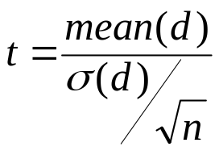

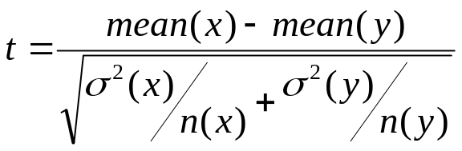
Calculating t-test (t statistic)
First calculate t statistic value and then calculate p value
For the paired student’s t-test, t is calculated using the following formula:
And n is the number of pairs being tested.
For an unpaired (independent group) student’s t-test, the following formula is used:
Where σ (x) is the standard deviation of x and n (x) is the number of elements in x.
Where d is calculated by

Slide 17



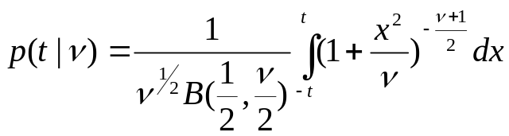
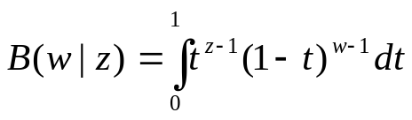
Calculating t-test (p value)
When carrying out a test, a P-value can be calculated based on the t-value and the ‘Degrees of freedom’.
There are three methods for calculating P:
  One Tailed >:
  One Tailed <:
  Two Tailed:
  Where P is calculated in the following way:
The number of degrees (v) of freedom is calculated as:
  UnPaired: n (x) +n (y) -2
  Paired: n- 1
where n is the number of pairs. This value should normally be greater than 1.
where B is the beta function:

Slide 18
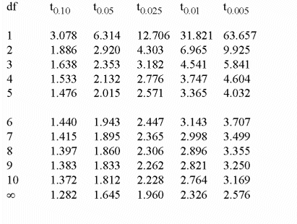
Calculating t and p values
You will usually use a piece of software to calculate t and P
  (Excel provides that !).
You may calculate t yourself it is easy !
You are not required to know the equations for p:
  You can assume access to a function p(t,v) which calculates p for a given t value and v (number of degrees of freedom)
  or alternatively have a table indexed by t and v

Slide 19
t-test Interpretation
Results of the t-test: If the p-value associated with the t-test is small (usually set at p < 0.05), there is evidence to reject the null hypothesis in favour of the alternative.
In other words, there is evidence that the mean is significantly different than the hypothesized value. If the p-value associated with the t-test is not small (p > 0.05), there is not enough evidence to reject the null hypothesis, and you conclude that there is evidence that the mean is not different from the hypothesized value.
Reject H
Reject H
0
0
.025
.025
-2.0154
0
2.0154
t
Note as t increases, p decreases
T (value) must > t (critical on table) by P level

Slide 20
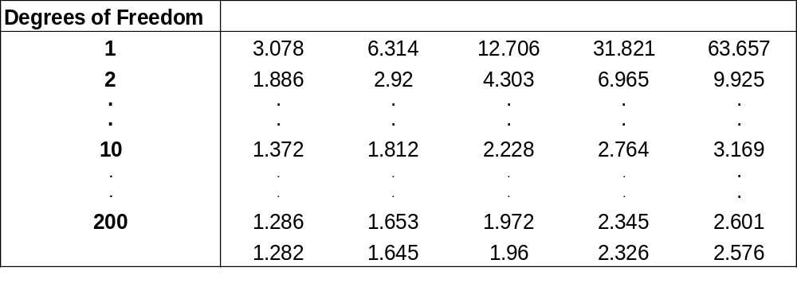

Using the t Table
The table provides the t values (t_{c}) for which P(t_{x} > t_{c}) = A
A
= .05
A
= .05
The t distribution is
symmetrical around 0
-t_{c}
=-1.812
t_{c}
=1.812
t_{.100}
t_{.05}
t_{.025}
t_{.01}
t_{.005}

Slide 21
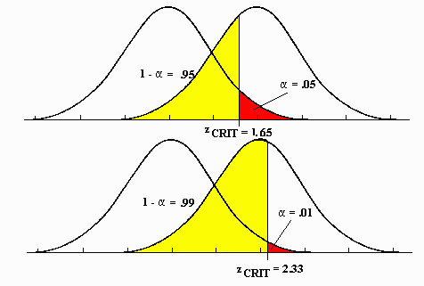
Graphical Interpretation
The graphical comparison allows you to visually see the distribution of the two groups. If the p-value is low, chances are there will be little overlap between the two distributions. If the p-value is not low, there will be a fair amount of overlap between the two groups. There are a number of options available in the comparison graph to allow you to examine the two groups. These include box plots, means, medians, and error bars.
You can do that using the t distribution curves
Or using box and whiskers graphs, error bars, etc

Slide 22
Back to the Gene Expression problems
The Experiment
  Micro-array experiment measures gene expression in Rats (>5000 genes).
  The Rats split into two groups: (WT: Wild-Type Rat, KO: Knock Out Treatment Rat)
  Each group measured under similar conditions
  Question: Which genes are affected by the treatment? How significant is the effect? How big is the effect?
5000 red groups
5000 blue groups

Slide 23
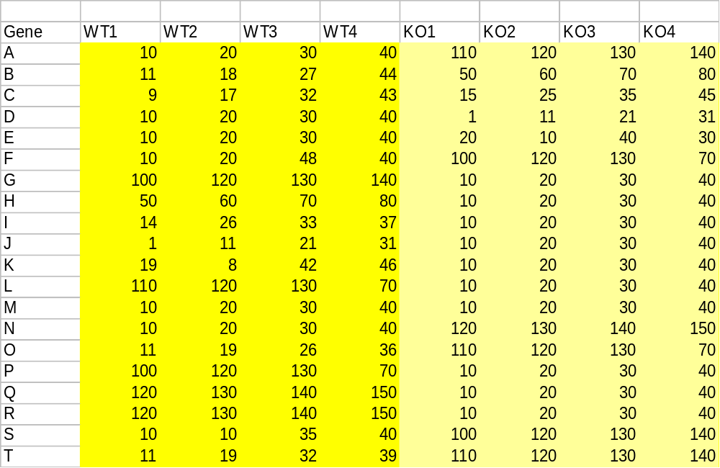
Calculating and Interpreting Significance
Consider the following examples, and assume a paired experiment:

Slide 24
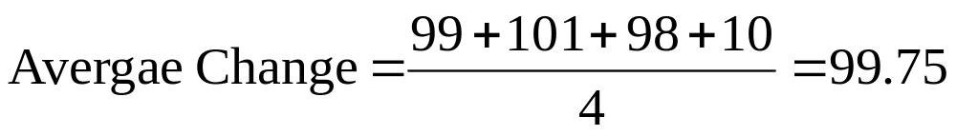
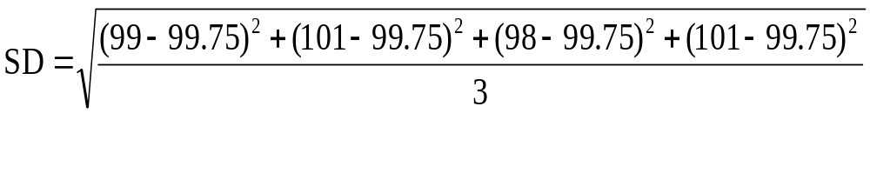
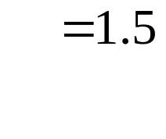
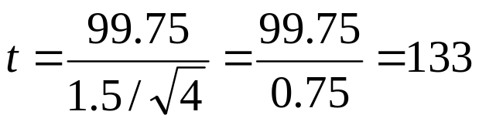
Consider Gene T for a paired experiment
For a paired test
  KO1 – WT1 =110 - 11 = 99
  KO2 – WT2 =120 - 19= 101
  KO3 – WT3 =130 - 32 = 98
  KO4 – WT4 =140 - 39 = 101
Paired Experiment, v = N-1=3,
p(v,t) = p(3,133) = 0.000000937 (6 zeros)
Where d is calculated by

Slide 25
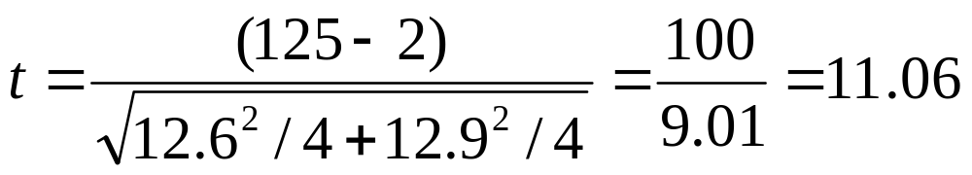
Consider Gene T for unpaired experiment
For unpaired experiment
Average WT=25 S.D.=12.6
Average (KO)=125 S.D. = 12.9
UnPaired Experiment, v = N1+N2-2=6
p(v,t) = p(6,11.06) = 0.0000325818 (5 zeros)

Slide 26
High Effect High Significance
Genes A, N, H, Q, R show both high effect and high significance
Take Gene A, assuming paired test:
For Either Test Average Difference is = 100, SD. = 0
t value is near infinity,
p is extremely low in paired case, but only very low (5 zeros in unpaired, Why ?

Slide 27
Consider other genes
Gene U:
  Small Change (for pairs = average change =9.25)
  Good significance (paired p = 0.024, unpaired p = 0.077)
Gene I:
  KO1 – WT1 = 10 - 14 = -4
  KO2 – WT2 = 20 - 26= -6
  KO3 – WT3 = 30 - 33 = -3
  KO4 – WT4 = 40 -37 = +3
  Small Change= (for pairs, average change = -2.5)
  But low significance mainly because not all change in same direction

Slide 28
Interpretation of t-test (Paired)
t-value = Signal/Noise ratio
t = Mean of differences
S.D. of differences
Value
Value
d₄
d₄
d₂
d₃
d₁
d₂
d₃
d =Diff
Sample ID
d =Diff
Sample ID
d_{avg}
d_{avg}
Sample ID
Case1: Low Variation around mean of differences
Sample ID
Case2: Moderate Variation around mean of differences

Slide 29
Interpretation of t-test (Paired)
Value
d₄
d₁
d₂
d₃
d =Diff
Sample ID
d_{avg}
Sample ID
Case3: Large Variation around mean of differences

Slide 30
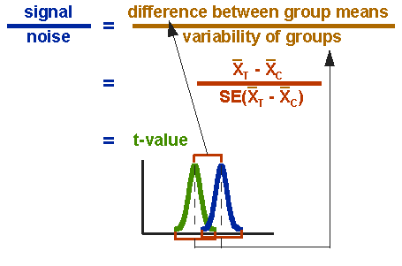

Interpretation of t-test again (Unpaired)
Unpaired:
The top part of the formula is easy to compute -- just find the difference between the means. The bottom part is called the standard error of the difference. To compute it, we take the variance for each group and divide it by the number of people in that group. We add these two values and then take their square root.

Slide 31
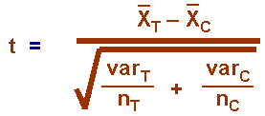
t-value
The t-value will be positive if the first mean is larger than the second and negative if it is smaller.
Once you compute the t-value you have to look it up in a table of significance to test whether the ratio is large enough to say that the difference between the groups is not likely to have been a chance finding.
To test the significance, you need to set a risk level (called the alpha level). The "rule of thumb" is to set the alpha level at .05.
This means that five times out of a hundred you would find a statistically significant difference between the means even if there was none (i.e., by "chance").

Slide 32
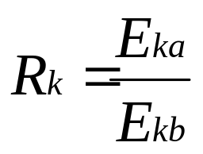
Expression Ratios
In Differential Gene Expression Analysis, we are interested in identifying genes with different expression across two states, e.g.:
  Tumour cell lines vs. Normal Cell Lines
  Different tissues, same organism
  Same tissue, different organisms
  Same tissue, same organism
  Time course experiments
We can quantify the difference (effect) by taking a ratio
I.e. for gene k, this is the ratio between expression in state a compared to expression in state b
  This provides a relative value of change (e.g. expression has doubled)
  If expression level has not changed ratio is 1

Slide 33
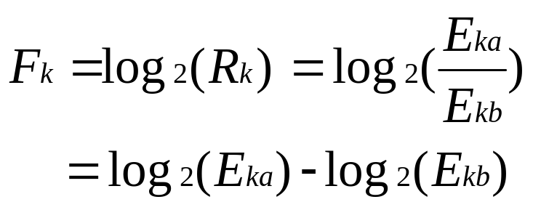
Fold Change
Ratios are troublesome since
  Up-regulated & Down-regulated genes treated differently
    Genes up-regulated by a factor of 2 have a ratio of 2
    Genes down-regulated by same factor (2) have a ratio of 0.5
  As a result
    down regulated genes are compressed between 1 and 0
    up-regulated genes expand between 1 and infinity
Using a logarithmic transform to the base 2 rectifies problem, this is typically known as the fold change

Slide 34
Examples of Fold Change
Gene ID | Expression in state 1 | Expression in state 2 | Ratio | Fold Change
A | 100 | 50 | 2 | 1
B | 10 | 5 | 2 | 1
C | 5 | 10 | 0.5 | -1
D | 200 | 1 | 200 | 7.65
E | 10 | 10 | 1 | 0
You can calculate Fold change between pairs of expression values:
e.g. Between paired measurements (Paired)
  (WT1 vs KO1), (WT2 vs KO2), ….
Or Between mean values of all measurements (Unpaired)
  mean(WT1..WT4) vs mean (KO1..KO4)

Slide 35
Calculating Effect (Fold Change)
Unpaired Test: Calculate difference between mean values
When calculating t-value for each row
Calculate Effect as:
Effect = log(WT) – log(KO)
2
2
Effect = log(WT / KO)
2
If WT = WO, Effect Fold Change = 0
If WT = 2 WO, Effect Fold Change = 1
...
Calculate Significance as – log (p_value)
10
If p = 0.1, -log(0.1) = 1 (1 decimal point)
If p = 0.01, -log (0.01) = 2 (2 decimal points)
...

Slide 36
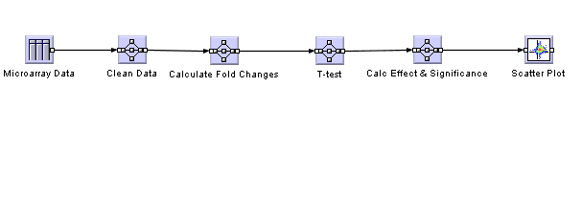
A Data Analysis Pipeline
To find genes that differ in their behaviour between the two classes the pipeline consists of a T-Test for each gene between the two different classes. The results of the T-Test are connected to the original table providing a P-Value that represents the similarity between the two classes.

Slide 37
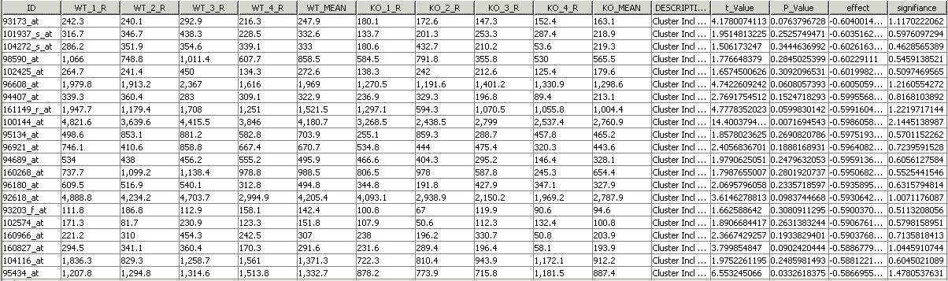
The Final Table
Two more nodes are used. The first to derive a value for effect the difference of the logged mean values of expression for each class. The second is to transform the P-Value on to a log scale to give a measure of significance
Effect = log(WT) – log(KO)
Significance = - log(p)
2
2

Slide 38
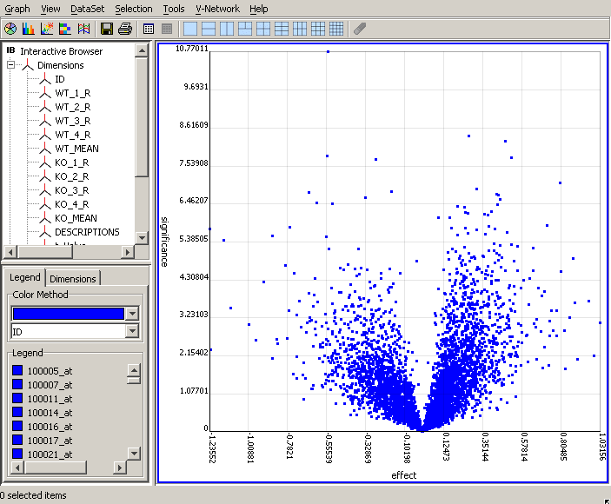
Visualise the Result :Volcano Plot
Effect vs. Significance
Selections of items that have both a large effect and are highly significant can be identified easily.
High Significance
Choosing log scales is a matter of convenience
Effect can be both +ve or -ve
High Effect & Significance
Boring stuff
Low
Significance
-ve effect
+ve effect

Slide 39
Numerical Interpretation (Significance)
Using log₁₀ for Y axis:
p< 0.01
(2 decimal places)
p< 0.1
(1 decimal place)
Using log₂ for X axis:

Slide 40
Numerical Interpretation (Effect)
Using log₁₀ for Y axis:
Effect has doubled
2¹ (2 raised to the power of 1)
Two Fold Change
Effect has halved
2^{0.5} (2 raised to the power of 0.5)
Fold Change=
Technical Jargon for comparing gene expression values
Using log₂ for X axis:

Slide 41
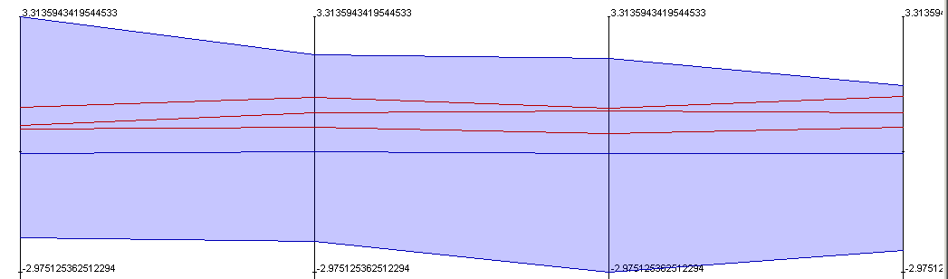
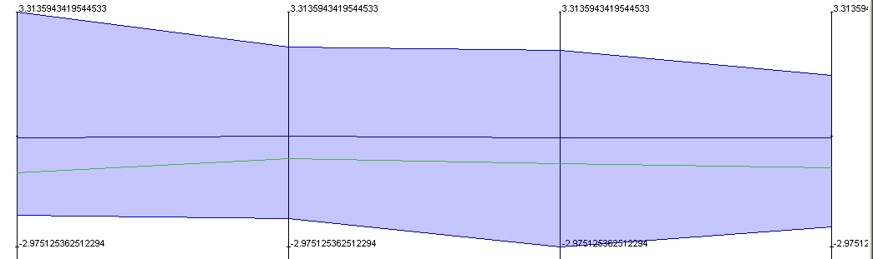
Interpretation of (Paired) t-test
0
fc1
fc2
fc3
fc4
The graph above plots the fold change for each measurement (WT1 vs KO1, WT2 vs KO2, WT3 vs KO2) for the red points
Notice all individual fold changes +ve and high,
Also notice variation in value is small
The graph to the right the fold change for each measurement (WT1 vs KO1, WT2 vs KO2, WT3 vs KO2) for the green point
Notice all individual fold changes -ve and high,
Also notice variation in value is small
0
fc1
fc2
fc3
fc4

Slide 42
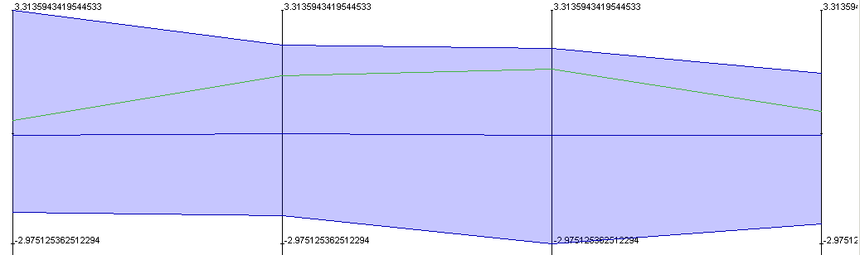
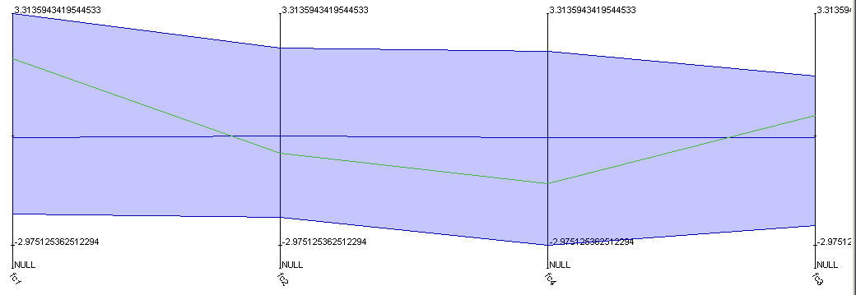
Interpretation of (Paired) t-test
0
fc1
fc2
fc3
fc4
The graph above plots the fold change for each measurement (WT1 vs KO1, WT2 vs KO2, WT3 vs KO2) for the chosen point
Notice all individual fold changes +ve and high, Also notice variation in value is large
The graph to the right plots the fold change for each measurement (WT1 vs KO1, WT2 vs KO2, WT3 vs KO2) for the chosen point
Notice all individual fold changes are both +ve and -ve and high, also notice variation in value is high
0
fc1
fc2
fc3
fc4

Slide 43
Summary
t-Test good for small samples (in our case 4 paired observations)
  t distribution approximates to normal distribution when degrees of freedom > 30
Data Analysis Pipeline suited for repetitive tasks, some task, visual representation intuitive
Volcano plot good for large sets of such observations

