Slide 1
Computational Gene Finding using HMMs
Nagiza F. Samatova
Computational Biology Institute
Oak Ridge National Laboratory
samatovan@ornl.gov

Slide 2
Outline
Gene Finding Problem
Simple Markov Models
Hidden Markov Models
Viterbi Algorithm
Parameter Estimation
GENSCAN
Performance Evaluation
Notes:
Gene Finding Problem
CpG problem as an example
Markov Model for CpG problem
Formal definition of Markov model
Hidden Markov Model for CpG problem
Formal definition of HMMs
Parameter Estimation
Topology Design
Viterbi Algorithm
HMM-based Gene Finding Approaches (GENSCAN, FGENESH, VEIL, HMMgene)
GENESCAN
Performance Evaluation

Slide 3
Gene Finding Problem
General task:
  to identify coding and non-coding regions from DNA
  Functional elements of most interest: promoters, splice sites, exons, introns, etc.
Classification task:
  Gene finding is a classification task:
    Observations: nucleotides
    Classes: labels of functional elements
Computational techniques:
  Neural networks
  Discriminant analysis
  Decision trees
  Hidden Markov Models (HMMs) Focus of today’s lecture
Notes:
As you were told before, the general task of gene finding is to identify coding and non-coding regions from stretches of DNA.
Of most interest are functional units such as:
Promoters
Splice Sites
Exons
Introns

Slide 4
General Complications
Not all organisms use the same genetic code:
  But computational methods are usually “tuned” for some set of organisms
Overlapping genes (esp., in viruses):
  Genes encoded in different reading fames on the same or on the complementary DNA
Prokaryotic vs. Eukaryotic genes
Notes:
The problem is very difficult. And in spite of the fact that the first papers on computational gene finding appeared more than 10 years ago, this area is still very active

Slide 5
Prokaryotic vs. Eukaryotic Genes
Prokaryotes
  small genomes
  high gene density
  no introns (or splicing)
  no RNA processing
  similar promoters
  terminators important
  overlapping genes
Eukaryotes
  large genomes
  low gene density
  introns (splicing)
  RNA processing
  heterogeneous promoters
  terminators not important
  polyadenylation

Slide 6
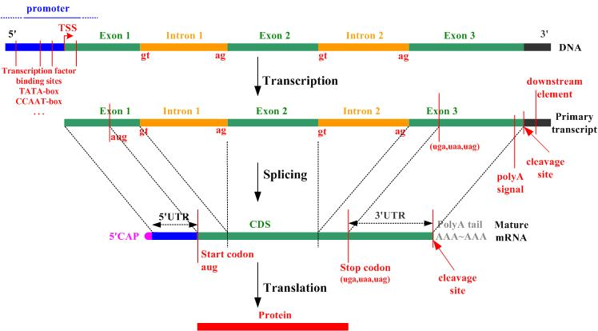
The Biological Model
Eukaryotic Gene Structure
Notes:
promoters – transcription factor binding
• start codons – begin translation
• stop codons – end translation
• intron splice sites
– donor sites
– acceptor sites
• polyadenylation signals
More on Intron Splice Sites
•GT-AG rule: splicing occurs between a
GU site at 5’ end of intron and an AG
site at the 3’ end
• there are usually many GT and AG
sequences within an intron that are not
used as splice sites
• how are correct splice sites recognized?
Pr(AG) = Pr(GT) = 1/16

Slide 7
Example: CpG islands
Notation:
  C-G – denotes the C-G base pair across the two DNA strands
  CpG – denotes the dinucleotide CG
Methylation process in the human genome:
  Very high chance of methyl-C mutating to T in CpG => CpG dinucleotides are much rarer
  BUT it is suppressed around the promoters of many genes => CpG dinucleotides are much more than elsewhere
    Such regions are called CpG islands
    A few hundred to a few thousand bases long
Problems:
  Given a short sequence, does it come from a CpG island or not?
  How to find the CpG islands in a long sequence
Notes:
As you can see the problem of gene finding is very complex.
Let’s look at a simpler example that I will use to introduce the main concepts behind standard Markov models, then a simple Hidden Markov Model.
In the human DNA wherever the dinucleotide CG occurs, the C nucleotide is typically chemically modified modified by methylation.
There is a high chance of this methyl-C mutating into a T.
As a result, CG dinucleotides are much rarer than would be expected from the independent probabilities of C and G.
However, for biologically important reasons, the methylation process is suppressed in short stretches of DNA, such as around the promoters,
Or ‘start’ regions of many genes.
In these regions we see many more CG dinucleotides than elsewhere. Such regions are called CpG islands. That are typically a few hundred to a few thousand base long.
There are two questions that we consider today:
Let’s start with the first question.

Slide 8
Markov Chain
Definition: A Markov chain is a triplet (Q, {p(x₁ = s)}, A), where:
Q is a finite set of states. Each state corresponds to a symbol in the alphabet Σ
p is the initial state probabilities.
A is the state transition probabilities, denoted by a_{st} for each s, t ∈ Q.
For each s, t ∈ Q the transition probability is: a_{st} ≡ P(x_{i} = t|x_{i-1} = s)
Output: The output of the model is the set of states at each instant time => the set of states are observable
Property: The probability of each symbol x_{i} depends only on the value of the preceding symbol x_{i-1} : P (x_{i} | x_{i-1},…, x₁) = P (x_{i} | x_{i-1})
Formula: The probability of the sequence:
P(x) = P(x_{L},x_{L-1},…, x₁) = P (x_{L} | x_{L-1}) P (x_{L-1} | x_{L-2})… P (x₂ | x₁) P(x₁)
Notes:
Let me first give a formal definition of a Markov Chain model and then show how this simple model can be used to answer these two questions.
Examples:
Markov model of the weather: The weather is observed once a day. States: Rain or snow, Cloudy, Sunny
Go over an example on p. 259 (left column)
Talk about:
the training set
How the transition matrix could have been calculated
How to calculate the probability to have a pattern s-s-r-r-s-c-s
State: the first-order assumption is too simplistic
Joke about the changing weather in Tennessee
Now, let see how we can apply this model to our CpG islands problem

Slide 9
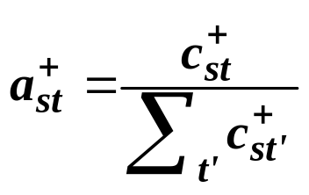
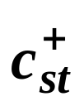
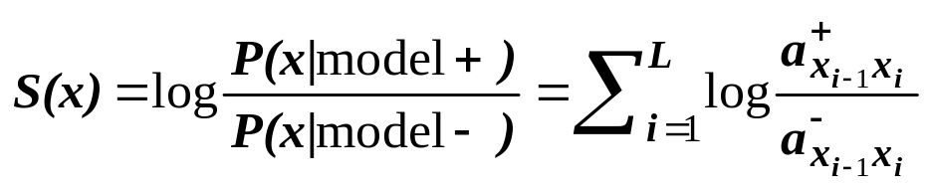
Markov Chains for CpG discrimination
a_{AT}
Training Set:
  set of DNA sequences w/ known CpG islands
Derive two Markov chain models:
  ‘+’ model: from the CpG islands
  ‘-’ model: from the remainder of sequence
Transition probabilities for each model:
To use these models for discrimination, calculate the log-odds ratio:
A
T
a_{AC}
a_{GT}
C
G
a_{GC}
A state for each of the four letters A,C, G, and T in the DNA alphabet
Arrow <-> probability of a residue following another residue
is the number of times letter t followed letter s in the CpG islands
+ | A | C | G | T
A | .180 | .274 | .426 | .120
C | .171 | .368 | .274 | .188
G | .161 | .339 | .375 | .125
T | .079 | .355 | .384 | .182
Notes:
Let’s first look at the Markov chain for DNA.
Set of states are: A,C, T, and G
Probability of certain residue to follow another residue – How we derive them is a separate issue
Then we can calculate the probability that some stretch of DNA sequence was generated by this Markov model.
Give an example for CGCGG

Slide 10
Histogram of log-odds scores
10
5
Non-CpG
CpG islands
0
-0.4 -0.3 -0.2 -0.1 0 0.1 0.2 0.3 0.4
Q1: Given a short sequence x, does it come from CpG island (Yes-No question)?
  S(x)
Q2: Given a long sequence x, how do we find CpG islands in it (Where question)?
  Calculate the log-odds score for a window of, say, 100 nucleotides around every nucleotide, plot it, and predict CpG islands as ones w/ positive values
  Drawbacks: Window size
Notes:
Here is the histogram of length normalized scores of all the sequences for both CpG islands and non-CpG islands

Slide 11
HMM for CpG islands
How do we find CpG islands in a sequence?
A: 1 C: 0 G: 0 T: 0
A: 0 C: 1 G: 0 T: 0
A: 0 C: 0 G: 1 T: 0
A: 0 C: 0 G: 0 T: 1
Build a single model that combines both Markov chains:
  ‘+’ states: A₊, C₊, G₊, T₊
    Emit symbols: A, C, G, T in CpG islands
  ‘-’ states: A₋, C₋, G₋, T₋
    Emit symbols: A, C, G, T in non-islands
If a sequence CGCG is emitted by states (C₊,G₋,C₋,G₊), then:
In general, we DO NOT know the path. How to estimate the path?
A₊
C₊
G₊
T₊
A₋
C₋
G₋
T₋
A: 1 C: 0 G: 0 T: 0
A: 0 C: 1 G: 0 T: 0
A: 0 C: 0 G: 1 T: 0
A: 0 C: 0 G: 0 T: 1
Note: Each set (‘+’ or ‘-’) has an additional set of transitions as in previous Markov chain
Notes:
We would like is to build a single model for the entire sequence that incorporates both Markov chains.
We have two states corresponding to each nucleotide symbol:
A+
A-
The transition probabilities are set so that within each group they are the same as in the Markov models.
But there are small probabilities of switching between the components.
Switch from + to – is more likely than from – to +.
There is not 1-to-1 correspondence between states and symbols. Each state might emit different symbols.
There is no way to say which state emitted symbol xi
Let me give you another example of HMM:
Give example with URNs on p.260 or a kid selecting balls from boxes and busy mom
Let’s give a more formal definition of an HMM

Slide 12
HMM (Hidden Markov Model)
Definition: An HMM is a 5-tuple (Q, V, p, A, E), where:
Q is a finite set of states, |Q|=N
V is a finite set of observation symbols per state, |V|=M
p is the initial state probabilities.
A is the state transition probabilities, denoted by a_{st} for each s, t ∈ Q.
  For each s, t ∈ Q the transition probability is: a_{st} ≡ P(x_{i} = t|x_{i-1} = s)
E is a probability emission matrix, e_{sk} ≡ P (v_{k} at time t | q_{t} = s)
Output: Only emitted symbols are observable by the system but not the underlying random walk between states -> “hidden”
Property: Emissions and transitions are dependent on the current state only and not on the past.

Slide 13
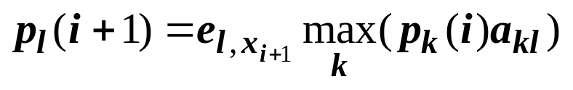
Most Probable State Path: the Viterbi Algorithm for decoding
Notation:
  π – the sequence of states, or the path
  π_{j} – the j-th state in the path
  Decoding – Observation sequence => underlying states
The most probable path (w/ the highest probability):
  π* = argmax_{π} P(x, π) over all possible π (# of paths grows exponentially => brute force approach is impractical)
  Can be found recursively, using dynamic programming (Viterbi algorithm)
  Foundation: any partial subpath ending at a point along the true optimal path must itself be an optimal path leading up to that point. So the optimal path can be found by incremental extensions of optimal subpaths
p_{k}(i) is the probability of the most probable path ending in state k with observation i
Notes:
It is no longer possible to say what state the system is in by looking at the output (observable) symbol.
But we are more interested in the sequence of underlying states that were used to generate an observable sequence of symbols.
The process of identifying the underlying sequence of states, given the sequence of observable symbols is called decoding.
There are different approaches to decoding.
I will describe the most common one, called the Viterbi algorithm. It is a dynamic programming algorithm. The foundation behind
the dynamic programming approach is …

Slide 14

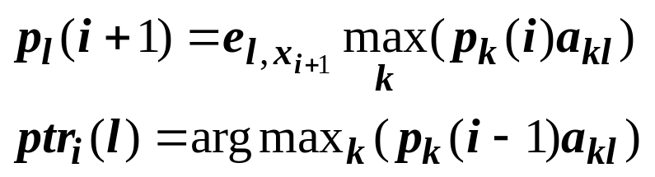
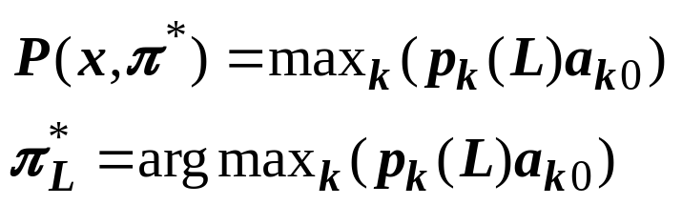
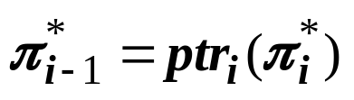
Algorithm: Viterbi
Initialization (i=0):
Recursion (i=1…L):
Termination:
Traceback (i=L…1):
Computational Complexity:
Brute Force: O(N^{L})
Viterbi: O(L*N²)
N – number of states, |Q|
L – sequence length, |x|

Slide 15

CpG Example: Viterbi Algorithm
Sequence: CGCG
i
i+1
p |  | C | G | C | G
β | 1 | 0 | 0 | 0 | 0
A₊ | 0 | 0 | 0 | 0 | 0
C₊ | 0 | .13 | 0 | .012 | 0
G₊ | 0 | 0 | .034 | 0 | .0032
T₊ | 0 | 0 | 0 | 0 | 0
A₋ | 0 | 0 | 0 | 0 | 0
C₋ | 0 | .13 | 0 | .0026 | 0
G₋ | 0 | 0 | .01 | 0 | .00021
T₋ | 0 | 0 | 0 | 0 | 0
p_{k} (i)
k
l
.036
+ | A₊ | C₊ | G₊ | T₊
A₊ | .180 | .274 | .426 | .120
C₊ | .171 | .368 | .274 | .188
G₊ | .161 | .339 | .375 | .125
T₊ | .079 | .355 | .384 | .182
p_{l} (i+1)
a_{kl}
Notes:
Thus, for an entire DNA sequence of length L we will be able to find an optimal path. If we follow this path then we switch between the + and – models. These switches will indicate the locations of CpG islands and non-CpG islands.

Slide 16
How to Build an HMM
General Scheme:
  Architecture/topology design
  Learning/Training:
    Training Datasets
    Parameter Estimation
  Recognition/Classification:
    Testing Datasets
    Performance Evaluation

Slide 17
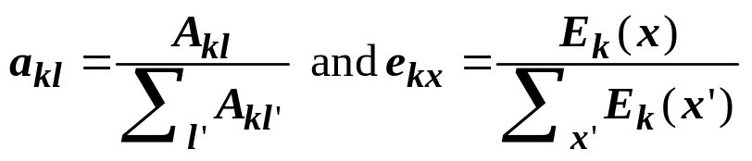
Parameter Estimation for HMMs (Case 1)
Case 1: All the paths/labels in the set of training sequences are known:
  Use the Maximum Likelihood (ML) estimators for:
  Where A_{kl} and E_{k}(x) are the number of times each transition or emission is used in training sequences
  Drawbacks of ML estimators:
    Vulnerable to overfitting if not enough data
    Estimations can be undefined if never used in training set (add pseudocounts to reflect a prior biases about probability values)
Notes:
Analogy with a kid and balls

Slide 18
Parameter Estimation for HMMs (Case 2)
Case 2: The paths/labels in the set of training sequences are UNknown:
  Use Iterative methods (e.g., Baum-Welch):
    Initialize a_{kl} and e_{kx} (e.g., randomly)
    Estimate A_{kl} and E_{k}(x) using current values of a_{kl} and e_{kx}
    Derive new values for a_{kl} and e_{kx}
    Iterate Steps 2-3 until some stopping criterion is met (e.g., change in the total log-likelihood is small)
  Drawbacks of Iterative methods:
    Converge to local optimum
    Sensitive to initial values of a_{kl} and e_{kx} (Step 1)
    Convergence problem is getting worse for large HMMs

Slide 19
HMM Architectural/Topology Design
In general, HMM states and transitions are designed based on the knowledge of the problem under study
Special Class: Explicit State Duration HMMs:
  Self-transition state to itself:
    The probability of staying in the state for d residues:
      p_{i} (d residues) = (a_{ii})^{d-1}(1-a_{ii}) – exponentially decaying
    Exponential state duration density is often inappropriate
      Need to explicitly model duration density in some form
  Specified state density:
    Used in GenScan
a_{ii}
a_{jj}
q_{i}
q_{j}
…
…
p_{i}(d)
p_{j}(d)
q_{i}
q_{j}
Notes:
The probability to rain 7 days in a row. How about to have sunny days 7 days in row if it is summer or winter?

Slide 20
HMM-based Gene Finding
GENSCAN (Burge 1997)
FGENESH (Solovyev 1997)
HMMgene (Krogh 1997)
GENIE (Kulp 1996)
GENMARK (Borodovsky & McIninch 1993)
VEIL (Henderson, Salzberg, & Fasman 1997)

Slide 21
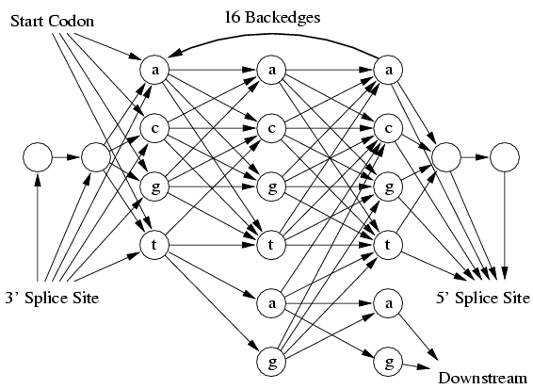
VEIL: Viterbi Exon-Intron Locator
Contains 9 hidden states or features
Each state is a complex internal Markovian model of the feature
Features:
  Exons, introns, intergenic regions, splice sites, etc.
Exon HMM Model
Upstream
Start Codon
3’ Splice Site
Exon
Intron
Stop Codon
5’ Splice Site
Downstream
5’ Poly-A Site
Enter: start codon or intron (3’ Splice Site)
Exit: 5’ Splice site or three stop codons (taa, tag, tga)
VEIL Architecture
Notes:
It can enter the exon model either through the start codon model or through an intron (3’ splice site).
It can be exited through a 5’ splice site or through three possible stop codons
Inside the exon model, nucleotides are grouped into triplets to reflect the codon structure:
transitions between third and first codon positions +. Multiples of three nucleotides are accomodated

Slide 22
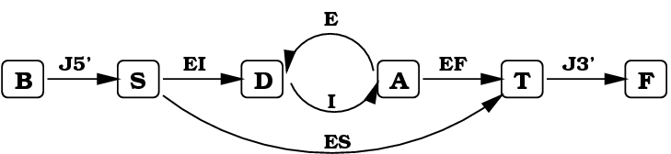
Genie
Uses a generalized HMM (GHMM)
Edges in model are complete HMMs
States can be any arbitrary program
States are actually neural networks specially designed for signal finding
J5’ – 5’ UTR
EI – Initial Exon
E – Exon, Internal Exon
I – Intron
EF – Final Exon
ES – Single Exon
J3’ – 3’UTR
Begin Sequence
Start Translation
Donor splice site
Acceptor splice site
Stop Translation
End Sequence
Notes:
In Genie the signal sensors (splice sites) and content sensors (coding potential) are neural networks.
The output of these networks are interpreted as probabilities.

Slide 23
GenScan Overview
Developed by Chris Burge (Burge 1997), in the research group of Samuel Karlin, Dept of Mathematics, Stanford Univ.
Characteristics:
  Designed to predict complete gene structures
    Introns and exons, Promoter sites, Polyadenylation signals
  Incorporates:
    Descriptions of transcriptional, translational and splicing signal
    Length distributions (Explicit State Duration HMMs)
    Compositional features of exons, introns, intergenic, C+G regions
  Larger predictive scope
    Deal w/ partial and complete genes
    Multiple genes separated by intergenic DNA in a seq
    Consistent sets of genes on either/both DNA strands
Based on a general probabilistic model of genomic sequences composition and gene structure
Notes:
Incorporate descriptions of basic transcriptional, translational and splicing signals, as well as length distributions and compositional features of exons, introns and intergenic regions.
Distinct sets of model parameters are derived to account for the many substantial differences in gene density and structure observed in distinct C+G compositional regions of the human genome.
Moreover, new models of the donor and acceptor splice signals capture potentially important dependencies between signal positions.

Slide 24
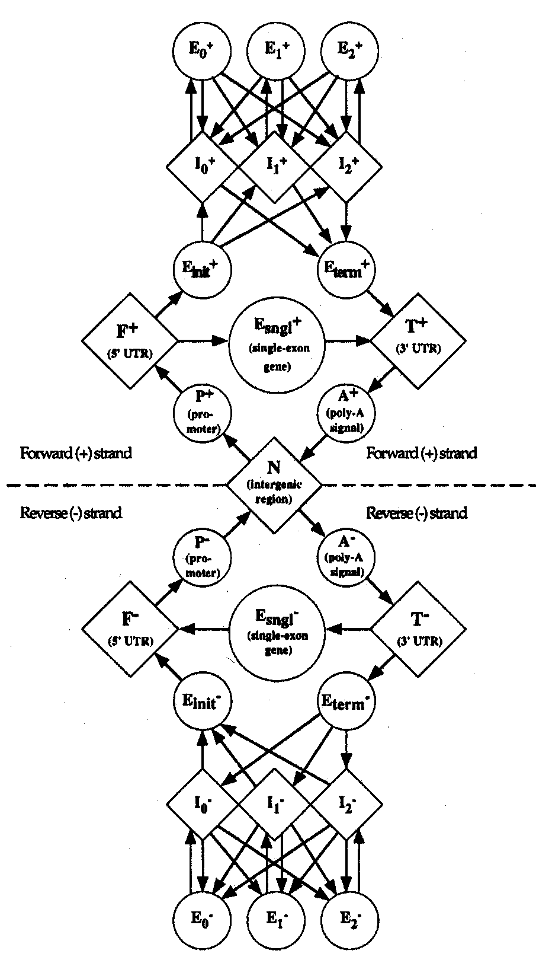
GenScan Architecture
It is based on Generalized HMM (GHMM)
Model both strands at once
  Other models: Predict on one strand first, then on the other strand
  Avoids prediction of overlapping genes on the two strands (rare)
Each state may output a string of symbols (according to some probability distribution).
Explicit intron/exon length modeling
Special sensors for Cap-site and TATA-box
Advanced splice site sensors
Fig. 3, Burge and Karlin 1997
Notes:
In many gene finders, genes are first predicted on one strand, and then on the other rather than modeling both strands simultaneously.
Such construction avoids prediction of overlapping genes on the two strands which is very rare

Slide 25
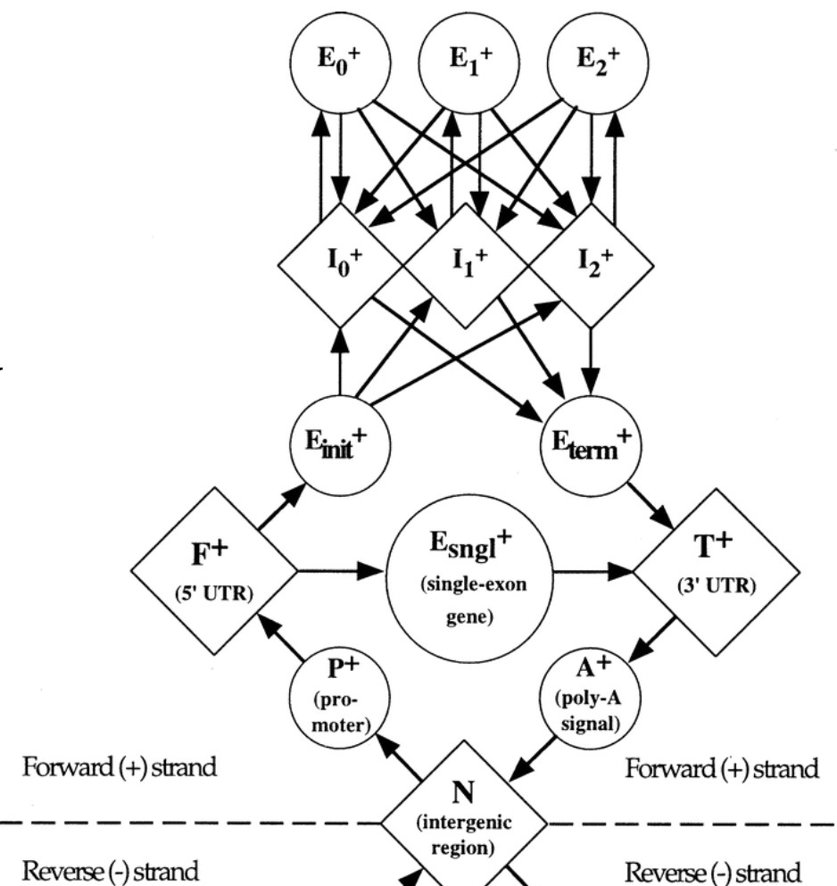
GenScan States
N - intergenic region
P - promoter
F - 5’ untranslated region
E_{sngl} – single exon (intronless) (translation start -> stop codon)
E_{init} – initial exon (translation start -> donor splice site)
E_{k} – phase k internal exon (acceptor splice site -> donor splice site)
E_{term} – terminal exon (acceptor splice site -> stop codon)
I_{k} – phase k intron: 0 – between codons; 1 – after the first base of a codon; 2 – after the second base of a codon

Slide 26





Accuracy Measures
Sensitivity vs. Specificity (adapted from Burset&Guigo 1996)
TP FP TN FN TP FN TN
Actual
Predicted
Actual
Coding / No Coding
TP
FP
Predicted
No Coding / Coding
FN
TN
Sensitivity (Sn) | Fraction of actual coding regions that are correctly predicted as coding
Specificity (Sp) | Fraction of the prediction that is actually correct
Correlation Coefficient (CC) | Combined measure of Sensitivity & Specificity Range: -1 (always wrong) → +1 (always right)
Notes:
Evaluation Statistics
sensitivity: how many does your program predict to be “genes” for all the known genes in your test set
specificity: among the ones your program predicts to be “genes”, how many of them are actually real genes
CC takes into account a possible difference in the sizes of coding and non-coding sets

Slide 27
Test Datasets
Sample Tests reported by Literature
  Test on the set of 570 vertebrate gene seqs (Burset&Guigo 1996) as a standard for comparison of gene finding methods.
  Test on the set of 195 seqs of human, mouse or rat origin (named HMR195) (Rogic 2001).
Notes:
Paper: published by Rogic & Mackworth (2001) Evaluation of gene finding programs. Genome Research, 11: 817-832.
Source Details: 7 common computer programs, used for the identification of protein coding genes in eukaryotic genomic sequences, include:
MZEF (Zhang 1997), HMMgene (krogh 1997), GENSCAN (Burge 1997), FGENES (Solovyev 1997), Genie (Kulp 1996), GeneMark (Borodovsky & McIninch 1993), Morgan (Salzberg 1998a).
Steps: Search the Human Genome DB at NCBI -> Select the specified Dataset -> Input into the Web Implementations of the methods tested respectively -> Analyze the Output

Slide 28
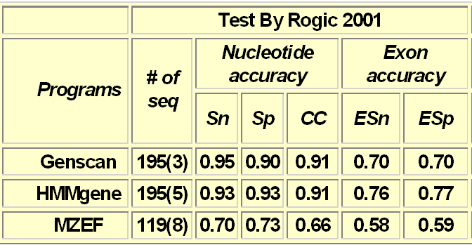
Results: Accuracy Statistics
Table: Relative Performance (adapted from Rogic 2001)
Complicating Factors for Comparison
Gene finders were trained on data that had genes homologous to test seq.
  Percentage of overlap is varied
Some gene finders were able to tune their methods for particular data
Methods continue to be developed
# of seqs - number of seqs effectively analyzed by each program; in parentheses is the number of seqs where the absence of gene was predicted;
Sn -nucleotide level sensitivity; Sp - nucleotide level specificity;
CC - correlation coefficient;
ESn - exon level sensitivity; ESp - exon level specificity
Needed
Train and test methods on the same data.
Do cross-validation (10% leave-out)
Notes:
Comparing gene finders is difficult:
What works best when?
There is an active debate about the relative performance of gene finders.
Burge and Karlin (1998) ignore HMMgene in their comparisons – emphasis is on GeneScan
Stein (2001) discusses operation of GeneScan and ignores HMMgene.
Kraemer et al (2001) find that GeneScan (and their algorithm FFG) are better than HMMgene on fungal DNA.
In a more comprehensive recent comparison Rogic et al (2001) find that HMMgene and GeneScan perform equally well on mammalian data – but with different strengths.

Slide 29
Why not Perfect?
Gene Number
  usually approximately correct, but may not
Organism
  primarily for human/vertebrate seqs; maybe lower accuracy for non-vertebrates. ‘Glimmer’ & ‘GeneMark’ for prokaryotic or yeast seqs
Exon and Feature Type
  Internal exons: predicted more accurately than Initial or Terminal exons;
  Exons: predicted more accurately than Poly-A or Promoter signals
Biases in Test Set (Resulting statistics may not be representative)
  The Burset/Guigó (1996) dataset:
    Biased toward short genes with relatively simple exon/intron structure
  The Rogic (2001) dataset:
    DNA seqs: GenBank r-111.0 (04/1999 <- 08/1997);
    source organism specified;
    consider genomic seqs containing exactly one gene;
    seqs>200kb were discarded; mRNA seqs and seqs containing pseudo genes or alternatively spliced genes were excluded.
Notes:
Gene Number:
The number of genes predicted in a sequence is usually approximately correct but it may also happen that, for instance, a predicted gene splices together exons from two real genes, or vice versa.
Organism:
The program was designed primarily to predict genes in human/vertebrate genomic sequences: accuracy may be lower for non-vertebrates.
For prokaryotic or yeast sequences, the programs ‘Glimmer’ (Salzberg 1998) and/or ‘GeneMark’ (Borodovsky & McIninch 1993) are recommended.
Exon and Feature Type:
As a rule, internal exons are predicted more accurately than initial or terminal exons, and exons are predicted more accurately than polyadenylation or promoter signals. Predicted promoters, in particular, are not reliable. If promoters are of primary interest, you may wish to try Martin Reese's NNPP program.
Biases in Test Set:
the resulting statistics may not be completely representative of the performance of the programs on typical genomic DNA sequences.
The Burset/Guigó dataset:
undoubtedly biased toward short genes with relatively simple exon/intron structure.
The Rogic dataset:
1) DNA sequences extracted from GenBank release 111.0 (April 1999) must be entered after August 1997; 2) the source organism as specified; 3) only genomic sequences containing exactly one gene were considered; 4) mRNA sequences and sequences containing pseudo genes or alternatively spliced genes were excluded; 5) sequences longer than 200kb were discarded because some programs can only accept sequences up to that length.
Future Work
The research group @MIT is currently developing another program, GenomeScan, which is more accurate when a moderate or closely related protein seq is available.

Slide 30
What We Learned…
Genes are complex structures which are difficult to predict with the required level of accuracy/confidence
Different HMM-based approaches have been successfully used to address the gene finding problem:
  Building an architecture of an HMM is the hardest part, it should be biologically sound & easy to interpret
  Parameter estimation can be trapped in local optimum
Viterbi algorithm can be used to find the most probable path/labels
These approaches are still not perfect

Slide 31
Thank You!

