Slide 1

Credit Card Fraud Classification

Slide 2

Data Source
Kaggle: Fraud Detection - Credit Card
Every credit card transaction detail is included in the collection.
In particular, the class column indicates the following: Classes 0 and 1: Non-fraudulent and fraudulent, respectively

Slide 3
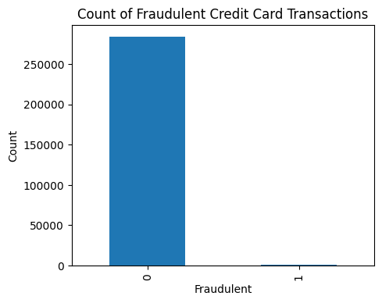
Summarize Data
no of Real Transactions = 284315 and the % of real transactions = 99.827 %
no of fraud Transactions = 492 and the % of fraud transactions = 0.173 %

Slide 4
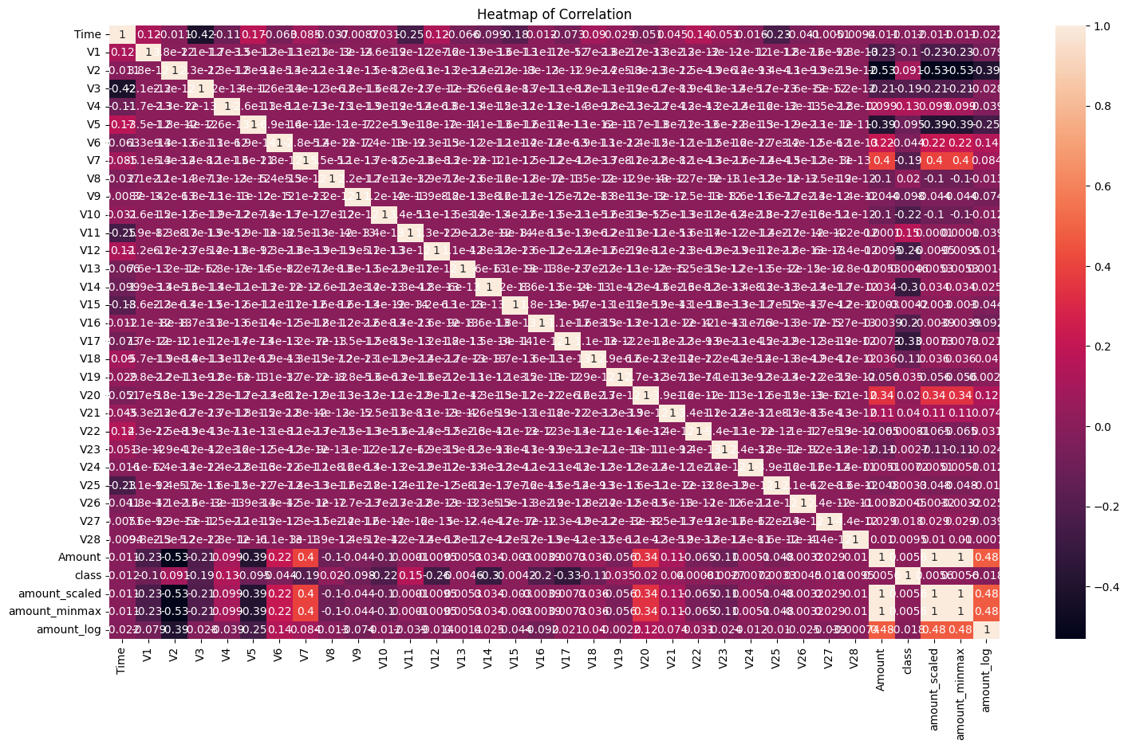
Heatmap

Slide 5
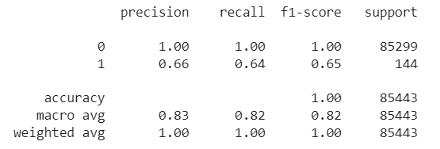
Baseline for model
# Logistic Regression with imbalanced datafrom sklearn.linear_model import LogisticRegressionlogreg = LogisticRegression()logreg.fit(X_train, y_train) LogisticRegression()y_pred = logreg.predict(X_test)#Model Evolutionfrom sklearn import metricsprint(metrics.classification_report(y_test, y_pred))
Accuracy :0.99883 AUC : 0.81916 Precision : 0.65714 Recall : 0.63889 F1 : 0.64789

Slide 6
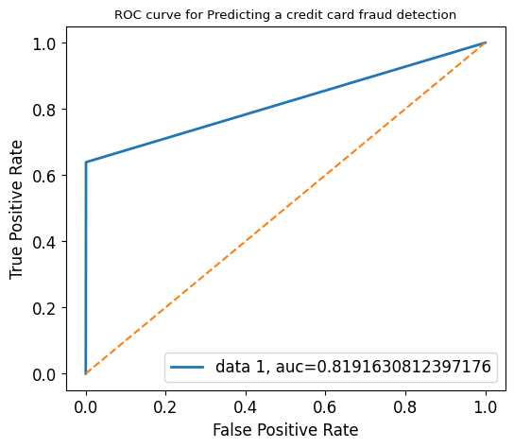
ROC
metrics.roc_auc_score(y_test , y_pred)

Slide 7
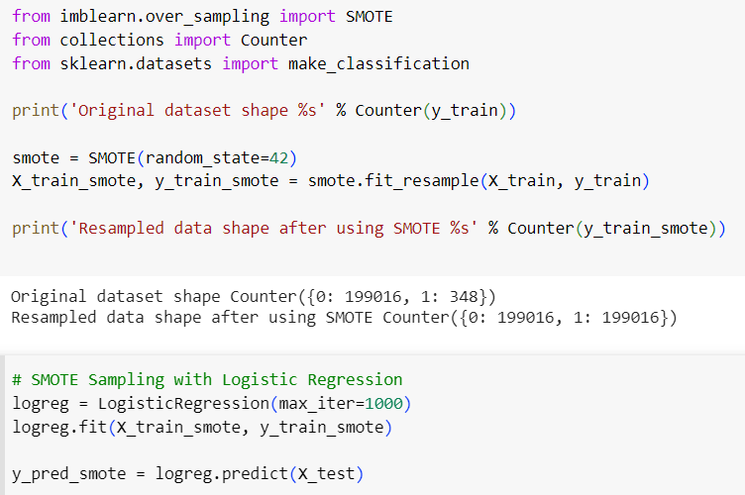
SMOTE
Logistic Regression with SMOTE data
Original dataset shape Counter({0: 199016, 1: 348}) Resampled data shape after using SMOTE Counter({0: 199016, 1: 199016})

Slide 8
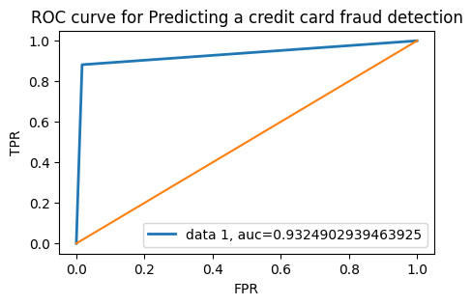
ROC
Accuracy :0.98287 AUC : 0.93249 Precision : 0.08069 Recall : 0.88194 F1 : 0.14785
cnf_matrix
array([[83852, 1447],
[ 17, 127]])

