Slide 1
Towards an Integration between Machine Learning and Neuroscience
Presented by:
Swayanshu Shanti Pragnya

Slide 2
Problem Statement:
Image classification is the task of taking an input image and generating a class or a probability of classes that best describe the image.
Datasets:
1. MNIST Dataset (http://yann.lecun.com/exdb/mnist/)
60,000 training examples, 28 x 28 image
10,000 test examples, 28 x 28 image
2. CIFAR-10 Dataset (https://www.cs.toronto.edu/~kriz/cifar.html)
Consists of 60,000 32x32 color images in 10 classes, with 6,000 images per class. 50,000 training images and 10,000 test images.

Slide 3

Limitations of Backpropagation (BP) in biology
Weight Transport Problem
The same weights are used for forward-pass and backward error propagation. However, synapses are unidirectional.
Linear Feedback Problem
Although the BP feedback path is linear, neurons are not.
Spiking Issue
Neuron spike. BP is defined for rates.
The Target Issue
Most BP applications rely on a large number of examples with predefined labels, but where do those labels come from? (unknown)

Slide 4
Method(s):
Machine learning algorithms:
SVM, KNN, t-SNE (different perplexities)
Feedback alignment algorithm (from scratch)
CNN (inspired by the biological visual system)
Spiking neural network in Nengo Loihi,
Tuning curves (to explore the activities of neuron while classifying results)

Slide 5
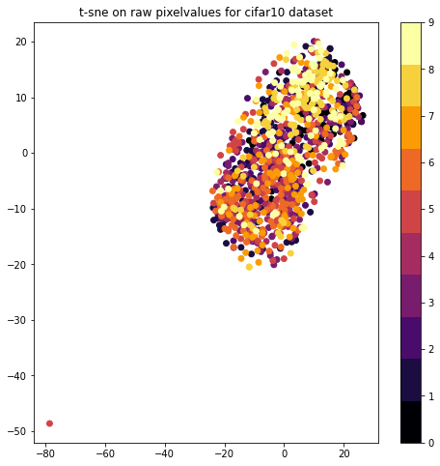
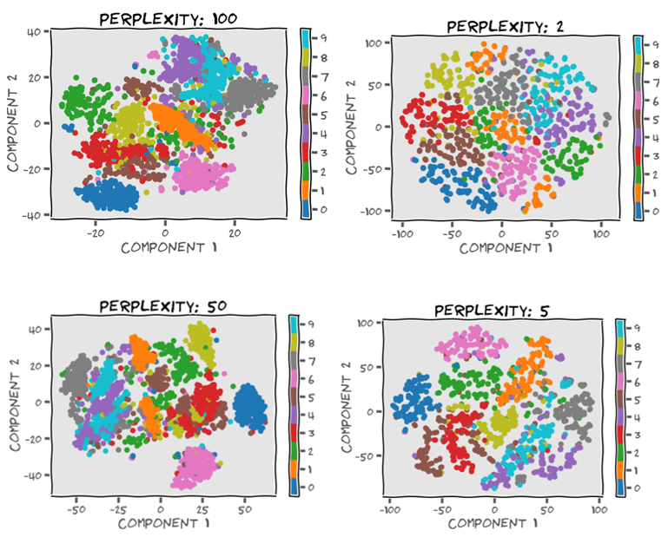
T-SNE
T-SNE on MNIST

Slide 6
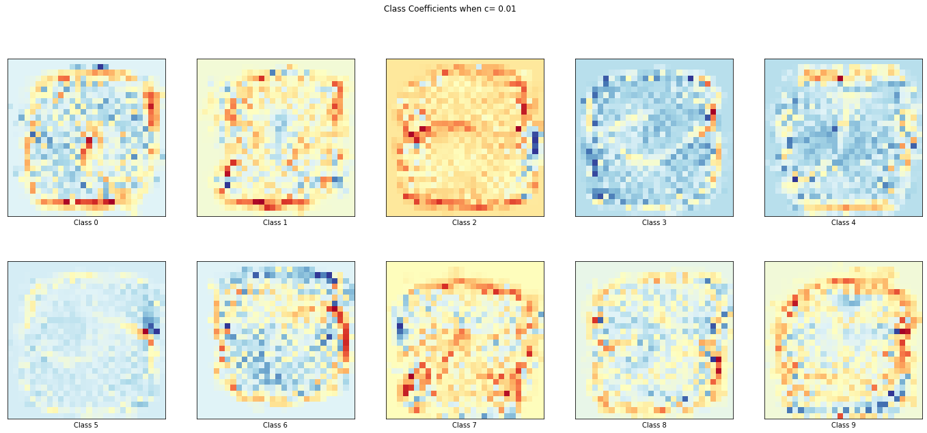
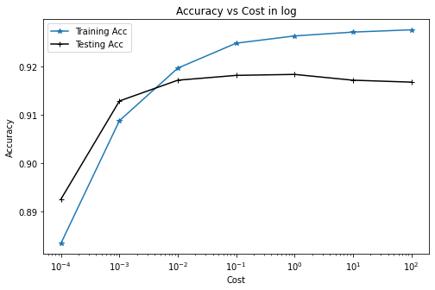
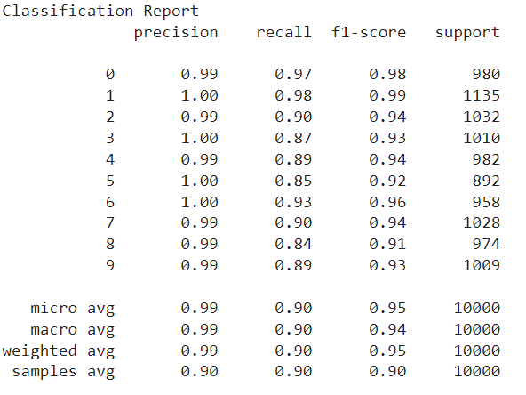
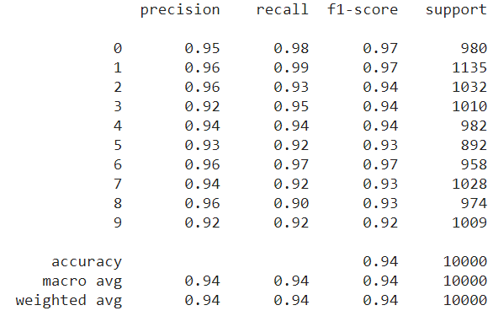
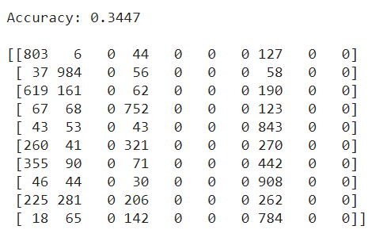
SVM
KNN
Decision Tree
Random Forest

Slide 7
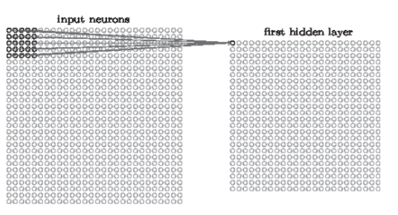
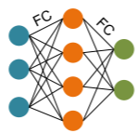
ANN to SNN conversion
Fully Connected network [3]
A layer of neurons with locally convolution layers that is hidden.
Source: http://neuralnetworksanddeeplearning.com/chap6.html#introducing_ convolutional_networks
FA algorithm:
Constructing reverse or backward matrices
Backpropagation
Compute error gradient from top layer
Loop through the layers, beginning at the 2nd from the top and working down to last layer.
iii. Angle computation (the angle formed by the delta signal and the delta signal generated by BP)

Slide 8
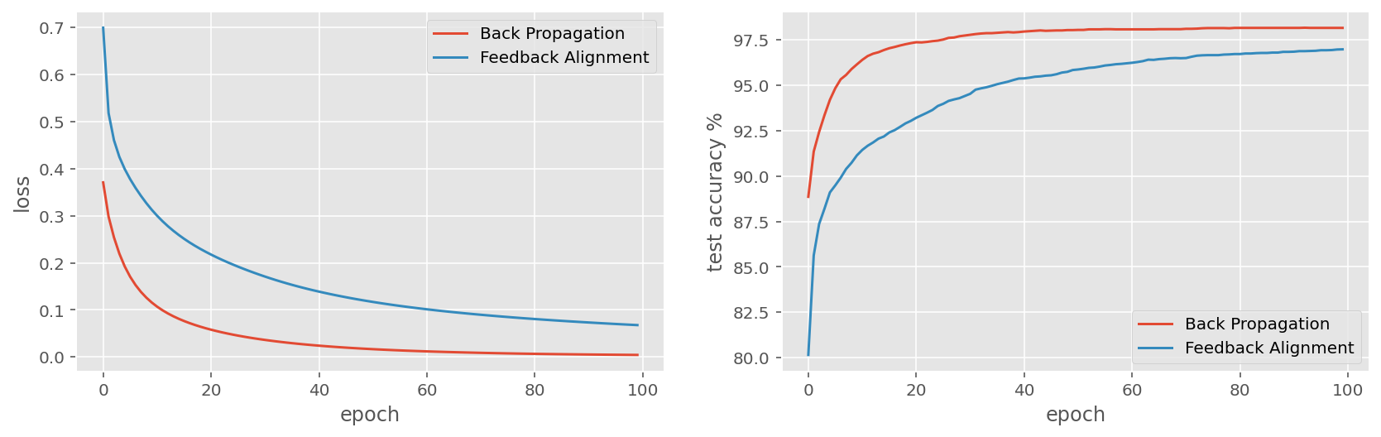

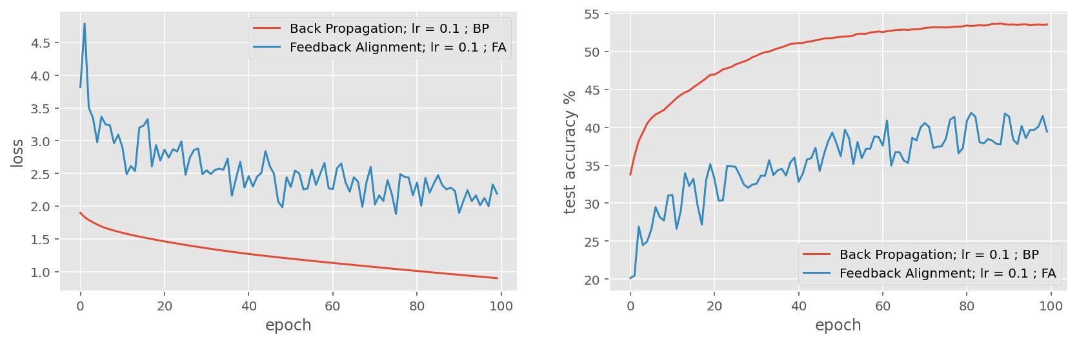
Comparison between FA & BP Algorithm Performance
MNIST
CIFAR10
 | MNIST | CFAR10 | Loss
BP accuracy (%) | 98.2 | 53.36 | 0.90
FA accuracy (%) | 96.98 | 40.11 | 2.18

Slide 9
Neural Activity [4]

Slide 10
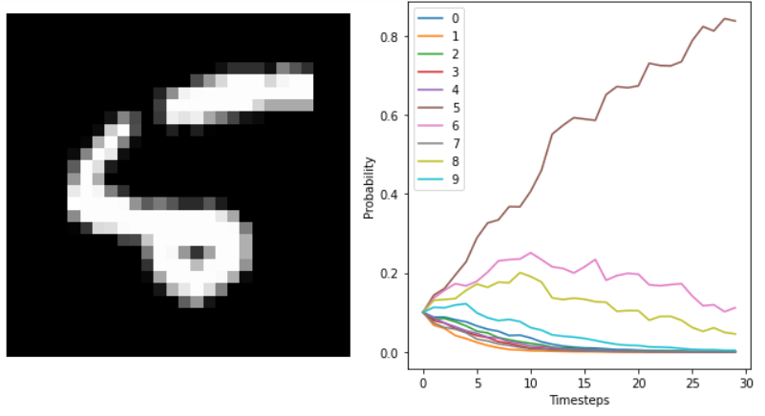
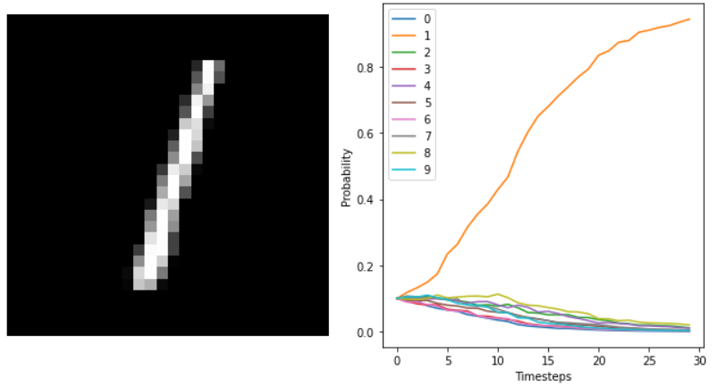
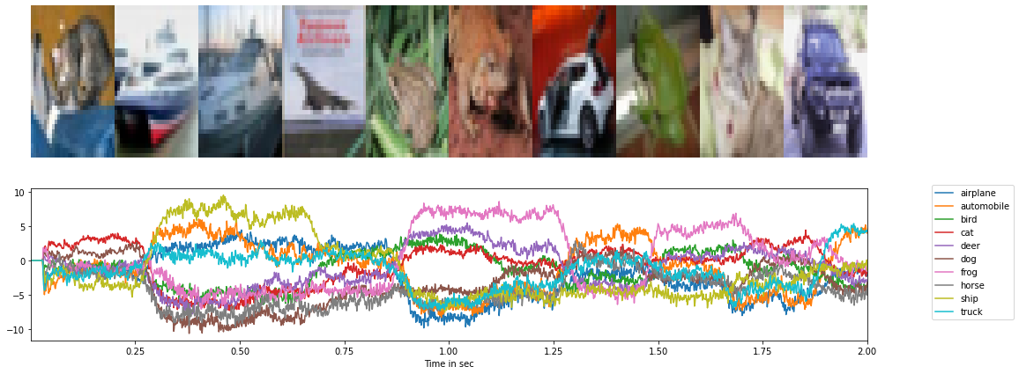
SNN
loss: 0.0105
Accuracy after training: 0.986400, 0:04:00 MNIST and 91.07 CIFAR10

Slide 11
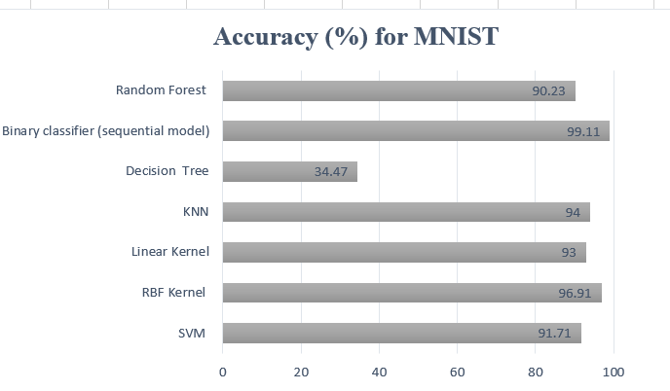
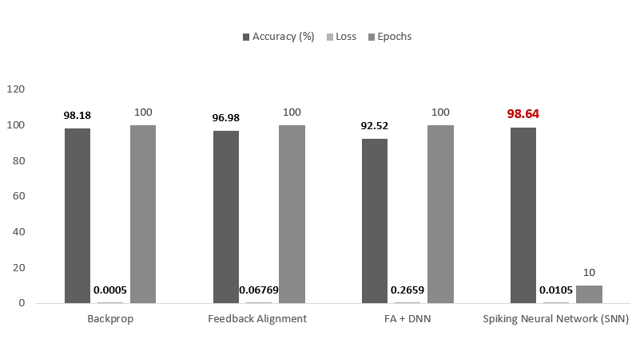
ML vs DL Algorithms

Slide 12
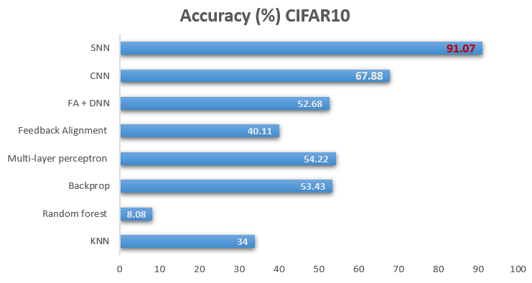
CIFAR10 Result Comparisons

Slide 13
References:
[1] A. Nøkland, "Networks, Direct Feedback Alignment Provides Learning in Deep Neural," Cornell University, p. 9, 2016.
[2] M. Lechner, "LEARNING REPRESENTATIONS FOR BINARYCLASSIFICATION WITHOUT BACKPROPAGATION," in ICLR, Klosterneuburg, Austria, 2020.
[3] L. Deng, Y. Wu, X. Hu et al., Rethinking the performance comparison between SNNS and ANNS. Neural Networks (2019), doi: https://doi.org/10.1016/j.neunet.2019.09.005.
[4] https://www.cs.ryerson.ca/~aharley/vis/conv/flat.html

