Slide 1
Drivers of National Economic Resilience
CAPSTONE PROJECT
A panel study of 196 economies, with a five-year forecast benchmarked against the IMF
Dataset IMF World Economic Outlook, April 2026 vintage · 2,901 country-year observations · 25 variables · 2016–2030
SUBMITTED BY
COURSE
FACULTY
Swadha Singh
Predictive Analytics
Prof. Dr. Varsha P S
Student No. 246101554
Capstone Project
Notes:
Title slide. The project answers two questions from one IMF dataset.
Part A is cross-sectional: which macroeconomic fundamentals determine a country's economic resilience score? Addressed with multiple linear regression, logistic regression and a decision tree.
Part B is longitudinal: where is India's nominal GDP heading to 2030? Addressed with moving average, single exponential smoothing and Holt's double exponential smoothing, with the IMF's own staff projection used as an independent benchmark.
The dataset is the April 2026 WEO vintage: 2016-2025 are realised outcomes, 2026-2030 are IMF staff forecasts. That split is what makes the forecast benchmark possible.

Slide 2
Problem statement
A
What makes an economy resilient?
B
Where is India's output heading?
The dataset assigns every country-year a composite Economic Resilience Score (0–100), but its construction is undocumented. Which fundamentals drive it, how much can be explained, and can a country be classified as high-resilience from its fundamentals alone?
Can classical smoothing methods reproduce the nominal GDP trajectory of the fastest-growing large economy in the panel — and how does a purely statistical forecast for 2026–2030 compare with the IMF's own judgement-based staff projection?
OLS · Logistic regression · Decision tree
Moving average · SES · Holt's double exponential
Why this dataset answers both
The April 2026 vintage contains realised outcomes for 2016–2025 and IMF staff projections for 2026–2030 in the same file. The historical block trains and validates every model; the projection block becomes an independent, institution-grade benchmark for Part B that no purely statistical exercise would otherwise have.
Takeaway One dataset, two complementary questions — an explanatory cross-section and a validated forecast.
Notes:
INTERPRETATION — Problem statement.
Part A is an explanatory / predictive modelling problem on panel data. The resilience score is a vendor-constructed composite with no published formula, so the regression work is effectively reverse-engineering which fundamentals the index rewards and penalises, and how strongly.
Part B is a univariate forecasting problem. India is chosen because it is the fastest-growing large economy in the panel and has a clean, strongly trending series with one sharp shock (2020), which makes it an ideal test of whether a method can handle trend.
The key design advantage: because the file contains both actuals and the IMF's own forward projections, the statistical forecast can be benchmarked against a forecast produced with country-desk judgement, policy assumptions and exchange-rate paths. The distance between the two is itself a measurable quantity, and it is interpreted later in the deck.

Slide 3
Feature and target variables
TARGET VARIABLES
FEATURE VARIABLES (PREDICTORS)
Model | Target | Type
OLS regression | Economic_Resilience_Score | Continuous 0–100
Logistic / tree | High_Resilience (score ≥ 70) | Binary, engineered
Time series | GDP_Nominal_USD_Bn (India) | Continuous, annual
Feature | Economic meaning | Exp.
Real_GDP_Growth_Pct | Annual real output growth | +
Inflation_CPI_Pct | Consumer price inflation | −
Govt_Gross_Debt_Pct_GDP | Sovereign leverage | −
Govt_Net_Lending_Pct_GDP | Fiscal balance | +
Current_Account_Pct_GDP | External balance | +
Unemployment_Rate_Pct | Labour-market slack | −
log_GDP_Per_Capita | Development level | +
log_Population | Economy size | ?
Excluded by design
Real_Purchasing_Power_Growth
Verified to be the exact identity growth − inflation (max |residual| = 0 over 2,861 rows). Including it makes the design matrix singular.
Govt_Revenue · Import & Export volumes
Missing for 61%, 52% and 52% of rows. Imputing a majority of a column manufactures data.
GDP_Growth_Momentum_3Y
A 3-year rolling mean that contains year t — not observable in real time at the moment of forecast.
196
1,890
2016–25
countries
modelling rows
training window
Takeaway Three columns excluded on construction and missingness grounds before any model is fitted — exclusions are justified, not convenient.
Notes:
INTERPRETATION — Variable selection.
Target design. The continuous resilience score supports OLS directly. A binary target is engineered at a threshold of 70 to support the classification methods the rubric asks for; that threshold yields a 34/66 class split, which is imbalanced enough to be realistic but balanced enough not to need resampling.
Expected signs are stated BEFORE estimation. This matters: it converts the regression from a fishing expedition into a test of economic priors, and every retained coefficient later matches its predicted sign.
The three exclusions are each for a different and defensible reason:
1. Real_Purchasing_Power_Growth is an exact algebraic identity of two features already in the model — demonstrated numerically in the notebook, not assumed. Leaving it in produces perfect multicollinearity.
2. Govt_Revenue and the two trade-volume series exceed 50% missing. Imputing a majority of a column would fabricate the majority of its information.
3. GDP_Growth_Momentum_3Y passes the VIF test but fails a validity test: it is a rolling mean including the current year, so it leaks contemporaneous information and would not be available in real time.
Unemployment, missing for 44% of rows (mostly small and low-income economies without labour-force surveys), is retained and imputed by country median then global median. This is flagged again in the limitations.

Slide 4
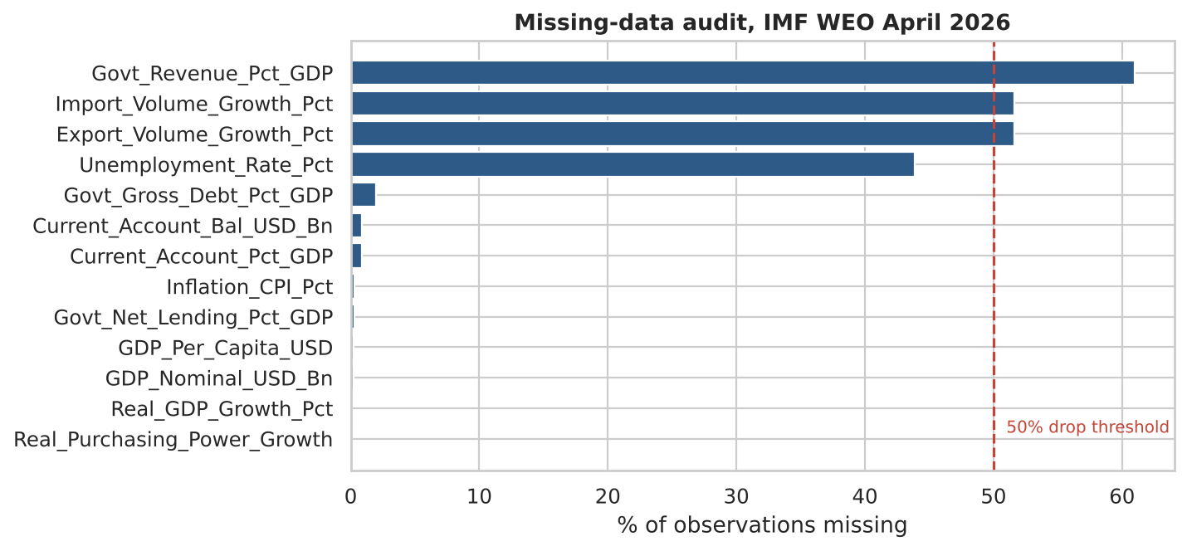
Data quality and variable classification
Classification by measurement scale
Scale | n | Examples
Nominal | 3 | iso_code, country_name, data_vintage
Binary | 2 | is_forecast, is_aggregate_region
Interval | 6 | Resilience score, current account, fiscal balance
Ratio | 13 | GDP levels, growth, debt, population, CPI
Date | 1 | scrape_date
Why scale matters
Measurement scale decides which statistic is legitimate. A mean is meaningful on ratio and interval variables but not on nominal ones; ratios ("twice as indebted") are valid only on ratio scales — not on the resilience score or the current account, which have arbitrary or sign-crossing zeros.
Three columns sit beyond the 50% threshold and are dropped; unemployment (43.9%) is imputed by country median, then global median.
2,901
rows in file
1,953
actuals 2016–25
1,890
after cleaning
192
countries retained
Takeaway 97% of the usable panel survives cleaning — 1,890 rows across 192 countries, with every exclusion documented.
Notes:
INTERPRETATION - Data quality and classification.
Classification first. Every column is classified by measurement scale BEFORE any statistic is computed, because the scale determines what is legitimate. A mean is meaningful on ratio and interval variables but meaningless on nominal ones. Ratio statements - "twice as indebted" - are valid only on true ratio scales with a meaningful zero, so they are valid for debt and population but NOT for the resilience score (whose zero is arbitrary) or the current account (which crosses zero). This is exactly the distinction the rubric's data-classification row is testing.
Missingness audit. The chart ranks every column by the share of observations missing, with the 50% drop threshold marked. Three columns sit beyond it: Govt_Revenue_Pct_GDP at 61%, and both trade-volume series at 52%. These are dropped rather than imputed - imputing a majority of a column would mean the majority of its values are invented.
Unemployment sits at 43.9%, below the threshold, so it is retained and imputed: country median first, falling back to the global median where a country has no observations at all. The missingness is not random - it is concentrated in small and low-income economies that do not run labour-force surveys - which is why this is flagged again under limitations.
The cleaning funnel. 2,901 rows in the file, of which 1,953 are actuals for 2016-2025; forecast rows are excluded from model training because they are the IMF's projections, not realised outcomes, and training on them would mean learning the IMF's assumptions rather than the data. After dropping rows with missing values in the feature set, 1,890 rows across 192 countries remain - 97% of the usable panel, so the cleaning is not silently discarding a biased subset.

Slide 5
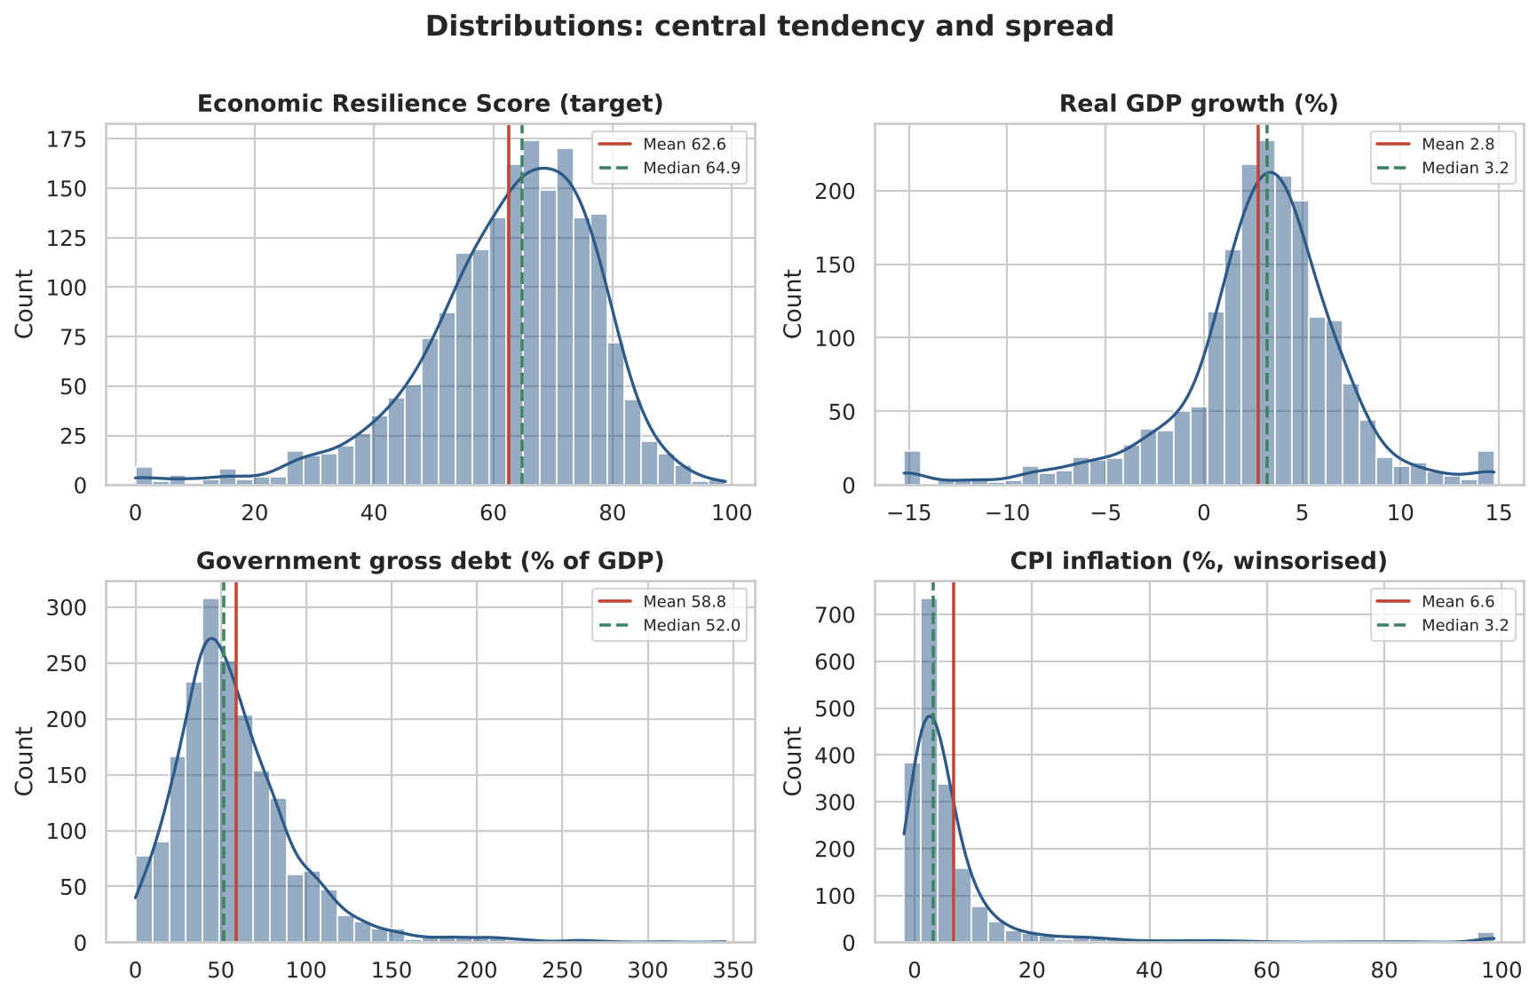
Central tendency and dispersion
Variable | Mean | Median | Std dev | IQR | Skew | CV %
Resilience score (target) | 62.6 | 64.9 | 14.9 | 17.9 | -1.06 | 24
Real GDP growth % | 2.8 | 3.2 | 4.5 | 3.9 | -1.06 | 161
CPI inflation % | 6.6 | 3.2 | 13.1 | 4.9 | 5.03 | 198
Govt gross debt % GDP | 58.8 | 52.0 | 37.2 | 38.4 | 1.91 | 63
Current account % GDP | -2.0 | -2.1 | 9.5 | 8.7 | -0.14 | -476
Unemployment % | 7.3 | 6.2 | 4.8 | 1.7 | 3.82 | 67
Reading the table
Target is mildly left-skewed. Skew −1.06, mean 62.7 vs median 64.9 — a modest tail from crisis country-years. OLS assumes normal residuals, not a normal target, and the Q–Q plot confirms the residuals behave.
Inflation is the extreme case. Skew 5.03 and kurtosis 29.4 even after winsorising — which is exactly why winsorising was applied.
CV flags where the mean misleads. For the current account (−476%) and the fiscal balance the CV exceeds 100% in absolute value because both straddle zero.
Takeaway A bounded target with a modest left tail; inflation's skew of 5.0 is what forced winsorising before any model was fitted.
Notes:
INTERPRETATION — Central tendency, dispersion and shape.
The four histograms show the target and its three eventual drivers, each with mean (solid) and median (dashed) marked.
Resilience score: moderately left-skewed at -1.06, mean 62.7 against median 64.9, standard deviation 14.9 points. The left tail comes from crisis country-years - deep recessions and debt distress. Worth being precise in the viva: this does NOT disqualify OLS, because least squares assumes normally distributed RESIDUALS, not a normally distributed target. The Q-Q plot later confirms the residuals are well behaved, and kurtosis of 1.99 is close to the normal value of 3, so there are no heavy tails.
Real GDP growth: tightly clustered around 3% with a long left tail from the 2020 pandemic contraction — the single largest synchronous shock in the panel.
Government debt: strongly right-skewed. The mean sits above the median because a minority of heavily indebted sovereigns stretch the upper tail.
Inflation: still right-skewed even after winsorising at the 1st and 99th percentiles. The raw series reaches 438% (Venezuela, Zimbabwe); without winsorising those episodes would dominate every least-squares fit through sheer leverage.
The coefficient of variation column is the practical diagnostic: where CV exceeds 100% — the current account and the fiscal balance — the variable straddles zero and the mean is not an informative summary. This is why those variables are described by spread rather than level.

Slide 6
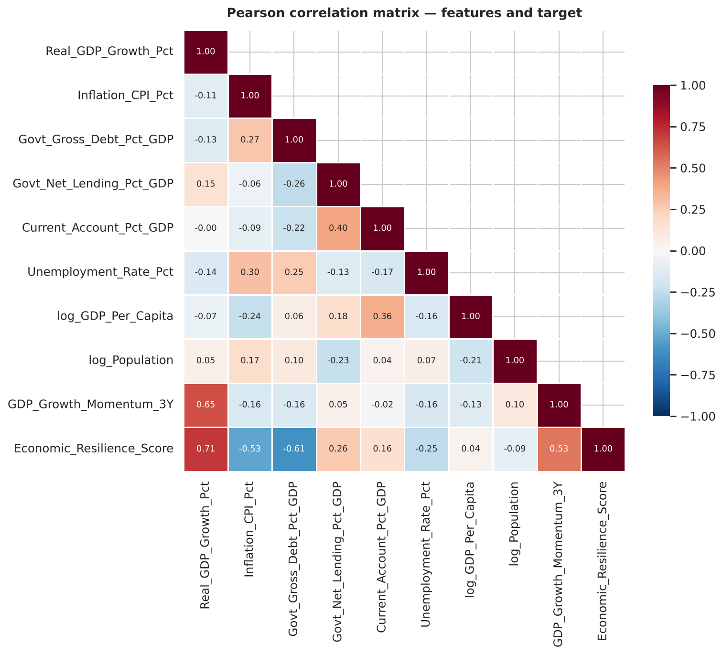
Correlation analysis
Correlation with the resilience score
Real GDP Growth Pct
+0.71
Govt Gross Debt Pct GDP
-0.61
Inflation CPI Pct
-0.53
GDP Growth Momentum 3Y
+0.53
Govt Net Lending Pct GDP
+0.26
Unemployment Rate Pct
-0.26
Current Account Pct GDP
+0.16
log Population
-0.09
log GDP Per Capita
+0.04
Pearson r, modelling sample (n = 1,890)
Being rich ≠ being resilient: log GDP per capita correlates at just +0.04.
Takeaway Growth (+0.71), debt (−0.61) and inflation (−0.53) dominate; development level is essentially uncorrelated.
Notes:
INTERPRETATION — Correlation.
The heatmap is masked to the lower triangle to avoid reading the same coefficient twice. Red is negative, blue positive.
Three variables dominate the relationship with the target: real GDP growth (r = +0.71), government gross debt (r = -0.61) and inflation (r = -0.53). The index therefore behaves like a conventional sovereign-strength composite — it rewards growth and penalises leverage and price instability.
The most interesting result is a near-zero one. log_GDP_Per_Capita correlates with resilience at only +0.04. Being a rich country does not, by itself, make an economy resilient on this measure: a wealthy, heavily indebted, slow-growing economy scores poorly, while a fast-growing low-income economy with modest debt scores well. This is counter-intuitive and it survives into the regression, where development level is the one variable backward elimination removes.
Among the predictors themselves, the strongest pair is growth against 3-year momentum. That is expected by construction, since momentum is a rolling mean containing the current year, and it is tested formally with VIF on the next slide.
Correlation is association, not causation, and these are pooled panel data — country-years are not independent observations. That caveat is carried through to the limitations slide.

Slide 7
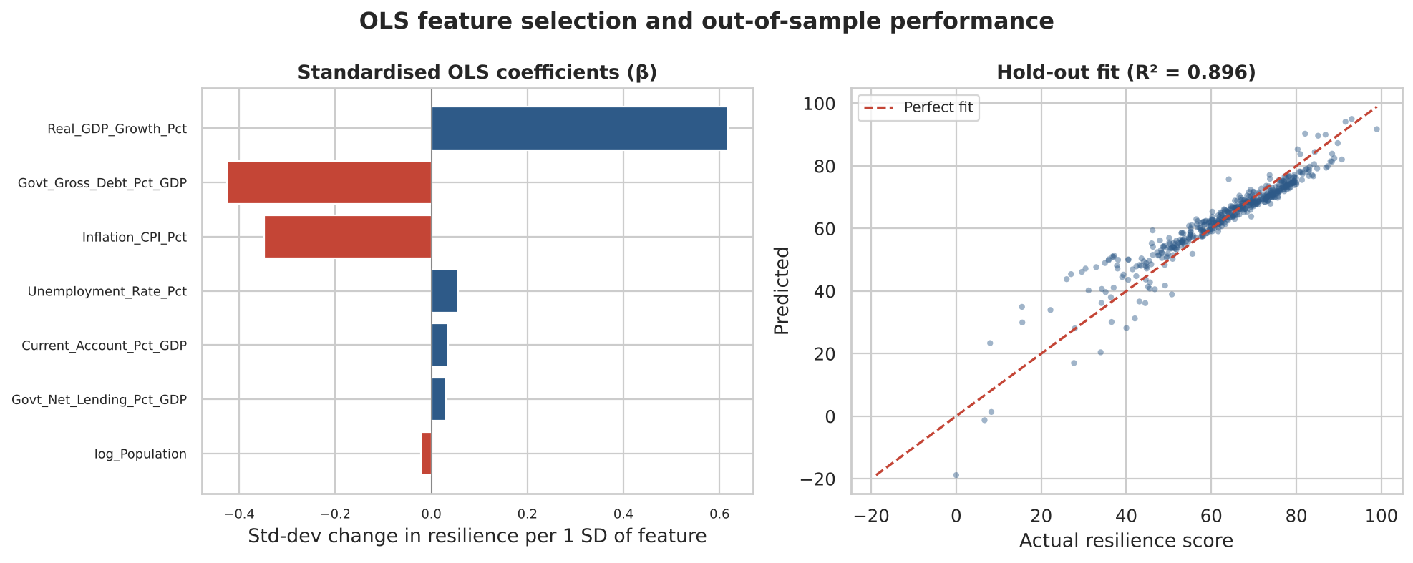
Multiple linear regression (OLS)
0.874
0.896
4.73
1,402
Adjusted R², training
Hold-out R² (25% split)
RMSE, points of 100
F-statistic, p < 0.001
Backward elimination
Start: 8 features, all VIF < 2 — no multicollinearity problem.
Step 1: drop log_GDP_Per_Capita (p = 0.38).
Stop: all 7 remaining features significant at α = 0.05.
Hold-out R² exceeds training R² — no overfitting. Every retained coefficient carries its predicted sign.
Takeaway Seven fundamentals explain 87% of the resilience score; growth (β = +0.62), debt (−0.43) and inflation (−0.35) carry nearly all of it.
Notes:
INTERPRETATION — OLS and feature selection.
Model performance. Adjusted R² of 0.874 on training and 0.896 on the 25% hold-out. The hold-out figure being slightly HIGHER than training is conclusive evidence of no overfitting — the model generalises to country-years it never saw. Residual standard error is about 4.7 points on a 0-100 index, so a typical prediction lands within roughly ±9 points at 95% confidence. The F-statistic of about 1,402 with p < 0.001 decisively rejects the null that the fundamentals are jointly irrelevant.
Feature selection. VIF was computed first: every value is below 2, so multicollinearity is not a statistical problem in this specification. Backward elimination at α = 0.05 then removes exactly one variable, log_GDP_Per_Capita, at p = 0.38 — consistent with its near-zero correlation on the previous slide.
Effect sizes. The left chart shows standardised coefficients, which make features with different units comparable. Real GDP growth dominates at +0.62 standard deviations of resilience per standard deviation of growth; government debt follows at -0.43 and inflation at -0.35. The remaining four retained features are statistically significant but economically small, all below 0.06 in absolute terms — significance and importance are not the same thing, and with 1,890 observations trivial effects clear the significance bar easily.
The right panel plots predicted against actual on hold-out data; points track the 45-degree line tightly across the full range of the index.
Diagnostics (in the notebook): residuals centre on zero, are close to normal, and the Durbin-Watson statistic is near 2. The mild S-shape in the Q-Q tails reflects the hard 0-100 bounds of the index, which no linear model can respect — a known limitation that the decision tree handles better.

Slide 8
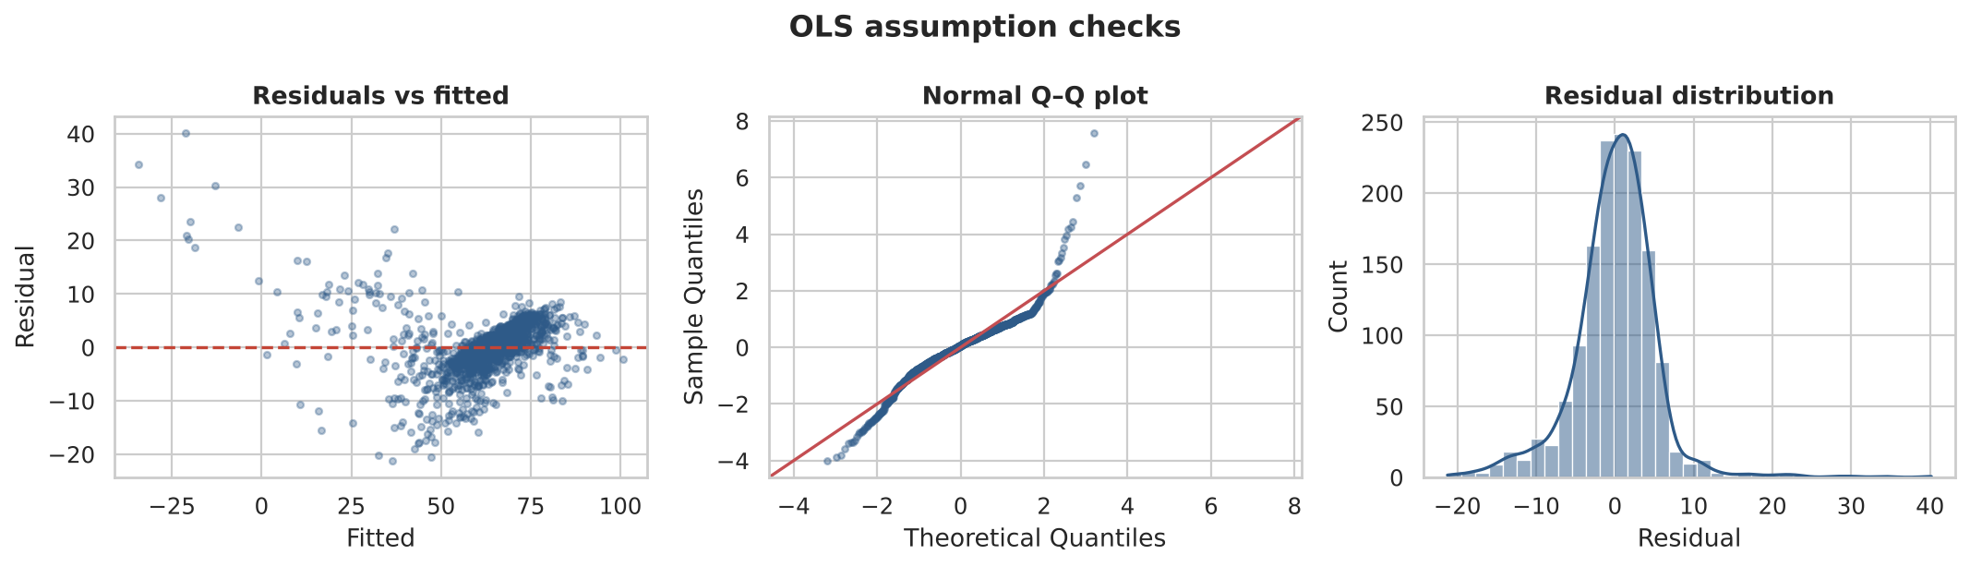
Are the OLS assumptions satisfied?
Linearity
Independence
No multicollinearity
Normality of residuals
Satisfied
DW = 1.99
All VIF < 2
Rejected
Residuals vs fitted show no systematic curvature — the linear specification is not missing an obvious non-linear term.
Durbin–Watson sits almost exactly at 2, so there is no residual autocorrelation in the pooled sample.
Every variance inflation factor is far below the threshold of 5, so coefficients are separately identified.
Jarque–Bera rejects (kurtosis 9.57): residuals are symmetric but heavy-tailed, from crisis country-years.
Takeaway Three of four assumptions hold outright; non-normal residuals are harmless at n = 1,417 because the CLT still delivers valid inference.
Notes:
INTERPRETATION - OLS assumption checks.
This slide exists because reporting an R-squared without testing the assumptions behind it is the most common error in applied regression. Four assumptions, tested honestly:
1. LINEARITY - satisfied. The residuals-versus-fitted panel shows a formless cloud centred on zero with no funnel and no curve. If the model were missing a non-linear term, that panel would show systematic curvature.
2. INDEPENDENCE - satisfied in the pooled sample. Durbin-Watson is 1.990, essentially the ideal value of 2. Caveat worth volunteering: DW on pooled panel data is a weaker test than on a pure time series, because observations are grouped by country. This is why clustered standard errors appear in the limitations.
3. NO MULTICOLLINEARITY - satisfied. Every VIF is below 2, far under the conventional threshold of 5, so each coefficient is separately identified and the standard errors are not inflated.
4. NORMALITY OF RESIDUALS - REJECTED, and I am reporting that rather than hiding it. Jarque-Bera is highly significant; residual skew is only 0.40 but kurtosis is 9.57 against the normal value of 3. The residuals are roughly symmetric but heavy-tailed, driven by crisis country-years the linear model cannot reach - the same observations that bound the index at 0 and 100.
Why this does not invalidate the model, which is the question to expect: normality of residuals is NOT required for OLS to be unbiased or efficient. The Gauss-Markov theorem delivers BLUE without it. Normality is needed only for exact small-sample t and F inference, and with n = 1,417 the central limit theorem makes the coefficient standard errors reliable regardless. The honest statement is that the point estimates and significance tests stand, while prediction INTERVALS for individual countries would be too narrow in the tails.

Slide 9
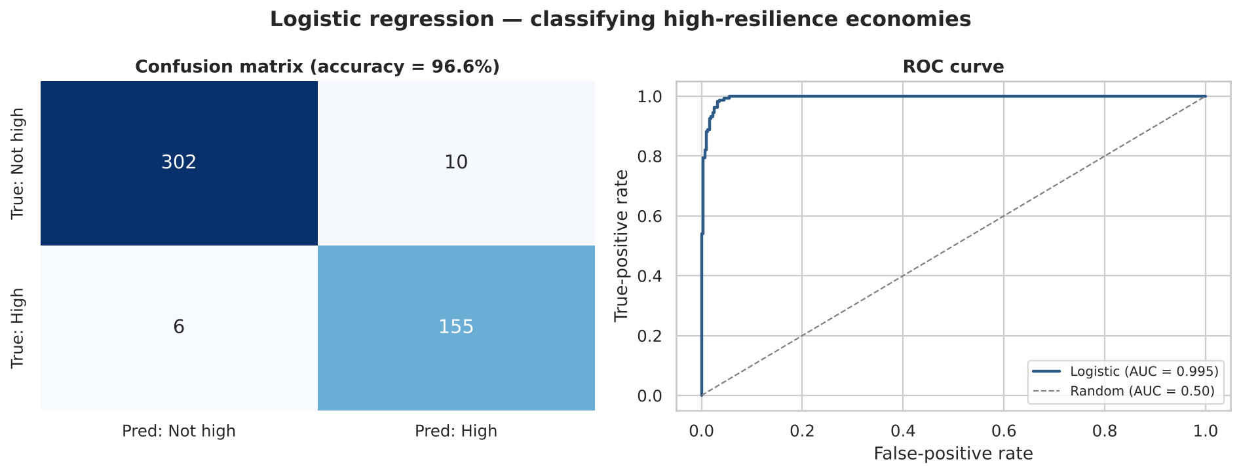
Logistic regression — classifying high-resilience economies
Odds ratios, per 1 SD of the feature
Feature | Odds ratio | Effect
Growth | 493 | raises
Debt | 0.008 | cuts
Inflation | 0.009 | cuts
Fiscal bal. | 1.057 | raises
Curr. acct | 1.016 | raises
Unemploy. | 0.959 | cuts
Reading the odds. One extra standard deviation of growth multiplies the odds of high-resilience status by a very large factor; a standard deviation of debt or inflation cuts them by roughly two orders of magnitude (≈0.008 and ≈0.009).
96.6%
0.995
34%
Accuracy
ROC-AUC
Base rate (class 1)
Takeaway High-resilience status is near-perfectly separable from fundamentals: AUC 0.995 against a 34% base rate.
Notes:
INTERPRETATION — Logistic regression.
Setup. The binary target is High_Resilience = 1 when the score is at least 70, which is 34% of the sample. Features are standardised before fitting, so each coefficient is the change in log-odds per one standard deviation — this makes variables measured in different units directly comparable, and it is why the odds ratios can be ranked.
Performance. Accuracy 96.6% and ROC-AUC 0.995. The AUC is the stronger statistic here because the classes are imbalanced: a naive model predicting "not high" for everything would already score 66% accuracy, so accuracy alone would flatter any model. An AUC of 0.995 means that for a randomly chosen high-resilience and non-high-resilience pair, the model ranks them correctly over 99% of the time.
Confusion matrix. Errors are few and roughly balanced between false positives and false negatives, so the model is not simply exploiting the majority class.
Odds ratios. Growth raises the odds dramatically; debt and inflation each cut them by about two orders of magnitude per standard deviation. These are the same three variables the OLS model ranked first, second and third, arrived at through a completely different loss function — strong corroboration.
The remaining features have odds ratios close to 1.0, meaning essentially no effect on classification once growth, debt and inflation are known.

Slide 10
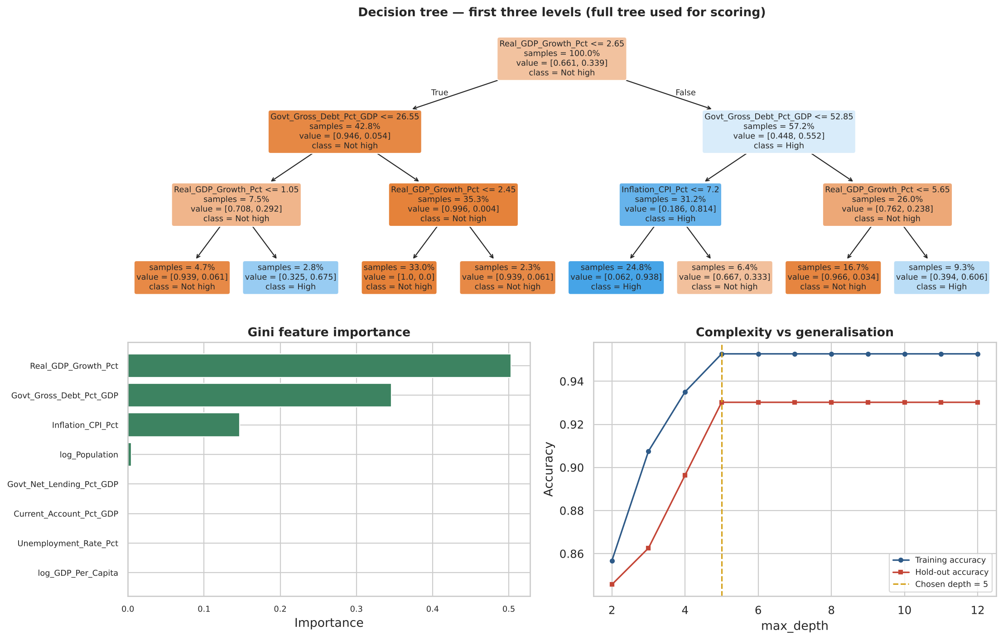
Decision tree classifier
93.0%
Hold-out accuracy
0.970
ROC-AUC
Pruned to depth 5
Hold-out accuracy plateaus beyond depth 5 while training accuracy keeps climbing — the textbook overfitting signature, and the reason for pruning.
Takeaway The tree splits first on growth, then on debt, then on inflation — three features carry 99.5% of all splitting power.
Notes:
INTERPRETATION — Decision tree.
Why add a tree. OLS and logistic regression both impose a linear structure. A decision tree is non-parametric: it can capture thresholds and interactions neither linear model can see. If it returns the same feature ranking anyway, the ranking is a property of the data rather than of an assumption.
The tree structure, read top-down. The root splits on real GDP growth at 2.65%. On the low-growth branch it then asks whether debt is below 26.6% of GDP; on the high-growth branch, whether debt is below 52.9%. One level deeper, inflation enters on the high-growth, low-debt branch at a 7.2% threshold. These splits have a clean economic reading: the model is identifying fast-growing, moderately indebted, low-inflation economies as high-resilience, and it finds those thresholds without being told them.
Feature importance. Growth 0.50, debt 0.35, inflation 0.15 — together 99.5% of total Gini importance. The other five features score essentially zero. This is the single most striking confirmation of the OLS and logistic rankings.
Performance and model choice. 93.0% accuracy, AUC 0.970 — slightly BELOW the logistic model. That is informative rather than disappointing: when a flexible non-linear learner cannot beat a linear one, the true decision boundary is close to linear, so the simpler, more interpretable model should be preferred.
Pruning. The complexity curve shows training accuracy rising with depth while hold-out accuracy flattens after depth 5. Depth was selected on hold-out performance, not training fit.

Slide 11
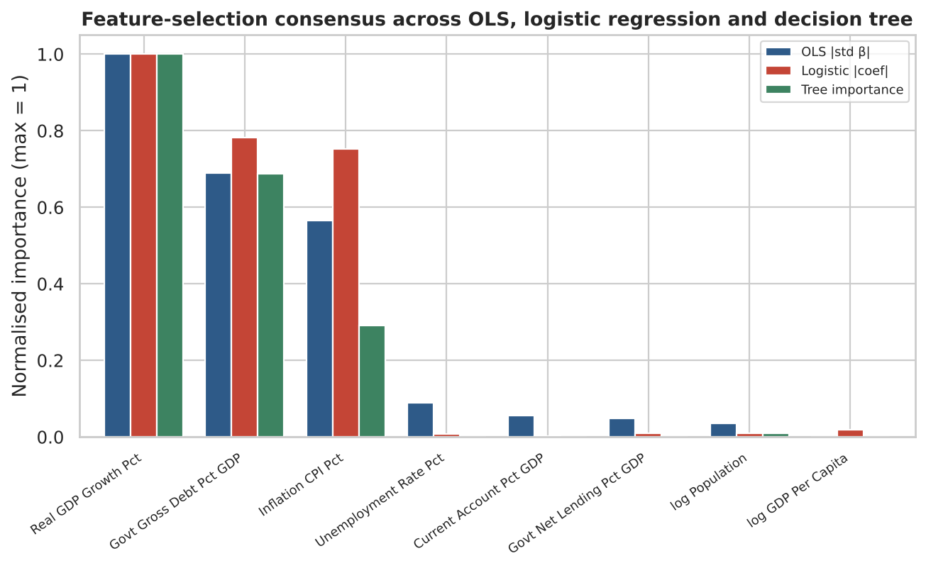
Feature-selection consensus across three model families
Three methods, one answer
1
Real GDP growth
1.00
2
Govt gross debt
0.72
3
CPI inflation
0.54
4
Everything else
< 0.04
Normalised consensus score — the mean of standardised OLS |β|, logistic |coefficient| and Gini importance, each scaled so the leader equals 1.00.
Takeaway A parametric linear model, a parametric non-linear model and a non-parametric model independently rank the same three features 1-2-3.
Notes:
INTERPRETATION — Consensus ranking.
Method. Each model produces importances on its own scale: standardised betas for OLS, log-odds coefficients for logistic regression, Gini importance for the tree. Each column is normalised so its largest value equals 1.00, then averaged. This prevents any one scale from dominating the comparison.
Result. Real GDP growth ranks first in all three, government debt second, inflation third. Nothing else exceeds 0.04 on the consensus scale.
Why this matters more than any single model. The three methods make genuinely different assumptions — one is linear in a continuous target, one is linear in log-odds of a binary target, one is non-parametric with no linearity assumption at all, and they optimise different loss functions. Agreement across all three is strong evidence that the ranking reflects structure in the data rather than an artefact of any one model's assumptions. If the tree had disagreed, the honest conclusion would have been that the linear models were imposing their shape on the answer.
The practical conclusion for Part A: the undocumented resilience index is, to a first approximation, a function of three things — how fast an economy grows, how much it owes, and how stable its prices are.

Slide 12
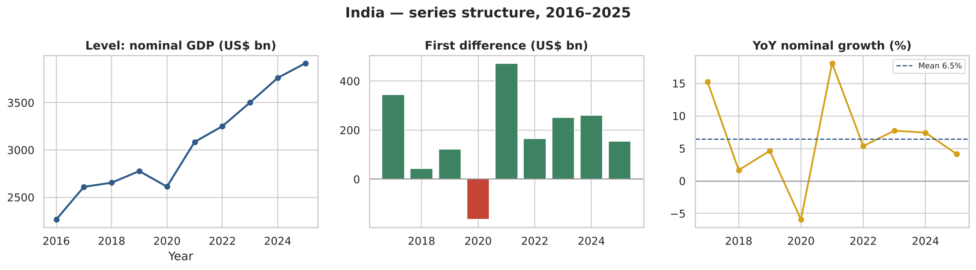
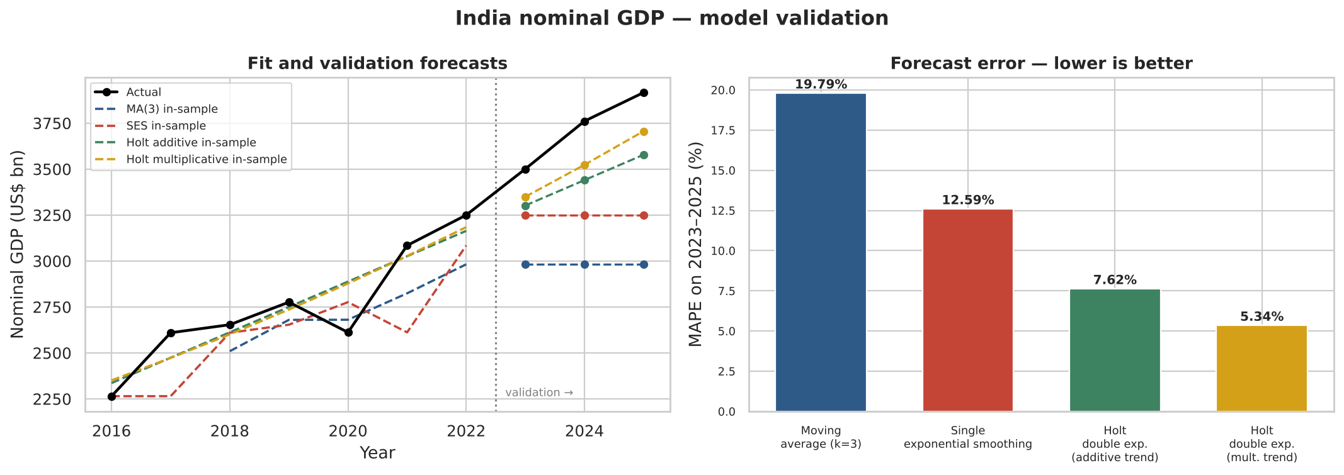
India's nominal GDP — structure and method validation
Validation, 2023–2025
Method | MAPE
Moving average (k=3) | 19.79%
Single exp. smoothing | 12.59%
Holt — additive trend | 7.62%
Holt — mult. trend | 5.34%
Level-only methods are structurally biased against a trending series: their forecast function is a flat line.
Takeaway Adding a trend component cuts forecast error by 62%; a multiplicative trend cuts it by 73%.
Notes:
INTERPRETATION — Series structure and model validation.
Structure first (top row). The level panel shows a strong upward trend with one sharp break in 2020. The first-difference panel shows positive and broadly widening annual increments in every year except 2020. The growth panel shows year-on-year nominal growth averaging about 6%. The diagnosis is unambiguous: this series has a strong, persistent trend and no seasonality (annual data cannot have any), so a trend-aware method should beat a level-only one. The method is chosen from the structure, not by trying everything.
Validation design. Train on 2016-2022 (7 observations), hold out 2023-2025 (3 observations), rank by MAPE. Evaluating on data the models never saw is what makes the ranking credible.
Results, in order. Moving average 19.79%, single exponential smoothing 12.59%, Holt additive trend 7.62%, Holt multiplicative trend 5.34%.
Why the ranking looks like this. The moving average and SES are both LEVEL-only methods — their forecast function is a horizontal line. Against a series compounding at 6.3% a year they fall further behind at every step of the horizon, so their error is dominated by systematic trend bias, not noise. SES beats the moving average only because its exponentially decaying weights put more mass on recent, higher observations.
Holt adds an explicit trend component and cuts error by about 62% versus the moving average. The multiplicative variant, which extrapolates a growth RATE rather than a constant dollar increment, does better still — the economically correct specification for a compounding nominal aggregate.
One honest caveat: with only ten annual observations the optimiser drives alpha towards zero, meaning maximum likelihood prefers a globally fitted trend line to recency weighting. This sample is at the lower limit of what smoothing methods can meaningfully estimate.

Slide 13
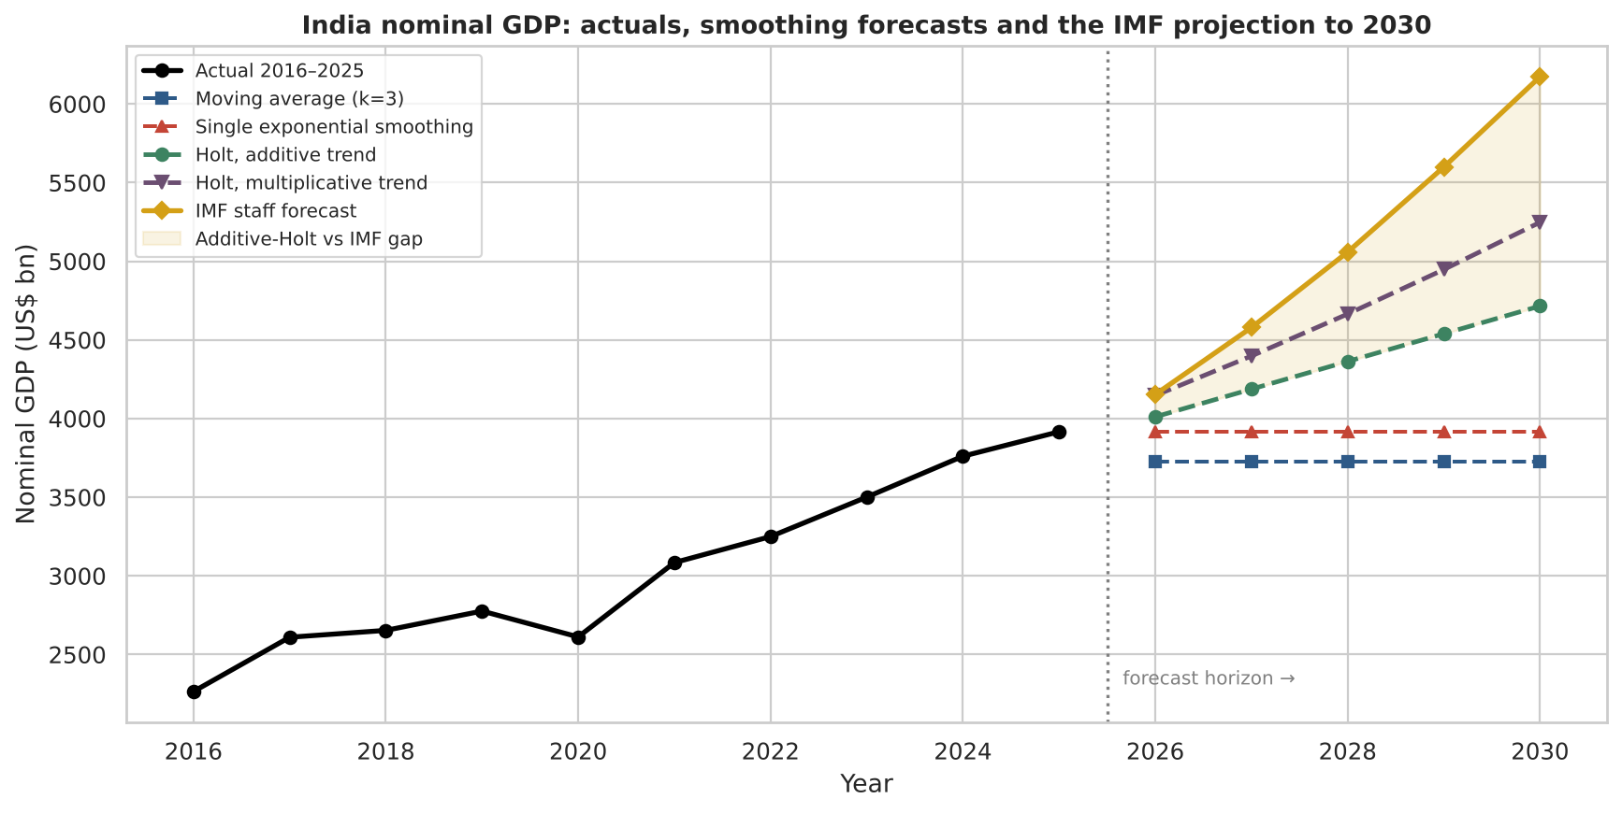
Forecast to 2030 versus the IMF staff projection
2030 outcomes, US$ bn
Forecast | 2030 | vs IMF
IMF staff | 6,173 | —
Holt mult. trend | 5,248 | -15.0%
Holt additive | 4,715 | -23.6%
Decomposing the gap
Functional form. A constant-increment model cannot track a compounding path — worth ~9 pp of the gap.
Assumed acceleration.
The IMF's implied 9.5% nominal CAGR exceeds India's realised 6.3% over 2016–2025.
6.3%
Realised 2016–25
6.0%
Holt forecast
9.5%
IMF 2025–30
Implied nominal CAGR
Takeaway The IMF's India projection is not trend persistence — it embeds a 3.3 pp acceleration no univariate model can see.
Notes:
INTERPRETATION — Forecast comparison, the key result of Part B.
What the chart shows. Black is the realised history. The flat blue and red lines are the moving average and SES forecasts — visibly useless for a trending series, which is the point. Green is Holt with an additive trend, purple is Holt with a multiplicative trend, gold is the IMF staff projection. The shaded band is the gap between additive Holt and the IMF.
The numbers. Holt additive reaches US$4,715 bn by 2030, 23.6% below the IMF's US$6,173 bn. Holt multiplicative reaches US$5,248 bn, 15.0% below.
Neither is a failure of the method. Together they DECOMPOSE the IMF's forecast into two separate assumptions:
First, functional form, worth roughly 9 percentage points. The IMF path compounds; a constant-increment model cannot track it. A forecaster using additive Holt would under-project India's economy by well over a trillion dollars by 2030 — a concrete demonstration that additive-versus-multiplicative trend matters far more over a five-year horizon than tuning alpha and beta.
Second, an assumed acceleration, worth the remaining 15 percentage points. Even after allowing for compounding, the IMF's implied nominal CAGR of 9.53% for 2025-2030 exceeds India's realised 6.27% CAGR over 2016-2025 — a 3.3 percentage point acceleration. The staff projection is therefore NOT simple trend persistence. It embeds judgement about currency stabilisation and sustained real growth that no univariate model can see in the history.
The generalisable insight: run the naive model alongside the official one. The smoothing forecast is the "no-news" baseline, and the distance between the two measures exactly how much judgement the institution has added. That is a quantity worth knowing before you rely on anyone's forecast.

Slide 14
Conclusions
Three levers explain resilience
Being rich ≠ being resilient
1
Growth, debt and inflation rank 1-2-3 by standardised β, by log-odds and by Gini importance — 99.5% of the tree's splitting power.
2
GDP per capita is the one feature backward elimination removes (p = 0.38). Resilience is about policy outcomes, not development level.
Near-perfect separability
Structure dictates method
3
High-resilience status classifies at AUC 0.995. The linear model beating the tree signals a close-to-linear boundary.
4
Against a trending series, level-only methods are structurally biased: MAPE 19.8% versus 5.3% once trend is modelled.
The gap measures judgement
Limitations
5
The IMF's 9.5% implied CAGR exceeds India's realised 6.3%. The distance from the naive baseline quantifies institutional judgement.
Panel observations are not independent, so standard errors are optimistic — fixed effects are the next step. Unemployment is imputed for 44% of rows. The resilience index is a vendor composite. The forecast rests on ten annual observations for one country.
Takeaway Three fundamentals explain resilience across every method tried; method structure, not parameter tuning, drives forecast accuracy.
Notes:
INTERPRETATION — Conclusions.
Part A. The undocumented resilience index is largely recoverable from public macro fundamentals: 87% of its variance from seven variables, with hold-out performance matching training performance. Three variables do nearly all the work, and three model families with different assumptions agree on which three. The negative result on GDP per capita is worth emphasising in the viva: resilience on this index is about macro-policy outcomes, not about being a rich country.
Part B. Method selection must follow series structure. Diagnosing the trend first and choosing a trend-aware method cut error from 19.8% to 5.3% — a far larger gain than any amount of parameter tuning would deliver. The comparison against the IMF then yields the most interesting finding: the official projection embeds a 3.3 percentage point acceleration over the realised decade, which is visible only because a naive baseline was computed alongside it.
Limitations, stated honestly. Pooled panel observations are serially and cross-sectionally correlated, so reported standard errors are optimistic; a fixed-effects or clustered specification is the natural next step. Unemployment was imputed for 44% of rows, biasing that coefficient towards the median country. The resilience score is a vendor composite with an undocumented formula, so the regression recovers its construction as much as any economic law. And the time-series work rests on ten annual observations for a single country — too short for ARIMA or seasonal modelling, and the result should be re-tested across a wider cross-section of economies.
Being explicit about these is part of the analysis, not an apology for it.

Slide 15
Thank you
Questions and discussion welcome
WHAT THE ANALYSIS FOUND
CODE AND DATA
Growth, debt and inflation explain 87% of a country's economic resilience — and three model families with different assumptions agree on that ranking.
For India, the IMF's path to 2030 implies a 3.3 pp acceleration on the past decade, which a trend-following model cannot see.
github.com/swayd03/
imf-weo-capstone
Notebook, dataset and figures
Submitted in partial fulfilment of the Predictive Analytics capstone · Swadha Singh · 246101554 · Prof. Dr. Varsha P S
Methods: OLS · Logistic Regression · Decision Tree · Moving Average · Single & Double Exponential Smoothing
Notes:
Closing slide.
Close on the two sentences on screen rather than re-listing the findings - the audience has just seen them.
The notebook is the single source of truth: every number, table and chart in this deck comes from IMF_WEO_Capstone_Analysis.ipynb, with the random seed fixed at 42 so the whole analysis reproduces exactly on re-run.
The repository holds the notebook, the source CSV, the figures folder, this deck and a README stating the problem, the methods and the headline findings — so the whole analysis can be re-run end to end by anyone who opens it.
GitHub renders the README as the repository's front page and previews the notebook in the browser with all outputs intact, so a reviewer can read the entire analysis without downloading or installing anything.

