Slide 1
BodySync
Plan: testing the score on highly cited Empatica stress datasets
ZU-PWD '25 + 7 public Empatica datasets with stress labels
Notes:
Quick recap of where we are, and then the plan for the next phase. The main change: besides our ZU-PWD dataset, we want to validate BodySync on public Empatica datasets that have real stress labels and are well cited.

Slide 2

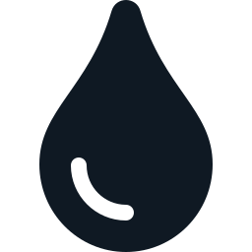
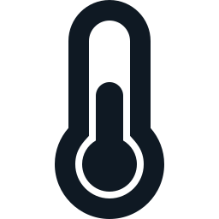

The vision: is your body in sync?
In sync
Signals move together the way they usually do for you
Desync
They stop agreeing: stress, illness, poor sleep?
Goal
A 0–100 score from a wristband, in everyday life
Heart rate
Sweat (EDA)
Skin temp
Breathing
Breathing is only measured when the wrist is still, so the score runs on the first three
Builds on Sun et al. (2026): body signals react to health information, but they were measured separately, once, in a lab
Notes:
Reminder of the original idea from our first presentation. Instead of looking at heart rate or sweat alone, we ask whether the signals move together the way they normally do for that person. When they stop agreeing, that's a desync. The paper by Sun et al. looked at each signal on its own, in one lab session; we want this from a wristband in daily life.

Slide 3
Why ZU-PWD alone is not enough
0
1/min
0
stress labels in the free copy
readings, summarised
citations so far
the self-reports are behind the IEEE DataPort paywall
fast reactions between signals are smoothed out
the dataset paper (PWI, 2025) is very new
Without labels we can compute a score, but we can't show that a low score means anything. We need data where people were known to be stressed.
Notes:
ZU-PWD is great for long-term everyday data, but the free copy has no stress ratings, the readings are one-minute summaries, and the dataset paper has no citations yet. So we can build a score on it, but we can't prove the score means anything. That's why we looked for labelled data.

Slide 4
Seven public Empatica datasets with stress labels
Dataset | Citations | Setting | People | Stress label
WESAD (Schmidt 2018) | 1,352 | Lab | 15 | Speech + maths stress test (TSST)
Nurse stress (Hosseini 2022, Sci Data) | 119 | Hospital shifts | 15 | Nurses rated their stress
Stress-Predict (Iqbal 2023) | 75 | Lab | 35 | Stroop test + interview
Stress + exercise (Hongn 2025, Sci Data) | 37 | Lab | 36 | Stress tasks + cycling sessions
EmpaticaE4Stress (2024, Data in Brief) | 26 | Lab | 29 | Timed puzzle tasks
ADARP (Sah 2022) | 13 | Daily life | 11 | Button press when stressed
CAN-STRESS (2025) | 1 | Daily life | 62 | Stress ratings 0–9
Citation counts from OpenAlex, October 2026
Notes:
These are all the public datasets we found that use an Empatica watch and record when people were stressed, sorted by citations. WESAD is the standard benchmark in wearable stress research with over 1,300 citations, and the nurse dataset is a well-known real-world one in Scientific Data. Together they cover about 200 people, in the lab and in daily life.

Slide 5
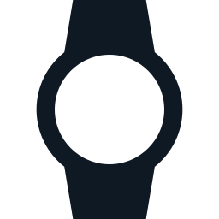
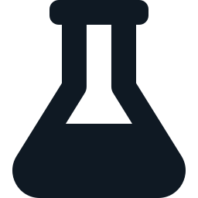

Why these datasets
Same sensors
All use the Empatica E4, the predecessor of our EmbracePlus. Same three signals: heart rate, sweat, skin temperature
Lab and real life
Four lab studies with a controlled stressor, three from daily life or work. This tests the score where stress is clear and where it is messy
Well cited
About 1,600 citations combined. WESAD alone is the field's standard benchmark
Notes:
Three reasons. Same sensors: the E4 is the older version of the watch in our dataset and measures the same three signals. A mix of lab and real life, so we see where the score works and where it gets harder. And they are well cited, so results on them are comparable with the literature.

Slide 6
Two candidate scores to compare
A
Sync score (original vision)
B
Personal-normal score
Rolling correlation between heart rate–sweat, heart rate–temp and sweat–temp. Low score = signals stop moving together the way they usually do for you
How far heart rate, sweat and temp are from your own normal for the same activity (asleep, resting, active). Low score = far from your normal
Both run 0–100 on the same windows. The question: which one drops when people are stressed?
Notes:
We keep the original sync idea as score A, and add a simpler comparison, score B: how far your signals are from your own normal, with a separate normal for sleeping, resting and being active, so exercise isn't mistaken for stress. That was one of PWI's weaknesses. We compute both on the same data and see which one actually tracks stress.

Slide 7
How we'll test it
1
2
3
4
5
Convert
Score
Check
Learn
Final test
All 7 datasets into one common format
Compute scores A and B for every window
Stress vs calm moments within each person (AUC)
Train on some datasets, test on unseen ones
Nurse + ADARP kept untouched until the end
The same pipeline then runs on ZU-PWD, using sleep and activity as checks
Notes:
Five steps. Convert every dataset to the same format. Compute both scores. Check, within each person, whether stressed moments score lower than calm ones. Then train a model on some datasets and test it on datasets it hasn't seen, because models often work on one dataset and fail on the next. Two real-world datasets, nurses and ADARP, stay untouched until the very end as a final test.

Slide 8




Keeping the results honest
Held-out datasets
Fair baselines
Nurse and ADARP are only used once, after everything else is fixed
Compare against plain signal values and a PWI-style weighted average
Exercise check
Report everything
The stress + exercise dataset shows whether a workout is mistaken for stress
Every dataset and every comparison is reported, including what doesn't work
Notes:
To avoid fooling ourselves: two datasets are held out until the end; both scores are compared against plain values and a PWI-style average; the exercise dataset checks the exercise confusion; and we report all results, not just the good ones.

