Slide 1




C-shape beam (side view)
I-shape beam (side view)
symmetric
2
2
2
2
$${\left(0, 45,−45,90\right)}_{s}$$
3
3
3
3
$$×$$
anti-symmetric
$$\left(0, 45,−45,90,90,45,−45,0\right)$$
3
2
2
3
3
2
2
3
2
3
3
3
2
2
symmetric
1
1
$${\left(0, 45,−45,90\right)}_{s}$$
3
The shaded web should have the orientation on the left shaded box, but it has to be defined by the orientation on the right, because there is only one element in the thickness direction.
The
2

Slide 2
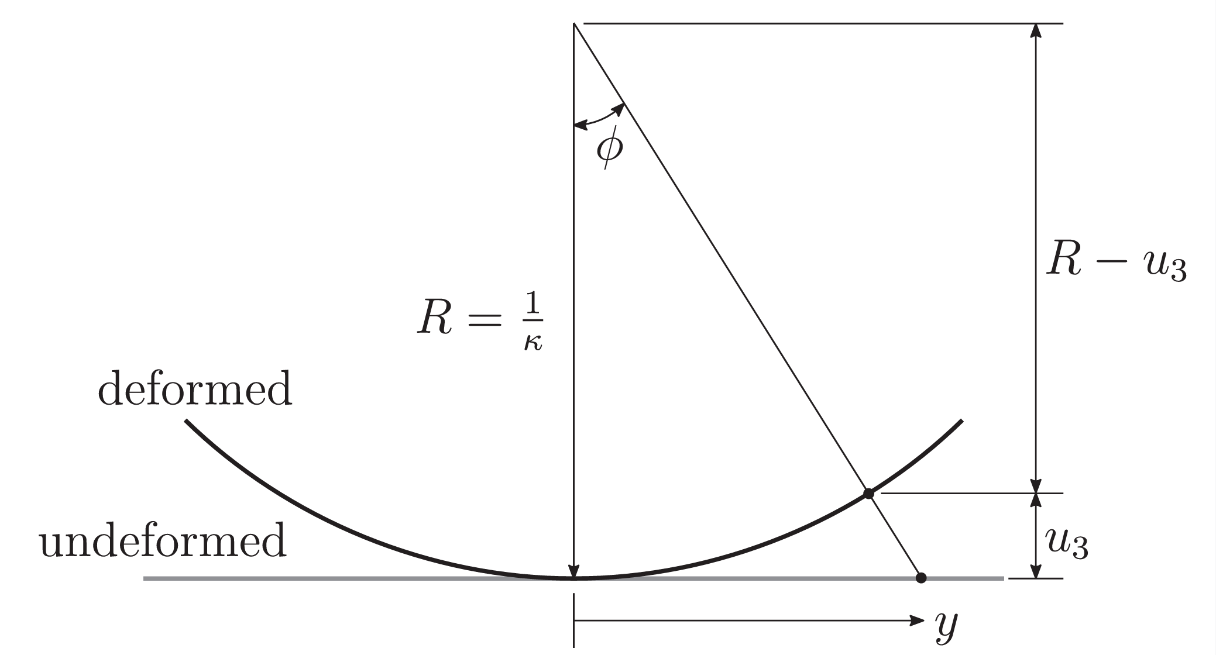


$$u_{2}$$
$$u_{2}$$
z

Slide 3






$$y$$
$$u_{1}∝y$$
$$u_{2}∝x$$
$$φ$$
$$(x,y)$$
$$x$$

