Slide 1

Pressure
Sean W. Barton
10/19/2015

Slide 2
Pressure
The continuous physical force exerted on or against an object by something in contact with it
In my line of work pressure it used to shift valves to control pressure from an oil well subsea (underwater) using a large manifold.
We use various ranges of pressure using hydraulic pumps that are electrically assisted by electrical motors to create pressure in lines of pipe or tubing until it reaches a set pressure and then we use sensors that detect the set pressure and turn off the electrical motors
Pressure varies depending on the application. I.e. if you want a lower pressure you use pressure regulators to reduce the pressure

Slide 3
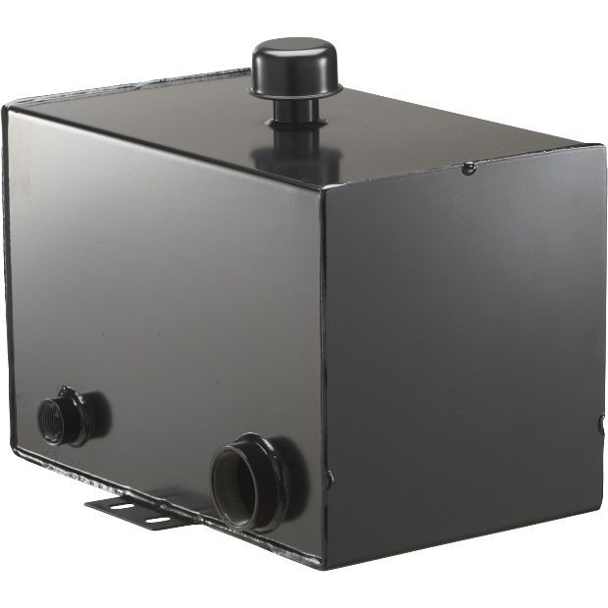
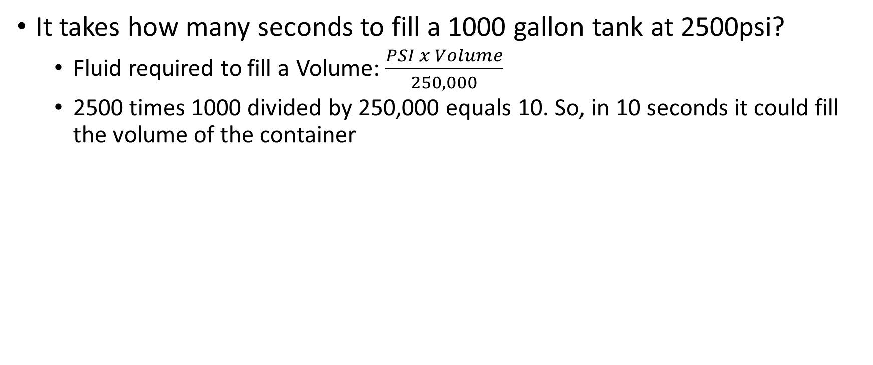
Word Problem
It takes how many seconds to fill a 1000 gallon tank at 2500psi?
  Fluid required to fill a Volume: $\frac{PSI x Volume}{250,000}$
  2500 times 1000 divided by 250,000 equals 10. So, in 10 seconds it could fill the volume of the container

Slide 4
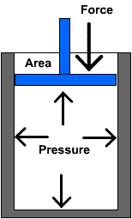
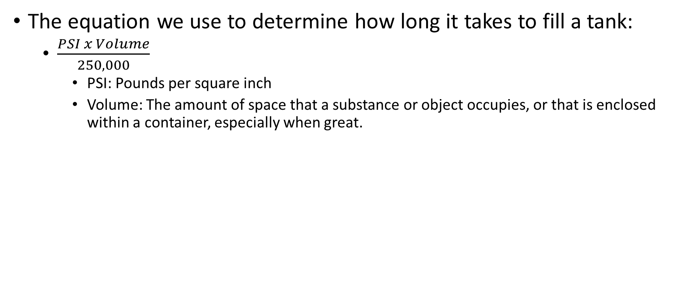
Formula
The equation we use to determine how long it takes to fill a tank:
  $\frac{PSI x Volume}{250,000}$
    PSI: Pounds per square inch
    Volume: The amount of space that a substance or object occupies, or that is enclosed within a container, especially when great.

Slide 5
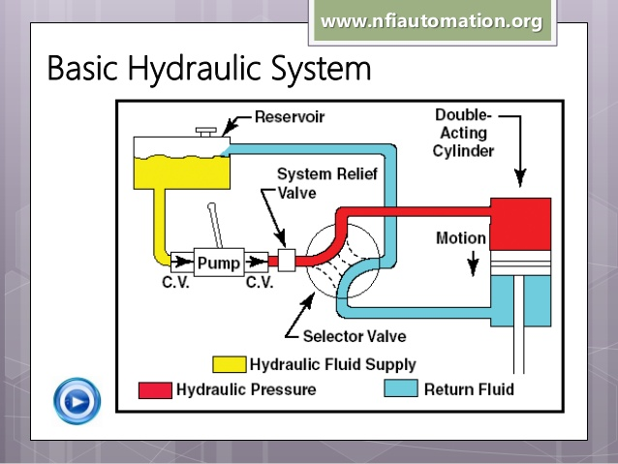
Video Concept
Basic Hydraulics
https://www.youtube.com/watch?v=mgkyabWnZFw

Slide 6
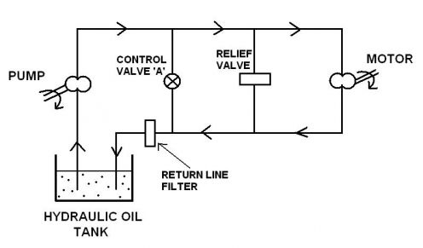
Fluid Power Webinar
For anyone interested in further learning about hydraulics this webinar is very detailed
https://www.youtube.com/watch?v=3xjB66zpnKI

Slide 7
Citations
Fluid power formula (Unknown). Fluid power formula. Retrieved from: http://hydraulicspneumatics.com/site-files/hydraulicspneumatics.com/files/archive/hydraulicspneumatics.com/Content/Site200/ebooks/01_01_2006/80281Ch22IFPBFo_00000052653.pdf
Marine engineering study materials (May 2, 2014). Hydraulic system basics. Retrieved from: http://marineengineeringonline.com/hydraulic-systems-basics/
Industrial hydraulics (October 5, 2013). Retrieved from: http://www.slideshare.net/geterrdone/industrial-hydraulics-26895643
IHS engineering360 (Unknown). Pressure sensors information. Retrieved from: http://www.globalspec.com/learnmore/sensors_transducers_detectors/pressure_sensing/pressure_sensors_instruments

