Slide 1
UNIVERSITY OF ZIMBABWE • DEPARTMENT OF COMPUTER SCIENCE
Clinic Appointment System
Mini Project Presentation — Programming Languages
Super Washington Banga • R2420381 • HCS
Anesu Prosper Matanhire • R2420441 • HCS
BSc Honours in Computer Science (HCS)
Python 3.12+ • 80 tests • all four P mod 4 twists
November 2026
Notes:
0:00-0:20 Super: Welcome. We are Super Washington Banga (R2420381) and Anesu Prosper Matanhire (R2420441), both BSc Honours Computer Science. 0:20-0:35 Anesu: This is our Programming Languages clinic appointment system, written in Python.

Slide 2
AGENDA
What this deck proves
• Domain hierarchy, encapsulation and invariants
• The PENDING → CONFIRMED → CANCELLED state machine
• Pure polymorphism with no runtime type checks
• Context-managed logging with exactly-once framing
• Diamond inheritance, C3 MRO and the counter proof
• All four P mod 4 twist behaviours
• D1–D6 trade-offs, testing and live-change readiness
PAIR DELIVERY
Super Washington Banga • R2420381
Anesu Prosper Matanhire • R2420441
Super leads architecture and Q1–Q5.
Anesu leads twists, logging and Q6–Q8.
Both answer design questions and live changes.
Super Washington Banga (R2420381) & Anesu Prosper Matanhire (R2420441)
UZ CS • Programming Languages
2
Notes:
0:35-1:05 Anesu: We will follow the brief in order, then defend the design decisions. Super will cover the model and state machine; I will cover logging, twists and testing. Both of us can answer questions.

Slide 3
THE BRIEF
Problem and constraints
• Register patients and three staff roles in one clinic.
• Book one-hour appointments in a simulated 0..168 hour week.
• Never read the wall clock: ask an injected Clock.
• Enforce unique IDs and no double-booking per staff or patient.
• Cancel only with legal status and timing rules.
• Log every action, including failures, exactly once.
• Implement the P mod 4 twist and survive a live change.
NON-NEGOTIABLE
No isinstance
No type()
No hasattr
No role-string dispatch
No enum type tags
No time/datetime in src
A new Staff subclass must work
without editing Clinic or the loop.
Super Washington Banga (R2420381) & Anesu Prosper Matanhire (R2420441)
UZ CS • Programming Languages
3
Notes:
1:05-1:45 Super: The brief is a small domain with deliberately strict design constraints. The most important non-negotiables are injected time and zero runtime type dispatch. That second constraint shapes every fee, buffer and discount decision.

Slide 4
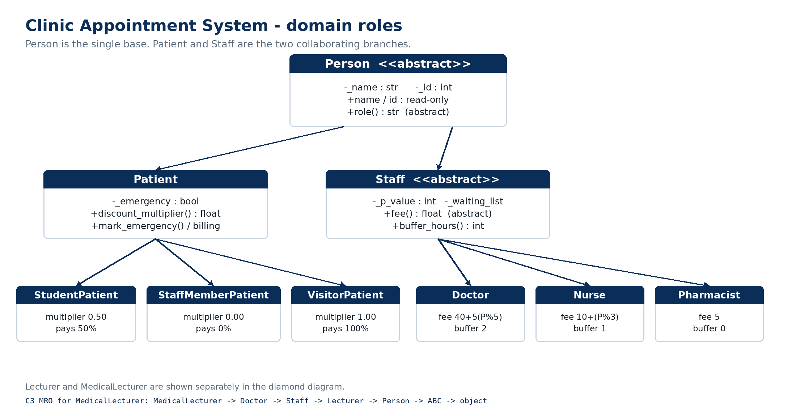
ARCHITECTURE
A small model with clear ownership
• Person is the single base; Patient and Staff are the two branches.
• Appointment owns its status and start hour.
• Clinic owns IDs, conflicts, offers and the log boundary.
• Clock, Logger and TwistPolicy are injected strategies.
Super Washington Banga (R2420381) & Anesu Prosper Matanhire (R2420441)
UZ CS • Programming Languages
4
Notes:
1:45-2:25 Super: This is the inheritance diagram. Person is the single base. Patient owns billing; Staff owns fees, buffers and its waiting list. Clinic is the aggregate root and the only object that sees the whole schedule. Appointment owns its status and start hour, which matters for D1.

Slide 5
Q1 / Q2
Encapsulation, validation and invariants
• All state is underscore-prefixed; read-only properties expose values.
• Collections return fresh tuples: appointments, staff, patients, waiting list, log entries.
• Empty/whitespace names and non-positive ids raise ValidationError (also ValueError).
• Clock and start hours are validated integers in 0..168.
• Formal invariant blocks sit above Appointment and Clinic.
patient = Patient(" Alice ", 1001)
assert patient.name == "Alice"
snapshot = clinic.appointments
snapshot.append(None) # AttributeError
# internal list unchanged
WHY IT MATTERS
A caller cannot mutate internal state, and an appointment cannot be forced into an illegal status.
Super Washington Banga (R2420381) & Anesu Prosper Matanhire (R2420441)
UZ CS • Programming Languages
5
Notes:
2:25-3:00 Super: Encapsulation is not just underscores. Every collection is copied out. The validation contract is enforced in the constructor, and ValidationError is also a ValueError, so the brief's expected exception type works. The invariants are written above the classes, not hidden in a separate document.

Slide 6
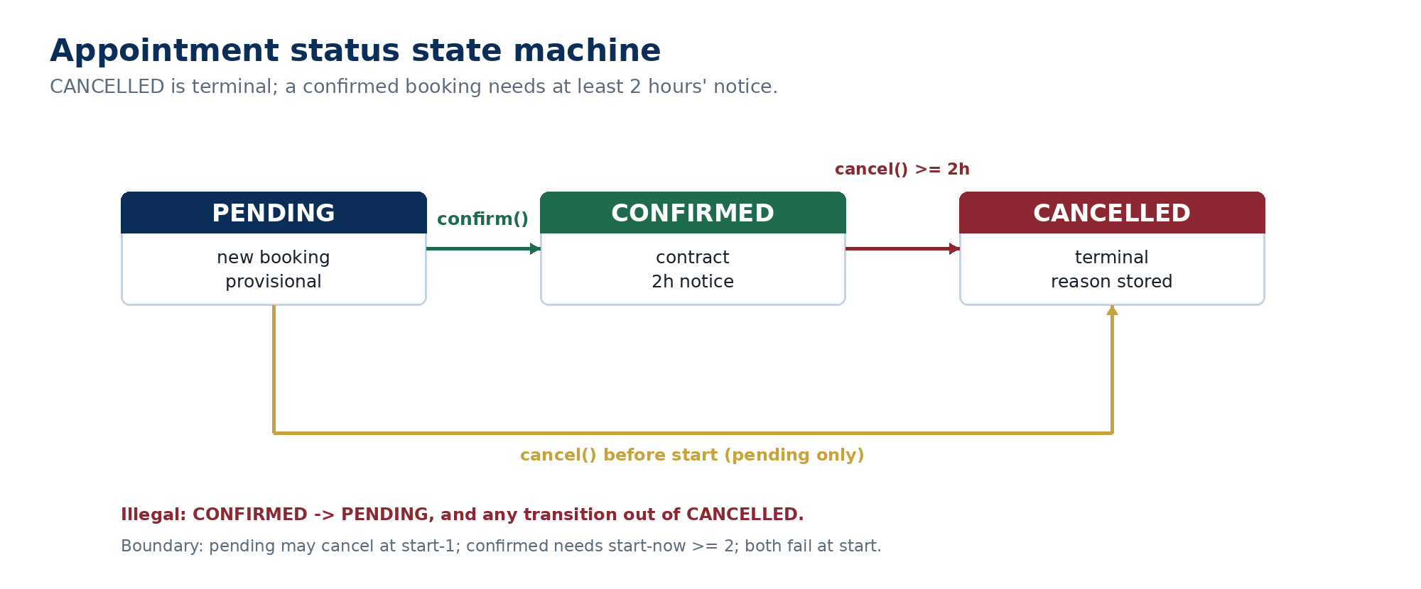
Q2 / D1
The appointment state machine
ENFORCED IN APPOINTMENT
• CANCELLED is terminal.
• Confirmed needs start - now >= 2.
• Pending may cancel until start - 1.
• Both fail once now >= start.
• D1: rule lives in Appointment, not Clinic or a separate policy.
Super Washington Banga (R2420381) & Anesu Prosper Matanhire (R2420441)
UZ CS • Programming Languages
6
Notes:
3:00-3:40 Super: The state machine is intentionally small. The key boundary is that a confirmed appointment can cancel at exactly start minus two, but not at start minus one. A pending appointment can cancel at start minus one, but not at start. Putting the rule inside Appointment means direct callers cannot bypass it; D1 discusses the trade-off with a separate policy object.

Slide 7
Q3 / D3
Pure polymorphism: one loop, zero type checks
for member in clinic.staff:
print(f"{member.role():<12} {member.fee():.2f}")
# Doctor 45.00
# Nurse 12.00
# Pharmacist 5.00
• Doctor: 40 + 5(P mod 5)
• Nurse: 10 + (P mod 3)
• Pharmacist: flat 5
• Adding Radiologist needs only a new Staff subclass.
• No Clinic or loop edit; the test suite proves it.
D3 ANSWER
When Pharmacist was added, the only production change was the new class. Fee, role and buffer dispatch were already virtual.
Super Washington Banga (R2420381) & Anesu Prosper Matanhire (R2420441)
UZ CS • Programming Languages
7
Notes:
3:40-4:20 Anesu: This is the pure-polymorphism proof. The loop never asks what type a staff member is. It calls role() and fee(). Adding a pharmacist required only the new class. Adding a radiologist in the tests required only a test-local subclass, not a Clinic edit.

Slide 8
Q4 / D5
Context-managed logging: exactly once
with self._logger.session() as log:
try:
...
except ClinicError as exc:
log.write(f"FAILED cancel #{id}: {exc}")
raise
[log] opened
FAILED cancel #3: too late
[log] closed
• Nested sessions are rejected; opened and closed are emitted once per operation.
• A broken sink or file never masks the primary domain exception (D5).
• The failure line deliberately has no [log] prefix, matching the brief exactly.
Super Washington Banga (R2420381) & Anesu Prosper Matanhire (R2420441)
UZ CS • Programming Languages
8
Notes:
4:20-5:00 Anesu: The with statement is the key language mechanism. Even when a domain exception is raised, __exit__ emits [log] closed exactly once. The logger records in memory first, so a disk failure is reported to stderr but cannot replace the real exception. The failed cancel line matches the brief's exact format.

Slide 9
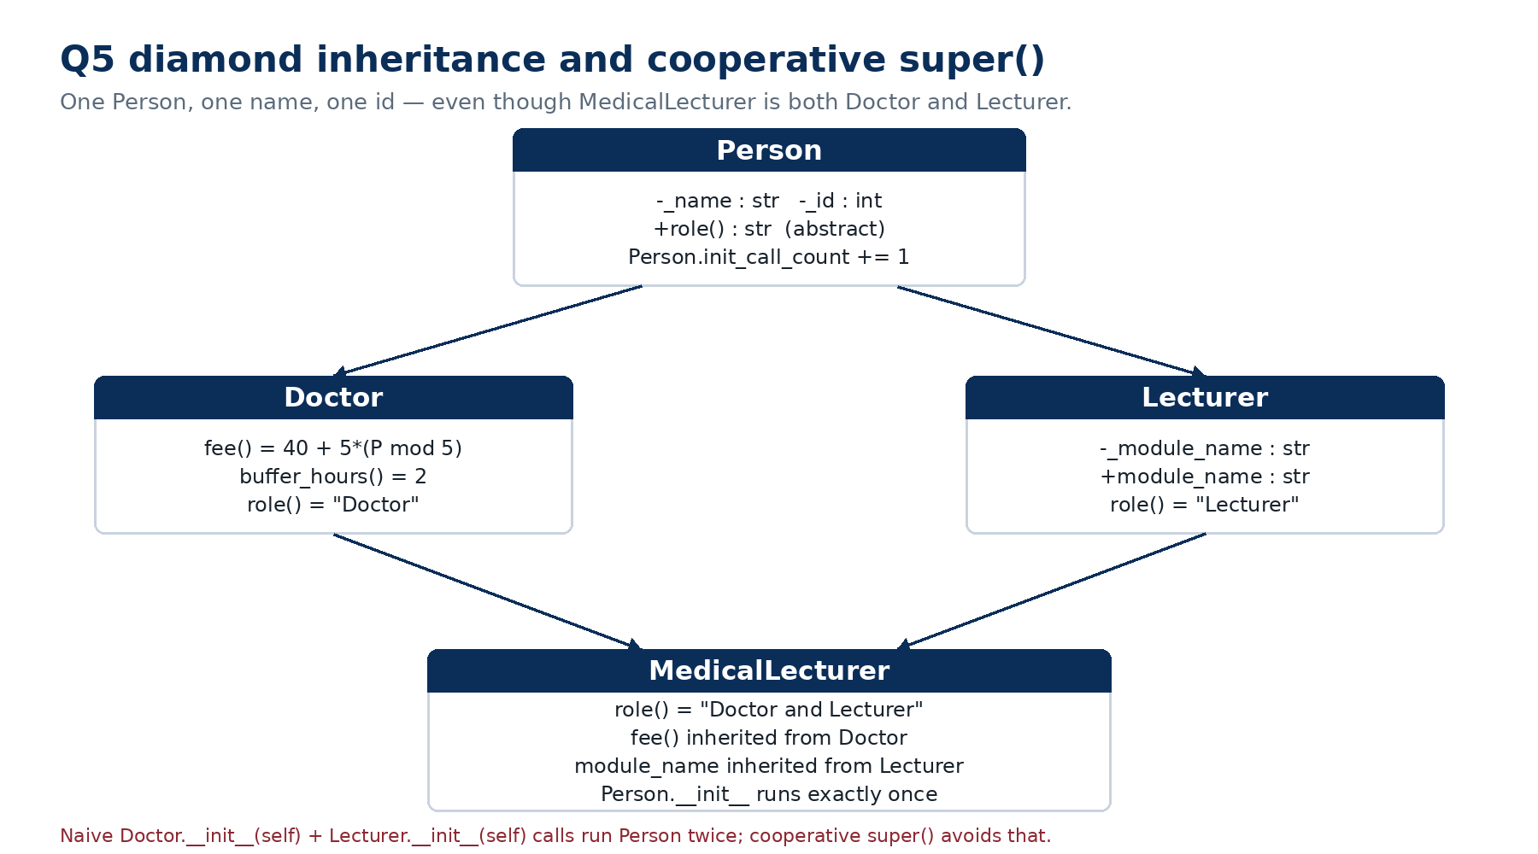
Q5 / D4
The diamond: one Person, one initialisation
• MRO: MedicalLecturer → Doctor → Staff → Lecturer → Person.
• Cooperative super() consumes each class's arguments.
• Person.__init__ delta is exactly 1.
• fee() is inherited from Doctor.
• Naive double-init would run Person twice.
Super Washington Banga (R2420381) & Anesu Prosper Matanhire (R2420441)
UZ CS • Programming Languages
9
Notes:
5:00-5:45 Super: This is the Q5 diamond. The MRO is MedicalLecturer, Doctor, Staff, Lecturer, Person. Cooperative super() carries the arguments through. The counter shows Person.__init__ ran once. MedicalLecturer.fee inherits the doctor rate, because this is a clinical appointment. A naive explicit double call would run Person twice; the test demonstrates delta 2.

Slide 10
Q6
One Clinic, four P mod 4 policies
P mod 4 | Policy | Active behaviour | Demo P
0 | Waiting list | Cancellation offers slot to first conflict-free patient | 2,420,380
1 | Emergency bump | Bump PENDING only; never a CONFIRMED booking | 2,420,381 / 2,420,441
2 | Staff buffer | Ask staff.buffer_hours(): doctor 2, nurse 1, pharmacist 0 | 4,840,822
3 | Discounts | Ask patient.discount_multiplier(): .5 / 0 / 1 | 2,420,383
SAFEGUARD
Clinic(clock, p_value=...) selects the policy once. Outside its active twist a capability is dormant, so the four behaviours never interfere.
Super Washington Banga (R2420381) & Anesu Prosper Matanhire (R2420441)
UZ CS • Programming Languages
10
Notes:
5:45-6:30 Anesu: The brief does not define P. We default to the first partner ID, which gives twist 1, but we implemented all four policies. Clinic accepts p_value. The policy is chosen once at construction. Dormant capabilities prevent buffer rules from leaking into the emergency twist, for example.

Slide 11
Q6 / TWIST 1
Emergency bump: PENDING only, never CONFIRMED
• Patient can be flagged with mark_emergency().
• A PENDING appointment at the same staff/hour may be bumped.
• The old appointment becomes CANCELLED with reason 'bumped'.
• A CONFIRMED appointment is a contract and is never bumped.
• Patient conflict is checked before bumping.
• A started PENDING appointment cannot be bumped.
# P = 2,420,381 -> mod 4 = 1
pending = clinic.book_appointment(patient_a, doctor, 14)
patient_b.mark_emergency()
clinic.book_appointment(patient_b, doctor, 14)
# pending.status == CANCELLED
# pending.cancellation_reason == "bumped"
Confirmed bump attempt -> logged FAILED book: cannot bump confirmed #3
Super Washington Banga (R2420381) & Anesu Prosper Matanhire (R2420441)
UZ CS • Programming Languages
11
Notes:
6:30-7:05 Super: Twist 1 is the emergency bump. The emergency patient can displace a pending appointment, because pending is provisional. The old record is cancelled with reason bumped. A confirmed appointment is never displaced. We check the patient conflict before touching the pending slot, so a failed emergency booking cannot destroy an unrelated appointment.

Slide 12
Q6 / TWISTS 0, 2, 3
Waiting list, buffer and discounts
0 • WAITING LIST
2 • BUFFER
3 • DISCOUNTS
• Staff owns the queue.
• Cancellation offers first conflict-free patient.
• New appointment is PENDING and logged.
• Example: cancel at 20 -> offer #2 at 20.
• Doctor 2, nurse 1, pharmacist 0.
• Free gap after [h, h+1).
• Clinic asks staff.buffer_hours().
• Example: doctor at 30 -> next at 33.
• Student pays 50%.
• Staff-member pays 0%.
• Visitor pays 100%.
• Example: doctor 45 -> student 22.50.
All three are dormant outside their active policy; each delegates to a virtual domain method.
Super Washington Banga (R2420381) & Anesu Prosper Matanhire (R2420441)
UZ CS • Programming Languages
12
Notes:
7:05-7:55 Anesu: The other three twists share one pattern. The waiting list is staff-owned and Clinic coordinates the offer. Buffer is a free gap after the one-hour slot, and Clinic asks the staff object. Discounts live on the patient. Each capability is dormant outside its active twist, so one Clinic implementation stays deterministic.

Slide 13
Q7
D1–D6: decisions and trade-offs
D1
D2
D3
2-hour rule
Clock injection
Pharmacist
Appointment owns it; Clinic supplies now. Alternative: policy object.
Boundary tests at start-3, -2, -1, start and 168 without sleeping.
Only new class; loop and Clinic unchanged. Test adds Radiologist.
D4
D5
D6
Diamond
Log failure
Twists
C3 + super() -> one Person. Naive double call -> delta 2.
Best-effort, stderr fallback, never masks domain exception.
Staff owns queue; confirmed is a contract; virtual buffer/discount.
Super Washington Banga (R2420381) & Anesu Prosper Matanhire (R2420441)
UZ CS • Programming Languages
13
Notes:
7:55-8:40 Super: D1 puts the rule in Appointment for cohesion; a policy object is the alternative if windows become configurable. D2 is why the clock is injected. D3 is the Open/Closed proof. D4 is the MRO proof. D5 is the log-failure policy. D6 answers the four twist questions: staff owns the queue, confirmation is a contract, buffer is virtual, and discount lives on the patient.

Slide 14
Q8 / VERIFICATION
Testing and five-minute demo evidence
80
95%
49/49
4
tests
source coverage
log frames
twists
unittest + pytest
632 statements
opened / closed
all exercised
• python3 -m unittest discover -s tests -v
• pytest -q
• python3 main.py
• main.py shows Q1–Q6, all four twists and deliberate failures.
FAILED cancel #3: too late
FAILED book: staff conflict at hour 14
FAILED book: cannot bump confirmed #3
Person.__init__ delta: 1
Student multiplier 0.50 -> 27.50
Super Washington Banga (R2420381) & Anesu Prosper Matanhire (R2420441)
UZ CS • Programming Languages
14
Notes:
8:40-9:25 Anesu: The suite has 80 tests. Source coverage is 95%, with the misses concentrated in defensive fallbacks. The demo emits 49 opened and 49 closed markers, so the exactly-once claim is visible. The three deliberate failures are part of the demo, not accidents: too-late cancellation, staff conflict and a confirmed bump attempt.

Slide 15
CLOSE
What we would change, and what we proved
• All eight questions are answered in code, README and this deck.
• The design stays open for new staff and patient types.
• The state machine, logging and twists are deterministic and tested.
• P ambiguity is handled with a policy per residue.
• Next step: persistence/UI and a live-change rehearsal.
THANK YOU
Questions?
Super Washington Banga
R2420381 • HCS
Anesu Prosper Matanhire
R2420441 • HCS
Super Washington Banga (R2420381) & Anesu Prosper Matanhire (R2420441)
UZ CS • Programming Languages
15
Notes:
9:25-10:00 Super: To close: every question is answered, the design is open for new roles, and the risky behaviours are tested. The next engineering steps would be persistence, a UI and a live-change rehearsal. Thank you — we welcome questions.

