Slide 1
AutoLabels
By SWC

Slide 2
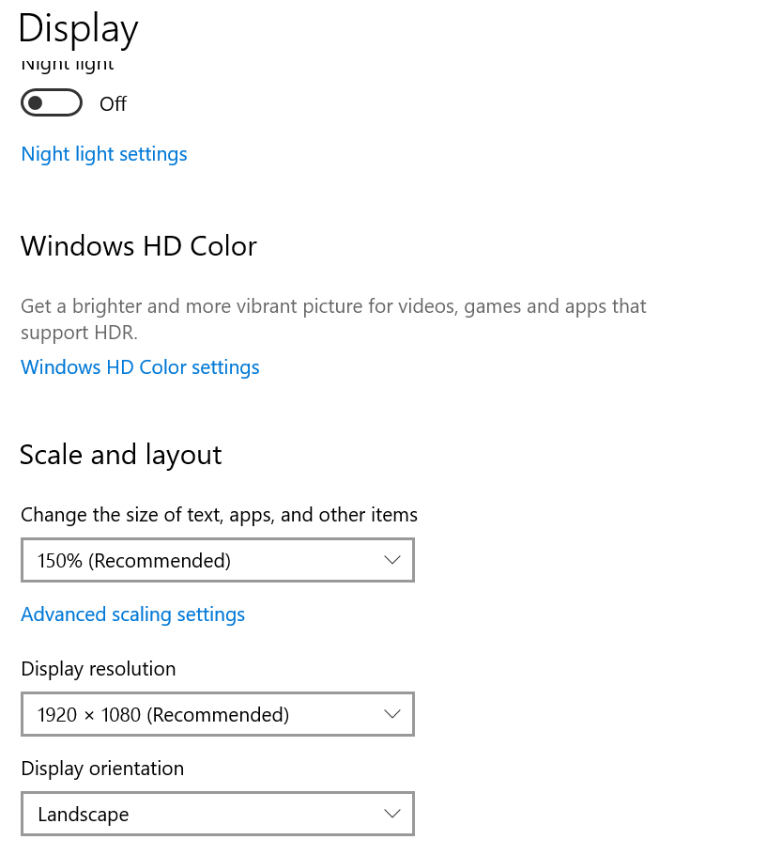

Setup 1 - General
Start > Settings > Display must look like this
EQV must be in your Chrome bookmarks in the very first (far left) slot
https://astrazeneca-eqv.veevavault.com/
A shortcut for SAP and GPF_Reporting must be on your taskbar

Slide 3
Setup 2 – API Access
You must have API (application programming interface) access to EQV.
This can be done by submitting a ticket on AskAZ
Go to https://azprod.service-now.com/askaz?id=askaz_support
Search for anything, scroll down to the bottom right of the page, and select ‘Still need help?’
AskIT
Request Something
Description should be along the lines of…
“Request EQV veeva vault API access to retrieve up to date SPRs for the creation of labels for Support Services Manufacturing Sciences.”

Slide 4
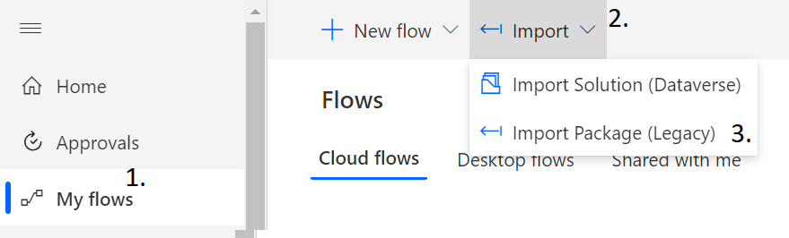
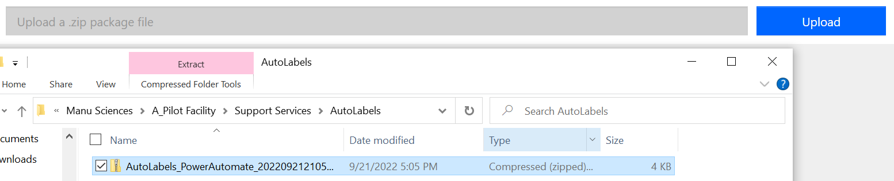
Setup 3 – Power Automate
Navigate to Power Automate
Select ‘My flows’
Select ‘Import’
Select ‘Import Package (Legacy)’
Select ‘Upload’
Upload the zip file found in the AutoLabels
folder in the SS shared drive
Once uploaded, the flow should automatically be set up. It may require you to allow connections, if so, allow them.

Slide 5
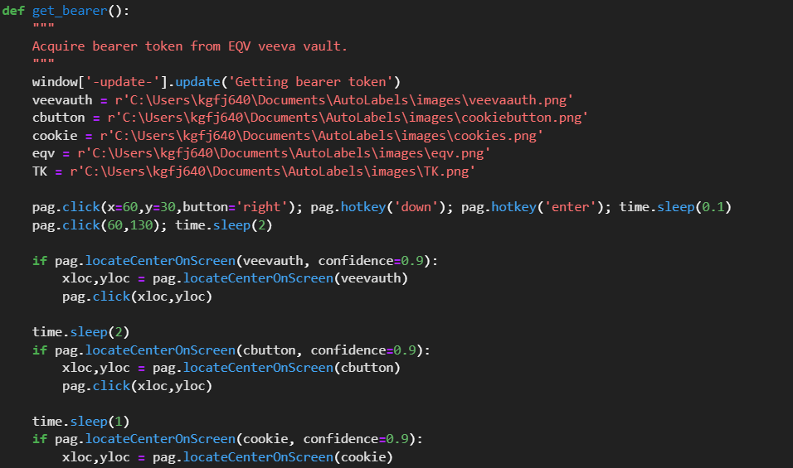
How does it work?
Get the bearer token from EQV.
This allows us to make API requests
to get up to date SPR information.
Note: I am working on a feature that will
bypass the need for a bearer token

Slide 6
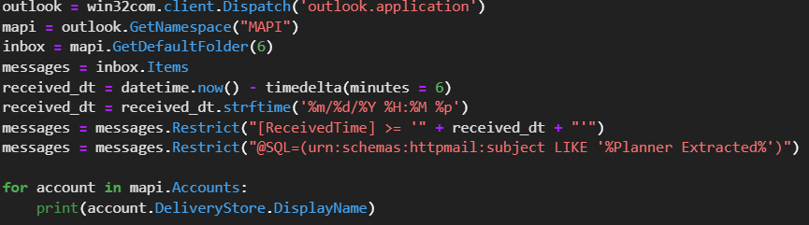
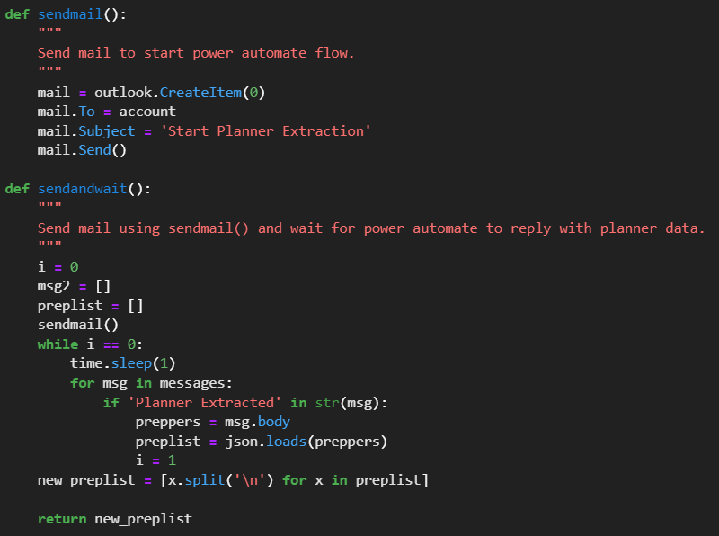
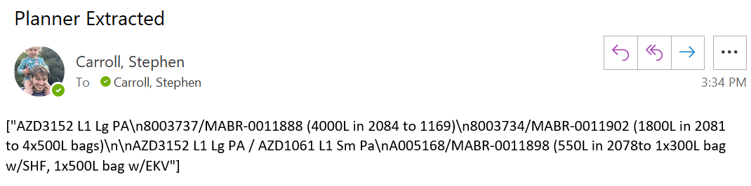
How does it work?
2. Send yourself an email to initiate the
Power Automate flow, then wait for a response.

Slide 7
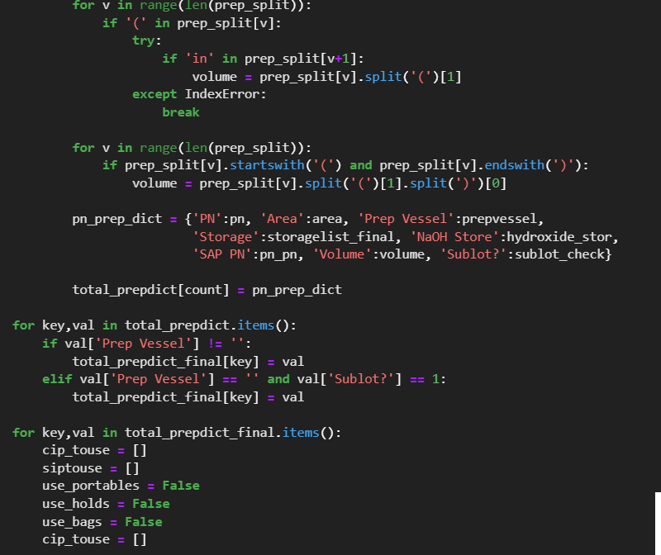
How does it work?
3. Magic is then done on the information received from Power Automate to extract the PN, volume, area, storage vessels, as well as any CIPs or SIPs.

Slide 8
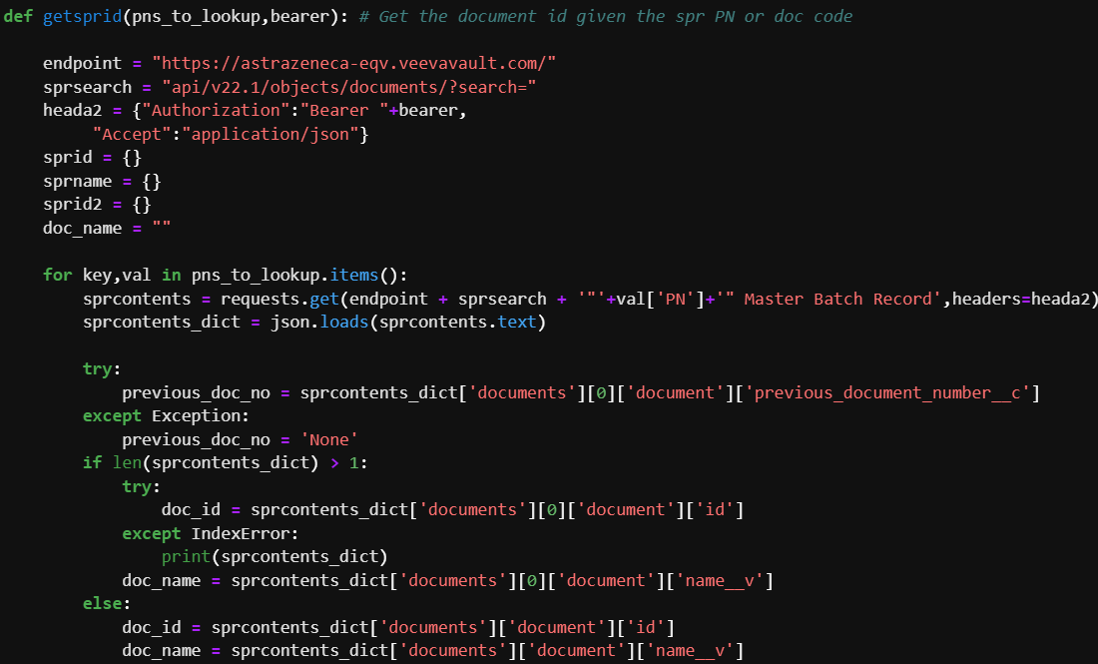
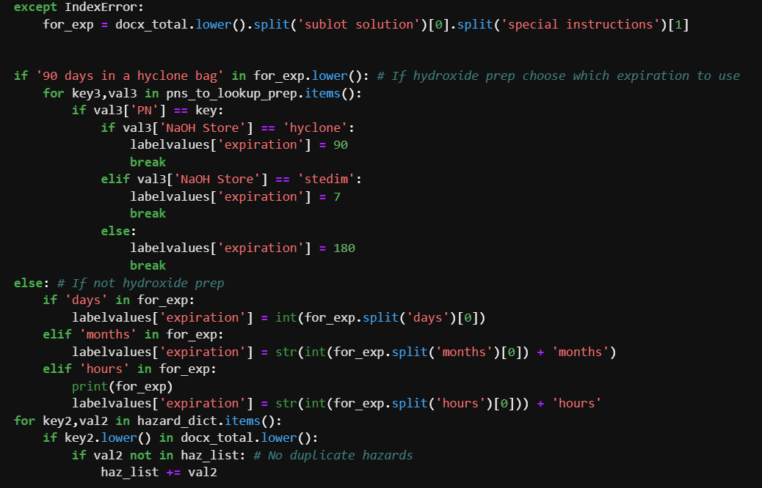
How does it work?
4. Using the bearer token acquired in step 1, an API request is made to EQV to let us get information on the components, storage conditions, expiration date, and whether the solution requires testing the pH, cond, osmo, or turbidity.

Slide 9
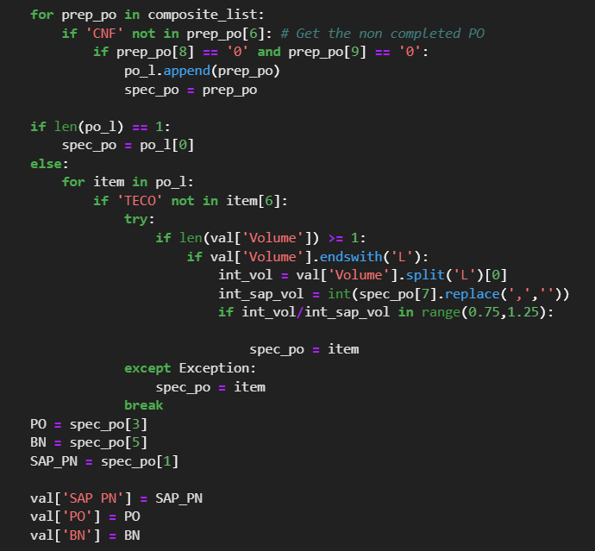
How does it work?
5. SAP is then opened and the PO and BN for each prep is found using the COOISPI
transaction.

Slide 10
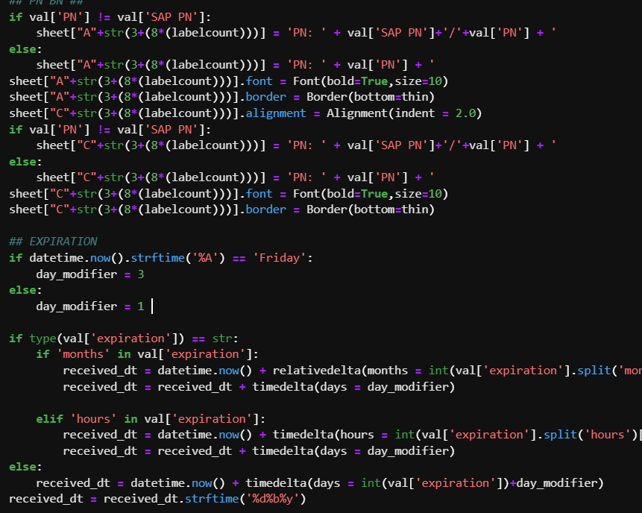
How does it work?
6. Labels can then be made. A prompt will appear for the user to change any BNs or POs that the previous step did not correctly determine.
An example case that may require the user to fix the BN or PO is the same solution being prepped today and tomorrow with similar volumes.
Note: I am working on a fix for getting the correct expiration, for example, if it is weighed on Thursday and not prepped until Monday.

Slide 11
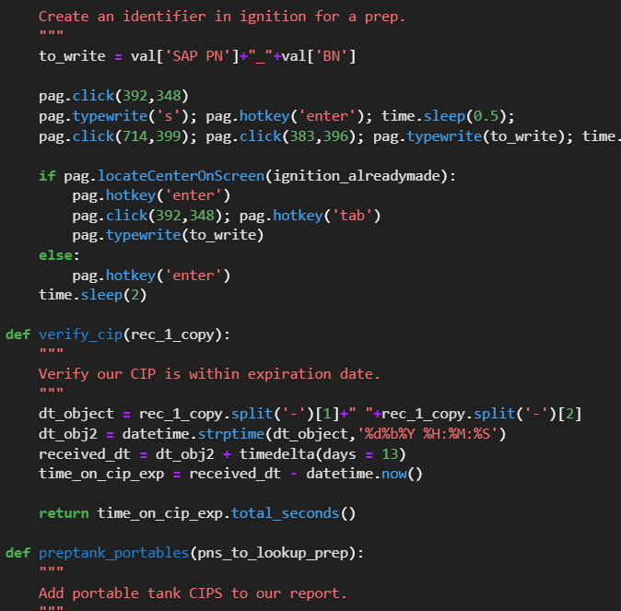
How does it work?
7. Finally, Ignition (GPF_Reporting) is opened and reports are made.

Slide 12
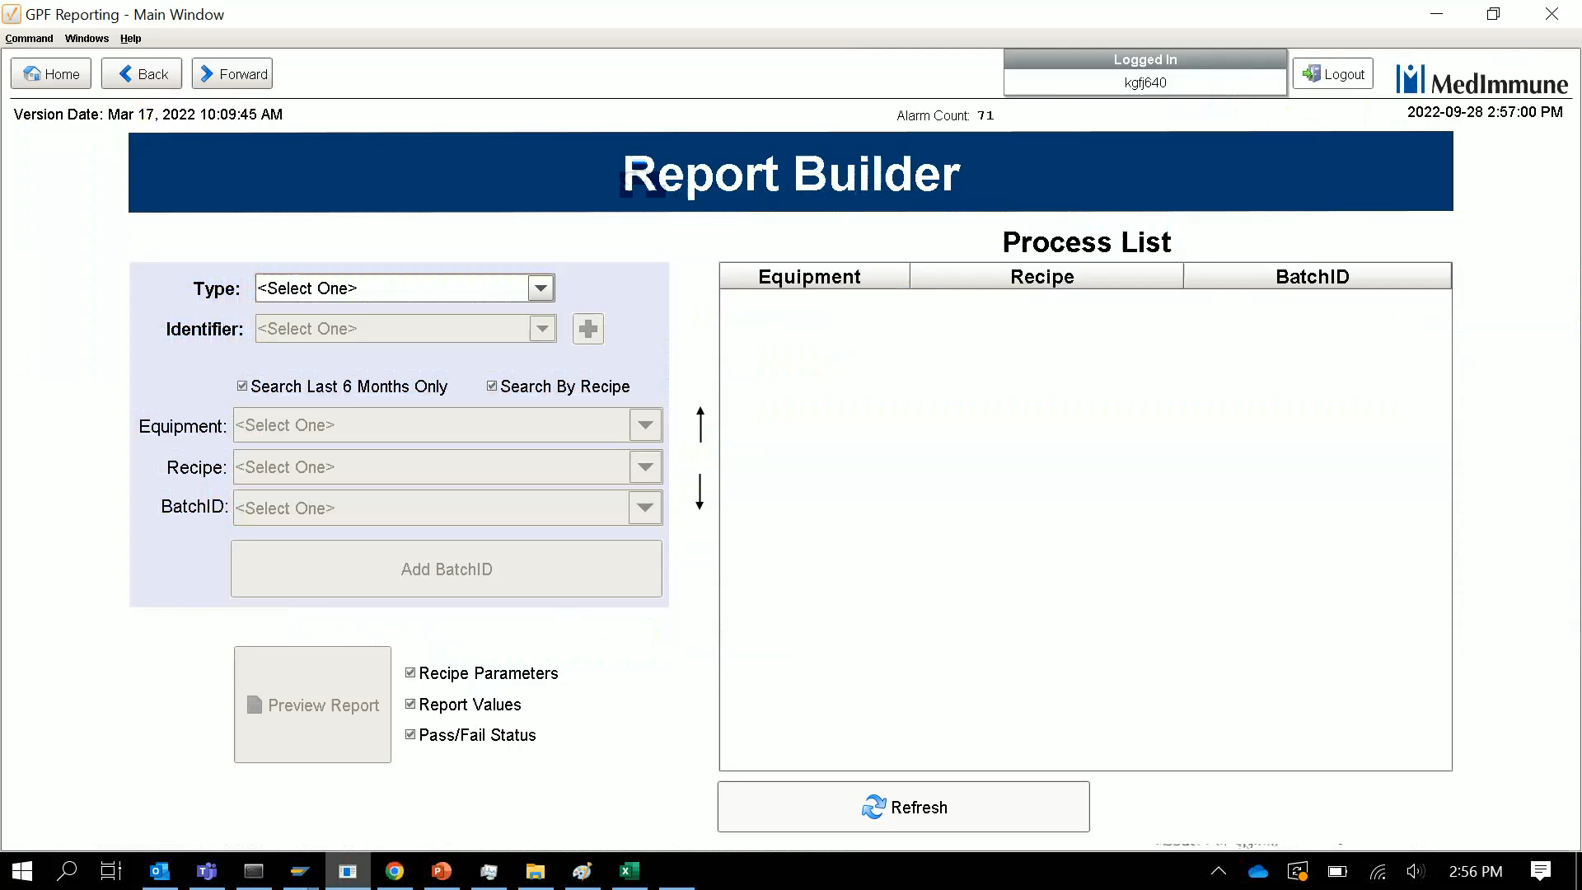
Report generation

