Slide 1
Welcome!
Titus Brown
Qingpeng Zhang
John Blischak

Slide 2
Goals!
Drive-by introduction to:
Cloud computing
Basic Illumina sequence quality evaluation & control
De novo mRNAseq assembly
A (our) “protocol” for mRNAseq analysis => diff expr
Variant calling protocol, too
This will let you explore other online resources to your heart’s content, we hope!
Other protocols & tutorials
khmer-protocols
ged.msu.edu/angus/tutorials-2013

Slide 3
Our goals:
Answer your questions!
Help you figure out what questions to ask!
Point to further materials!

Slide 4
Structure of day
Start by logging into cloud machines, grabbing data, running analyses.
Coffee break at 10:30
After lunch, check out variant calling.
Coffee break at 2:30
Some open time, if possible
Starting your own cloud machine (costs $$, but: freedom!).

Slide 5
Strategy
Run stuff!
Talk while it’s running.
Ask questions whenever!

Slide 6
Technology!
Stickies
Minute cards
…Dropbox?

Slide 7
Etherpad?

Slide 9
Why… the cloud?
Rental computers for small and BIG problems.
Completely reproducible; independent of institution; so I can write tutorials!
Once you get something working in the cloud, your local sysadmins can often help you get it running at your institution. If not, well, you can always pay $$.
(How much? est $150 compute/$1000 mRNAseq sample)

Slide 11
The challenges of non-model transcriptomics
Missing or low quality genome reference.
Evolutionarily distant.
Most extant computational tools focus on model organisms –
Assume low polymorphism (internal variation)
Assume reference genome
Assume somewhat reliable functional annotation
More significant compute infrastructure
…and cannot easily or directly be used on critters of interest.

Slide 12
The problem of lamprey…
Diverged at base of vertebrates; evolutionarily distant from model organisms.
Large, complicated genome (~2 GB)
Relatively little existing sequence.
We sequenced the liver genome…

Slide 13
Assembly
It was the best of times, it was the wor
, it was the worst of times, it was the
isdom, it was the age of foolishness
mes, it was the age of wisdom, it was th
It was the best of times, it was the worst of times, it was the age of wisdom, it was the age of foolishness
…but for lots and lots of fragments!

Slide 14
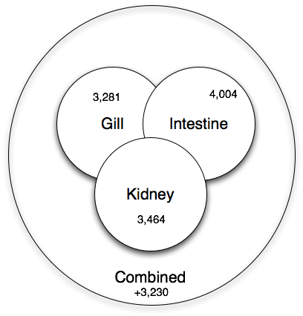
Co-assembly is important for sensitivity
Shared low-level transcripts may not reach the threshold for assembly.

Slide 15
Two problems:
We want to assemble a lot of stuff together.
We need to construct transcript families (to collapse isoforms) without having a reference genome.

Slide 16
Diginorm

Slide 17
Solution: Digital normalization (a computational version of library normalization)
Suppose you have a dilution factor of A (10) to B(1). To get 10x of B you need to get 100x of A! Overkill!!
This 100x will consume disk space and, because of errors, memory.
We can discard it for you…

Slide 18
Digital normalization

Slide 19
Digital normalization

Slide 20
Digital normalization

Slide 21
Digital normalization

Slide 22
Digital normalization

Slide 23
Digital normalization

Slide 24
Digital normalization approach
A digital analog to cDNA library normalization, diginorm:
Is single pass: looks at each read only once;
Does not “collect” the majority of errors;
Keeps all low-coverage reads;
Smooths out coverage of regions.
=> Enables analyses that are otherwise completely impossible.

Slide 25
Partitioning transcripts into families based on overlap

Slide 26
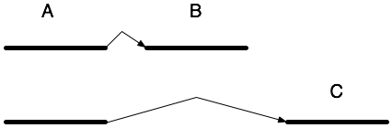
Isoform analysis – some easy…

Slide 27
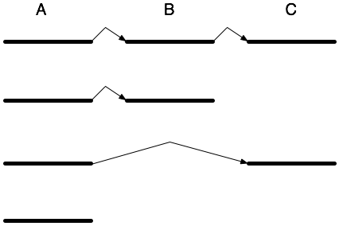
Isoform analysis – some hard
Counting methods mostly rely on presence of unique sequence to which to map.

Slide 28
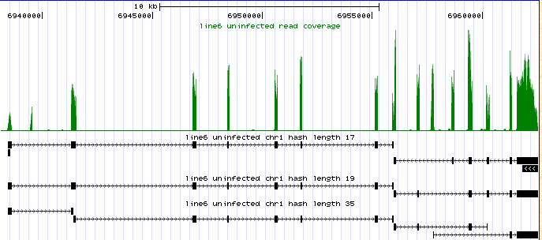
Exons are easy to locate, given genomic sequence
Notes:
Transcripts are then mapped back to the chicken genome. Because the transcripts are mature mRNA, only exons will map to the genome.
The solid boxes represent exons.
As shown in this figure, different isoforms are detected using different parameter settings. The explanation for this phenomenon is unknown. The goal of this step is to define all exons in each gene.

Slide 29
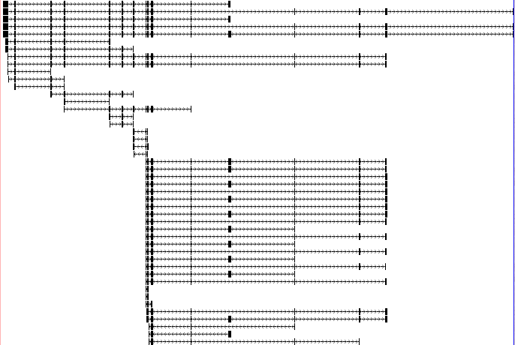
Genome-reference-free assembly leads to many isoforms.
Massive redundancy!

Slide 30
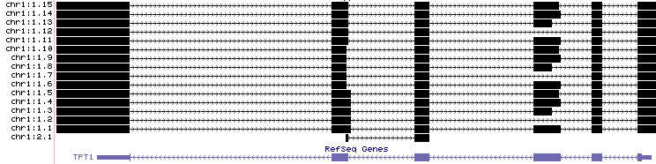
Gene models can be “collapsed” given genomic sequence... But don’t always have.

Slide 31
Solution: Partitioning transcripts into “transcript families”
Pell et al., 2012, PNAS
Notes:
XXX

