Slide 1



Boot camp highlights
Version Control|Testing|Data Management
EGI Forum
Manchester 11th April 2013
Mike Jackson
The Software Sustainability Institute
http://www.software.ac.uk

Slide 2
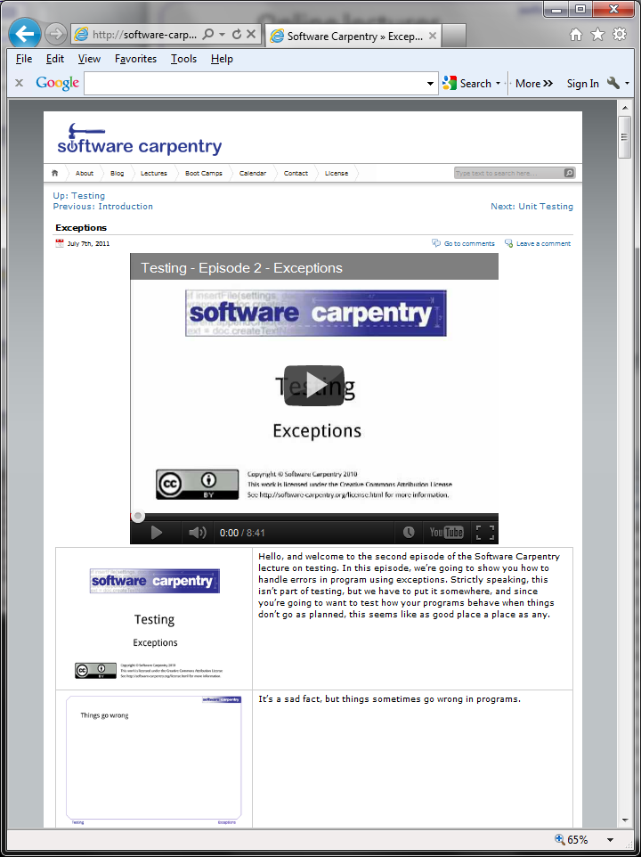
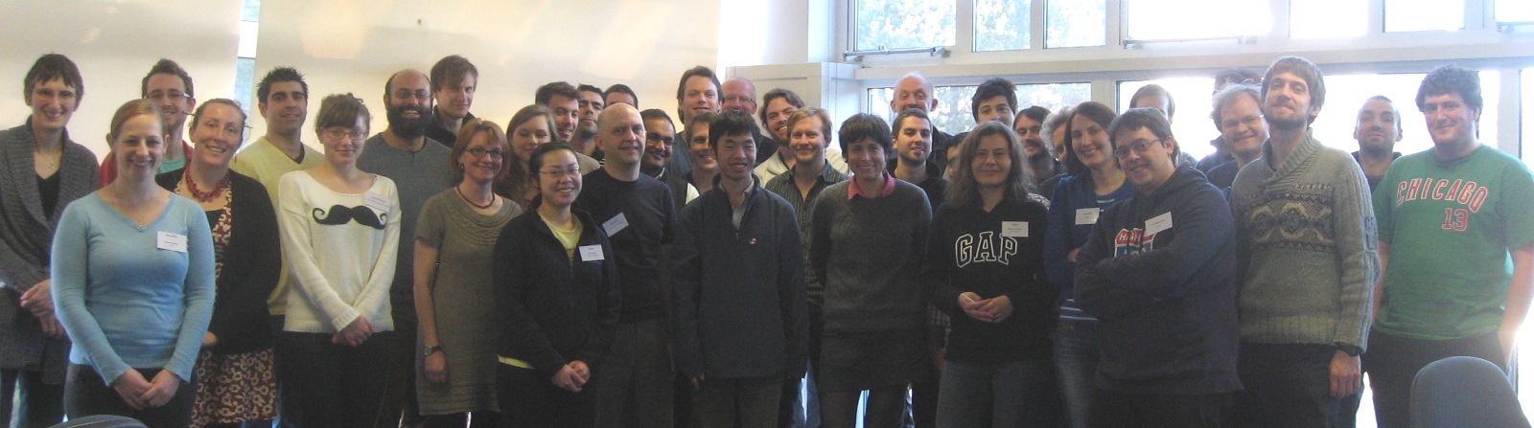
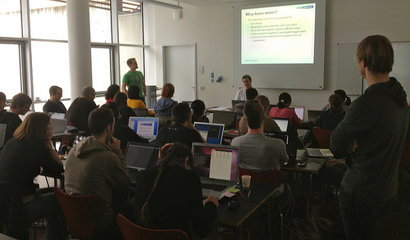
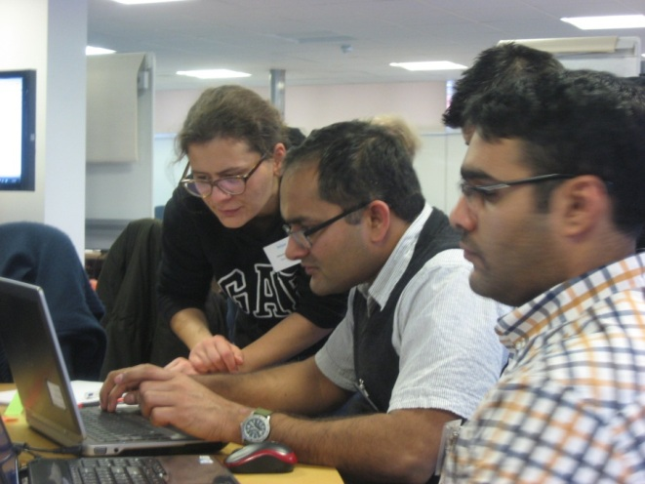
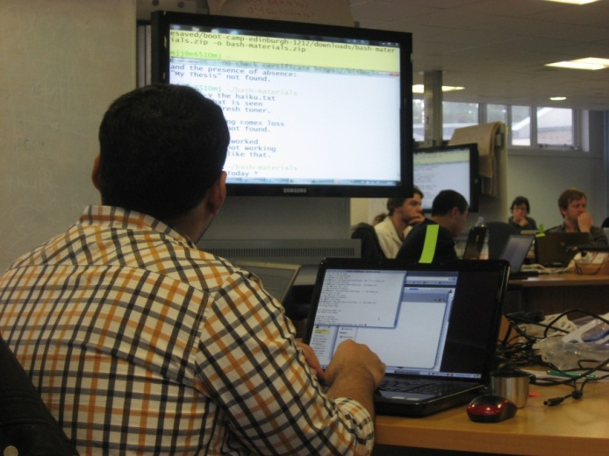
What is Software Carpentry?

Slide 3
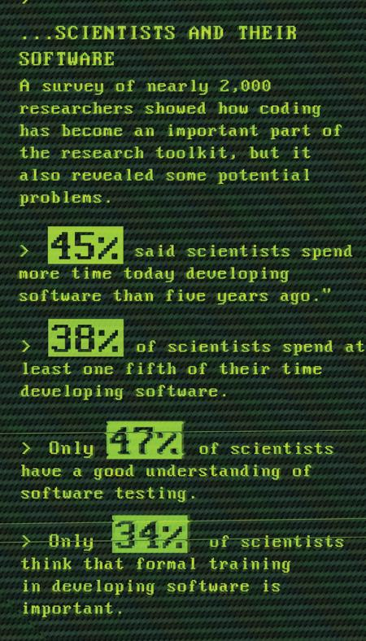
Why?
Courtesy of Greg Wilson and Neil Chue Hong.
Data from Hannay et al, “How Do Scientists Develop and Use Scientific Software?
SECSE '09 Proceedings of the 2009 ICSE Workshop on Software Engineering for Computational Science and Engineering, IEEE Computer Society, 2009. DOI: 10.1109/SECSE.2009.5069155

Slide 4

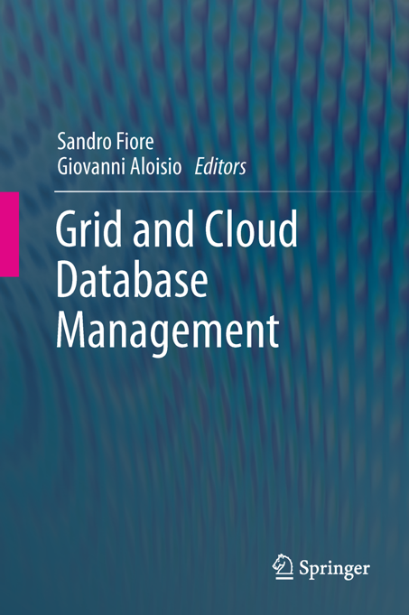

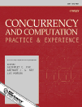
Software development =/= research
or
Software development skills help you to
  Get more done
  In less time
  With less pain
More time for research!

Slide 5
Boot camp “highlights”
Version control 11:00
  Record provenance
  Quickly retrieve code, configuration files, text used to produce data in a presentation, poster or thesis
  Collaborate on code and papers
Testing 14:00
  Automatically check for expected outputs
  Help ensure correctness of code
  Make changes (and fix bugs) without introducing bugs
Data management 16:00
  Manage large amounts of data systematically and efficiently
  Get the database to access, filter, combine and aggregate data
Free up time for research!

Slide 6
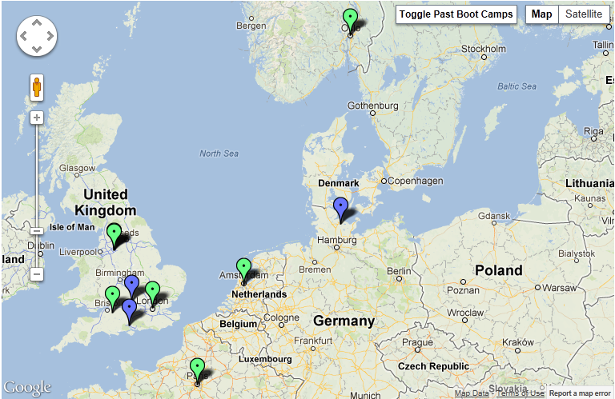
Upcoming boot camps
http://software-carpentry.org/bootcamps

