Slide 1

The Unix Shell
Introduction
Copyright © Software Carpentry 2010
This work is licensed under the Creative Commons Attribution License
See http://software-carpentry.org/license.html for more information.
Notes:
Hi!
My name is Karin Lagesen, and today I will teach you a bit about the unix shell.
The unix shell does a lot of things that can today be done using other tools, so why do we teach you this? Mostly because a lot of other things use the shell. If you want to install programs or work with a remote machine, the shell is the best way for doing this. Also, on another level, the shell will allow us to teach you a bit about the power of computers, the things a computer can do for you.

Slide 2
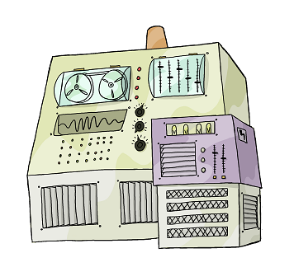
Notes:
So, a computer can do several things. The main things here are:

Slide 3
Run
Programs

Slide 4
Run
Programs
Store
Data

Slide 5
Run
Programs
Store
Data
Communicate
with each other

Slide 6
Run
Programs
Store
Data
Communicate
with each other
Interact
with us

Slide 7
Interact
with us
Notes:
So, how does a computer interact with us?

Slide 8
Interact
with us
Telepathy
Notes:
We could use telepathy - you might have heard about the computers that they have connected to peoples brains. Still in its infancy, so we might want to go a different way.

Slide 9
Interact
with us
Telepathy
Speech
Notes:
Some computers can be spoken to today,

Slide 10
Interact
with us
Telepathy
Speech
WIMP
(windows, icons, mice, pointers)
Notes:
However, most people today use windows, and mice to interact with their computer.

Slide 11
Interact
with us
Rewiring
Telepathy
Speech
WIMP
Notes:
Way back when the only way people could interact with computers was by rewiring them.

Slide 12
Interact
with us
Rewiring
Telepathy
Typewriter
Speech
WIMP
Notes:
But, in between rewiring and using windows and mice, the typewriter model was how people interacted with the computer, and this is the model that we will use today.

Slide 13
Typewriter
Notes:
When I say typewriter, what I actually mean is

Slide 14
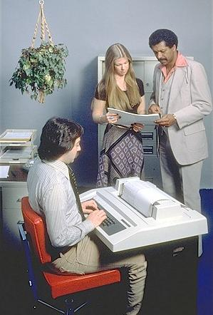
Typewriter
Line printer + keyboard
Notes:
When I say "typewriter", I actually mean a line printer connected to a keyboard. These devices only allowed input and output of the letters, numbers, and punctuation found on a standard keyboard, so programming languages and interfaces had to be designed around that constraint

Slide 15
Typewriter
Line printer + keyboard
Text only
Notes:
This means that we are dealing with text only

Slide 16
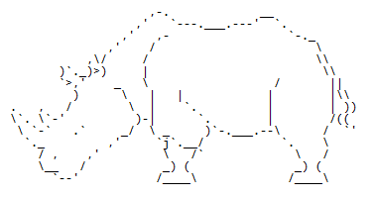
Typewriter
Line printer + keyboard
Text only
Notes:
Hoever, if we did want to, we could actually manage to draw images like this – ascii art.

Slide 17
Typewriter
Line printer + keyboard
Text only
CLUI: command-line user interface
Notes:
This way of interacting with a computer is called using a command-line user interface.

Slide 18
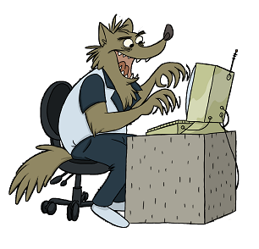
user logs in
Notes:
So how do we use this interface? We always start by logging in

Slide 19
user logs in
user types command
Notes:
Once on the command line, the user types in commands

Slide 20
user logs in
user types command
computer executes command
and prints output
Notes:
Next, the computer does what the user asked it to do,and returns the results to the user.

Slide 21
user logs in
user types command
computer executes command
and prints output
user types another command
Notes:
Then, the user can type in another command,

Slide 22
user logs in
user types command
computer executes command
and prints output
user types another command
computer executes command
and prints output
Notes:
Which again gets executed by the computer, and the results are again returned to the user.

Slide 23
user logs in
user types command
computer executes command
and prints output
user types another command
computer executes command
and prints output
⋮
user logs off
Notes:
All the way until the user logs off

Slide 24
user logs in
user types command
computer executes command
and prints output
user types another command
computer executes command
and prints output
⋮
user logs off
Notes:
Now, we have the computer and the user – in this case we have a special program

Slide 25

user logs in
user types command
computer executes command
and prints output
user types another command
computer executes command
and prints output
⋮
user logs off
shell
Notes:
Called the shell that

Slide 26
user logs in
user types command
computer executes command
and prints output
user types another command
computer executes command
and prints output
⋮
user logs off
shell
Notes:
Actually is a gobetween between the two.

Slide 27
A shell is just a program that runs other programs
Notes:
A shell is a special program in that it doesn´t really do something in and of itself, its only role is to run other programs.

Slide 28
A shell is just a program that runs other programs
Most popular is bash (the Bourne again shell)
Notes:
The most popular here is the BASH shell, which is what we are going to teach you today.

Slide 29

A shell is just a program that runs other programs
Most popular is bash (the Bourne again shell)
Notes:
Some of you are going to use cygwin, which also gives you bash.

Slide 30
A shell is just a program that runs other programs
Most popular is bash (the Bourne again shell)
Using it feels a lot more like programming
than using windows, a mouse, etc.
Notes:
You will notice that using the shell feels different than using a a mouse and windows, in fact, it is an exellent way of introducing you to how programming feels.

Slide 31
A shell is just a program that runs other programs
Most popular is bash (the Bourne again shell)
Using it feels a lot more like programming
than using windows, a mouse, etc.
Commands are terse and often cryptic
Notes:
But – note, the commands are often terse and cryptic, not always easy to understand what they do, and not easy to remember either.

Slide 32
A shell is just a program that runs other programs
Most popular is bash (the Bourne again shell)
Using it feels a lot more like programming
than using windows, a mouse, etc.
Commands are terse and often cryptic
Use it because:
Notes:
But, you should use it still, because

Slide 33
A shell is just a program that runs other programs
Most popular is bash (the Bourne again shell)
Using it feels a lot more like programming
than using windows, a mouse, etc.
Commands are terse and often cryptic
Use it because:
– many tools only have command-line interfaces

Slide 34
A shell is just a program that runs other programs
Most popular is bash (the Bourne again shell)
Using it feels a lot more like programming
than using windows, a mouse, etc.
Commands are terse and often cryptic
Use it because:
– many tools only have command-line interfaces
– allows you to combine tools in powerful new ways

Slide 35
created by
Greg Wilson
August 2010
Copyright © Software Carpentry 2010
This work is licensed under the Creative Commons Attribution License
See http://software-carpentry.org/license.html for more information.

