Slide 1

Putting it all together
Greg Wilson
Software Carpentry
Mike Jackson
The Software Sustainability Institute
This work is licensed under the Creative Commons Attribution License
Copyright © Software Carpentry and The University of Edinburgh 2010-2012
See http://software-carpentry.org/license.html for more information.

Slide 2
What we covered
Shell scripting
Version control using Mercurial
Python programming
Unit testing with nosetests
Data management with SQLite
Notes:
On the surface, this was what we covered.
But our aim was not to teach these tools, but to show how tools such as these deliver powerful benefits which make a positive contribution to your research.

Slide 3
Shell
Reduce errors by re-using tried-and-tested components
String together components into powerful computational and data processing pipelines
Avoid re-inventing the wheel and free up time to do research

Slide 4
Version control
Record the provenance of your code, documents or configuration files
Track which version of your software produced the data you used in a paper, presentation, poster or thesis
Back up your work
Productively collaborate
Notes:
Version control gives you who changed what and when.
Remember that you need to provide the why!

Slide 5
Python
Make it easier for colleagues to spot bugs in your code
Help others to validate what you did by peer review
Help others replicate or reproduce what you did
Encourage others to reuse what you did
Reduce your “truck factor”
Notes:
Modular code.
Meaningful names.
Indentation.

Slide 6
Unit testing
Ensure that your algorithms, implementation and data are correct and so that your research is correct
Make changes without introducing bugs
Fix bugs without introducing bugs
Remember Geoffrey Chang!

Slide 7
Data management
Record data in a simple, yet structured, form
Process data more efficiently by driving the processing down to the database
Avoid re-inventing the wheel and free up time to do research
Notes:
Databases are designed to be highly efficient and support highly powerful data access, filtering, and combination.
They’ve served their time in and been driven by the requirements of business!

Slide 8
Iteration and release
Continuous integration
Version control
Red
Green
Refactor
Test-driven development
Pair programming
and/or
code
reviews
Notes:
Pair programming. Driver and navigator. Swop after an hour. Peer review. Share ideas and expertise. Share knowledge of code. Collective ownership. Induct new team members. Less Facebook-ing!.
Code reviews. Share ideas and expertise. Fagan and Cohen.
TDD. Red (fail). Green (pass). Refactor (clean). Focus on what code should do rather than what it does. Code always tested. Promotes working in small steps.
Version control. Provenance. Commit small, complete units of work, ideally a reviewable unit.
Continuous integration (CI). Checkout/build/test/publish. Fail-fast. Name and shame. Always runnable. Always releasable. On which note…
Release early, release often – so long as it’s built and tested cf. MPA. Users often don’t know what they want until they have something they can use. A tool can change how users do their work. Short iterations avoid spending too much time building what turns out to be the wrong thing. Well-suited to research software. Requires less coordination as people can track what they do for a few days themselves. Easier to find bugs – 2 weeks worth of code, not 2 months or 2 years worth. Always have something that is working, tested and ready for release. MAUS and bi-monthly releases.
Concentric circles focusing on continuous feedback, collaborative working and small development cycles. Agile development methods, frequent feedback for developer and customer. Not an excuse for cowboy coding, or no process. Even if you are a solo these still benefit you!

Slide 9
It’s all just data
Shopping list
DNA sequence
Galactic coordinates
Function
Program
0s and 1s
Notes:
Some principles of computational thinking….
Anything can be considered as data.
Functions can be assigned to variables in Python.
To a compiler, source code is input data and binary code is output data.

Slide 10
Data must be interpreted
It means nothing on its own!
01100100011000010111100001100001
data
1,684,108,385
1.6635613602263159e+22
Computers are dumb – GIGO!
Notes:
These 32 bits represent the word data, the integer and the float, as well as a bluish-gray pixel, a medium-loud sound sample, a machine code instruction, and many more things.
Computer does not know or care e.g. if a variable is called temperature or t or Frankenstein or abc.
The computer does what it is told.

Slide 11
Programming is about creating and composing abstractions
Meaningful names
Comprehensible units
Separate…
  “what I do” – interface
  “how I do it” – implementation
Clarity over cleverness
Notes:
To use things you shouldn’t need to care about the implementation (unless you’re concerned with efficiency, for example).
Brian Kernighan, “…debugging is twice as hard as writing a program in the first place. So if you are as clever as you can be when you write it, how will you ever debug it?”

Slide 12
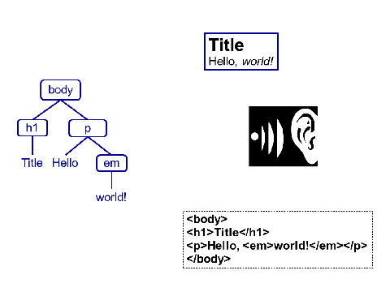
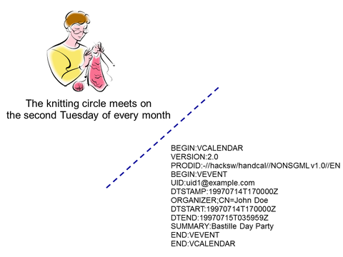
Models are for computers
…they’re good at structured data so help them out!
Views are for us…
Notes:
Structured data is better than unstructured data.
Models are representations that are easy for computers to work on.
Data are presentations of the model that we can understand.
HTML model and browser or audio-described views that make the content accessible.
Easy to go from model to view.
Very difficult to go from view to model e.g. parse audio, OCR of browser image.

Slide 13
Paranoia makes us productive
Improve quality => improve productivity
Think before you code
Validate inputs wherever they originate
Pair program and code review
Automate your build-and-test
Notes:
Why? Because higher quality => less errors => less recovery!
Think before writing code. What does “I want to count all the stars in this photograph” mean? Ask yourself What is a star? How many pixels does a star occupy?
Validate. Remember, GIGO. Devise data formats that support validation.
Automate. Continuous integration.
Reduce chances of getting it wrong next time.
Focus on things that can’t be automated until we write the code to automate them too!

Slide 14
Better algorithms are better than better hardware
But in terms of memory use…
Insertion sort
  O(n²) … O(n²)
Quick sort
  O(n log n) … O(n²)
Merge sort
  O(n log n) … O(n log n)
  O(1)
  O(log n)
  O(n)
Algorithms and data structures
Notes:
Algorithmic complexity. Estimate how many operations an algorithm will do, or how much memory it requires, as a function of the size of the problem we’re trying to solve. Some algorithms slow down gently as their inputs get larger, while others slow down so much that even if the whole universe was one large computer, it couldn’t solve any problem big enough to be interesting.
Big-O – worst-case order of growth (speed or space) as size of data set increases. Not efficiency but scalability.
O(1) – independent of data set size.
O(n) – directly proportional to data set size e.g. traverse an array is O(n)
O(n log n) – typical for data that is partitioned e.g. a tree, or quick and merge sorts. Data partitioned, partitions partitioned etc.
O(n²) – proportional to square of data set e.g. if algorithm processes every list element and processing requires another list traversal or other inner loops.
O(2^{n}) – exponential growth. Growth doubles for each new element in the data set. Not very scalable without masses of hardware!
Scalability is worse as O increases.
In terms of execution time, merge sort win. In terms of memory insertion is 1, quick is log n and merge can be n.
Algorithms are nothing without data structures to operate on and the performance of the former often derives from the latter e.g. arrays/lists and loops, trees and recursion. Faster hardware helps, but efficient implementations help more! Trade-off of complexity versus “good enough” – O(n²) may be preferred to O(n log n) if the latter is too complex and rewrite time would be best spent elsewhere.

Slide 15
The tool shapes the hand
Using a tool changes how you do the work the tool helps you to do
Writing software changes your understanding of what computers/software can do

Slide 16
All work and no play…
“Why Crunch Modes Doesn't Work: Six Lessons”, Evan Robinson
  http://www.igda.org/why-crunch-modes-doesnt-work-six-lessons
Continuous work reduces cognitive function 25% for every 24 hours!
Our greatest productivity occurs in the first four to six hours
Notes:
Take regular breaks away from the screen. Go for a walk. Avoid RSI!
And, on that note…

Slide 17
Iterative development does not just apply to software!
What were the good and bad points about this boot camp?
Notes:
Just ask Ridley Scott after he releases Blade Runner version 4 or Prometheus version 2!
Get a helper to scribe.
Go round each attendee in turn – one suggests a good point, the next a bad point etc.

Slide 18
Want to get involved?
Write online lectures and practicals
  Scientific python libraries e.g. PANDAS or SciPy image processing
  Version control in Git
  Something of use to your discipline
Want to be a helper…
  …or instructor?
  Edinburgh, December 4-5th, 2012
  Munich and Tuebingen, January 22-23rd, 2013
  Kiel, March 2013
Notes:
Looks good on a CV!
A chance to get teaching experience, a networking opportunity, trips to nice places!
Edinburgh can cover travel expenses.
And there are other boot camps always coming on-stream.

Slide 19
Want to get involved?
North American 3 week teaching tour
  MIT and Harvard => across the US => Stanford and Monterey
  Travel and accommodation covered
  Currently seeking funding
Get in touch!
  info@software.ac.uk
  info@software-carpentry.org
  Speak to Steve or Mike
Notes:
Should funding go through the tour would be open to those who have contributed to Software Carpentry (see previous slide) and want to get more experience as instructors.
We can add you to the UK software carpentry list so you’re aware of helper/instructor opportunities – no obligation!

